Slide 1


Tashkent state university of economics
Course: Money and banking
Lecture 1: Introduction to money and banking
PhD in Economics Nasriddinov Fazliddin

Slide 2
COURSE OBJECTIVES
1.
2.
3.
DEFINING MONEY BY ITS FUNCTIONS
TYPES OF MONEY
MONEY AGGREGATES

Slide 3
1
Money for ordinary people:
Synonym of income and wealth
2
Money for economists:
-Medium of exchange
-Unit of account
-Store of value

Slide 4
The difference between currency and money
Currency
(USA dollar)
A unit of exchange
Portable
Money
(Gold and Silver)
A unit of exchange
Store of value
Durable
Division
Portable
Durable
Division

Slide 5
Functions of money
Medium of Exchange
Unit of Account
Store of value

Slide 6
Medium of Exchange promotes
Efficiency
Specialization

Slide 7

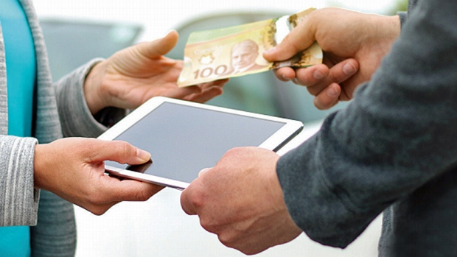

Slide 8
Unit of account
Money is used to measure value in economy. We measure value of goods and services in terms of money as we measure distance in terms of miles.

Slide 9
Store of value
Money is the most liquid asset but earns less interest than other assets
Holding much money is risky when hyperinflation exists

Slide 10
Types of Money
1. Commodity money
2. Paper money
3. Fiat money
4. Checks
5. E-money

Slide 11
Paper money and Fiat money

Slide 12
Money aggregates
According to recommendations of International Monetary Fund, components of money aggregates are M0, M1, M2, M3.
M0=Cash (not in bank’s vault and ATM)
M1=M0+transaction deposits
M2= M1+time deposits and saving deposits
M3=M2+deposit certificate of banks+ savings certificates of other financial institutions.

Slide 13
Money aggregates in USA
M1= Currency checking+ deposits +travel's checks
M2=M1+small time and saving deposits +mutual fund shares
M3=M2+big denomination deposits +savings certificates +midterm and long term repo contracts
M4= M3+government securities +corporative securities +bank accepts

Slide 14
THANK YOU FOR ATTENTION

