Slide 1
“COLLEGE WRITING”
Introduction vs conclusion
Akhmadjonov khasan
English teacher
12/01/2017

Slide 2
Agenda
Introductions
Conclusions

Slide 3
What is an introduction?
The first para
Is usually five to ten sentences
Catches the reader’s interest
Gives the general topic of the essay
Gives background info about the topic
States the main point (thesis)

Slide 4
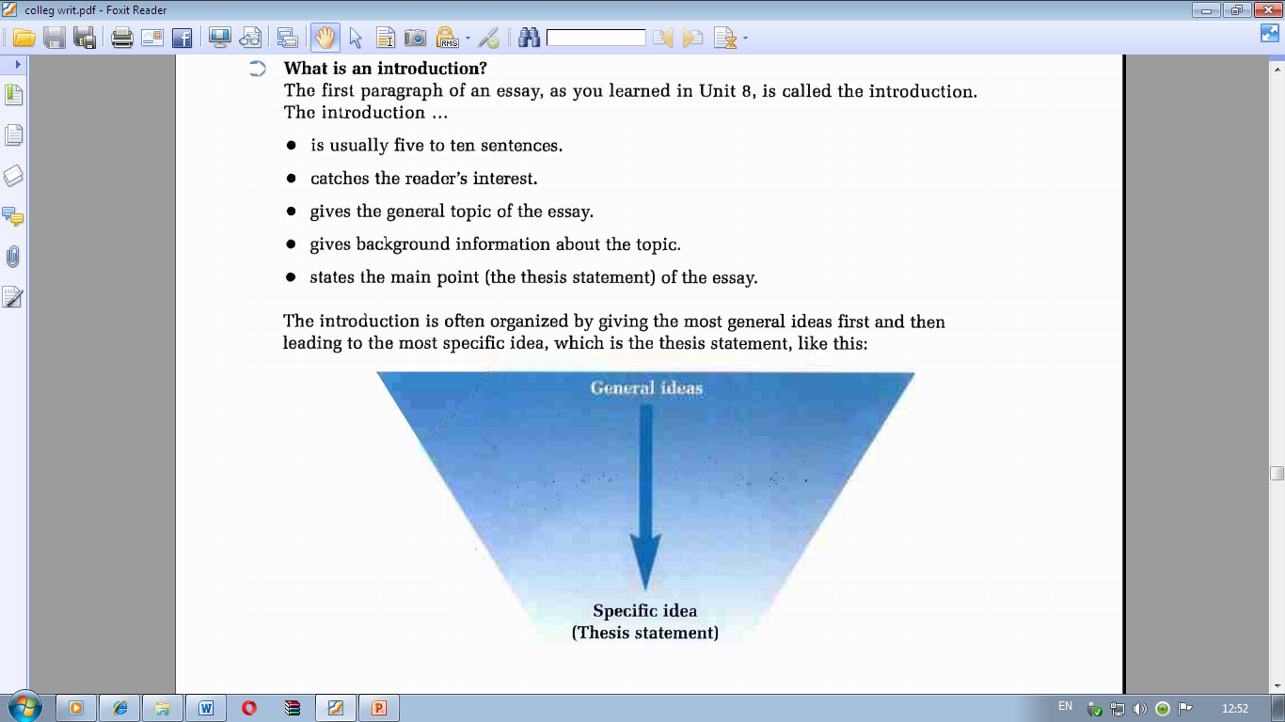

Slide 5
Strong intro
Introduces the topic clearly
Gives several sentences of info about the topic
States the thesis

Slide 6
How to make an interesting intro
Interesting facts or statistics
A personal story and example
An interesting quotation

Slide 7
The conclusion
The final para
Summarises the main points of the essay
Restates the thesis
Makes a final comment about the essay’s main idea
May emphasis an action that you would like the reader to take

Slide 8
Thank you!

