Slide 1
“COLLEGE WRITING”
Unity vs Coherence
Akhmadjonov khasan
English teacher
12/01/2017

Slide 2
Agenda
Unity
Coherence
Cohesive devices

Slide 3
Unity
Connection of all ideas to a single topic
All ideas should relate to thesis statement
Supporting sentences in a body should relate to the topic sentence
Editing outline for ideas to KEEP UNITY

Slide 4
Coherence
Related to unity
Ideas arranged in a clear and logical way
Unified and coherent text enables the reader easily understand

Slide 5
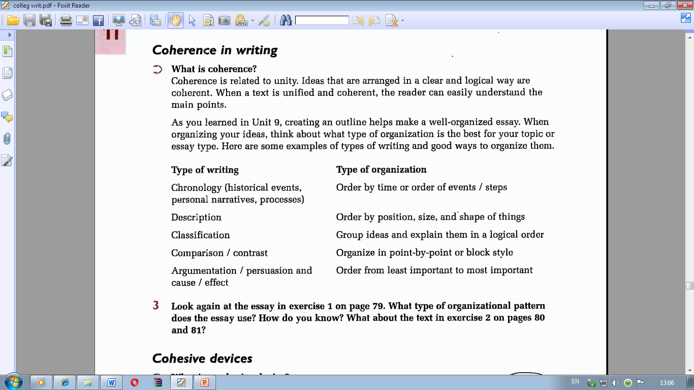
Coherence in Writing

Slide 6
Cohesive devices
Words and phrases that connect sentences and paragraphs together
Smooth flow of ideas
Transitions
Pronoun references
Repetition of key ideas

Slide 7
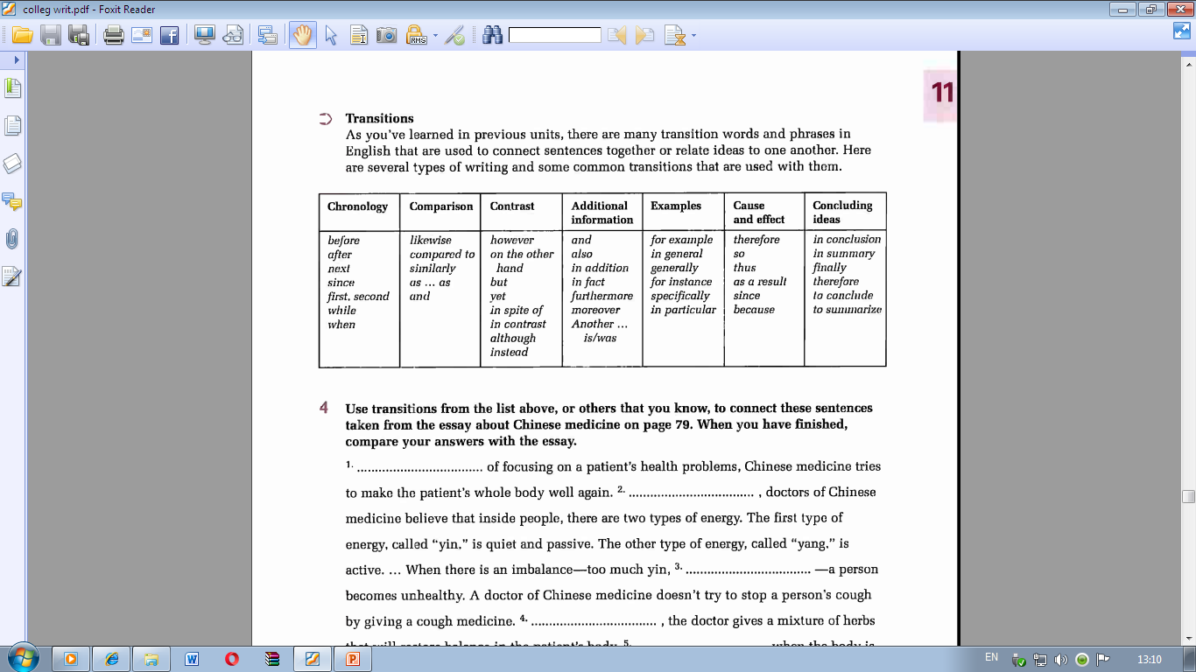

Slide 8
Thank you!

