Slide 1
Ob'еktlarni matеmatik modеllashtirishdagi tipik masalalari

Slide 2
Reja:
1.Dinamika tеnglamalari bo‘yicha statik tavsiflarni olish.
2.O‘tish funktsiyalari va chastotali tavsiflarni topish

Slide 3
Uzatish funksiyasi
W(p) = Y(p)/U(p) = [chiqish signali tasviri]/[kirish signali tasviri]
Uzliksiz chiziqli dinamik tizimning differensial tenglama ko’rinishdagi modeli
a_{n}y^{(n)}+ a_{n-1}y^{(n-1)}+ . . .+ a₁y׳+ a₀y= b_{m}u^{(m)}+ b_{m-1}u^{(m-1)}+ . . .+ b₁u׳+ b₀u (1)

Slide 4
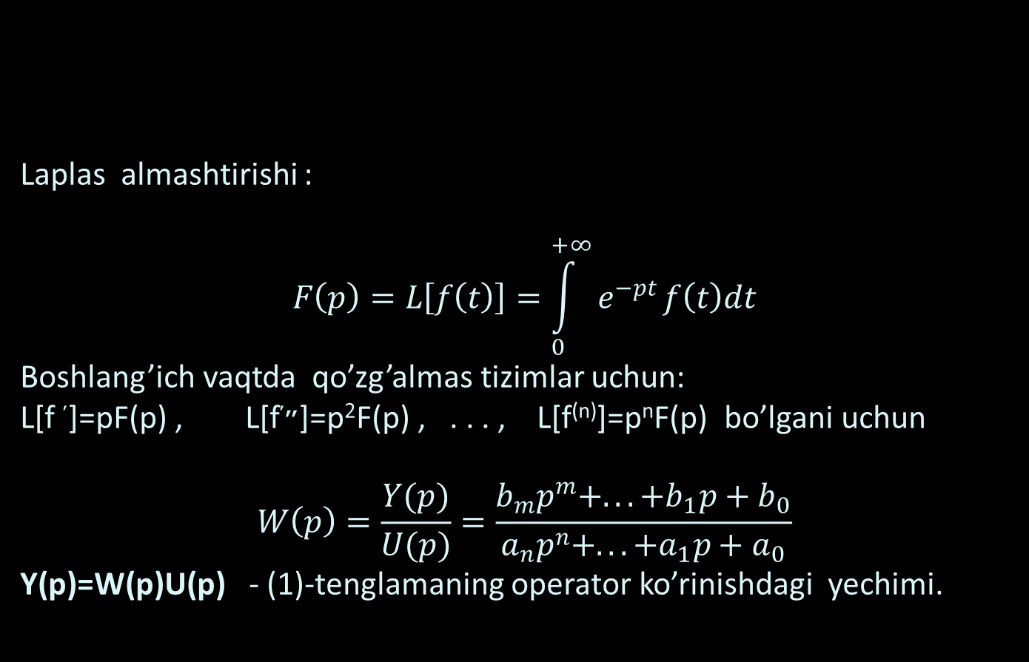
Laplas almashtirishi :
$$F\left(p\right)=L\left[f\left(t\right)\right]=\int_{0}^{+∞}{e^{−pt}}f\left(t\right)dt$$
Boshlang’ich vaqtda qo’zg’almas tizimlar uchun:
L[f ׳]=pF(p) , L[f״׳]=p²F(p) , . . . , L[f^{(n)}]=p^{n}F(p) bo’lgani uchun
$$W\left(p\right)=\frac{Y(p)}{U(p)}=\frac{b_{m}p^{m}+. ..+b_{1}p+b_{0}}{a_{n}p^{n}+. ..+a_{1}p+a_{0}}$$
Y(p)=W(p)U(p) - (1)-tenglamaning operator ko’rinishdagi yechimi.

Slide 5
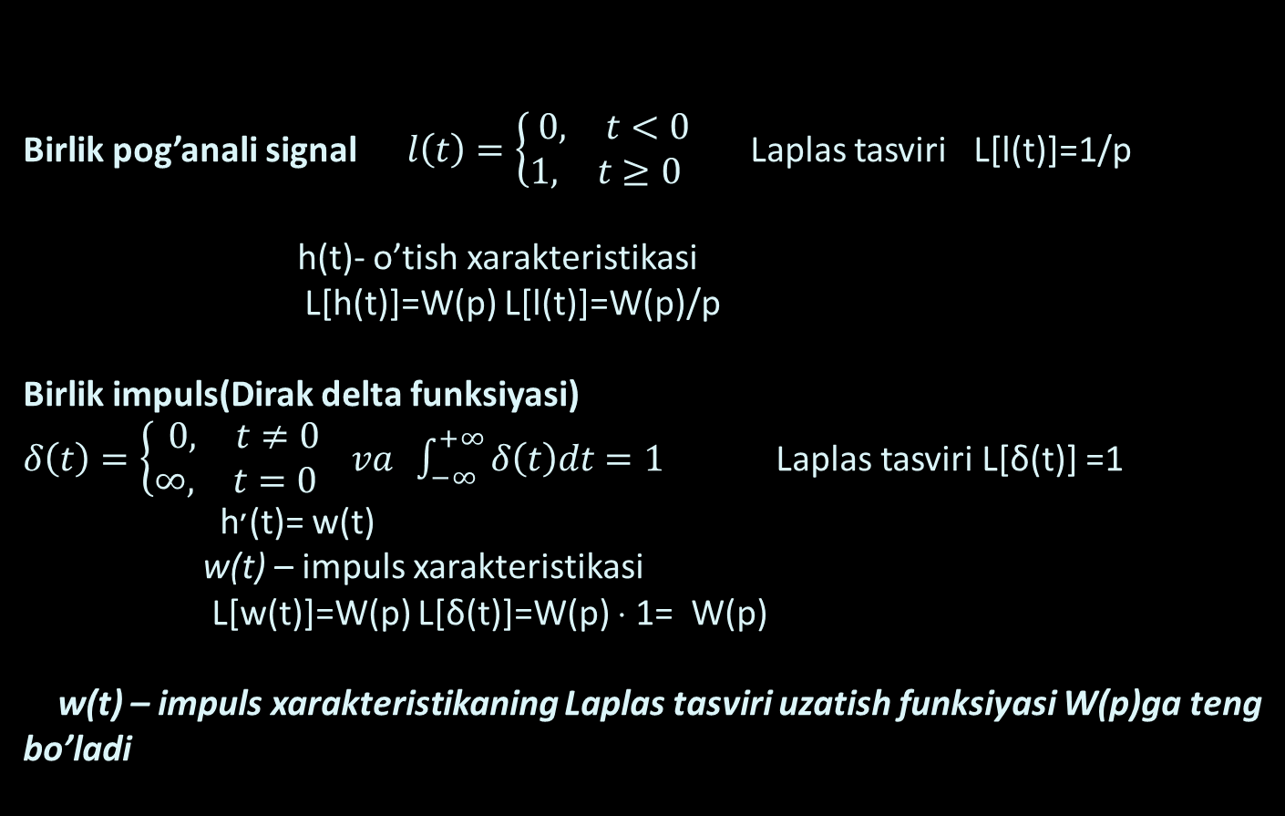
Birlik pog’anali signal $l\left(t\right)=\left\{\begin{matrix}\begin{matrix}0, & t<0\end{matrix} \\ 1\begin{matrix}, & t≥0 \end{matrix}\end{matrix} \right.$ Laplas tasviri L[l(t)]=1/p h(t)- o’tish xarakteristikasi
L[h(t)]=W(p) L[l(t)]=W(p)/p
Birlik impuls(Dirak delta funksiyasi)
$δ\left(t\right)=\left\{\begin{matrix}\begin{matrix}0, & t≠0\end{matrix} \\ \begin{matrix}∞, & t=0 \end{matrix}\end{matrix} va\right. \int_{−∞}^{+∞}{δ\left(t\right)dt=1}$ Laplas tasviri L[δ(t)] =1 h׳(t)= w(t) w(t) – impuls xarakteristikasi
L[w(t)]=W(p) L[δ(t)]=W(p) ⋅ 1= W(p) w(t) – impuls xarakteristikaning Laplas tasviri uzatish funksiyasi W(p)ga teng bo’ladi

Slide 6
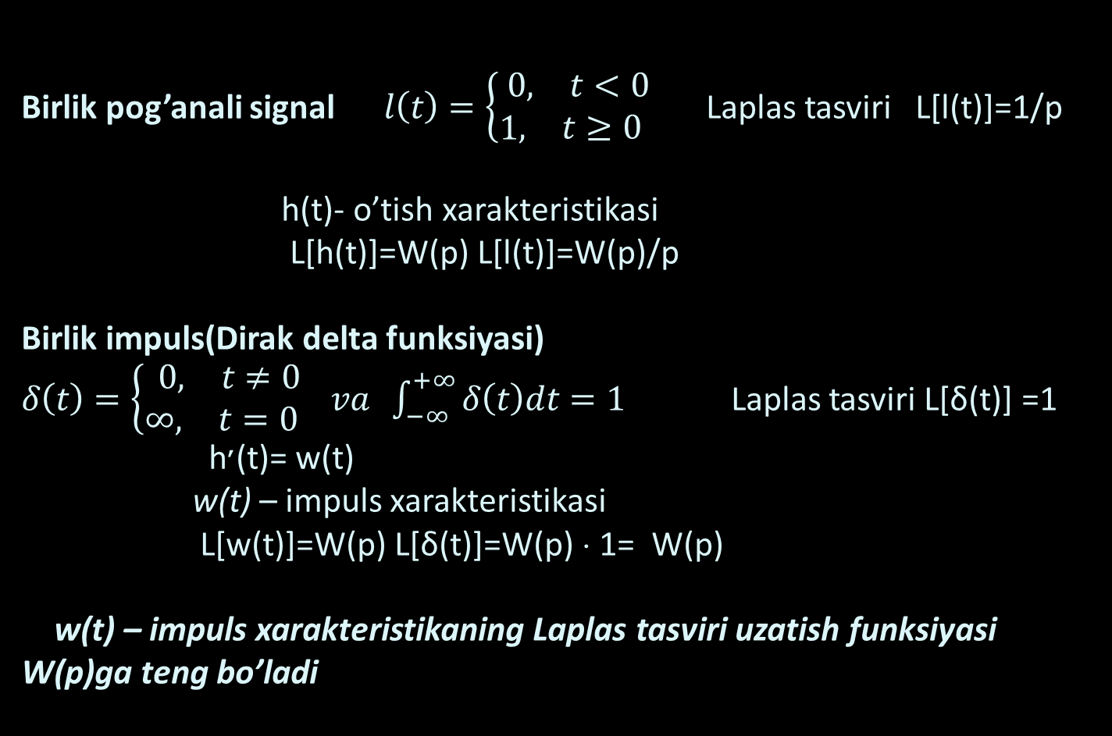
Birlik pog’anali signal $l\left(t\right)=\left\{\begin{matrix}\begin{matrix}0, & t<0\end{matrix} \\ 1\begin{matrix}, & t≥0 \end{matrix}\end{matrix} \right.$ Laplas tasviri L[l(t)]=1/p h(t)- o’tish xarakteristikasi
L[h(t)]=W(p) L[l(t)]=W(p)/p
Birlik impuls(Dirak delta funksiyasi)
$δ\left(t\right)=\left\{\begin{matrix}\begin{matrix}0, & t≠0\end{matrix} \\ \begin{matrix}∞, & t=0 \end{matrix}\end{matrix} va\right. \int_{−∞}^{+∞}{δ\left(t\right)dt=1}$ Laplas tasviri L[δ(t)] =1 h׳(t)= w(t) w(t) – impuls xarakteristikasi
L[w(t)]=W(p) L[δ(t)]=W(p) ⋅ 1= W(p) w(t) – impuls xarakteristikaning Laplas tasviri uzatish funksiyasi W(p)ga teng bo’ladi

Slide 7
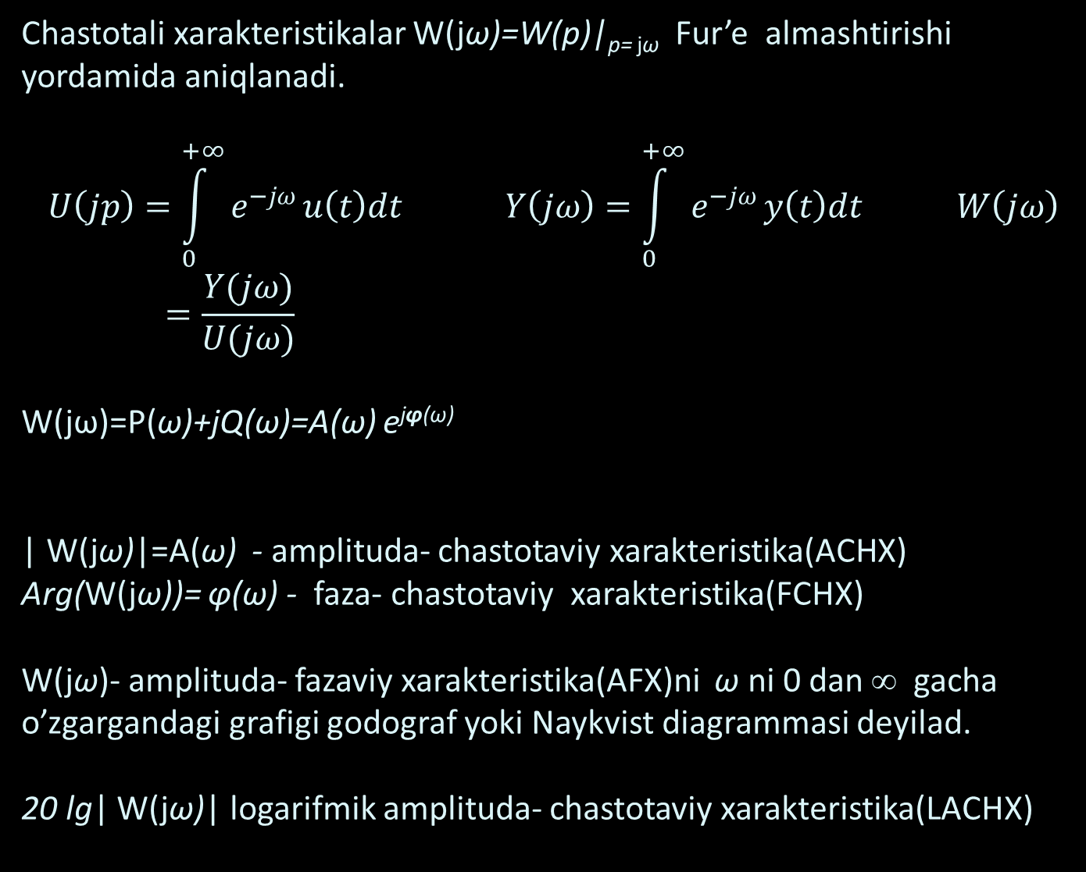
Chastotali xaraktеristikalar W(jω)=W(p)|_{p= jω} Fur’e almashtirishi yordamida aniqlanadi.
$$U\left(jp\right)=\int_{0}^{+∞}{e^{−jω}}u\left(t\right)dt Y\left(jω\right)=\int_{0}^{+∞}{e^{−jω}}y\left(t\right)dt W\left(jω\right)=\frac{Y(jω)}{U(jω)}$$
W(jω)=P(ω)+jQ(ω)=A(ω) e^{jφ(ω)}
| W(jω)|=A(ω) - amplituda- chastotaviy xarakteristika(ACHX)
Arg(W(jω))= φ(ω) - faza- chastotaviy xarakteristika(FCHX)
W(jω)- amplituda- fazaviy xarakteristika(AFX)ni ω ni 0 dan ∞ gacha o’zgargandagi grafigi godograf yoki Naykvist diagrammasi deyilad.
20 lg| W(jω)| logarifmik amplituda- chastotaviy xarakteristika(LACHX)

Slide 8
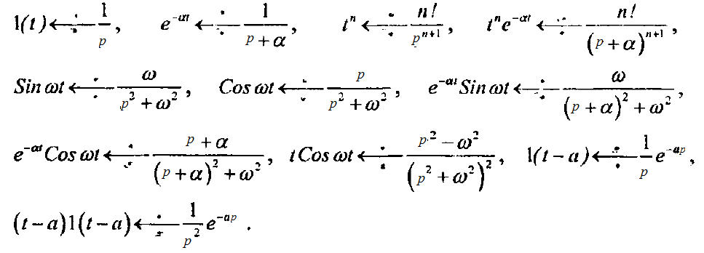
Ba’zi tasvirlar

Slide 9
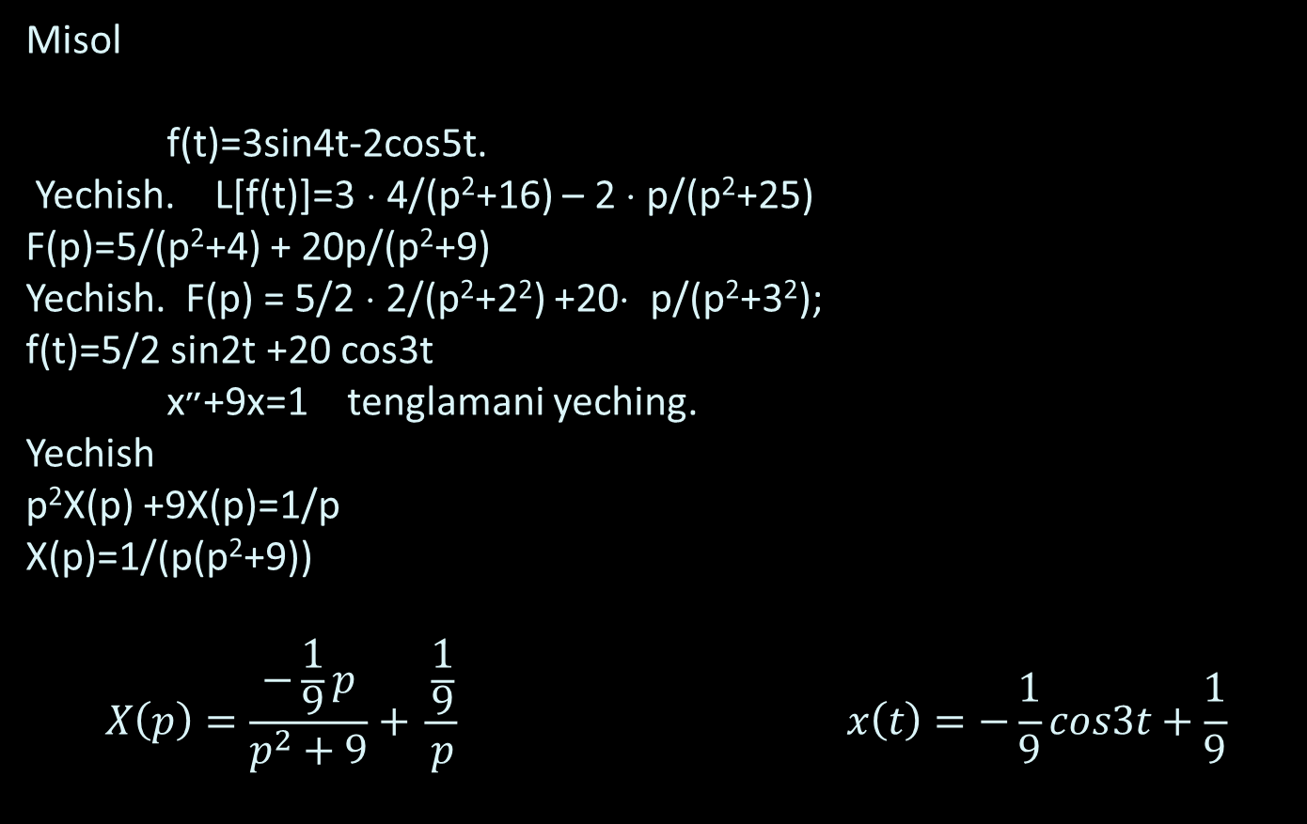
Misol f(t)=3sin4t-2cos5t.
Yechish. L[f(t)]=3 ⋅ 4/(p²+16) – 2 ⋅ p/(p²+25)
F(p)=5/(p²+4) + 20p/(p²+9)
Yechish. F(p) = 5/2 ⋅ 2/(p²+2²) +20⋅ p/(p²+3²); f(t)=5/2 sin2t +20 cos3t x״+9x=1 tenglamani yeching.
Yechish p²X(p) +9X(p)=1/p
X(p)=1/(p(p²+9))
$$X\left(p\right)=\frac{−\frac{1}{9}p}{p^{2}+9}+ \frac{\frac{1}{9}}{p} x\left(t\right)=−\frac{1}{9}cos3t+\frac{1}{9}$$

Slide 10
Ob'еktlarni matеmatik modеllashtirishdagi tipik masalalari
Statika va dinamikaning nochiziqli tеnglamalari bo‘yicha chiziqli modеllarini tuzish. Chiqish koordinatalariga tasodifiy jarayonlar va tеnglamalar paramеtrlarining fluktuatsiyasi ta'sirini o‘rganish. Chiqish koordinatalariga ma'lum chеklovlarga ko‘ra joiz boshqarishlar sohasini topish. Ob'еktlarni ish rеjimlarini optimallashtirish.
Ma'lum korrеlyatsion funktsiyalar bo‘yicha ob'еktning impuls funktsiyasini aniqlash. Impuls funktsiyasini topish masalasining noturg‘unlik tushunchasi. Noturg‘un masalalarni muntazamlashtirish usullari.

Slide 11
TAMOM!

