Slide 1
Making fashion design illustration
Using collage method

Slide 2
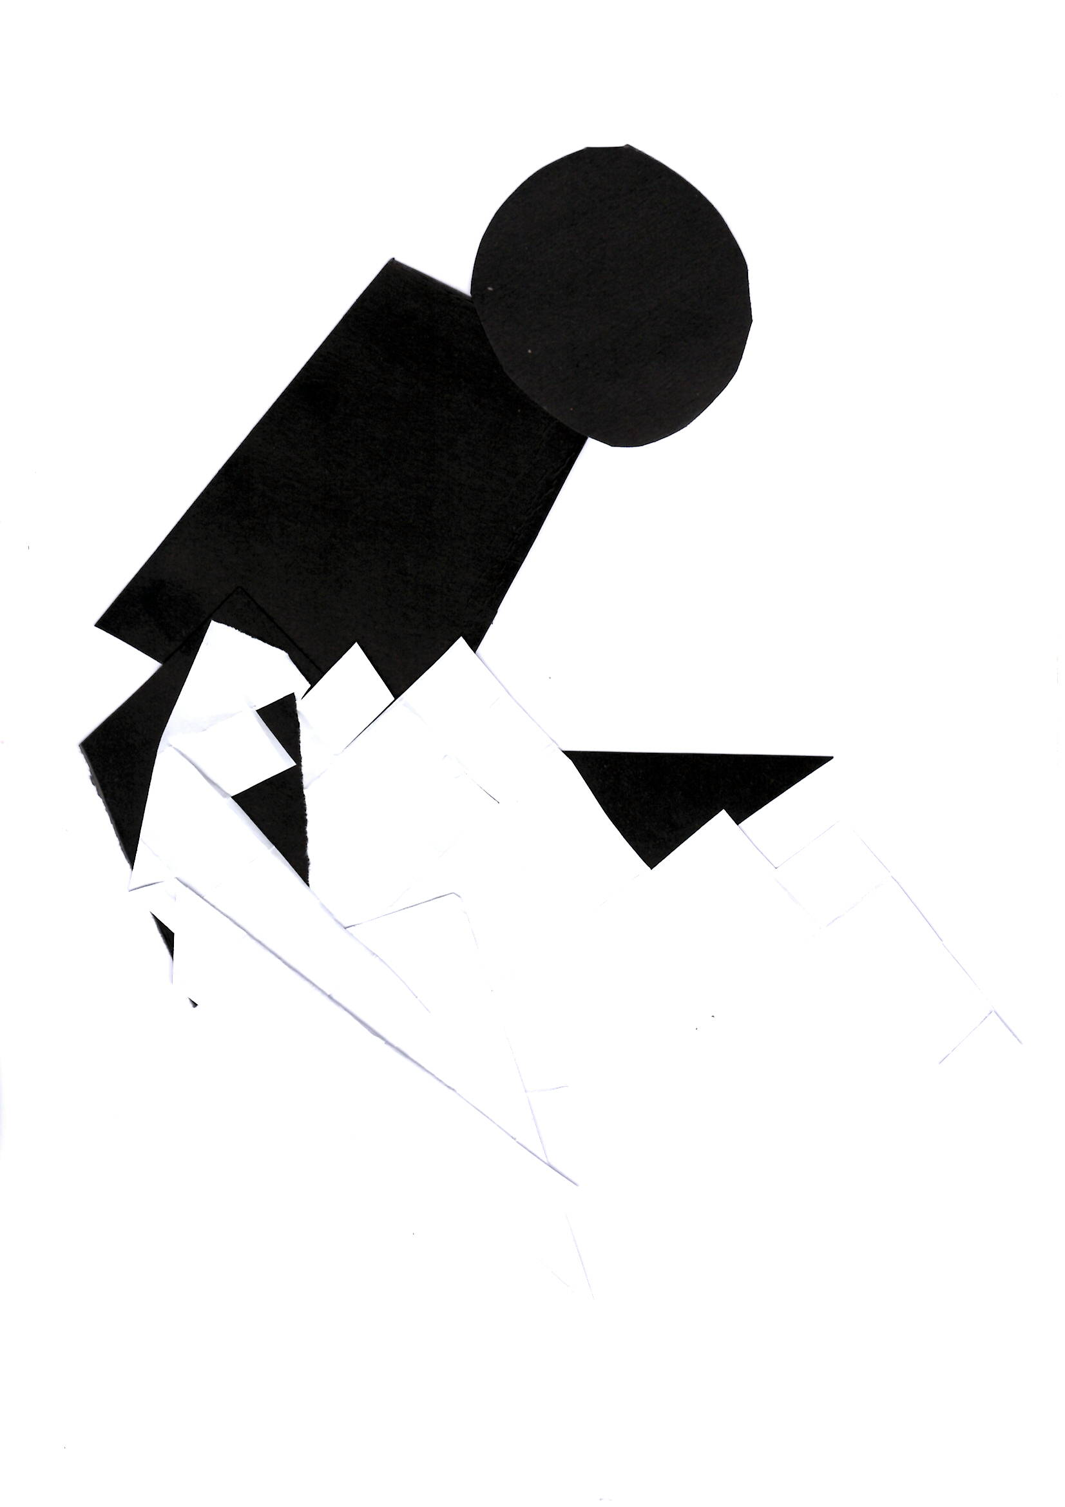
Composition making using black and white paper

Slide 3
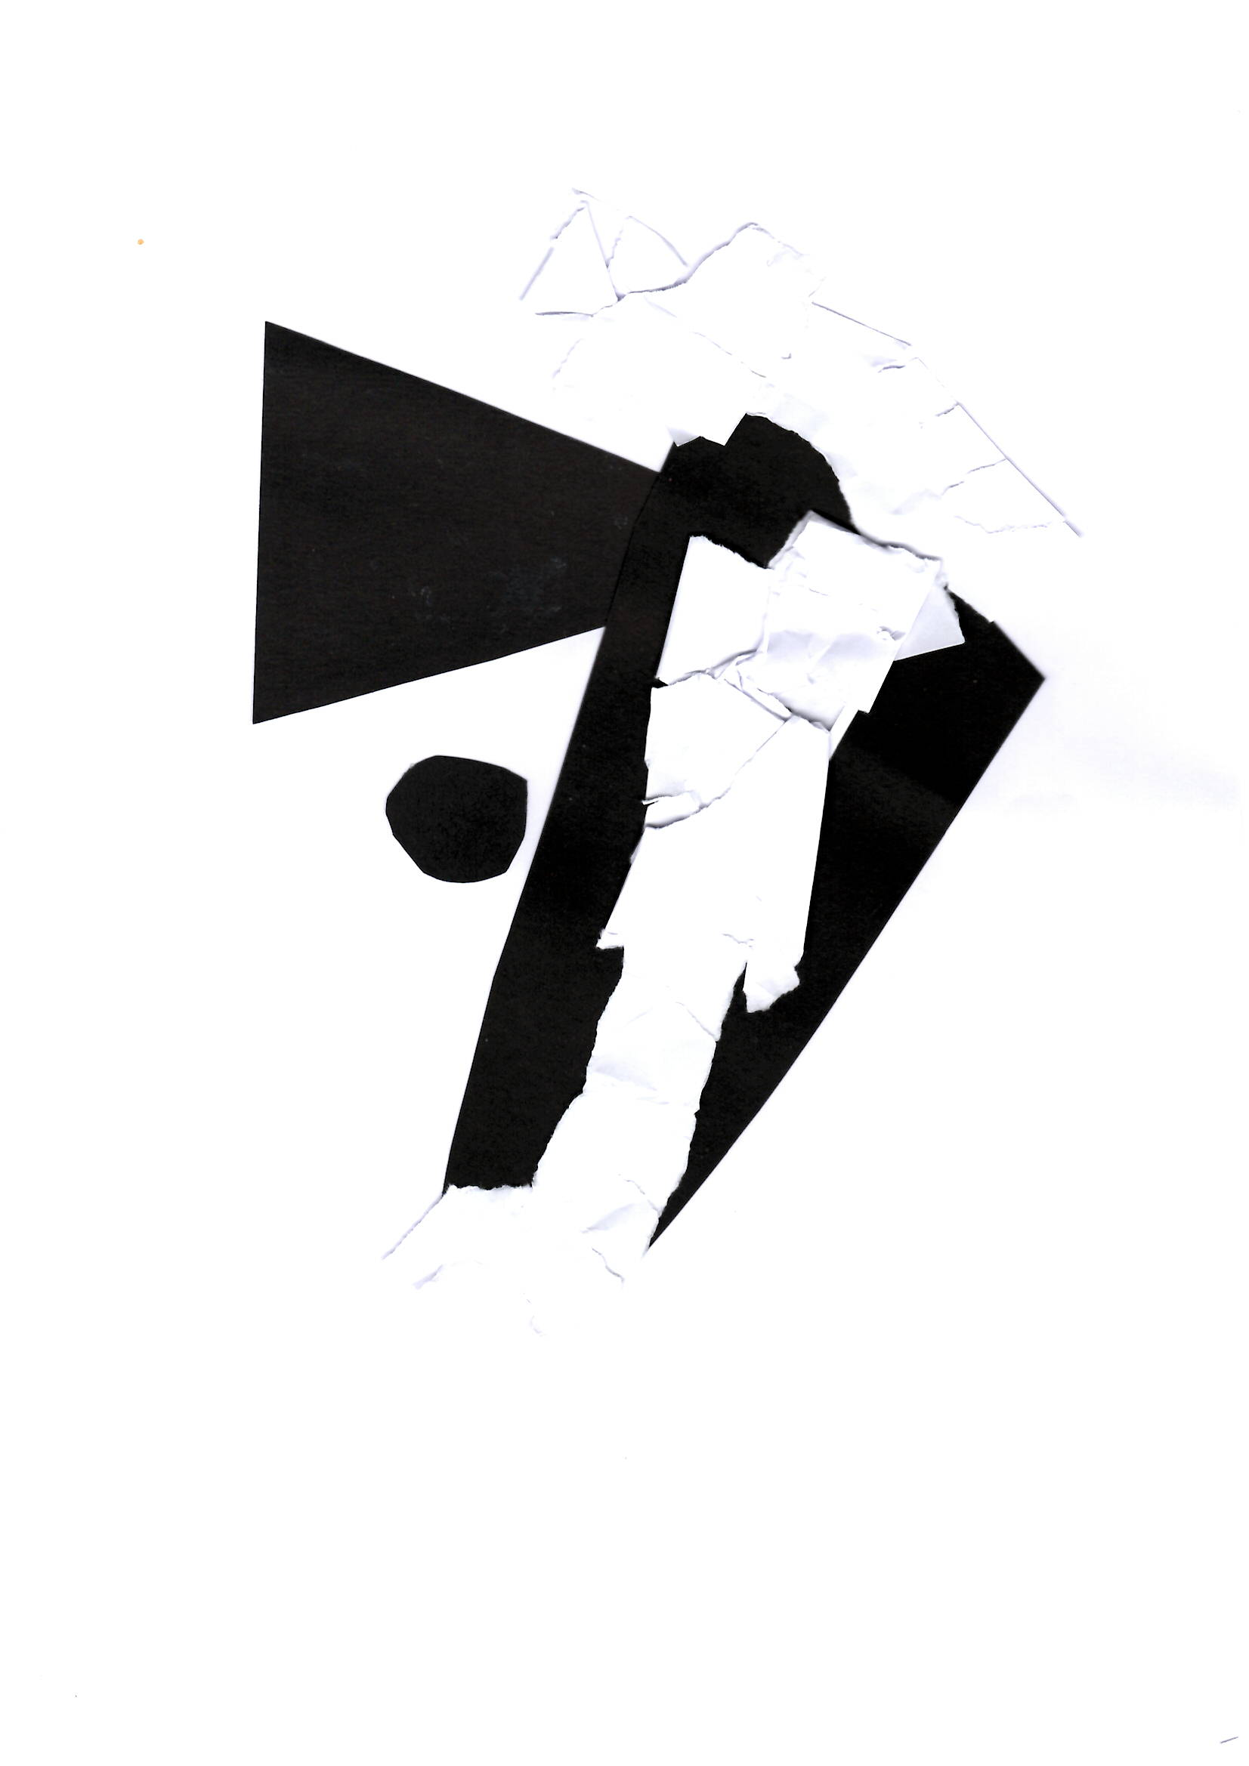
Composition making using a circle, a square and a triangle.

Slide 4
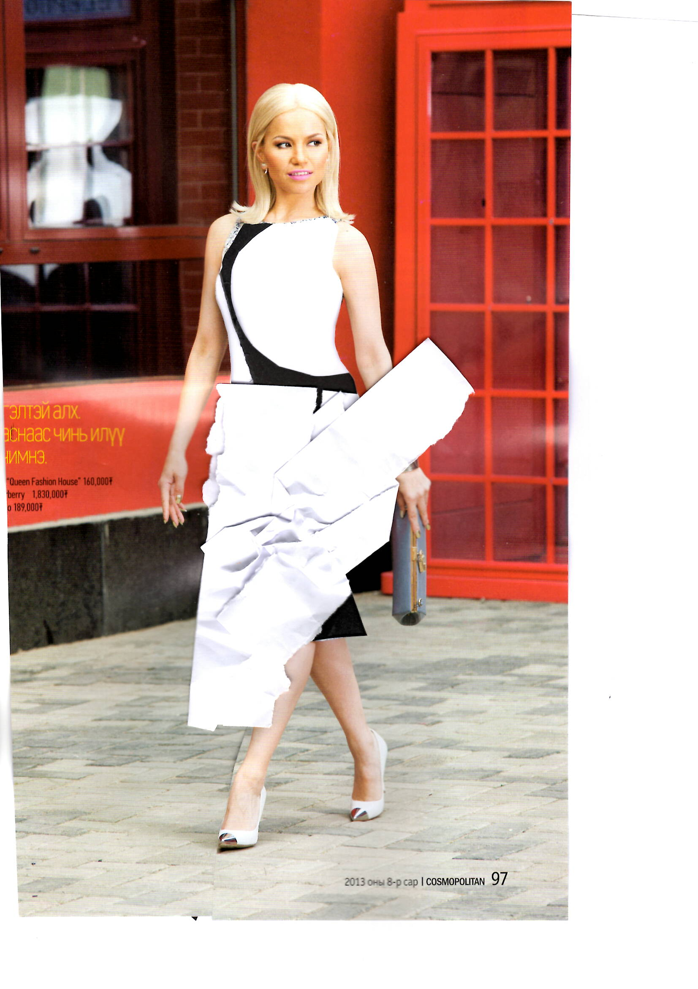
Using old magazines

Slide 5
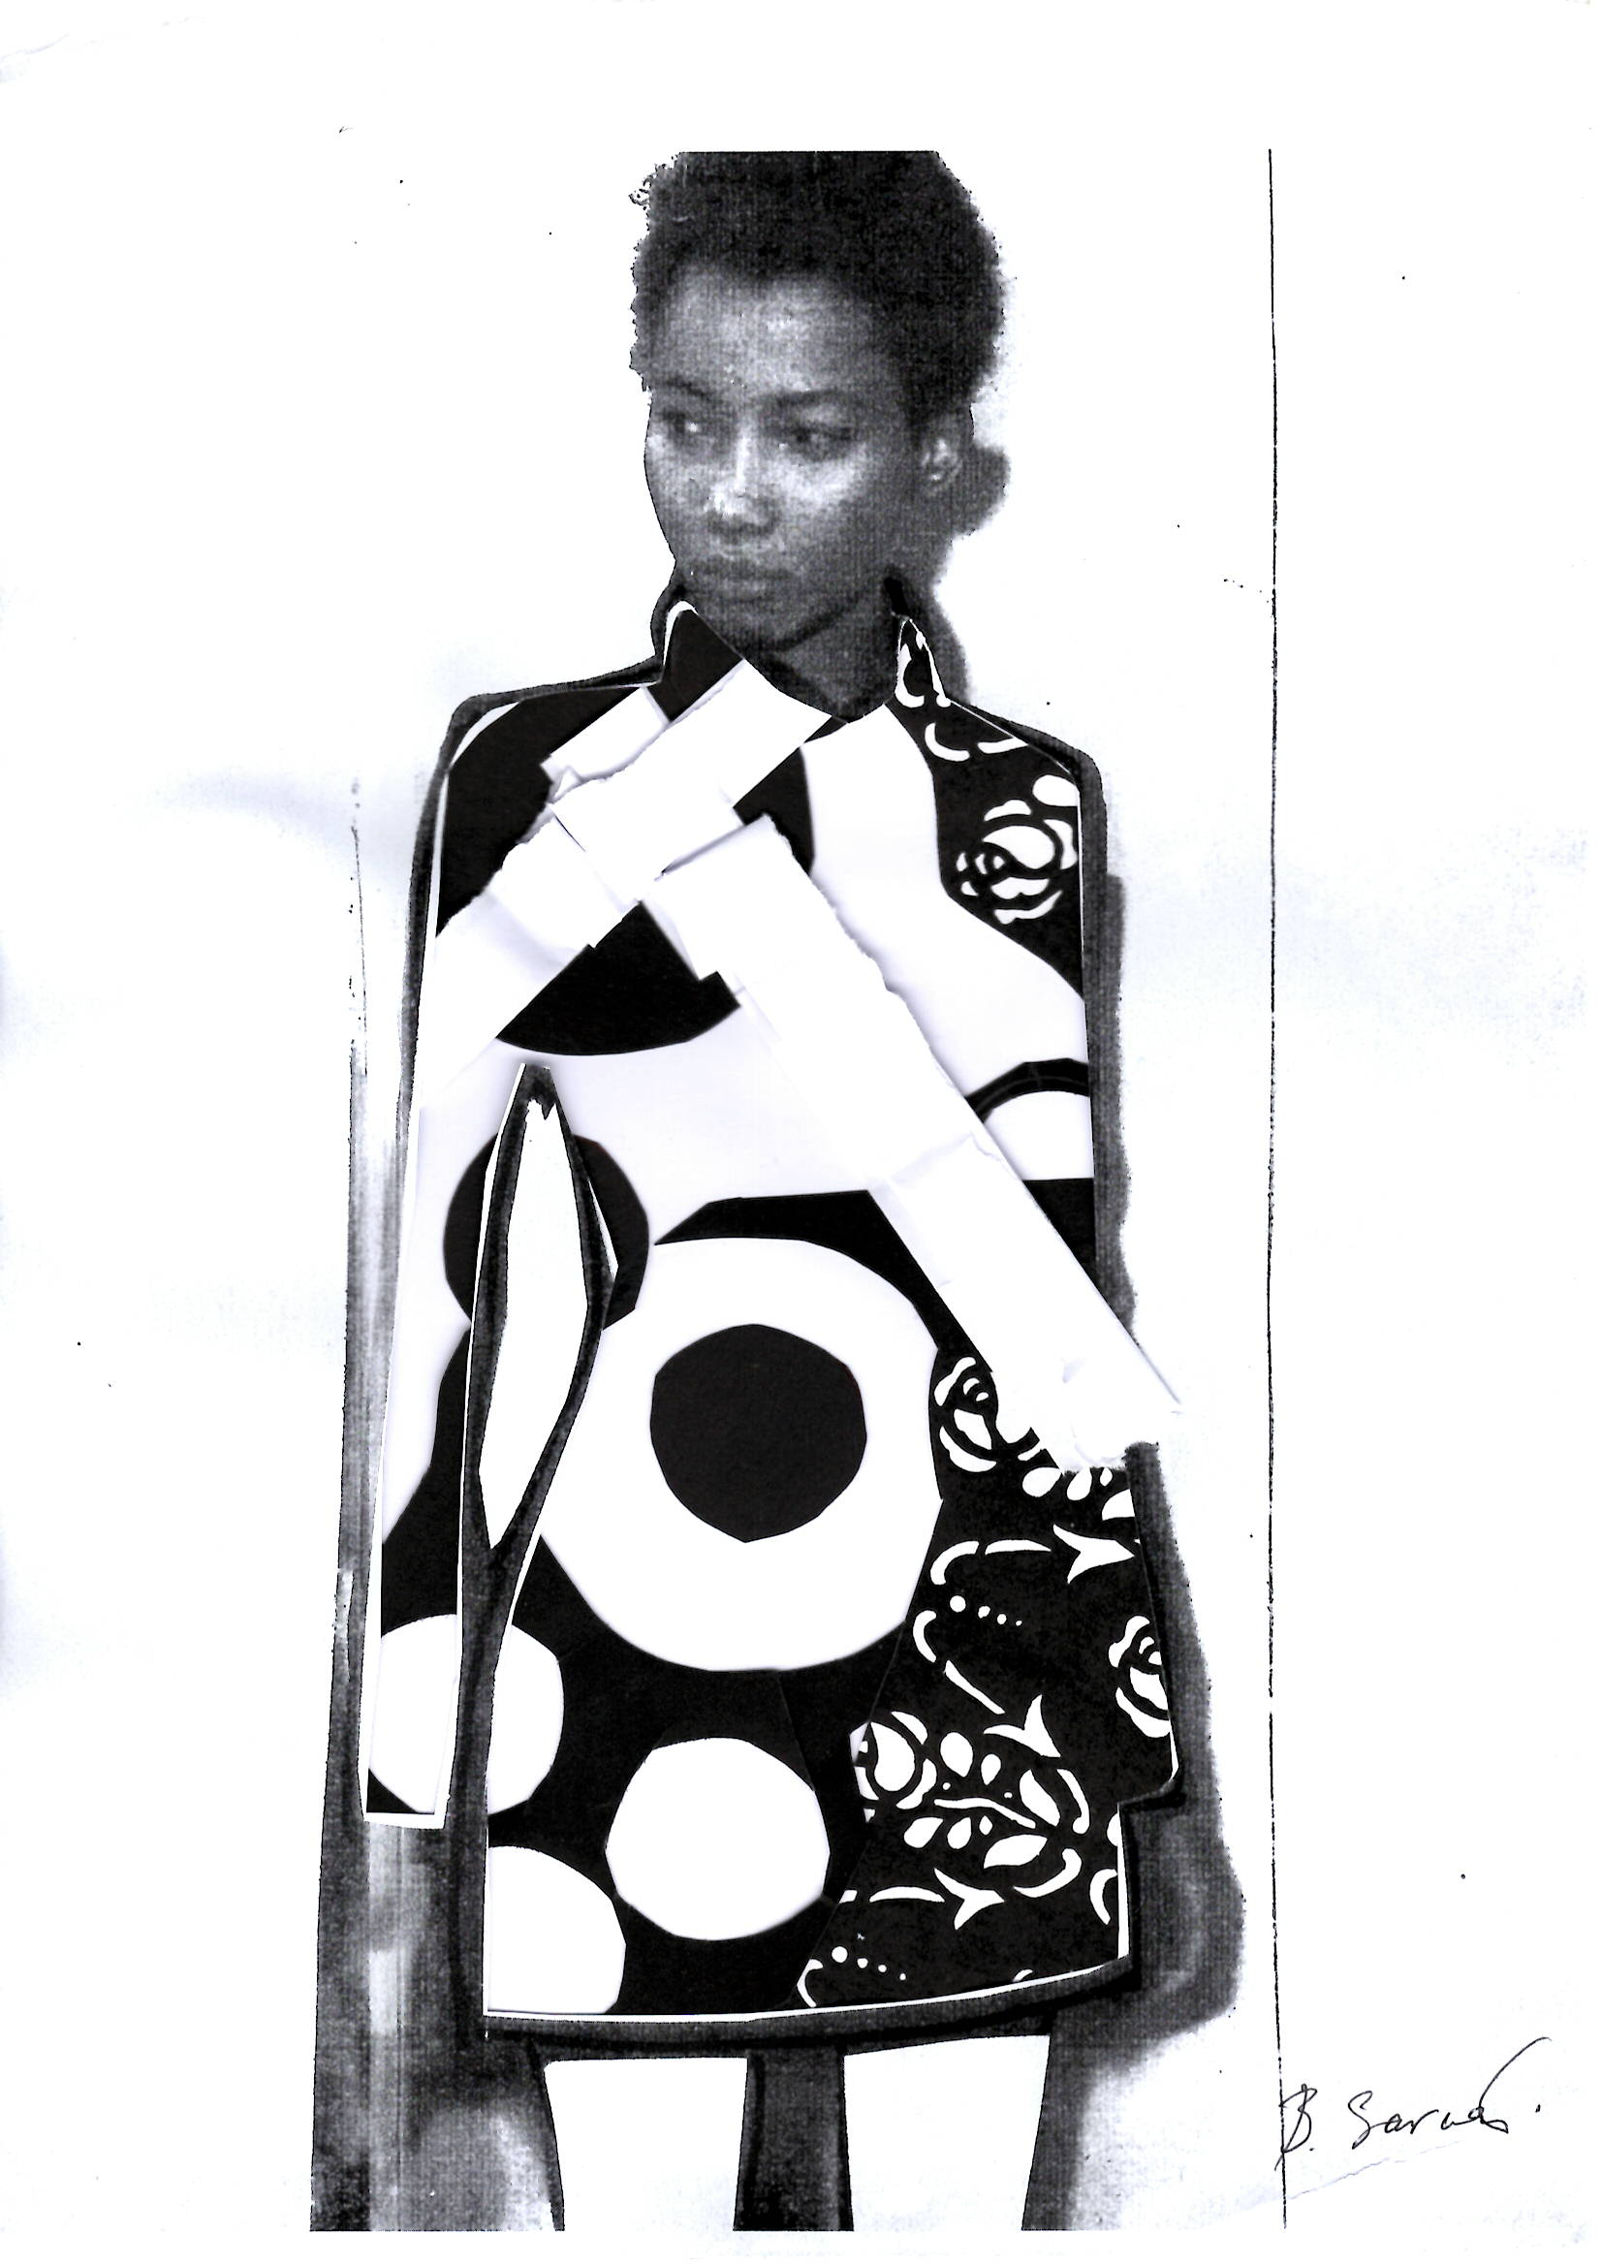
Collage with white and black papers

Slide 6
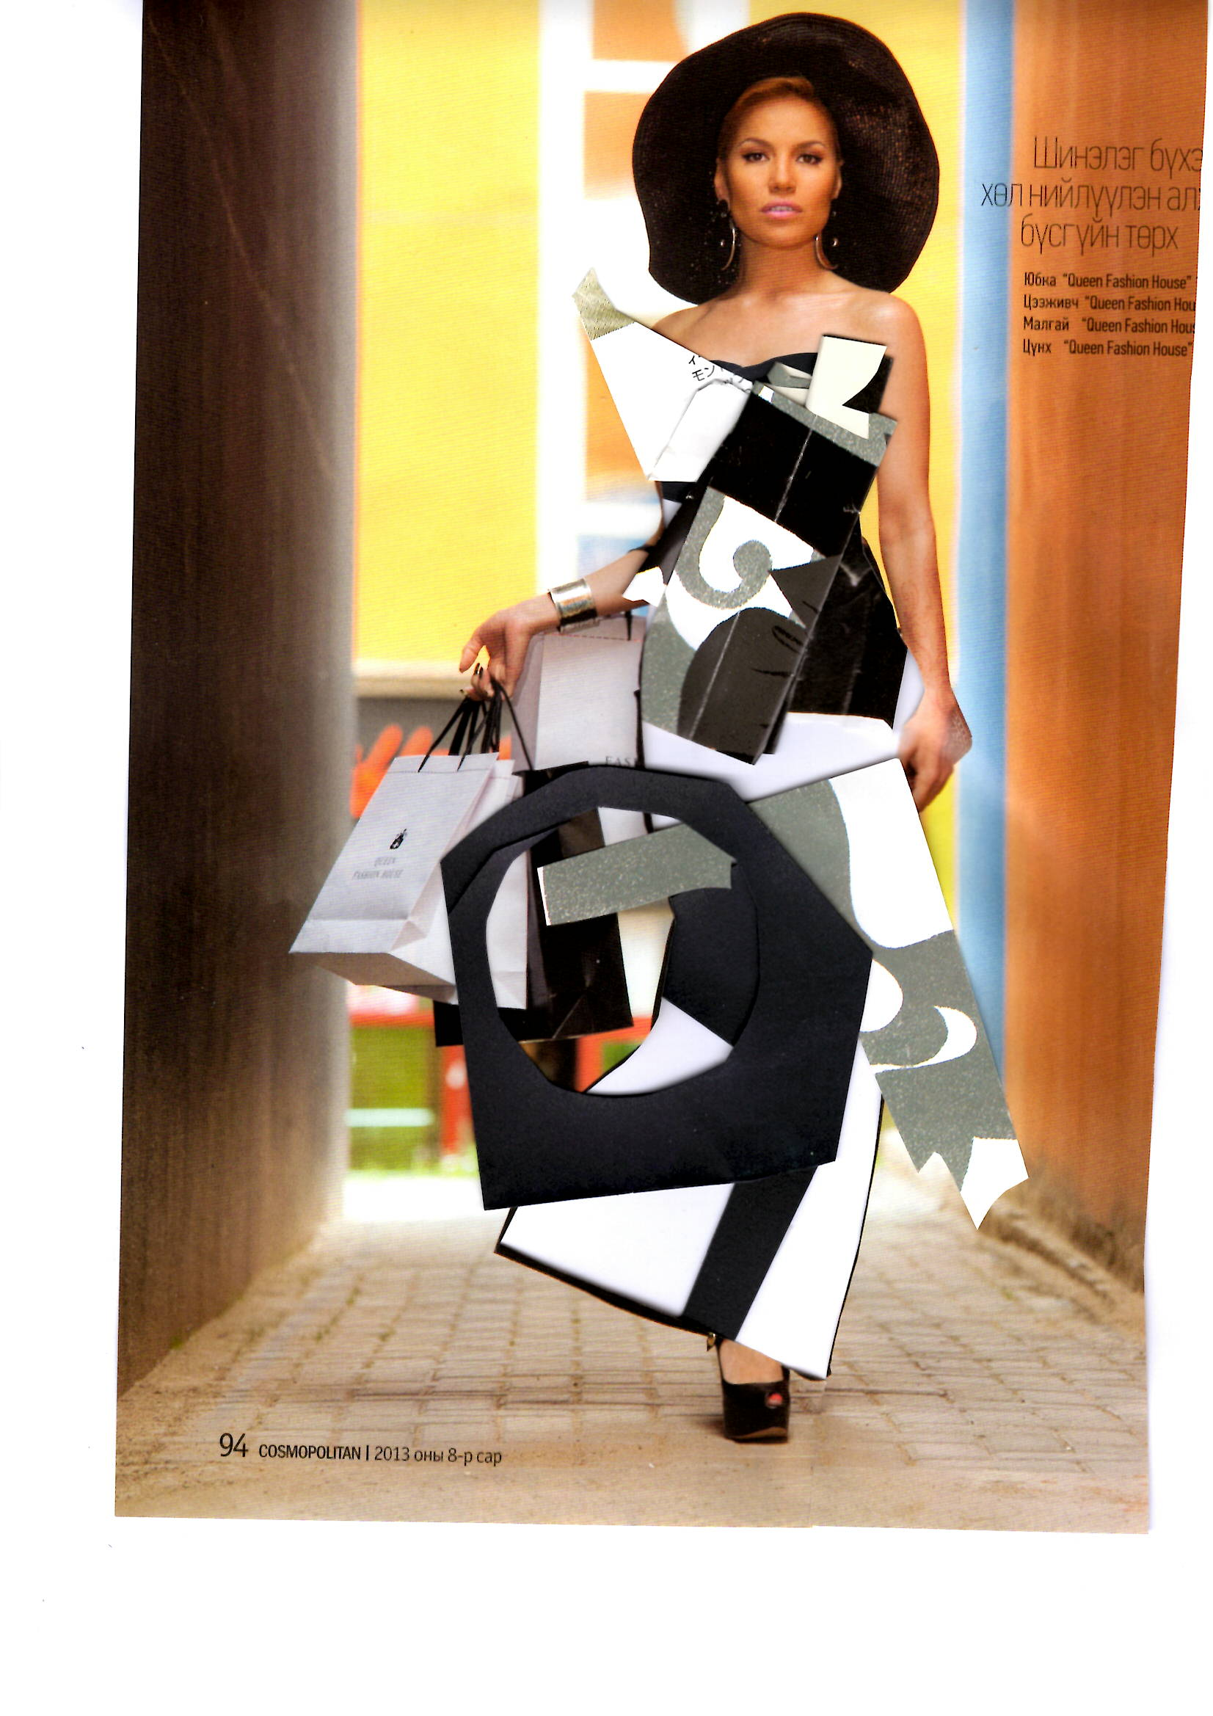
Collage with white and black papers

Slide 7
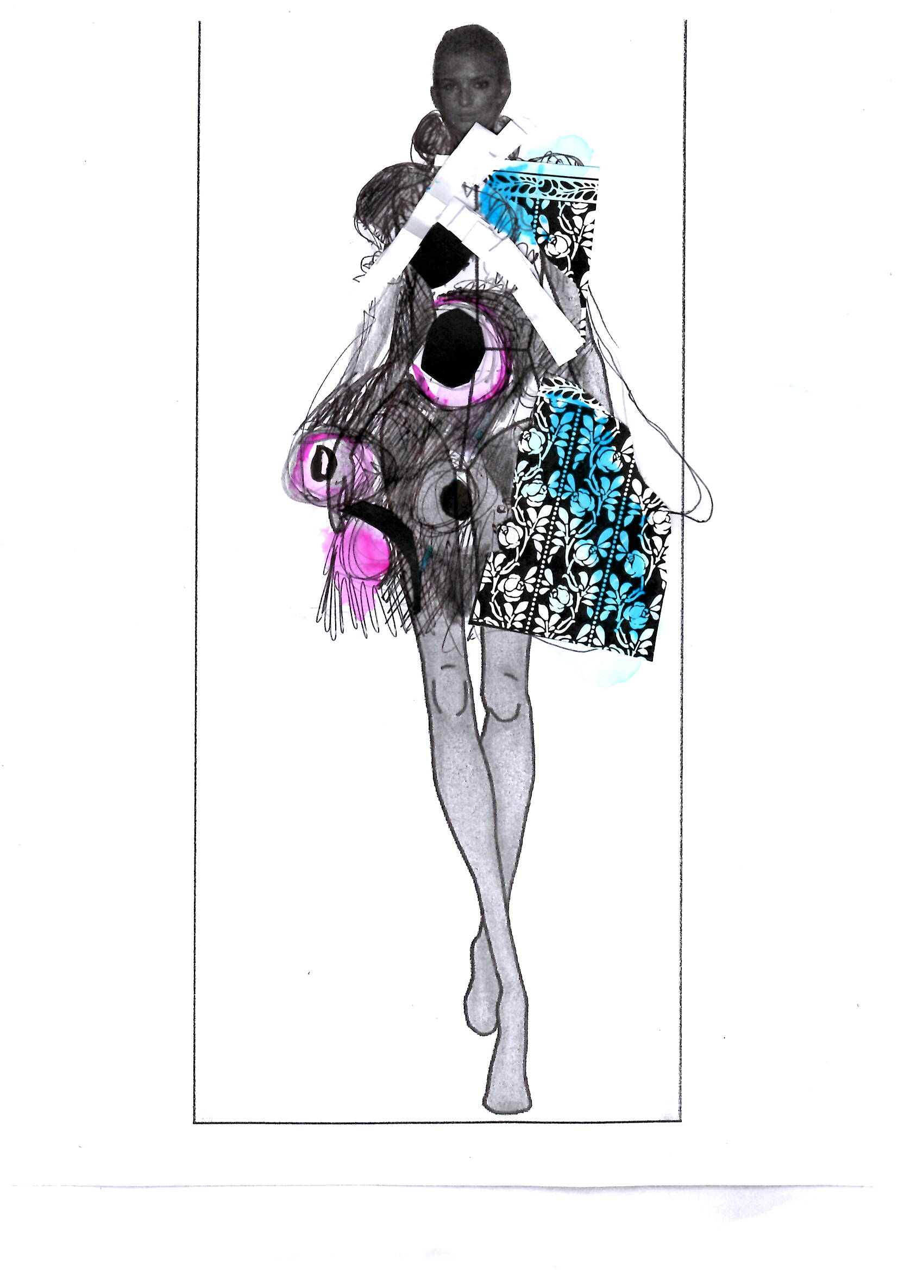
Collage with white and black papers

Slide 8
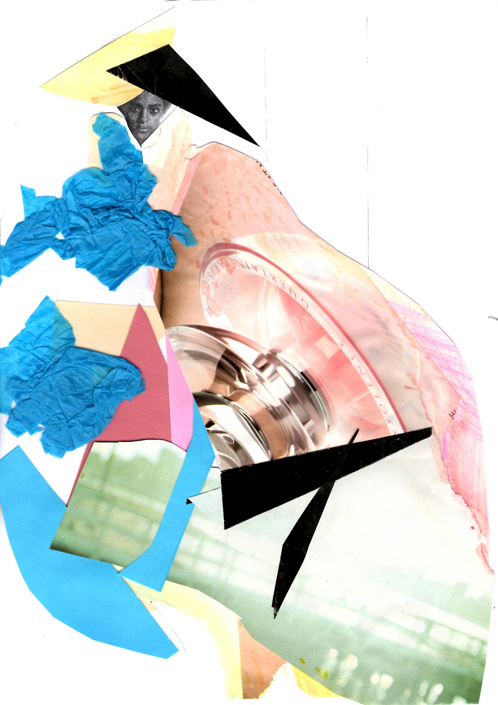
Homework assignment:
Make a free composition collage using pictures that you like.

