Slide 1
Fashion Design Illustration
Review lesson

Slide 2
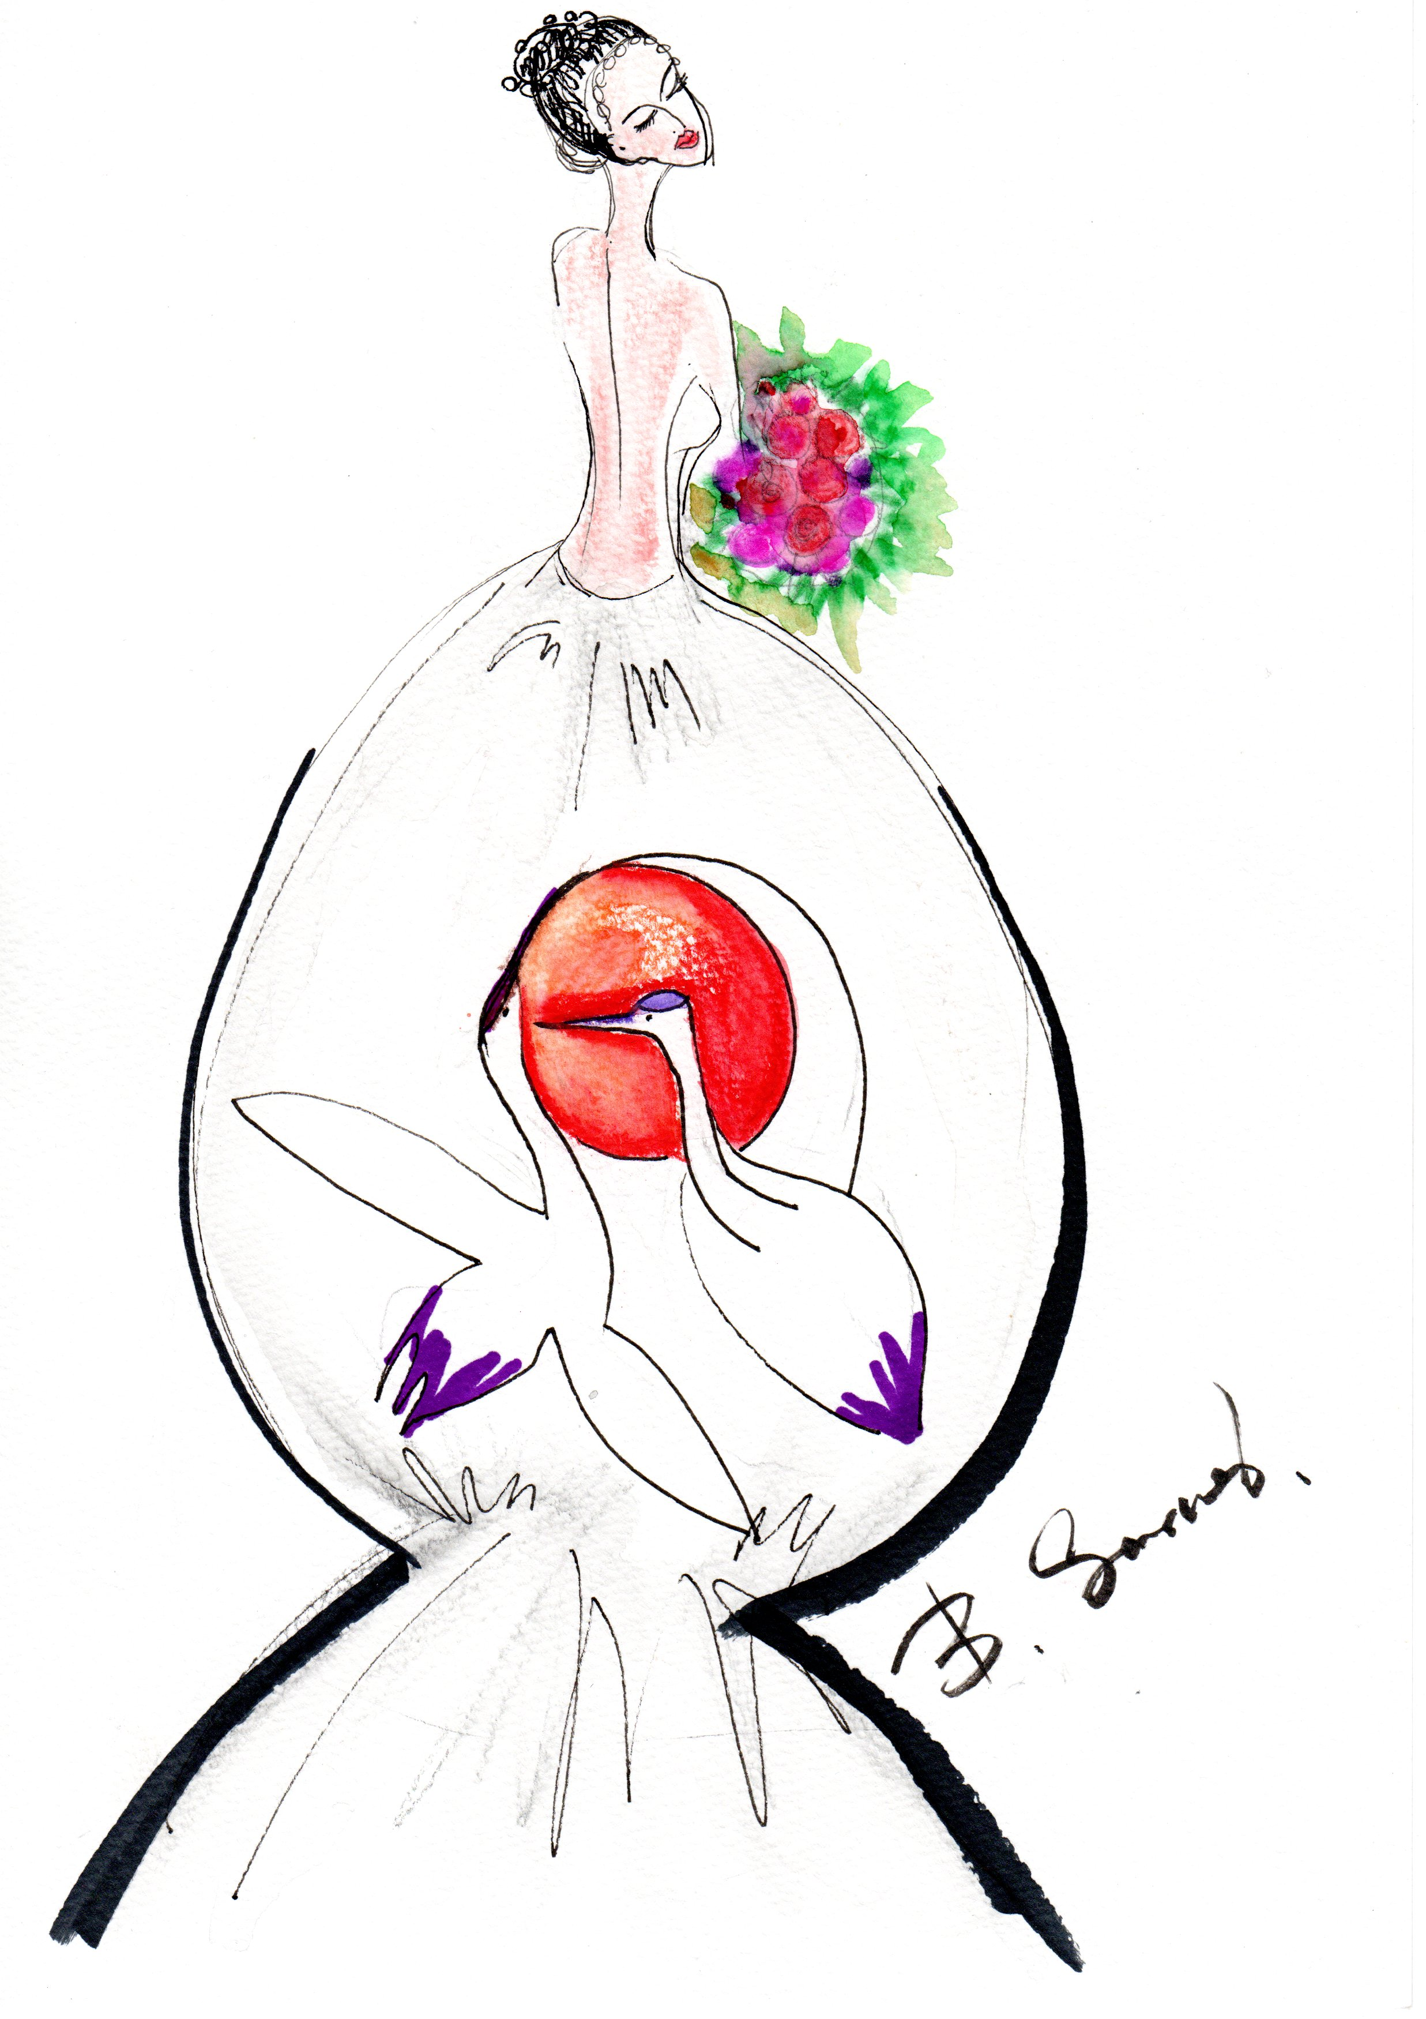
Review

Slide 3
Review: If you want to become a fashion designer or just if you like to draw and paint fashion design illustration!
Practice drawing lines all the time. Always carry a notebook and pencil!
Always do sketches everywhere, anytime!
Practice body proportion. Study and research about human body
Practice drawing different pose variations!
Study your own hands and feet!
Draw your own face!
Make collage from old magazines!
Practice male body drawing!

Slide 4
Review: If you want to become a fashion designer or just if you like to draw and paint fashion design illustration!
Practice child proportion. Study from children!
Make designs using imagination!
Get inspiration from nature, art, museums, movies and songs!
Do some flat style illustration!
Study movement of clothes! Do your own free style illustration!
Color your designs with different kind of materials! Watercolor, acrylics, soft pastels, crayons, color pencils, markers and coloring brushing pens can be all used!
Send to me your homeworks at info@sarnaibold.com, bb.sarnai@gmail.com

Slide 5
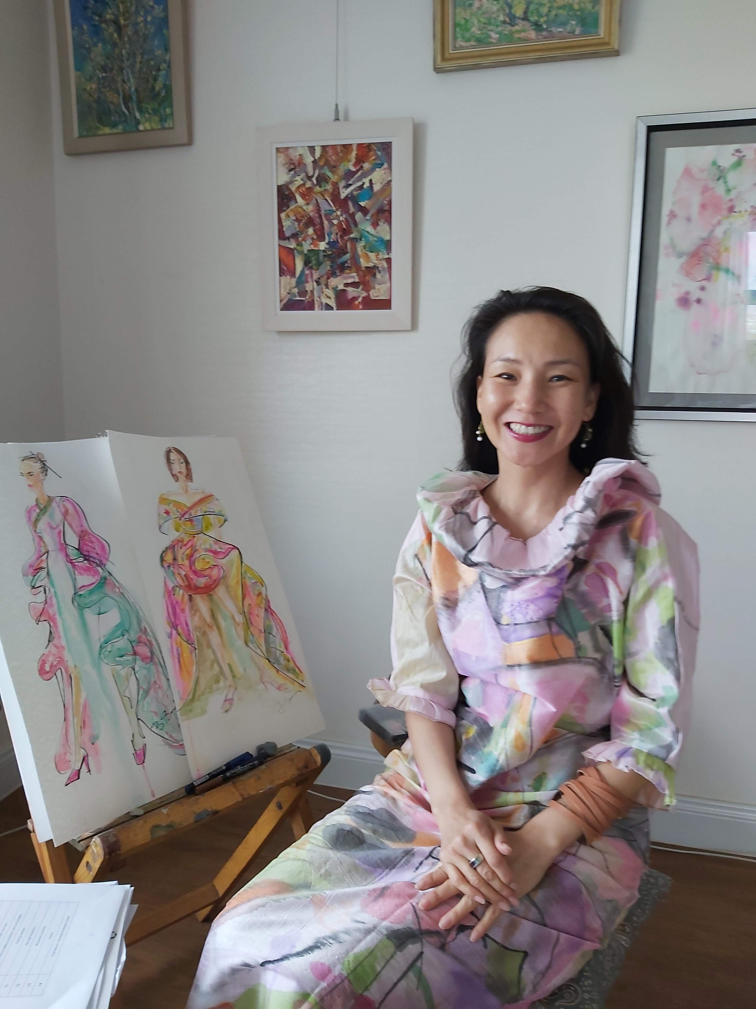
Stay in touch!
Visit my website sarnaibold.com and
send me your review about this course.
Tell me about yourself and stay in touch! <3
Love,
Your teacher Sarnai Bold

