Slide 1
Coloring the designs

Slide 2
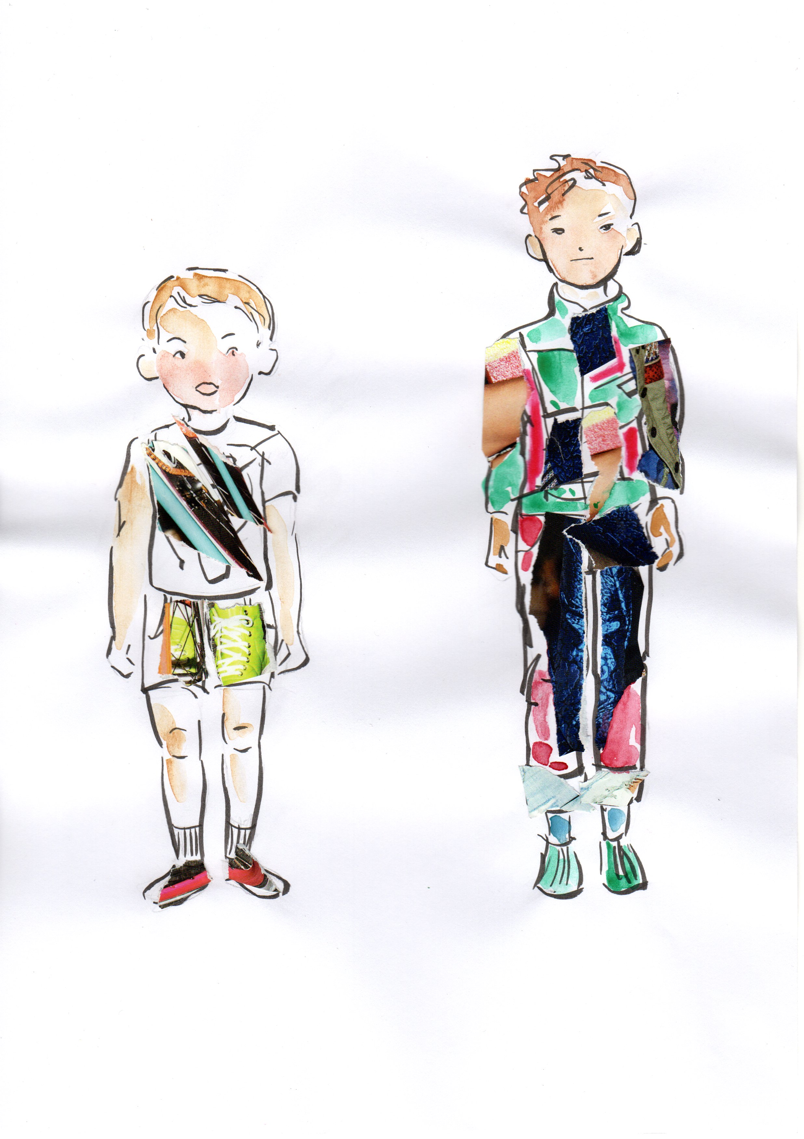
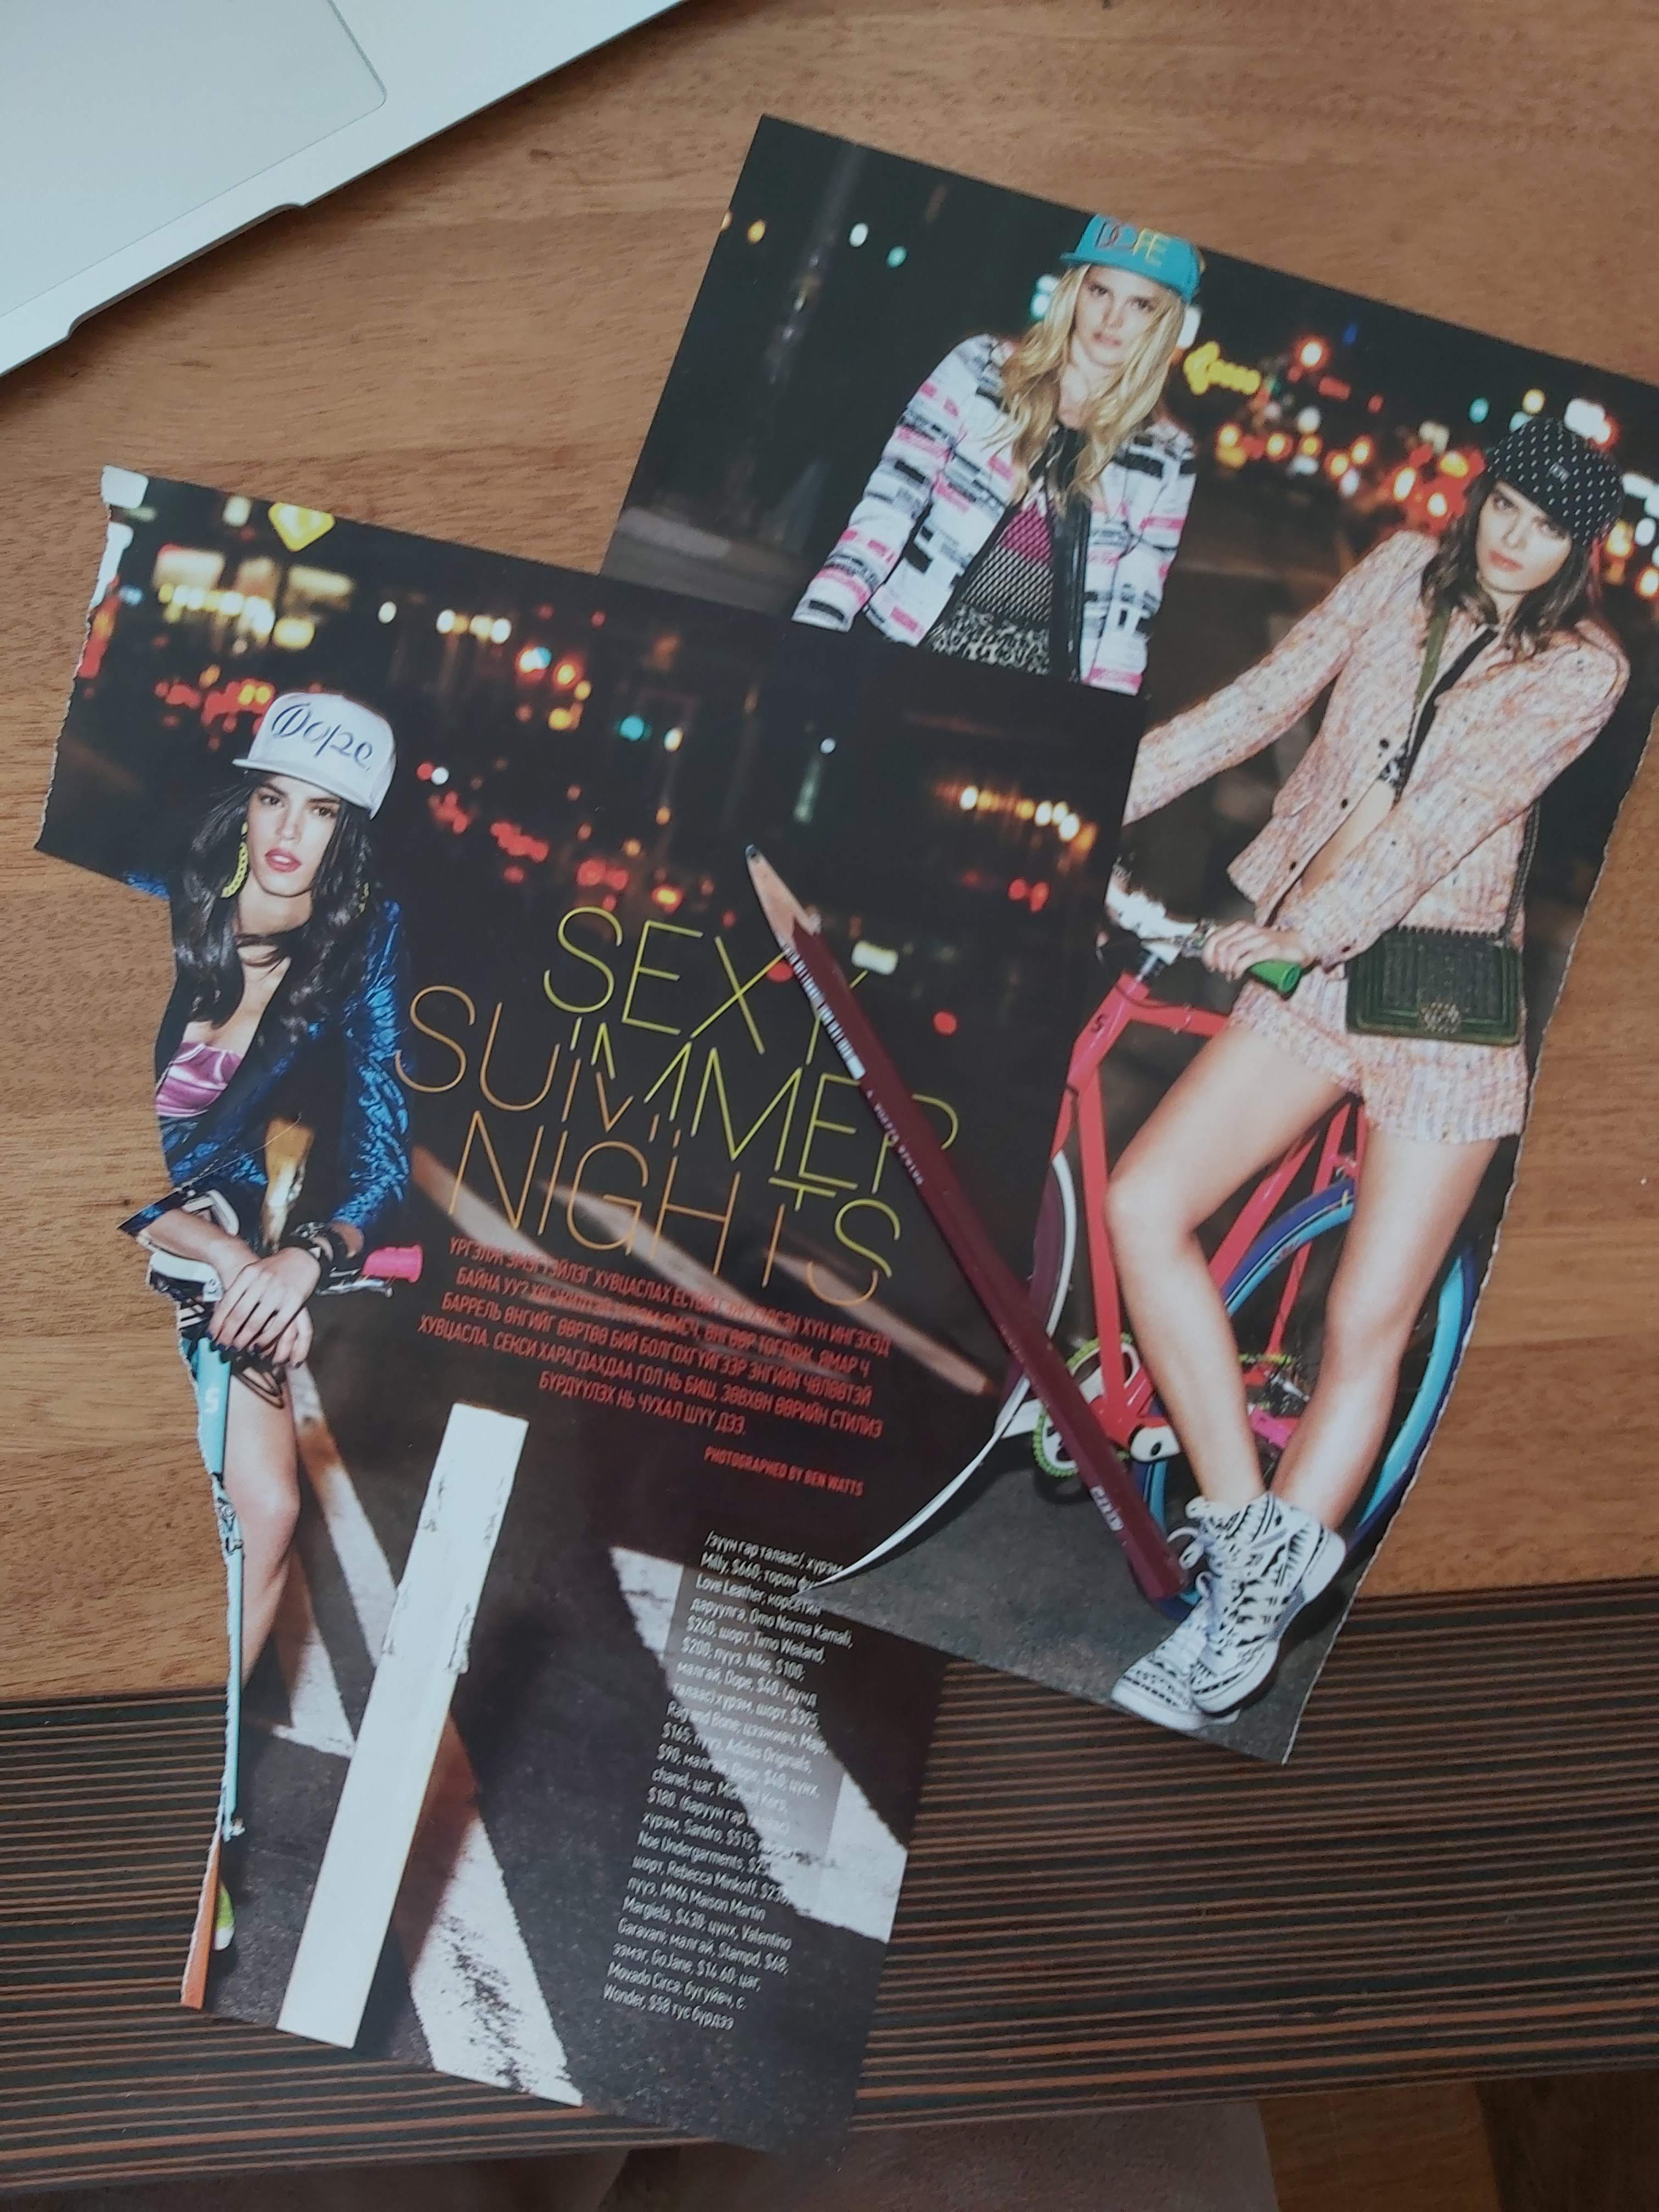
Coloring the designs
I made a collage from the right picture and put some watercolor on clothes also.
Inspiration color picture

Slide 3
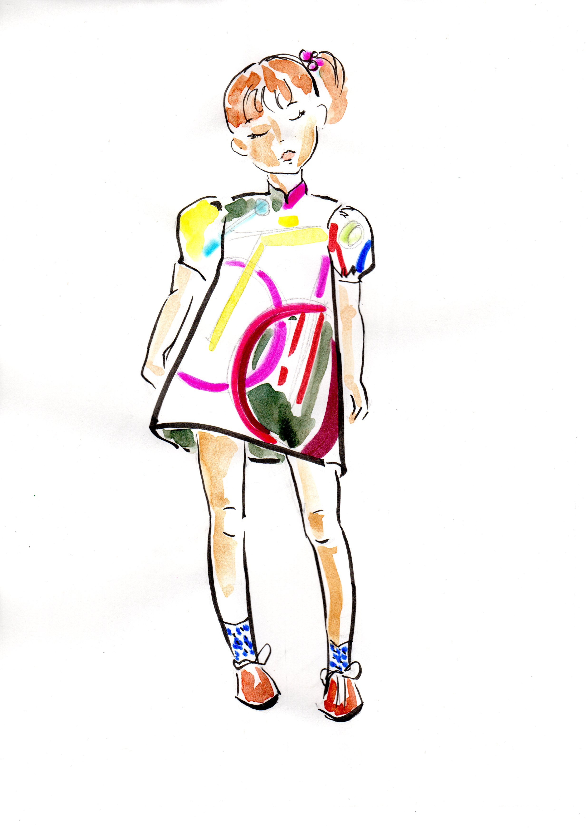
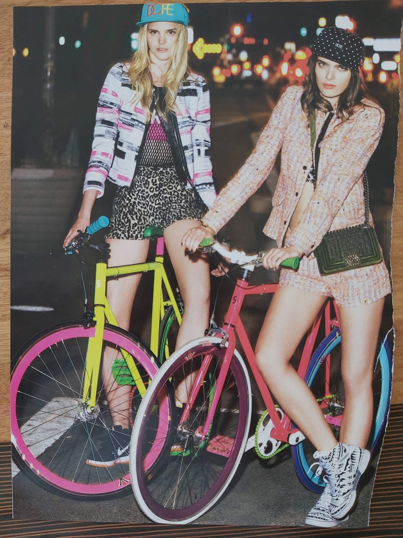
Coloring designs
Loved the bright colors of bicycles from this picture so just used it as an inspiration board.
Look how cute is her dress with bicycle colors!

Slide 4
Coloring designs
When you color your illustration it is great if you use as many kinds of materials as possible. Find which material suits you better and sometimes it is important to adjust it to the purpose of a design illustration.

Slide 5
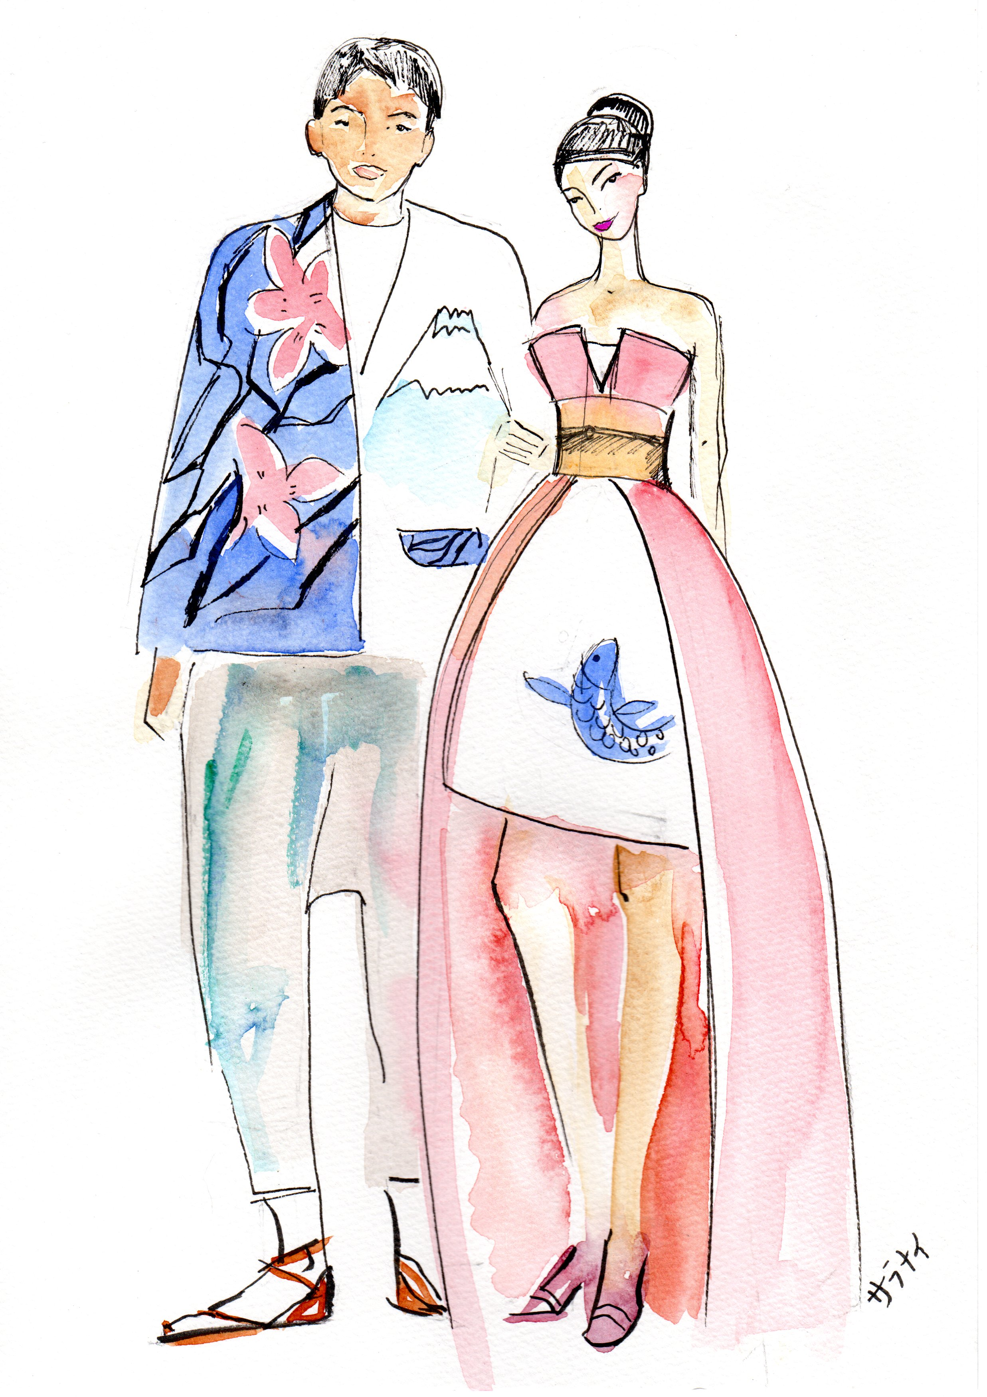
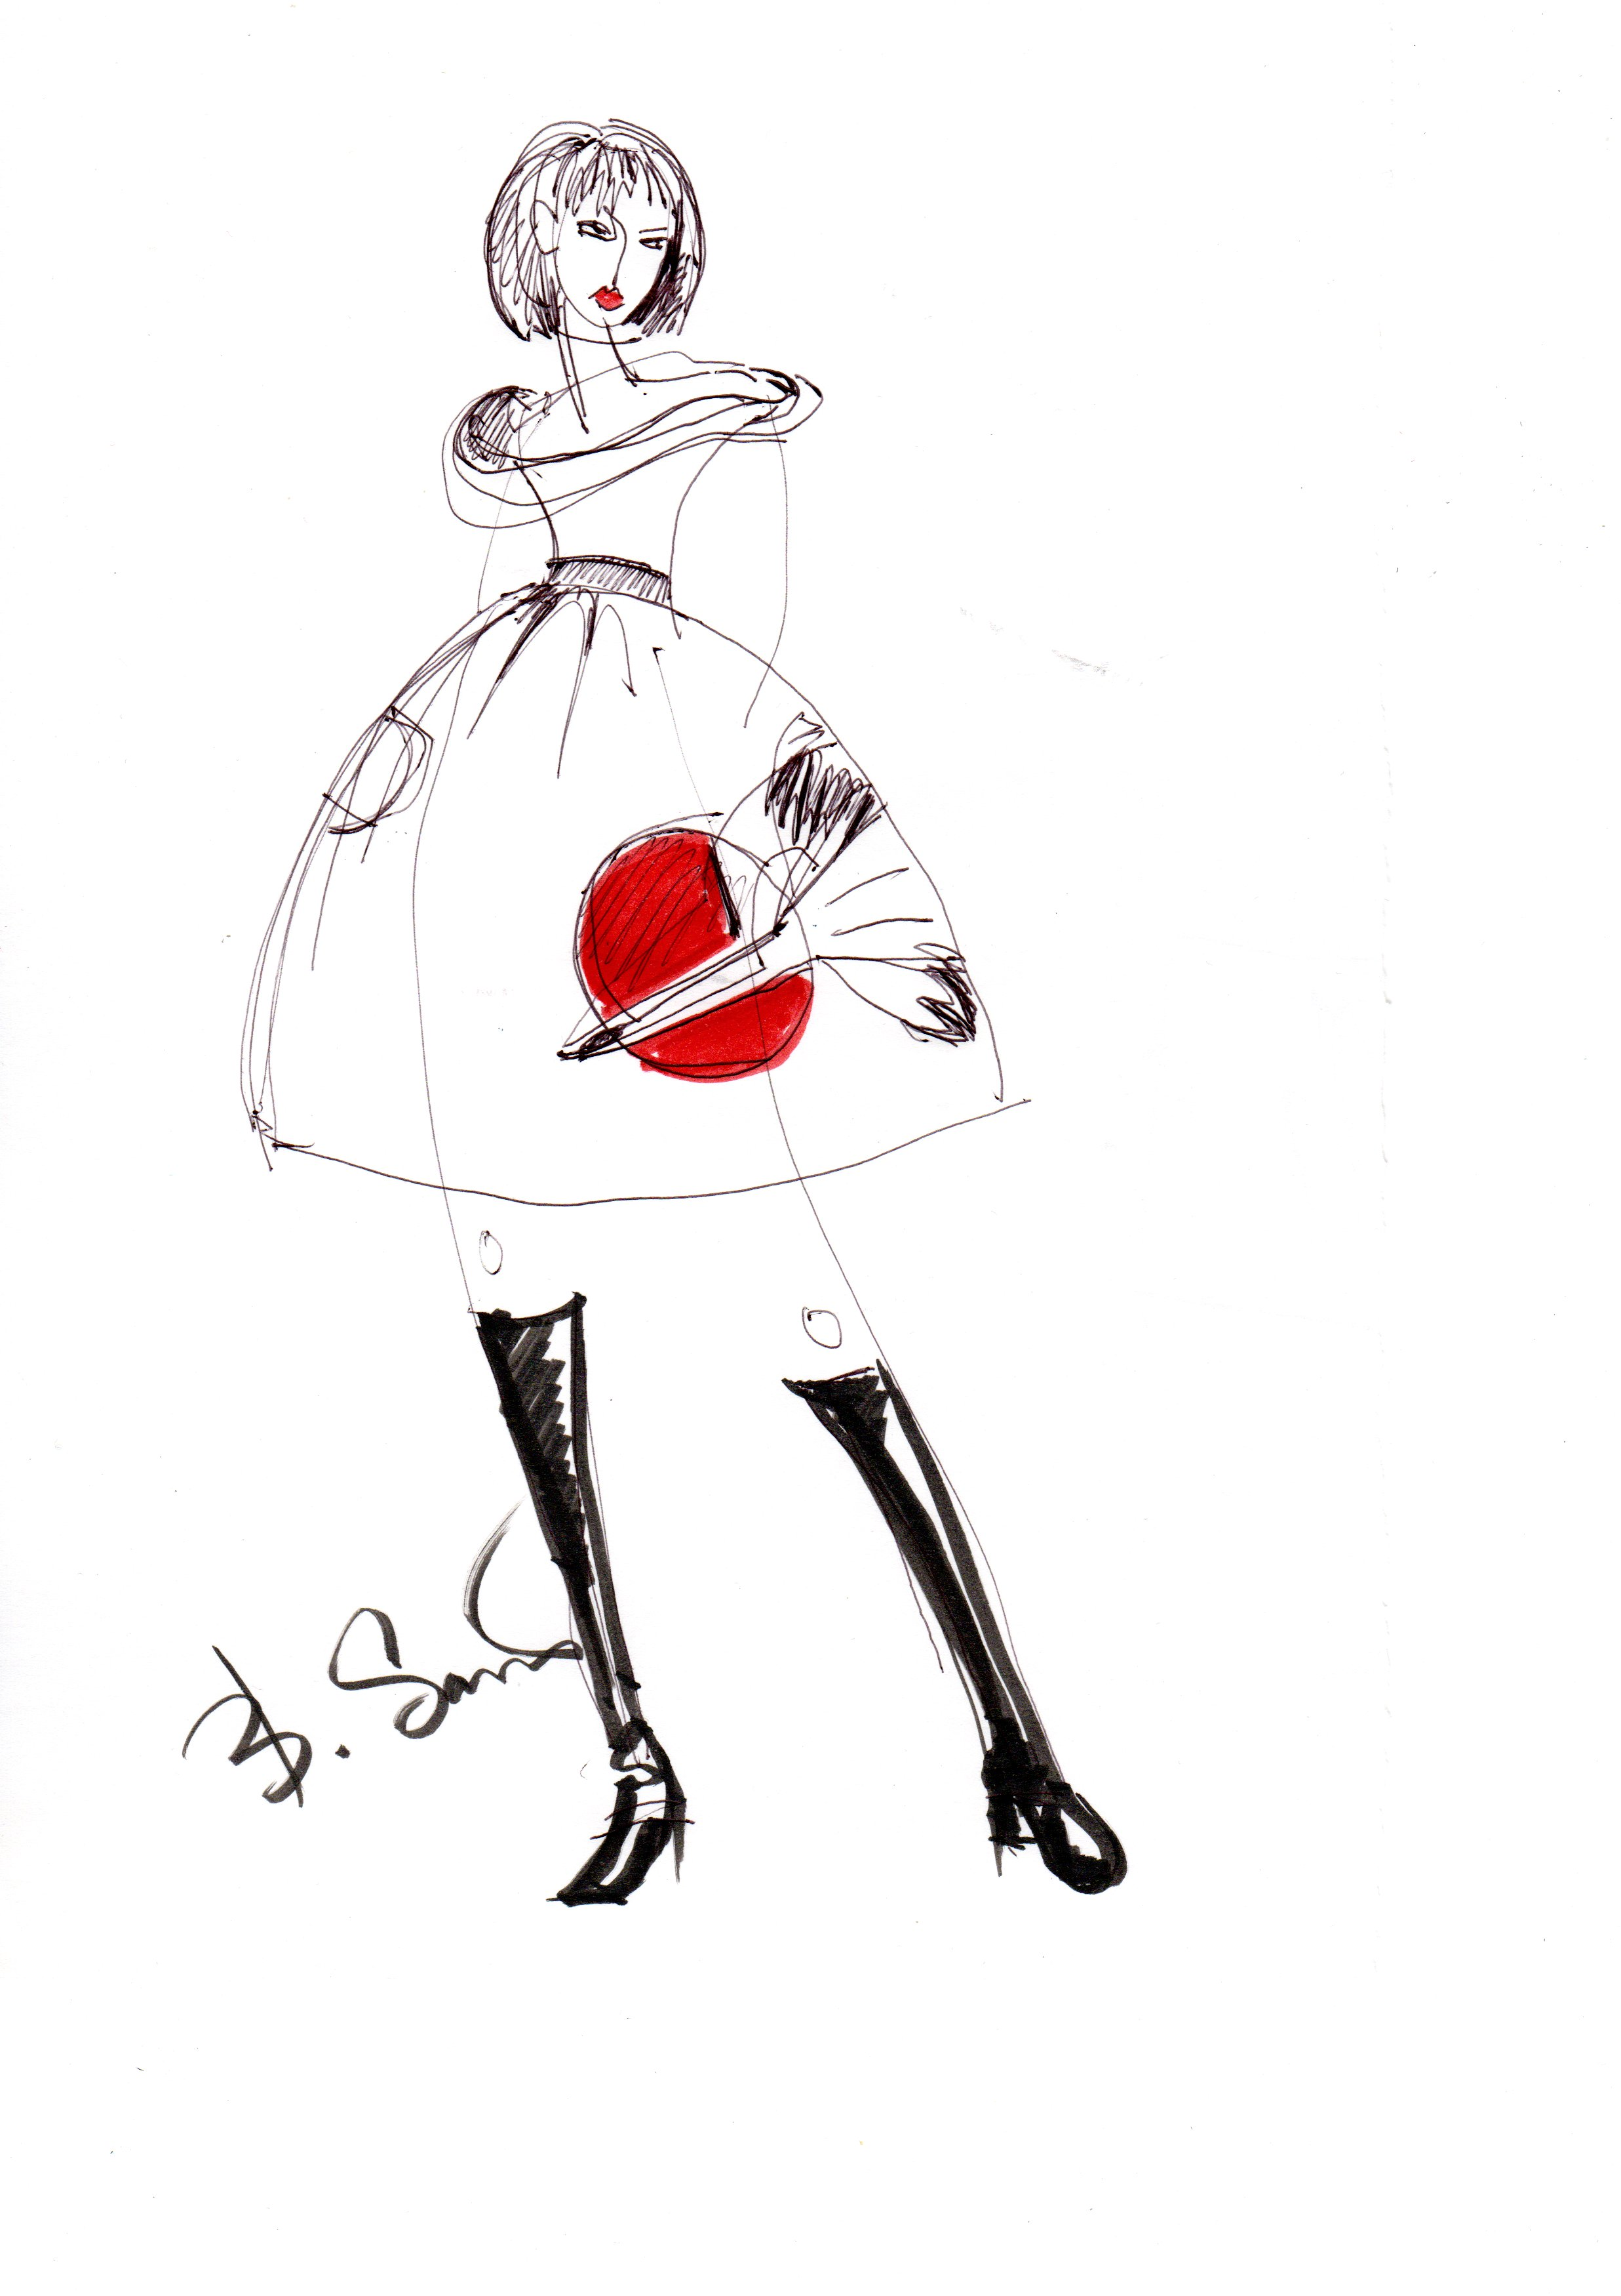
Coloring designs
Here, I mostly use black pen
Watercolor on paper

Slide 6
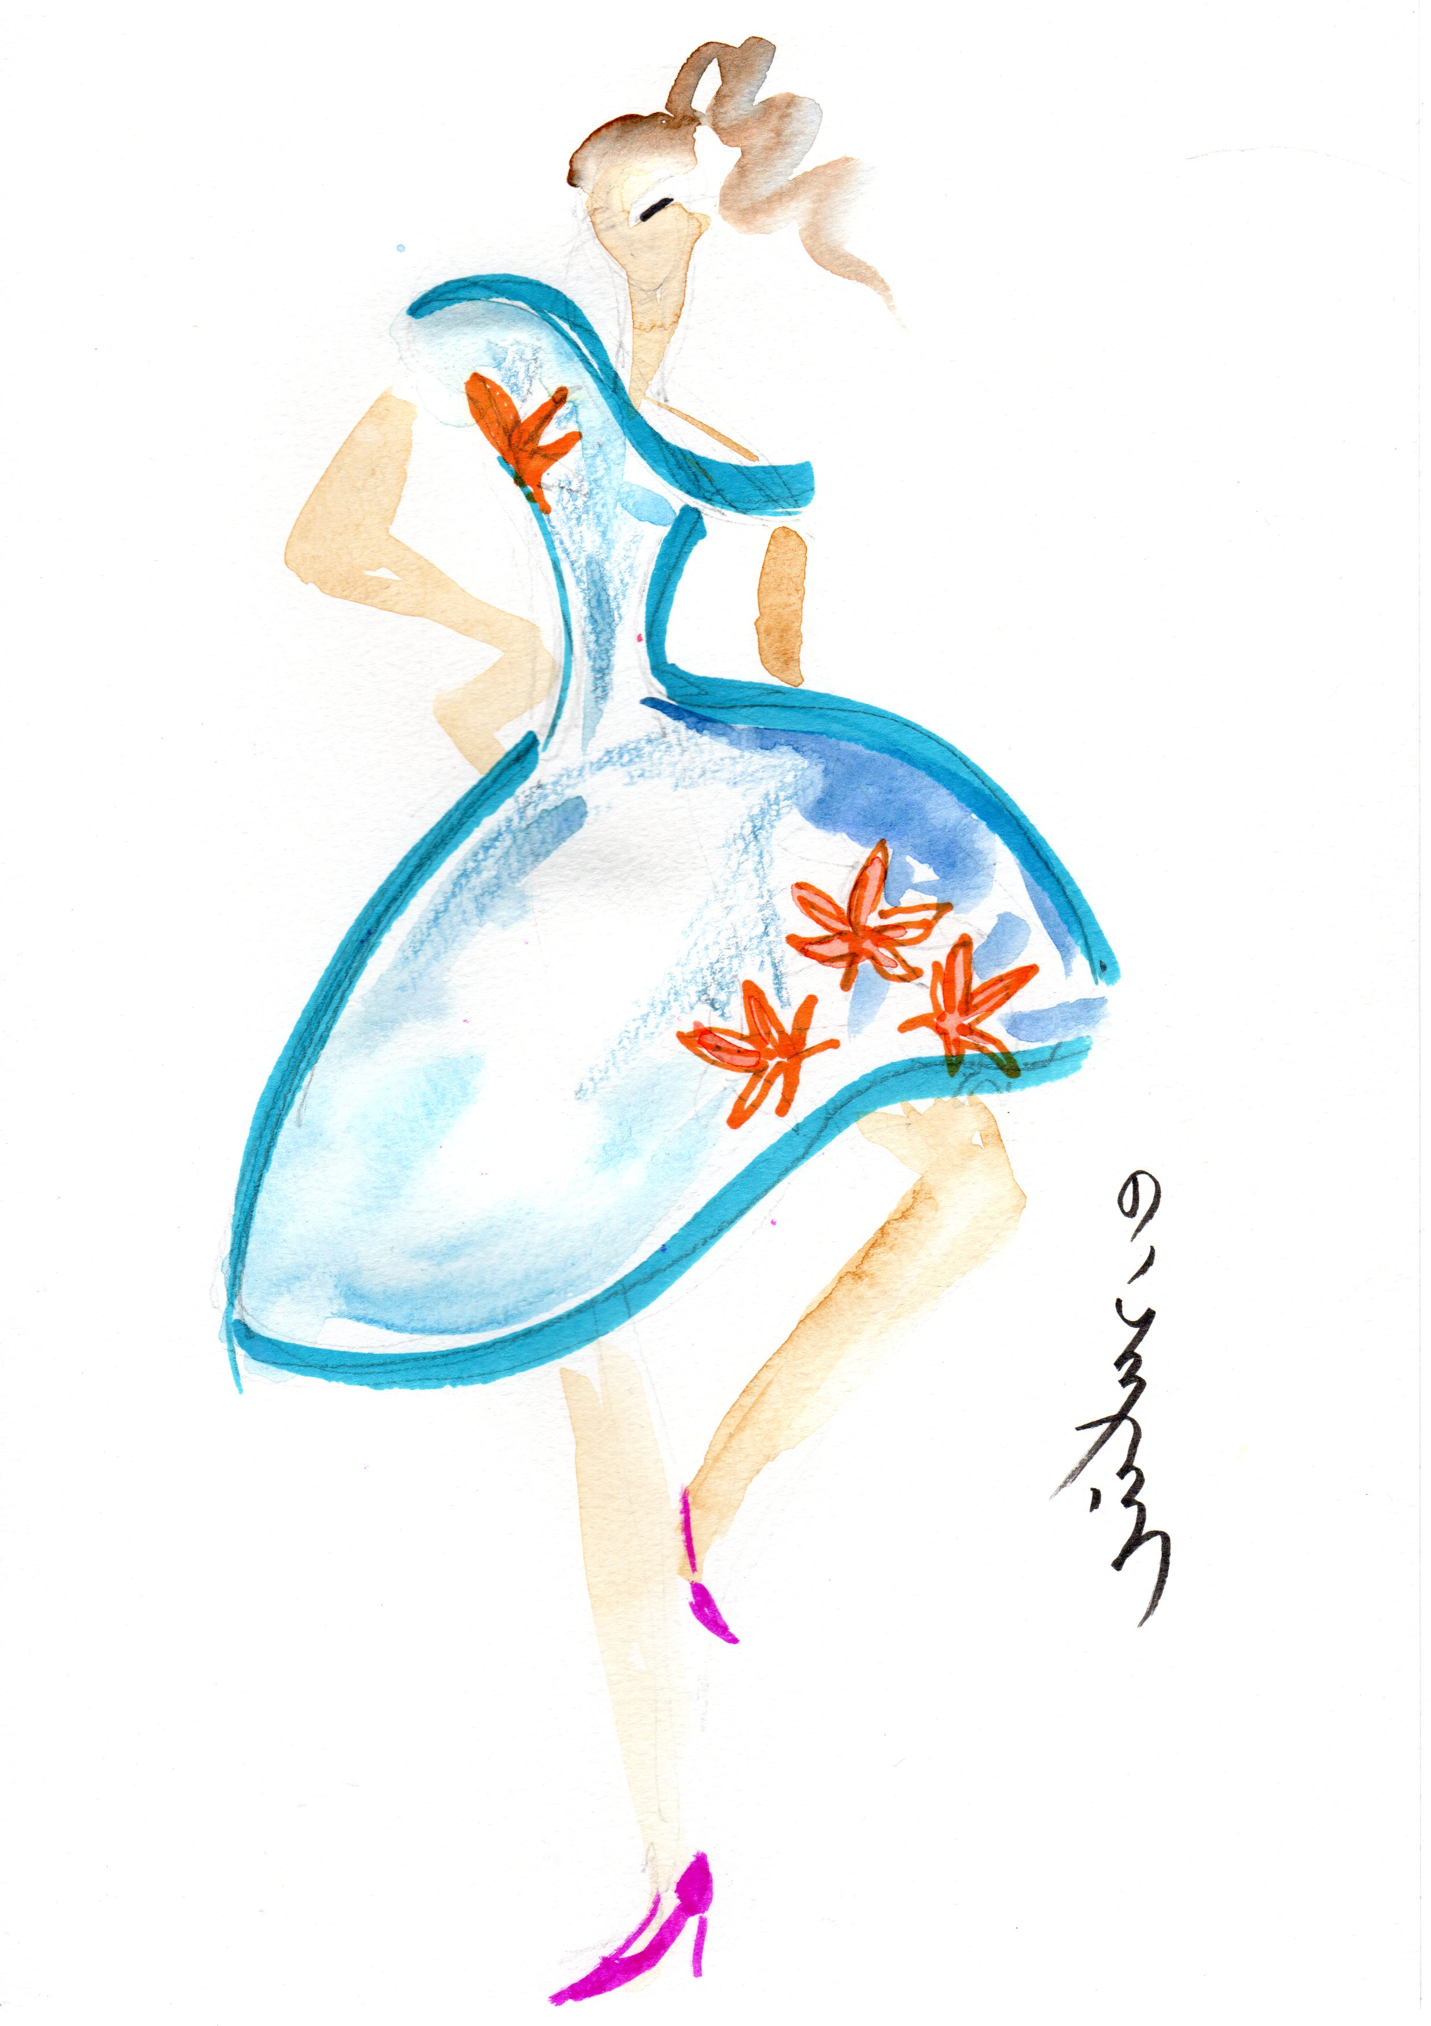
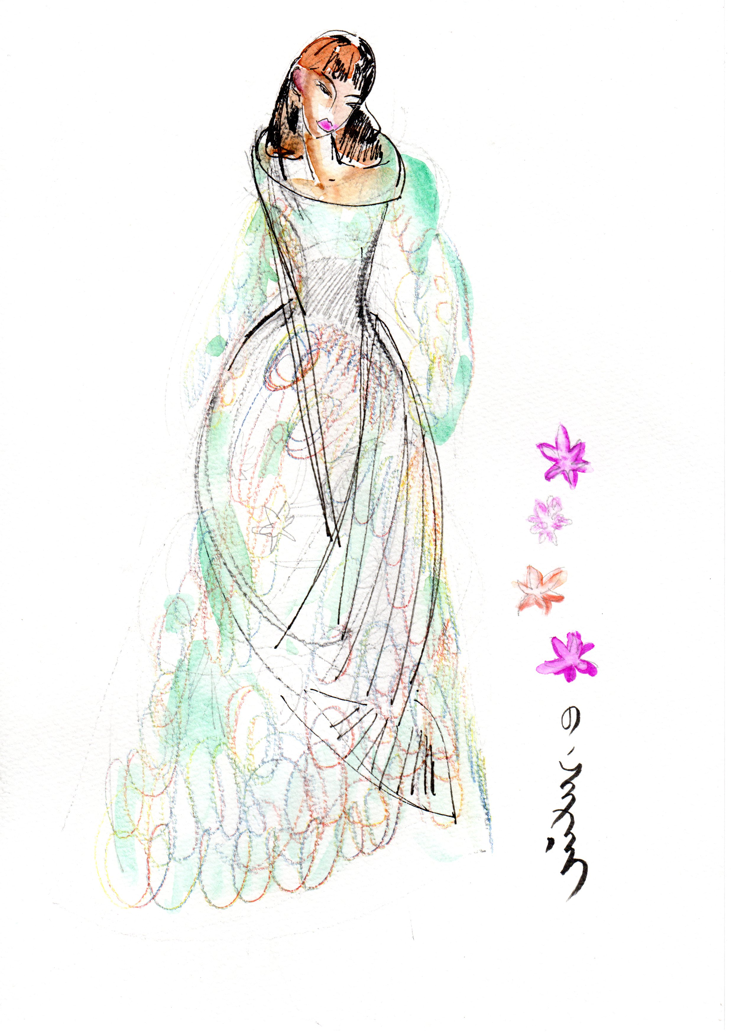
Coloring designs
Mostly used color pencils
Marker and watercolor on paper

