Slide 1
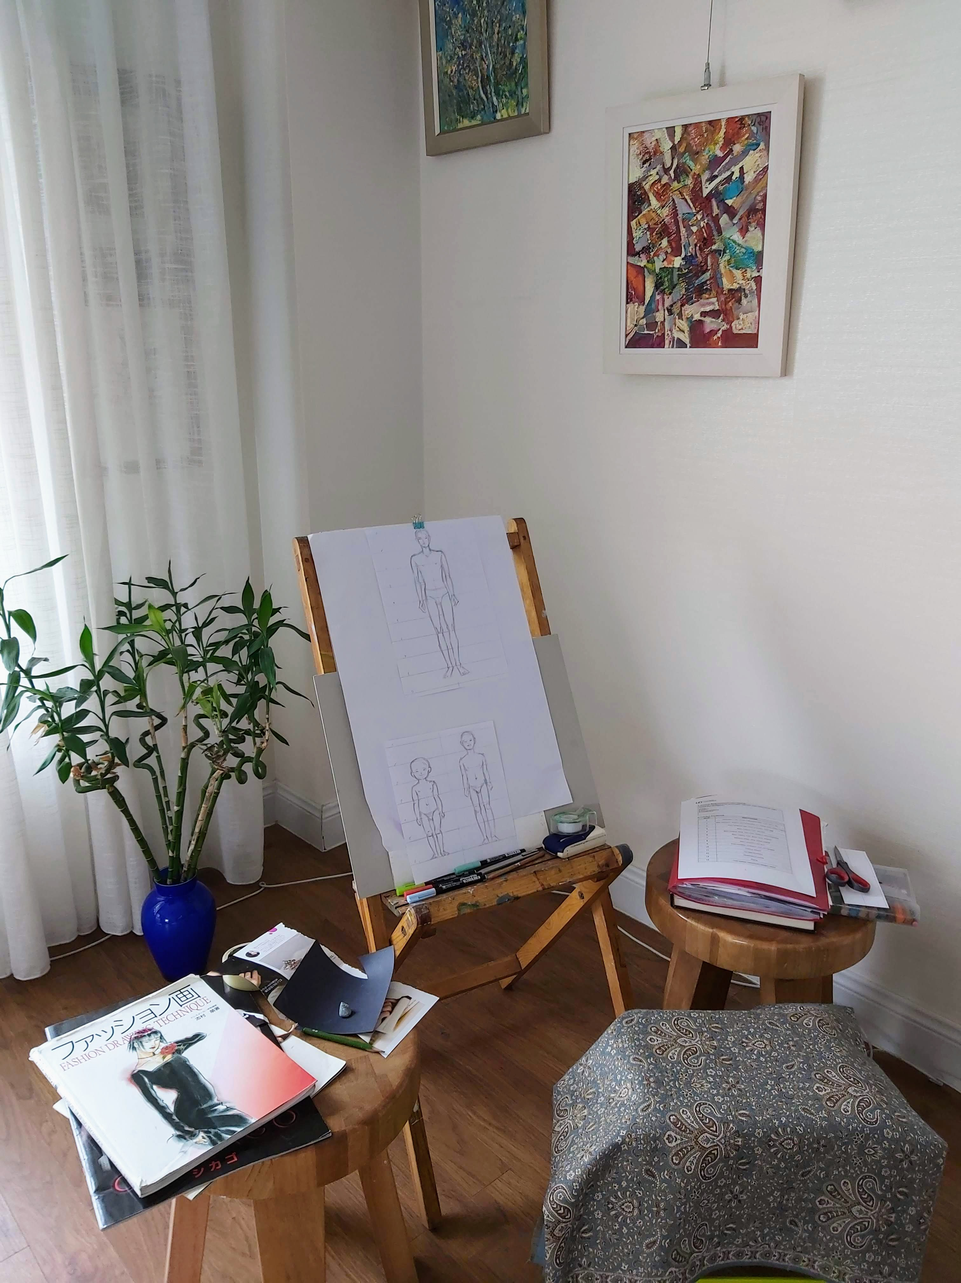
Movement of clothes
Free style drawing and painting

Slide 2
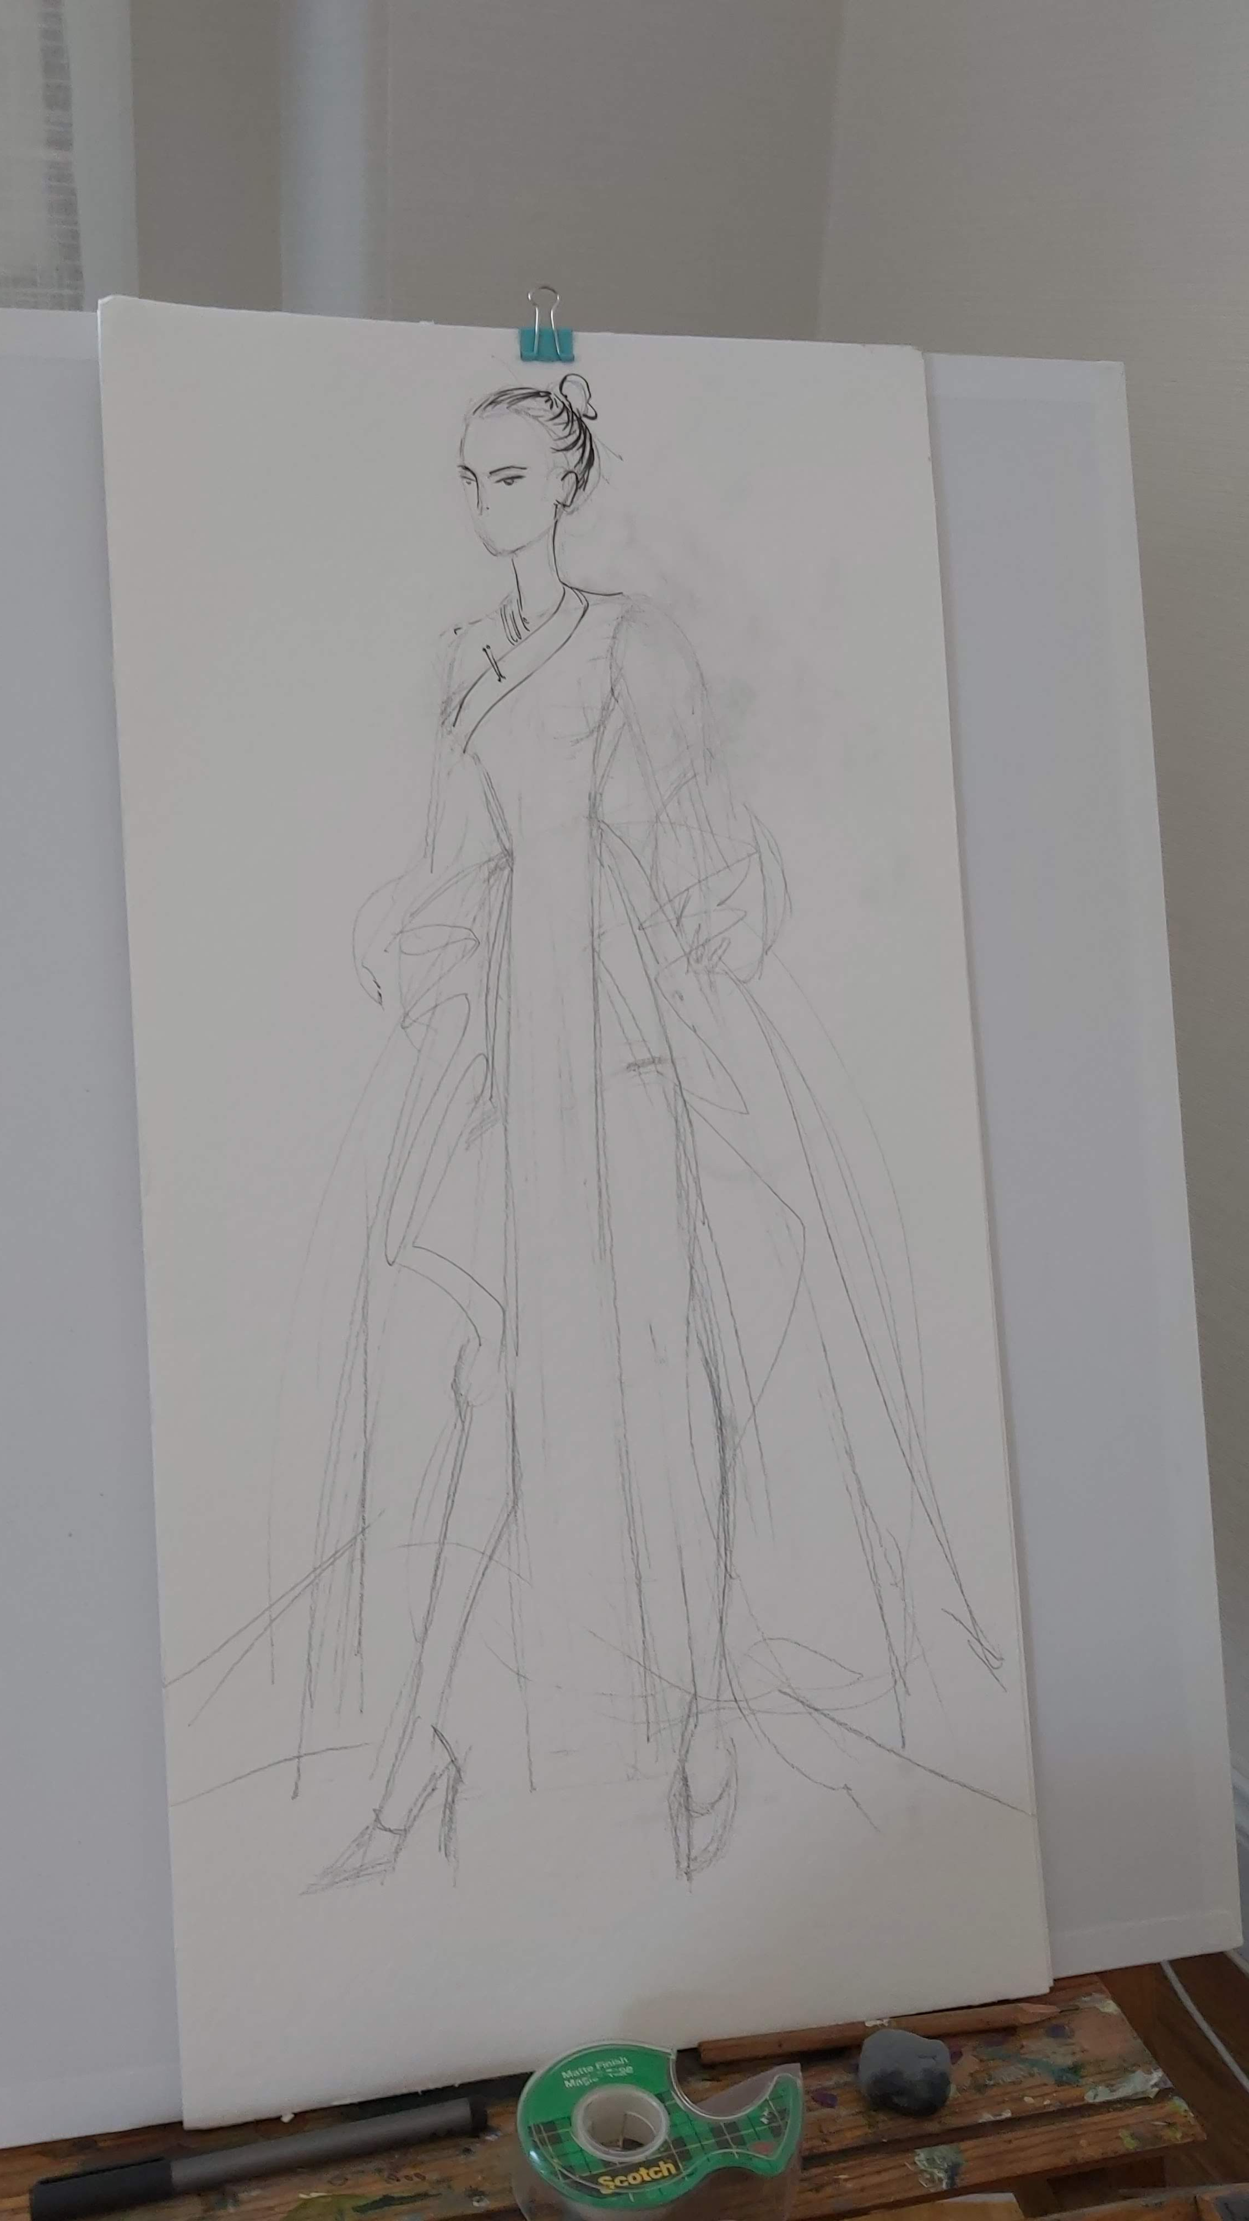
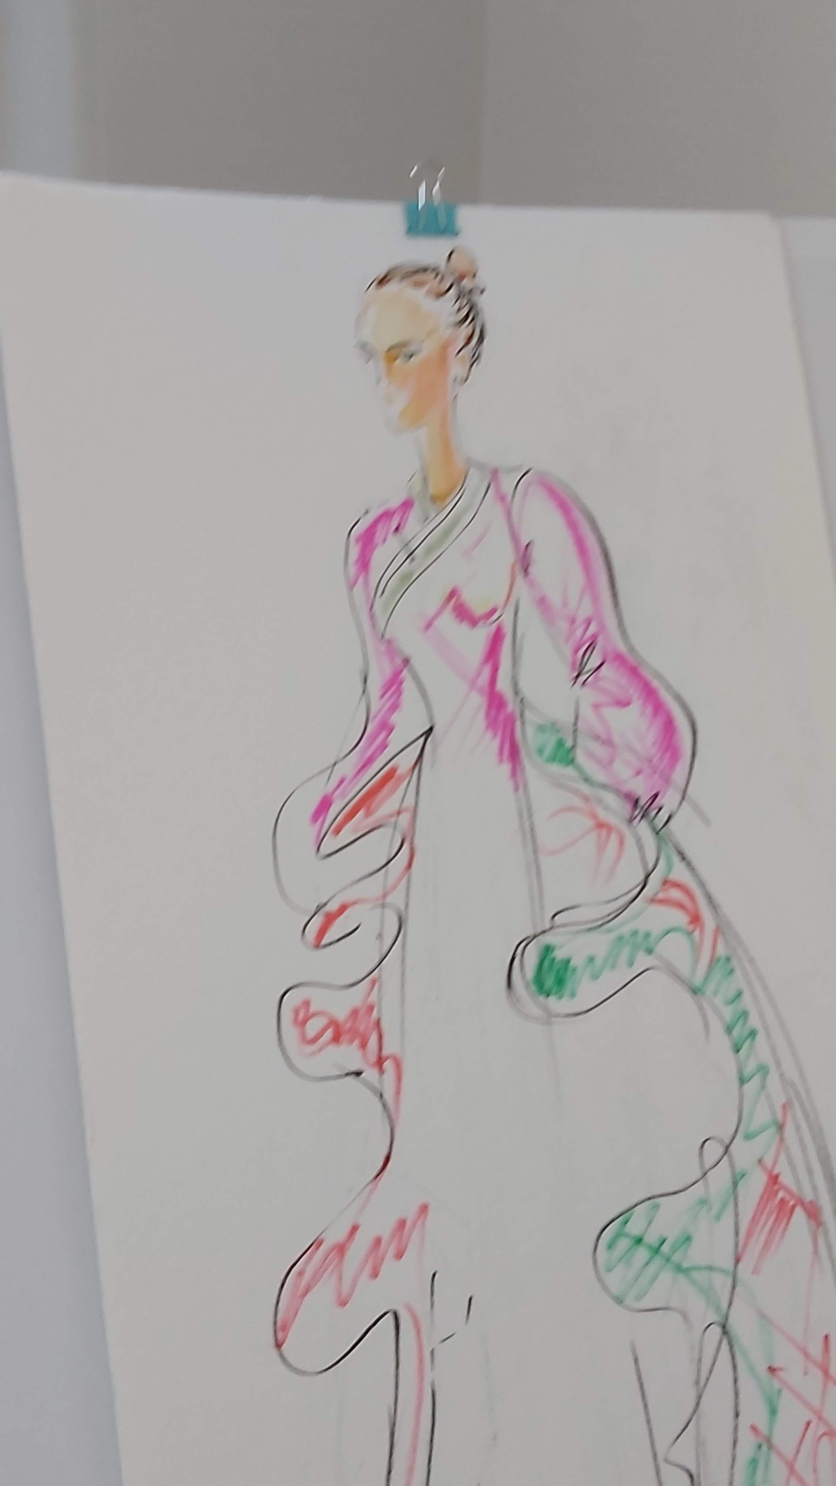
Movement of clothes
Let’s make a rough sketch of design
Find correct lines and emphasize with brushing pens.
For fashion design illustration it’s important to work quickly. Thus no need to cover the design completely. It’s advised to work on 2/3 of design.

Slide 3
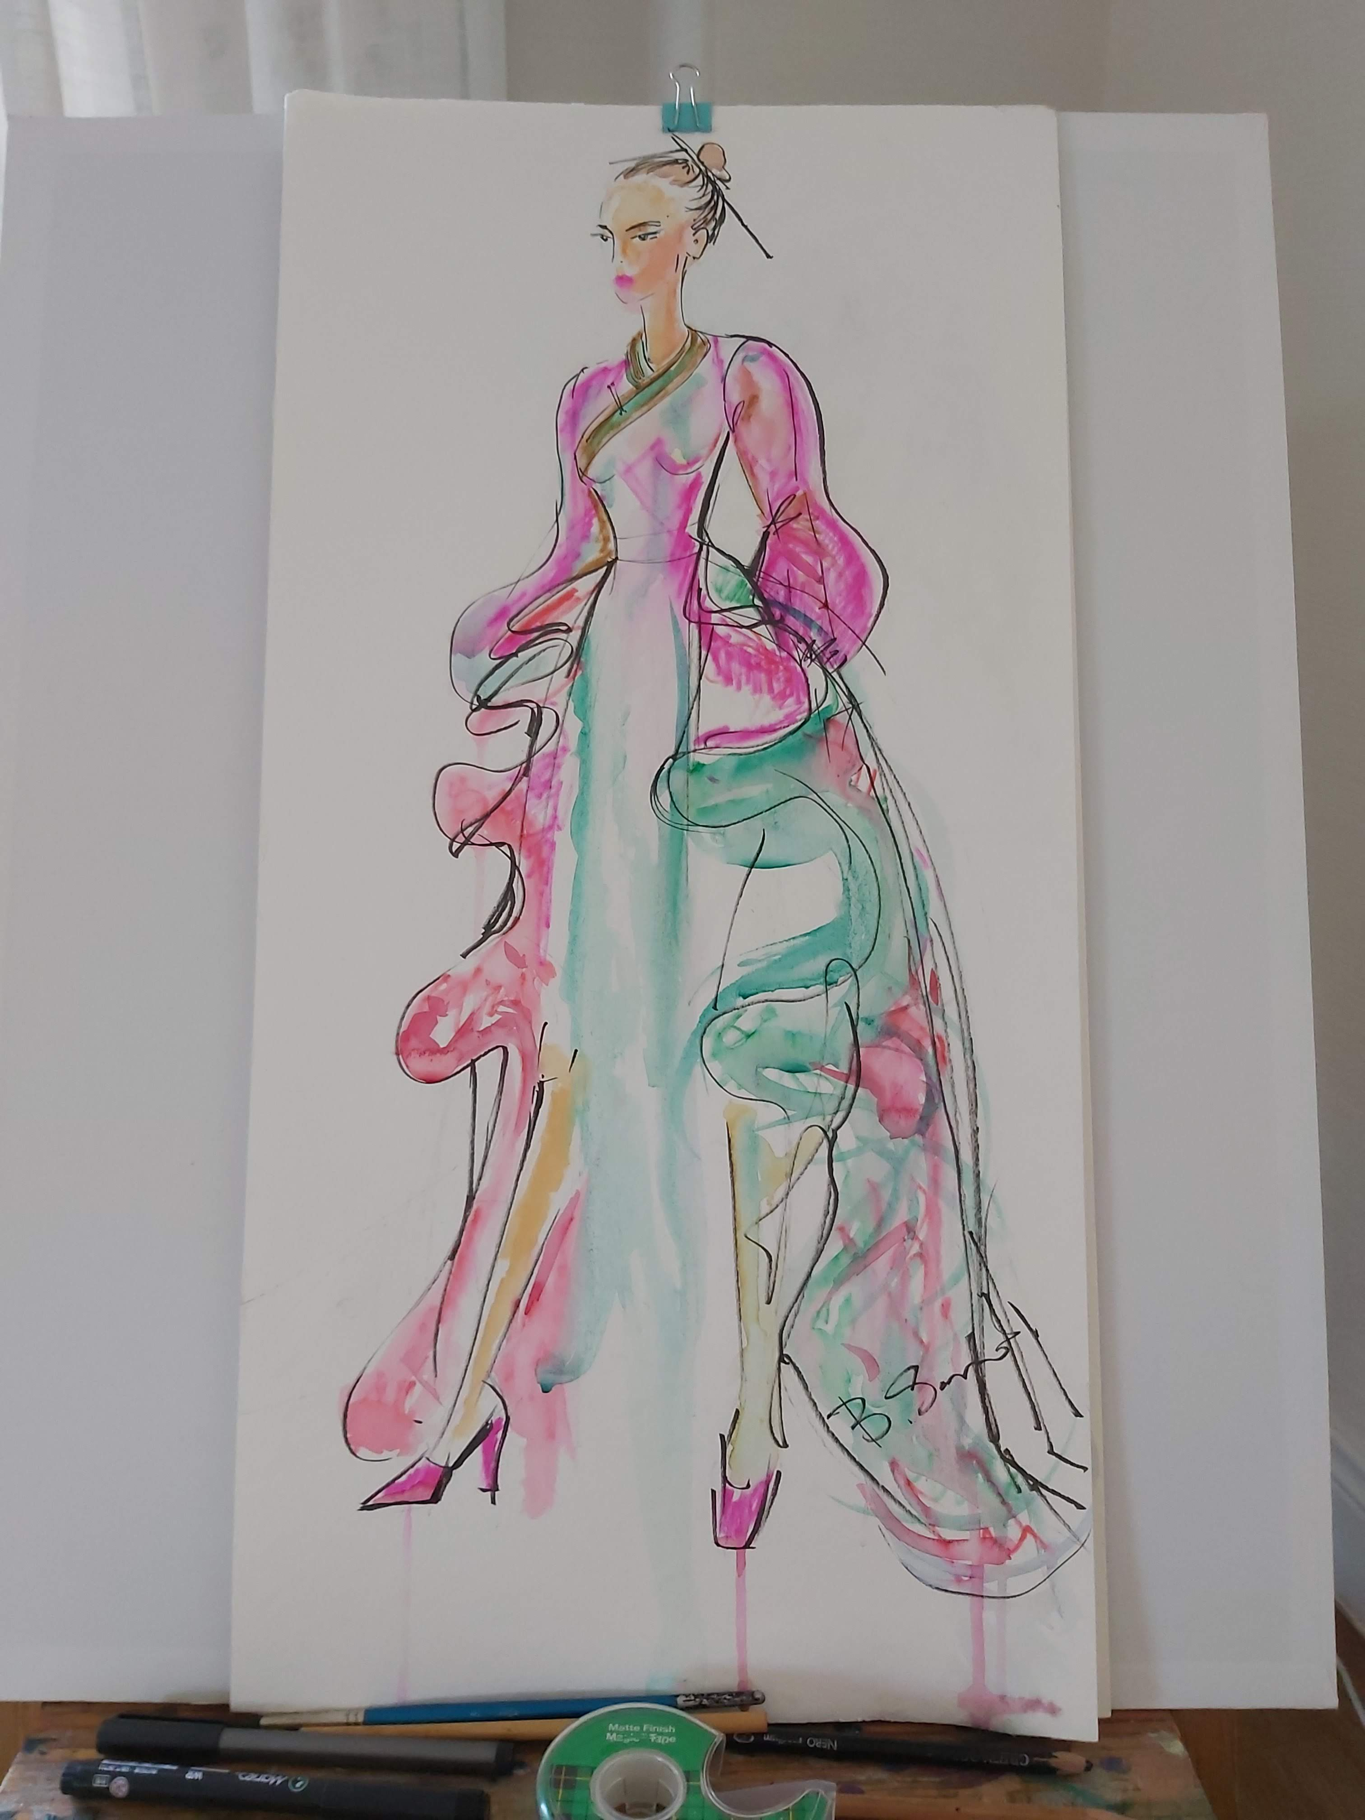
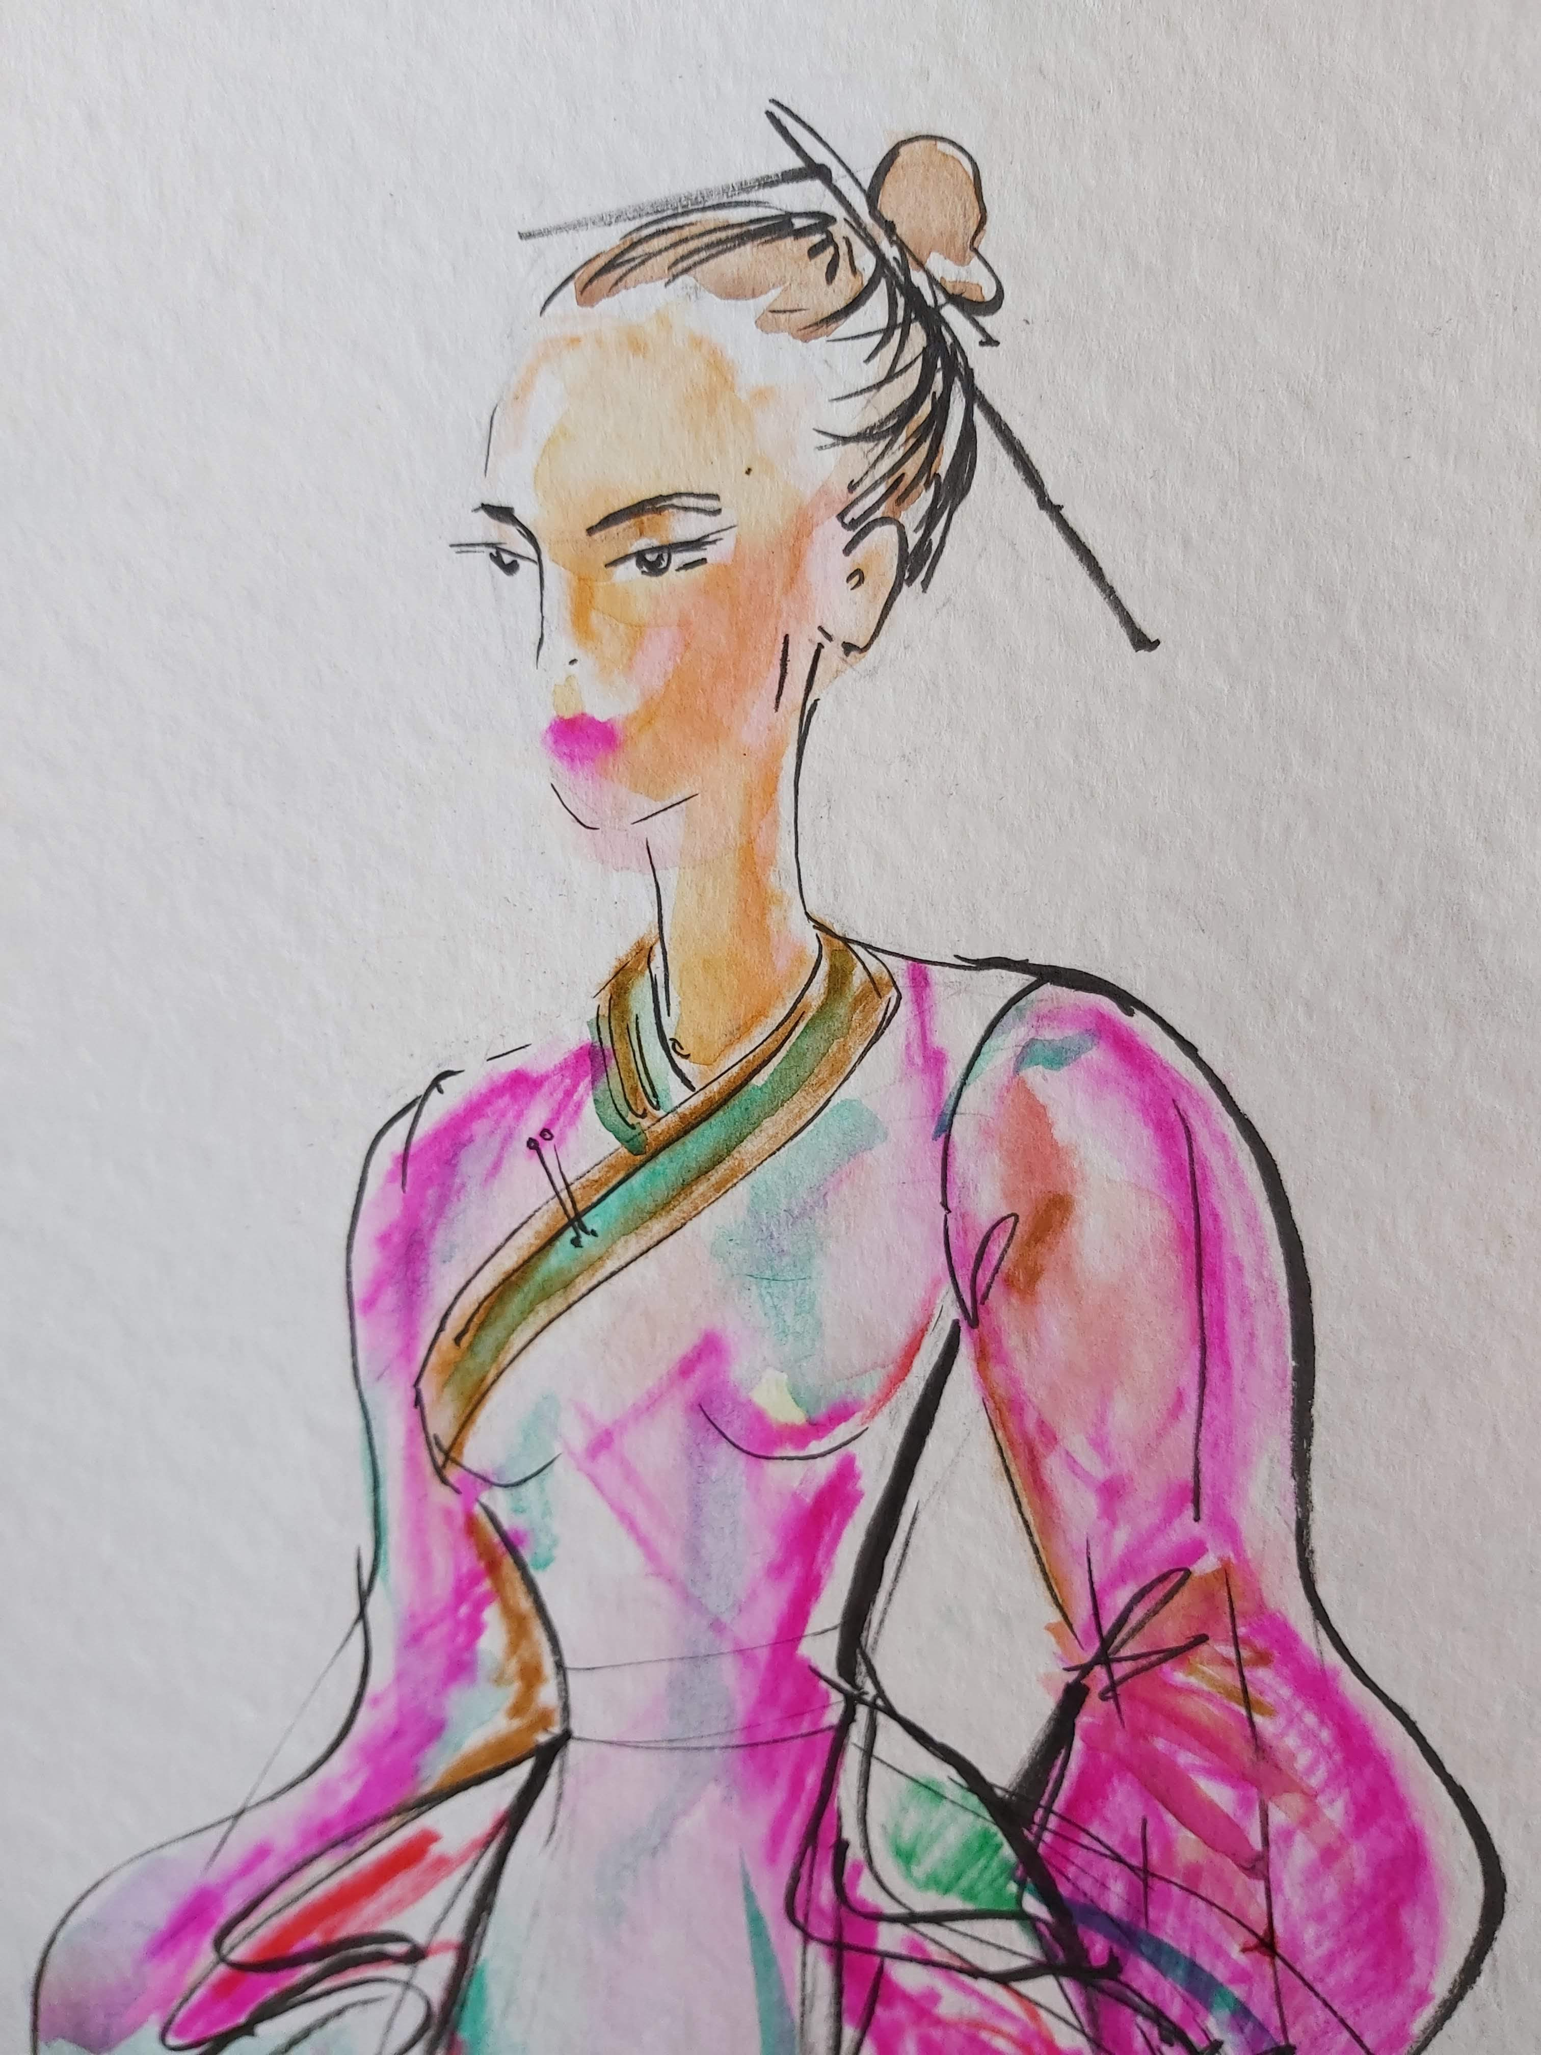
Materials to use
Pencils (HB-4B)
Paper for watercolor and pastels
Eraser
Palette
Brushes
Markers, brushing pens
Soft pastel
Watercolor
Micro line pens (0.05-0.8)
Color pencils
Acrylic

Slide 4
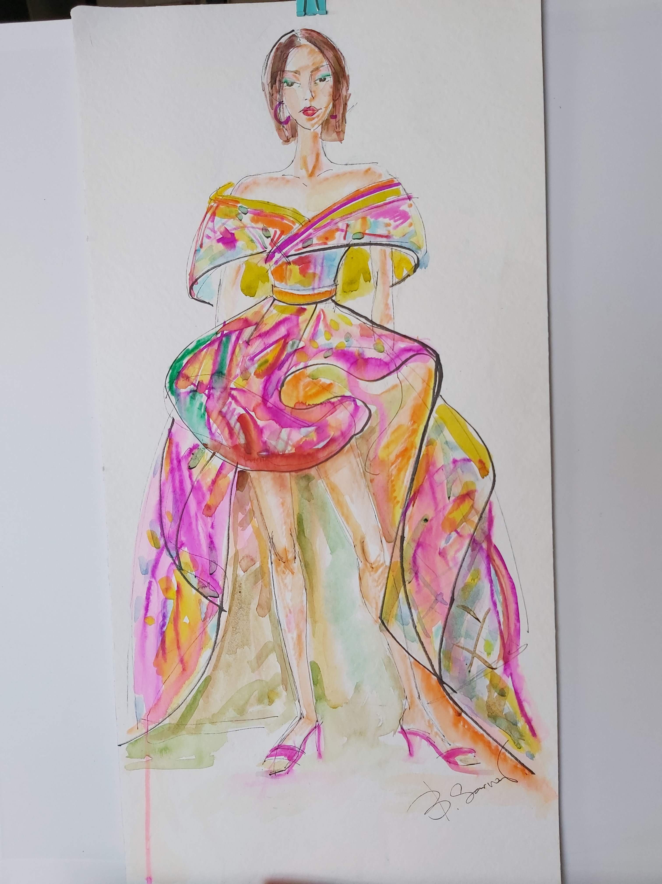
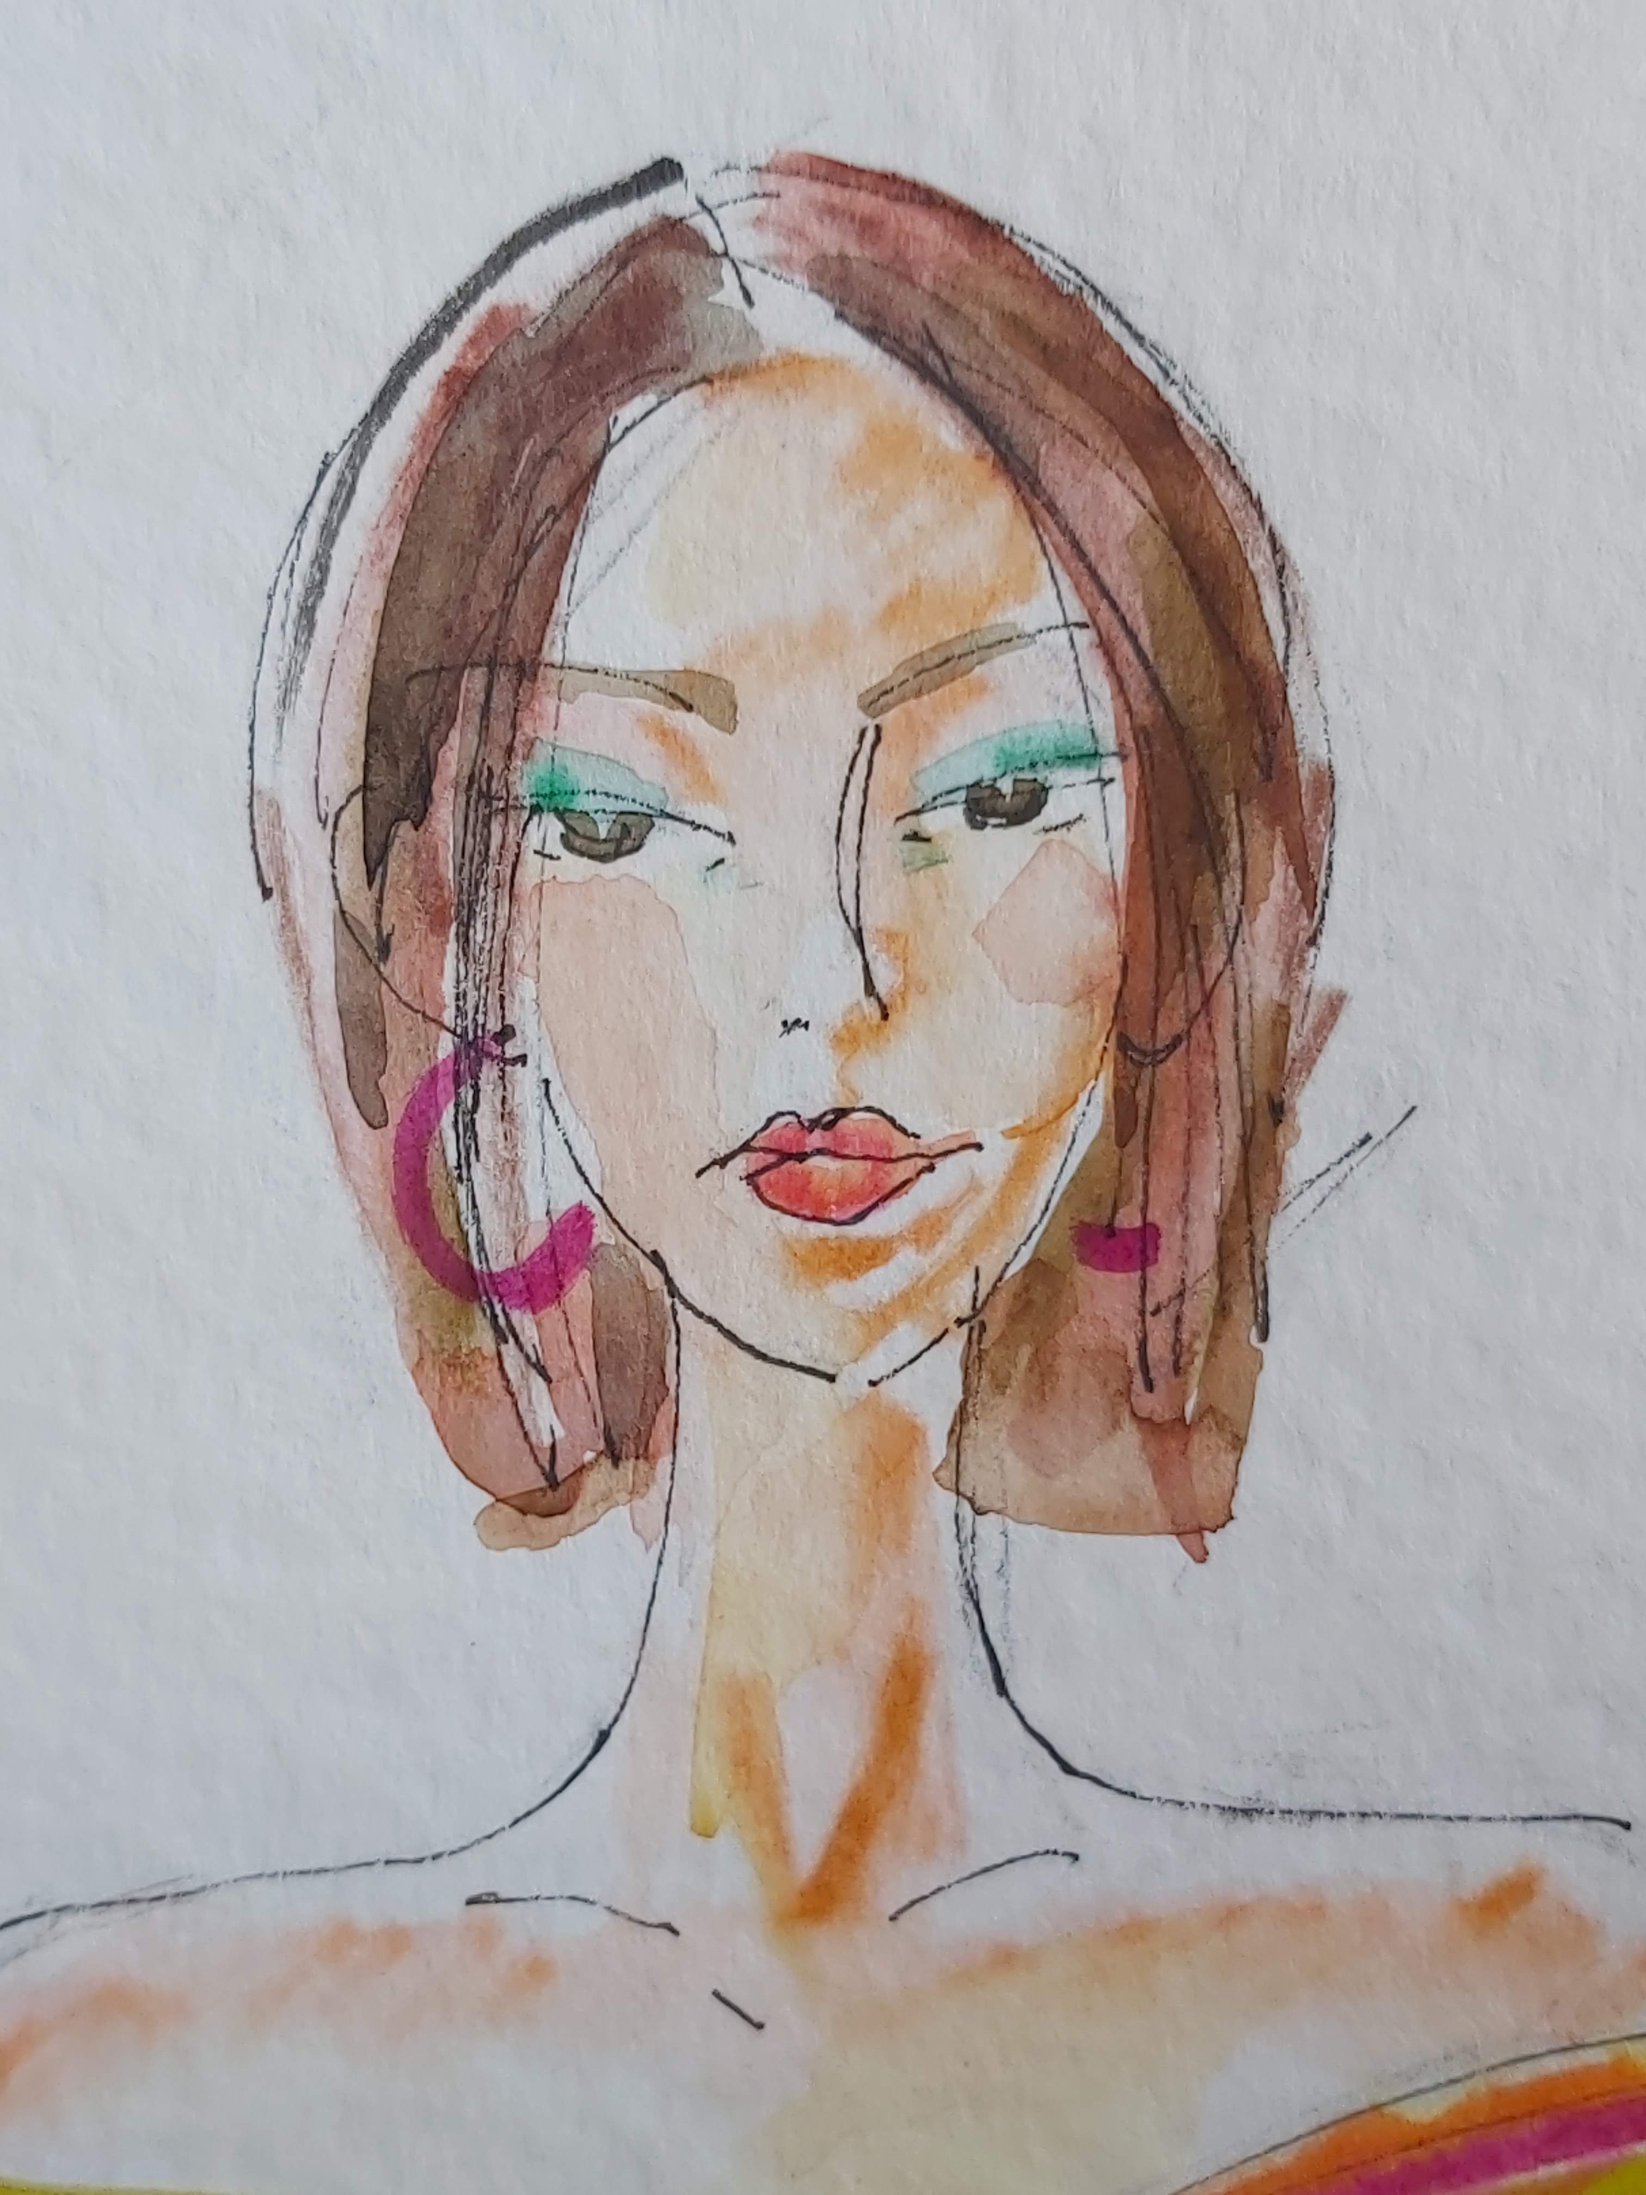
Skin coloring
It’s important to paint skin evenly transparent. Basically, beige, orange and pink colors are used for model skin. Depending on an image it’s good to try individualization as well.

Slide 5
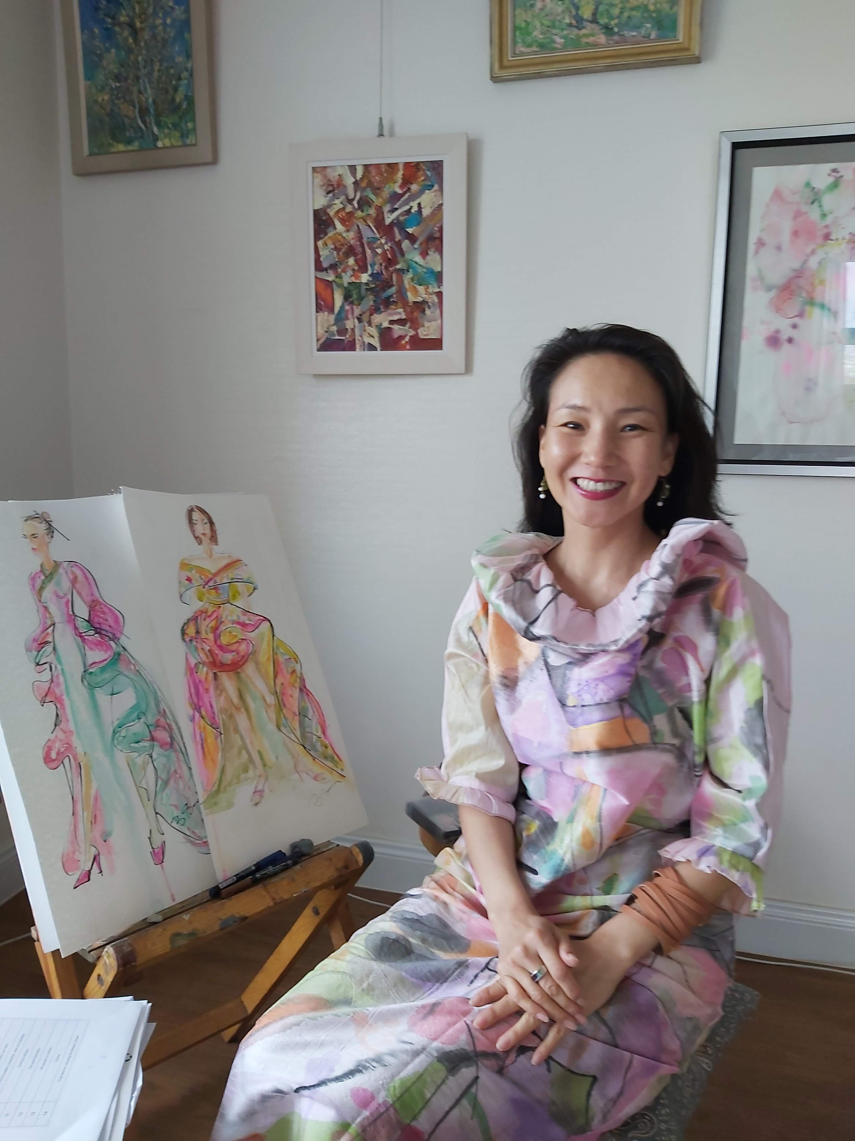
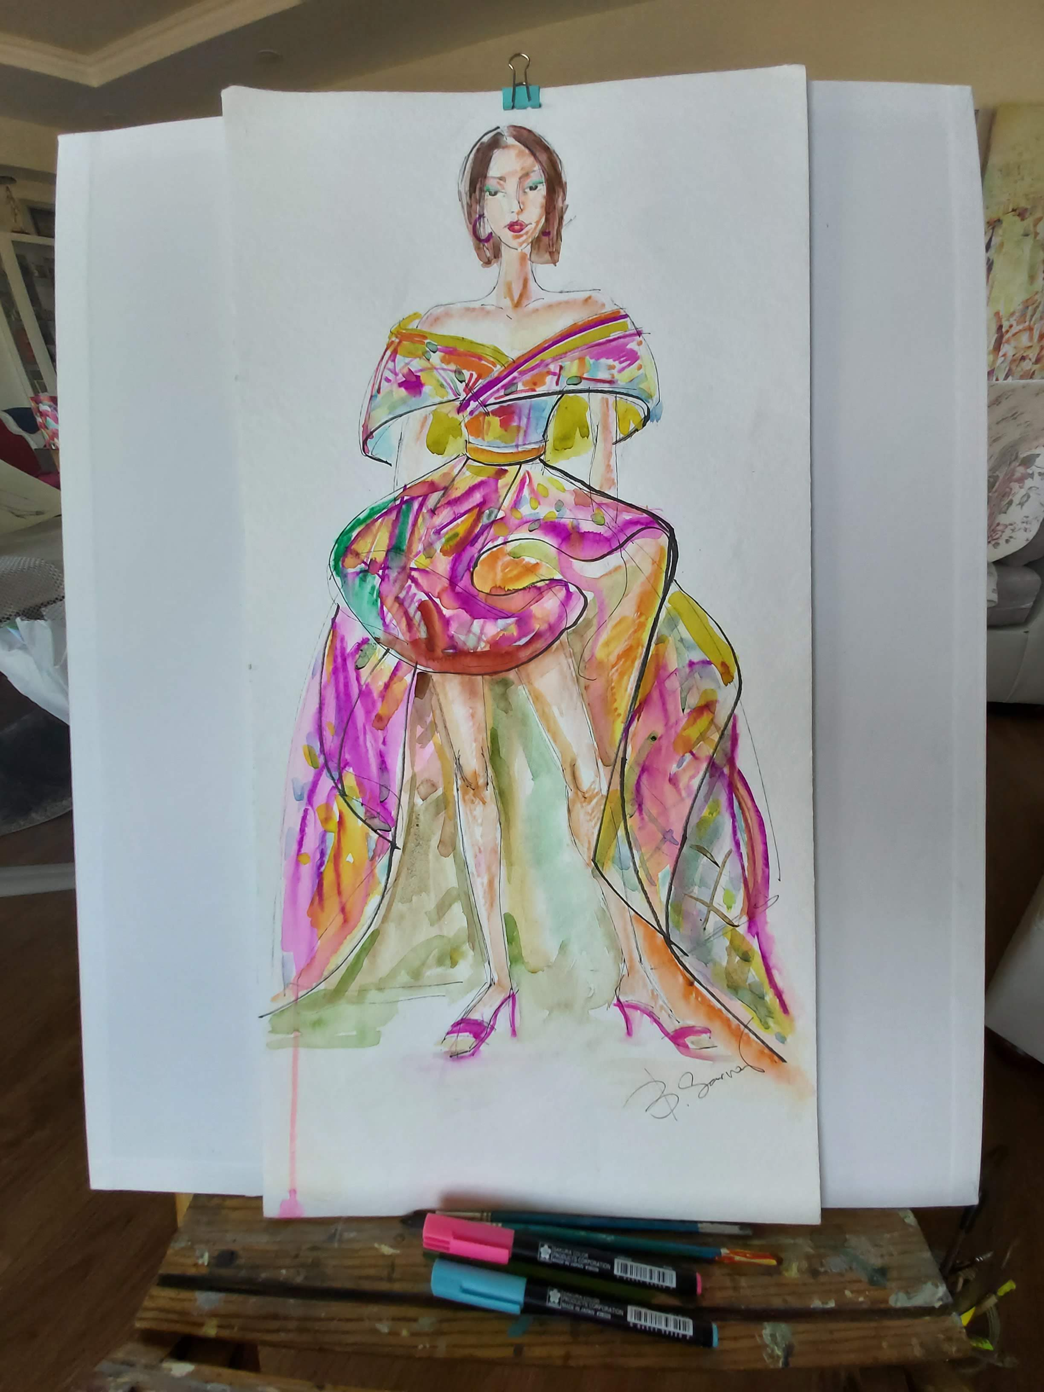
When you work on movement of clothing enhance fold lines, leave the light and work on shadow side.

