Slide 1
Flat style illustration
Item picture, Hanger illustration, Flat picture, Chibi picture

Slide 2
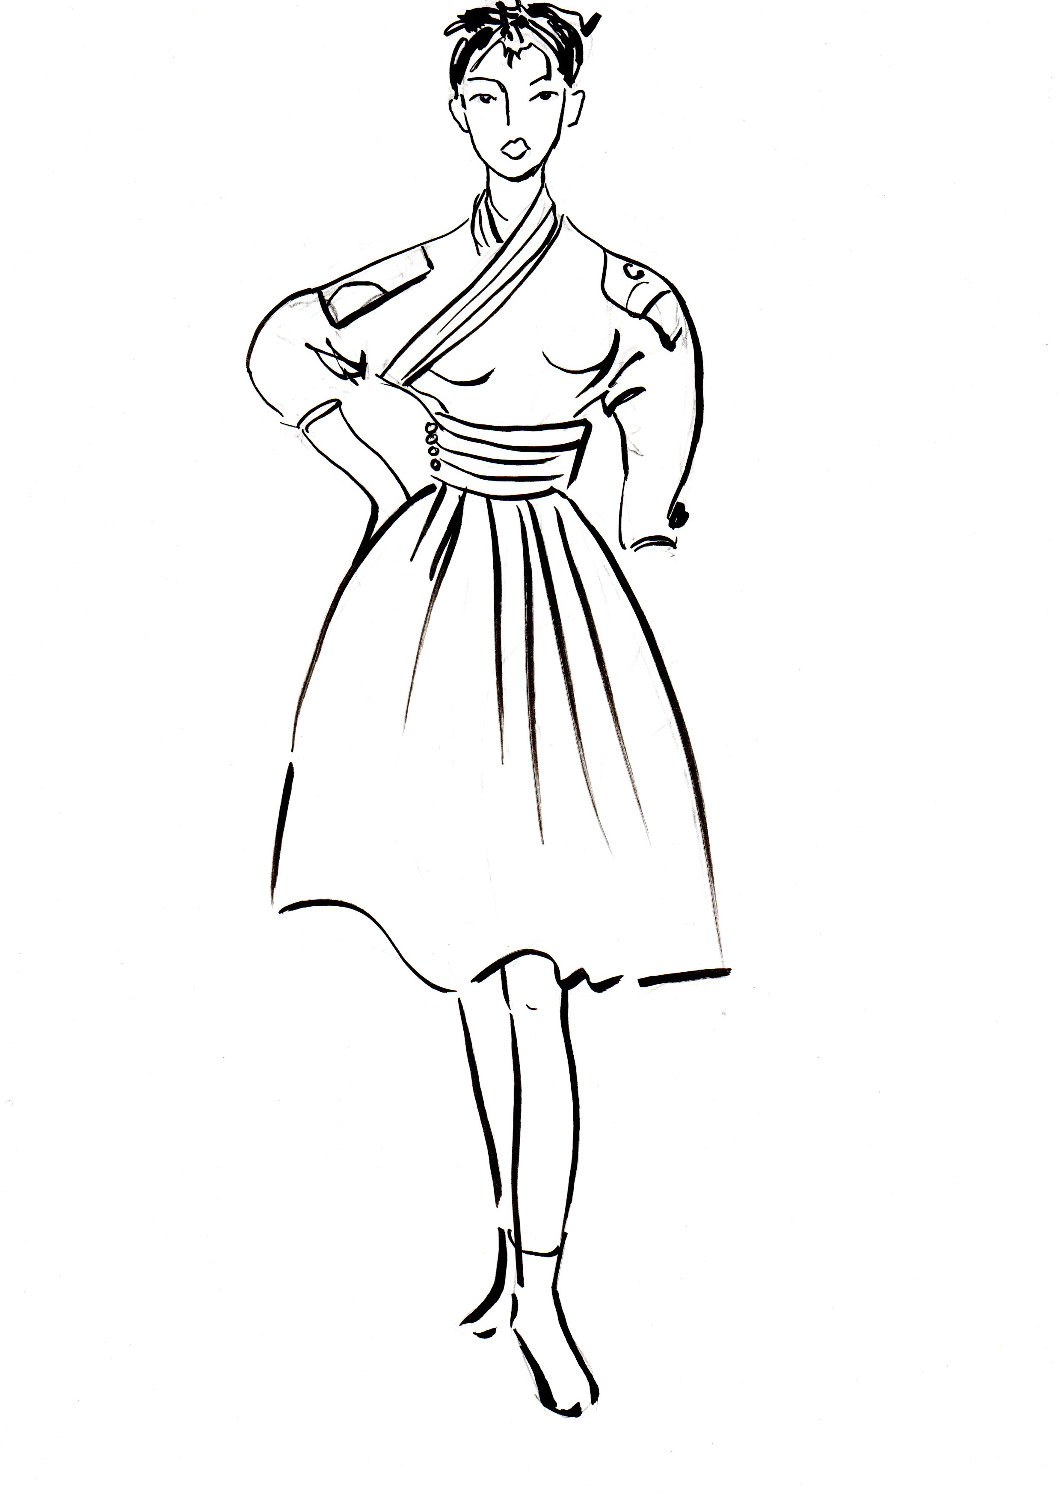
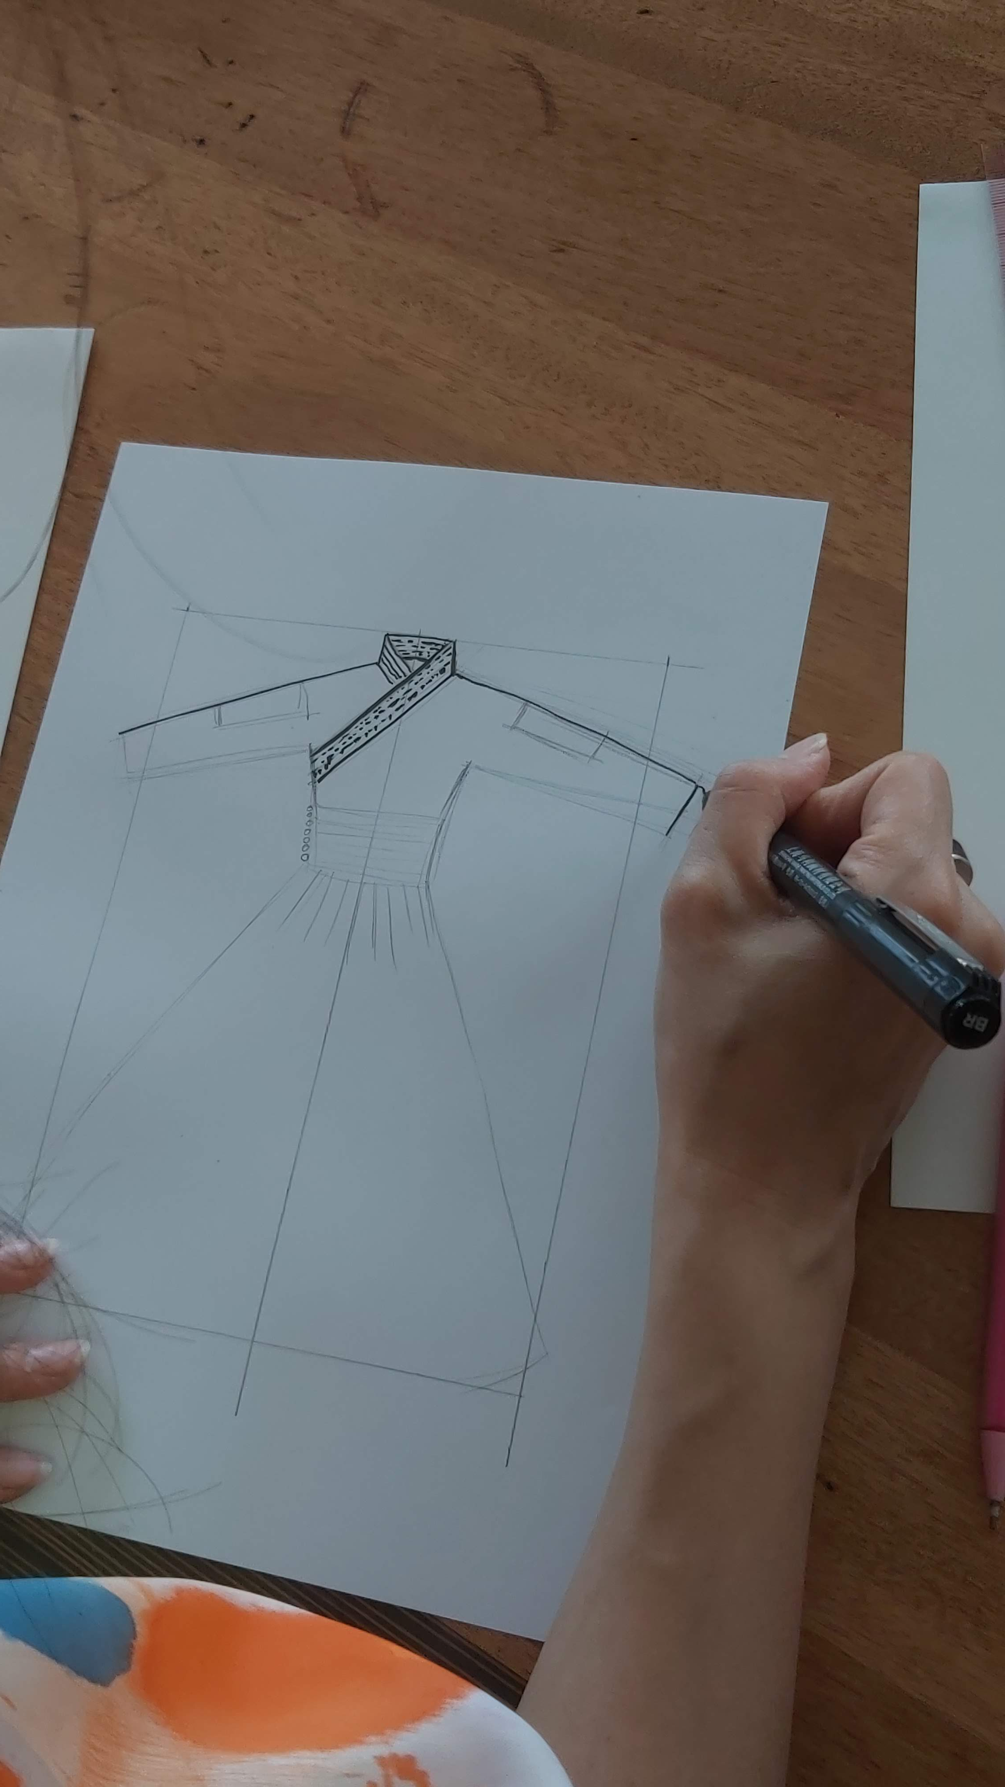
Flat style illustration
Flat style illustration is an illustration of clothing only. It is used in order to tell clearly about a clothing.
First, draw your own design illustration in free style.
Then convert it into flat style illustration, which will make it more comprehensible for people who will make a clothing realistic.

Slide 3
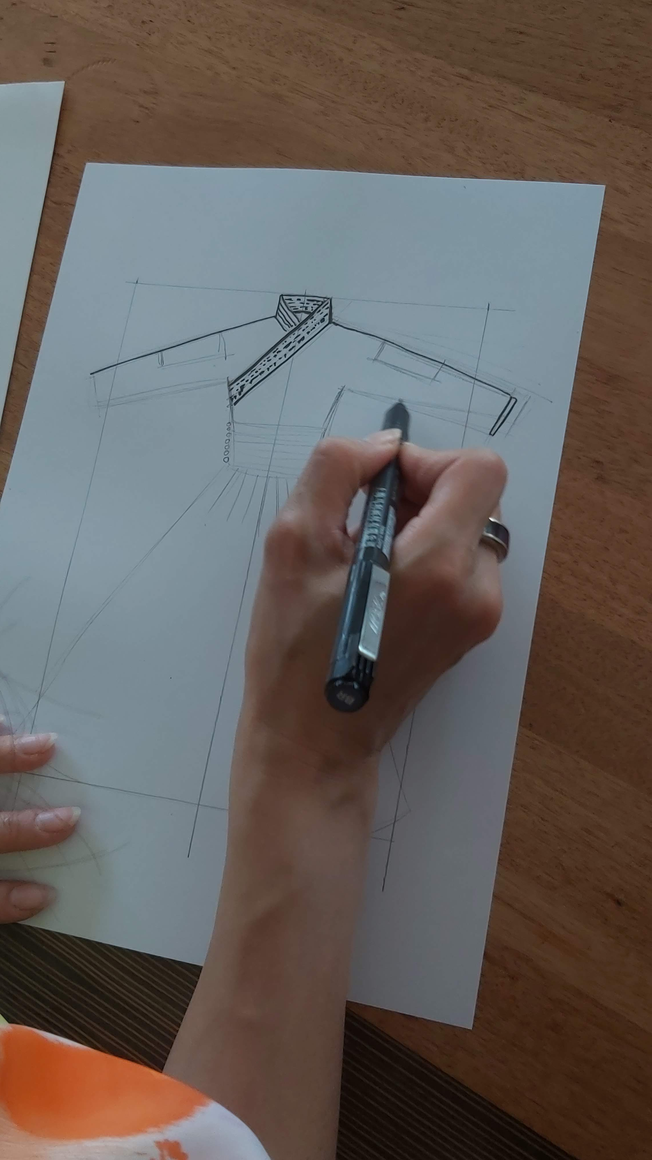
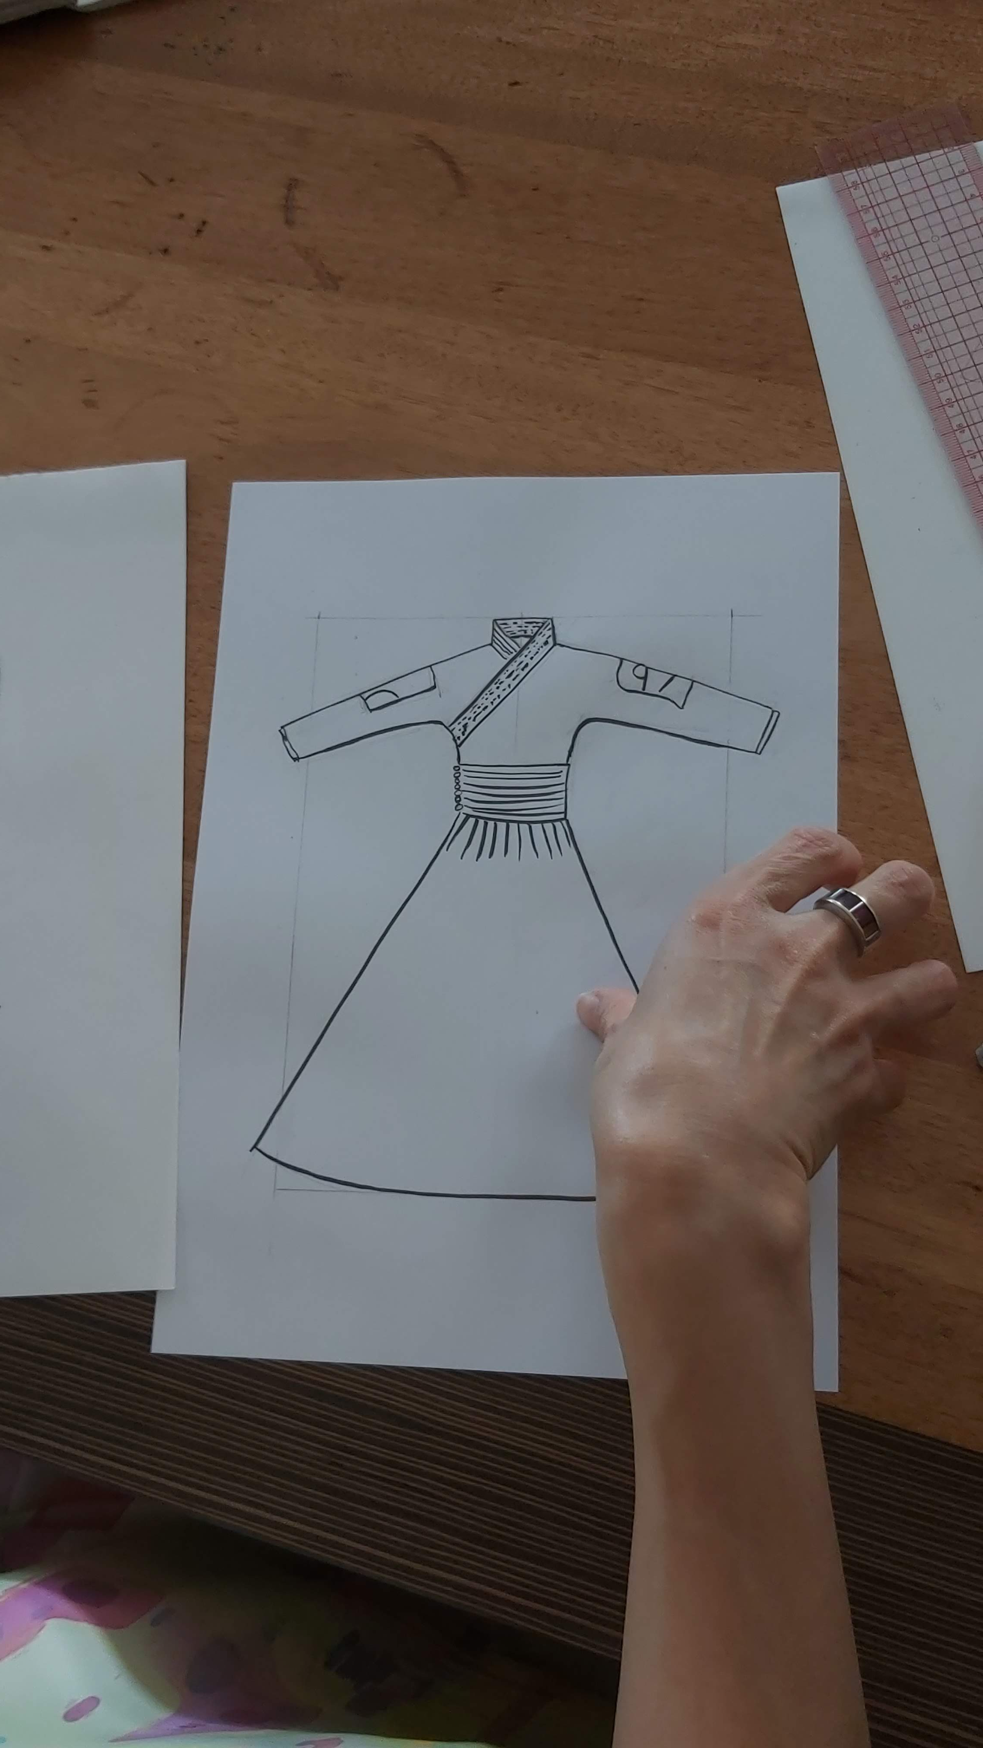
Flat style illustration
Flat style illustration is also used for back style, specification, and item constitution designs.
Draw in symmetry with clear and neat lines.

Slide 4
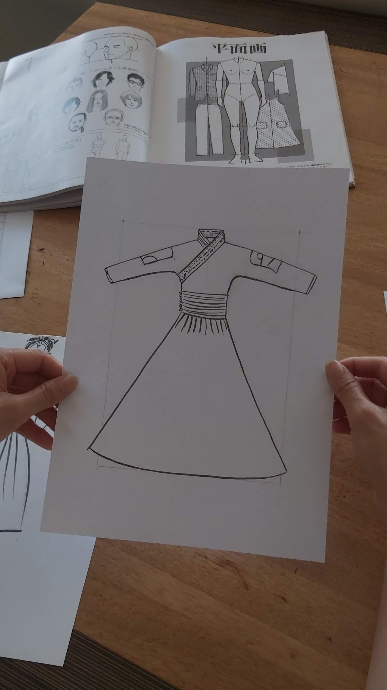
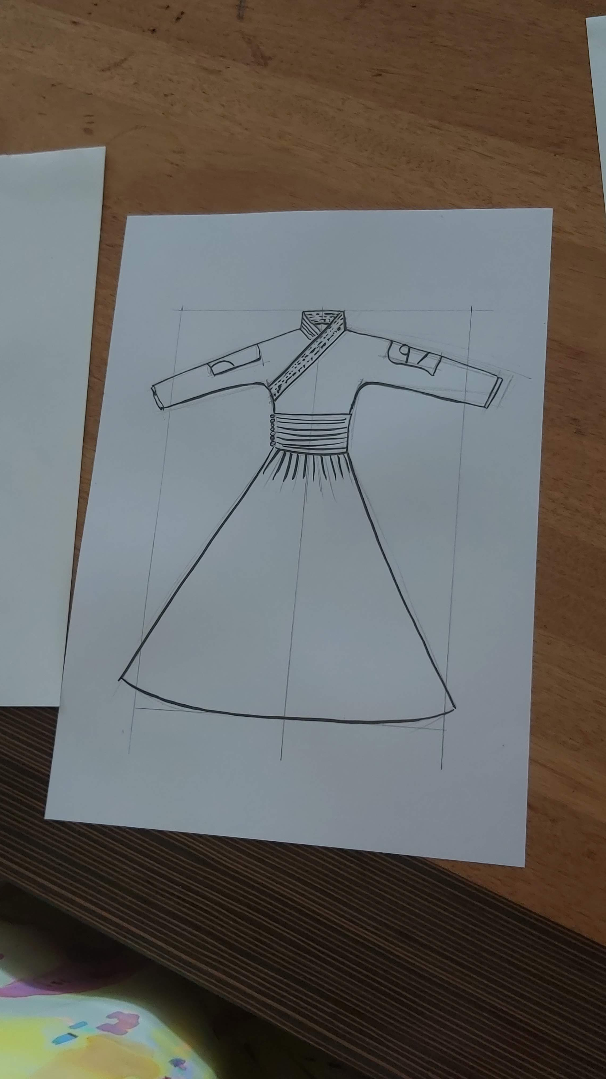
Flat style illustration
In drawing a flat style illustration it is not recommended to make deformation of clothing image.

Slide 5
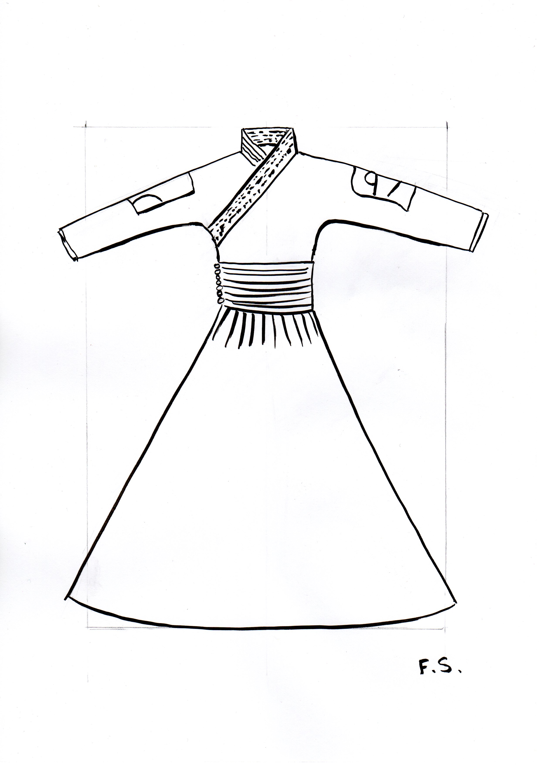
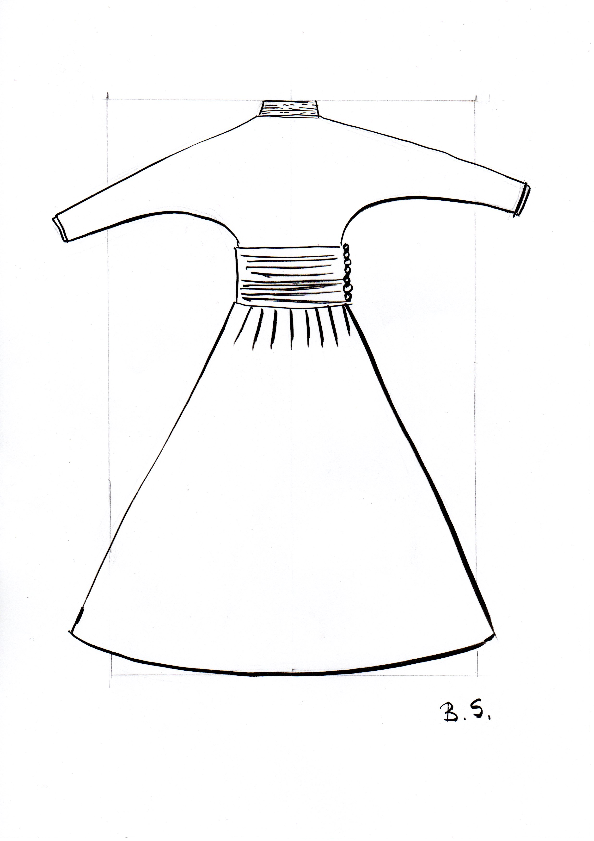
Flat style illustration sample
Draw silhouette, length, collar and pocket details. Even draw number of buttons.

Slide 6
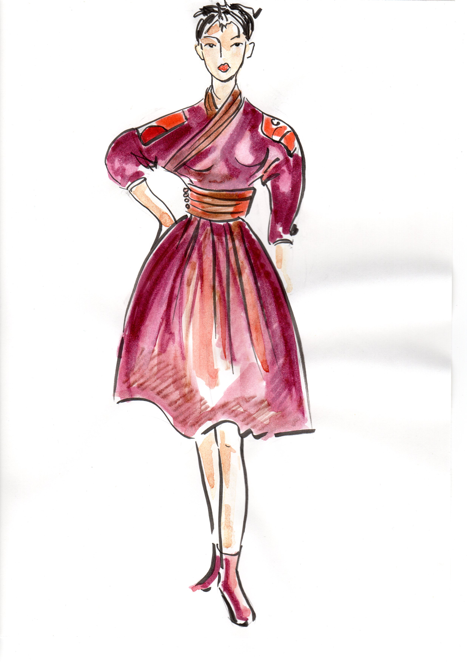
Original fashion design illustration of flat design illustration

