Slide 1
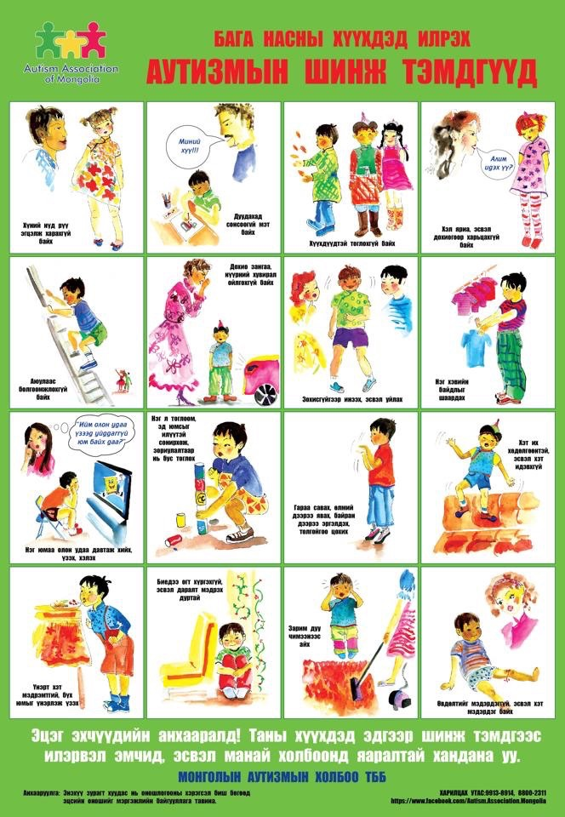
Child foundation proportion
Face and Hairstyle

Slide 2
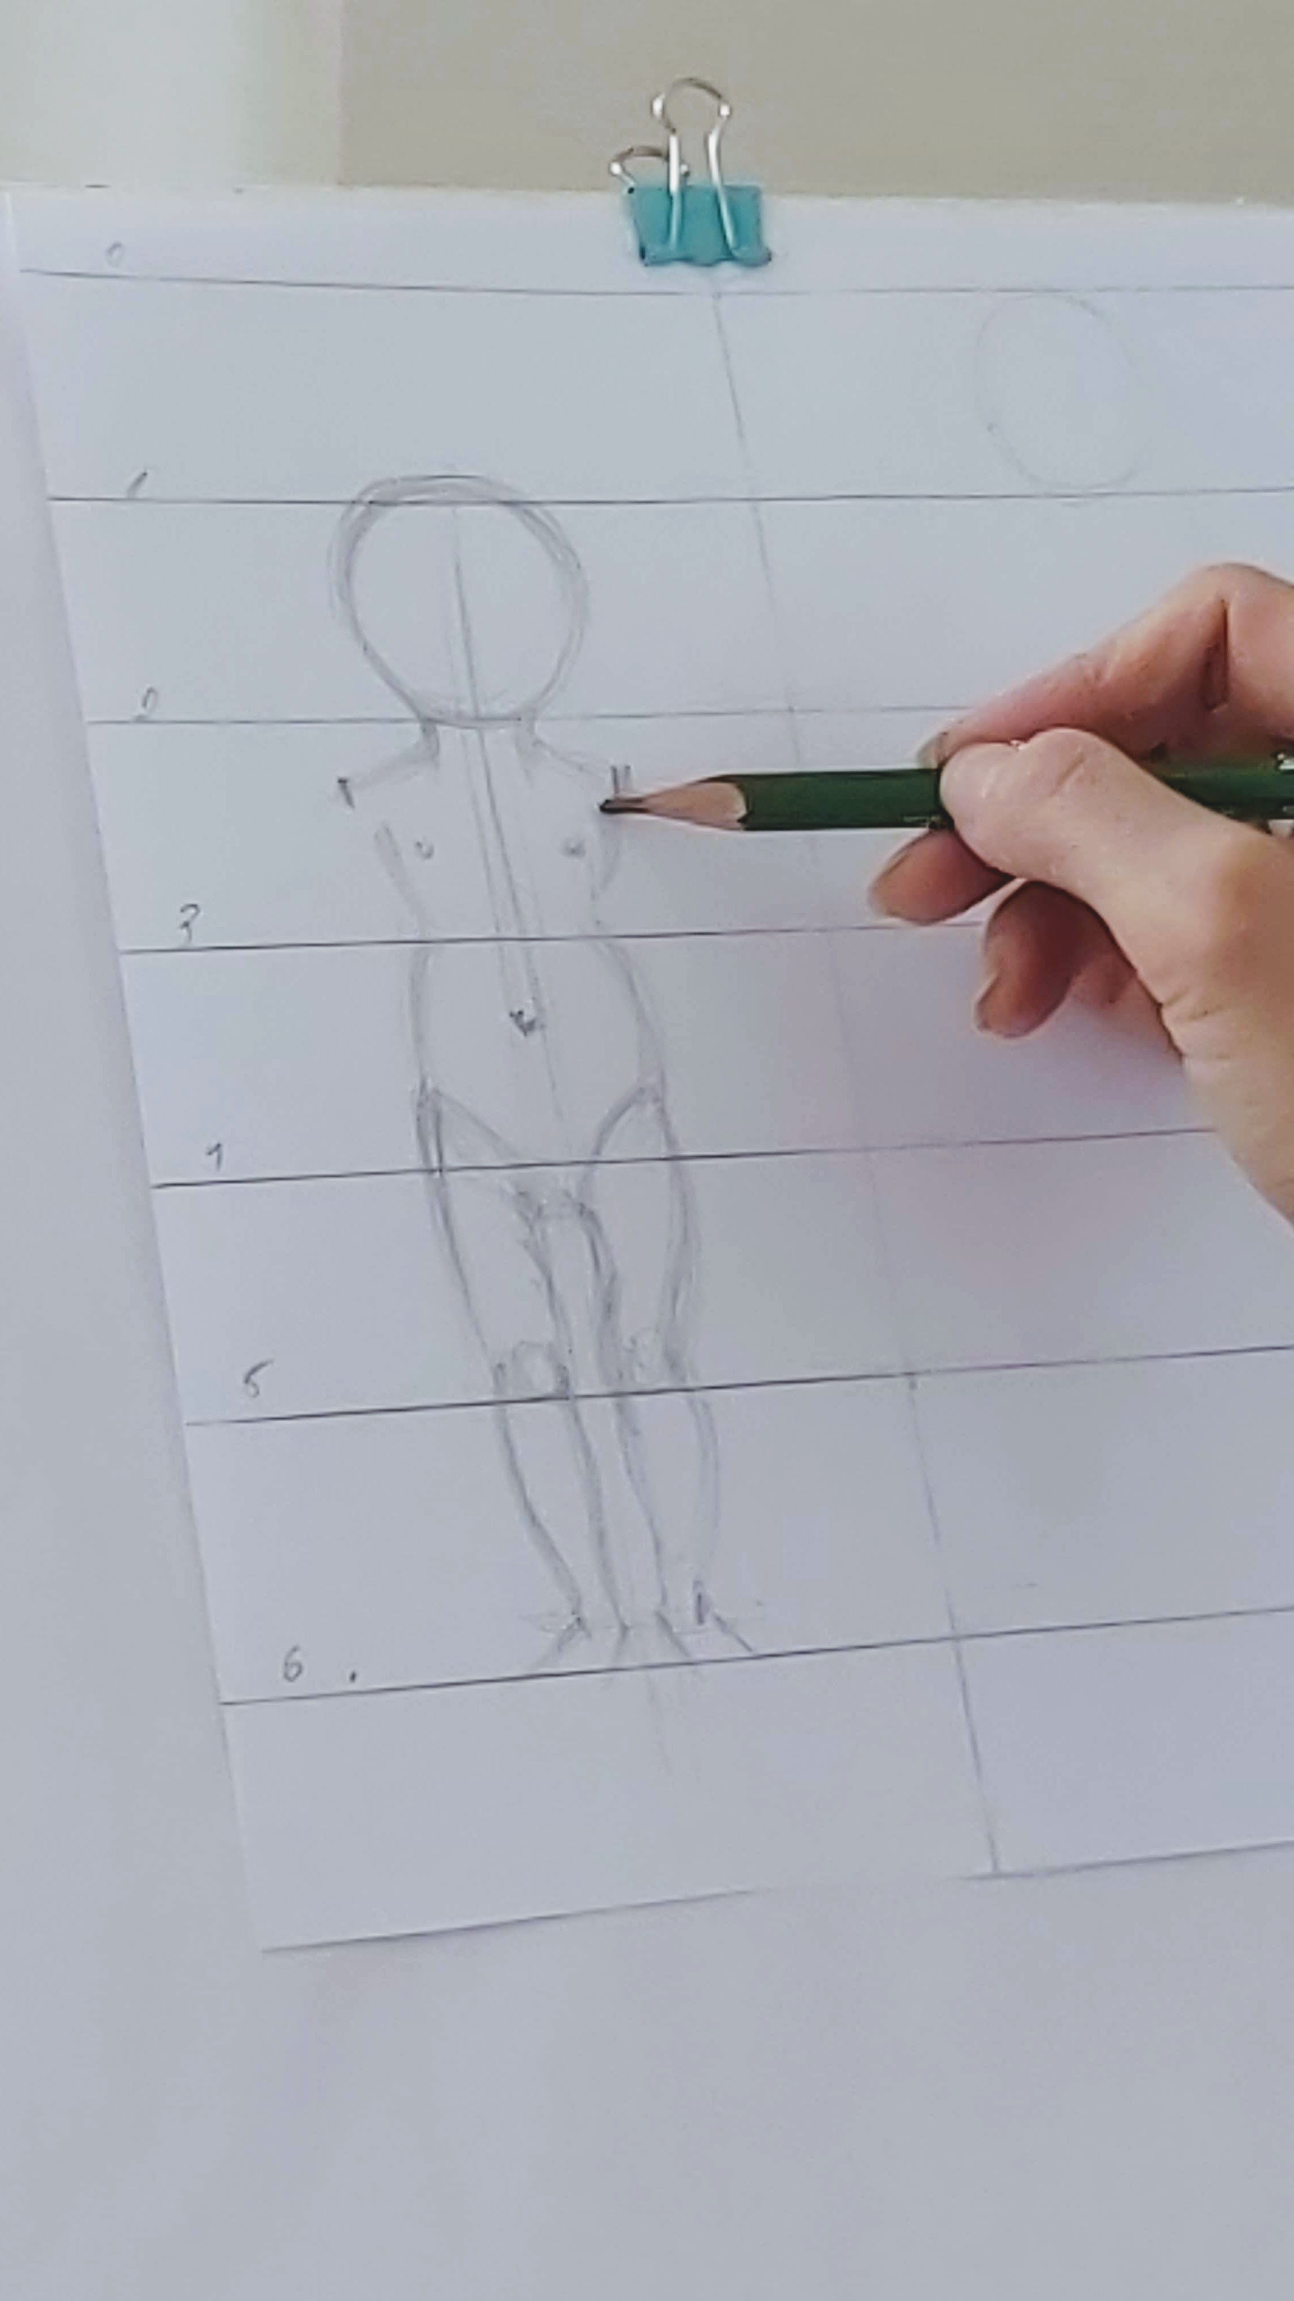
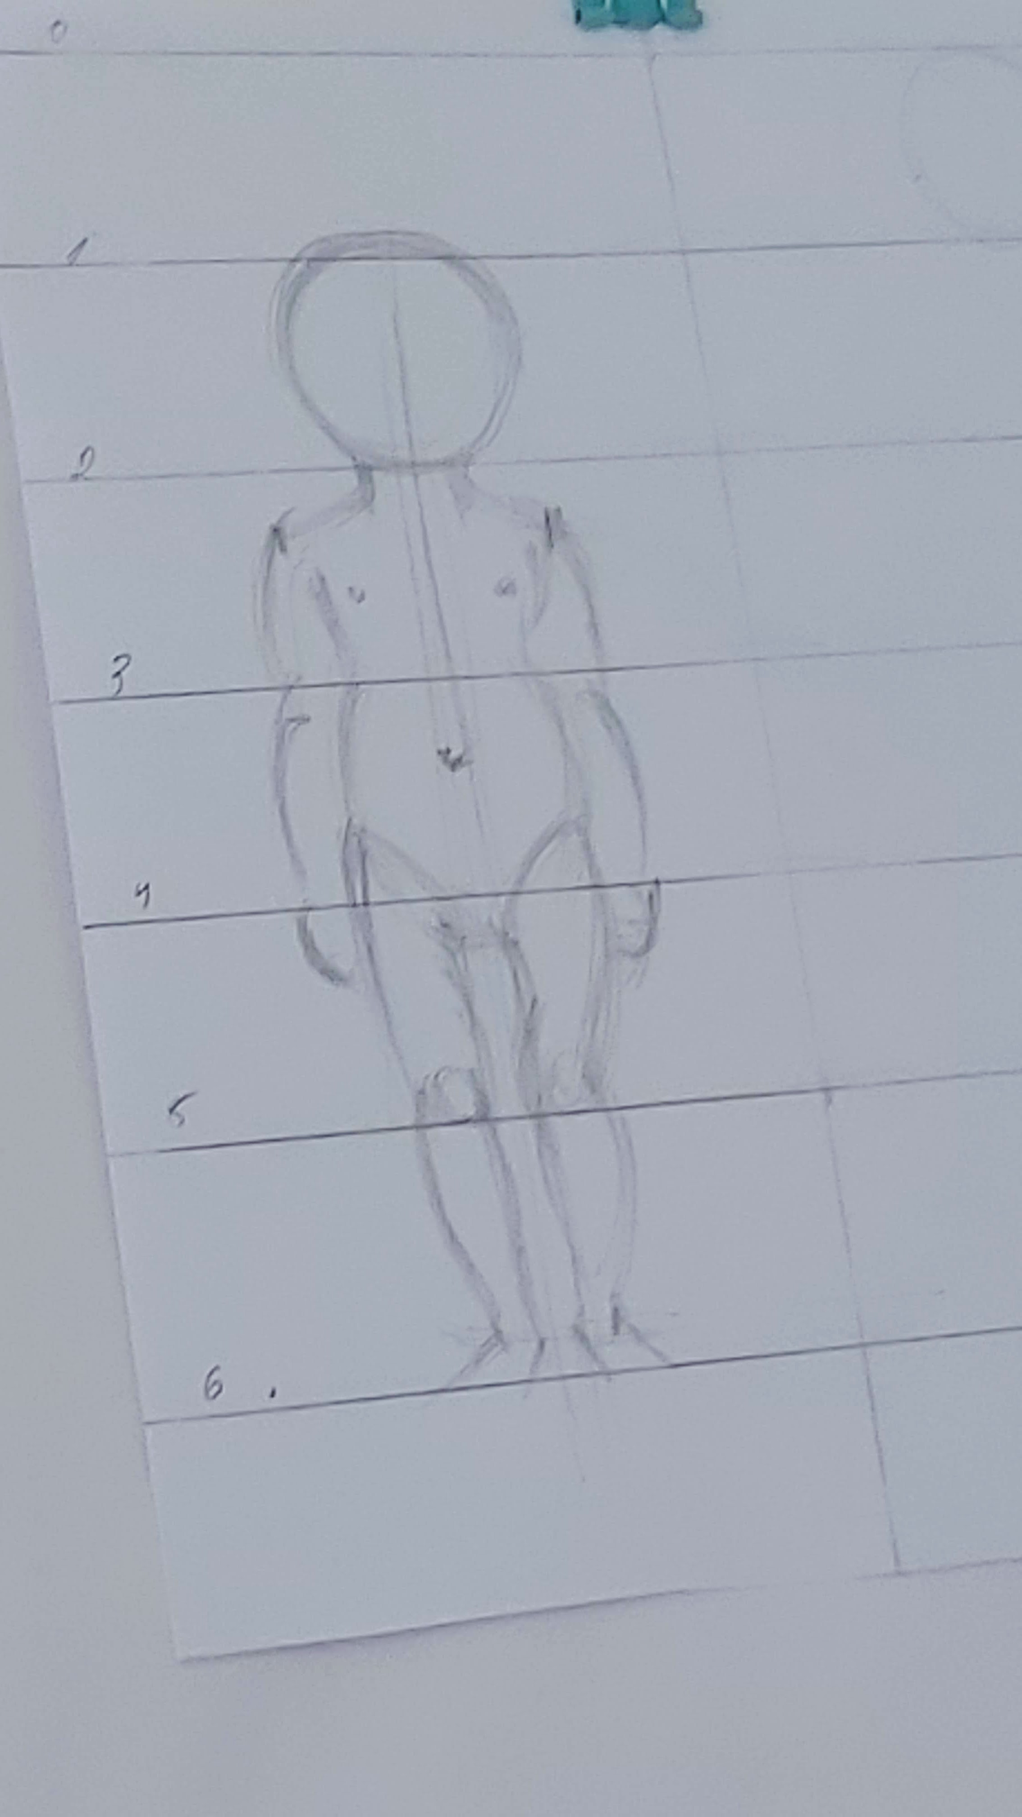
Basic proportion
To draw a child it is necessary to divide into age groups.

Slide 3
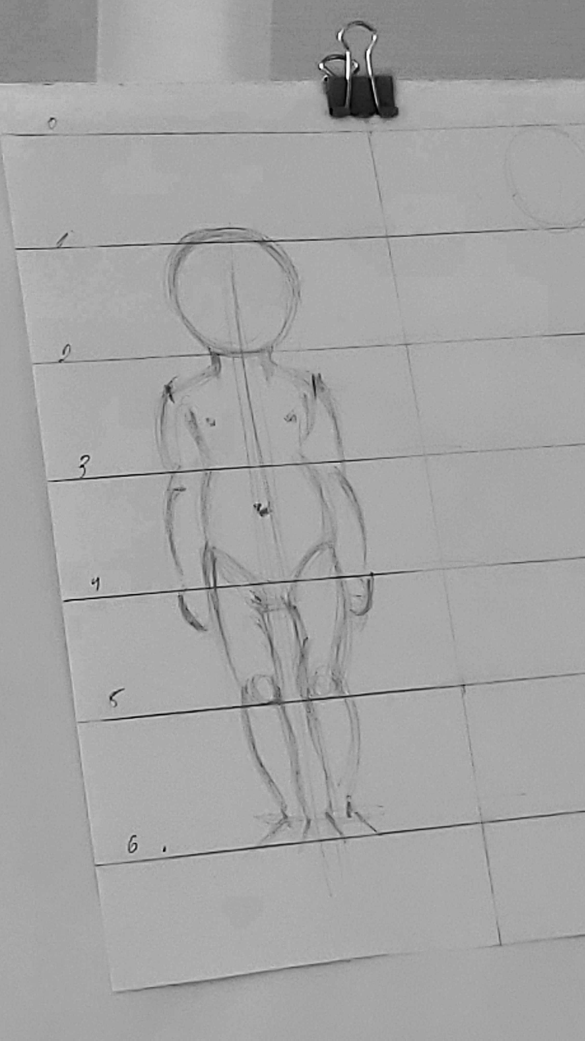
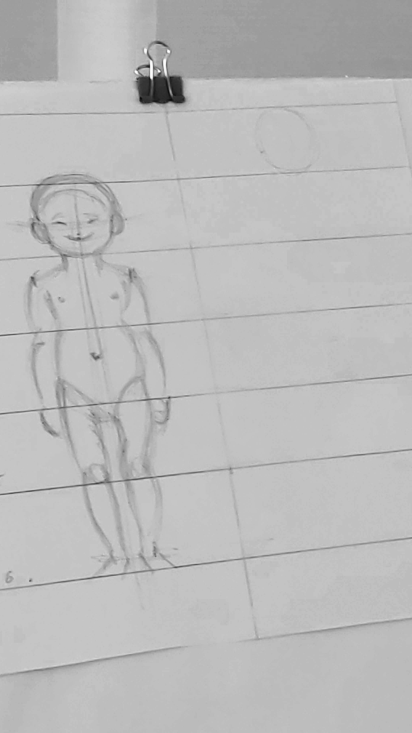
Basic proportion of 2-3 year old children

Slide 4
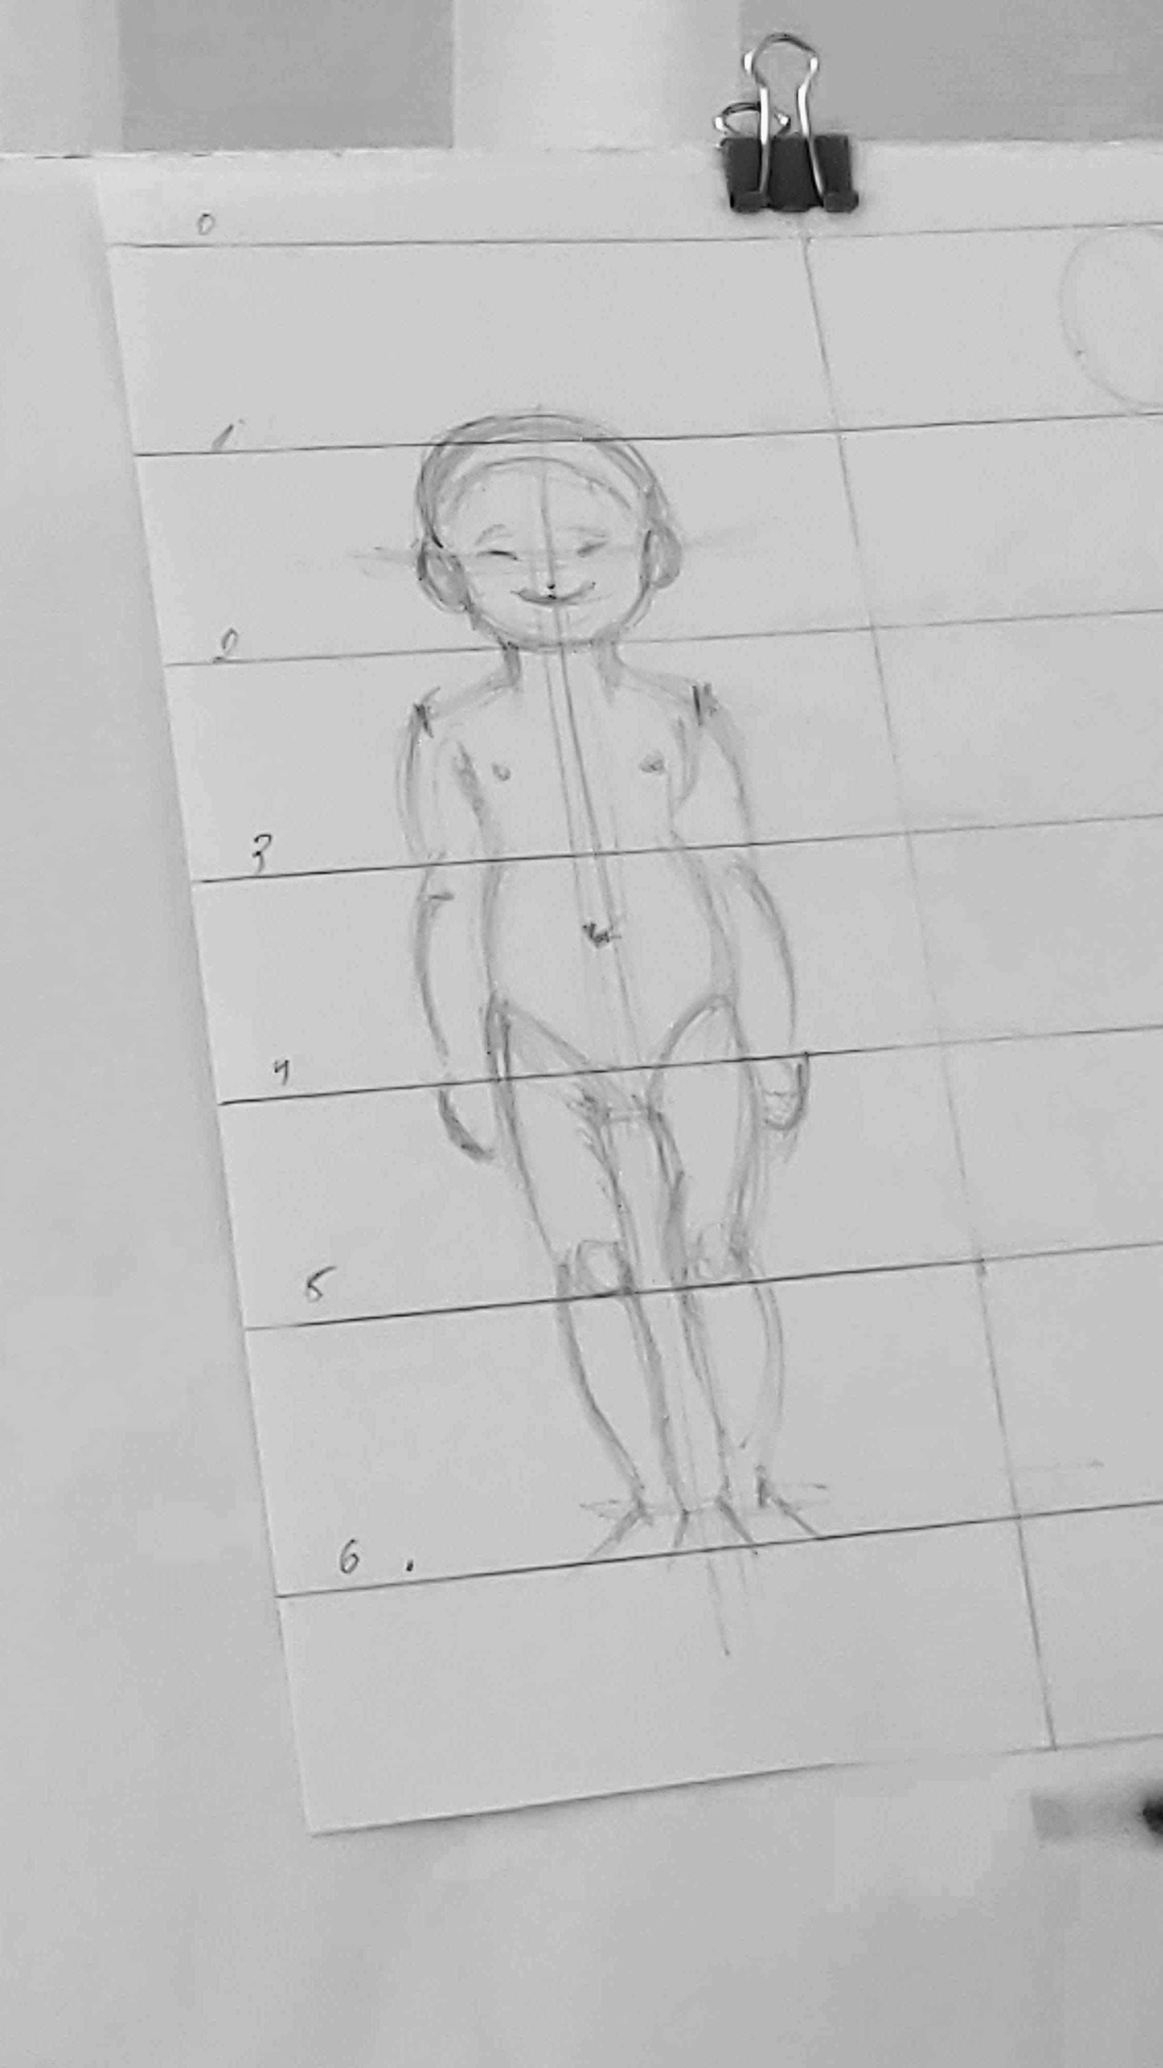
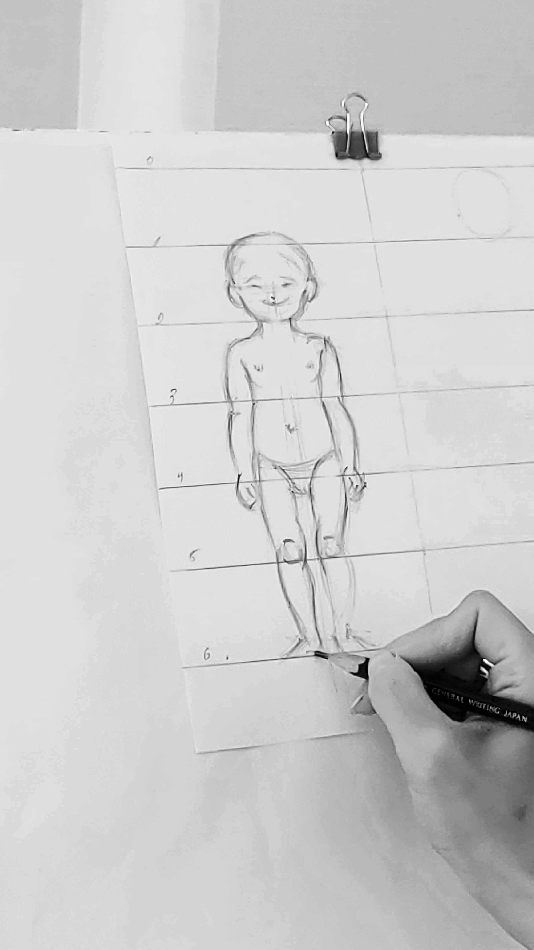
Basic proportion
Depending on age proportion is different.

Slide 5
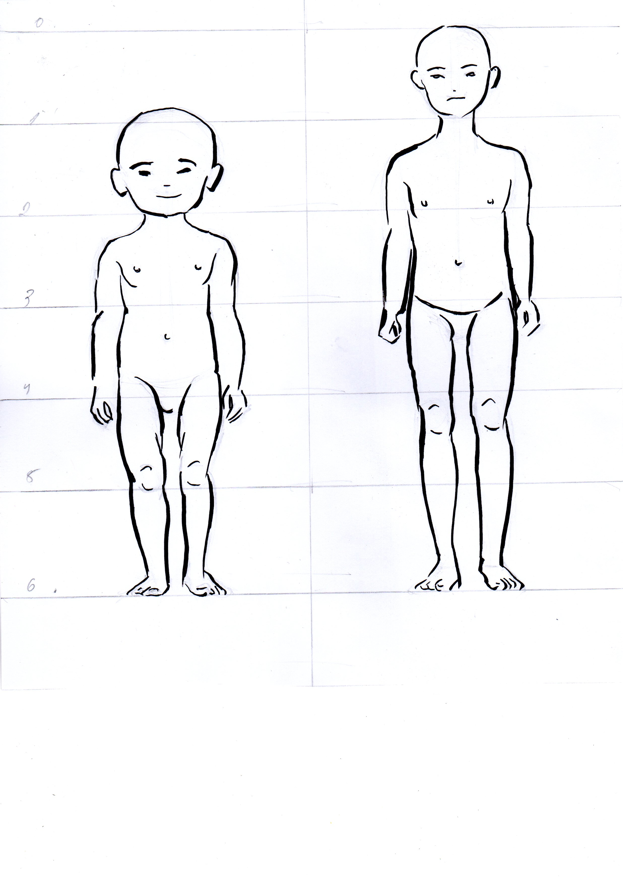
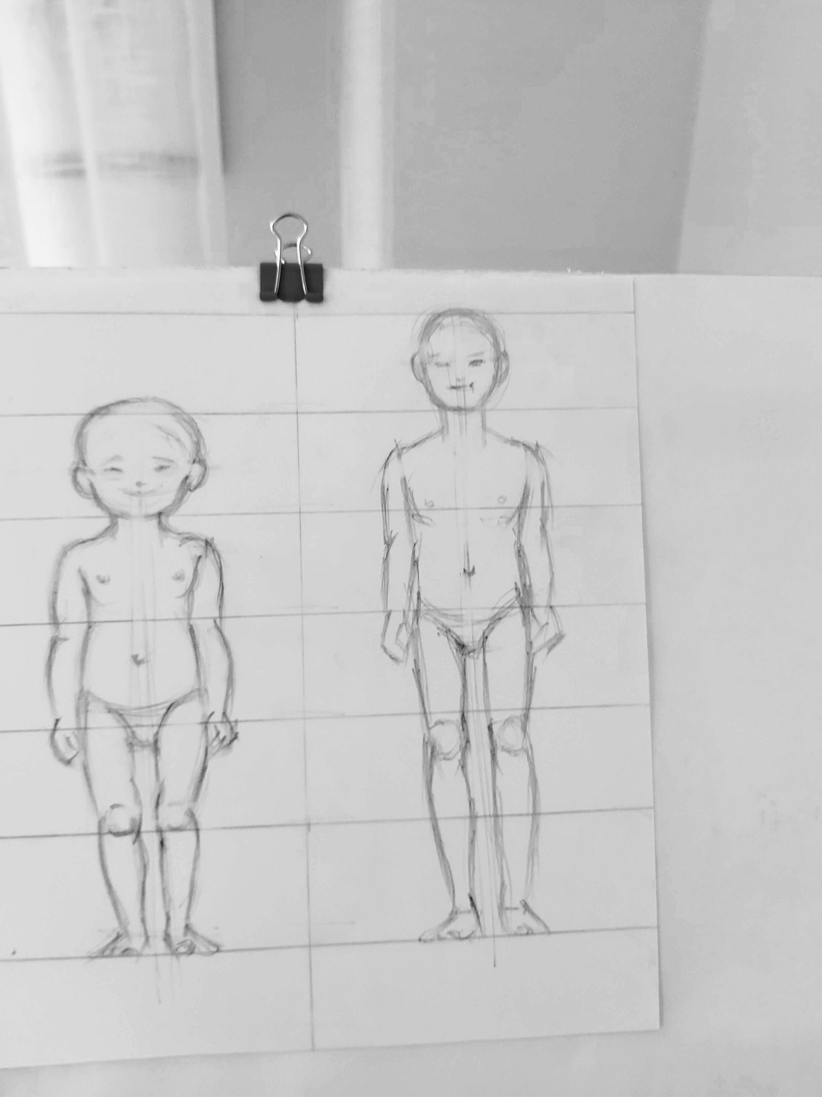
Basic proportion of 2-3 year old and 5-6year old children
Expression of face and hairstyle, drawing a childlike pose is important.

Slide 6
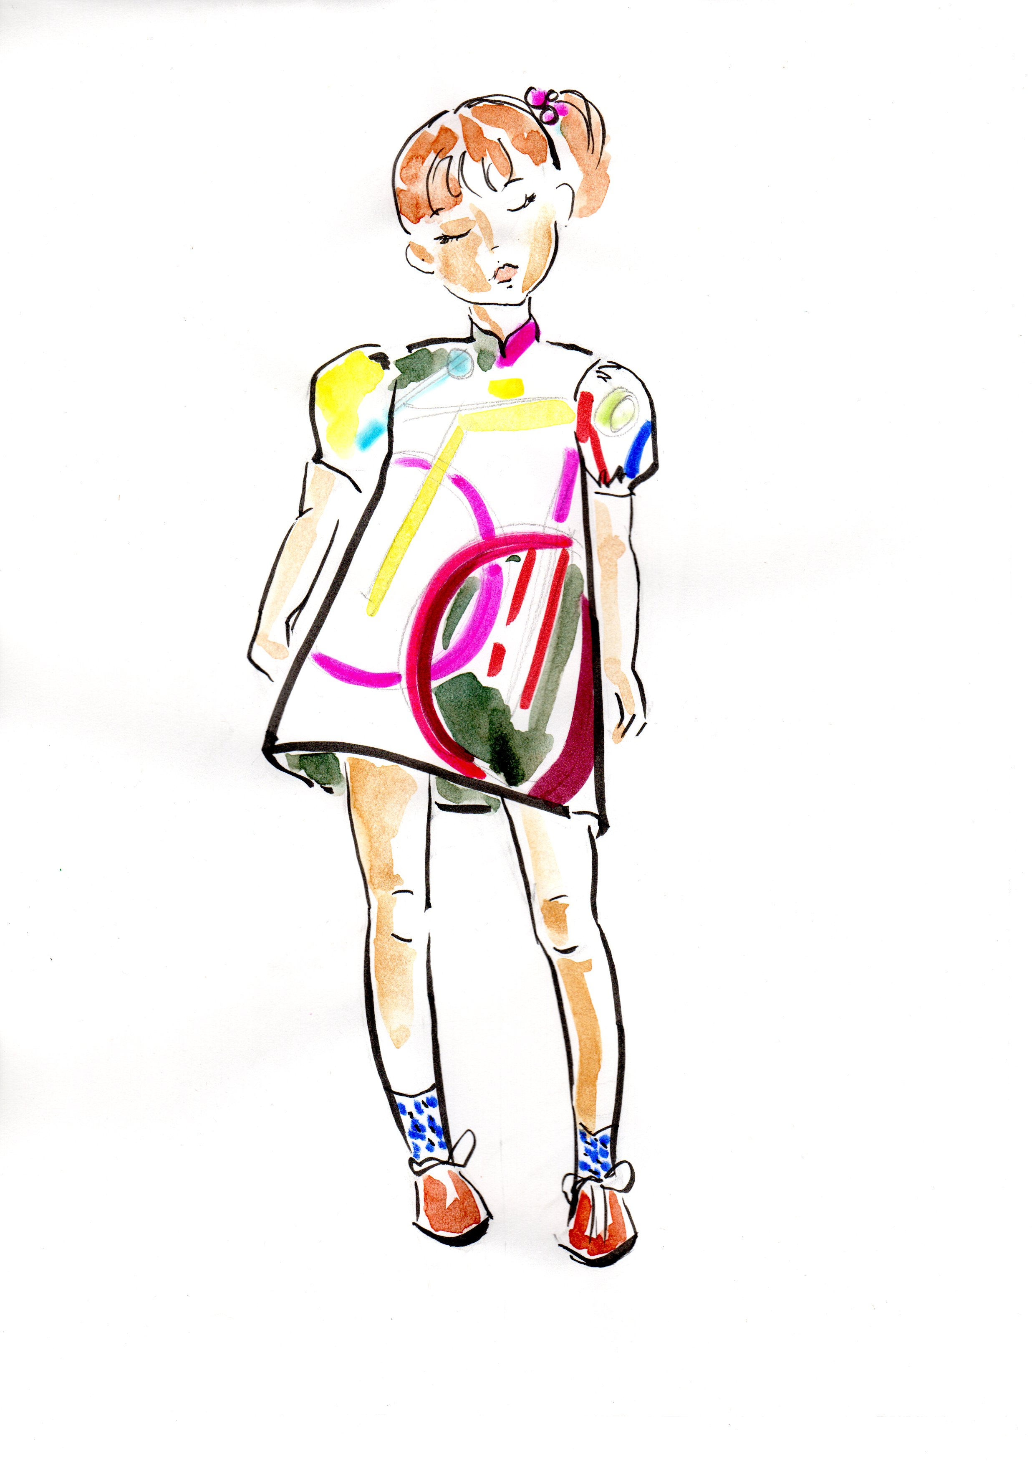
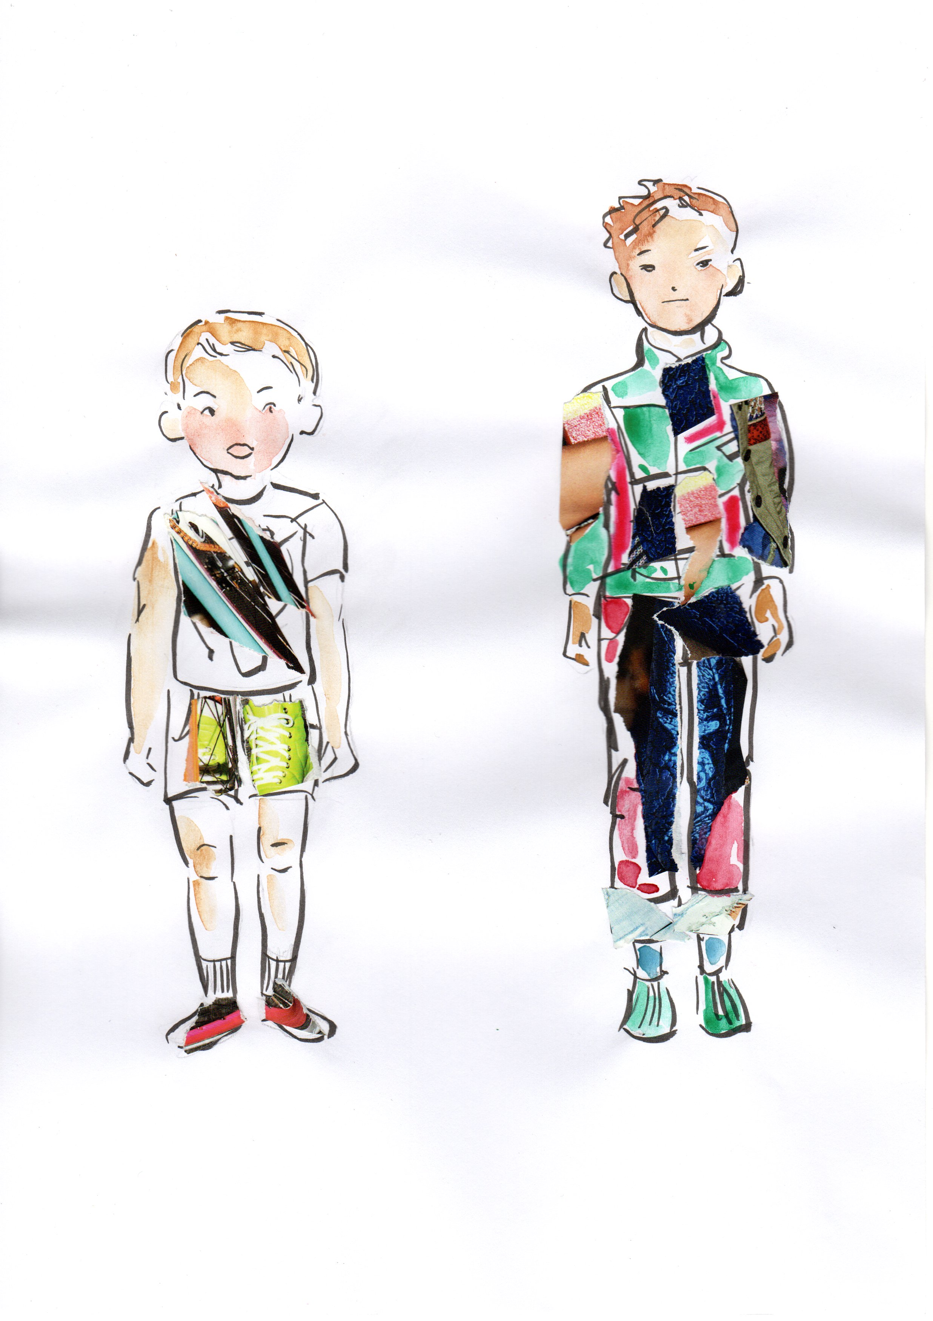
Basic proportion
Do a lot of research from children, find cuteness in them and draw. It’s ok to draw like a cartoon character. Find your own individual style.

