Slide 1
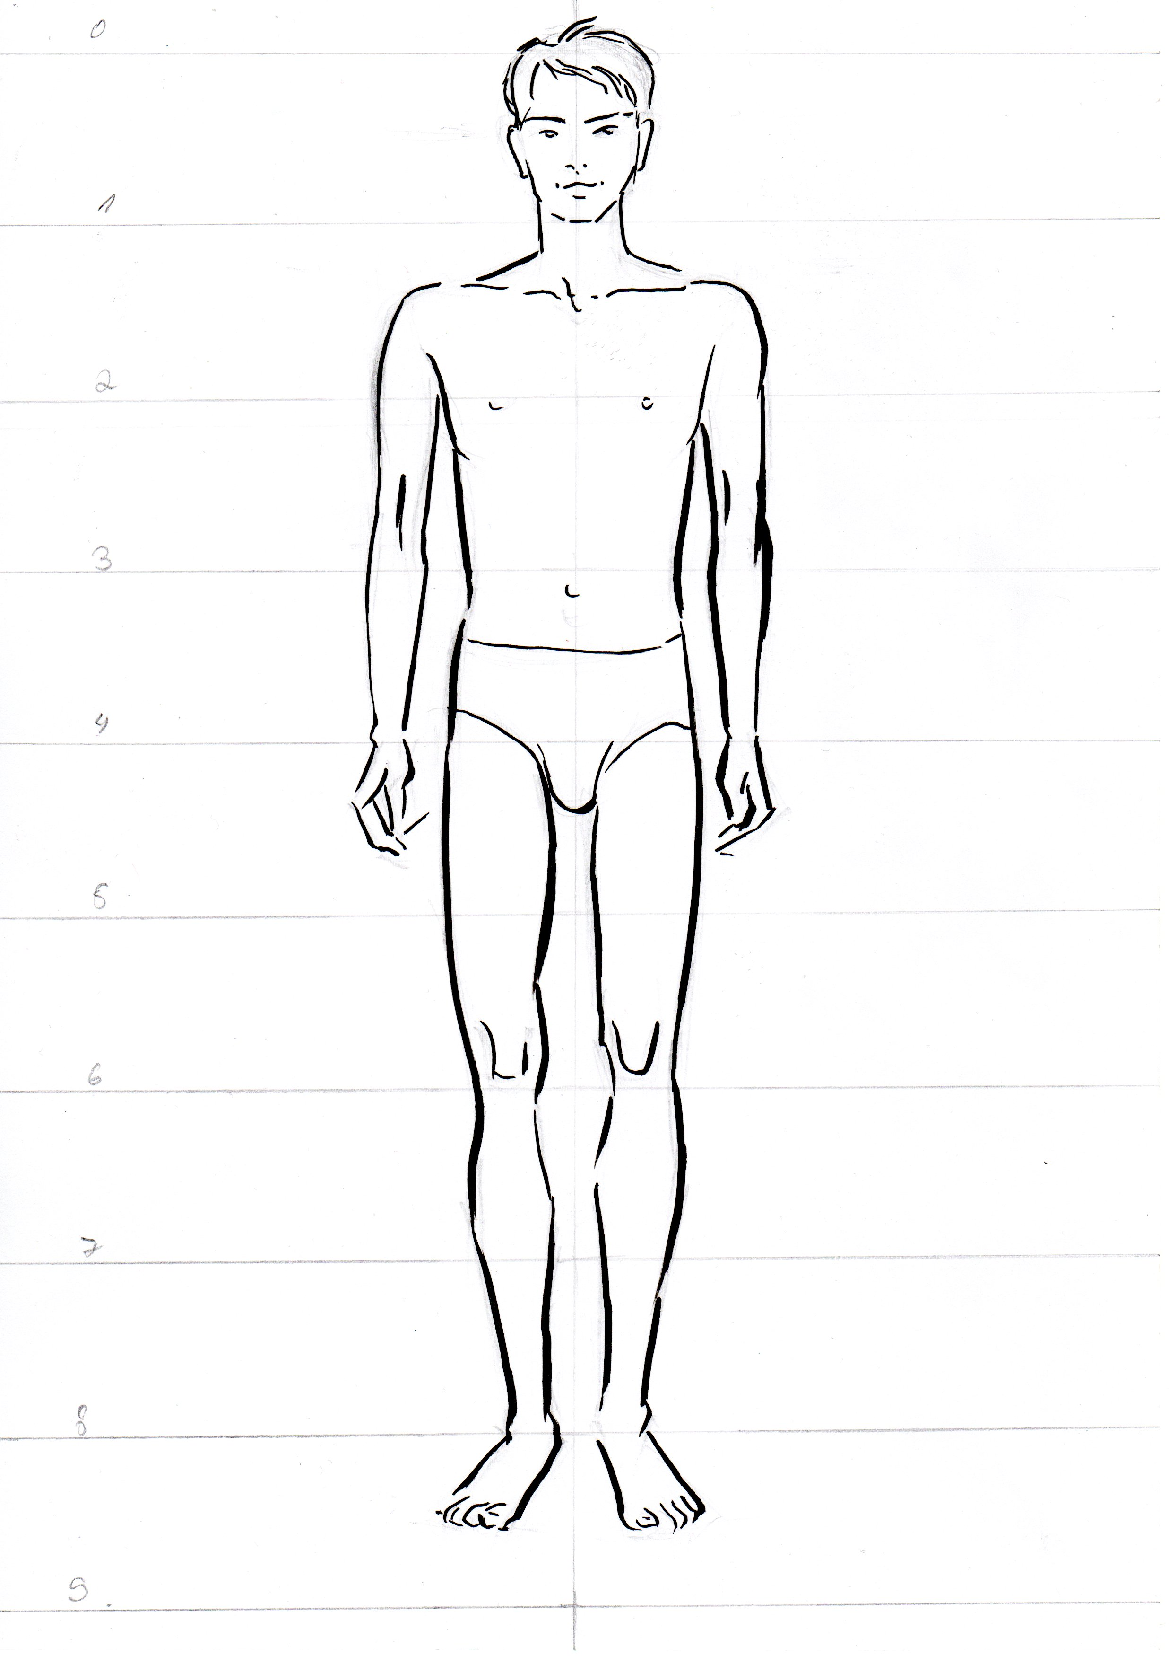
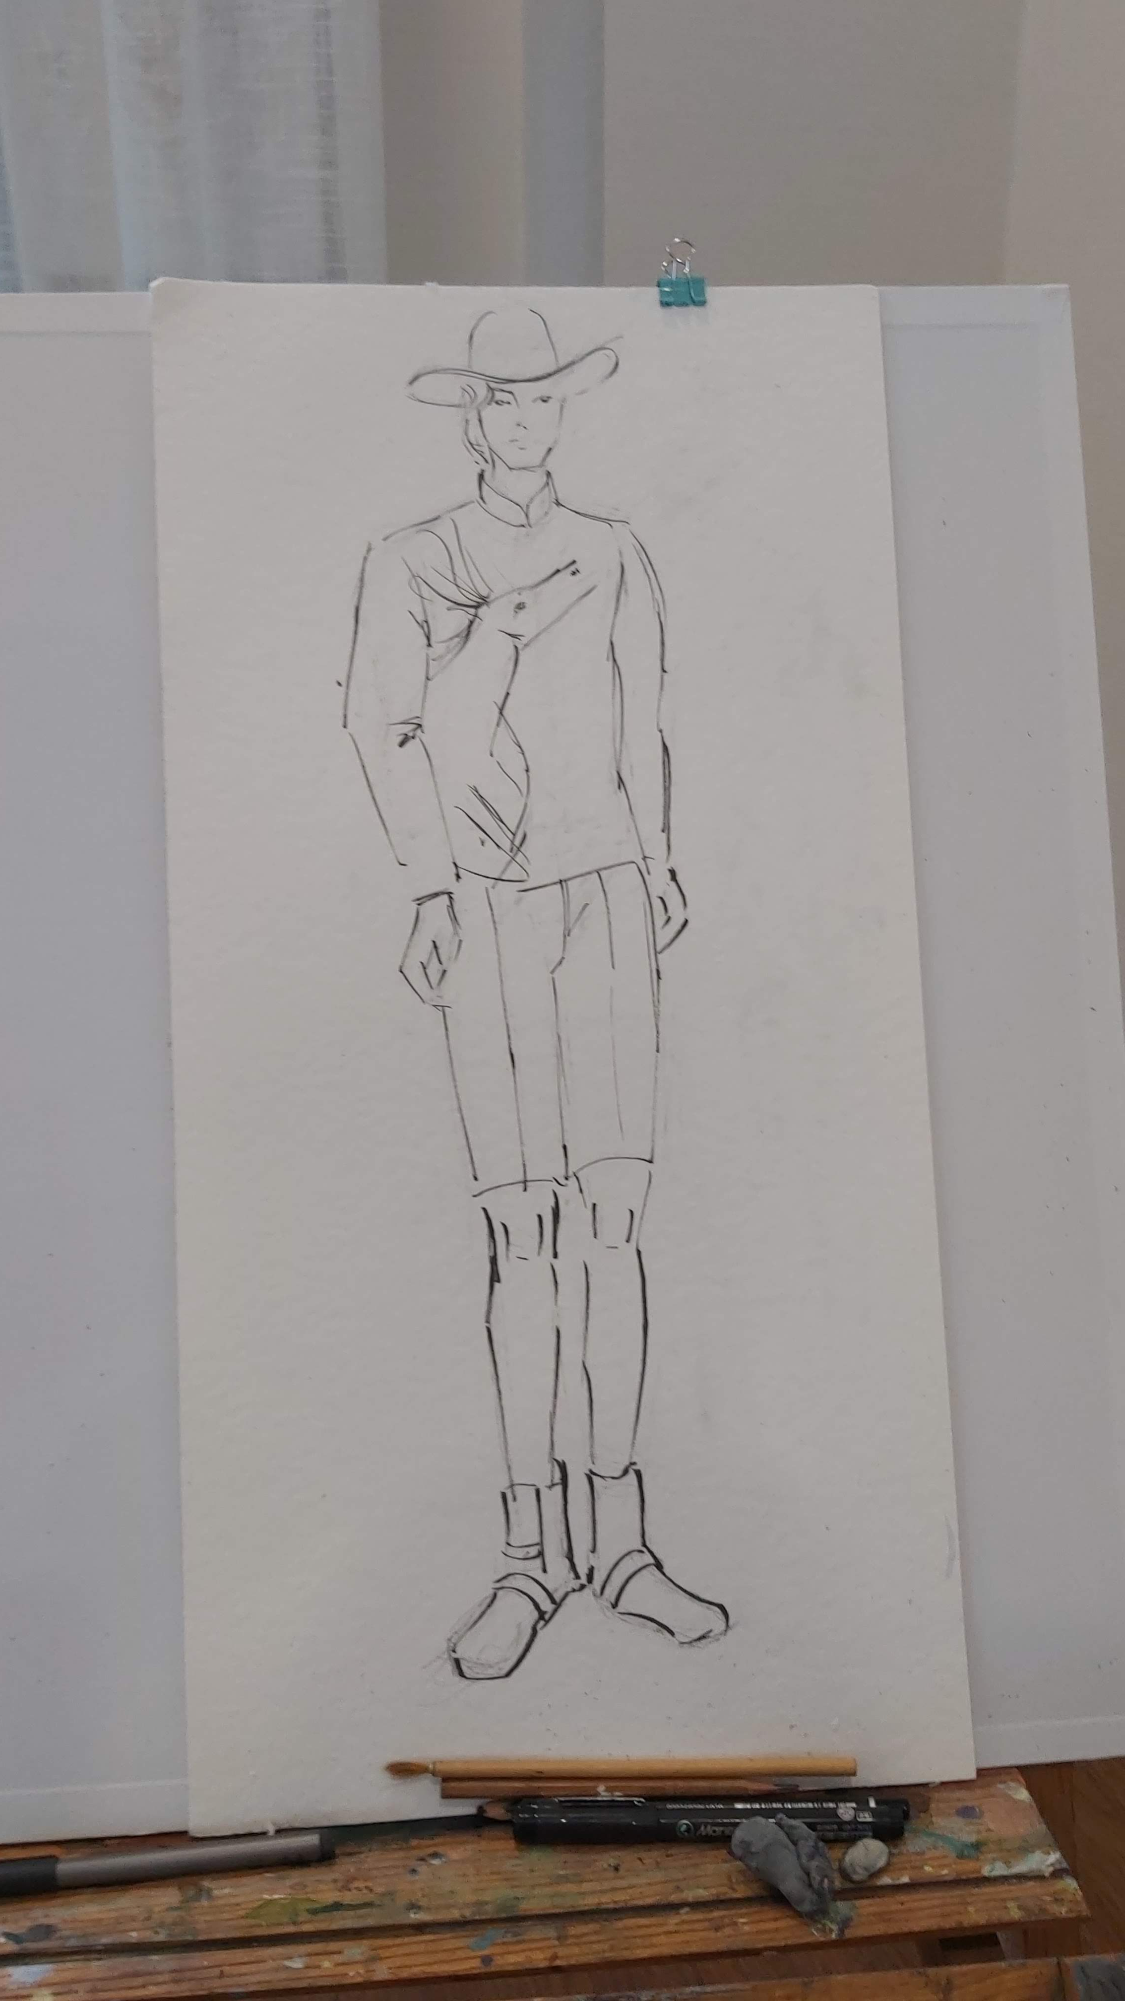
Men’s proportion and face drawing
Basic proportion

Slide 2
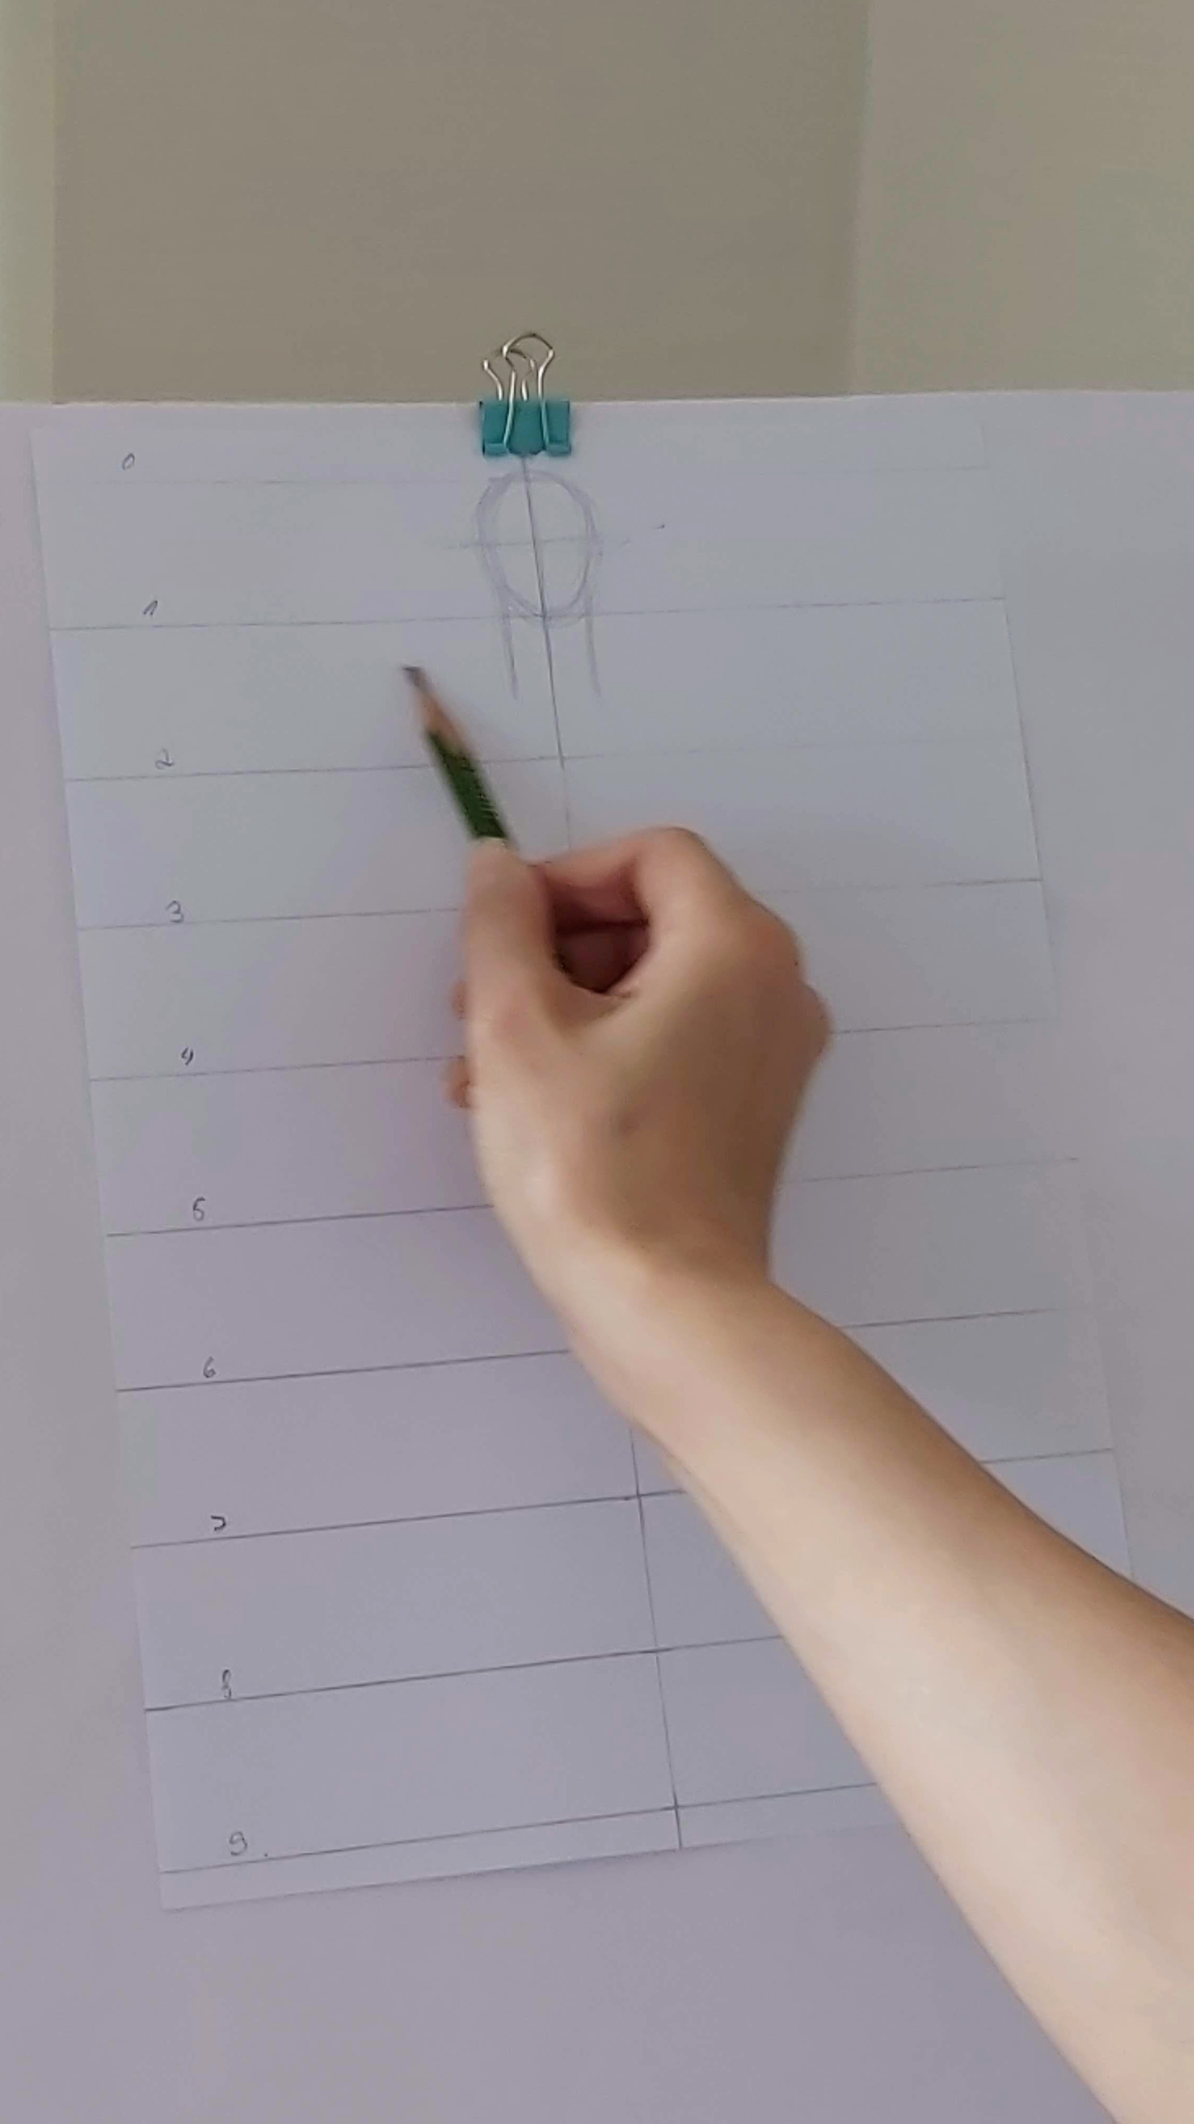
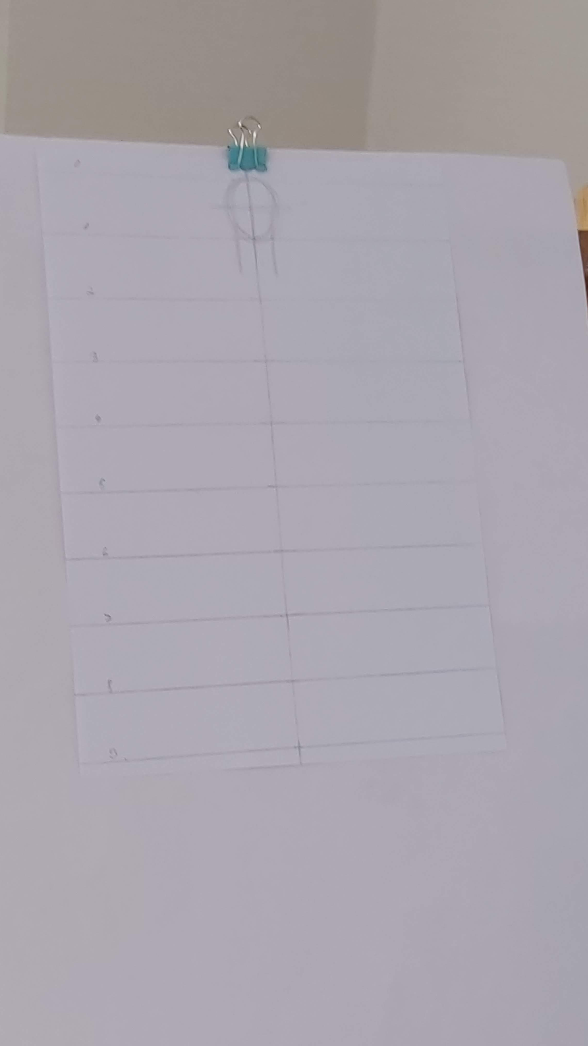
Men’s
Difference from ladies proportion:
Neck is wider

Slide 3
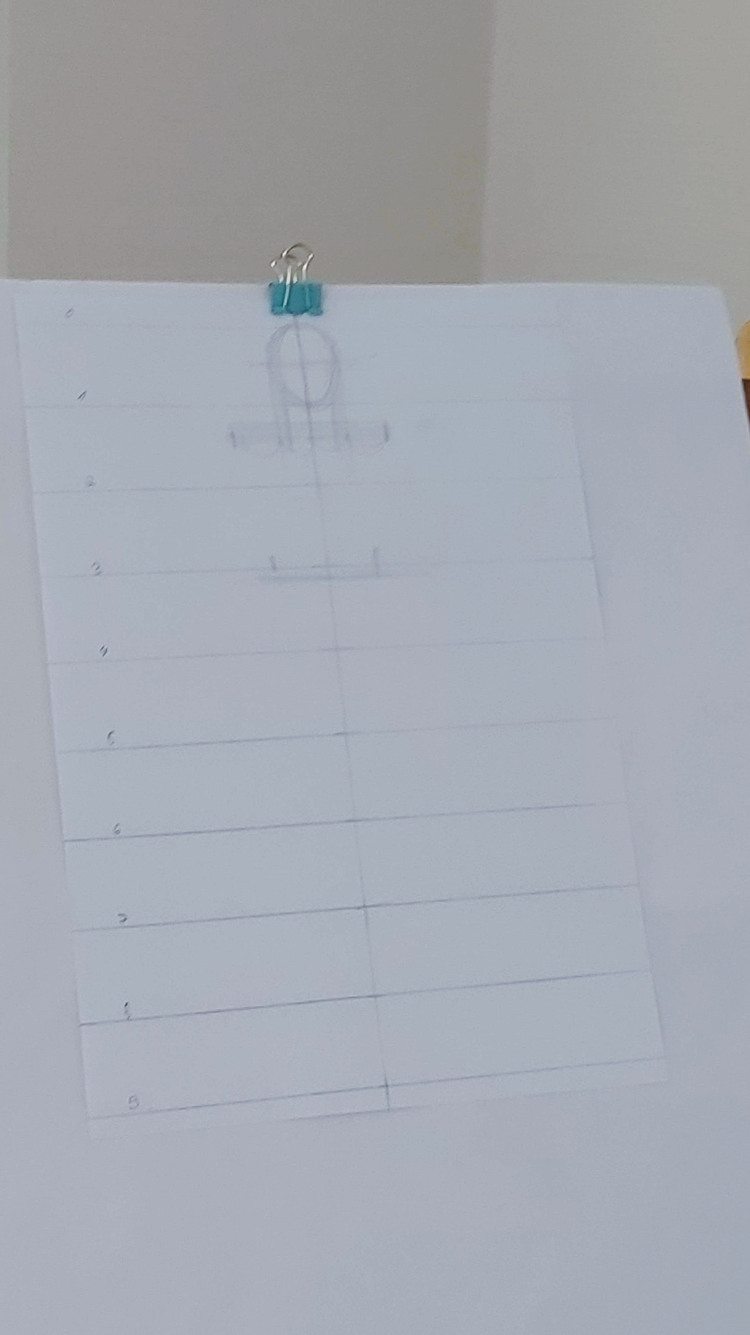
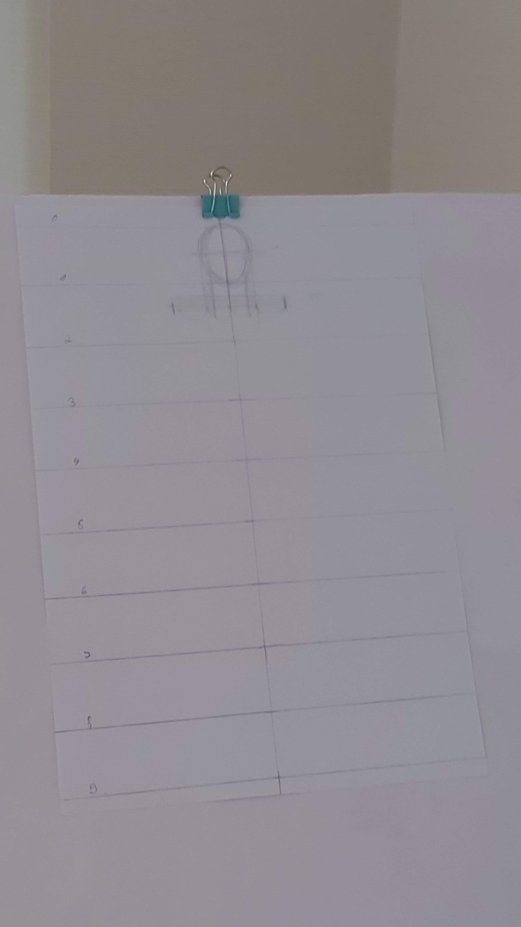
Men’s
Position of shoulder line is little bit higher. Make shoulder width broader.

Slide 4
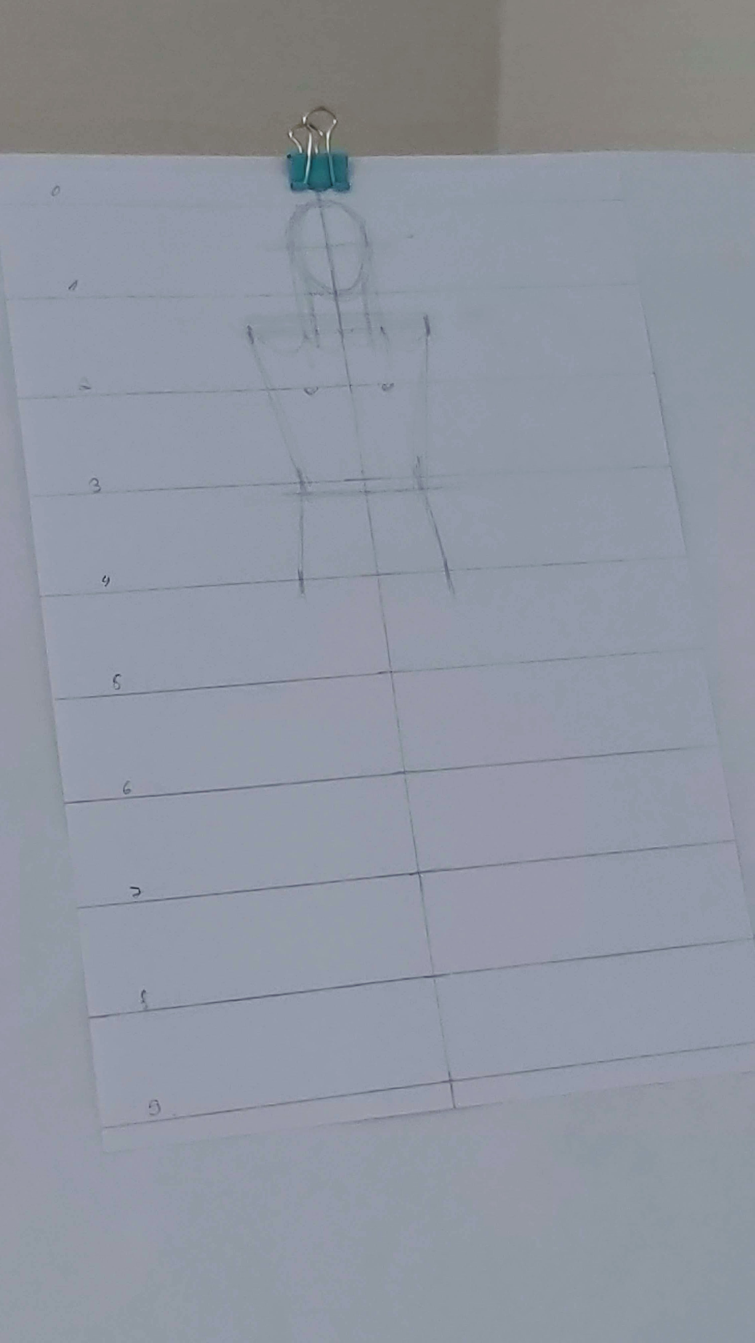
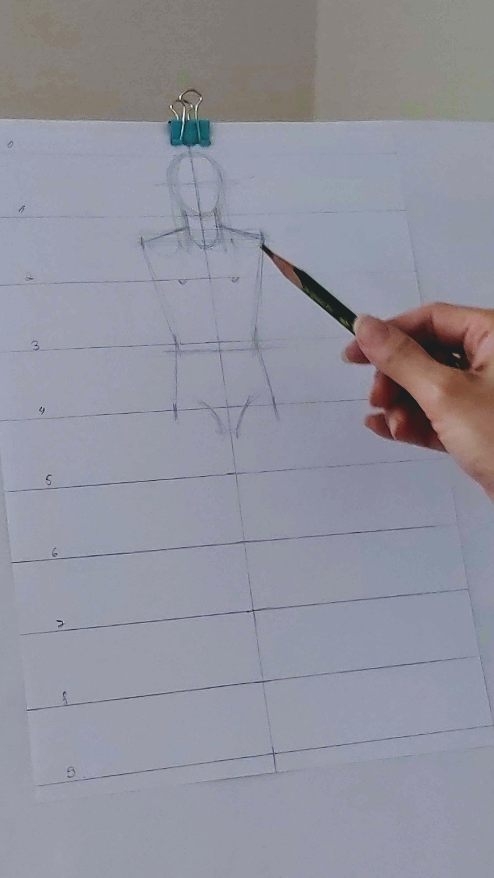
Men’s
Waist line is little bit lower than ladies waist line position. Make sure it is not thin suddenly.

Slide 5
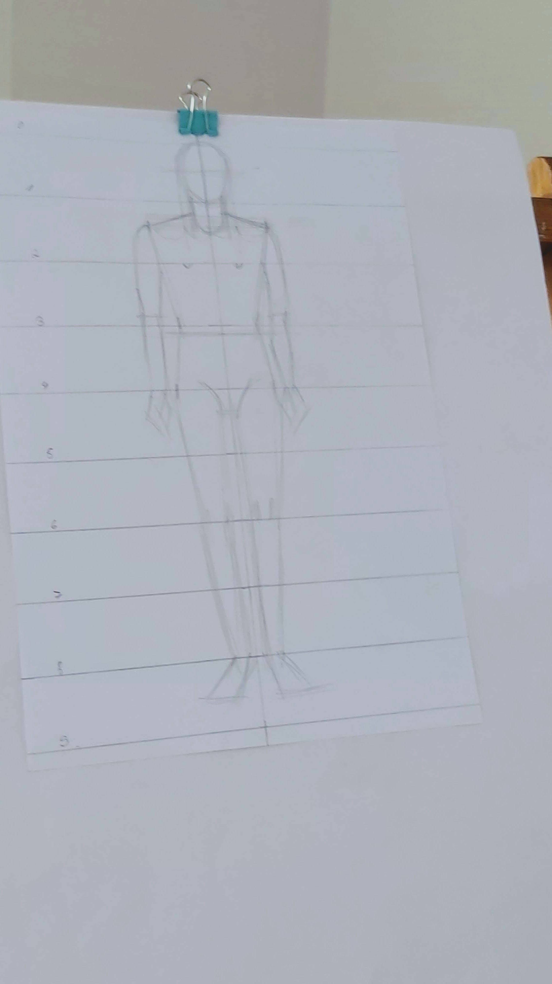
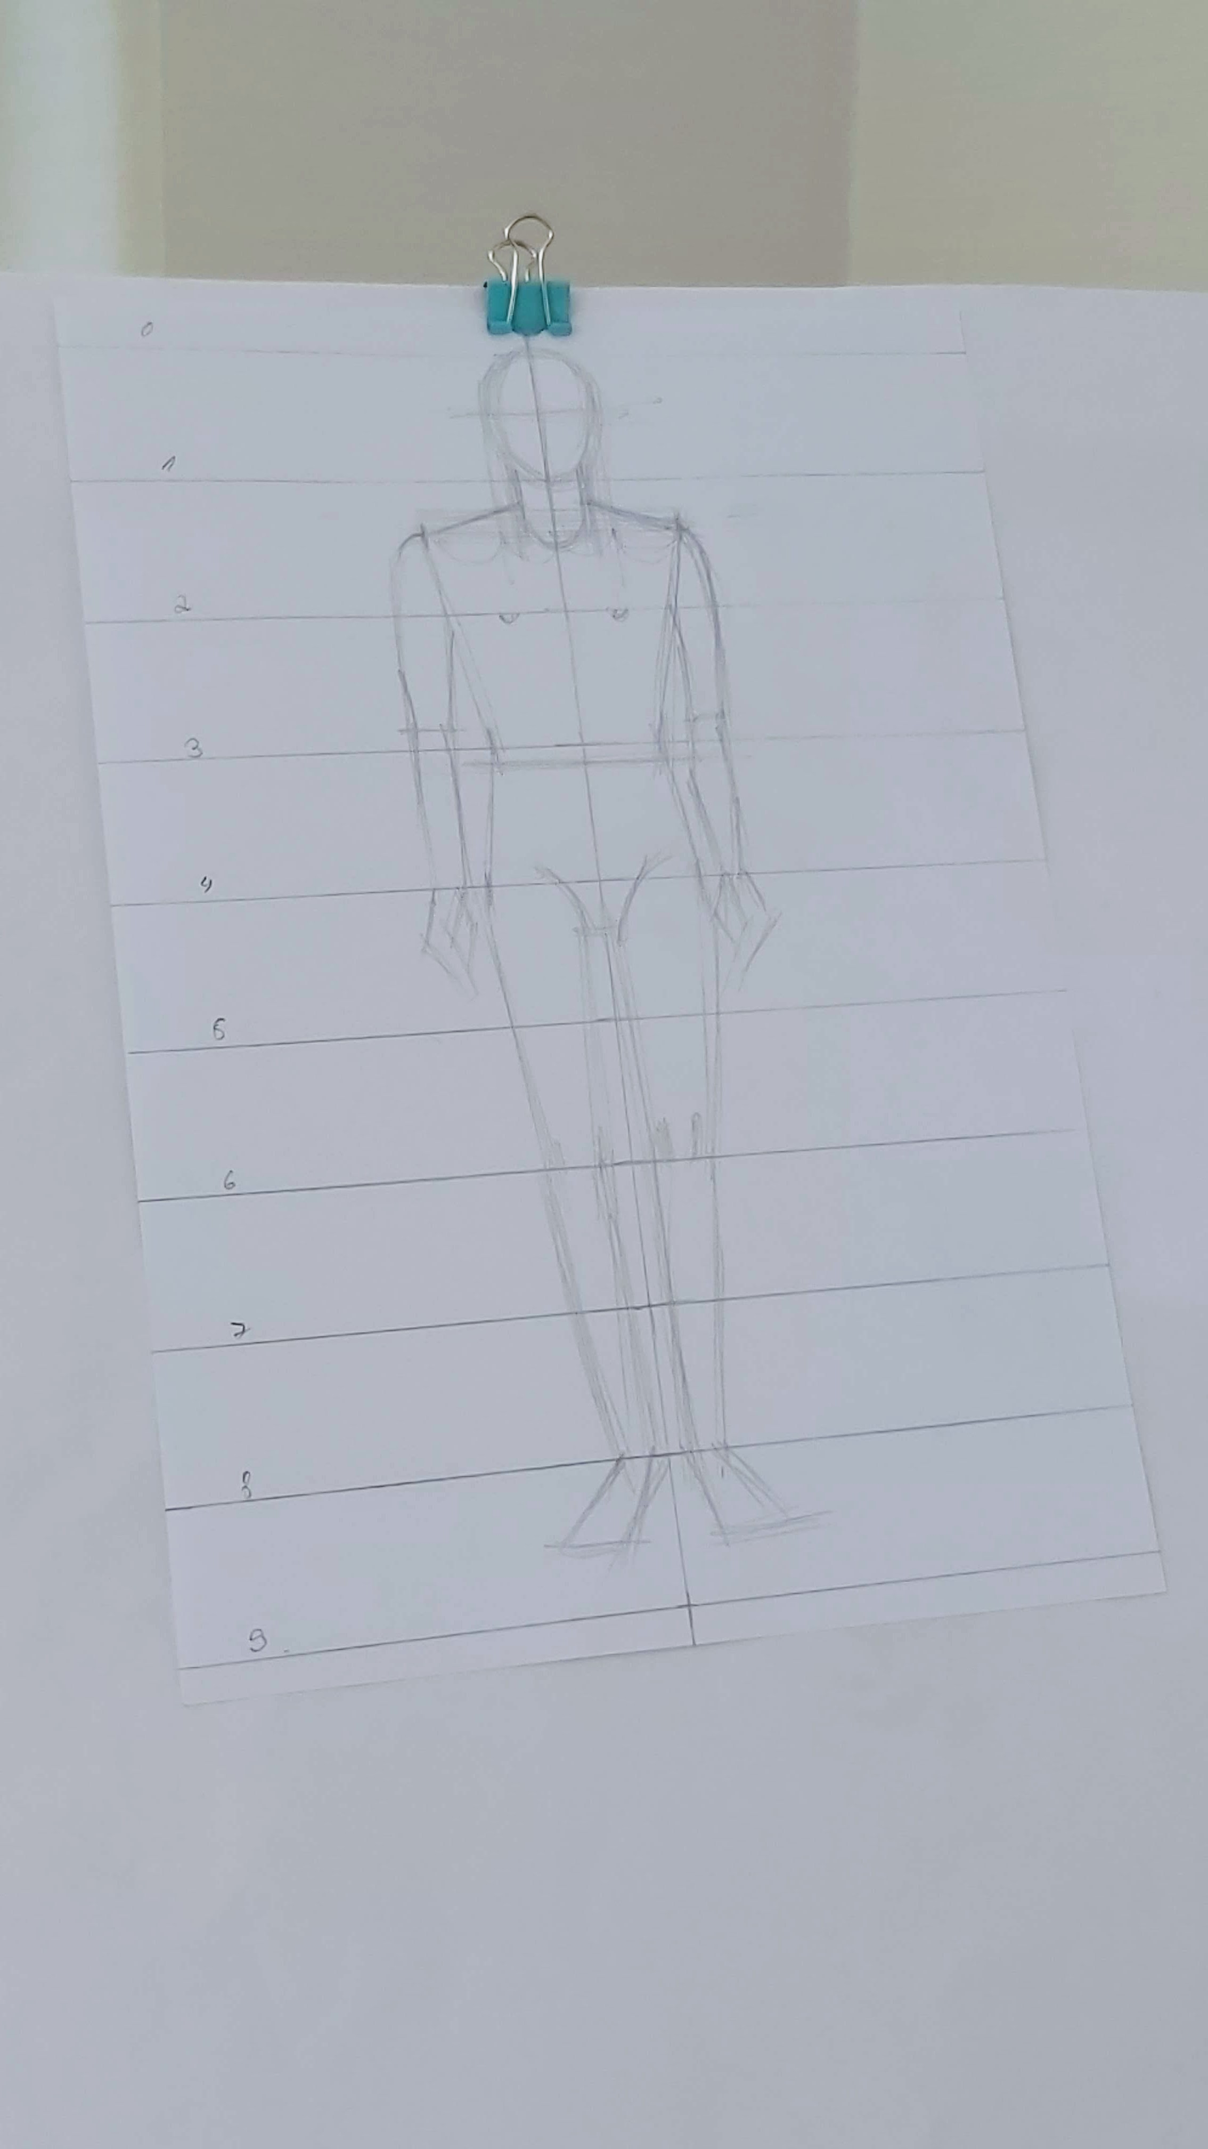
Men’s
Draw a small hip.

Slide 6
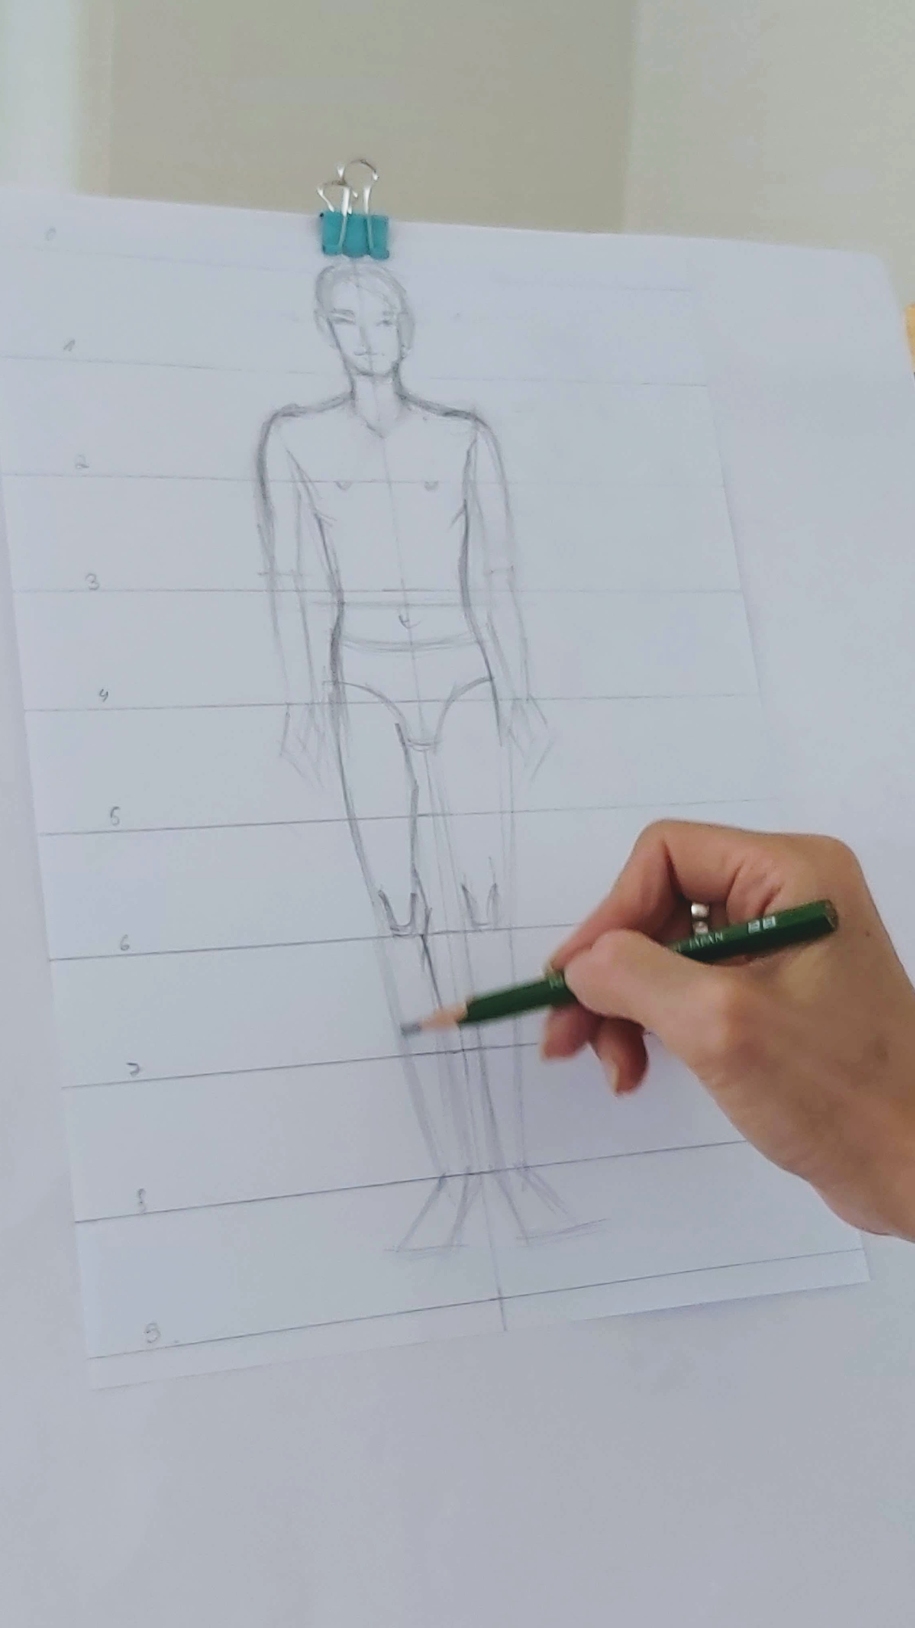
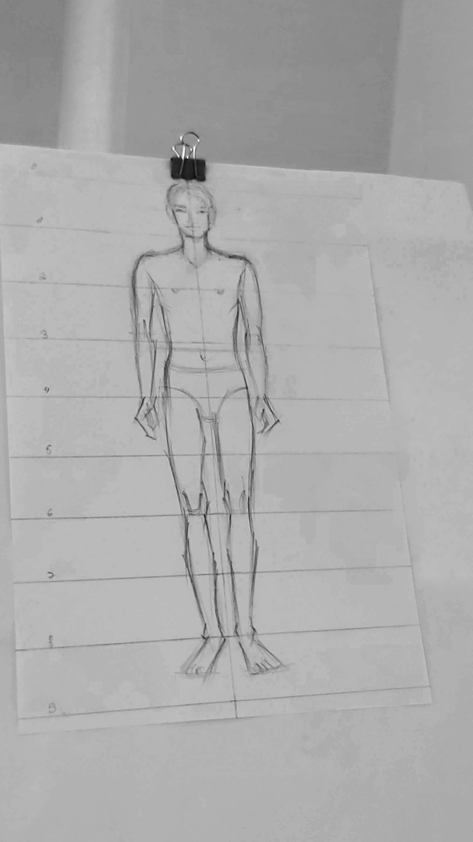
Men’s
In general emphasize shoulders and muscles more.

Slide 7
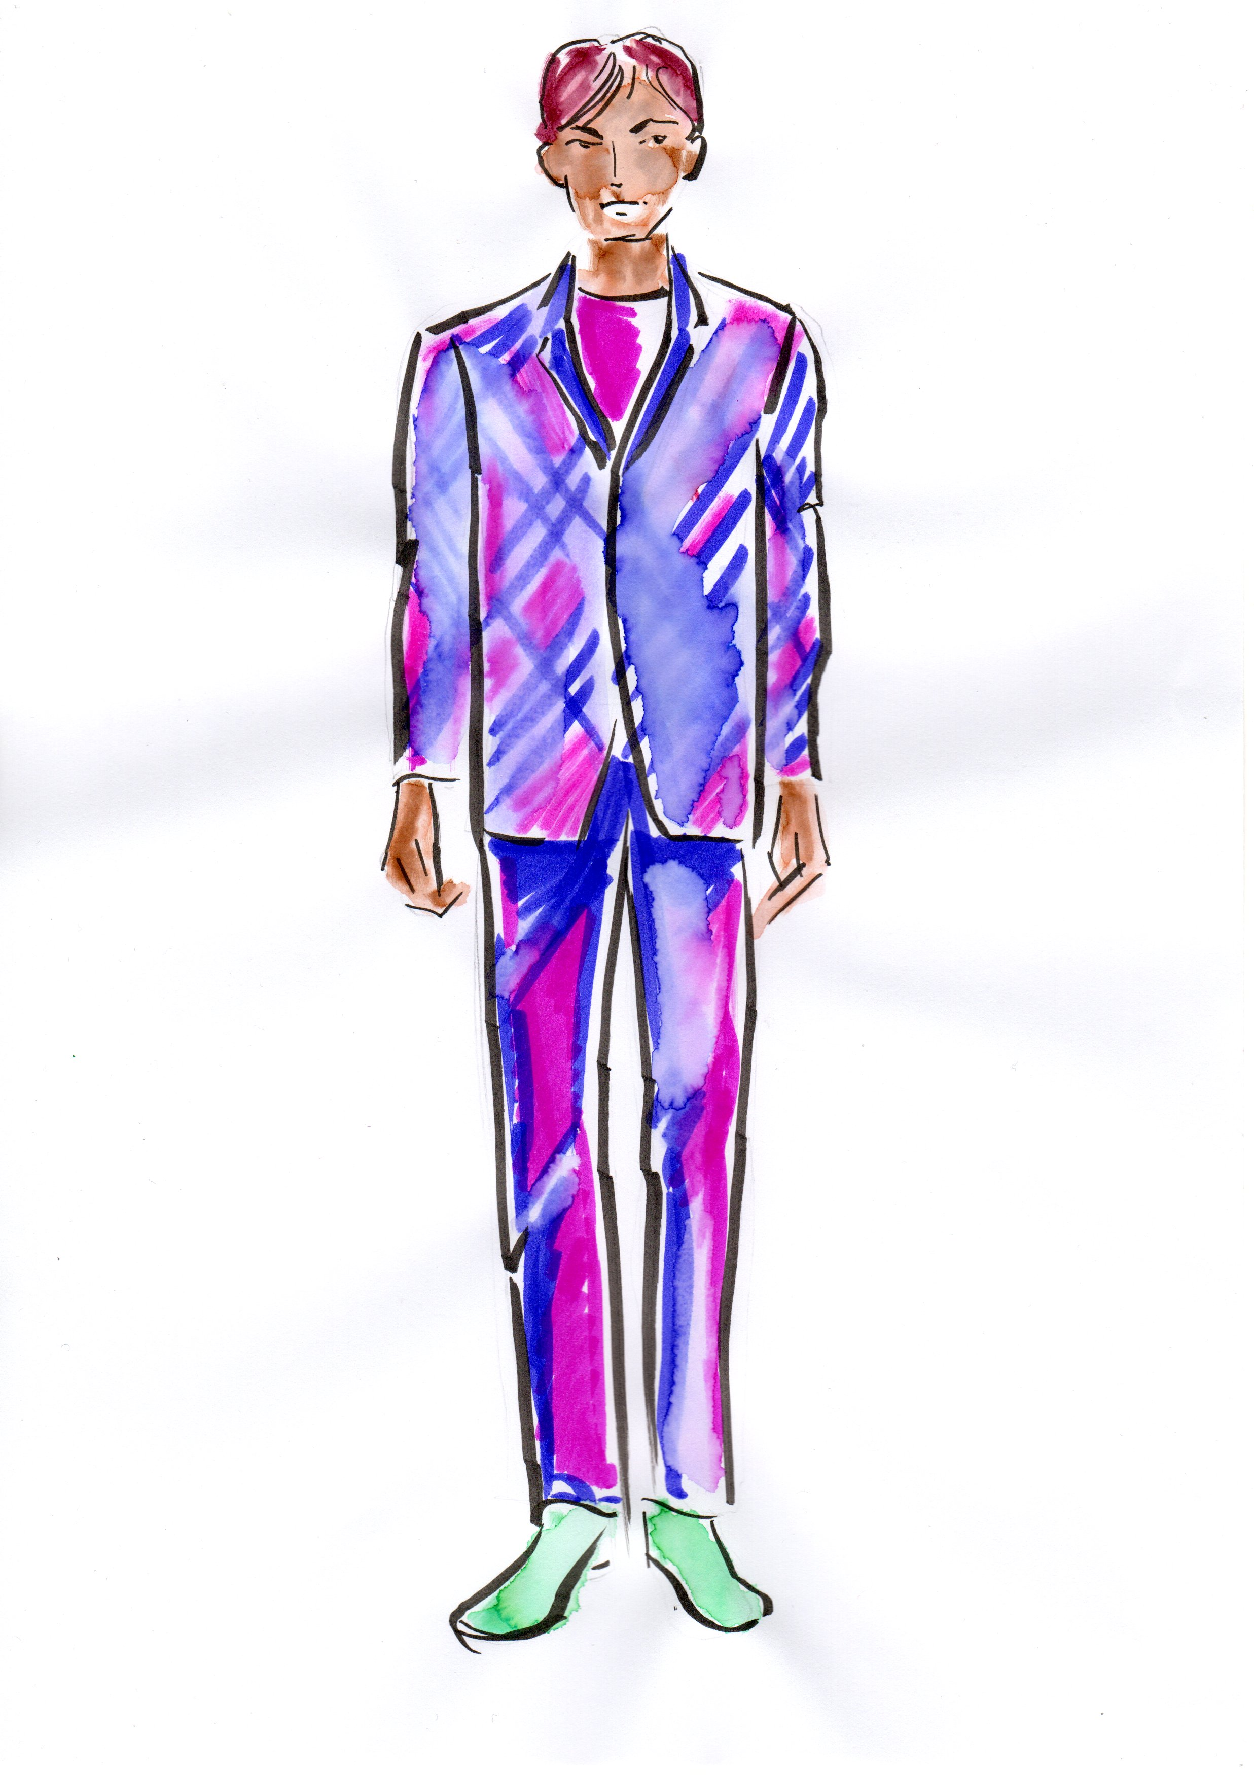
Men’s

