Slide 1
Basic Drawing:
Face, Hair Style
Drawing ways

Slide 2
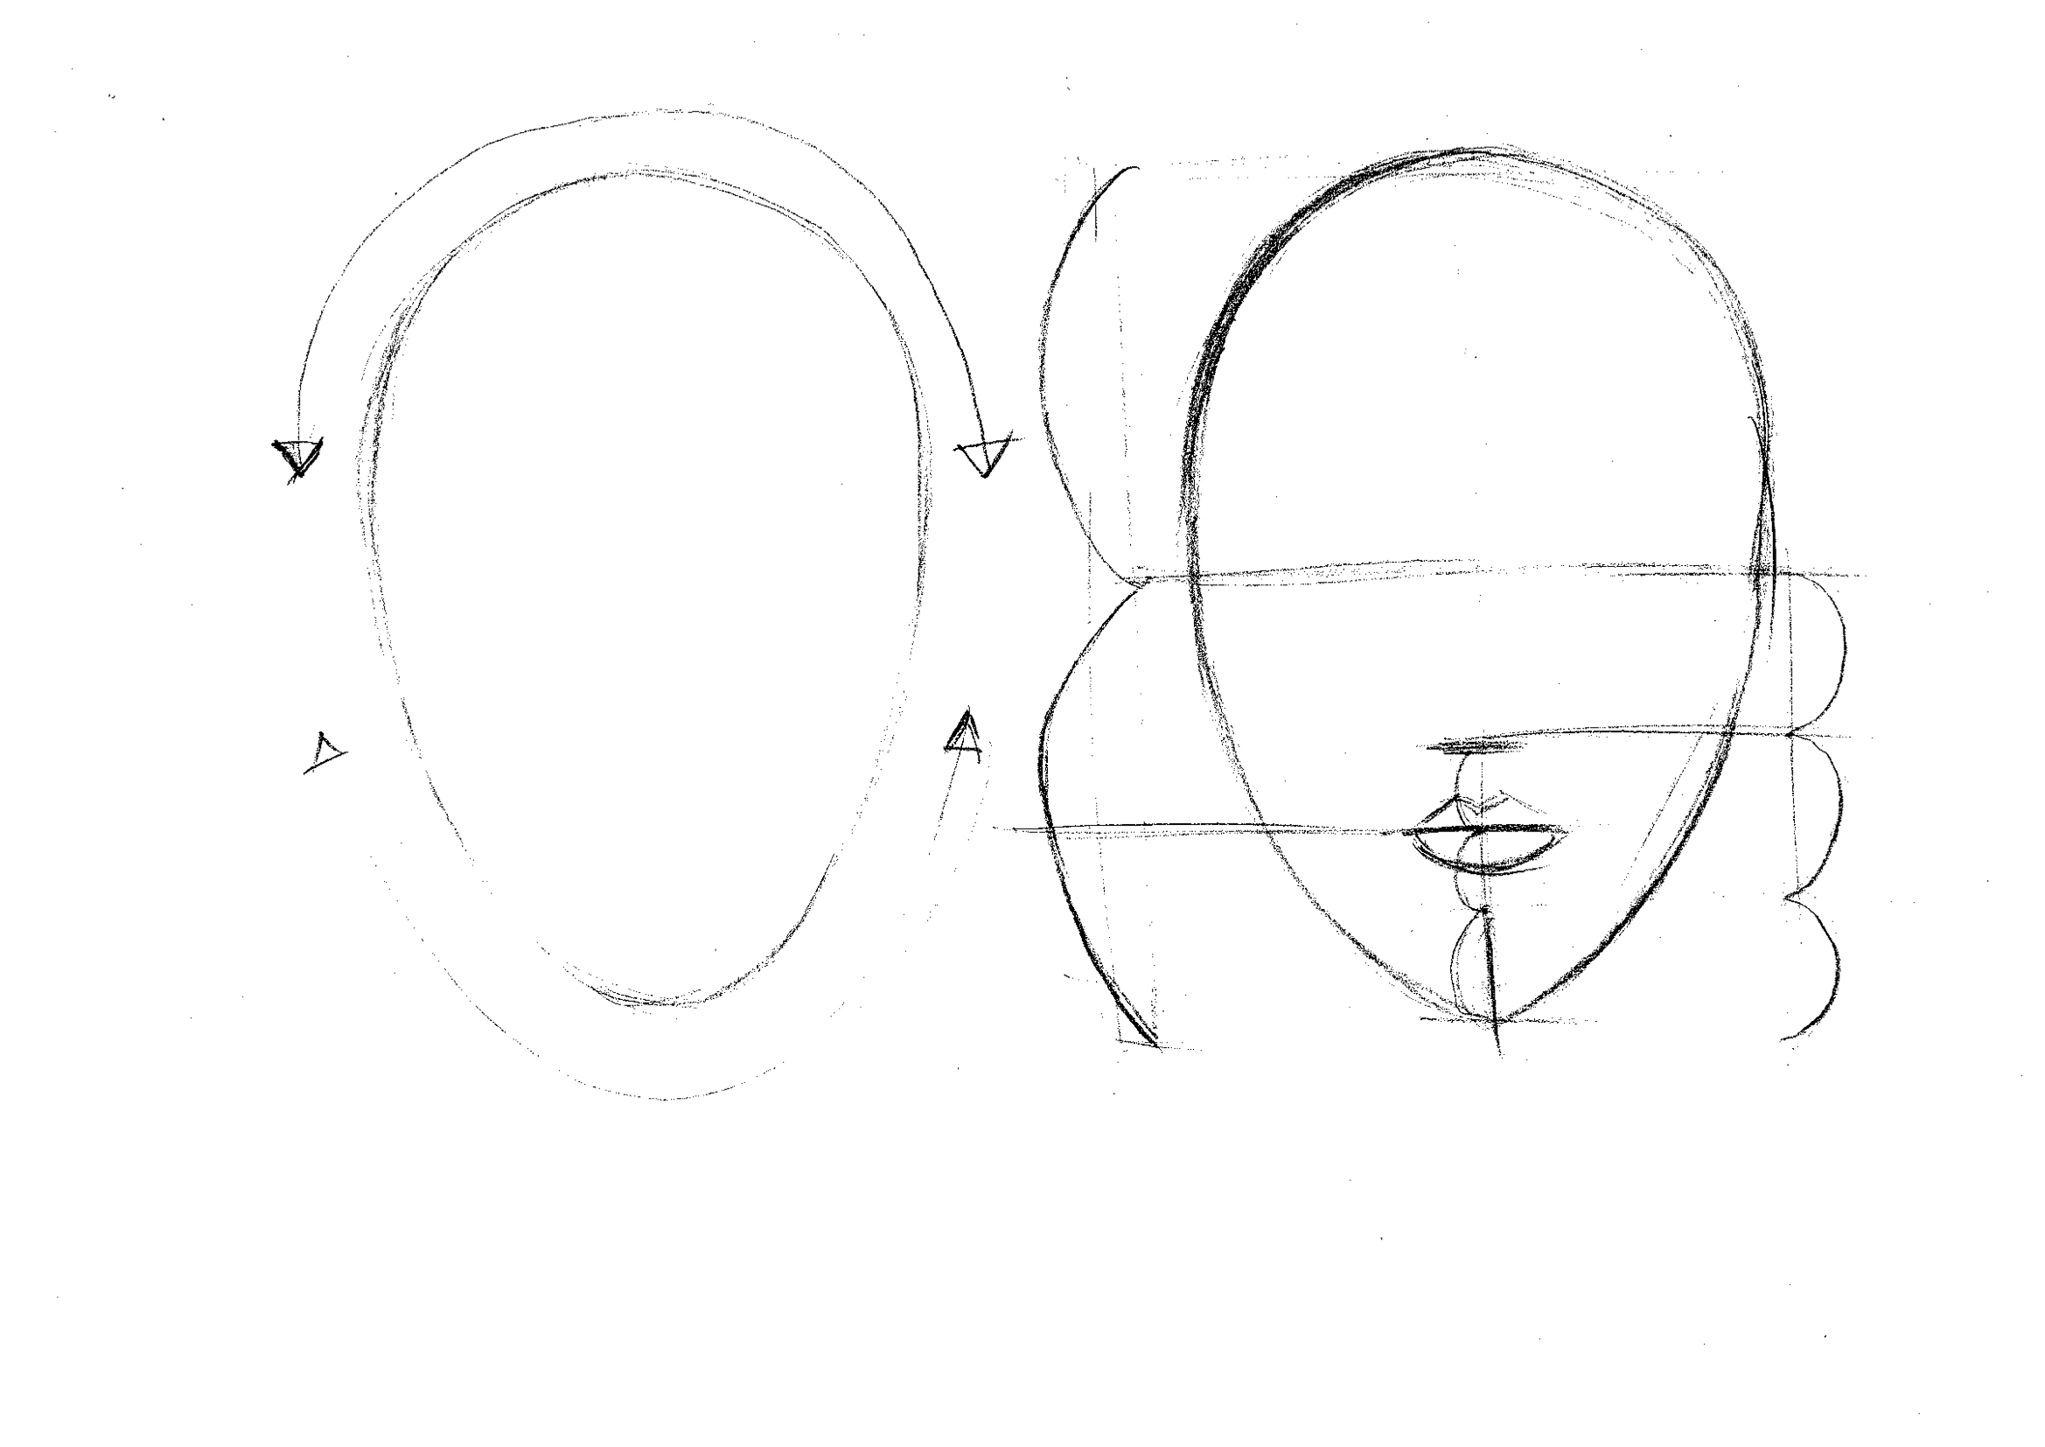
Front
1. Let’s draw an egg shape lightly.
Upper side is round,
lower side is little bit pointed around a chin.
2. Let’s draw an eye line
at ½ of a head.
3. Divide the space between eye line
and chin line into 3 parts,
then make a nose position from top little bit lower than the line at 1/3.
4. Divide the space between a nostril position and chin into 3 parts. 1/3 position from the top will be a lip line which is between upper and lower lips.
Eye Line
Nose
Lip Line

Slide 3
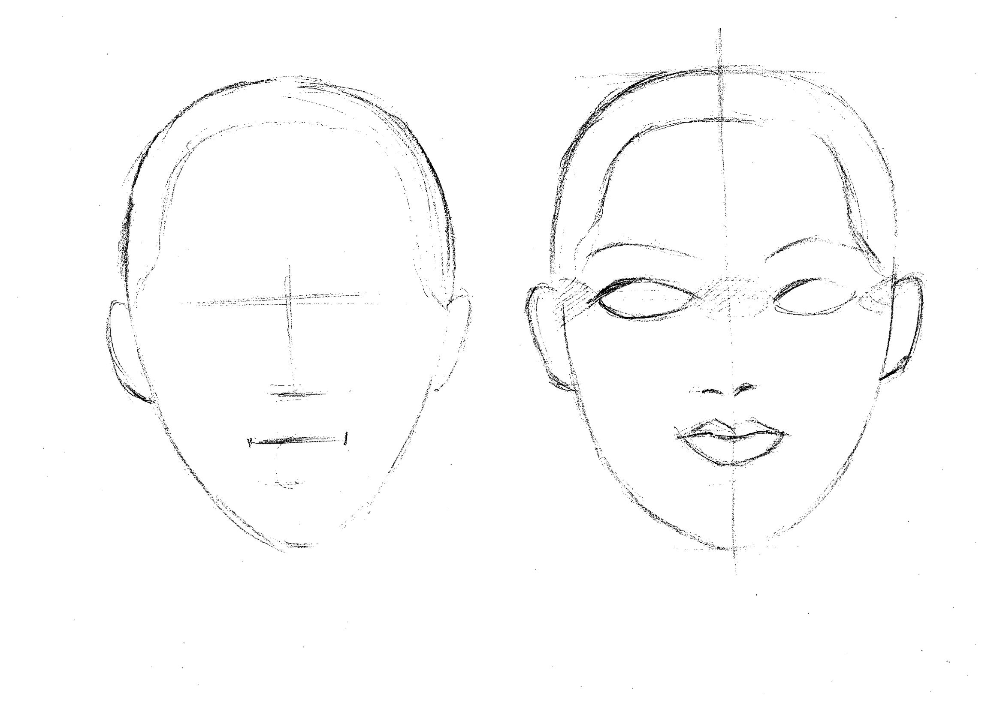
Front
5. On eye line draw an ear.
6. Then draw a hairline.
7. Draw eyes on eye line. (There should be a space of an eye between eyes).
8. Draw a nose (express nose in a simple form).
9. Draw lips. (Lips are one of charm points. Let’s research a form)

Slide 4
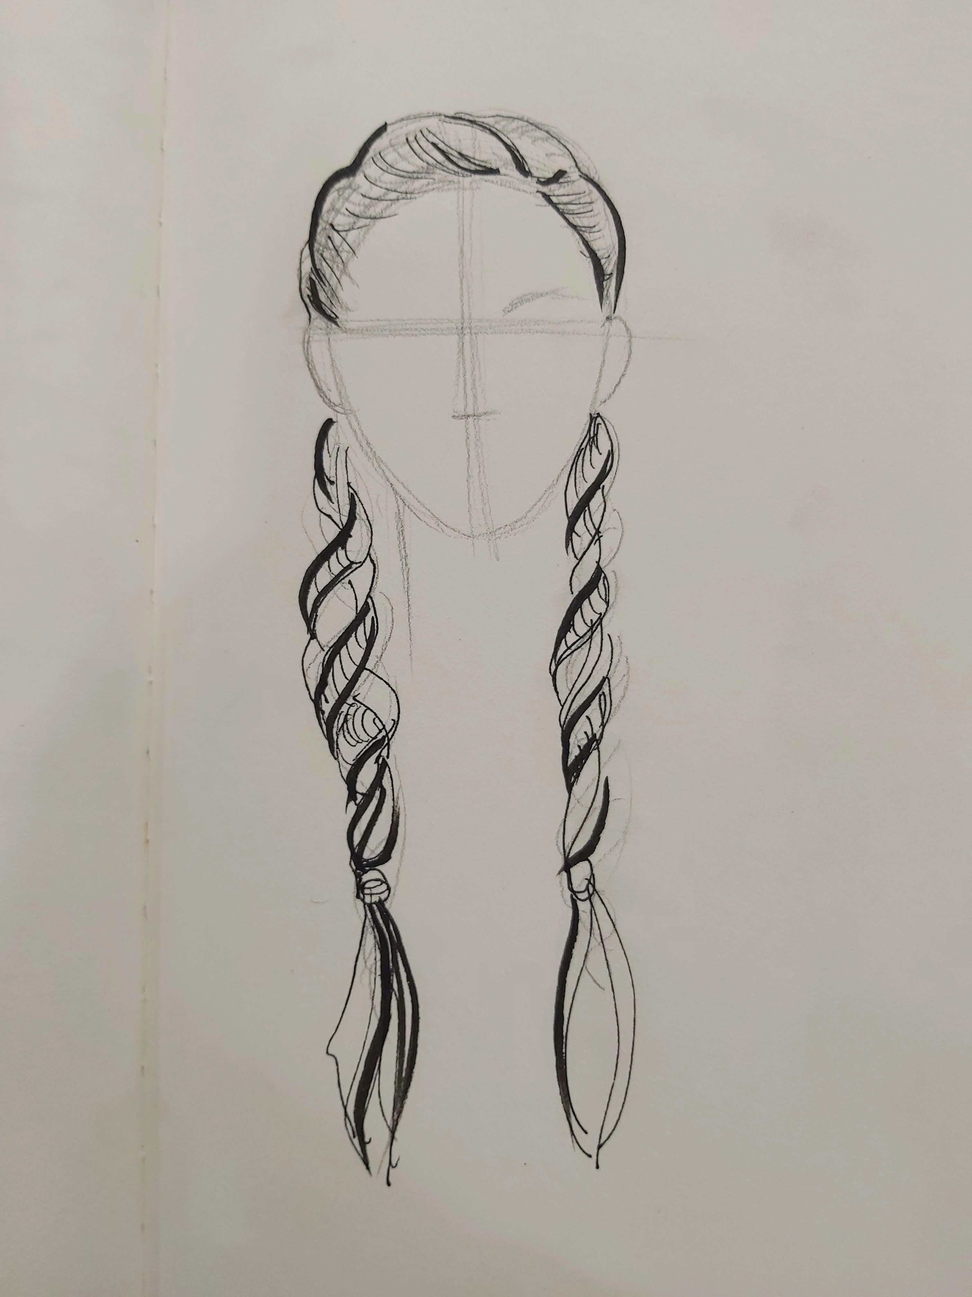
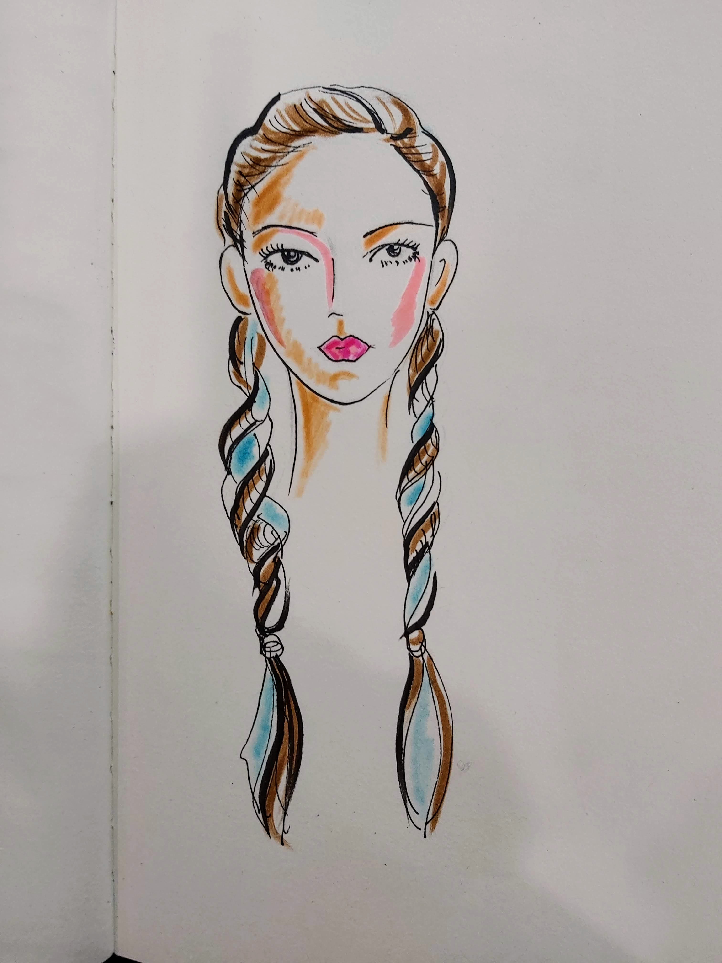
Hair Style
Hair style, together with clothing design becomes an important point to express a trend.
Always try to catch a new image.
Drawing points
Notice the form of the bangs. (When all hair is up, draw a hairline)

Slide 5
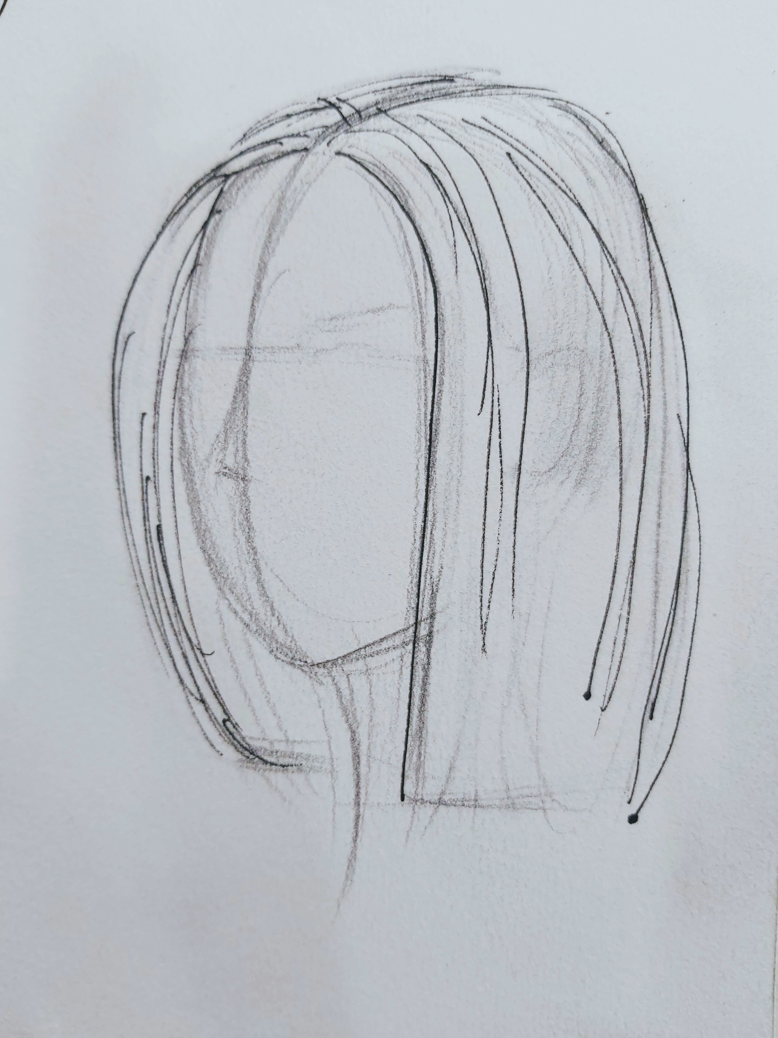
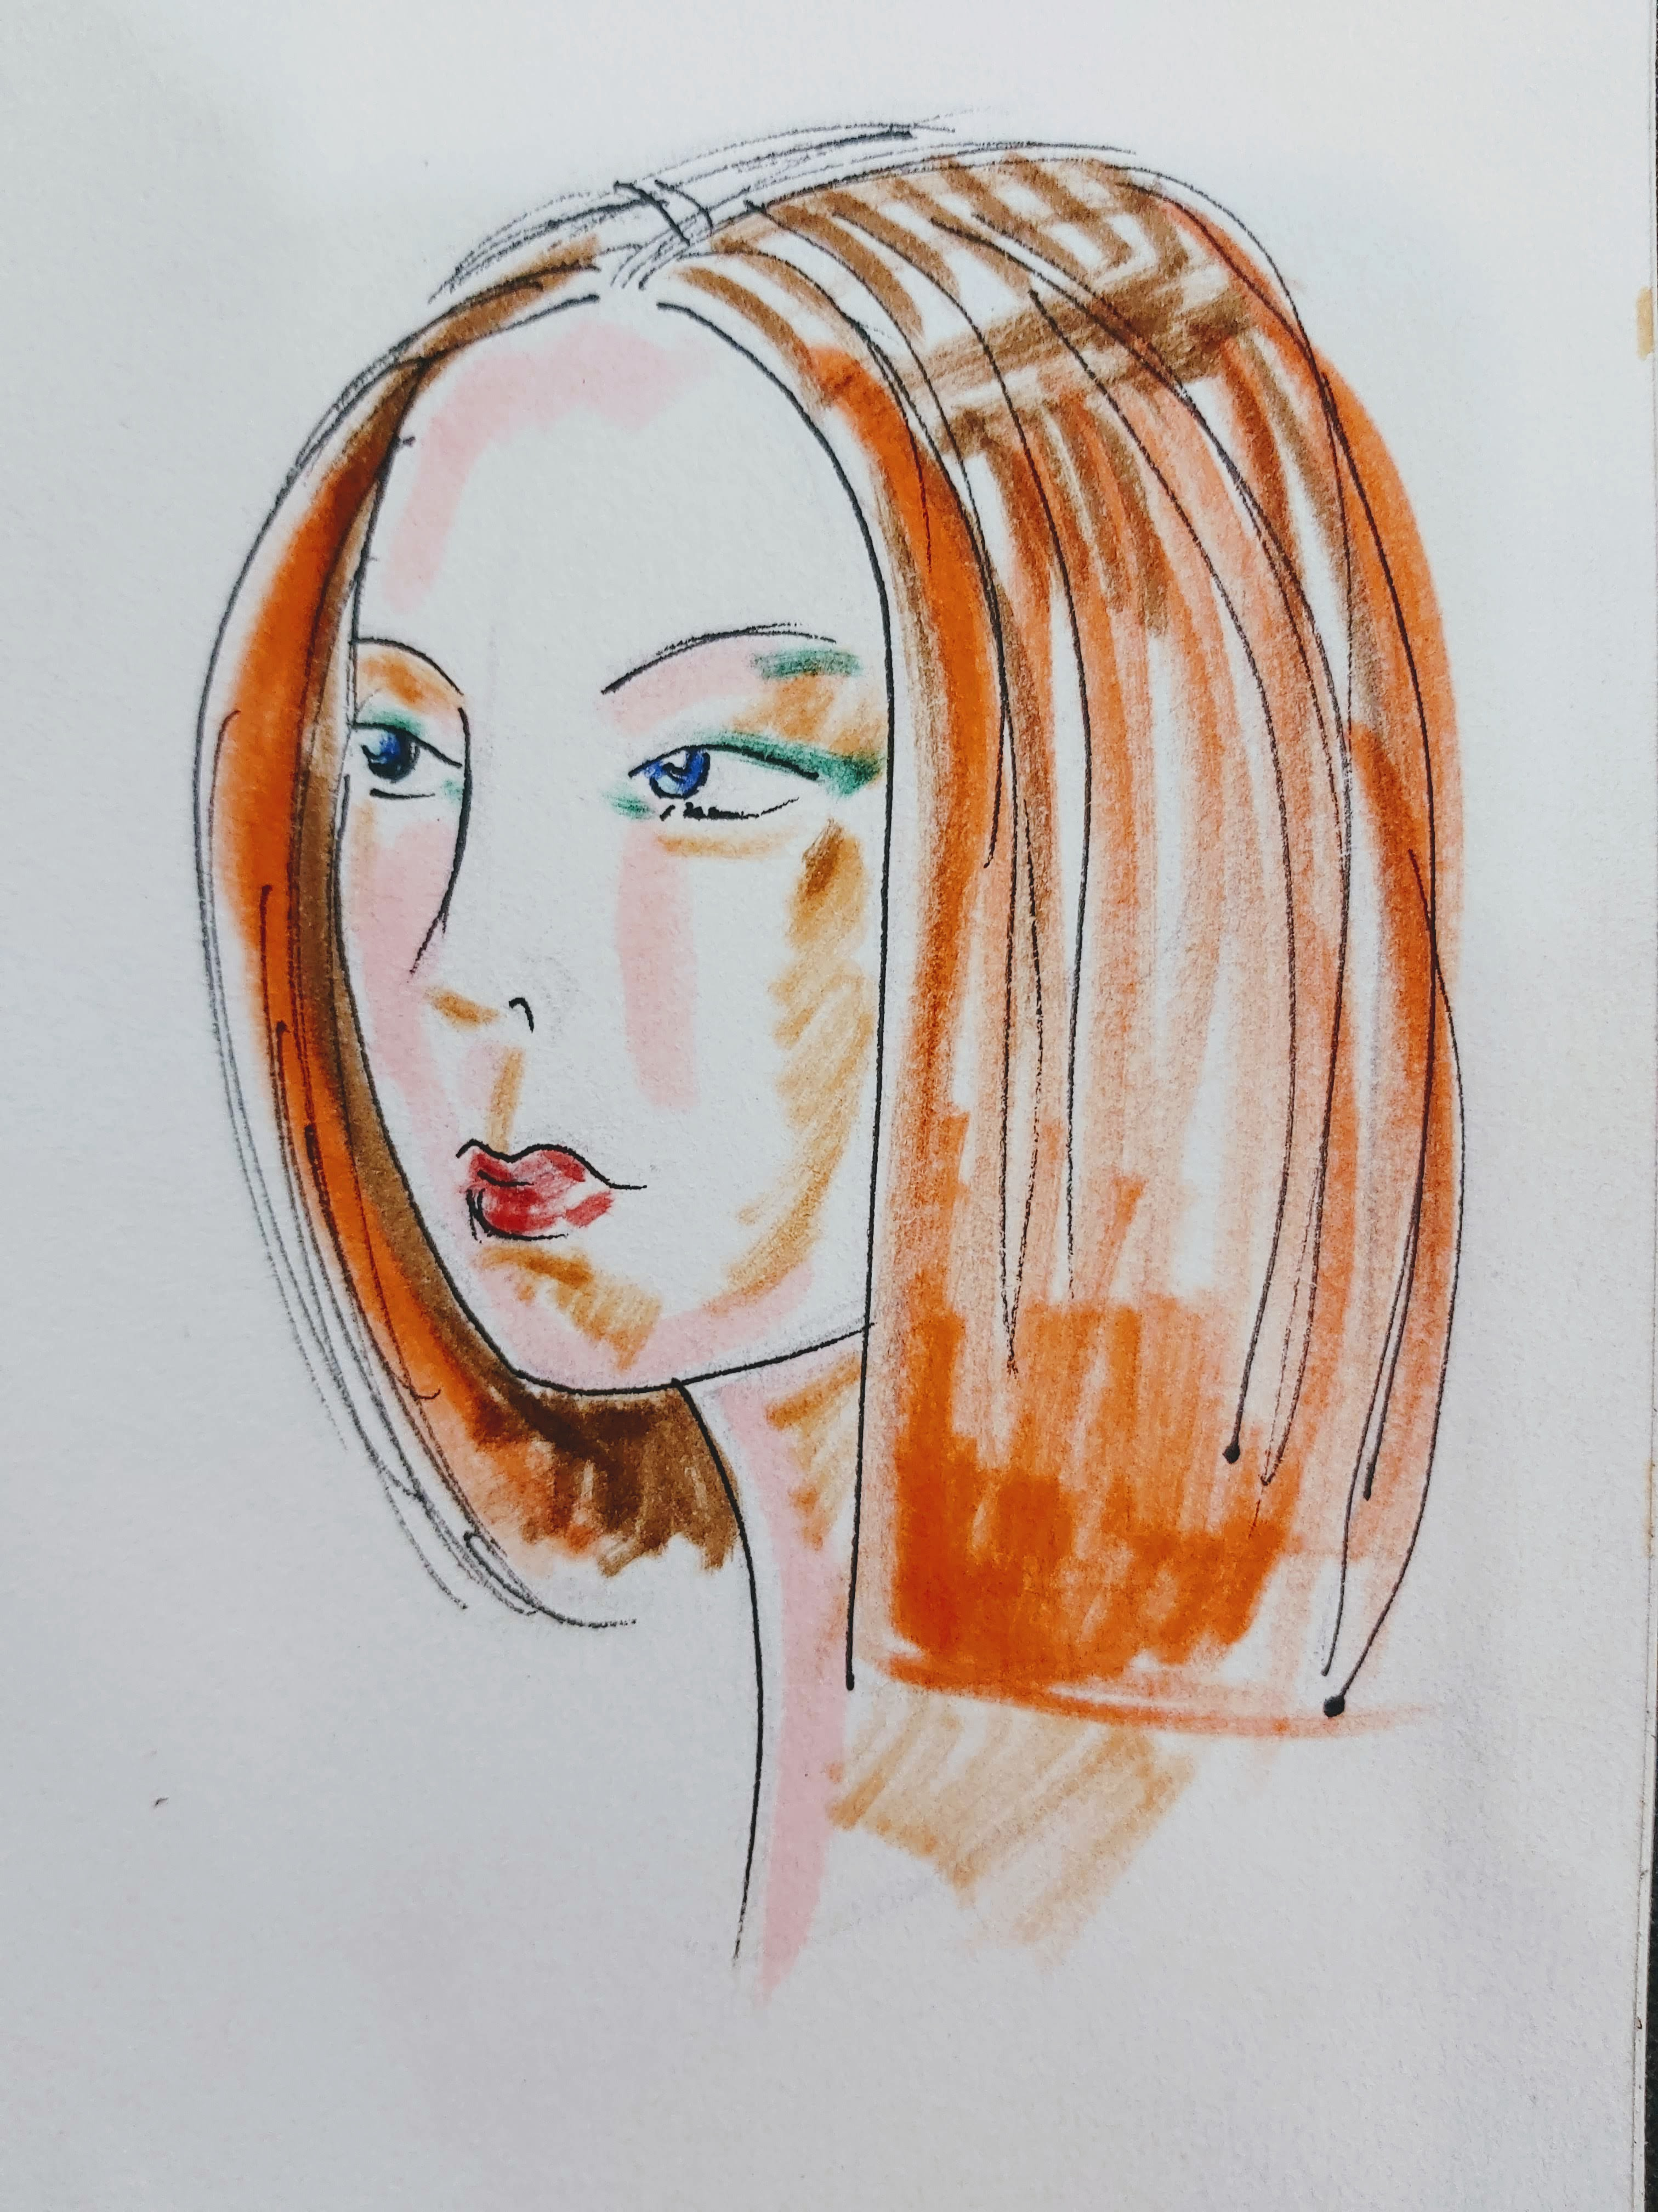
Hair Style
Draw in a silhoutte.

Slide 6
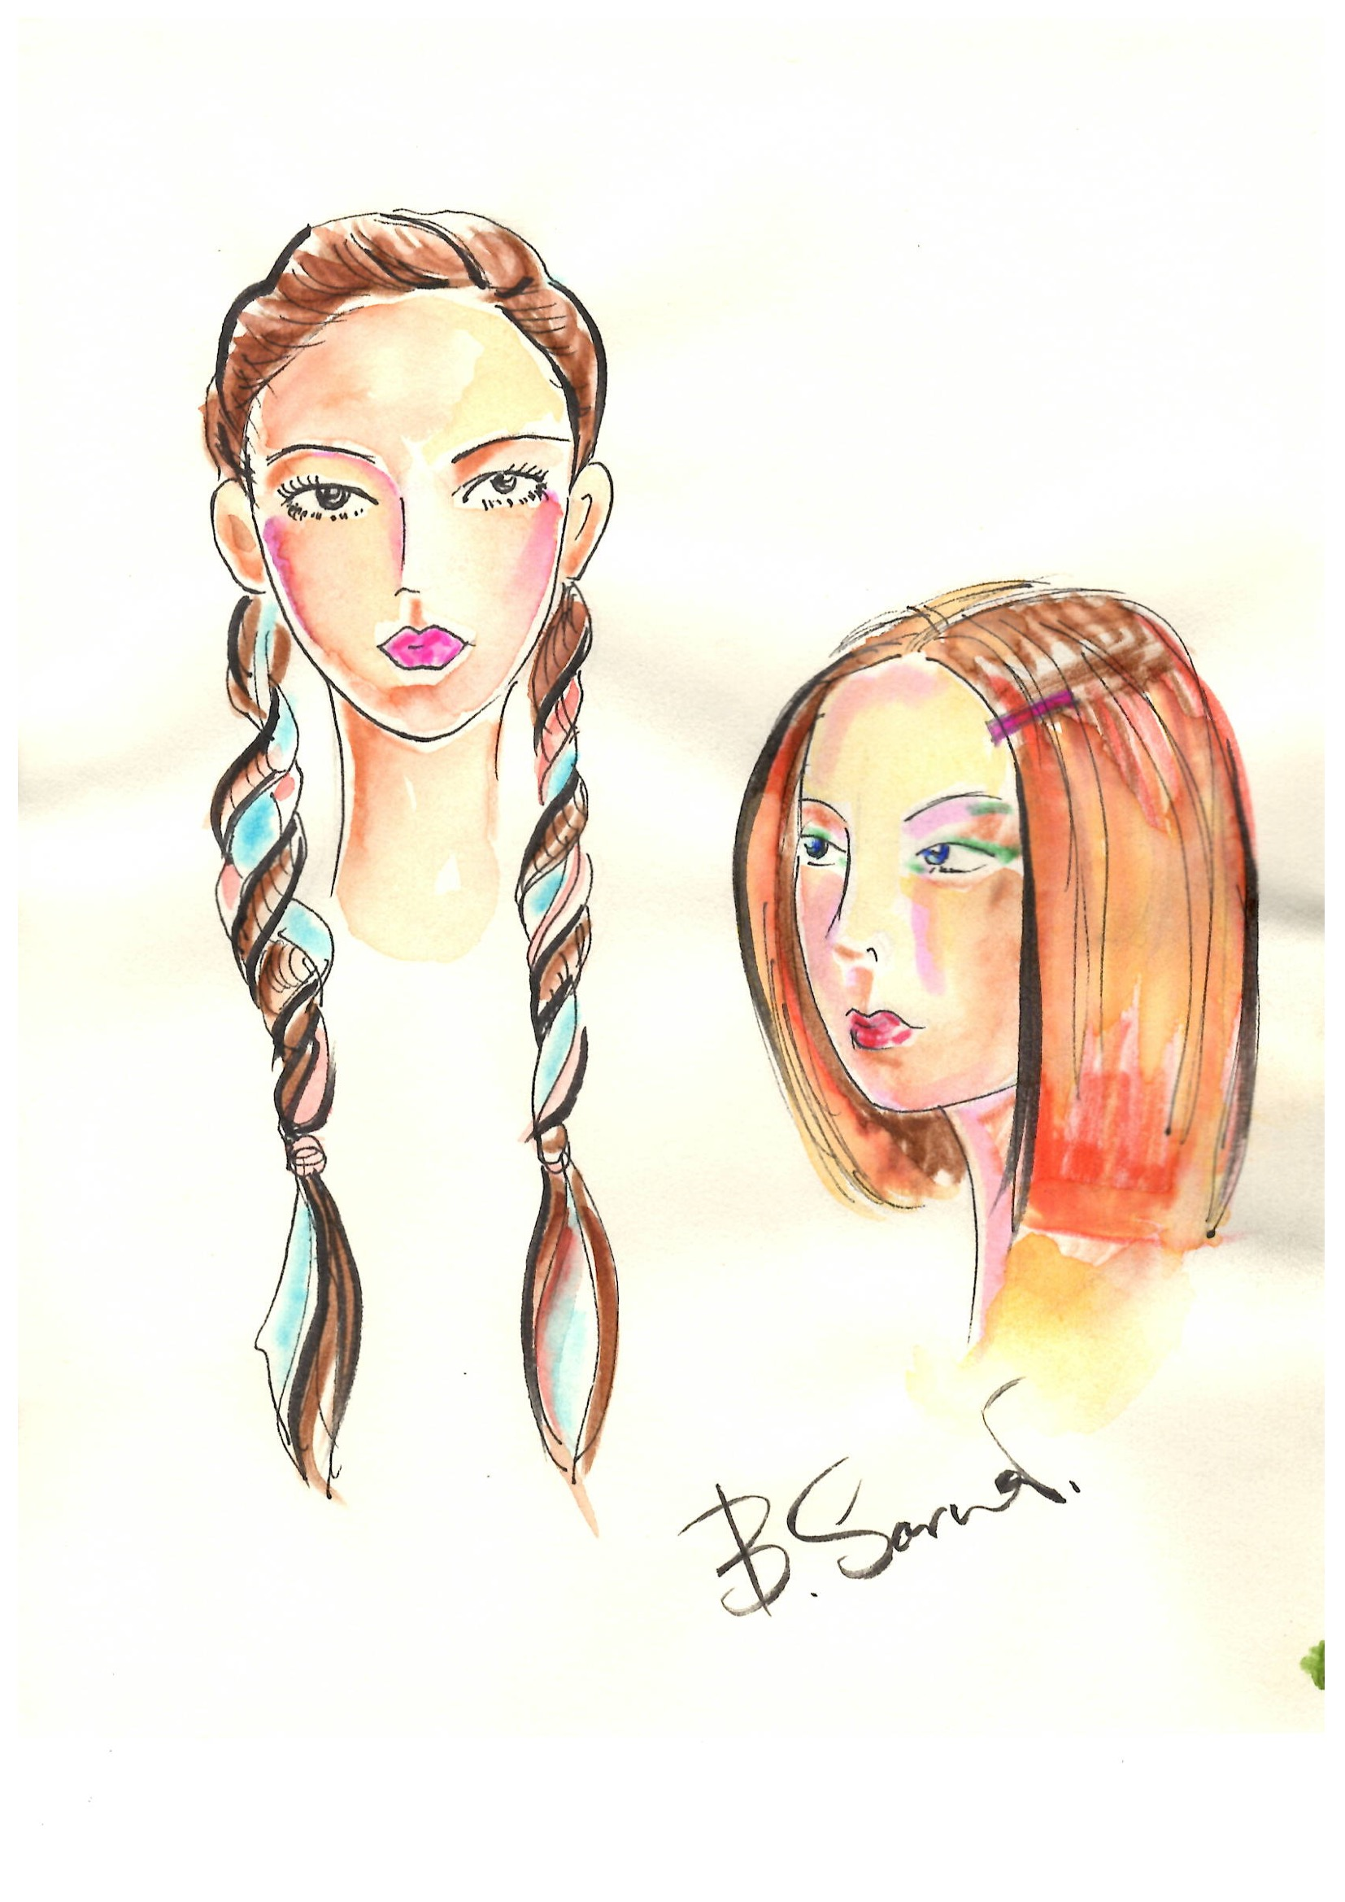
Hair Style
When drawing a flow of hair, it’s good enough to draw several hair.

Slide 7
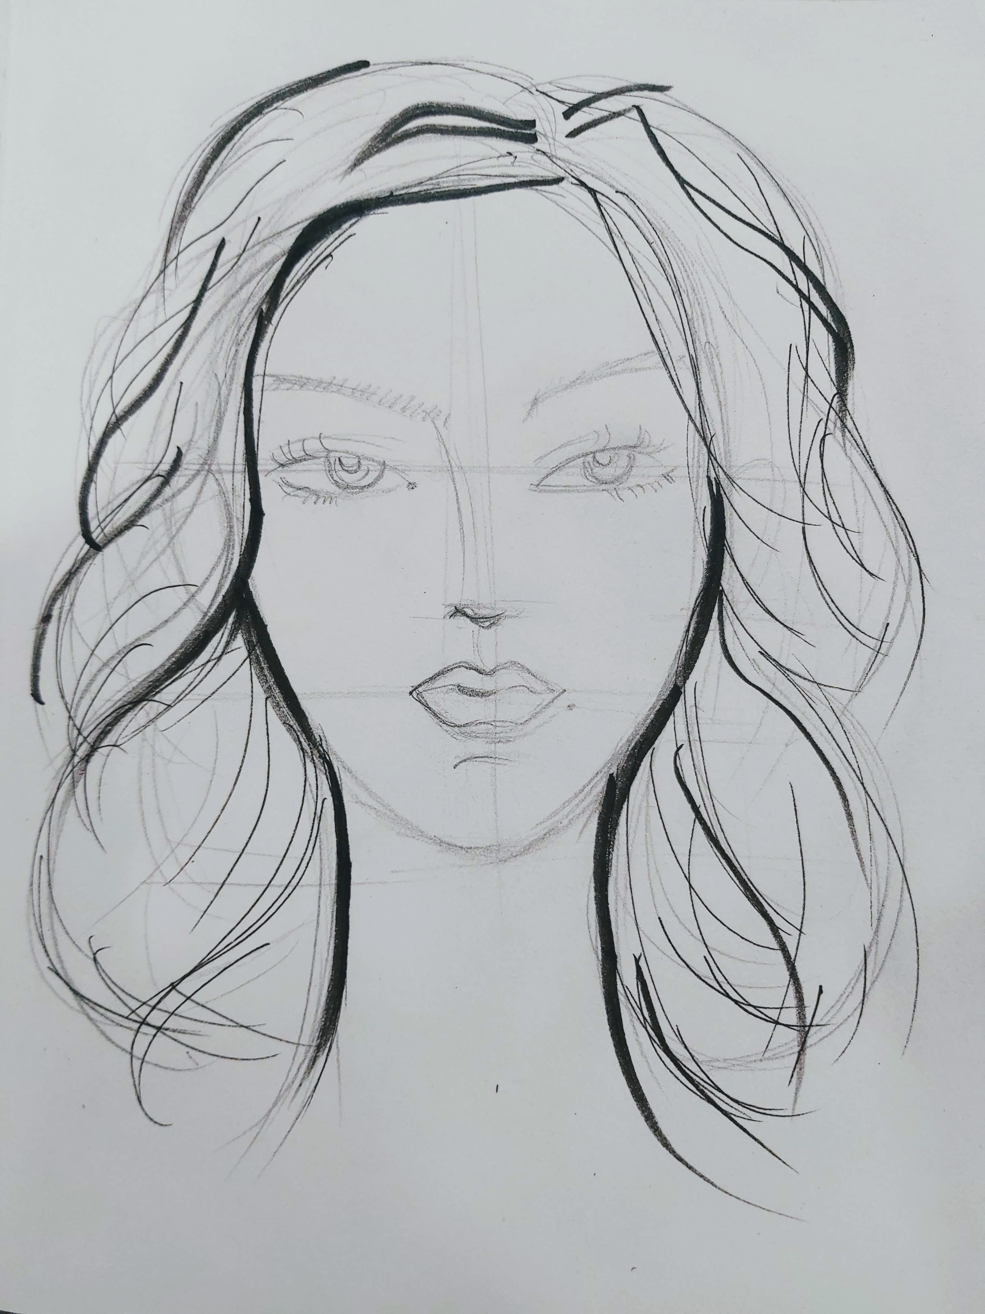
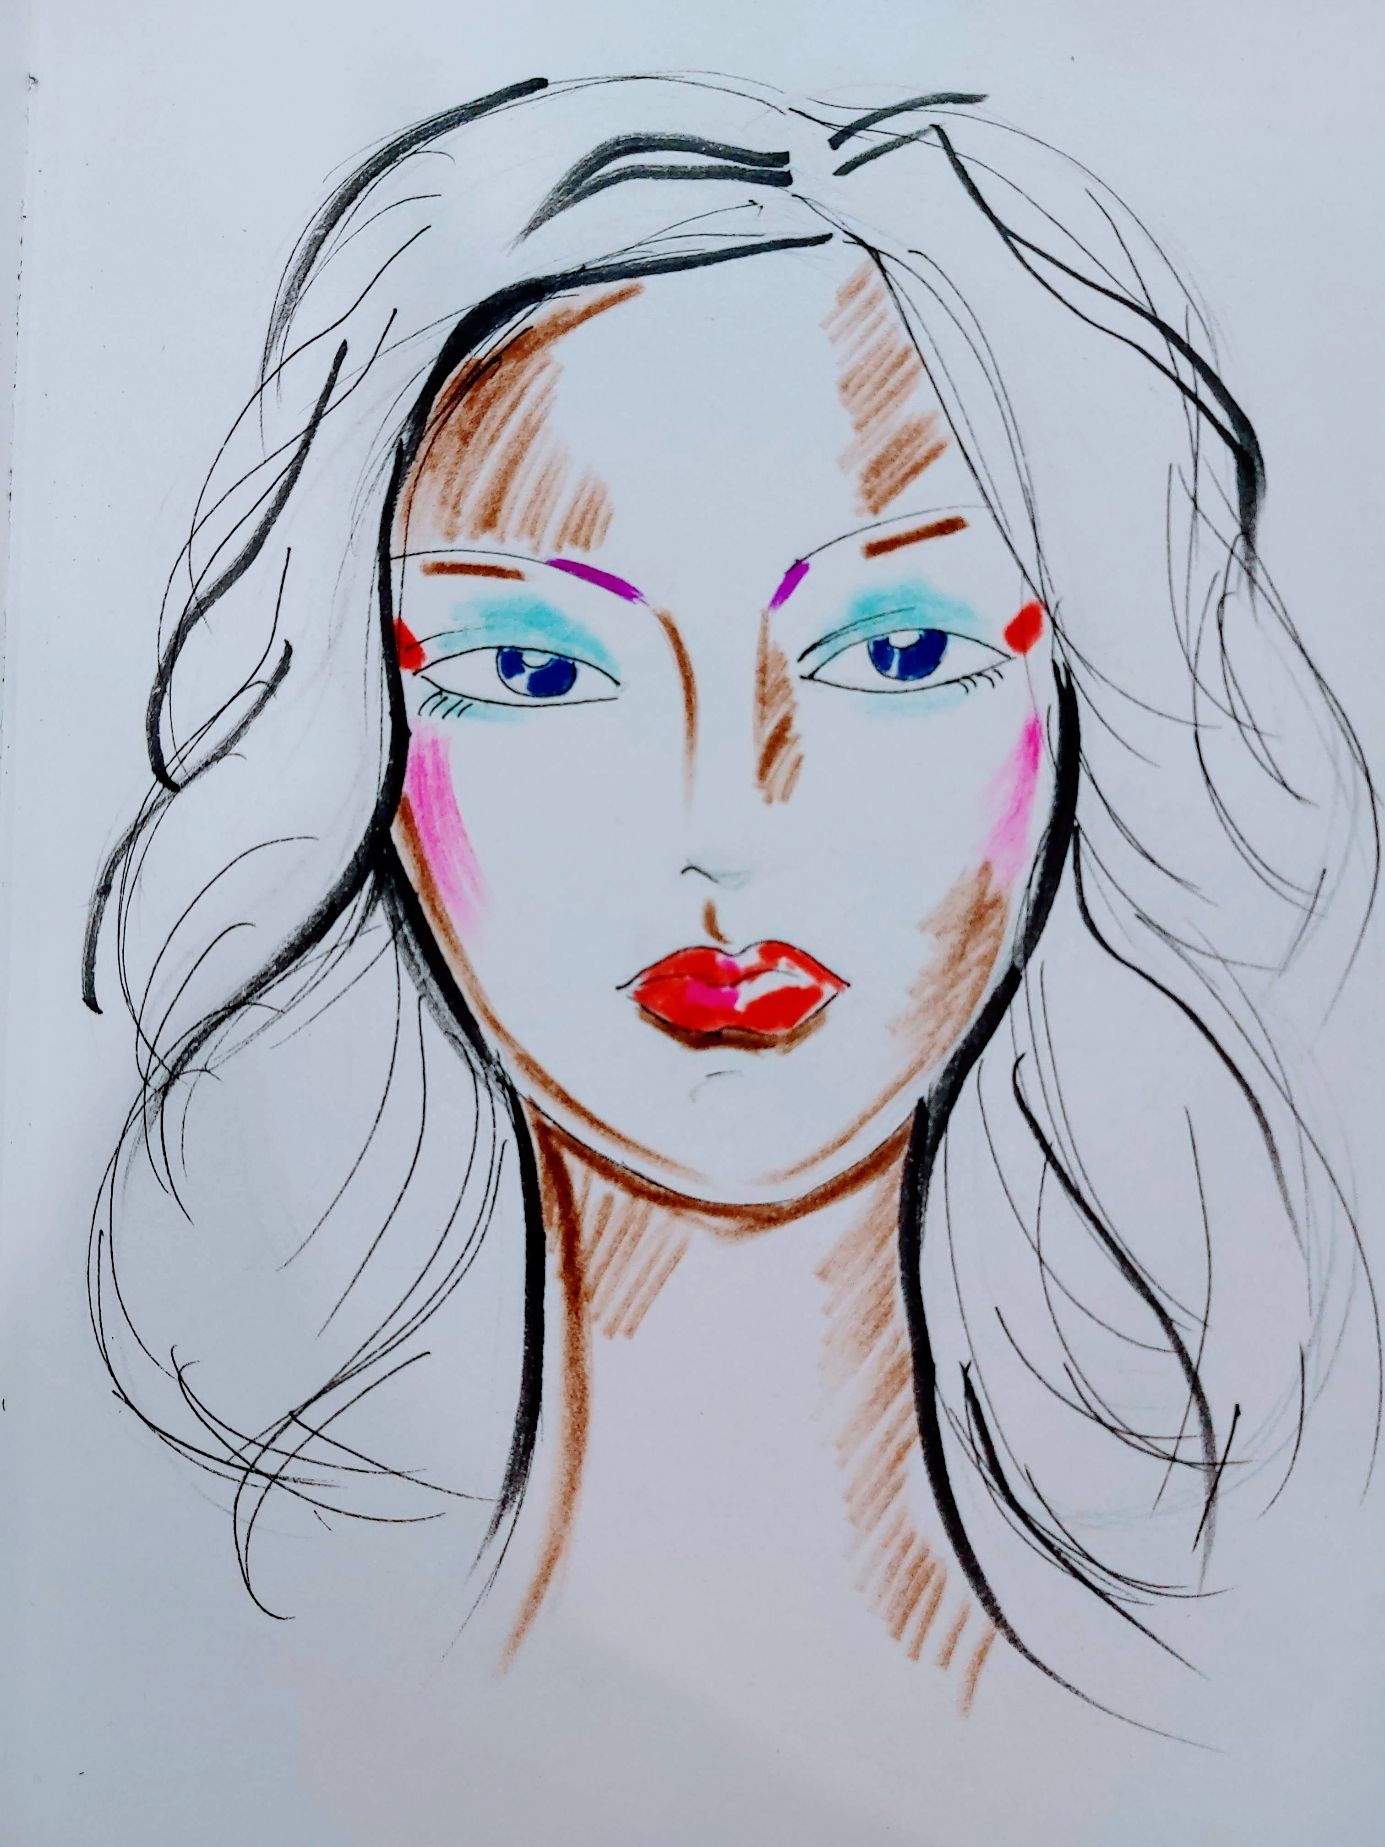

Slide 8
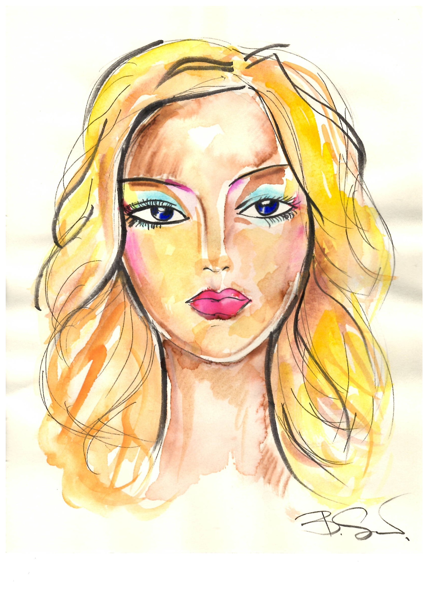
Hair Style
When you draw a face and hair in Fashion Design Illustration it’s enough to just make an image.

