Slide 1
Basic Drawing:
Feet, shoes, pose variation

Slide 2
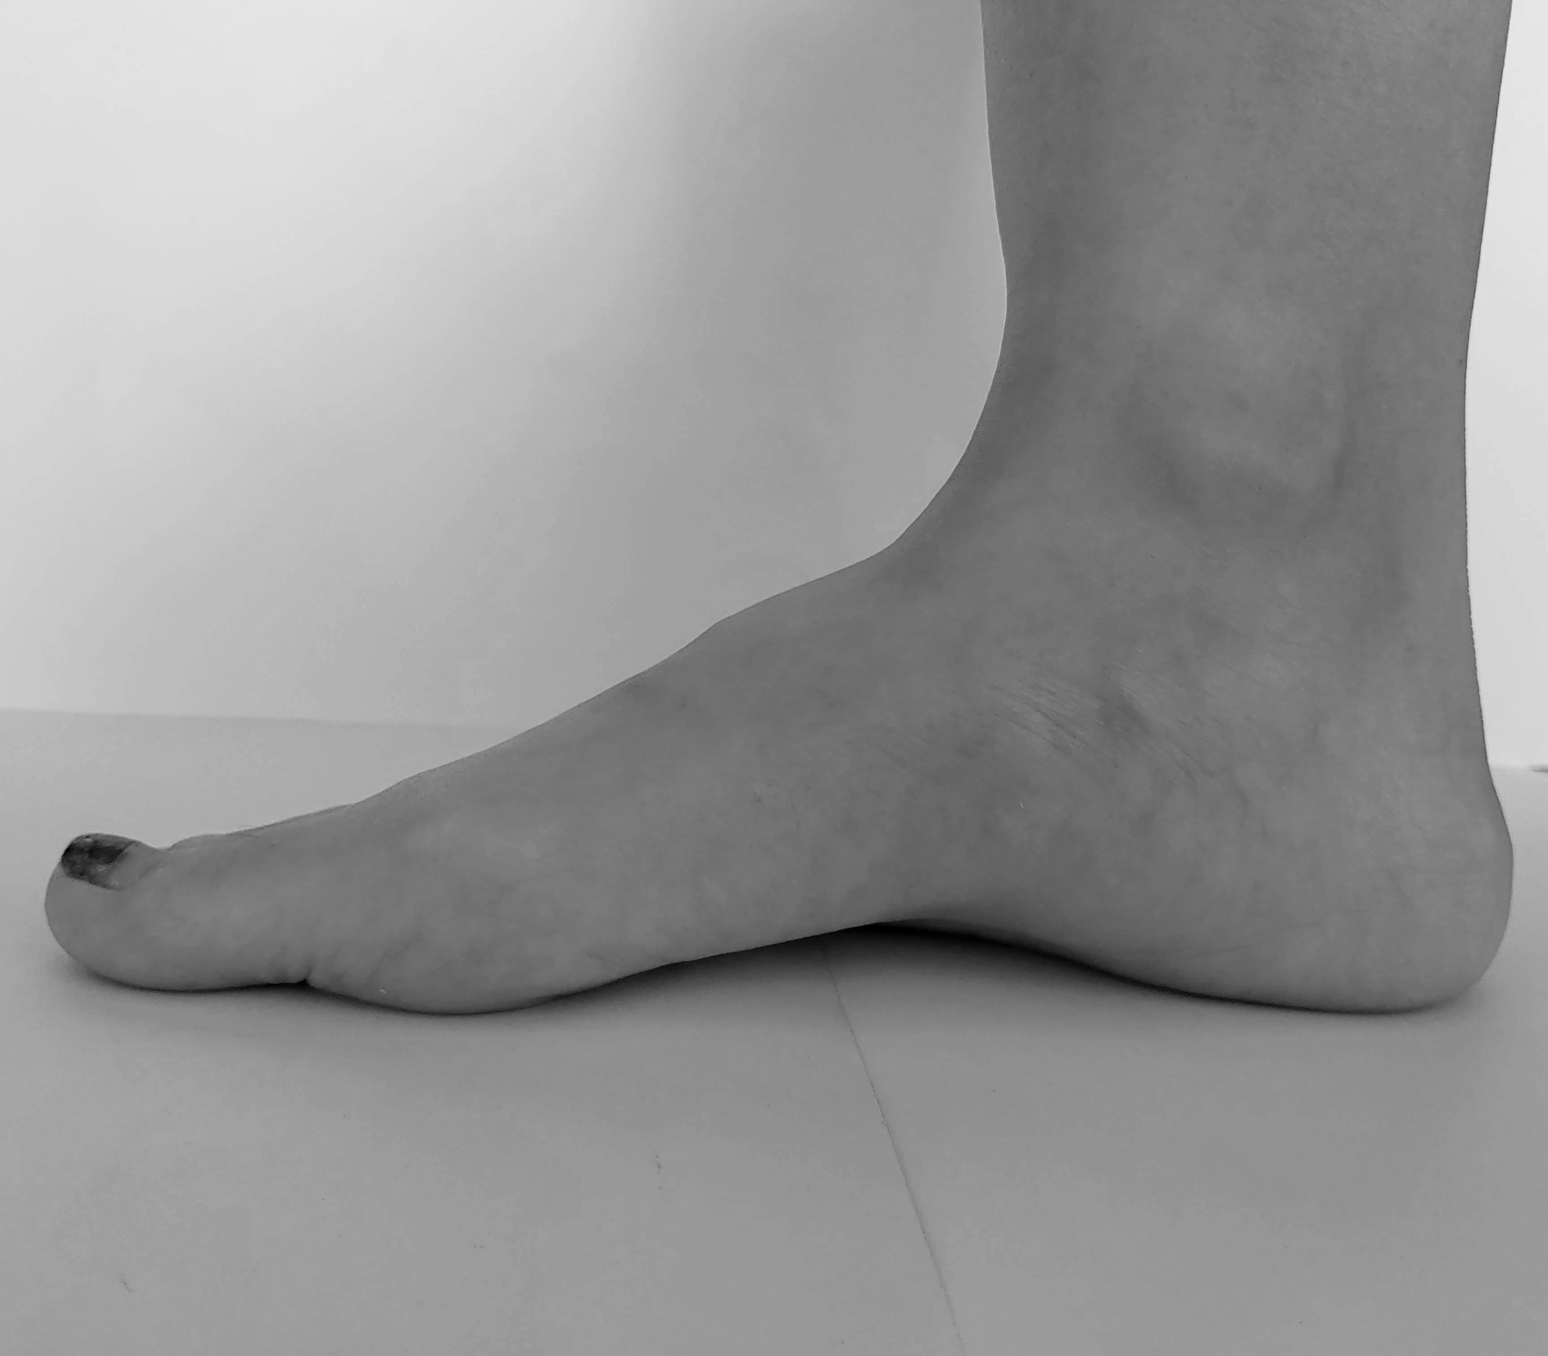
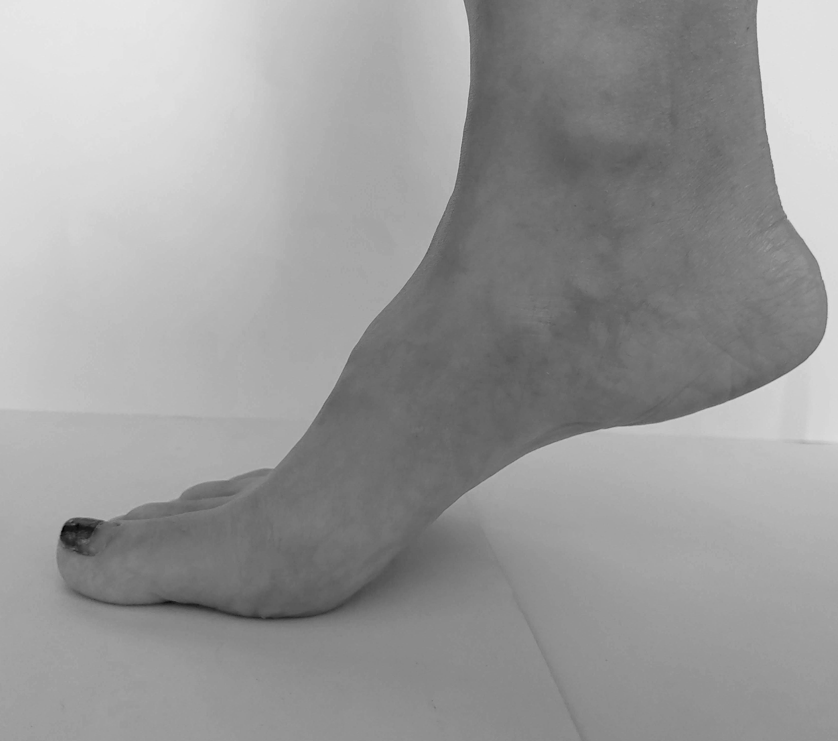
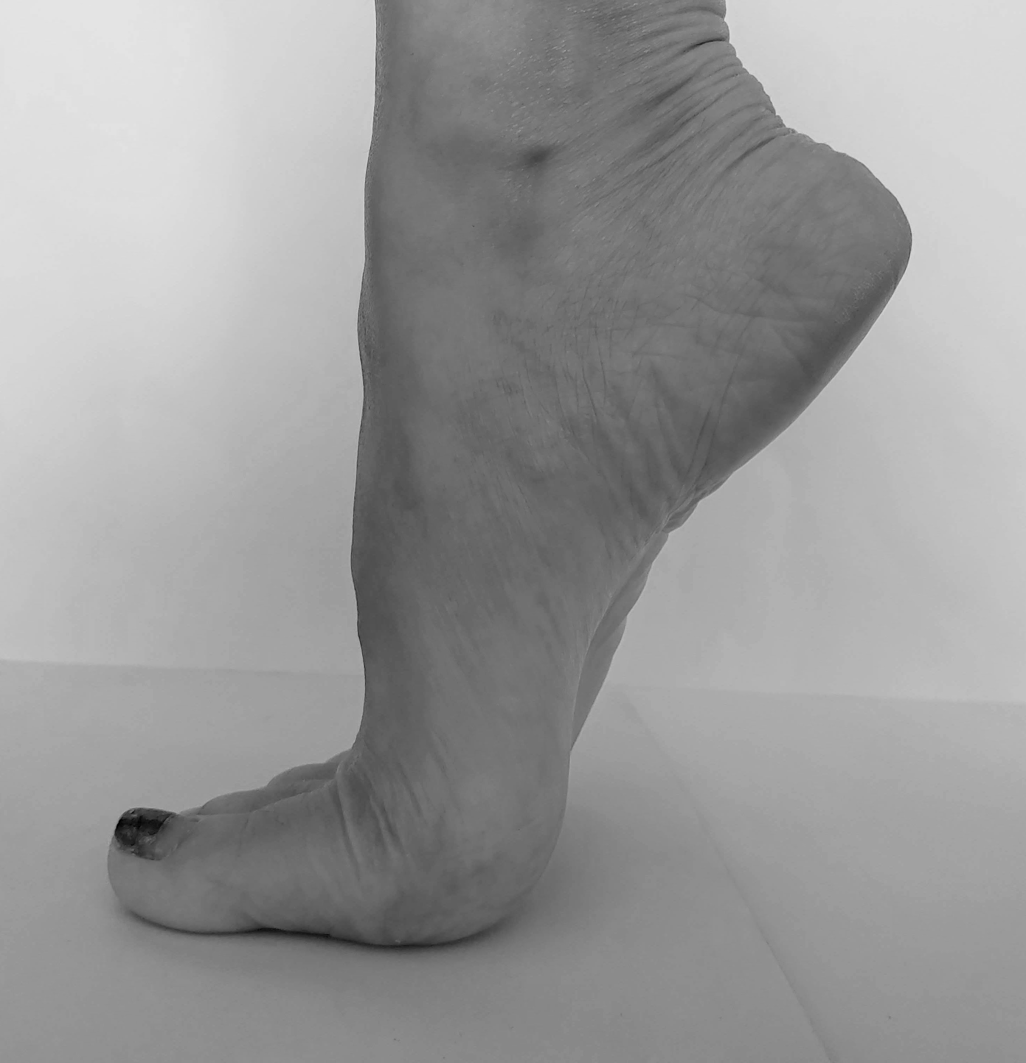
Basic: Foot
When you draw a naked foot imagine drawing a shoe.
Observe if the sole of a foot is attached to the ground,
or if toes are standing because of heels.

Slide 3
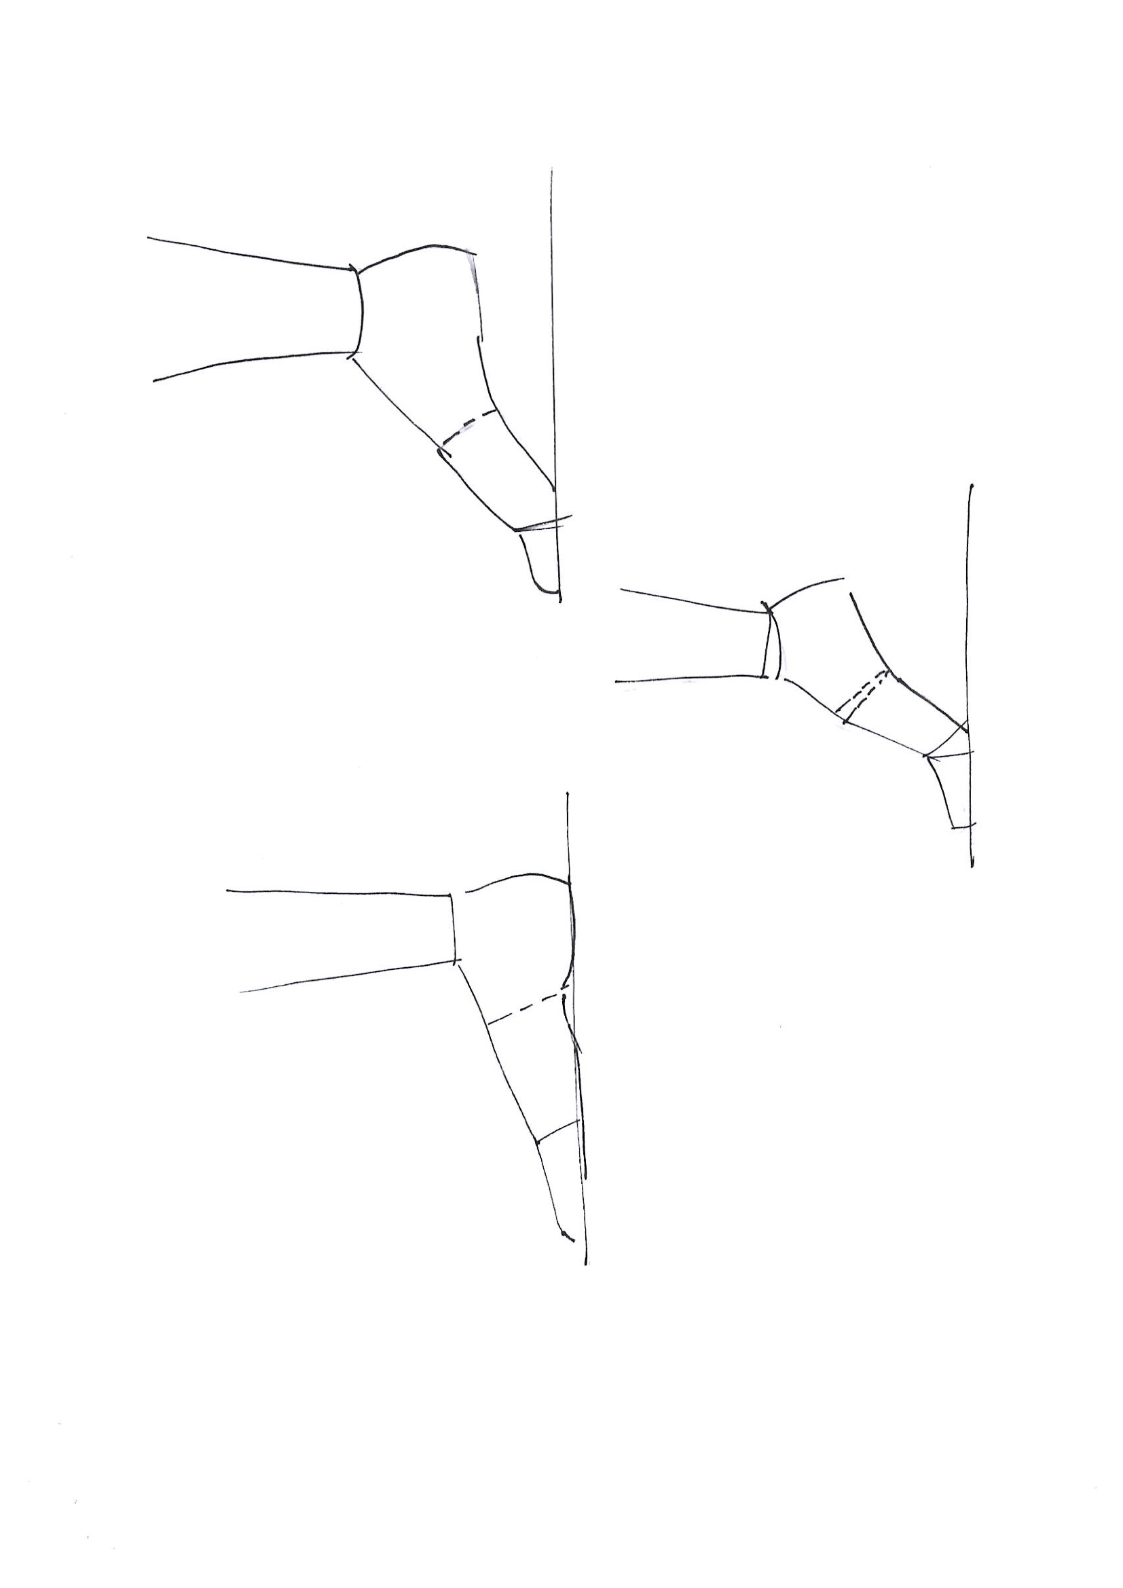
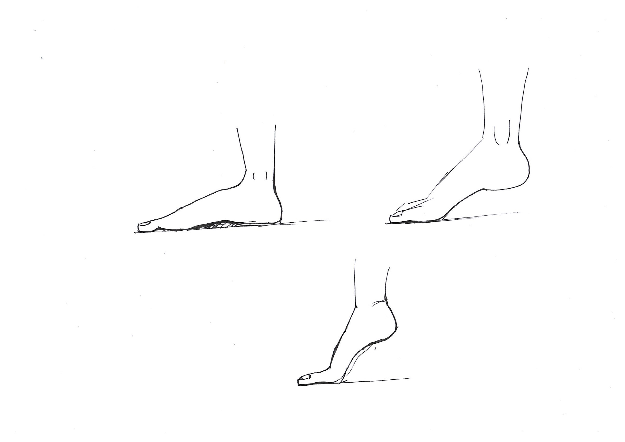
Basic: Foot

Slide 4
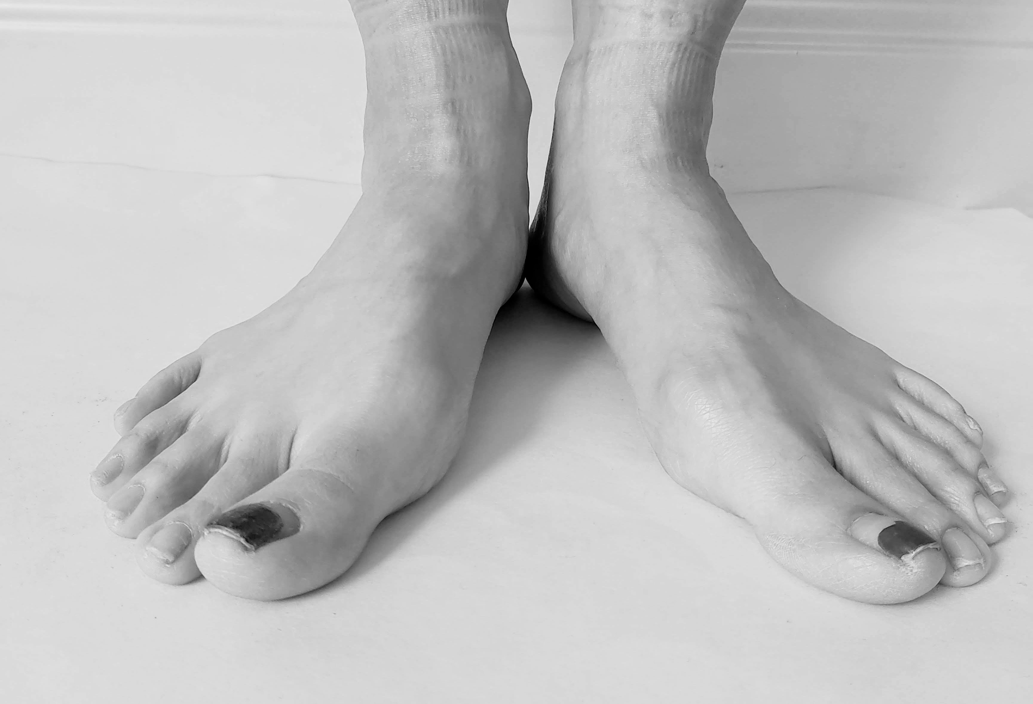
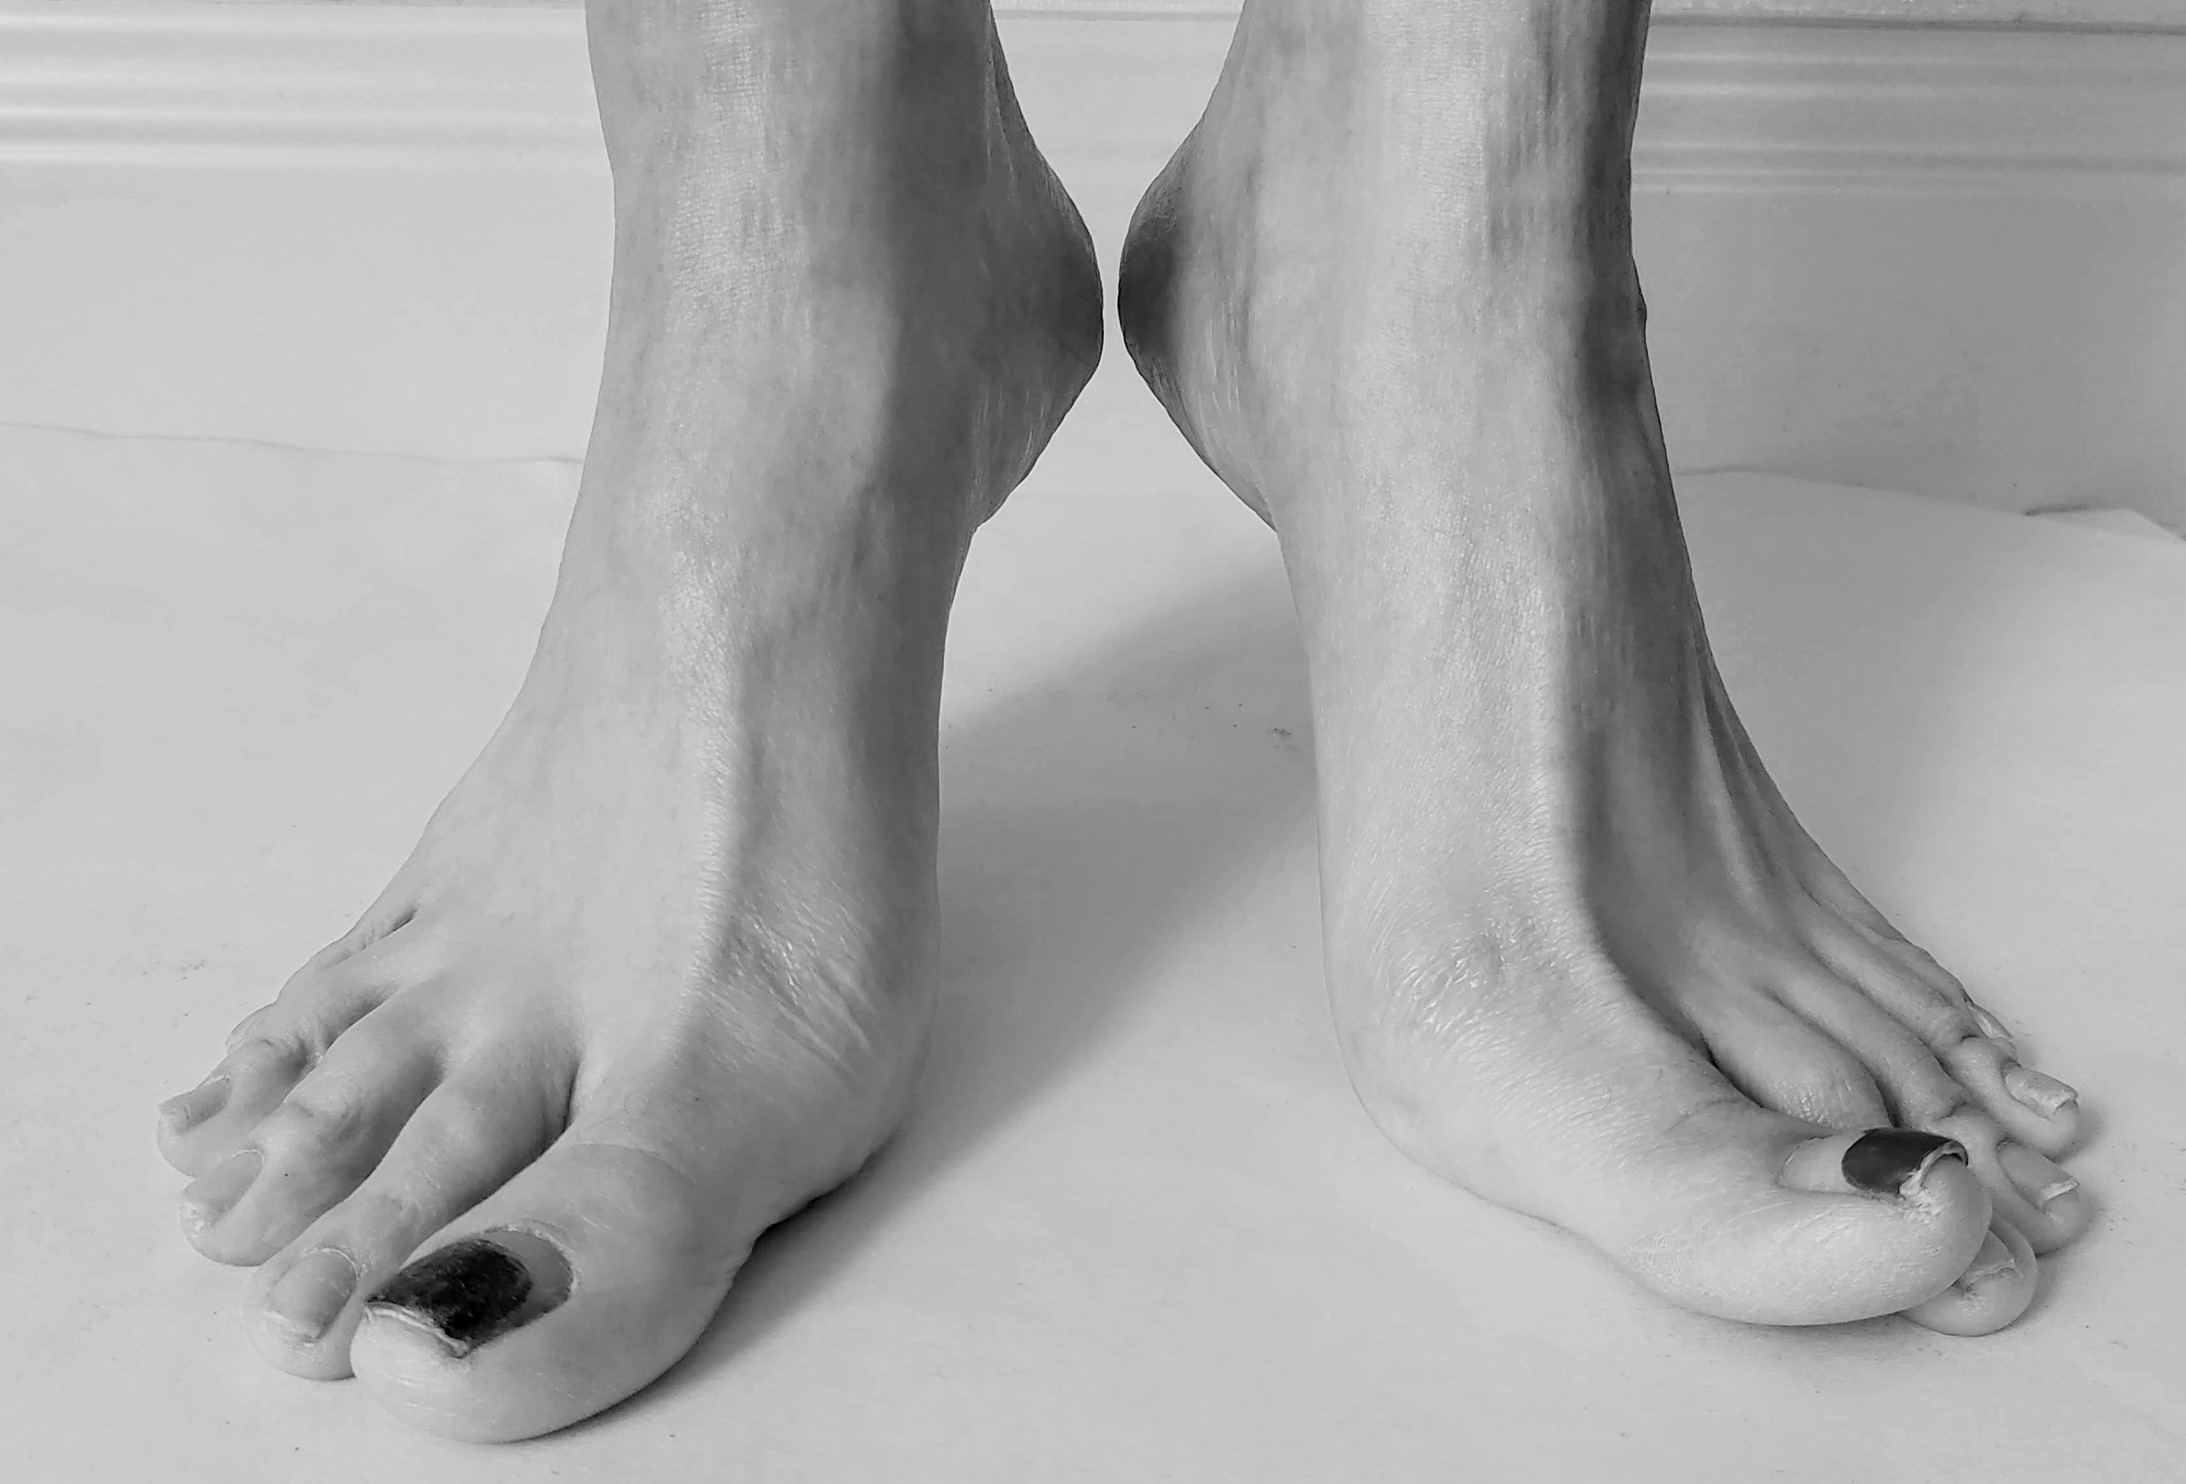
Basic: Foot

Slide 5
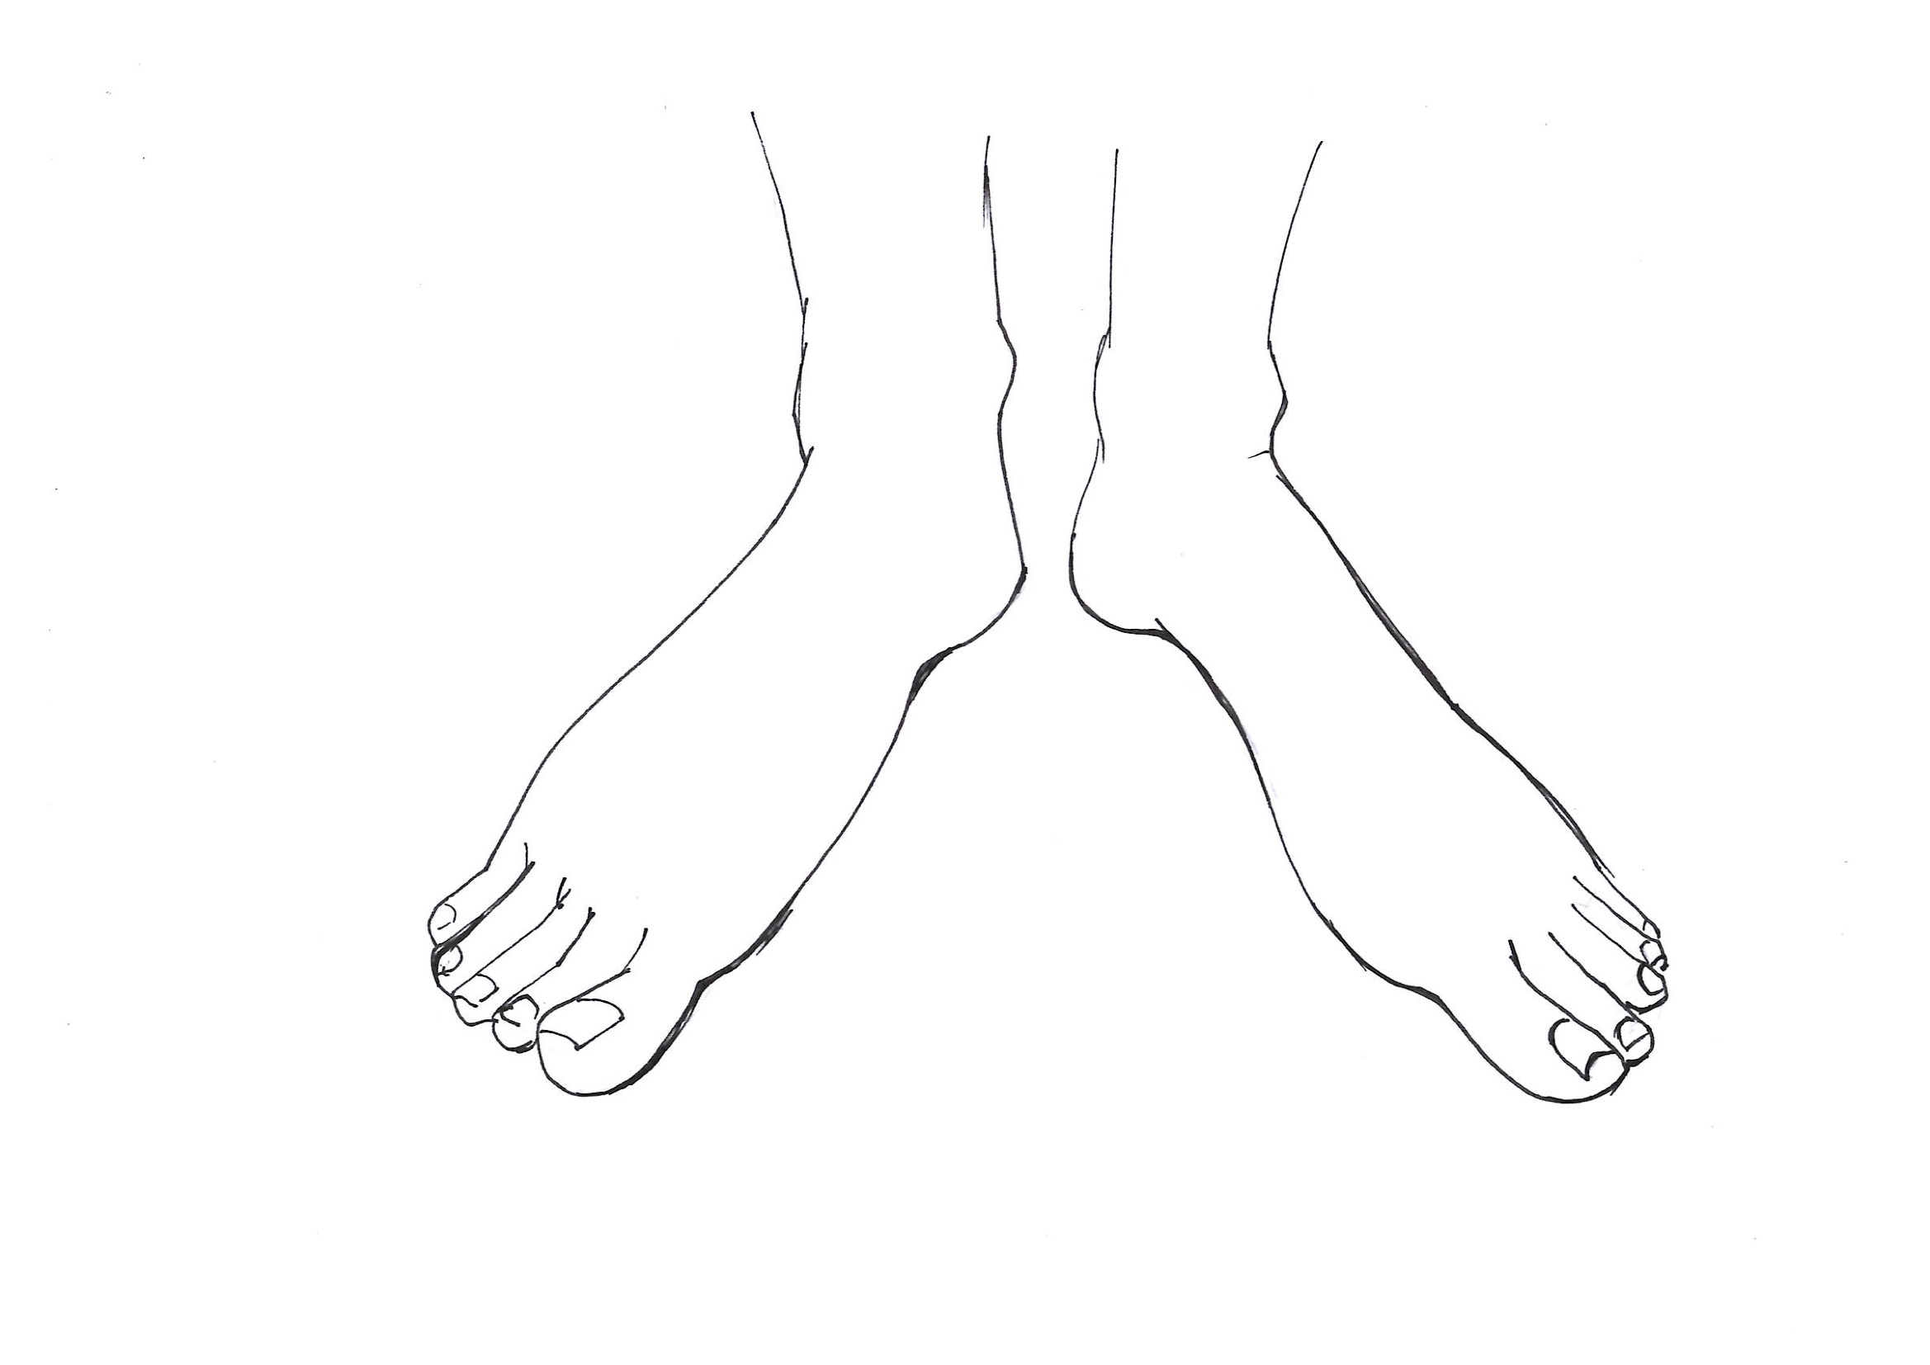
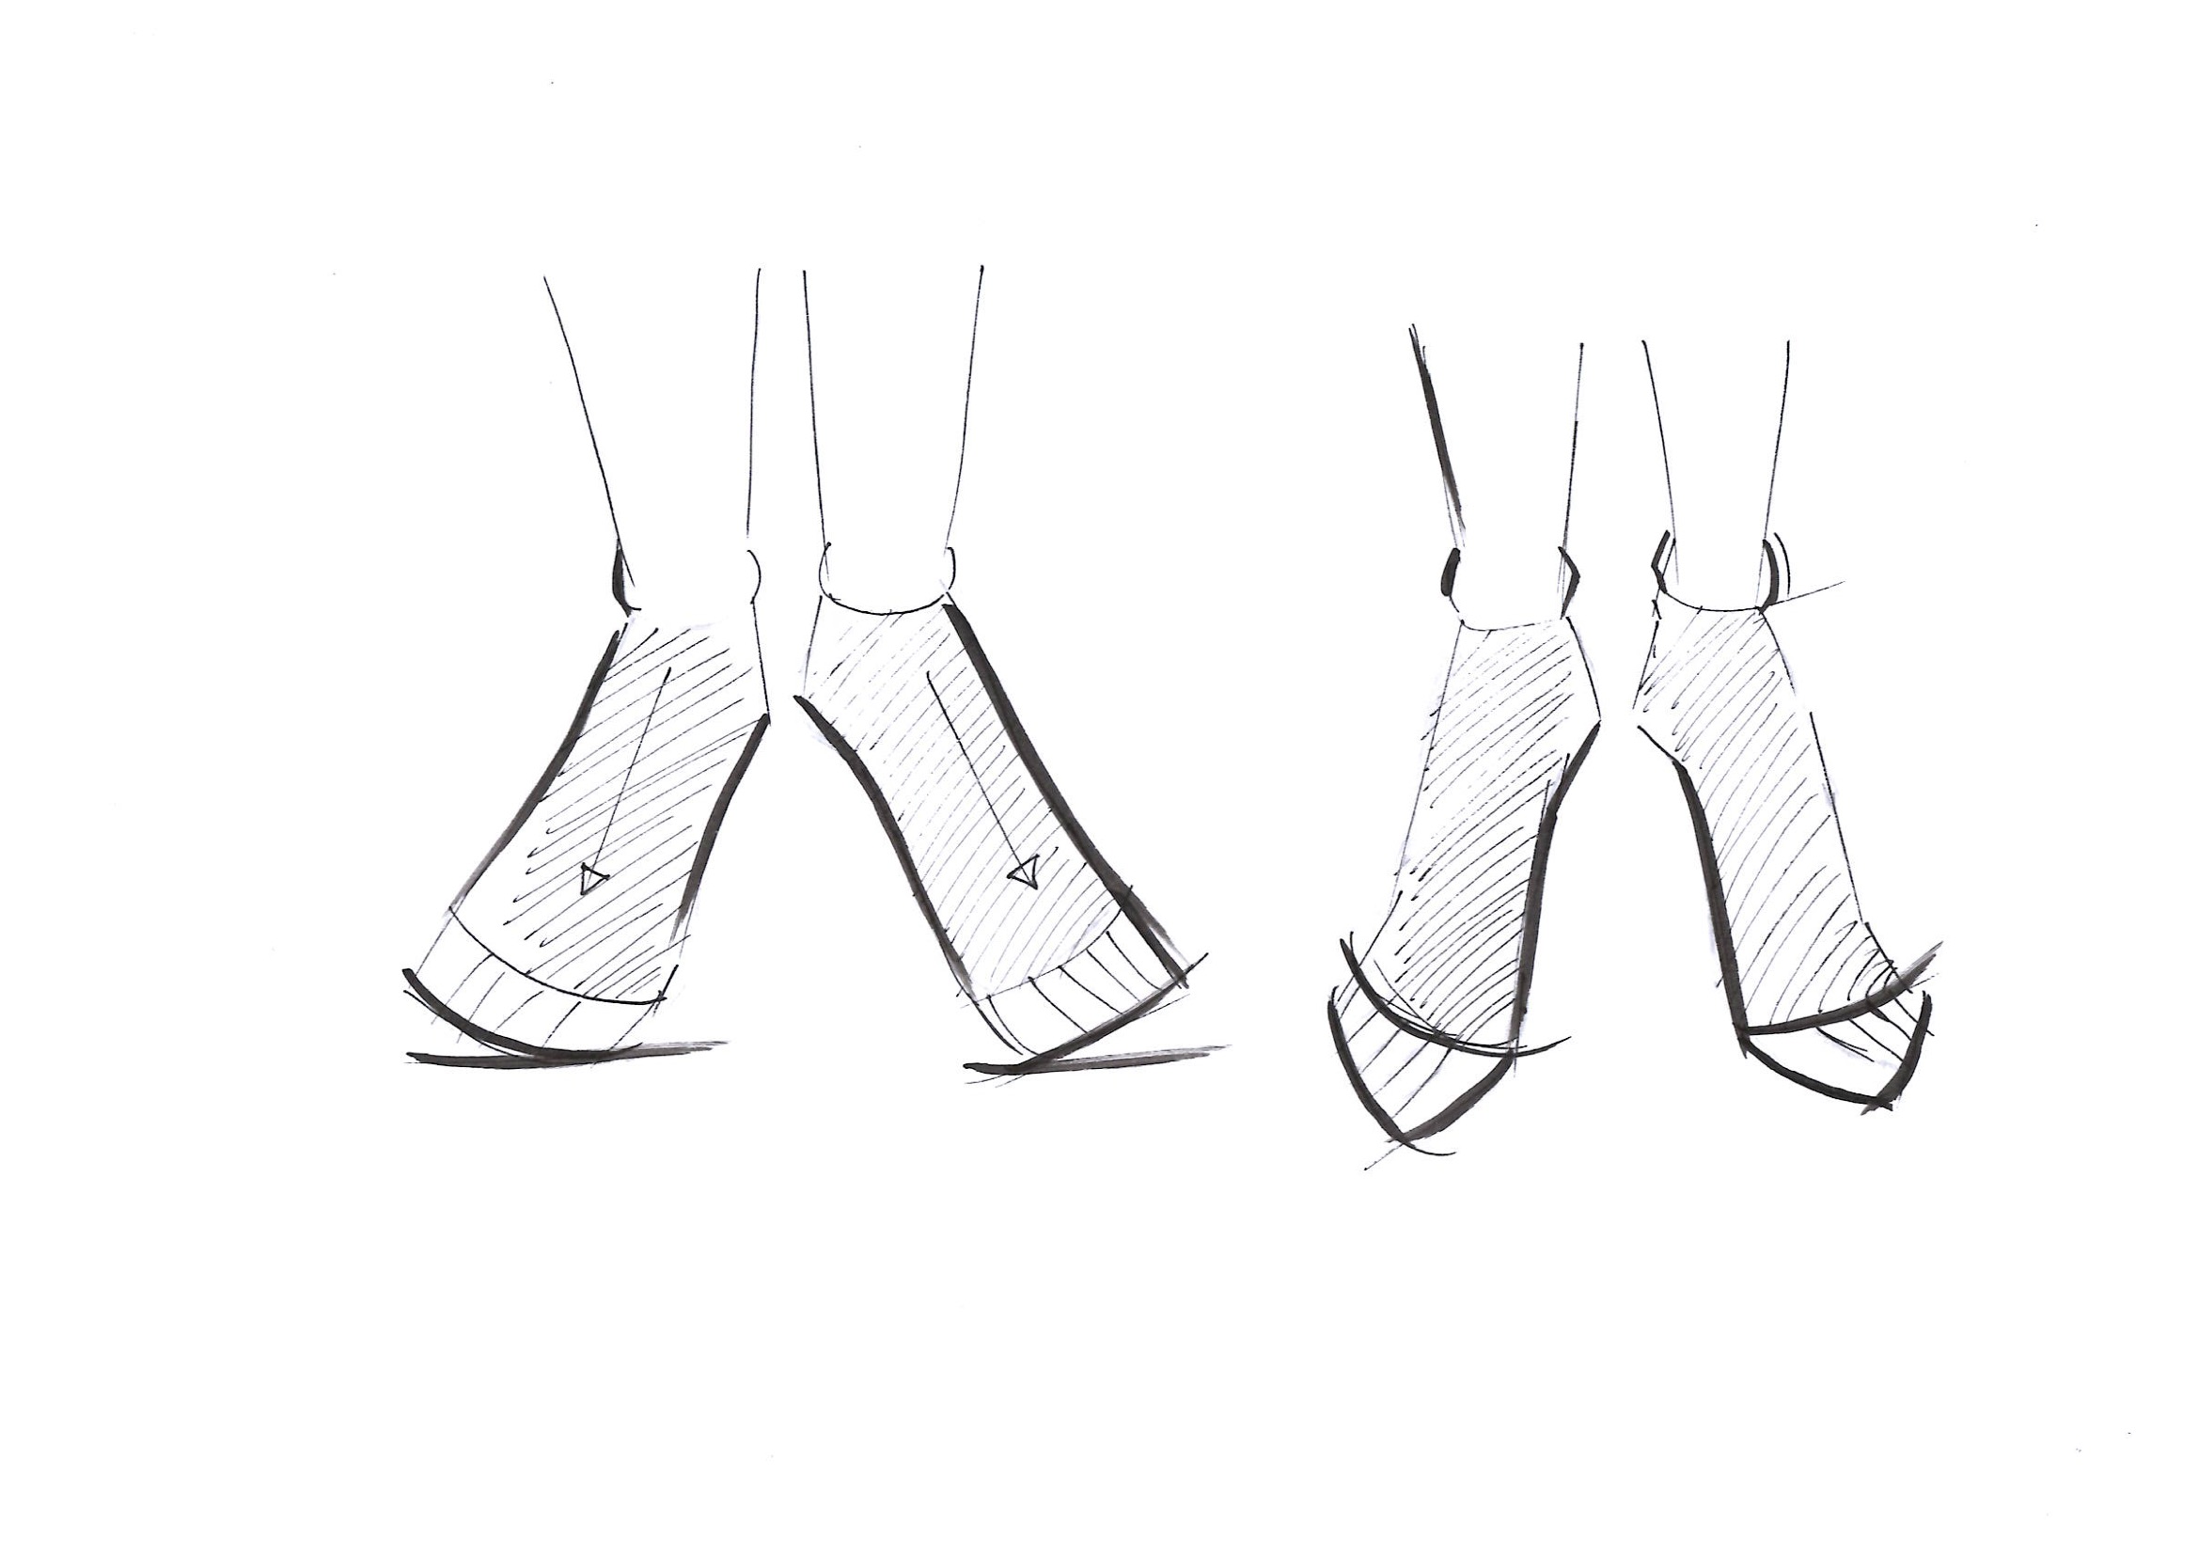
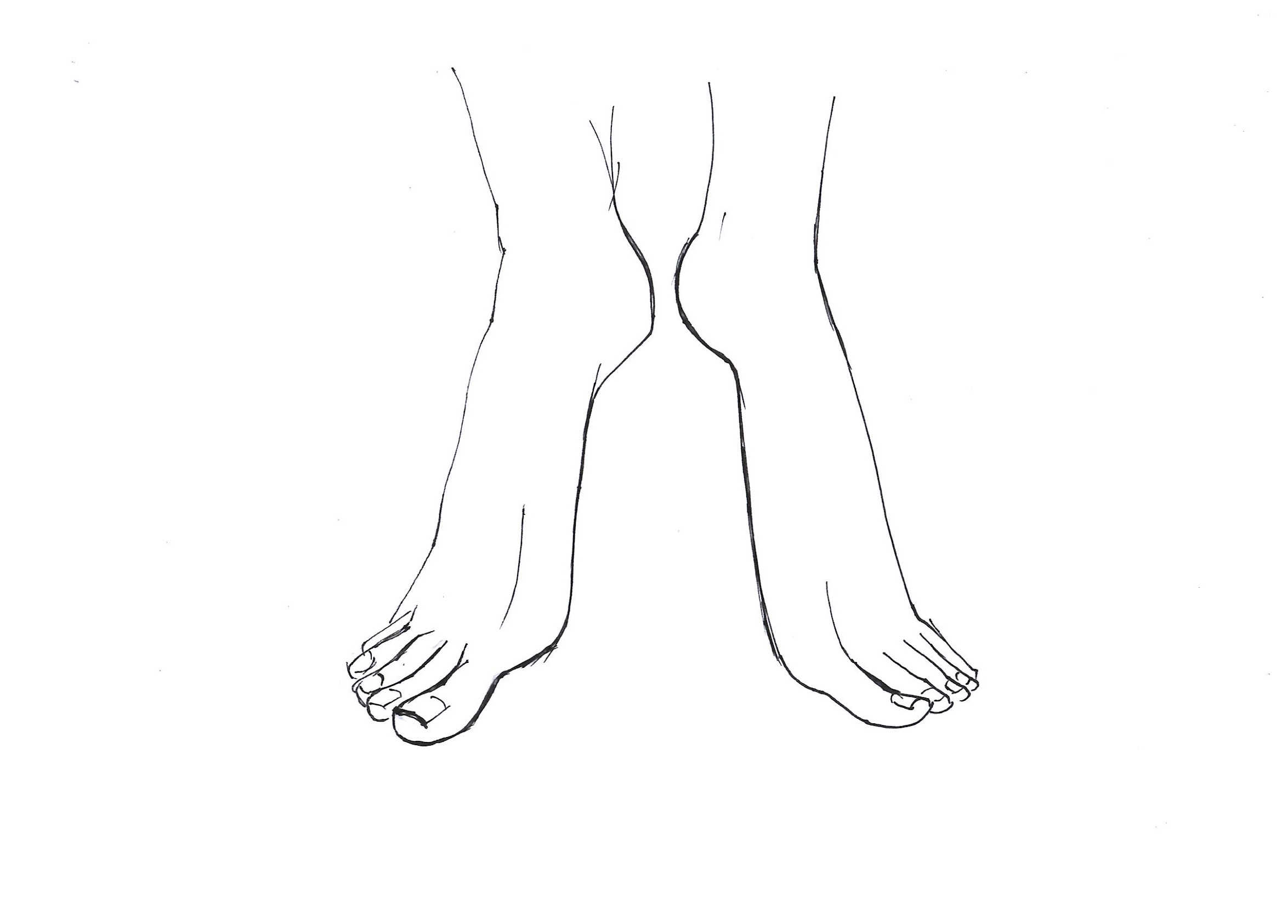

Slide 6
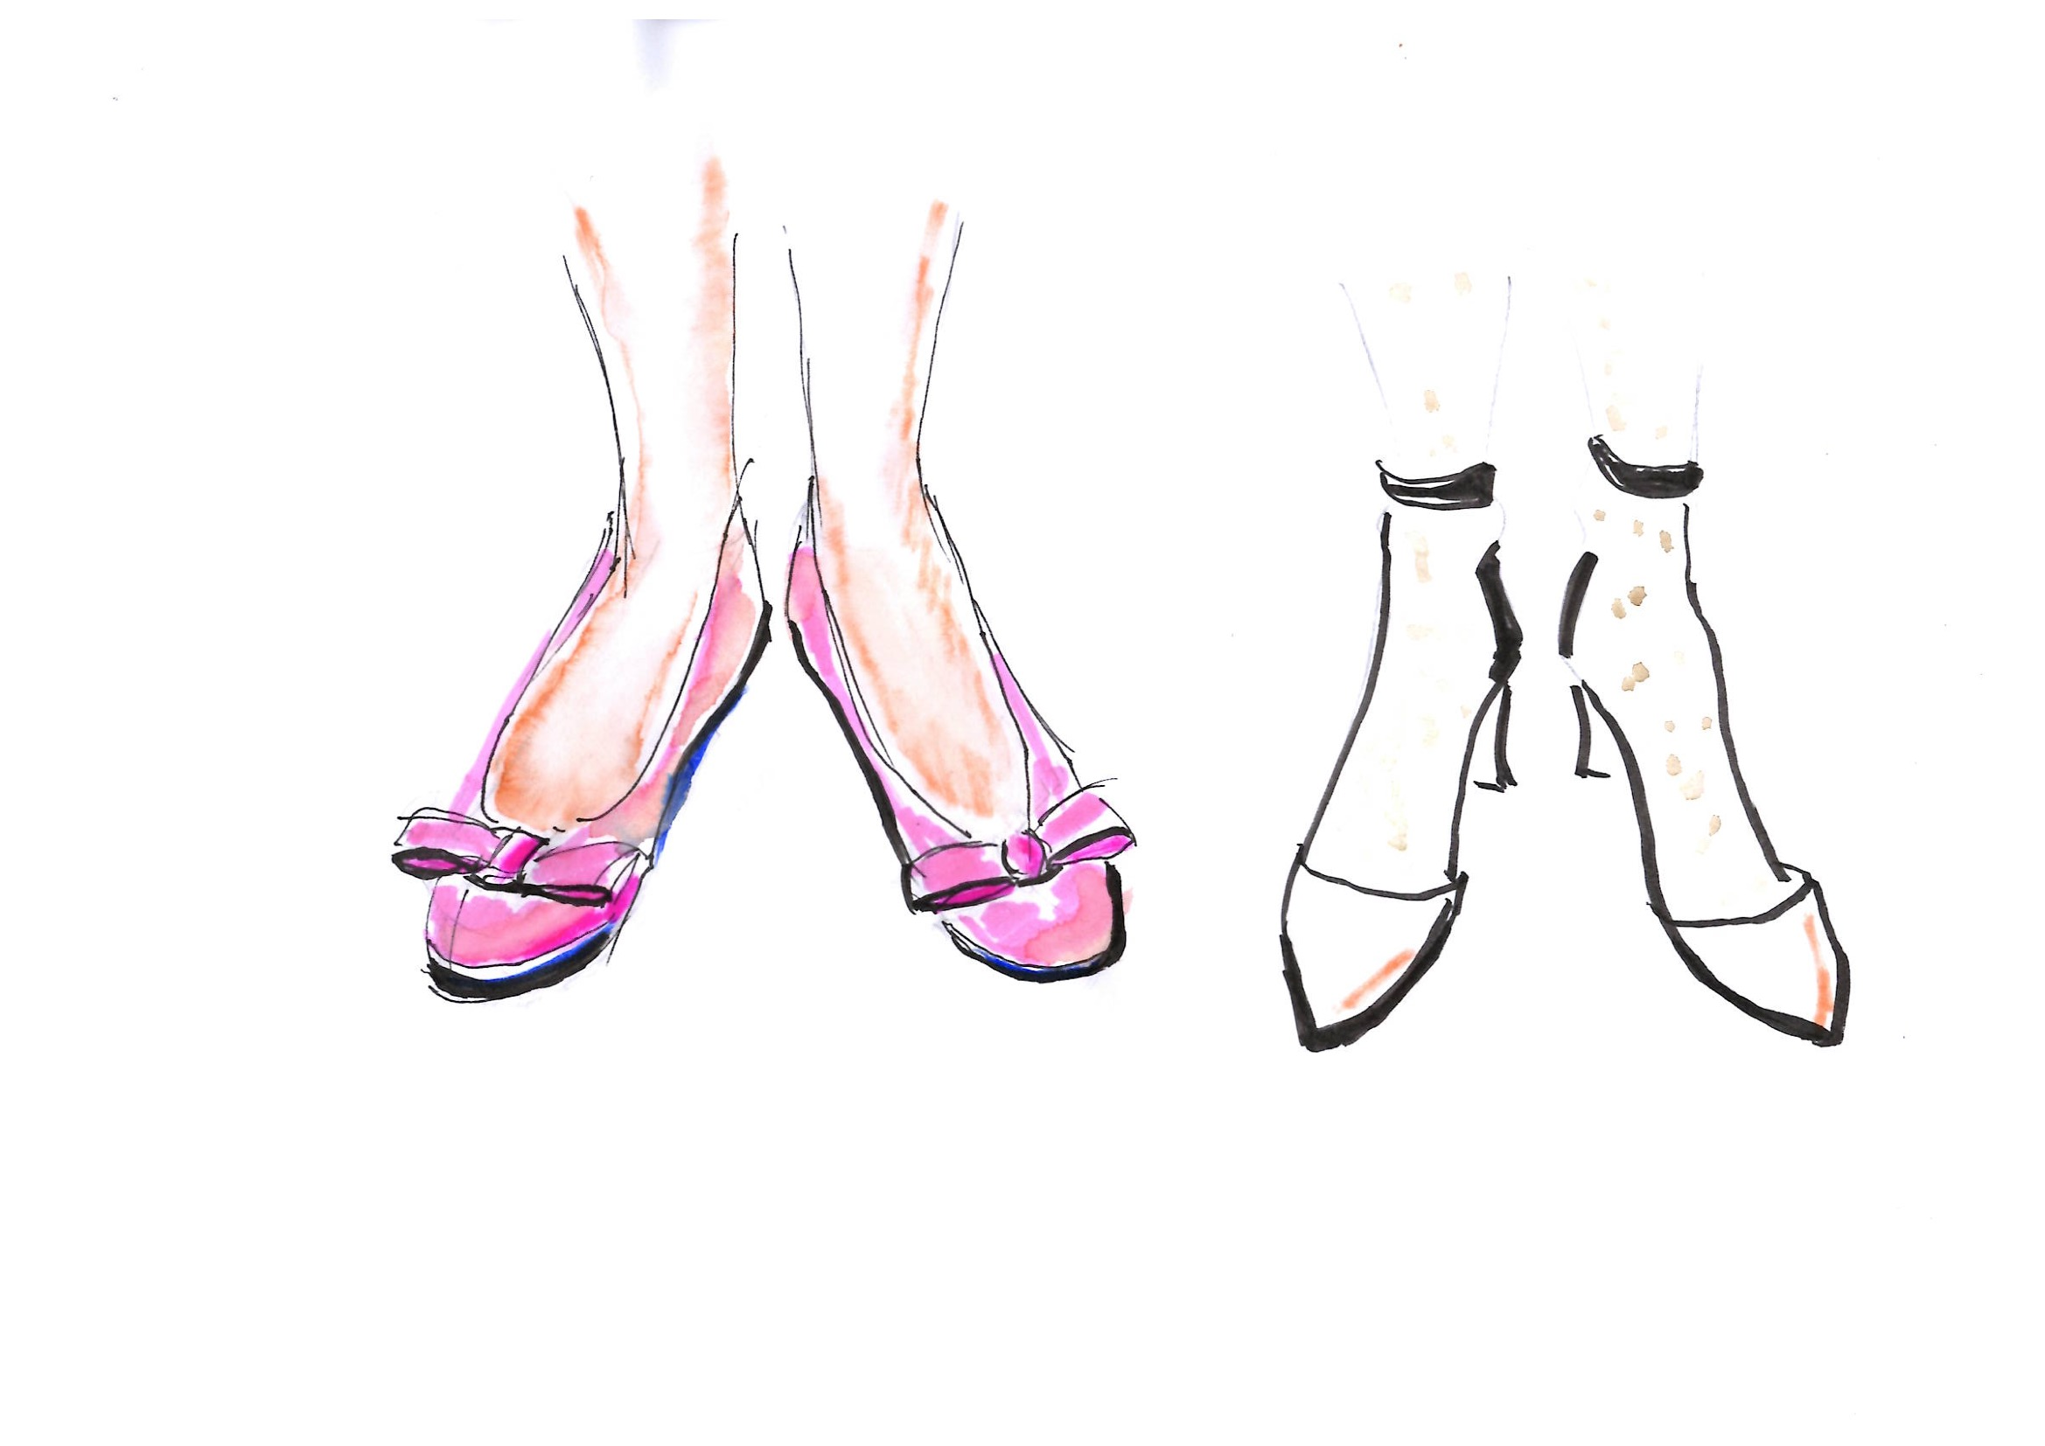
Homework
Try to draw shoe designs on basics of foot from front and side.

Slide 7
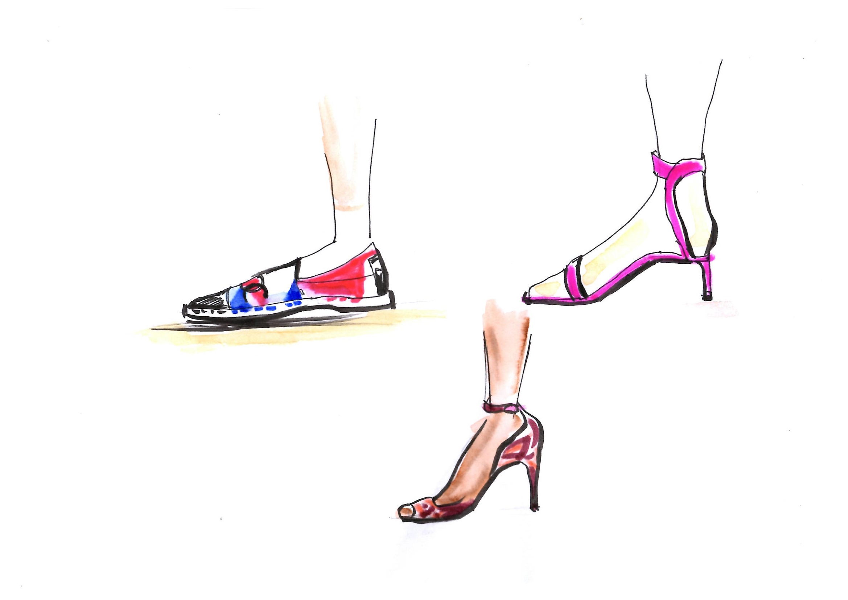
Homework

