Slide 1
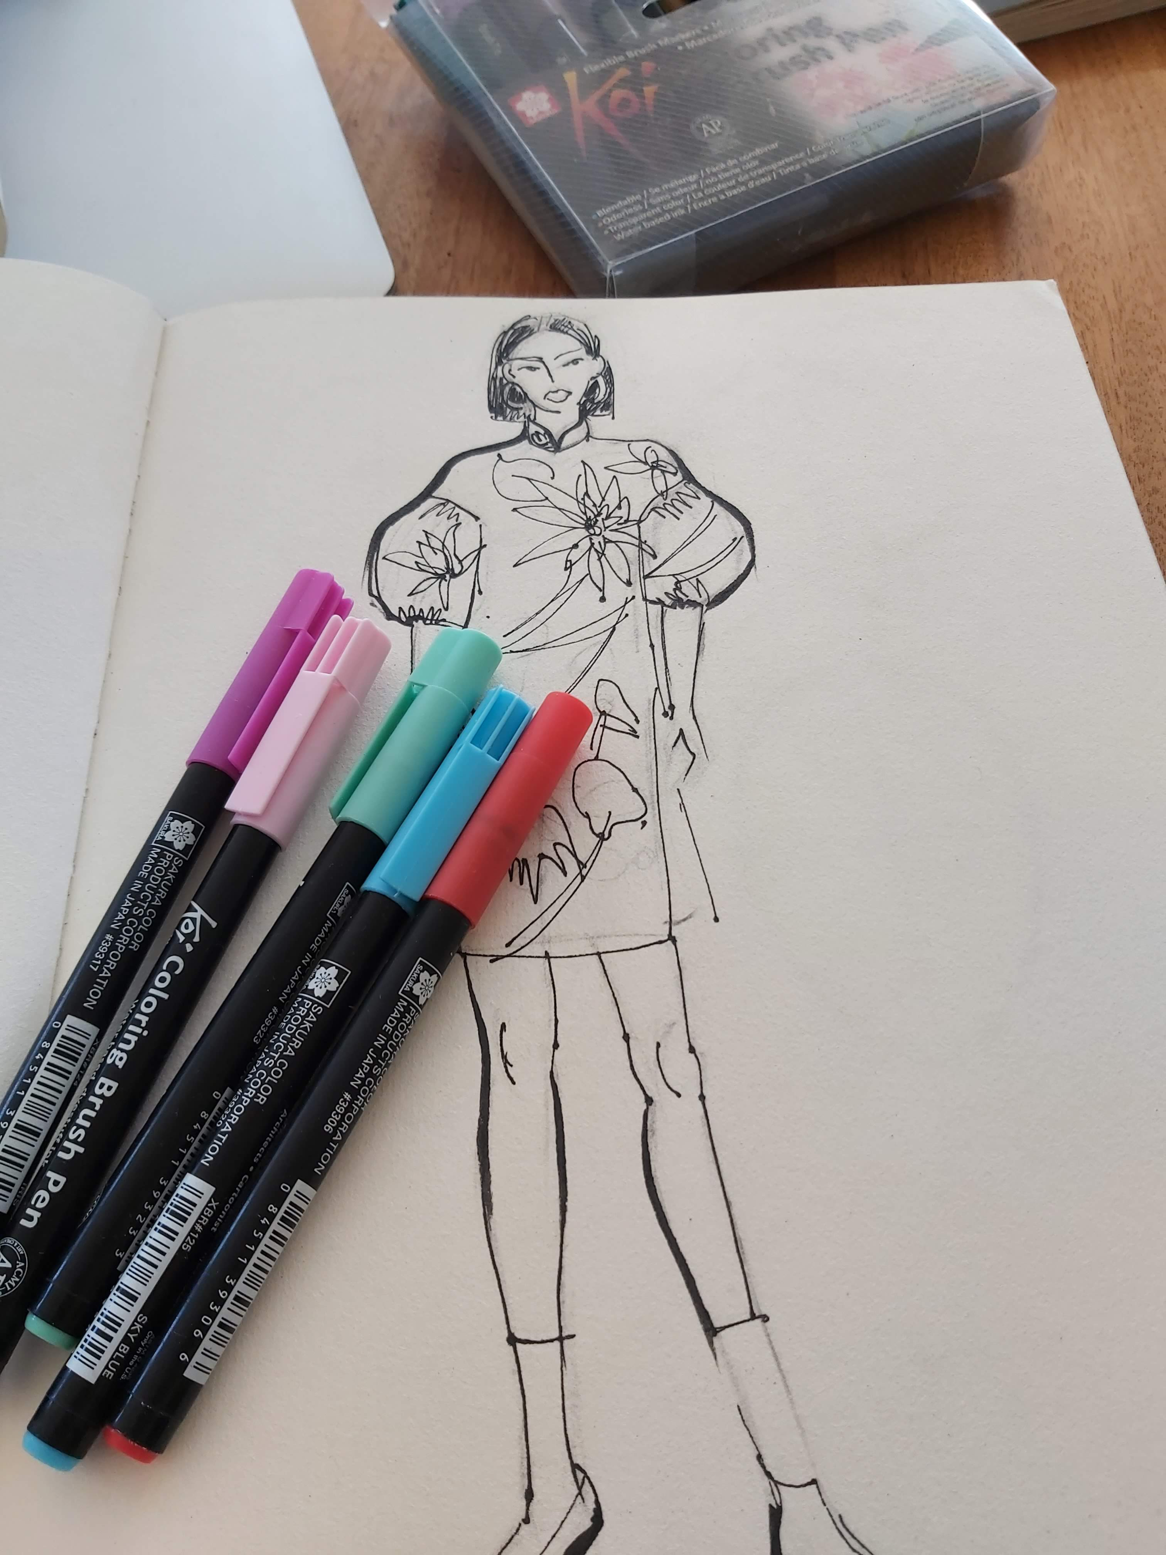
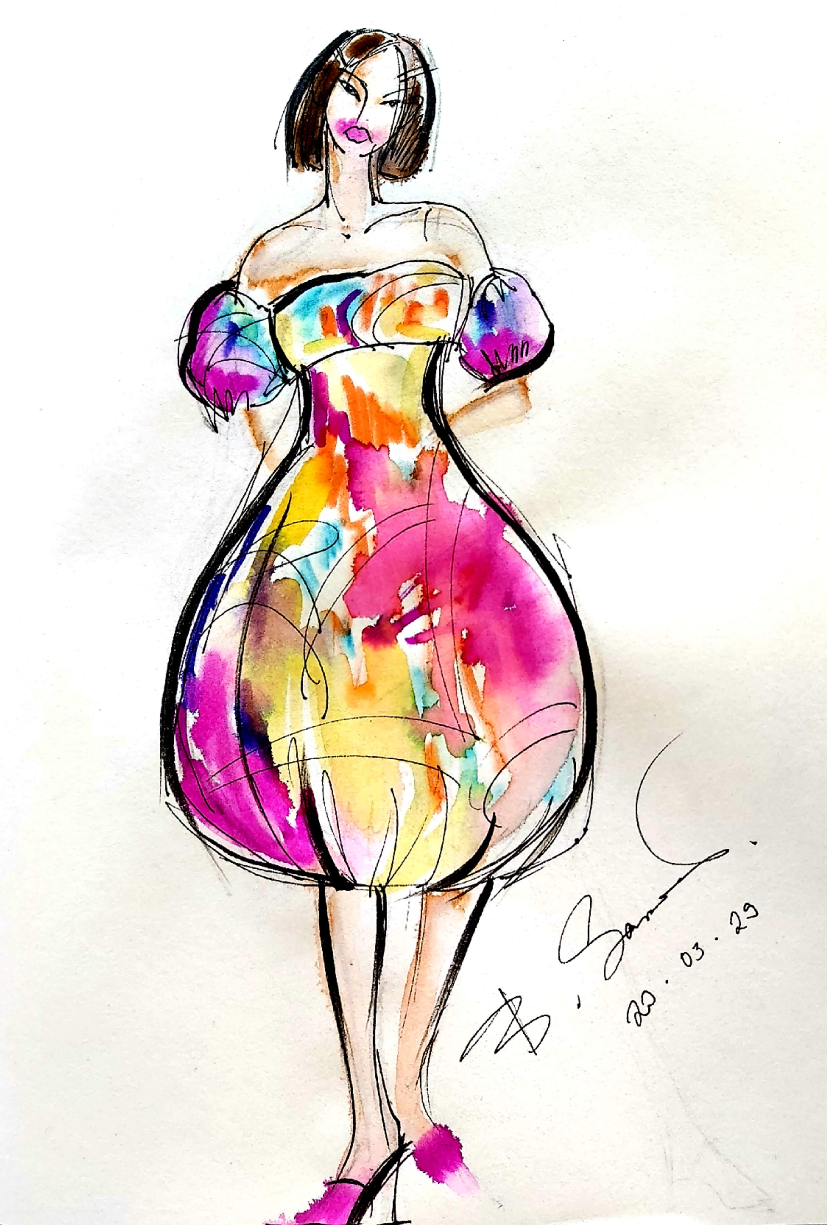
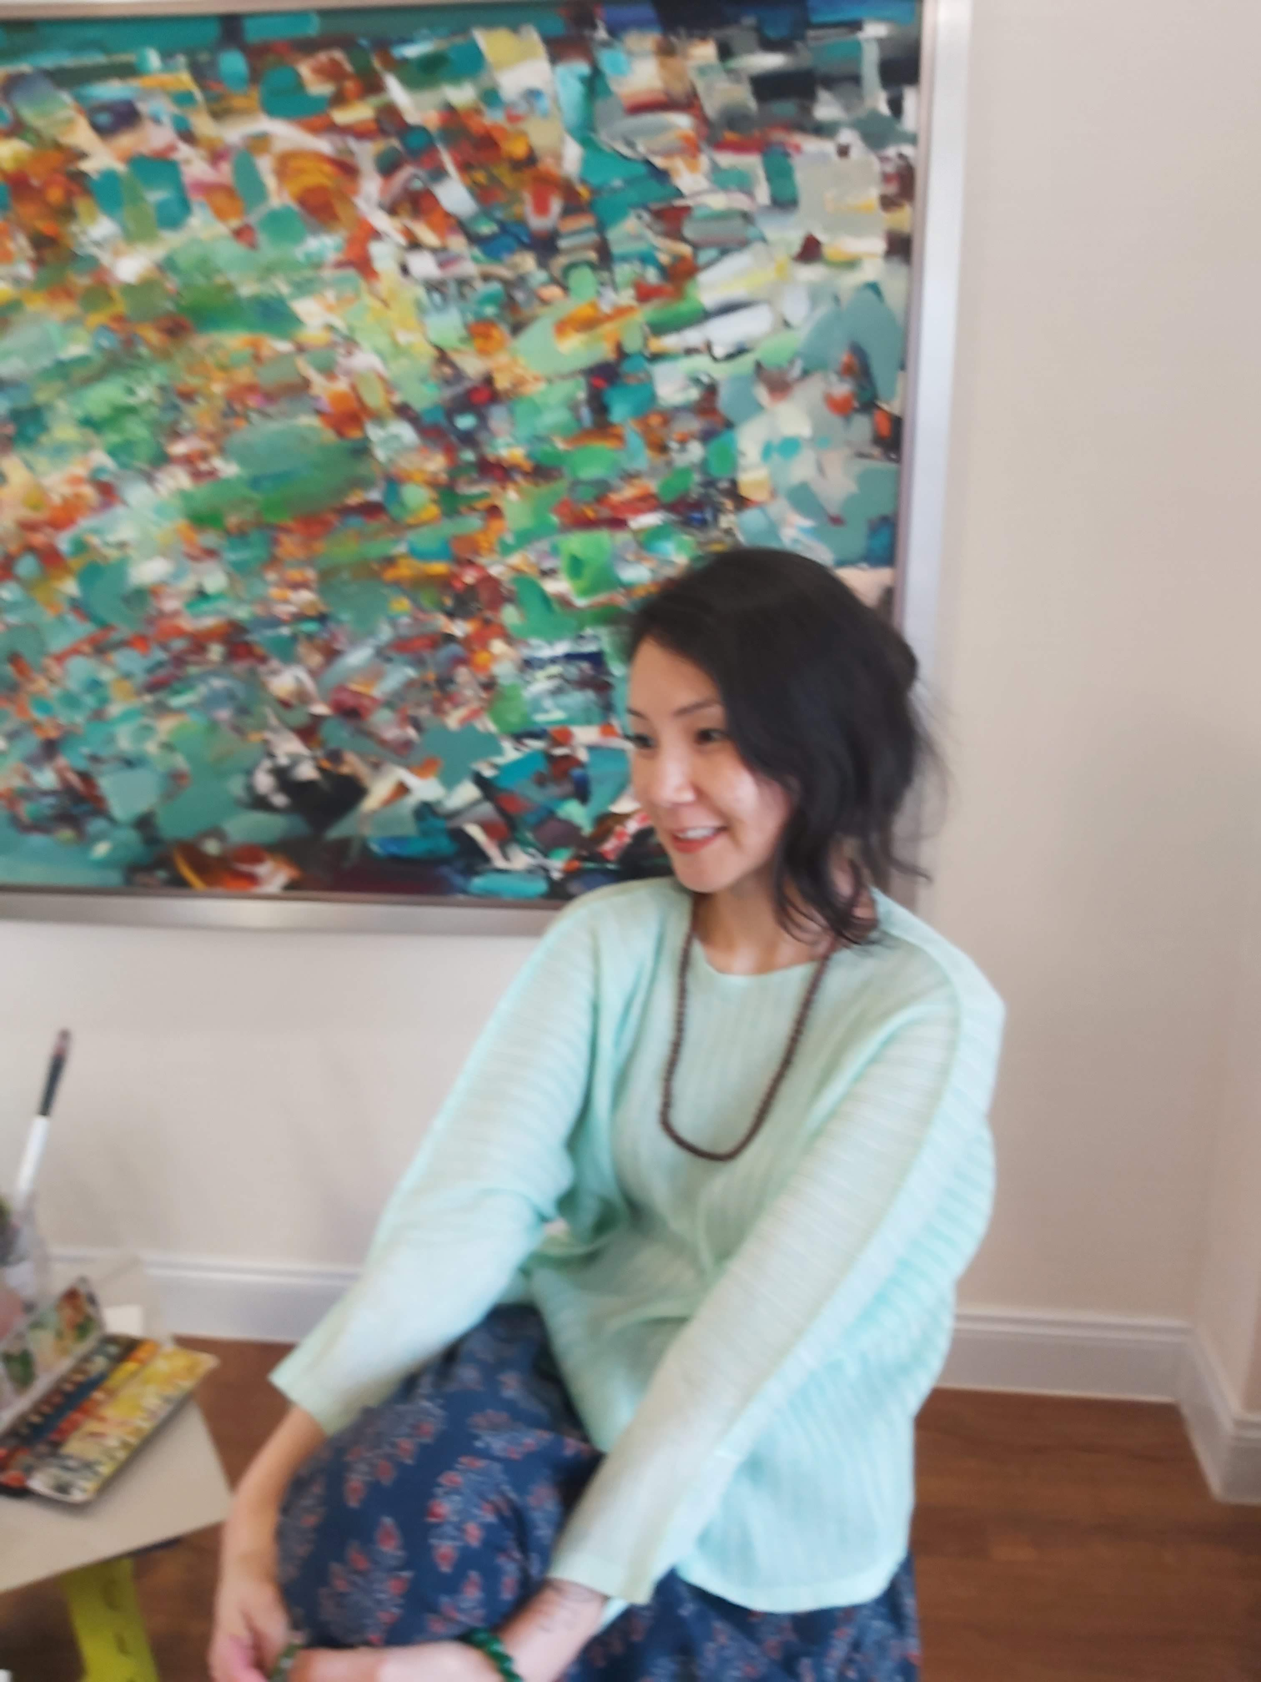
Fashion Design Illustration
By Sarnai Bold
Fashion design teacher
Mongolian State University of Arts and Culture

Slide 2
Lecture 1.
Introduction of the course: Preparatory talks: Lines, forms, etc.
Fashion Design Illustration course is about learning to draw the basic proportion of a model.
Proportion is based on the drawing method of Sarnai Bold, an artist and fashion designer who has graduated from Dressmaker gakuin, Sugino Gakuen in Tokyo, Japan. First of all, we learn how to draw a right proportion of a model from the front side, sides, back side. Learn about human anatomy and body parts. Basic drawing instructions based on geometrical figures and forms.
Then we learn about drawing a face, proportion of face and hairstyle.
In fashion illustration we will use different kinds of materials, like watercolor, acrylics, markers, pastels, crayons, pencils and pens.
Learn about different techniques to use various kinds of paints for different materials and clothes.
Fashion design illustration is essential to develop skills for women in order to make a dress for themselves and beneficial for those who wants to become a fashion designer.
It is an introductory skill to obtain for those wanting to
1. Become a good designer,
2. Run a fashion design studio,
3. For people who like to create and enjoy their own creations,
4. To fulfill their childhood dreams

Slide 3
Before the drawing
Lines
Before learning to make a fashion design illustration we have to learn how to draw. For this, we need to learn drawing with one pencil or pen. Using powerful line, rhythmical line, nervous line we draw a line which moves. Before learning to draw a human body, we need to research drawing a line and practice for many hours.

Slide 4
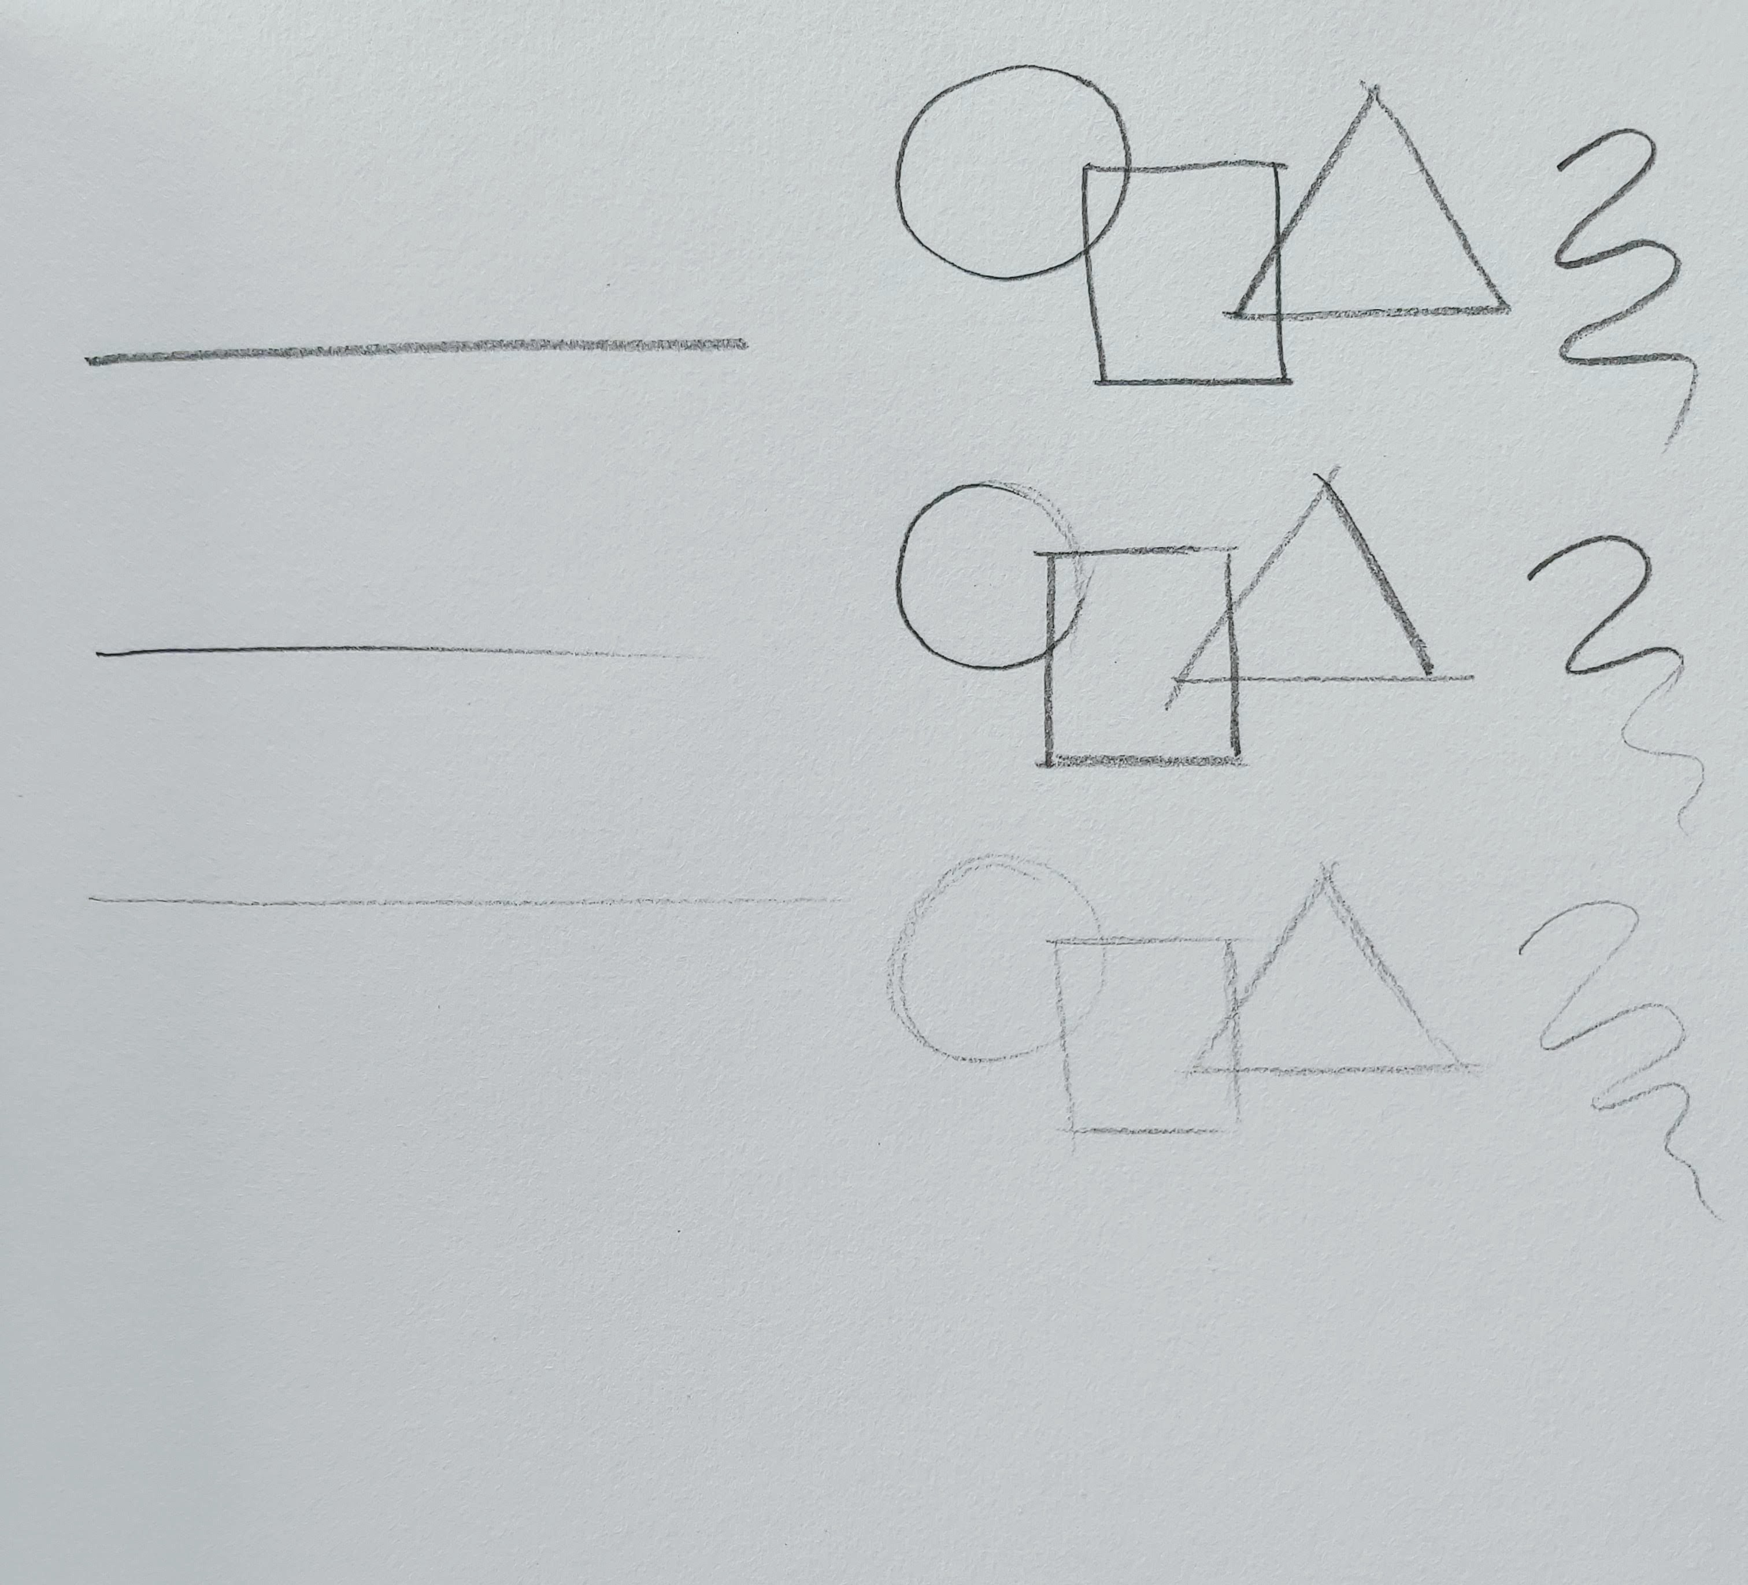
Lines
A-When you empower your line;
B-When you empower your drawing at first and then relax;
C-draw a line by relaxing as much as possible
This line is very important for rough sketches

Slide 5
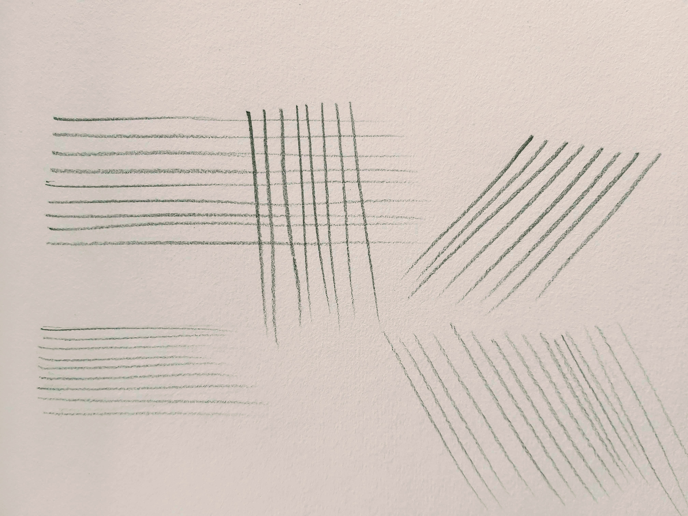
Line drawing practice
Horizontal, vertical and diagonal lines

Slide 6
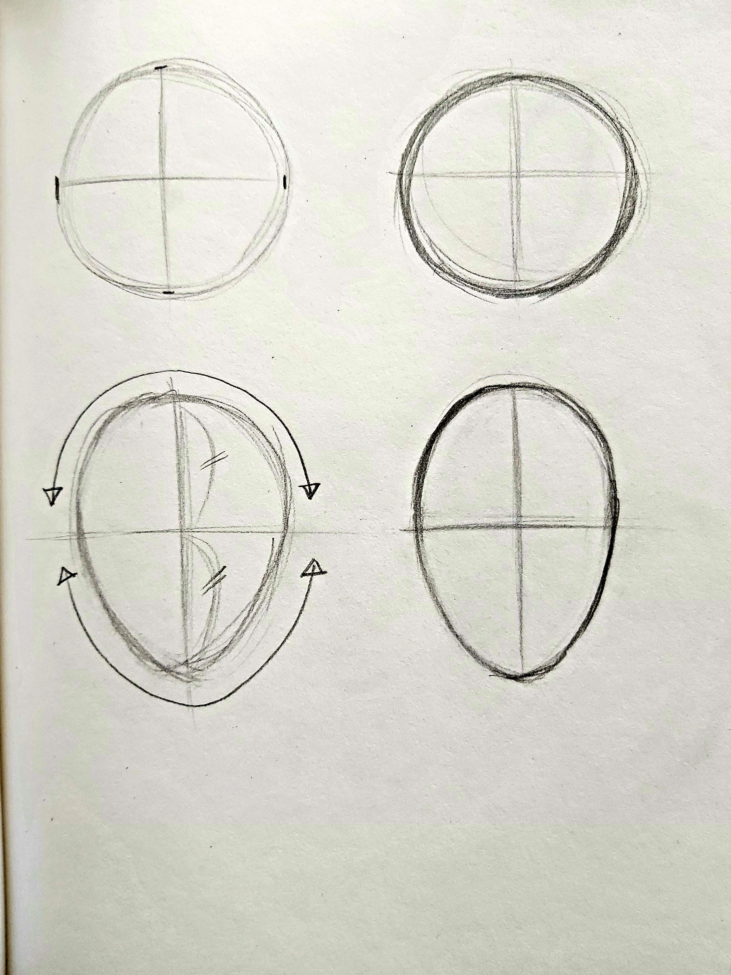
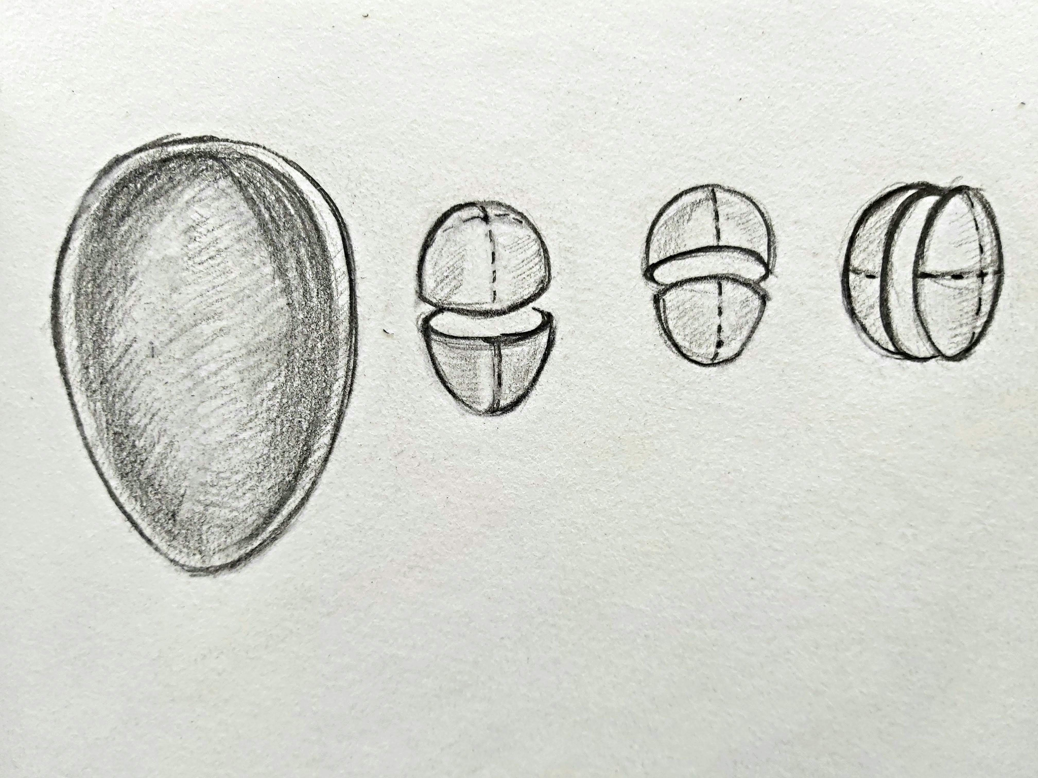
Forms
Circle→Egg shape
Three-dimensional
At first draw a line C
Draw cross lines, then make right and left same.
Make upper side more round of 1/2,
sharpen the bottom side.
Take every form in three-dimensional way

Slide 7
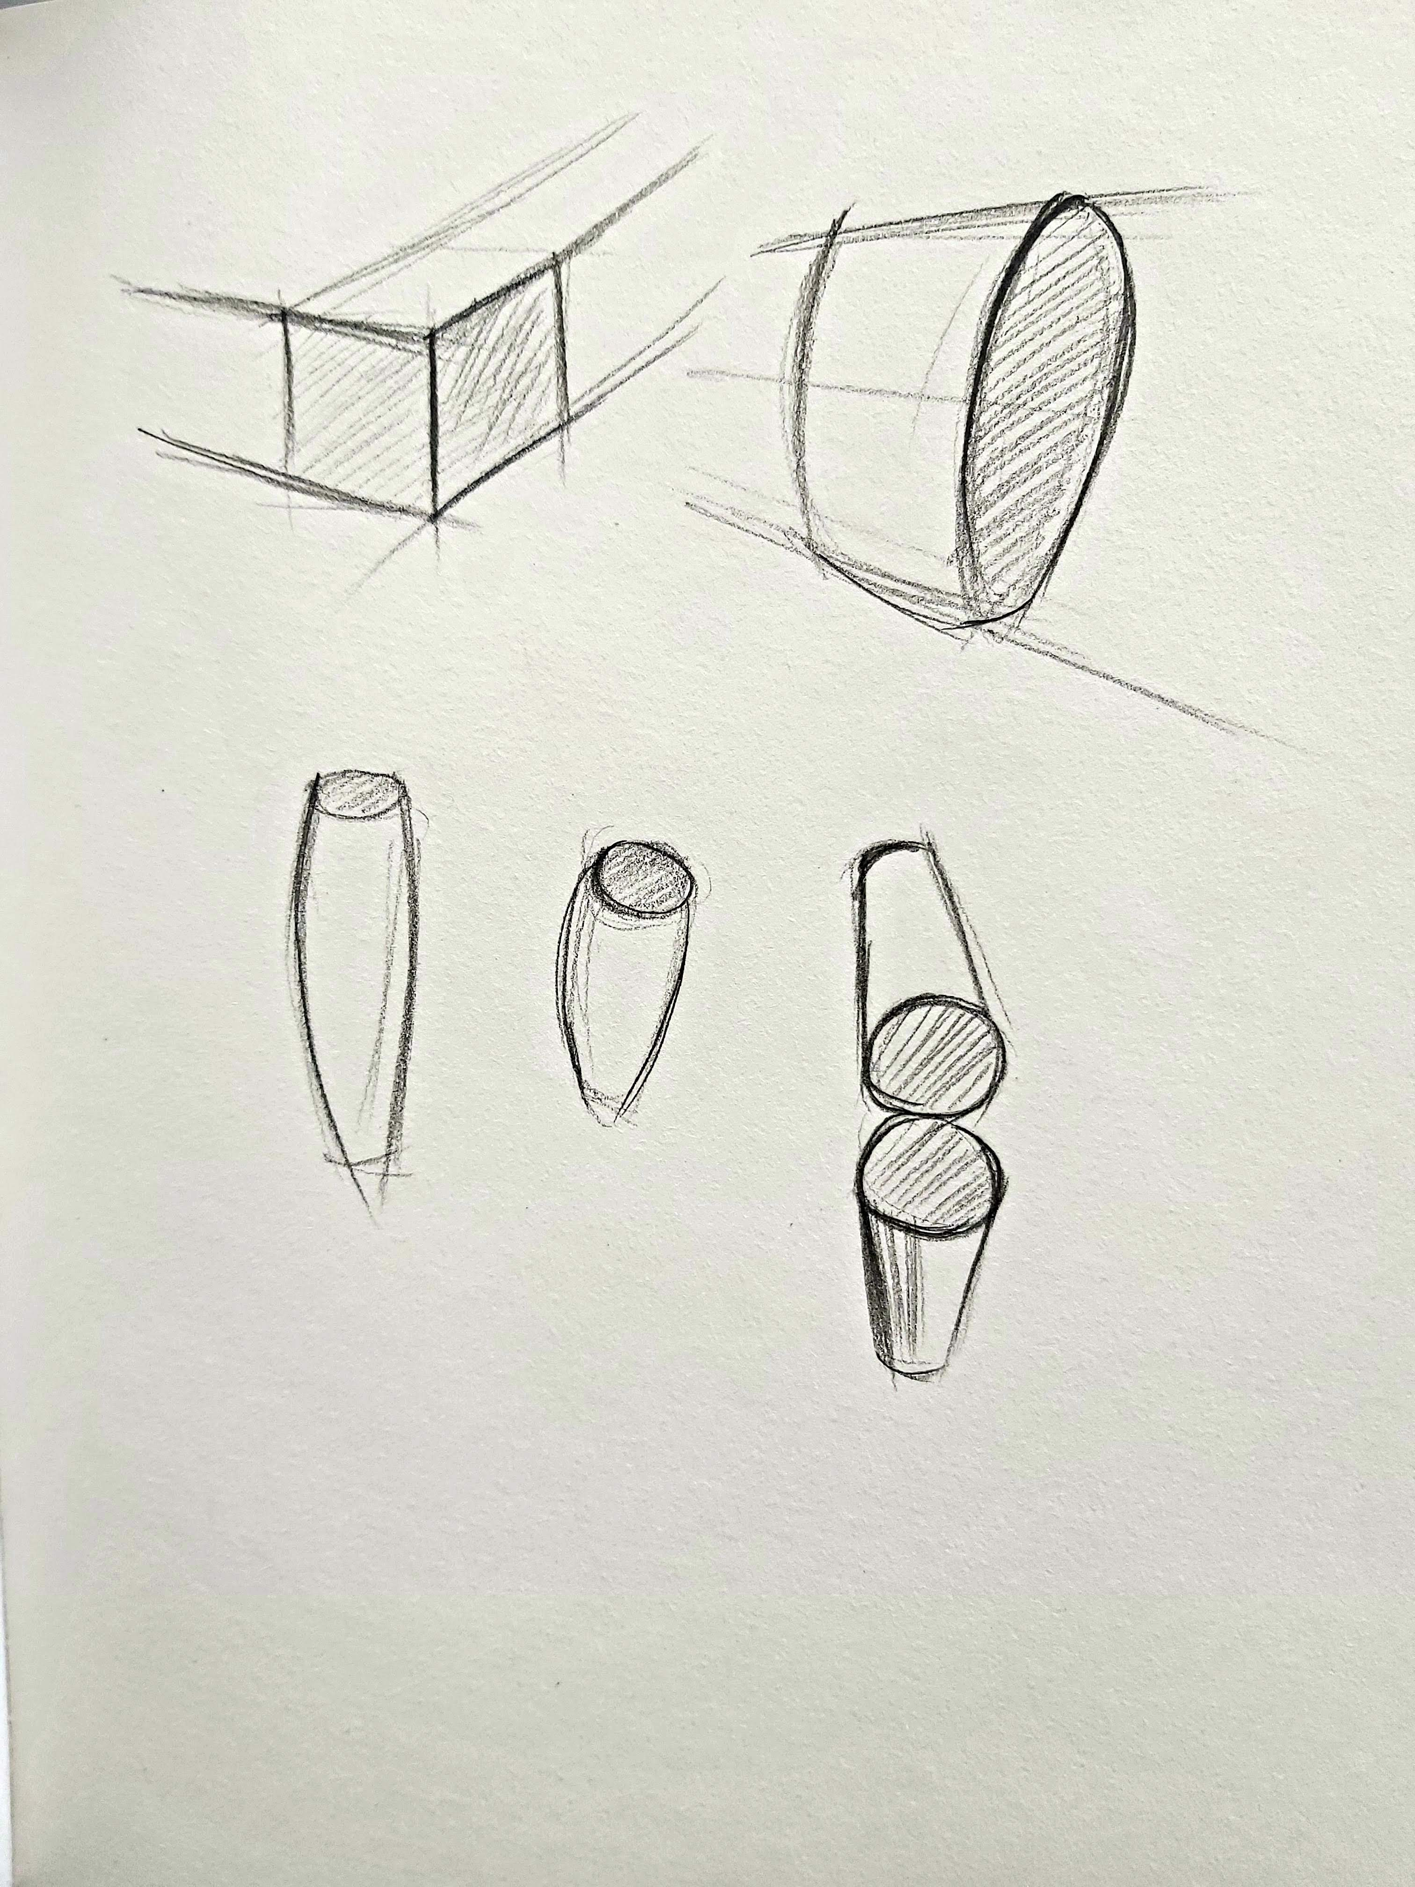
Forms
Perspective
When something is near it looks
more bigger and longer than what is far.

Slide 8
Homework
Practice drawing vertical, horizontal and diagonal lines as many times as possible.

