Slide 1
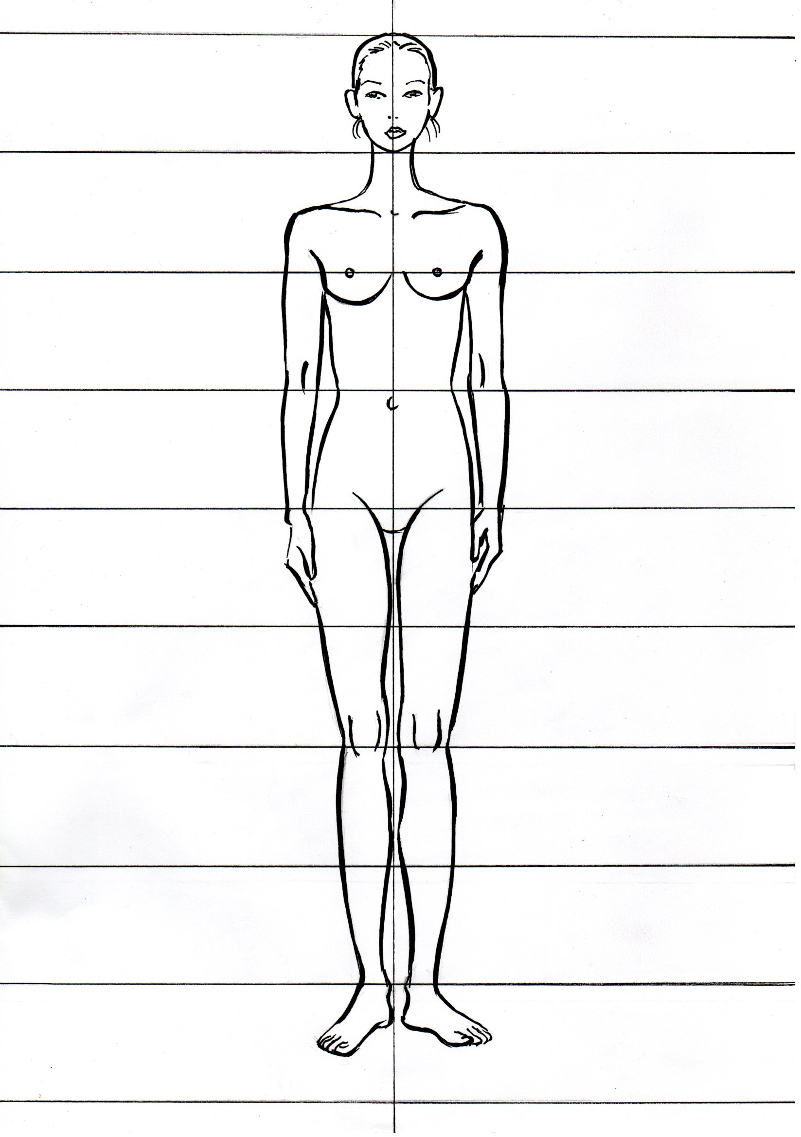
Human Body
Clothing is worn by a person. Let’s begin with an understanding of poses which will help making great designs.
Beautiful round lines following body’s structure, bones and muscles are necessary for drawing. Along making croquis and drawings looking at models, it’s important to have a time to study.

Slide 2
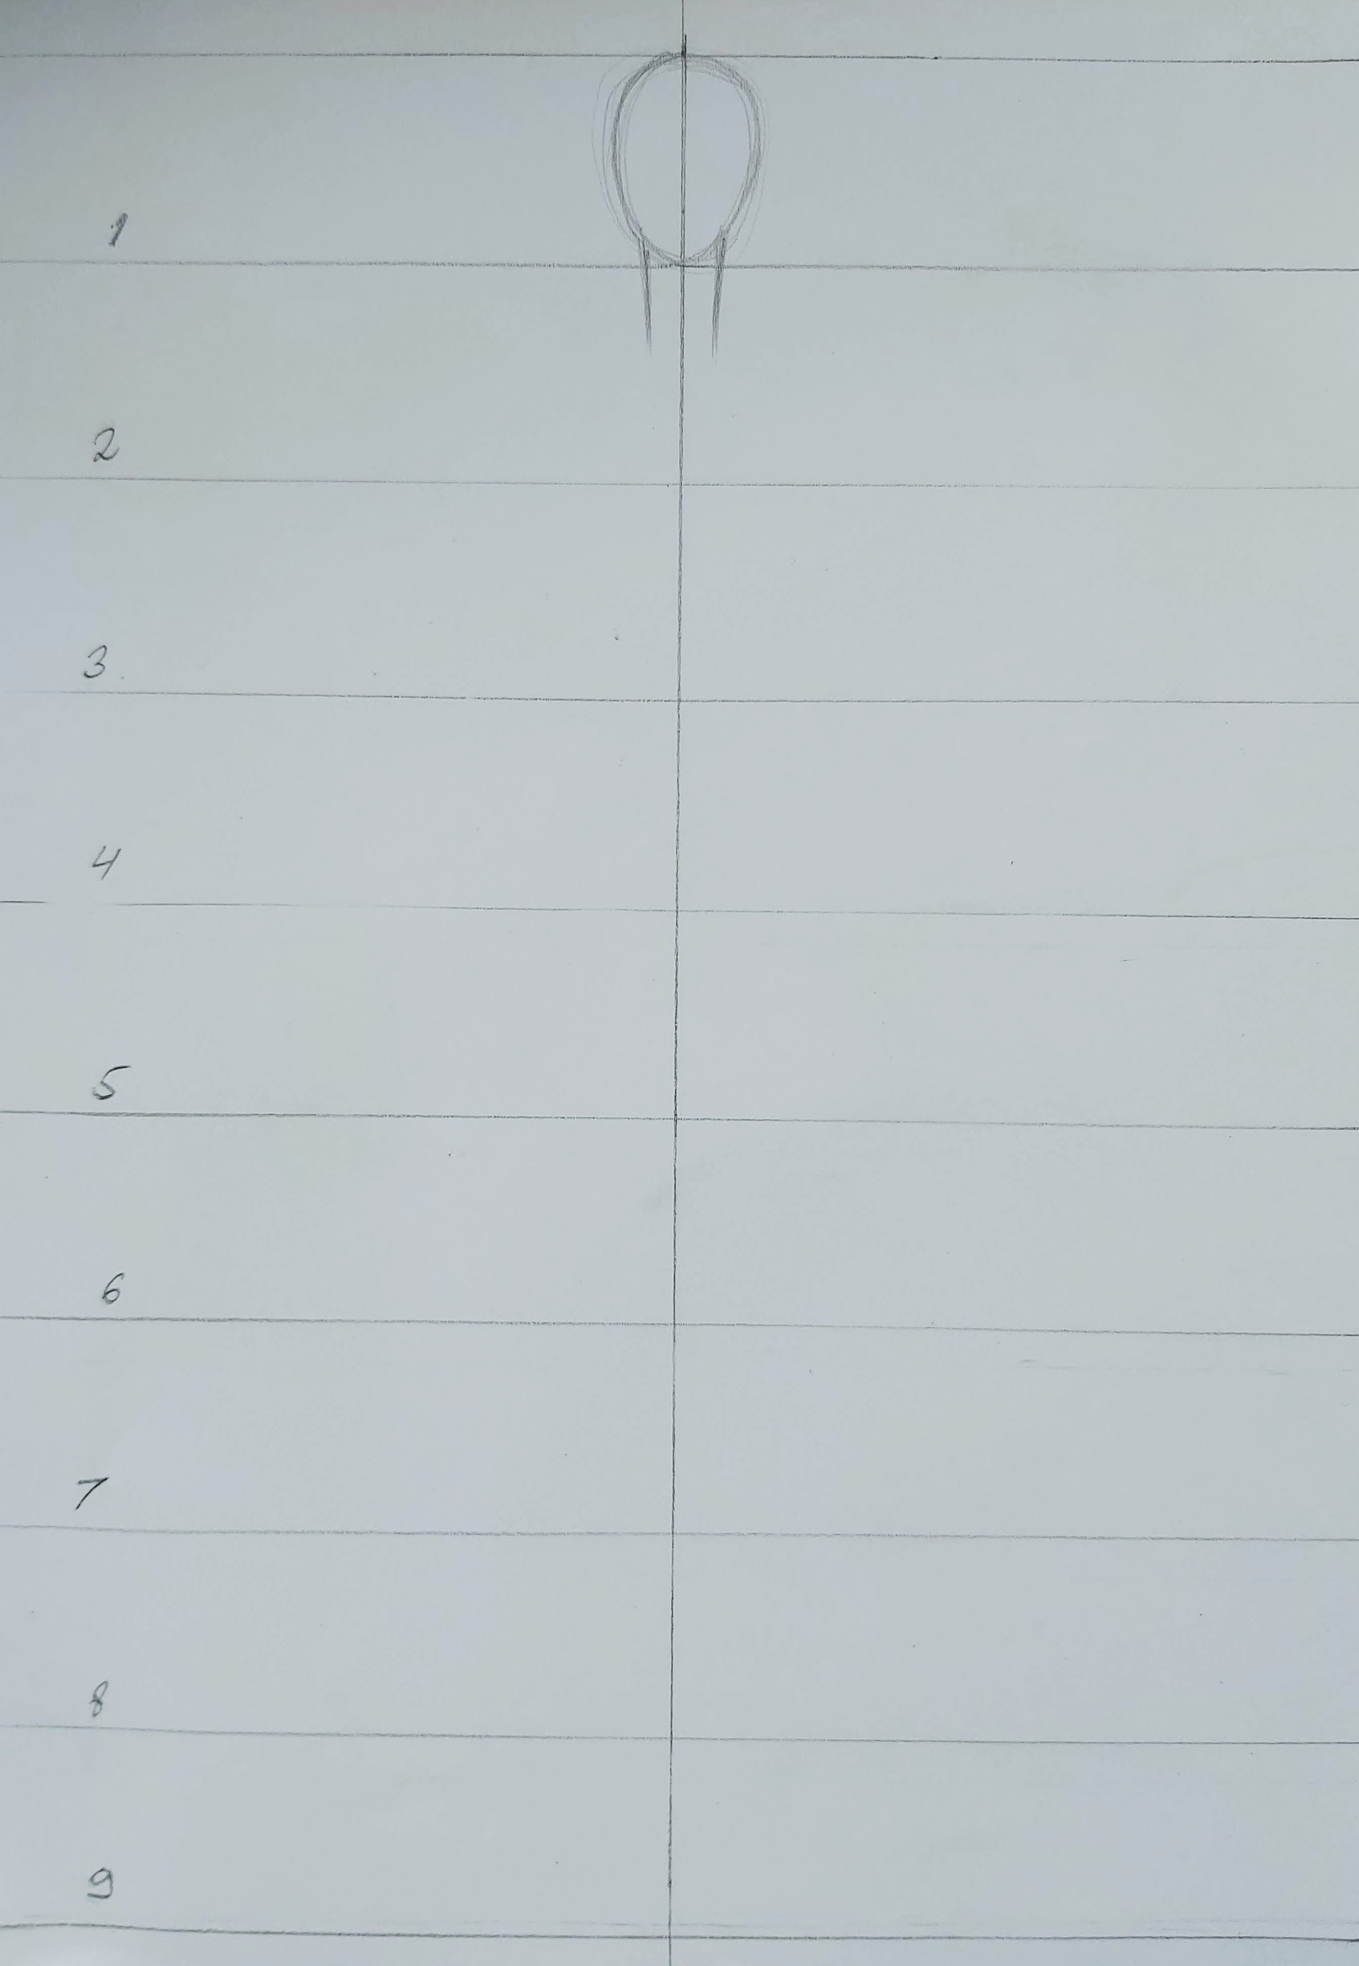
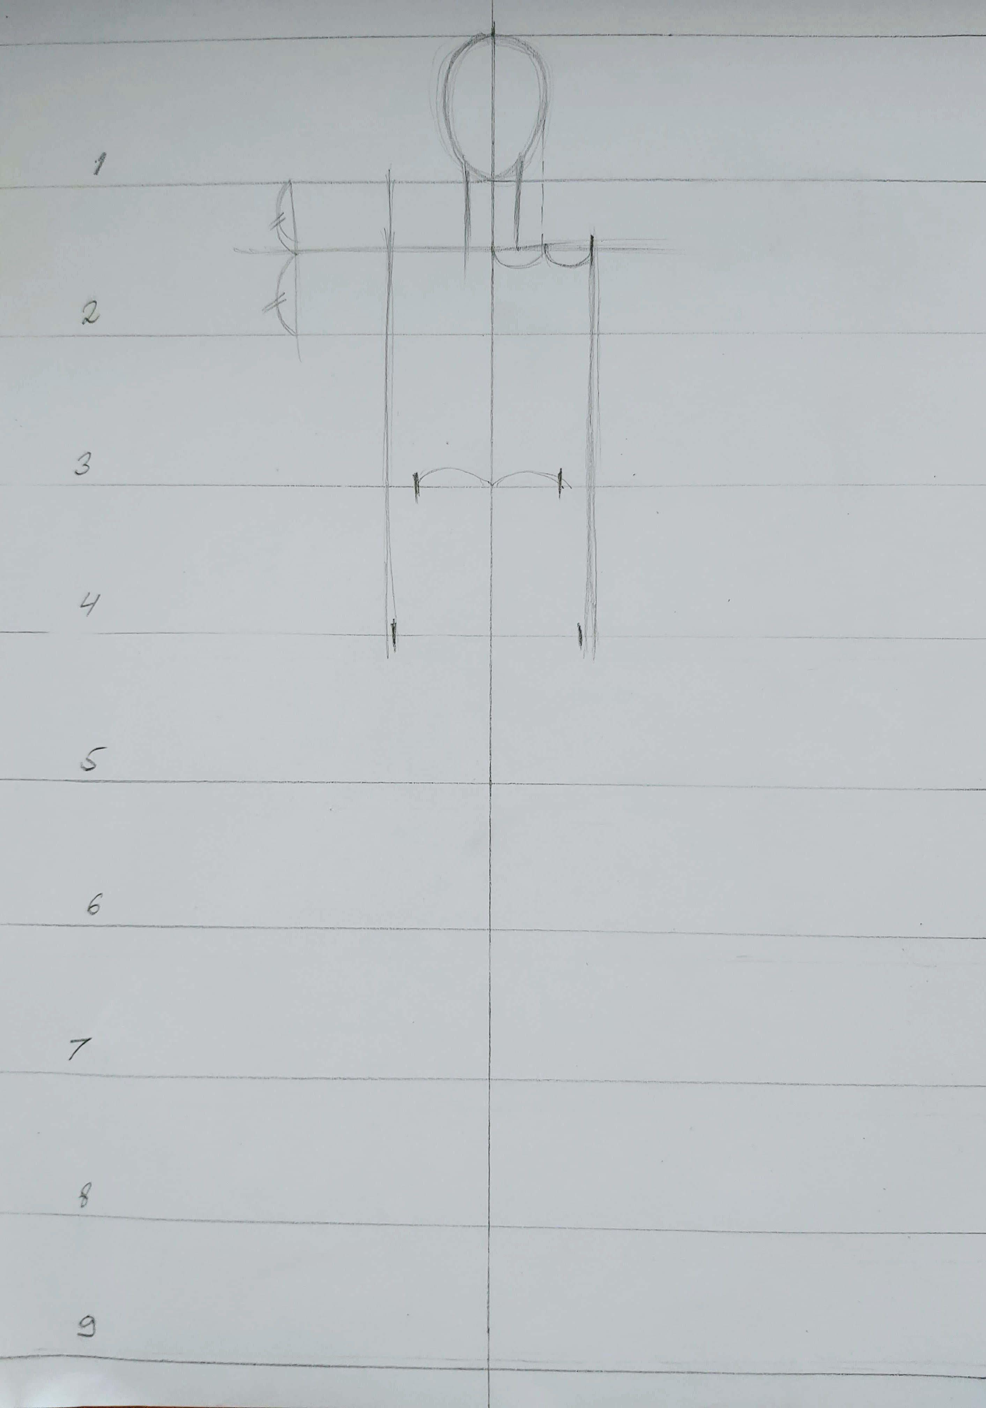
Proportion
1. Head side, Neck
2. Shoulder line. Shoulder width, Waist width, Hip width
In order to have a great balance, let’s divide a paper as it shown on the picture.
It’s ok to use many lines to draw. Let’s use a relaxed line until proportion comes naturally to our head.
2.
Let’s draw shoulder line,
which is little bit upper than 1 split’s 1/2
If you draw higher line it will make
an angular shoulder,
If you draw a low line it will
make a reclined shoulder.
On the top of the shoulder line
draw a shoulder width. (Little bit wider
than a width of a half face)
On waist line draw a waist width.
On hip line draw a hip width. (Much narrower
than a shoulder width) =Same size as
a bust width.
Waist
Hip
1.
Draw a head
Draw a neck (parallel line)

Slide 3
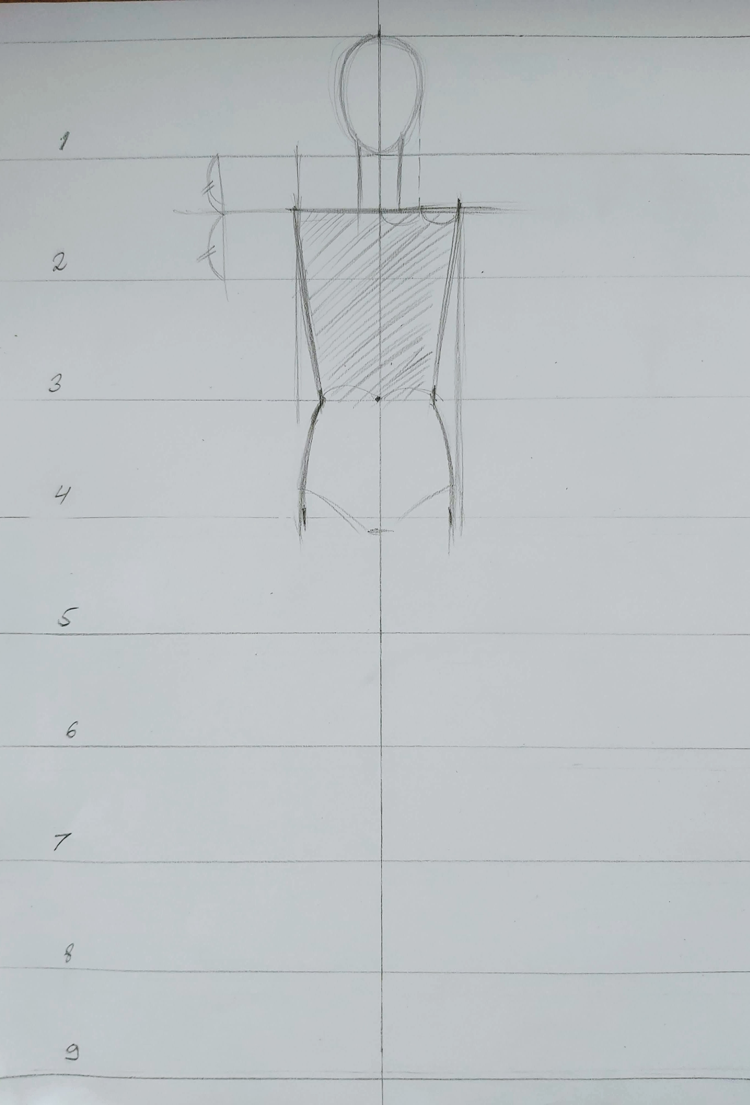
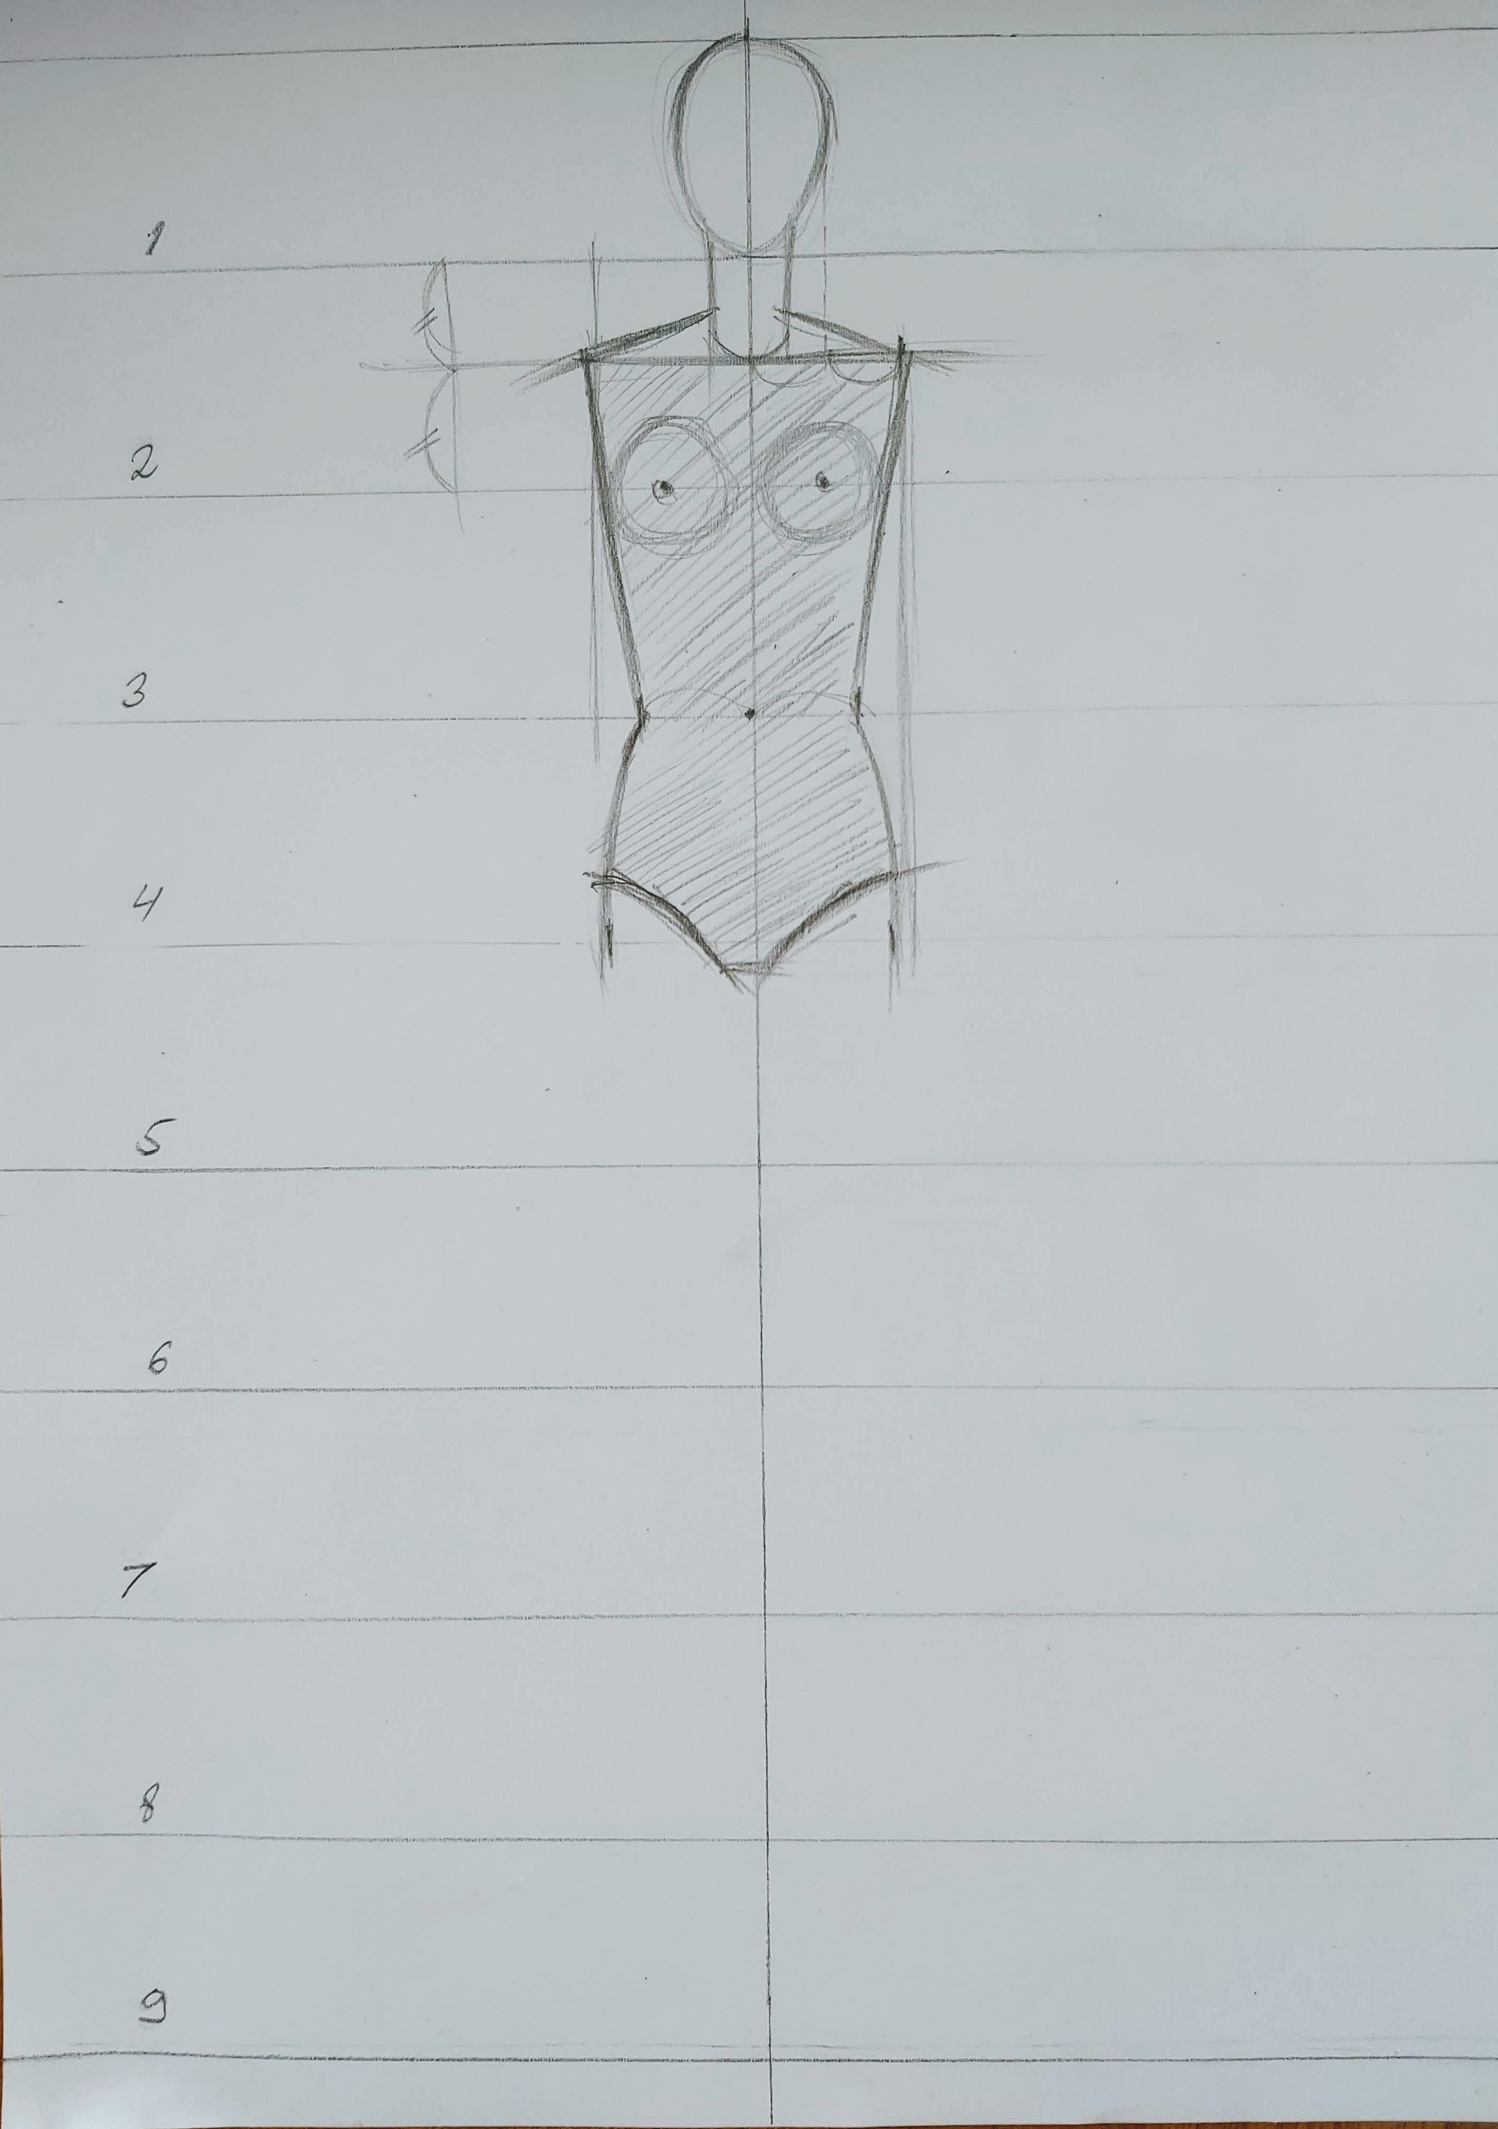
Proportion
3. Upper body
4. Shoulder falling, Lower body, Bust point, Neck
3.
Let’s connect all dots with lines. (Use a round line when you draw a lower body only.) This shape which is covered with pencil is Upper body.
4.
Now connect 1/2 of Neck line until
Shoulder line with Shoulder point
by straight line and make a shoulder falling.
Let’s make a Lower body by connecting base of leg and …
a round line.
Then draw a Bust Point
Let’s draw a neck and make it stand
Shoulder Point

Slide 4
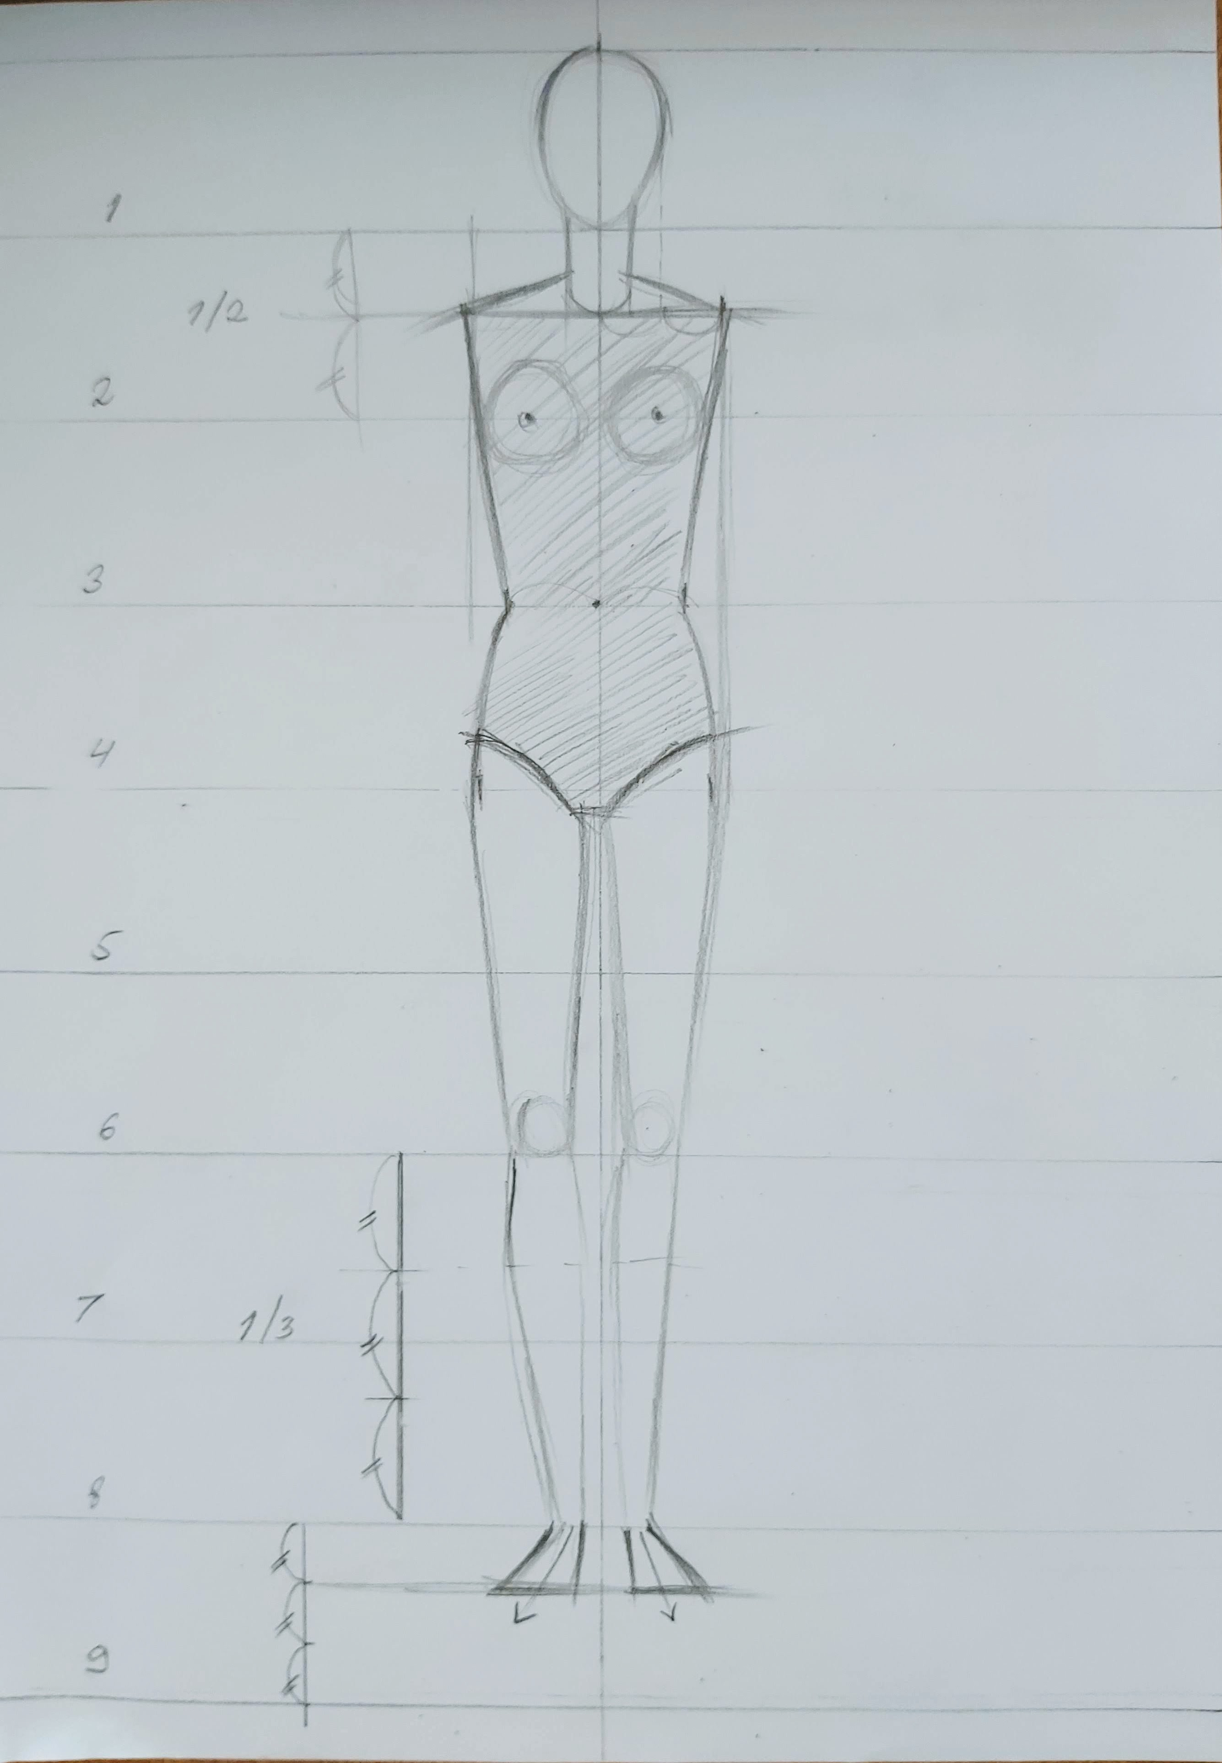
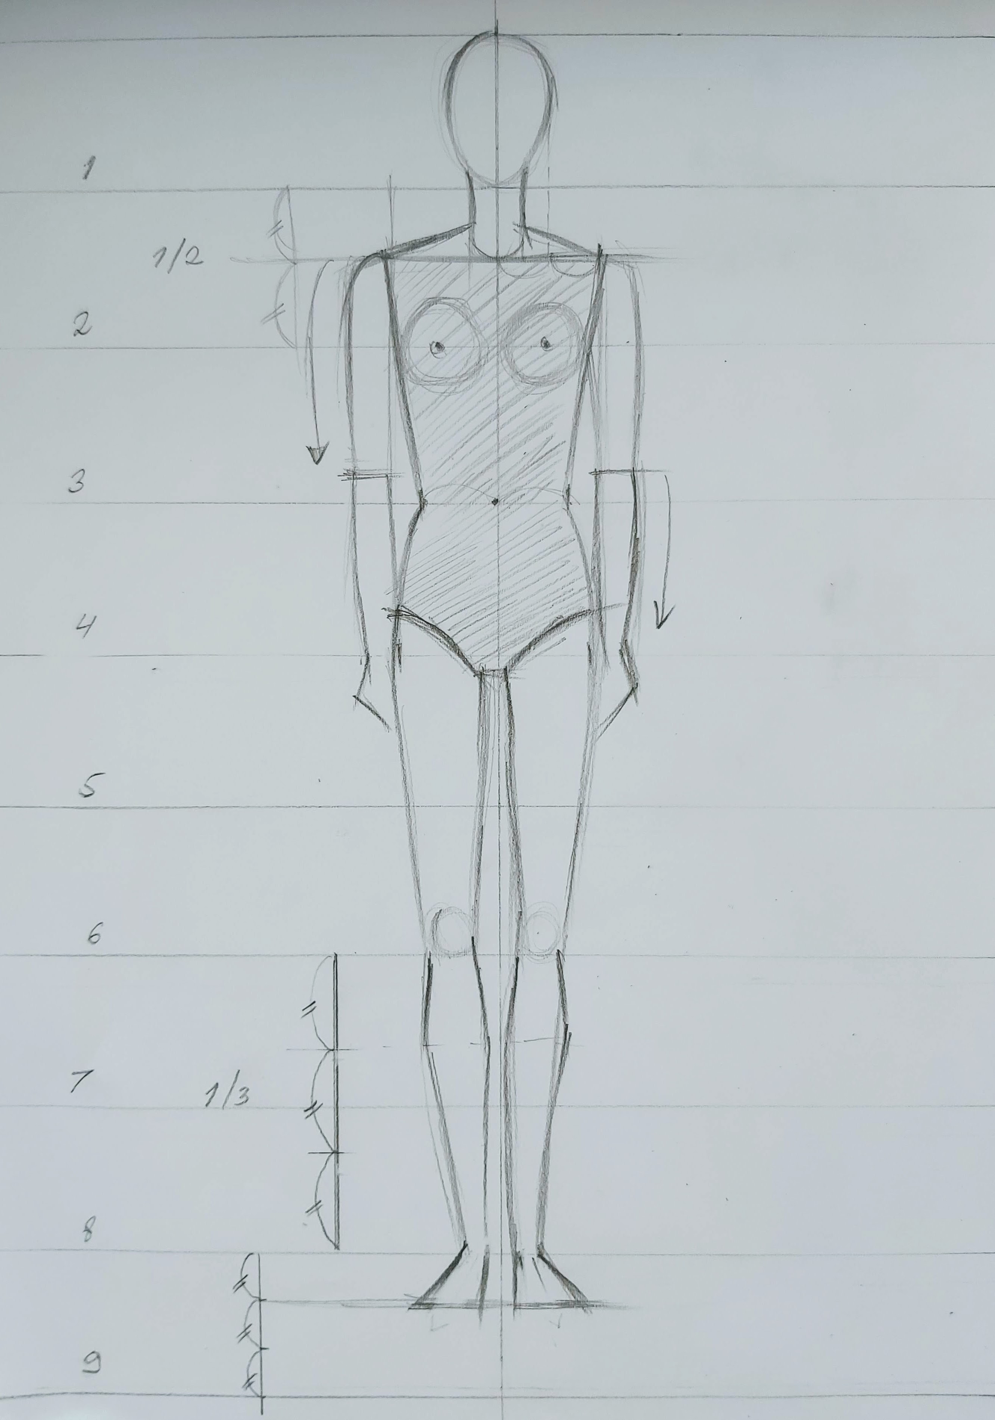
Proportion
5. Thigh, calf, leg, knee
6. Hand, upper arm, elbow
5.
At first from the base of legs till the ankle connect with a straight line. Then draw a thigh by making it narrower from both sides at knee position.
Let’s make a calf by drawing little bit thicker at 1/3 place from knee to ankle.
Draw a foot.
Verify a knee position.
6.
Draw a hand in triangular shape (The length
should cover more than a half of face)
Connect shoulder and hand tip. (When you draw an outer side make a shoulder endings with a little bit round corners and finish it with a straight line till the end of hands. On the inner side decide the thickness of an arm and draw a straight line till the wrists of hands.)
Leave arms as they are.
Make an elbow position little bit thicker.

Slide 5
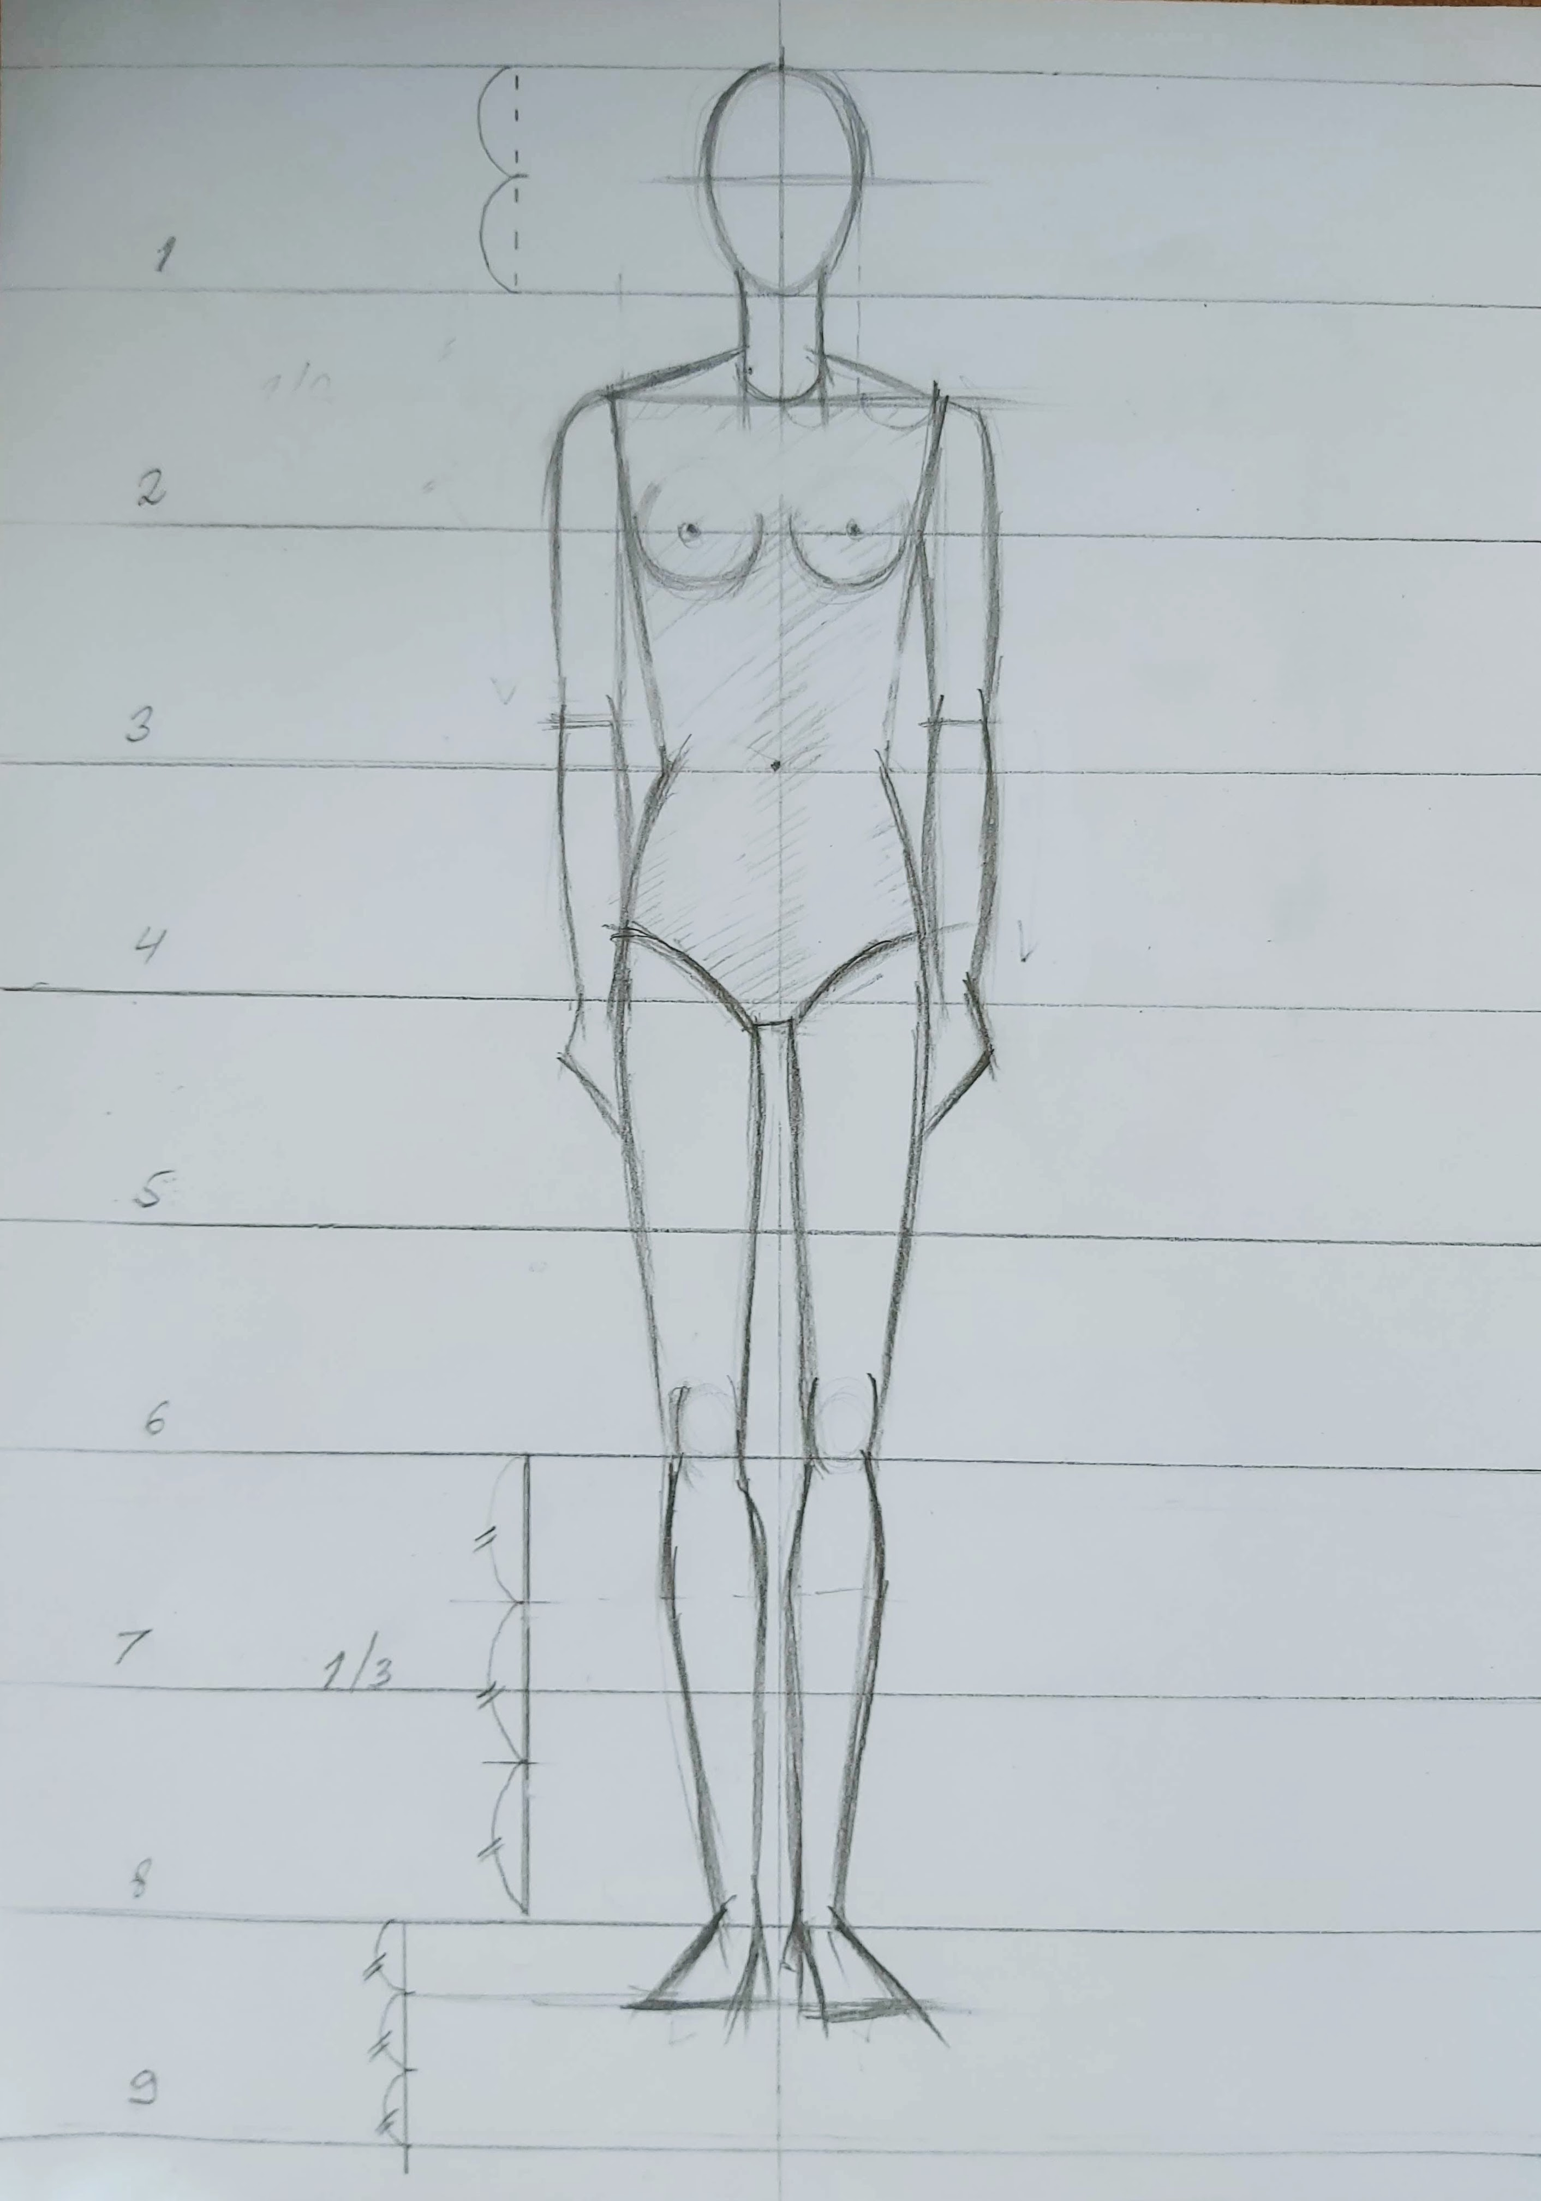
Split
Eye position 1/2
Shoulder Point
Shoulder Line
B.P.
(Bust Point)
Elbow (1/2 till wrist)
Waist
Wrist
The base of leg connection
Knee
Calf
Ankle

Slide 6
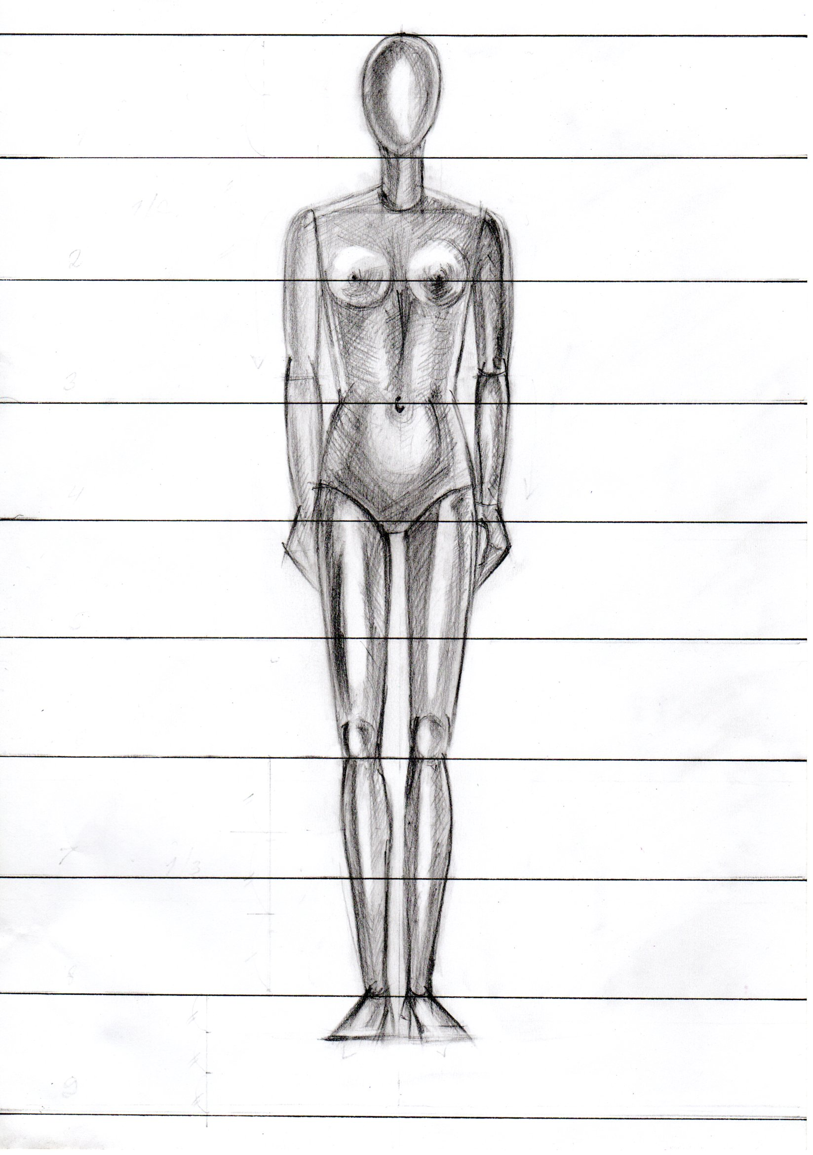

Slide 7
Fashion Design Illustration’s
proportion is usually little bit
longer than a real person.

