Slide 1
Pose Variations
When design comes naturally to head, let’s draw various beautiful poses.

Slide 2
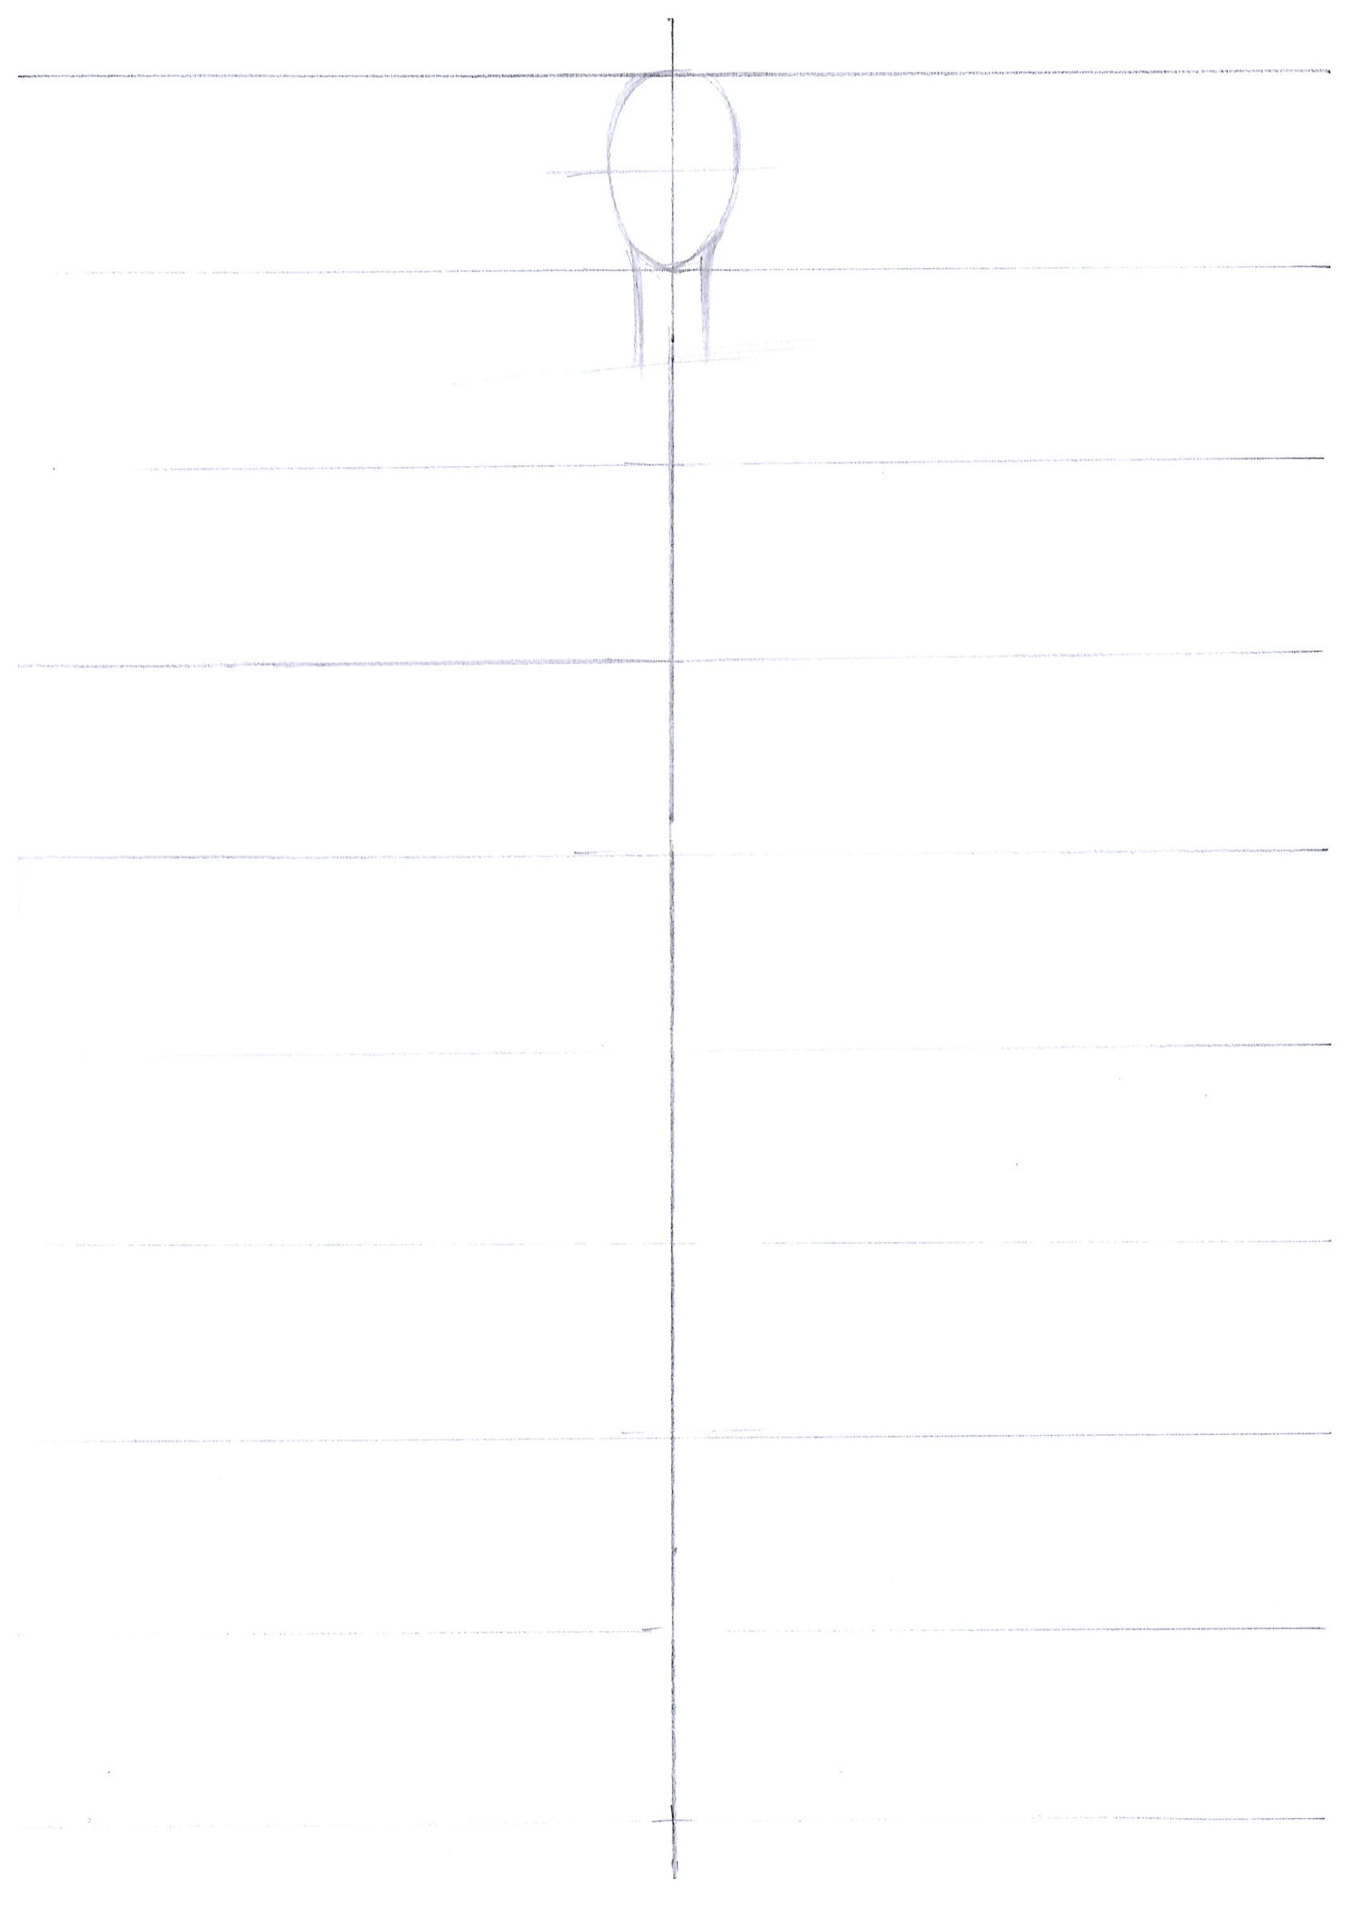
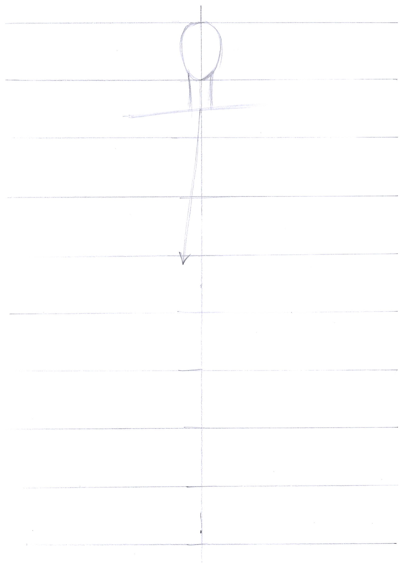
Pose Variation
Let’s draw a head
Let’s draw a shoulder line
tilted to the leg which has a center of gravity
3. Draw a neck line
4. Let’s draw a body’s center line.

Slide 3
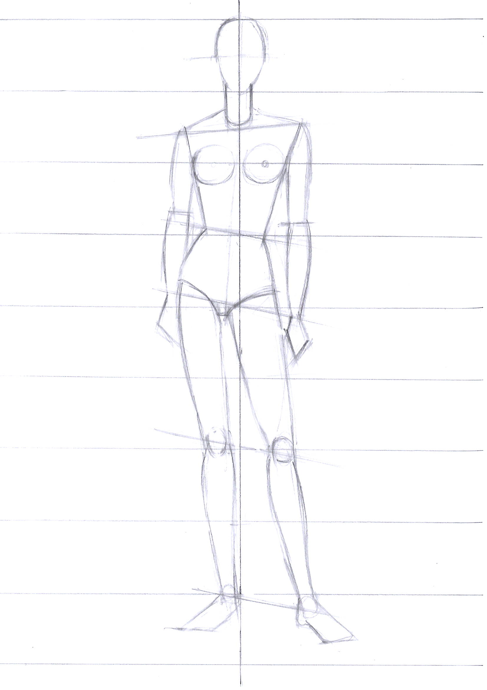
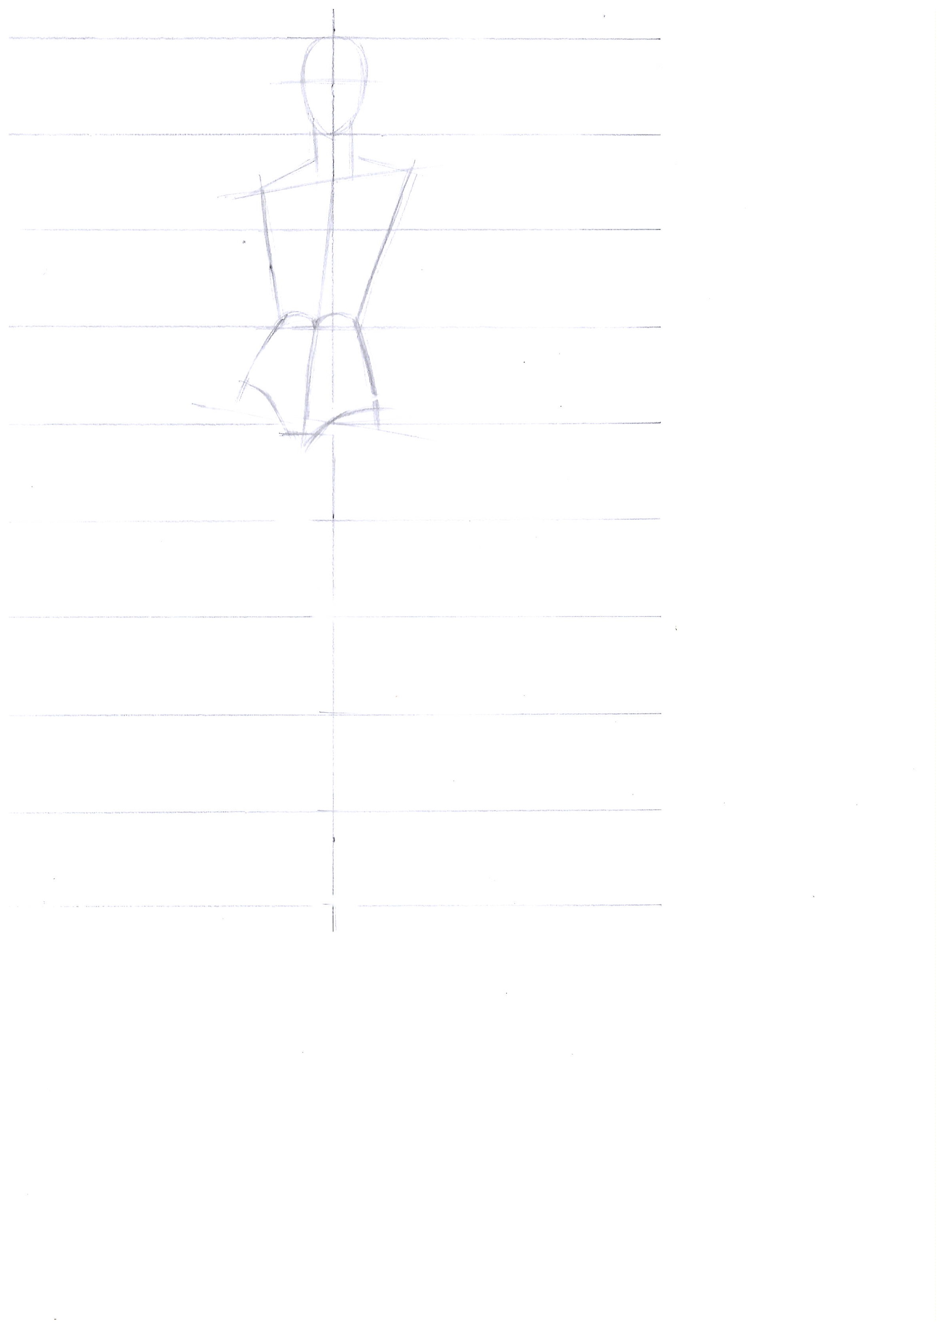
Pose Variation
5. From the central line of the body
let’s make equal right and left sides both on upper and lower parts of the body.
6. Decide ankle position.
Notice the center
of gravity. It should be
closer to the straight line.
7. Let’s draw legs.
Decide knee position.
8. Draw an arm.

Slide 4
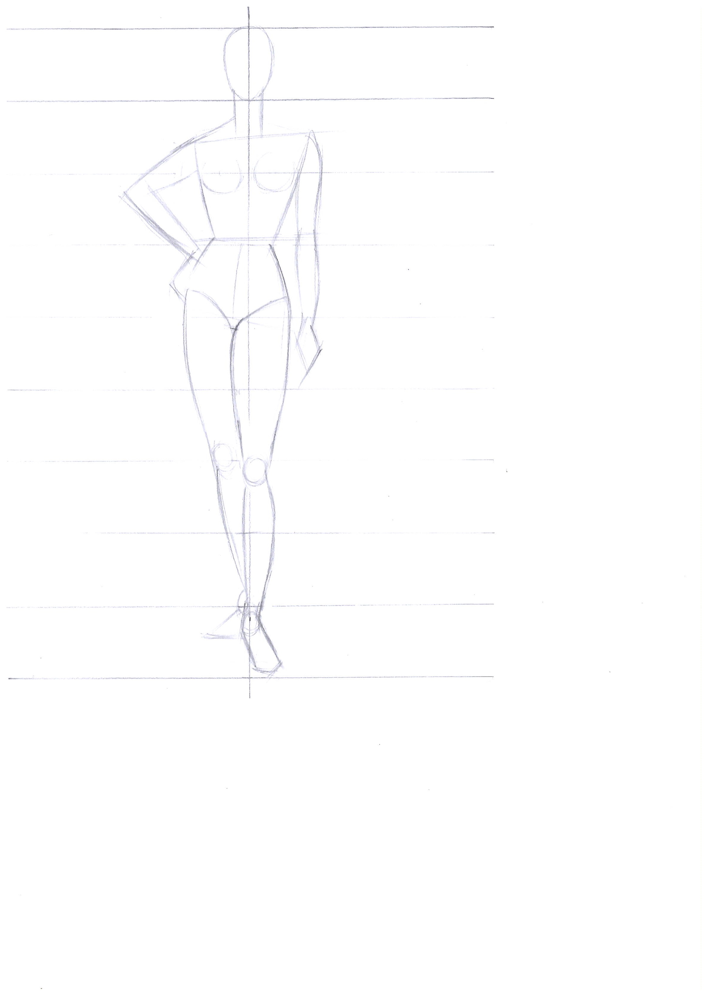
It’s possible to make different pose variations by making similar upper parts of the body and only changing leg movements.

Slide 5
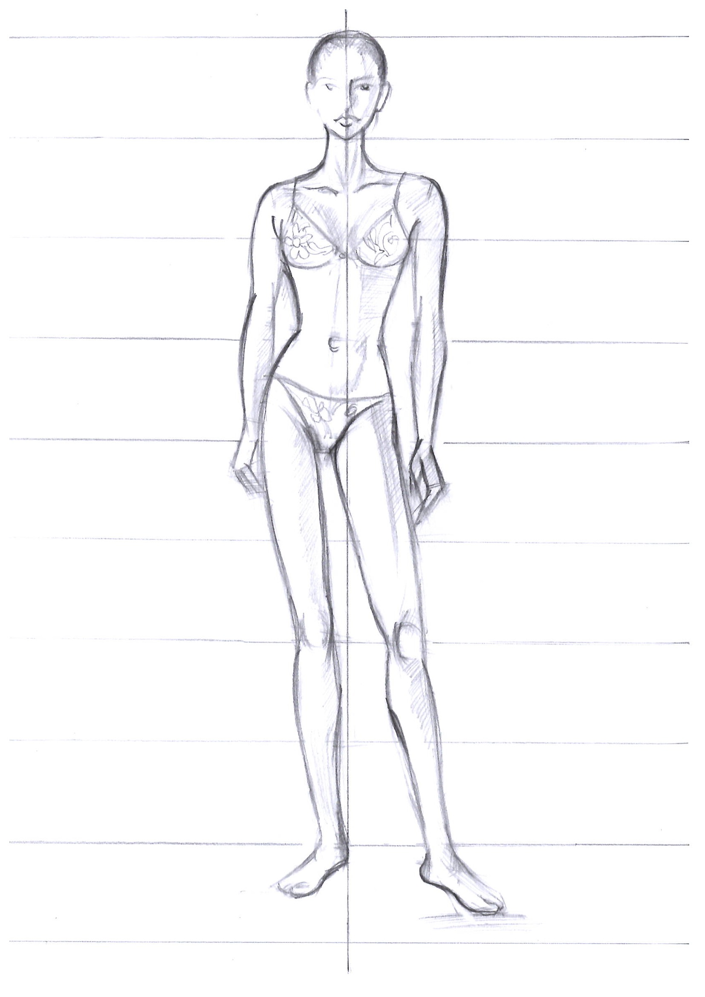
Completed model wearing a swimsuit.

Slide 6
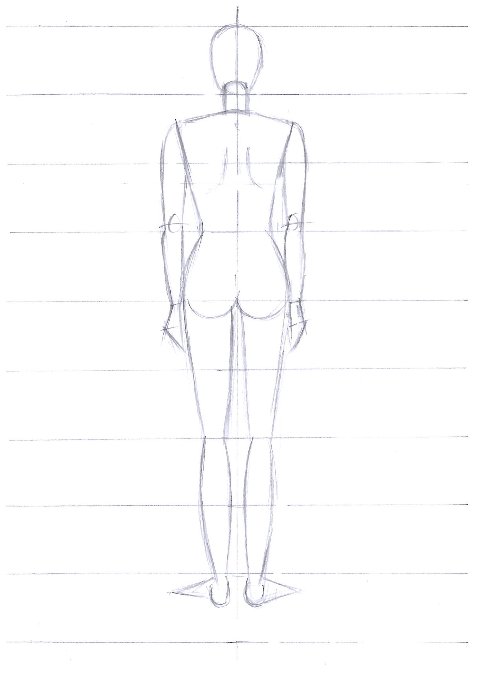
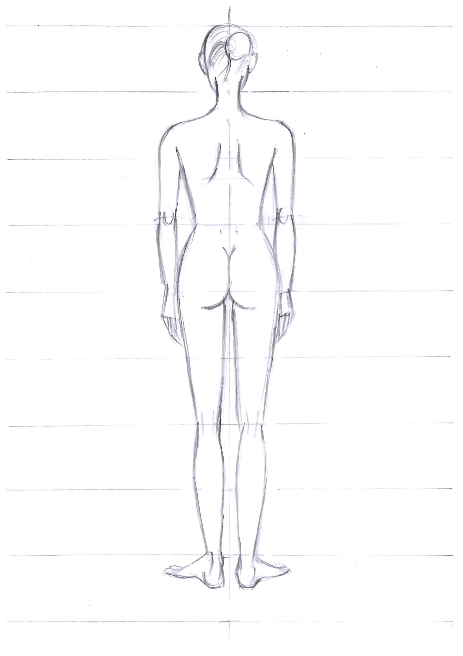
Pose Variation: Back side
Structure of a body from back side
Completed human body from back side

Slide 7
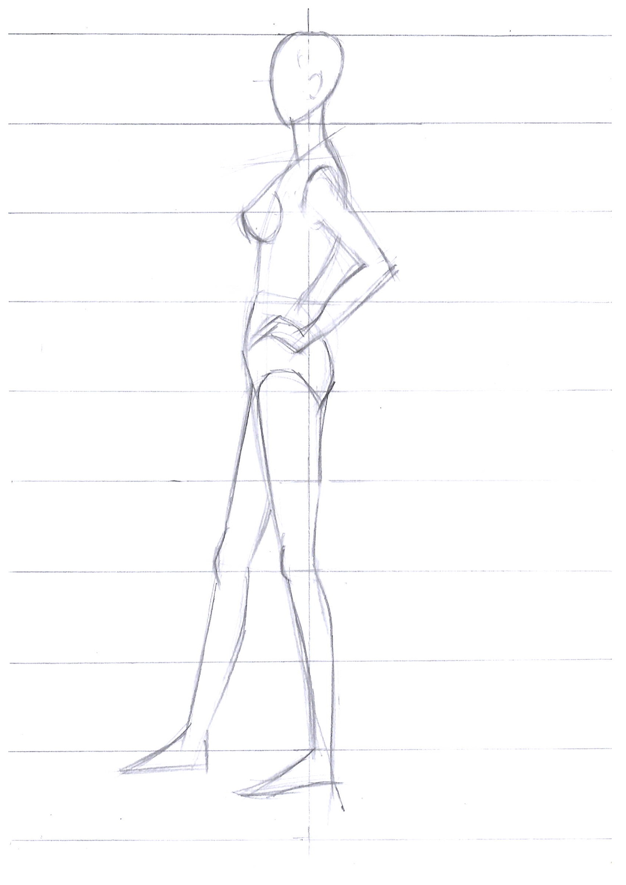
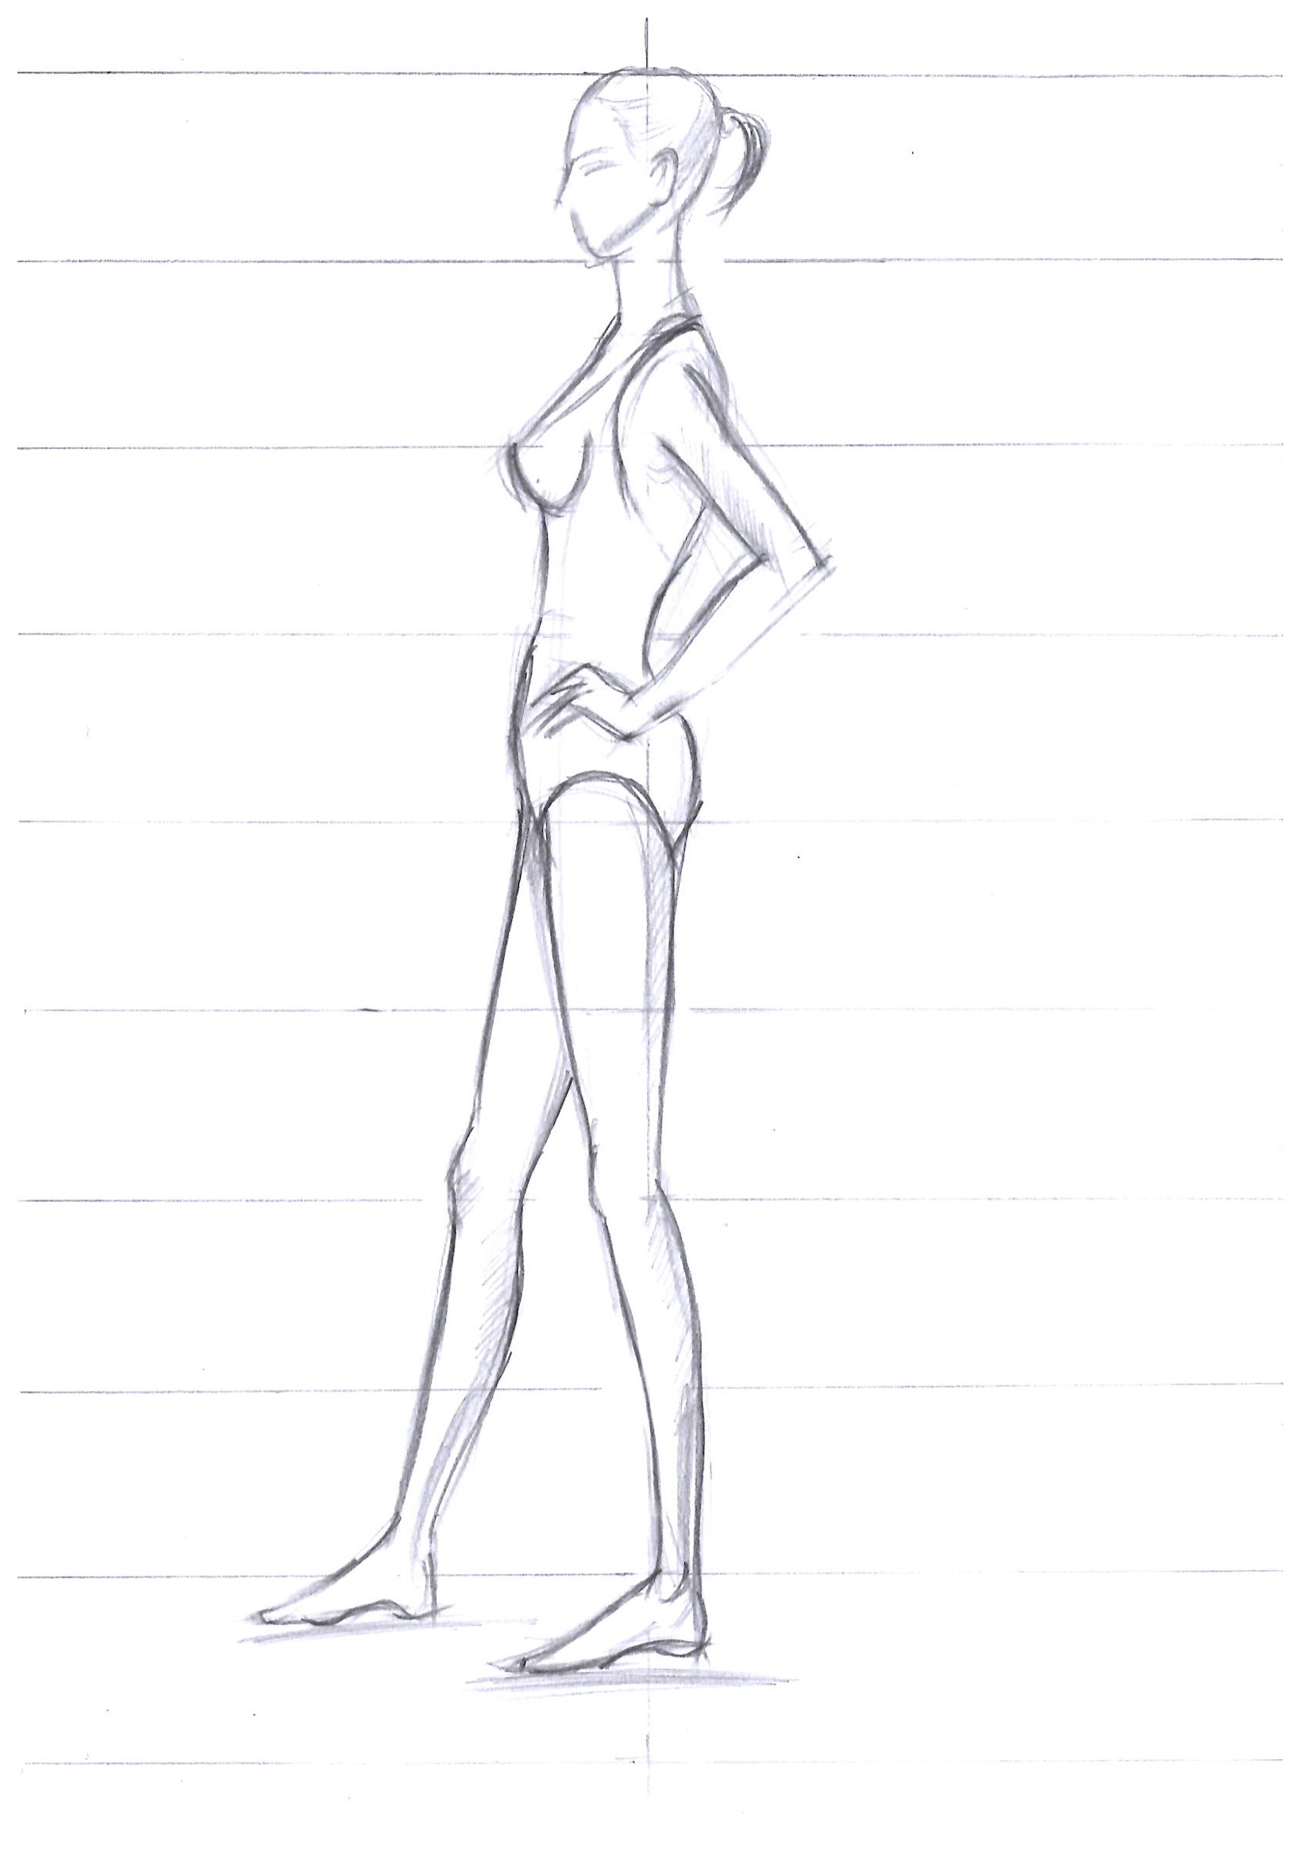
Pose variation: Side
Structure of a body from side
Completed human body from side

