Slide 1
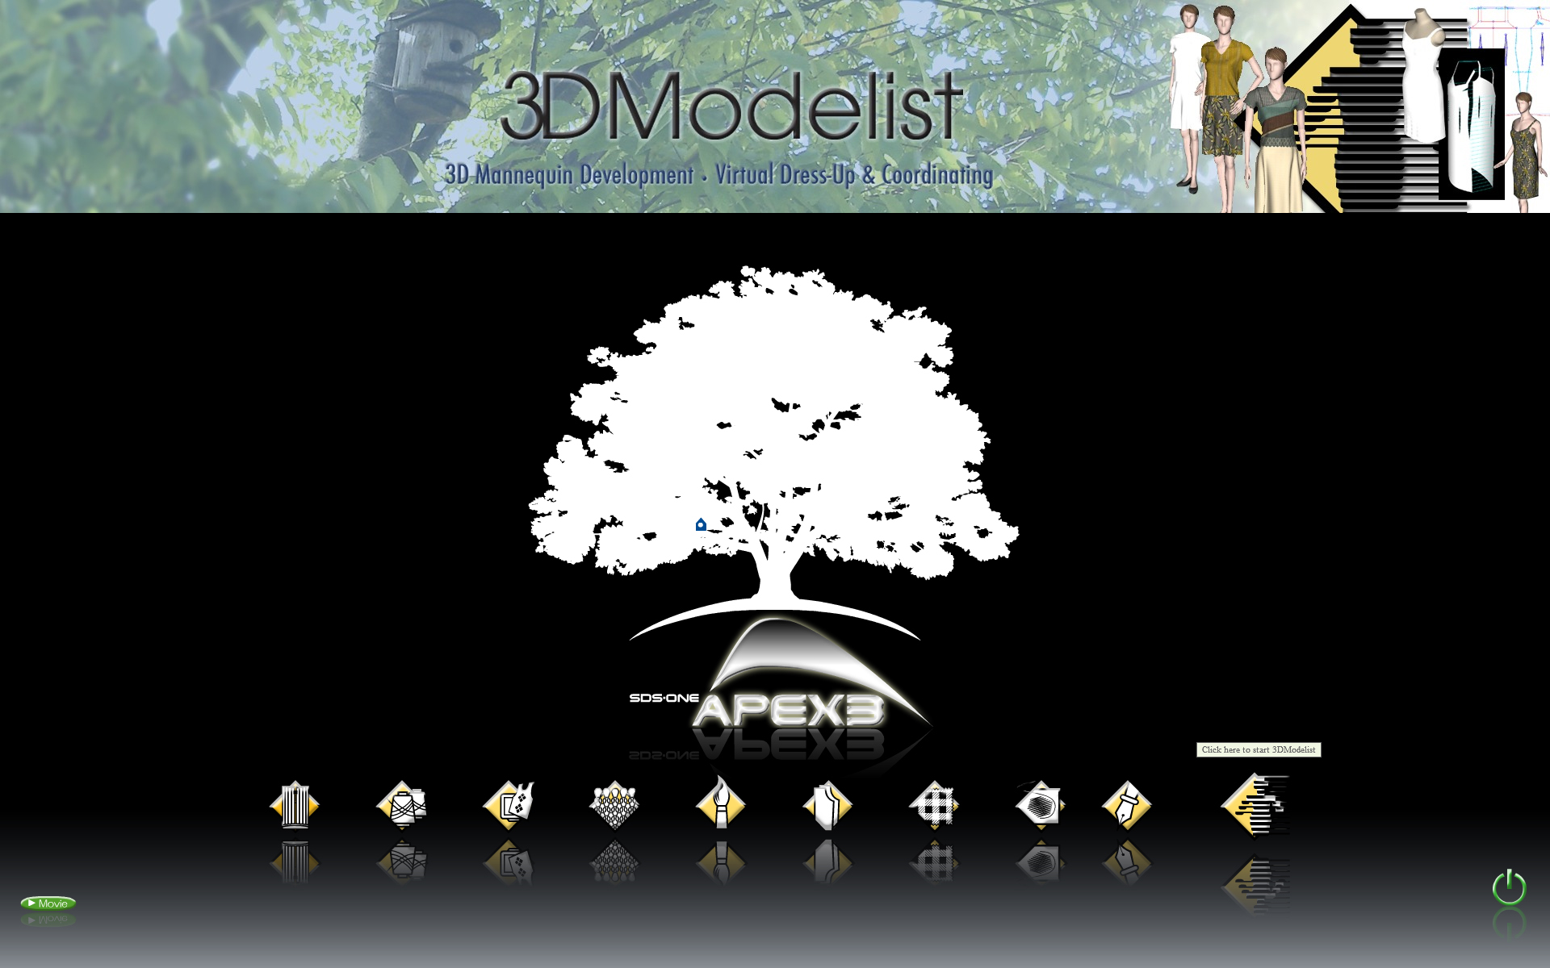

Slide 2
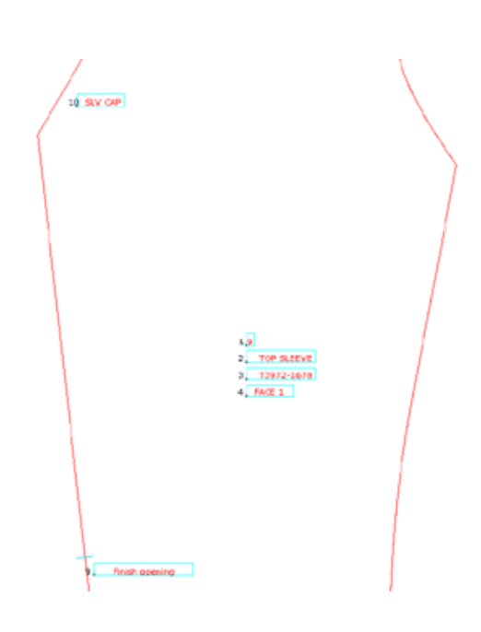
Types of character information
There are 2 character information to input for pattern: 1) parts information and 2) Name.
1. Parts information: (4 settings) Internal information to recognize parts. Item No.: Product number which can be set one for one window
Size: Size name for the pattern on the screen (e.g.) 9, M. etc. Part name: Name for each pattern
Fabric type: Fabric type to be used and number of necessary piece (1 for each of front and back bodies, total 2 pieces for left and right sleeves, etc.)
2. Name: Character to be output with plotter or printer which is writen on pattern as text. (See the figure on the right)

Slide 3
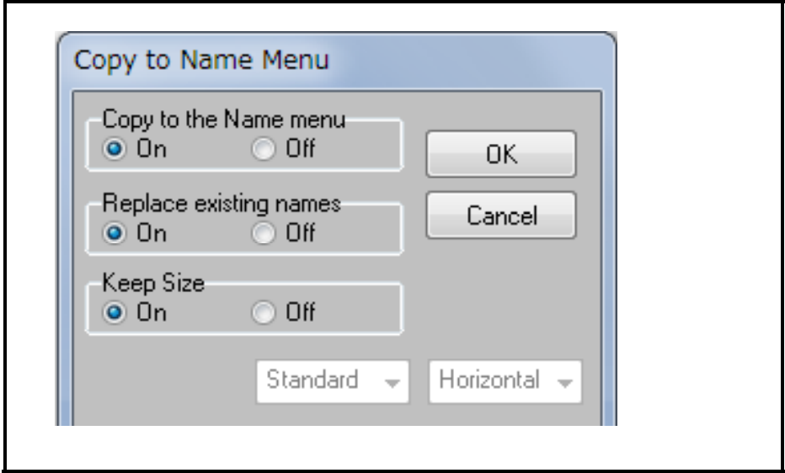
Copy to the Name menu:
Copies as [Name] when inputting part information. (Name number: 1 to 8)
* Procedure: 1) Input parts information. 2) Write character information such as comment by using [Name] function. (Name number: 9 and later)
☆When parts information and name do not work together, select [On] for [Copy to the Name menu] in Parts information menu. Then, press OK button.

Slide 4
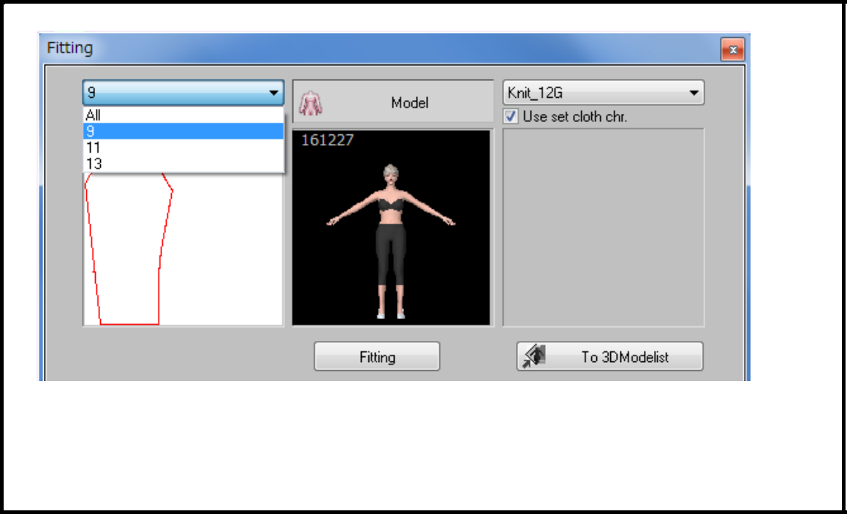
Working part information together with fitting
Size
When setting the data with grading executed or setting multiple sizes within window, size selection menu is displayed in fitting menu and only desired size can be selected.
When the data has only 1 size, selection menu is not displayed.

Slide 5
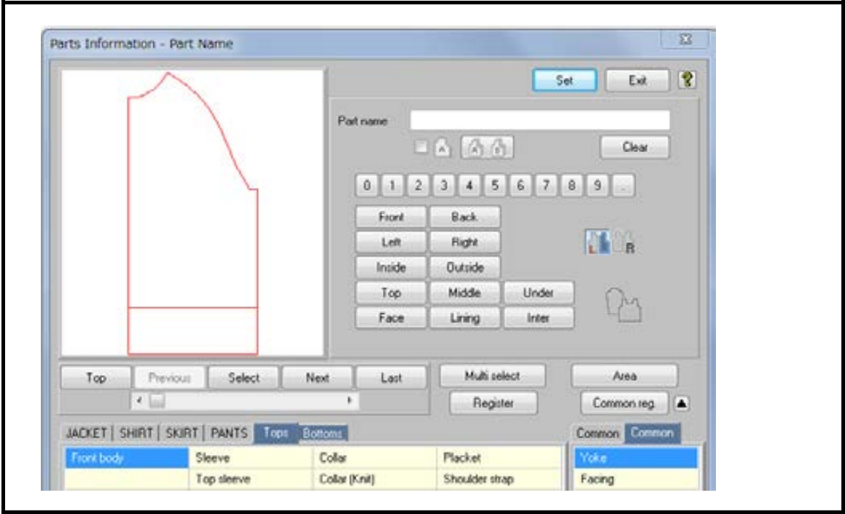
Part name
By inputting the word on colored tab in the menu, data is input simultaneously for [Layout Setting] (positional information on 3D) and [Knit Information] (working together when sending the pattern to KnitPaint software).
When setting on usual tab, [Layout Setting] is automatically input if words match when opening [3D Sewing Lines] menu.

Slide 6
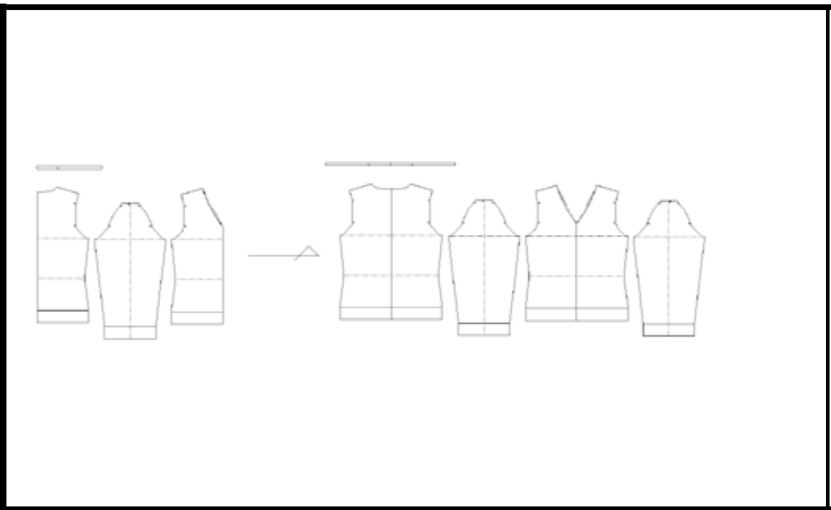
Fabric type
When setting pieces to be used, 2 pieces and the setting parts are copied for left and right in [Mirror] menu within fitting.
☆For the pattern with half body, it can be developed to both bodies by setting [Register Fold Line].

Slide 7
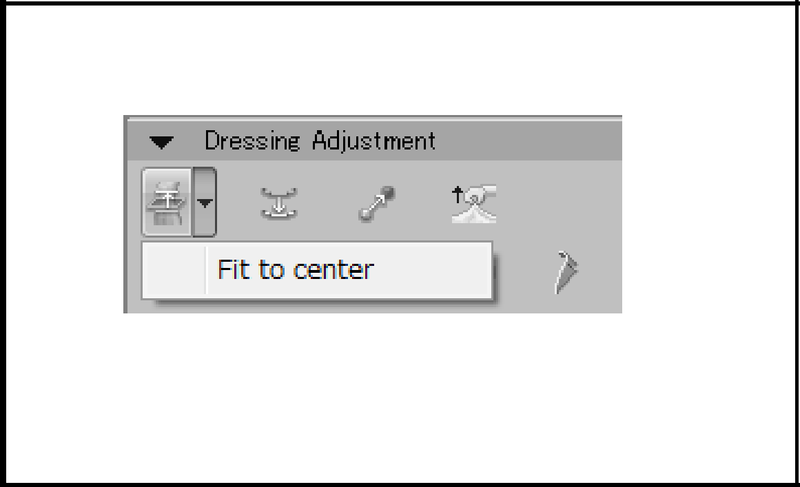
Name
By inputting [EXNAME] tab in name function, [Layout Setting] for part and [Dressing Adjustment] within fitting work together when conditions match.
When writing front center and back center, [Fit to center] in fitting is available and simulation can be executed by fixing the center line even for half body.

Slide 8
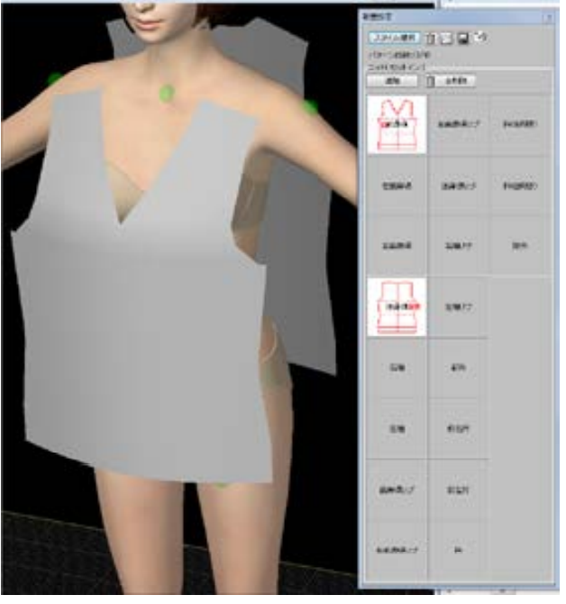
Reference information
Layout Setting
By setting each pattern, the pattern is laid out around the body for fitting.
☆By selecting style, often-used words are listed up. Even for the same layout setting, layout is automatically adjusted according to each style.

Slide 9
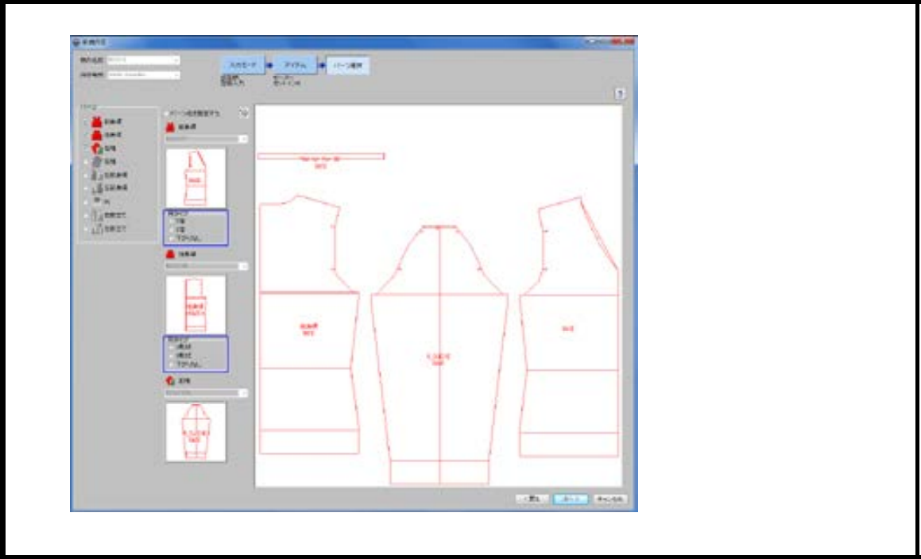
Knit information
Part information: By setting part name on the colored tab for part name, knit information is added. When opening the pattern data in knit software, element selection for each part and direction of pattern mirror process, etc. are automatically selected.

Slide 10
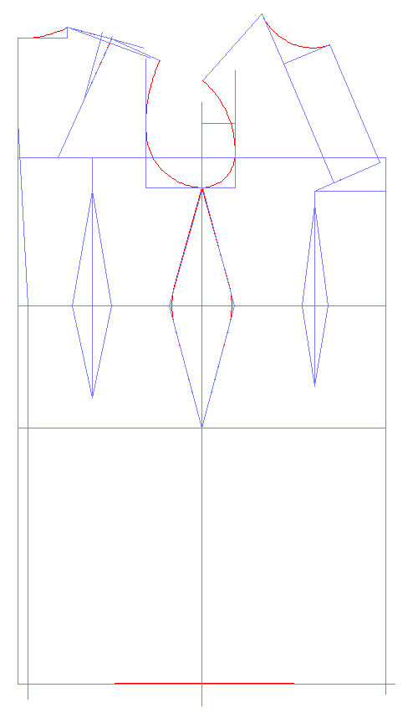
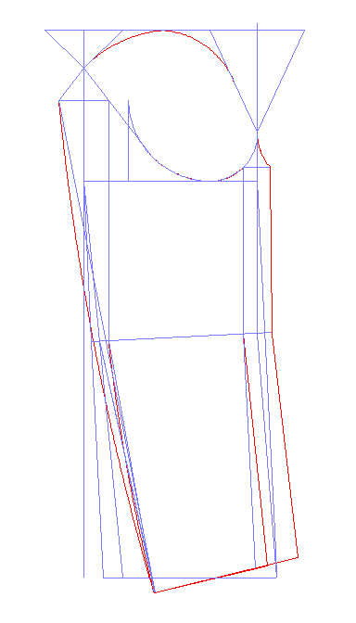

Slide 11
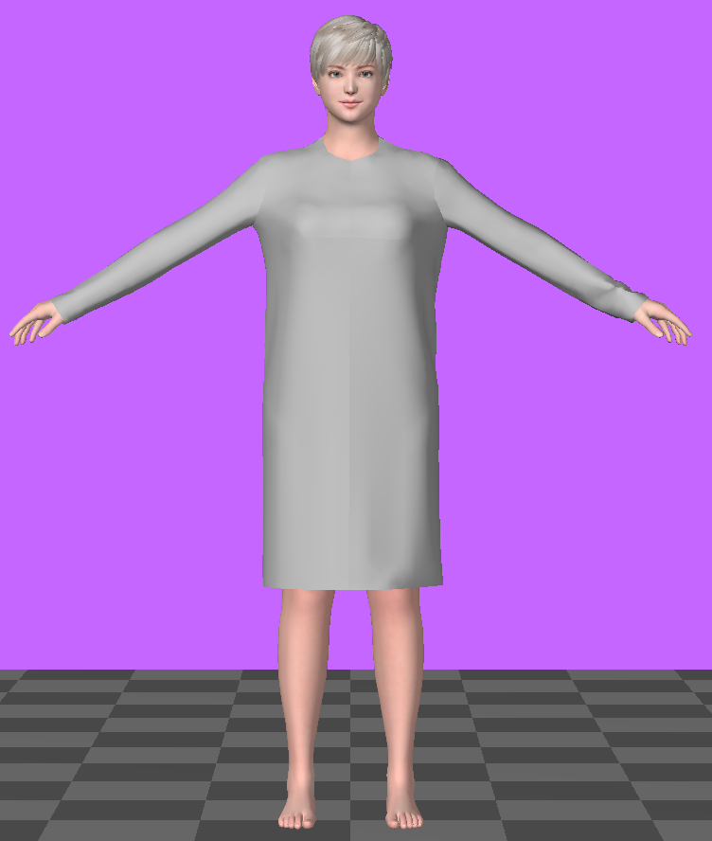

Slide 12
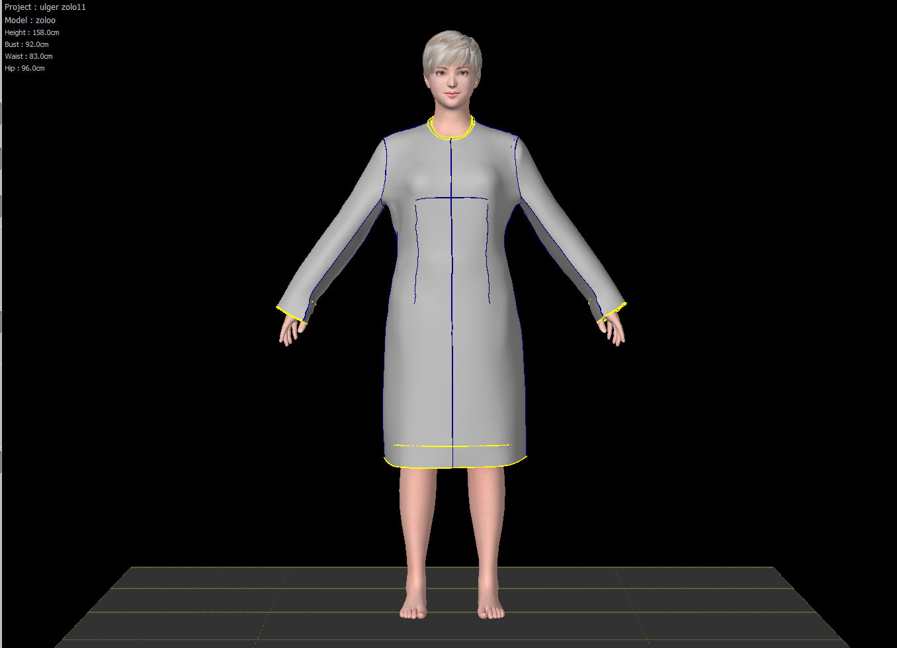

Slide 13
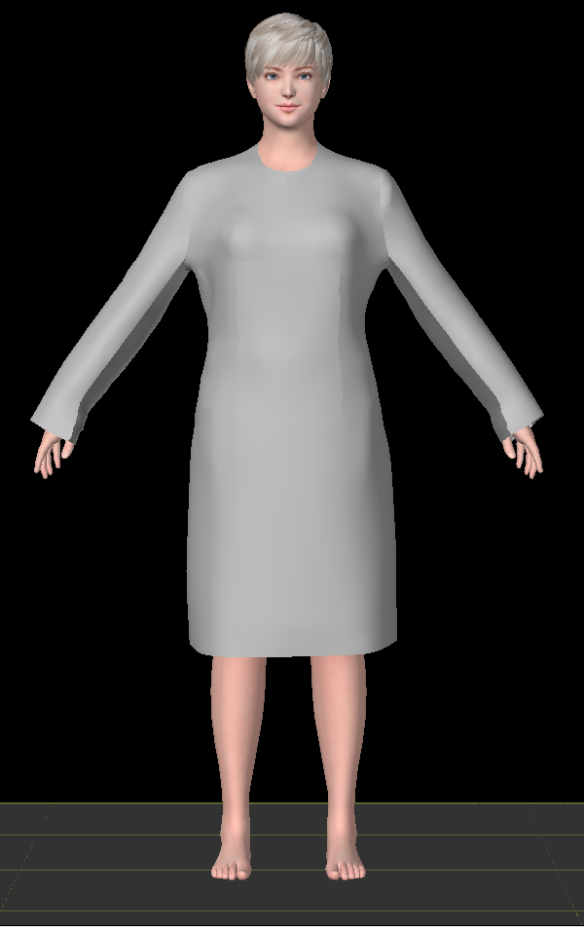
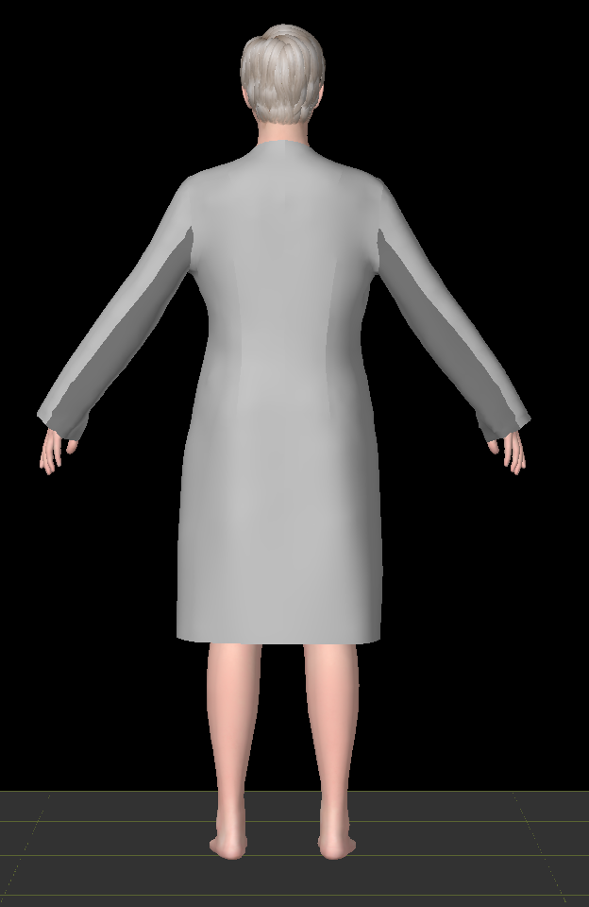

Slide 14
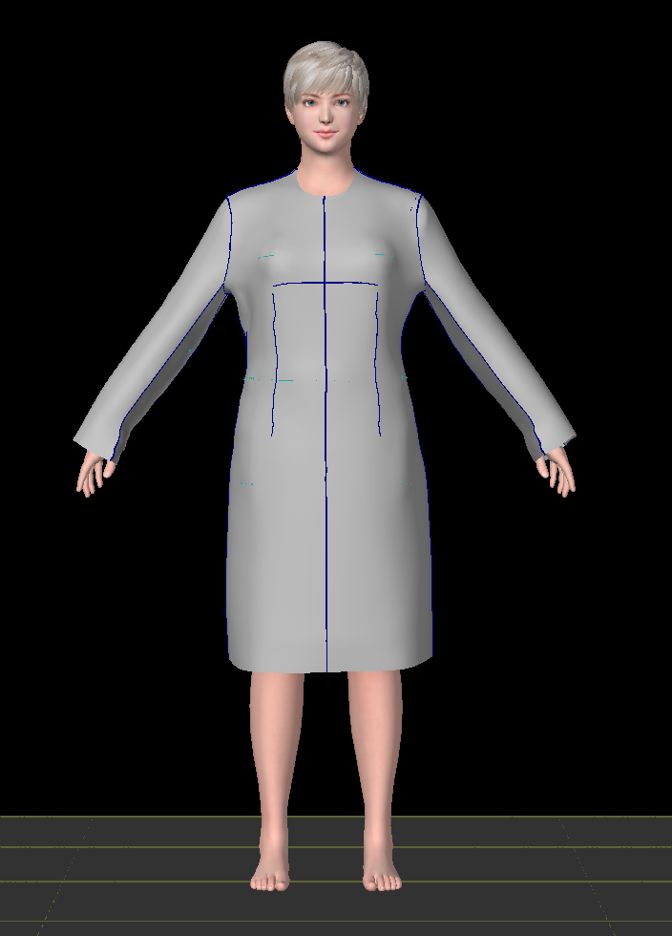
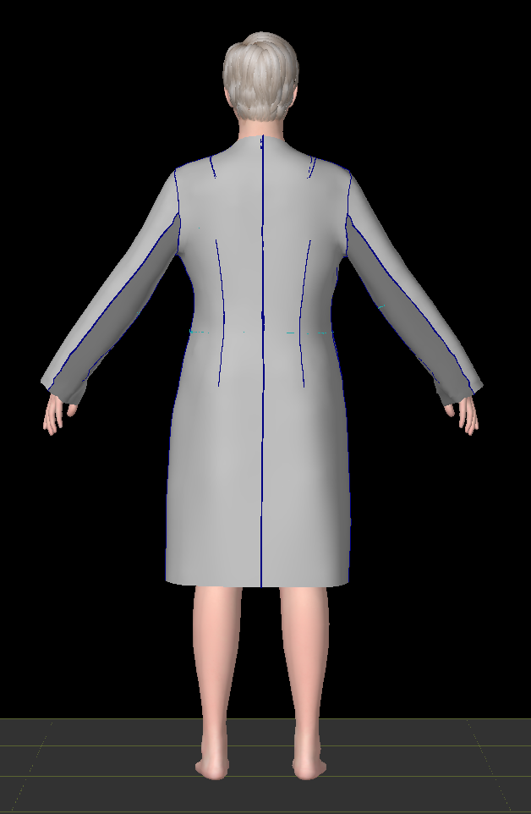

Slide 15
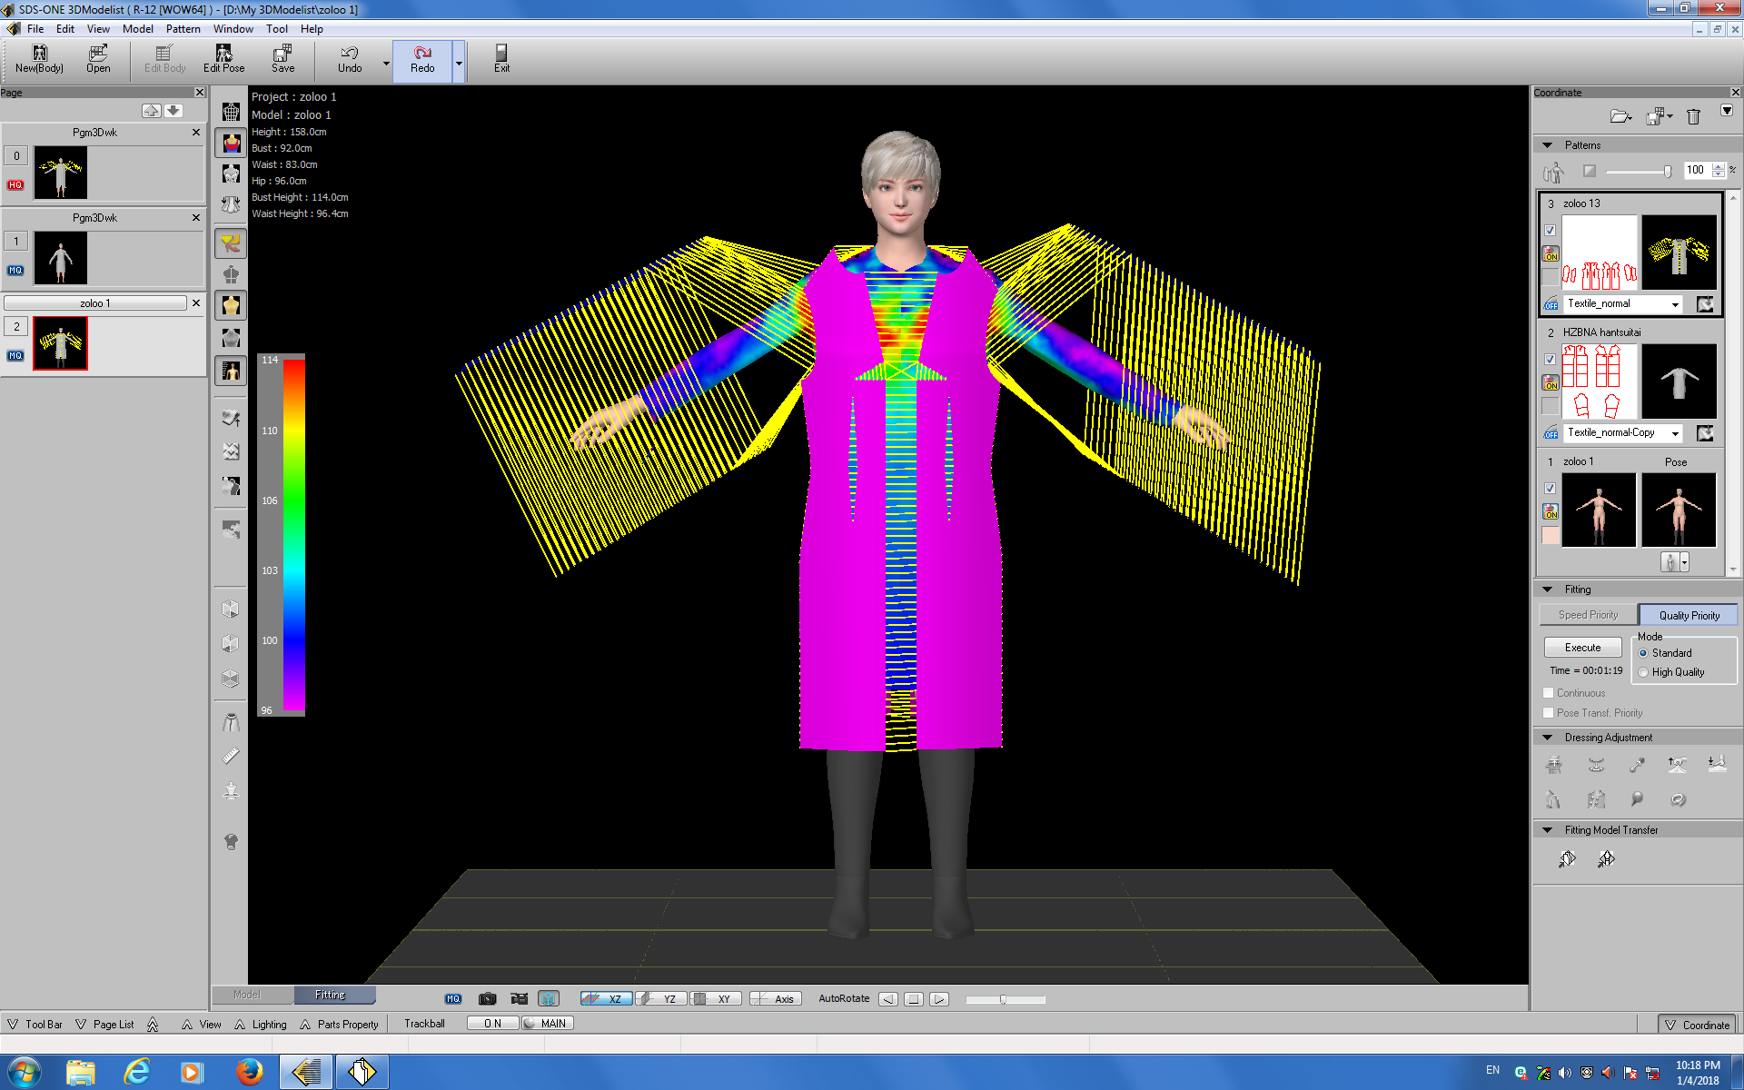

Slide 16
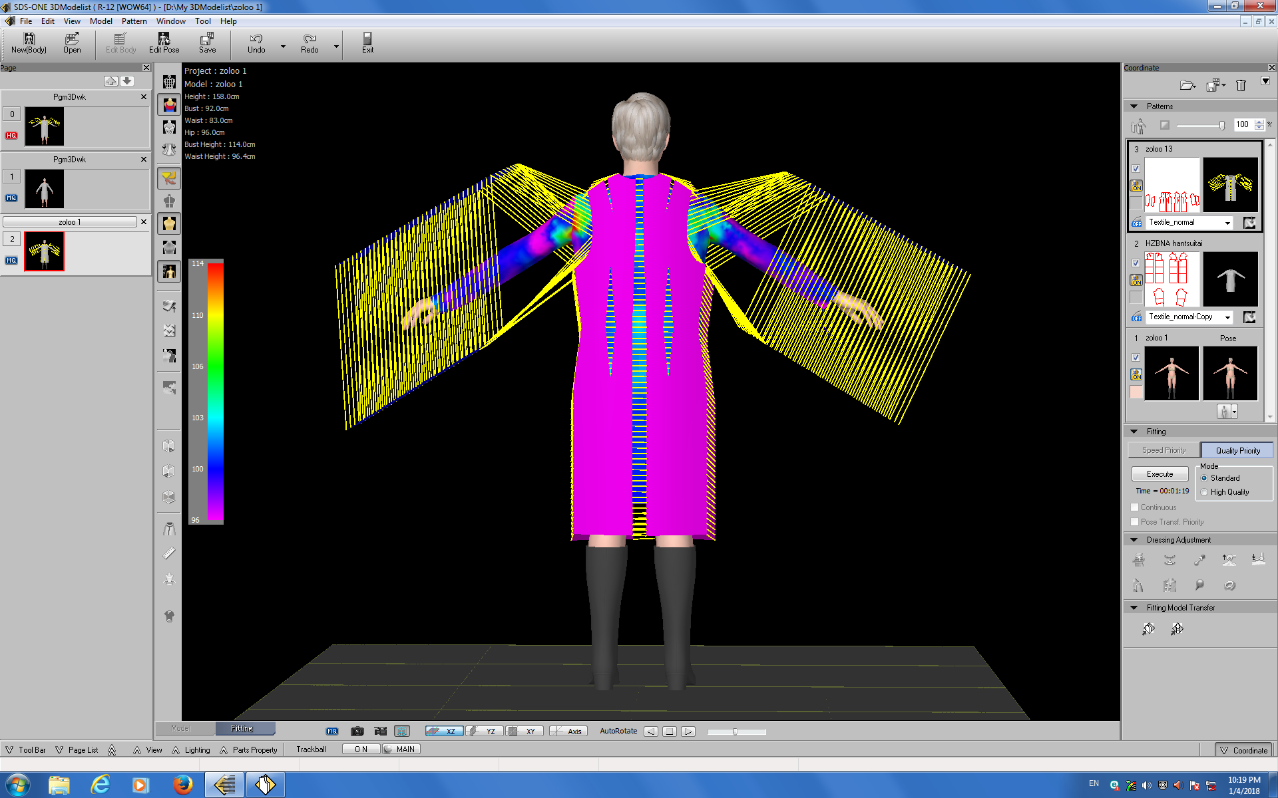

Slide 17
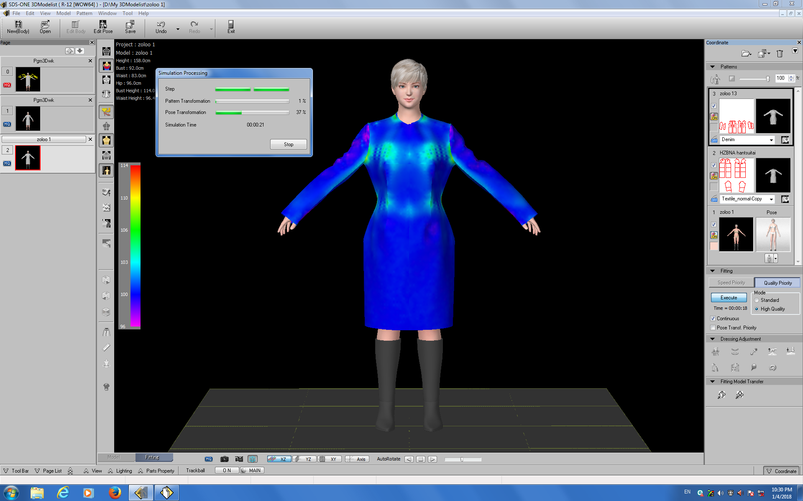

Slide 18
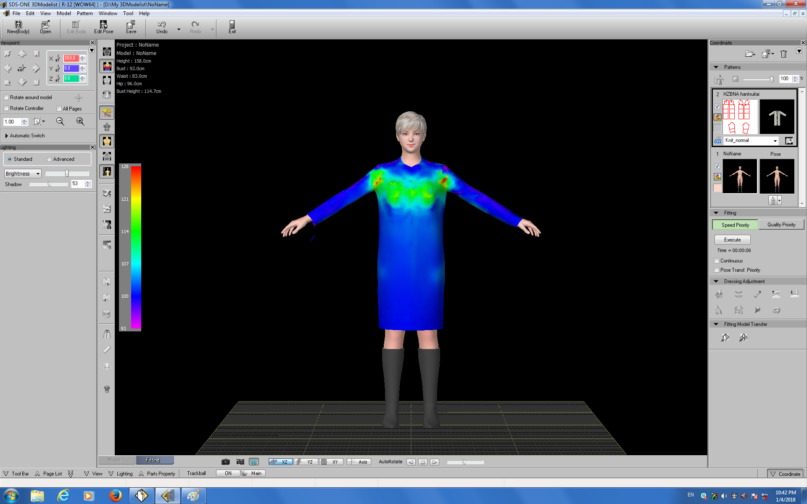

Slide 19
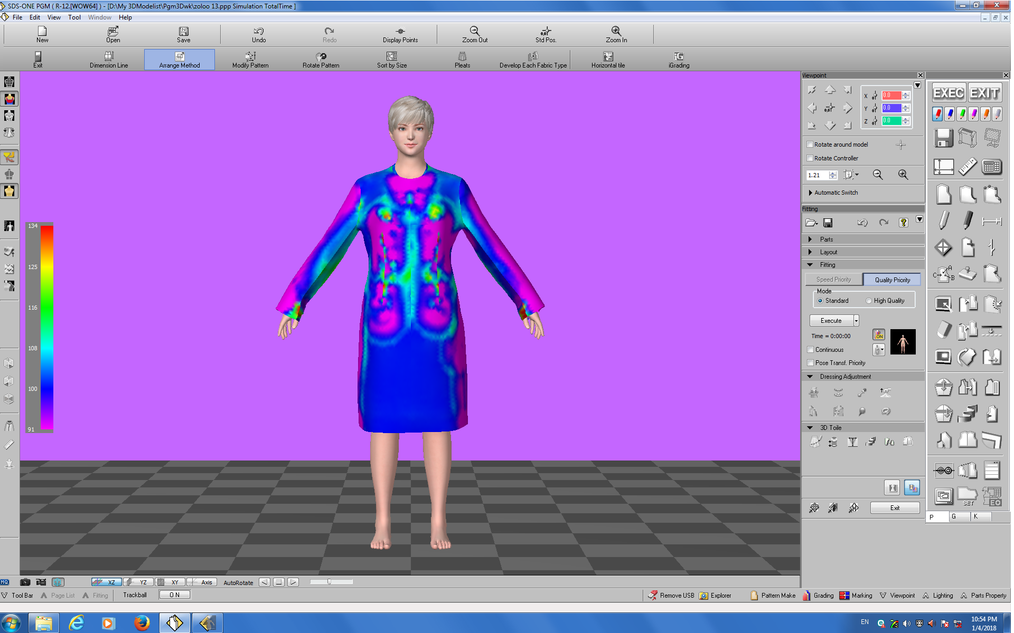

Slide 20
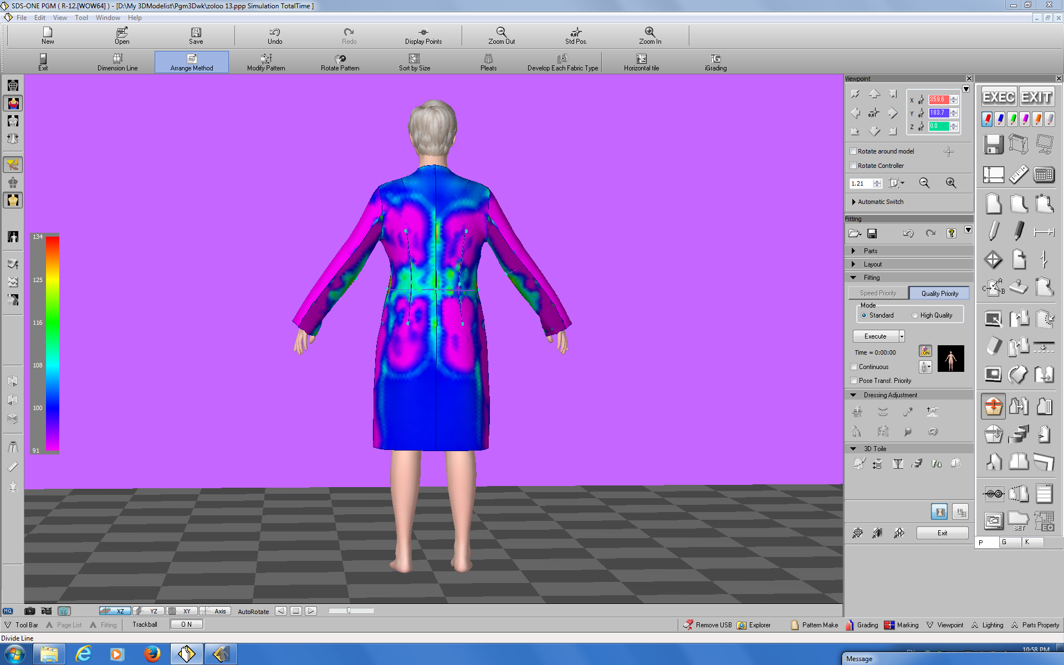

Slide 21
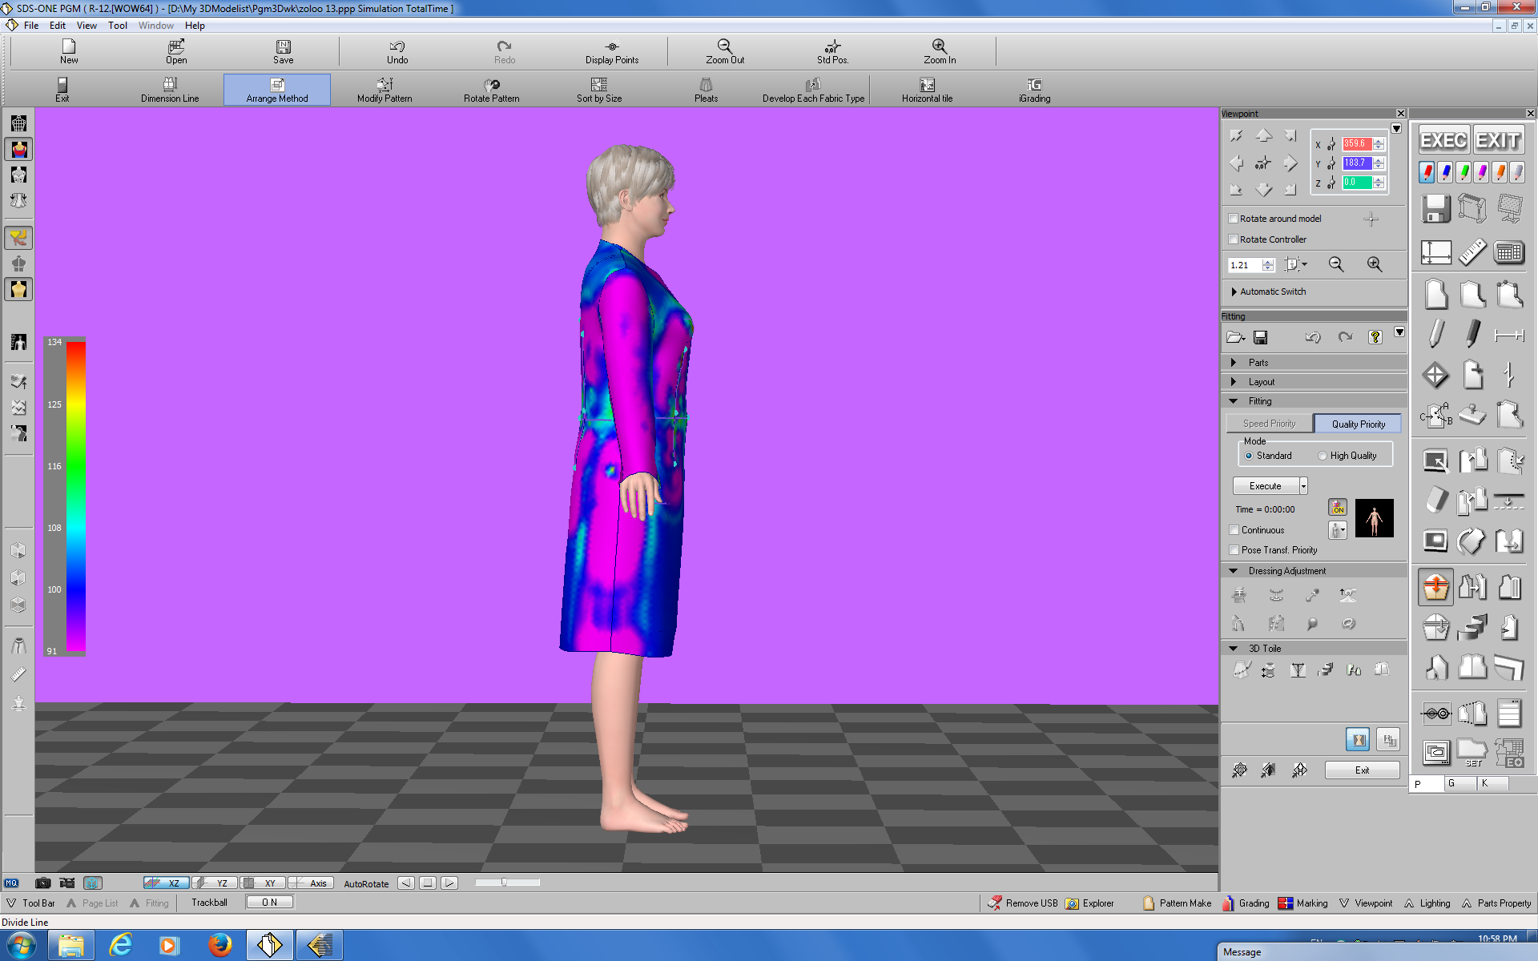

Slide 22
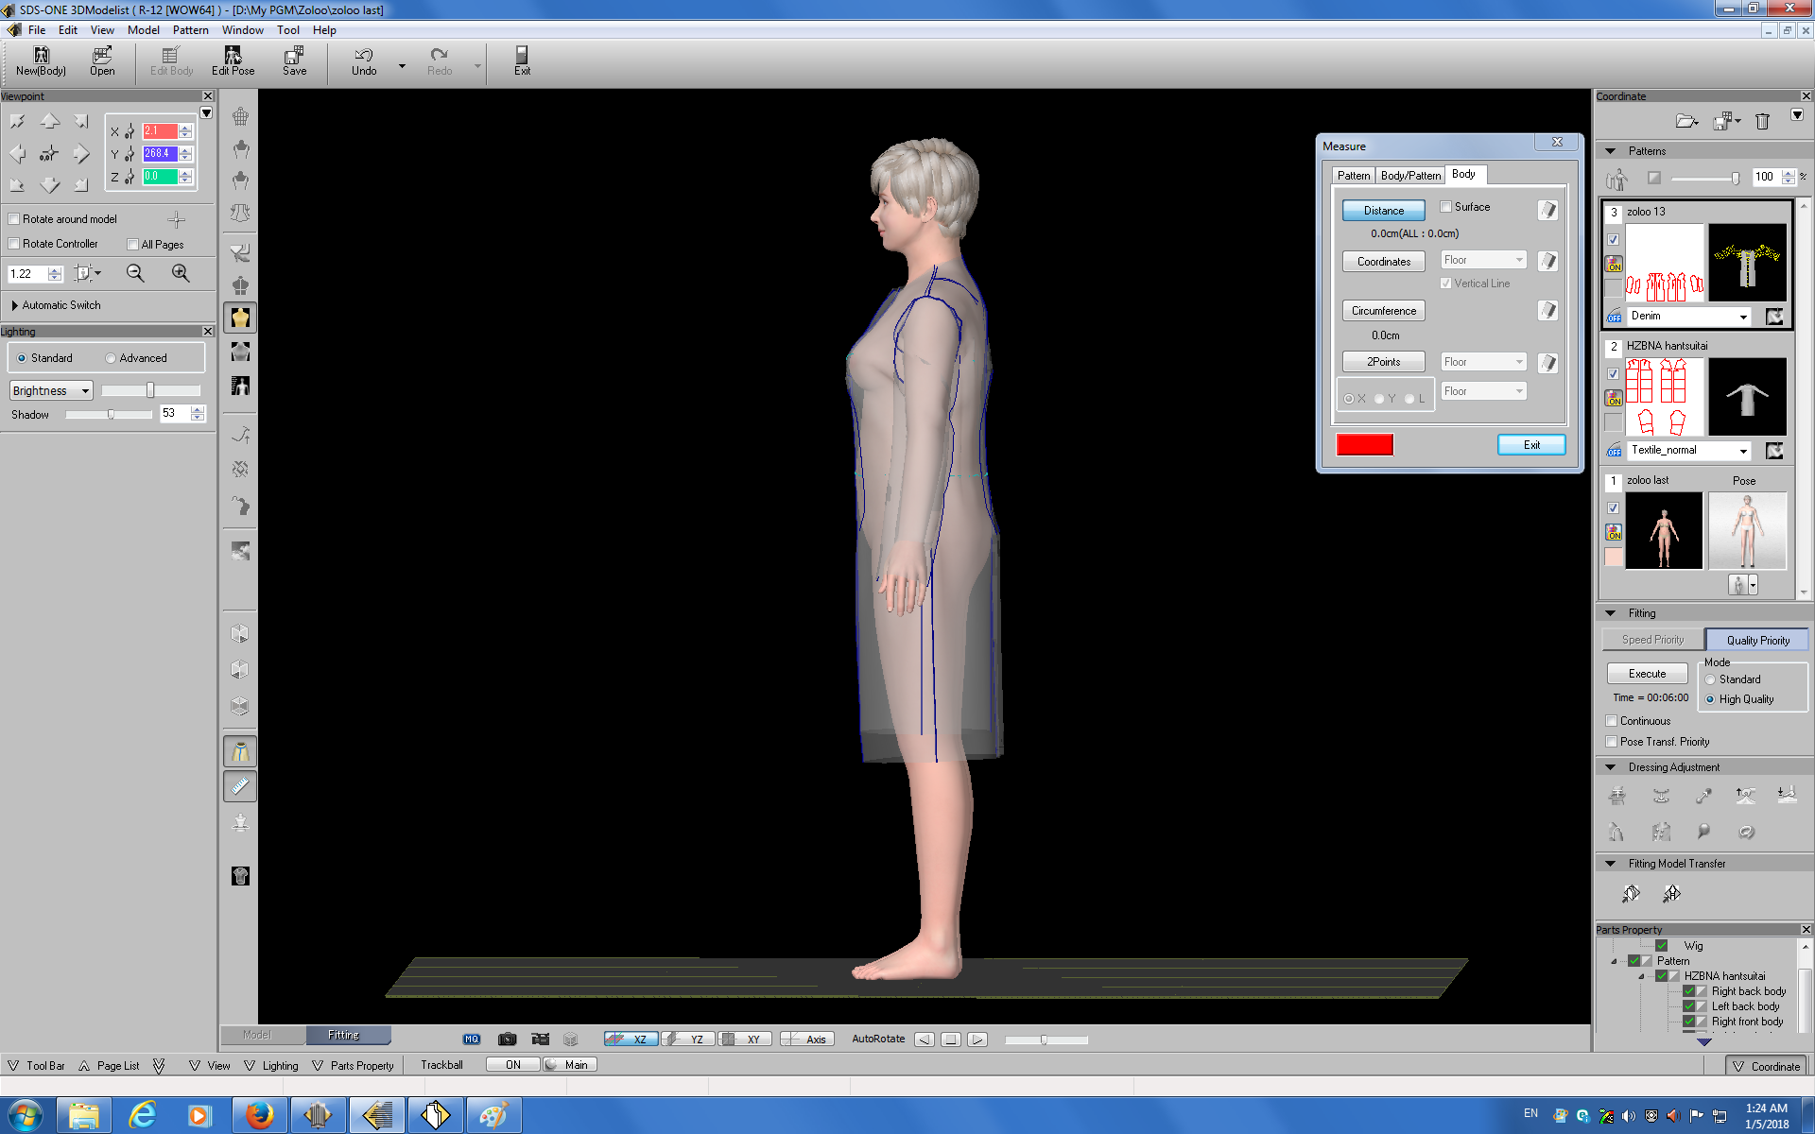

Slide 23
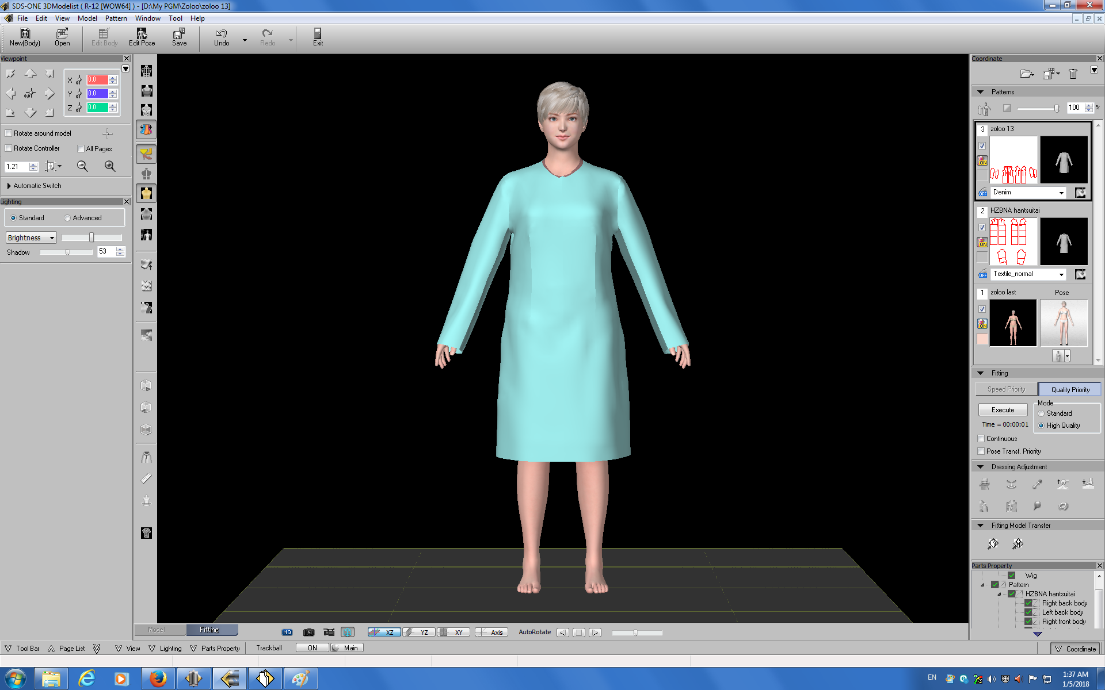

Slide 24
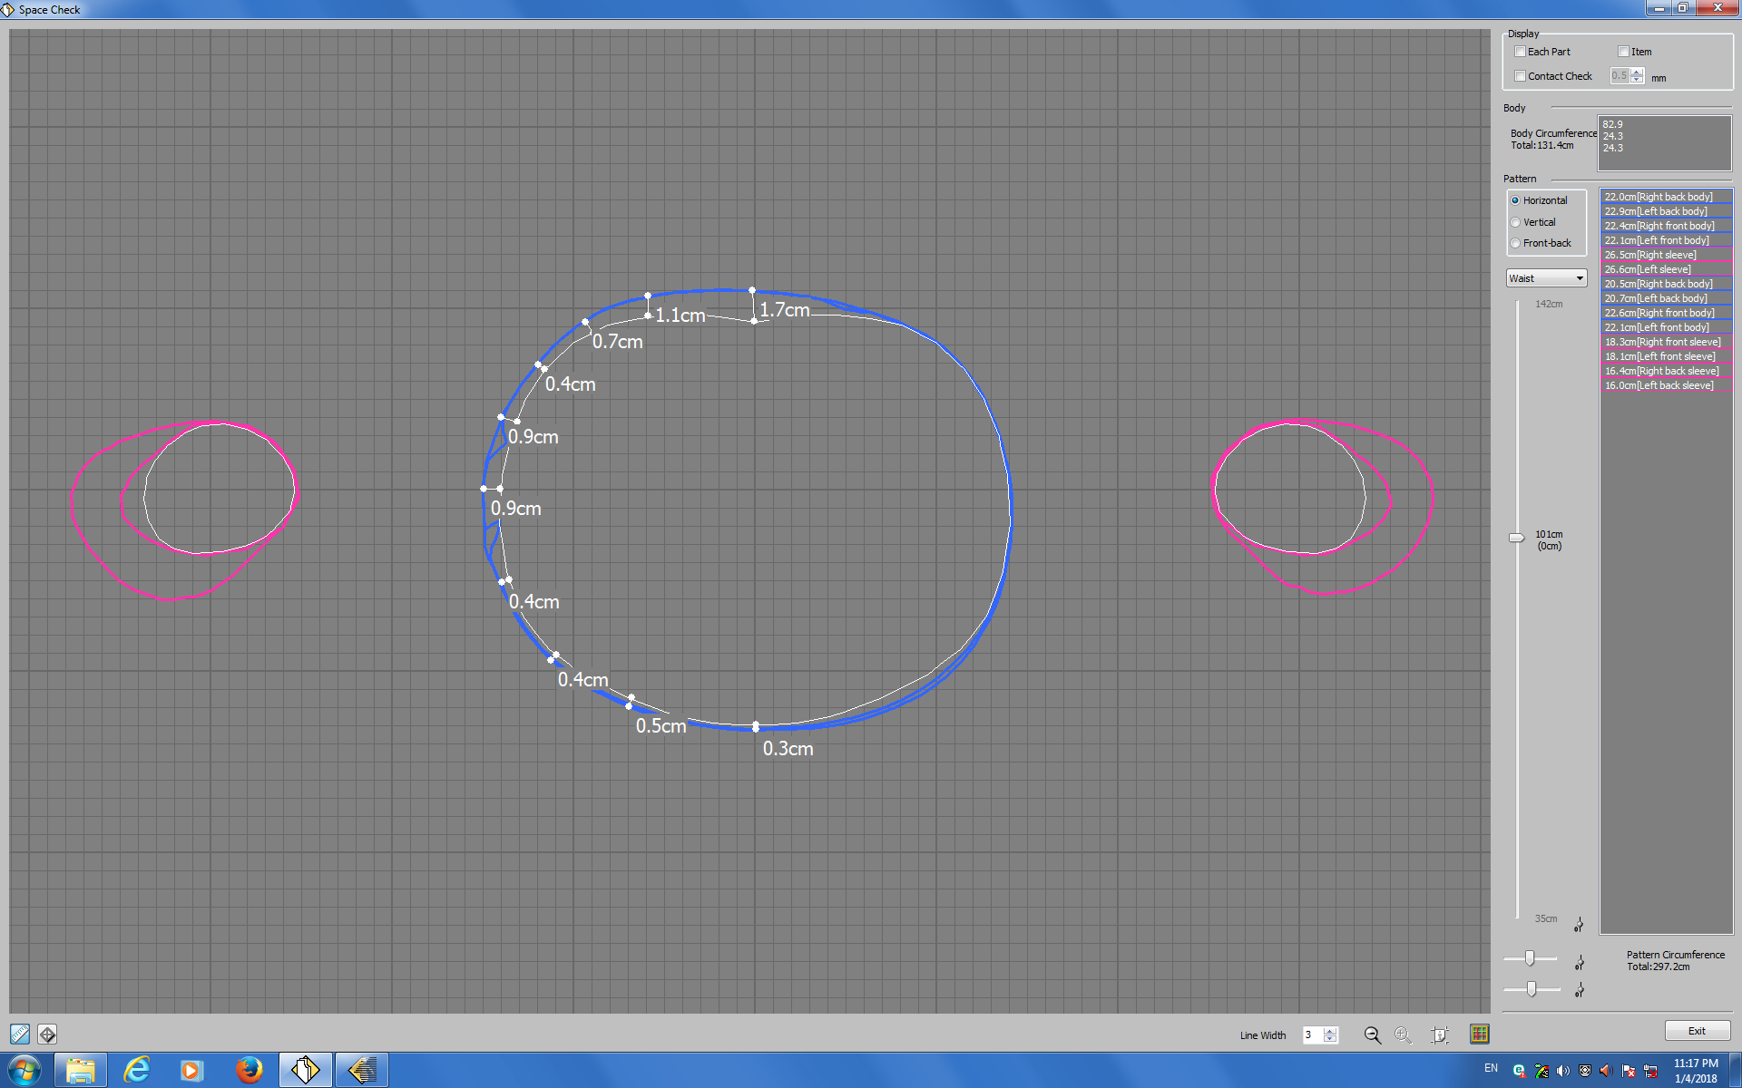

Slide 25
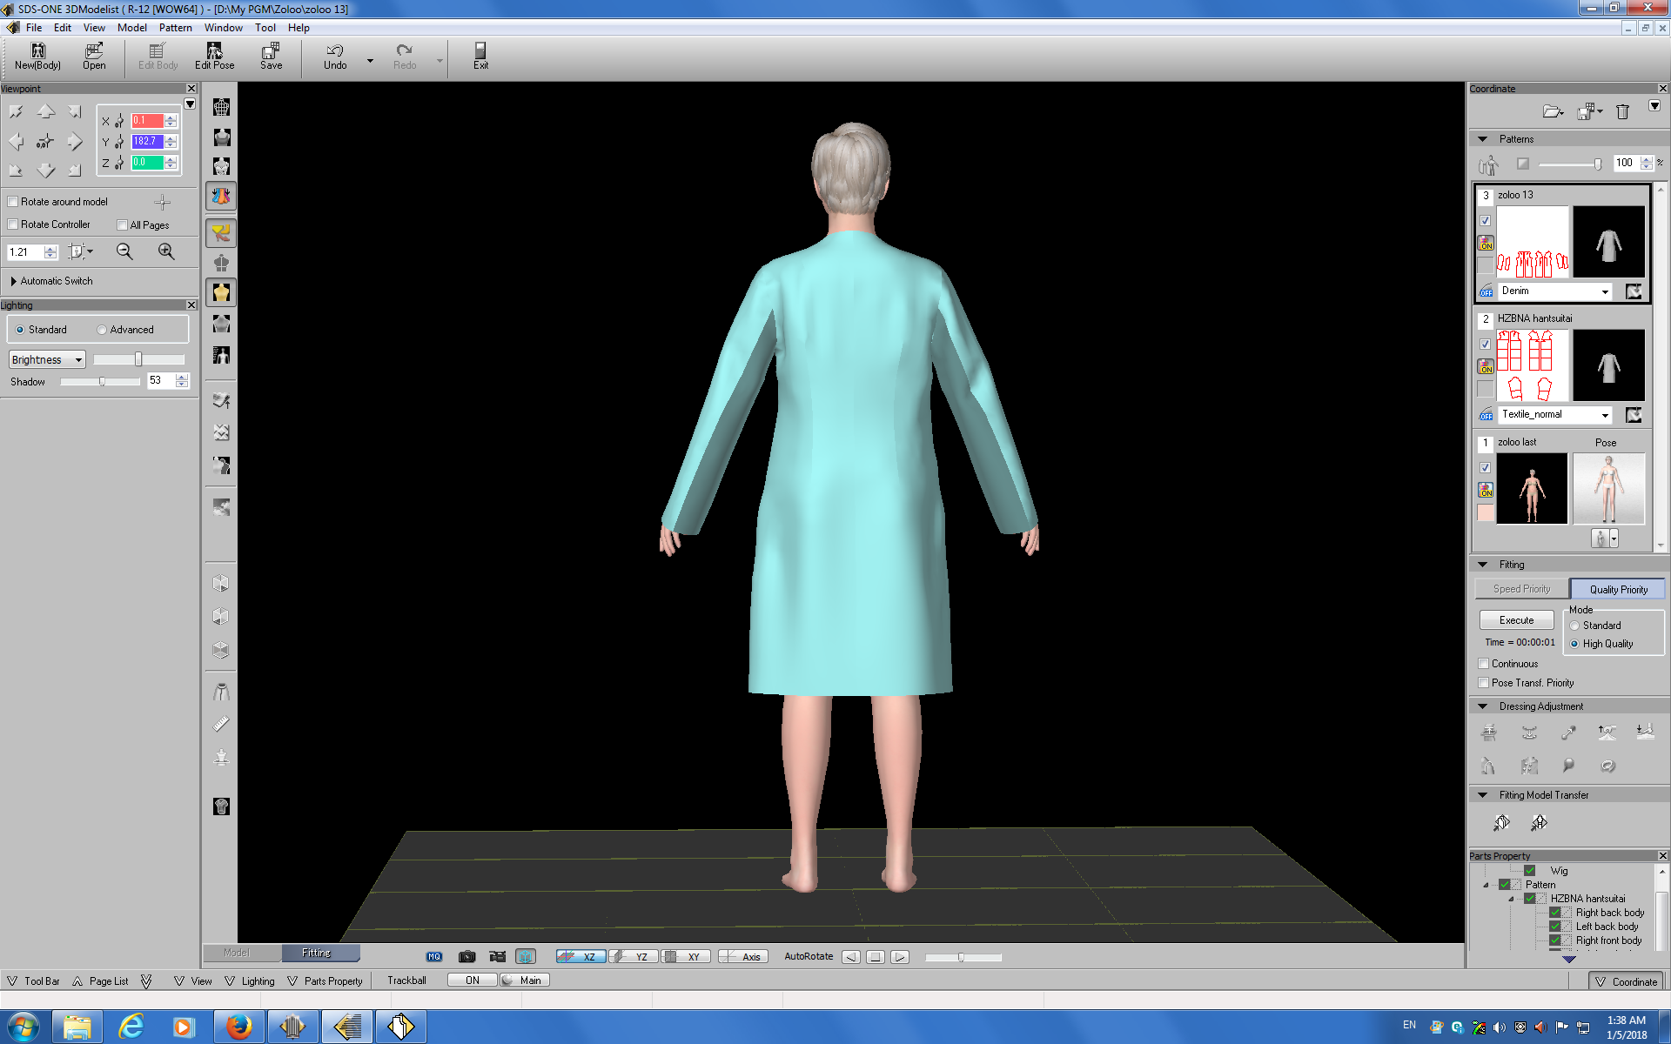

Slide 26
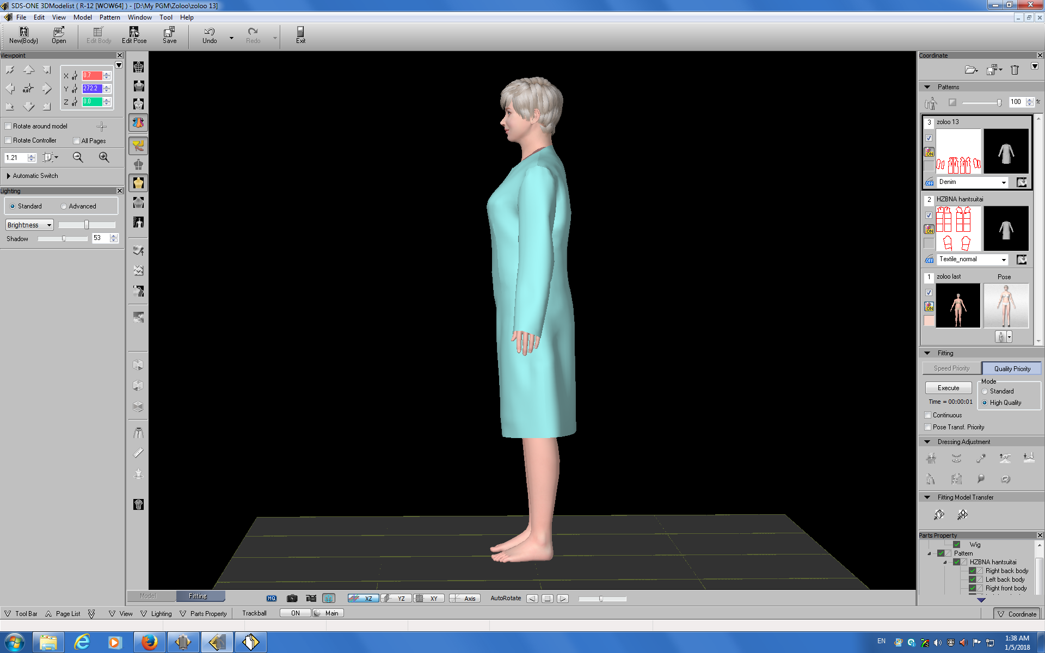

Slide 27
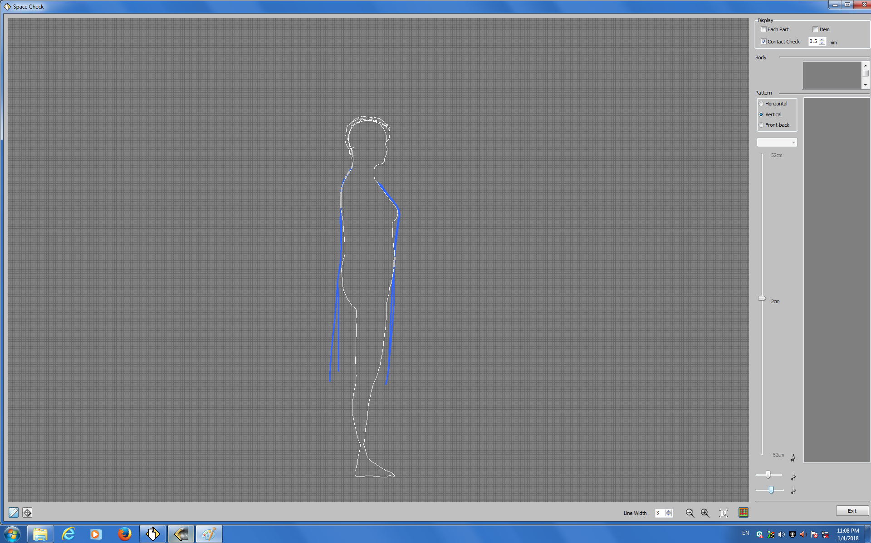

Slide 28
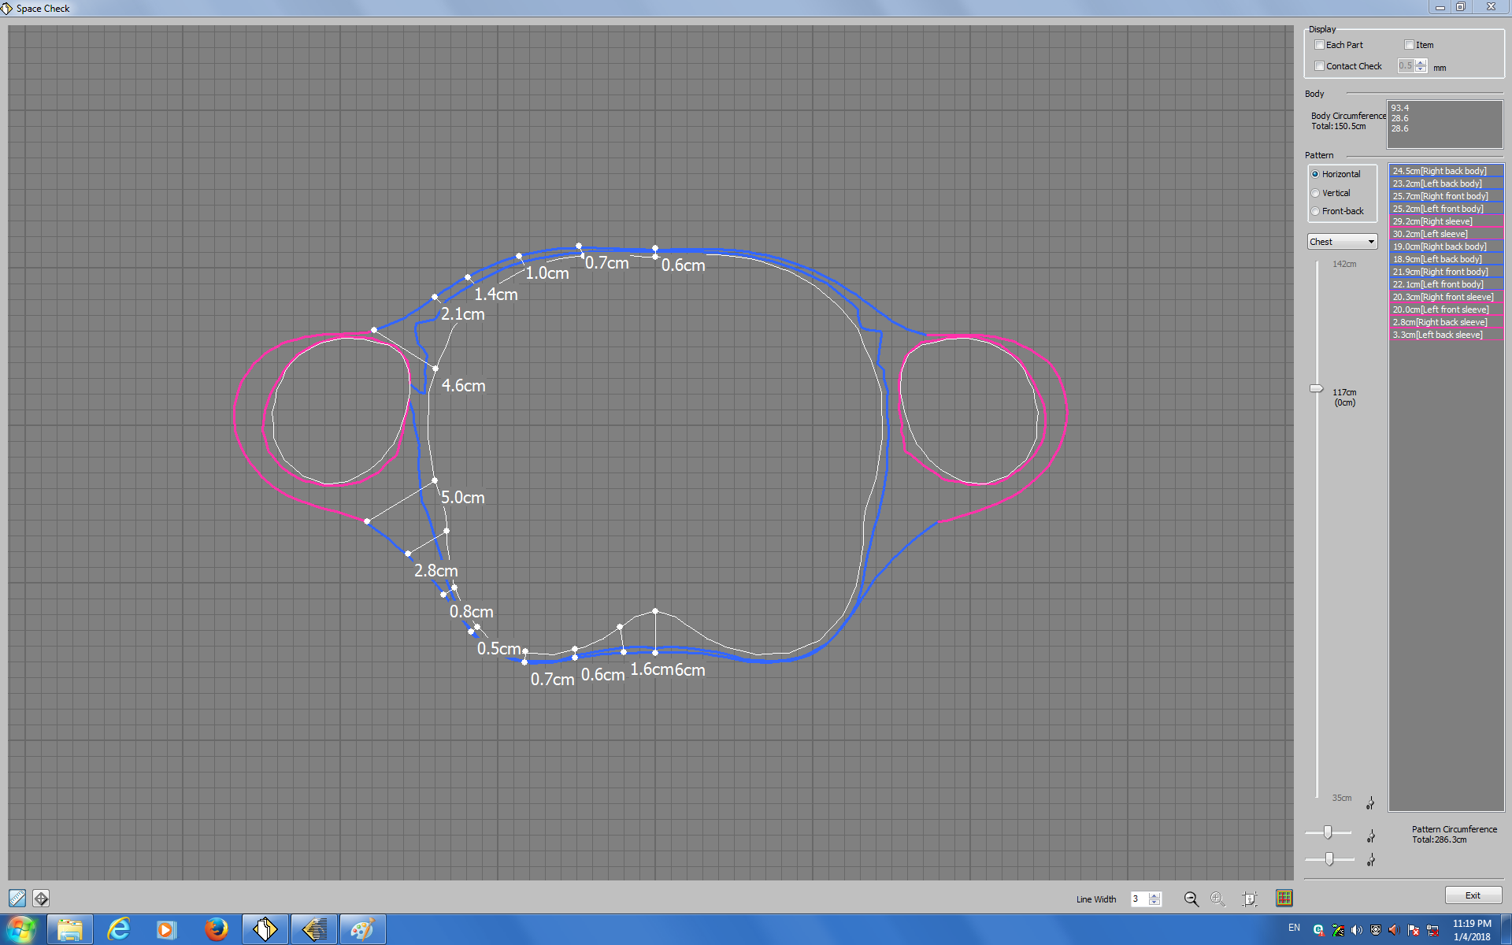

Slide 29
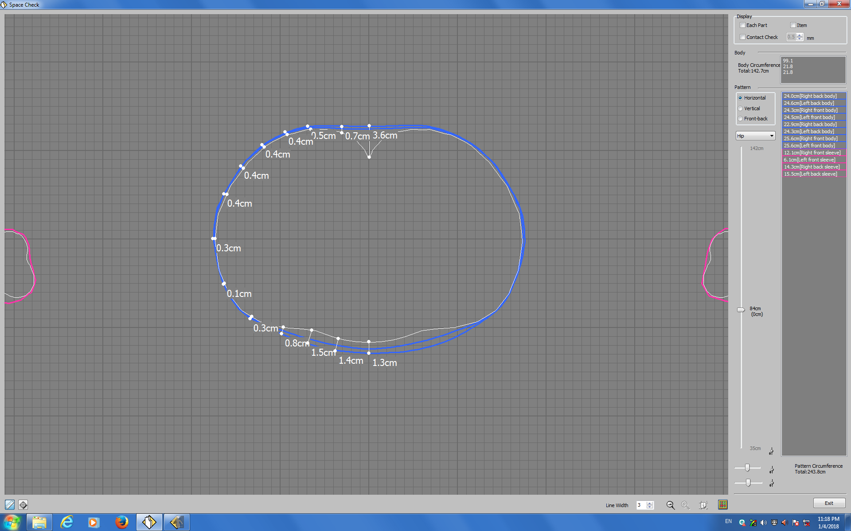

Slide 30
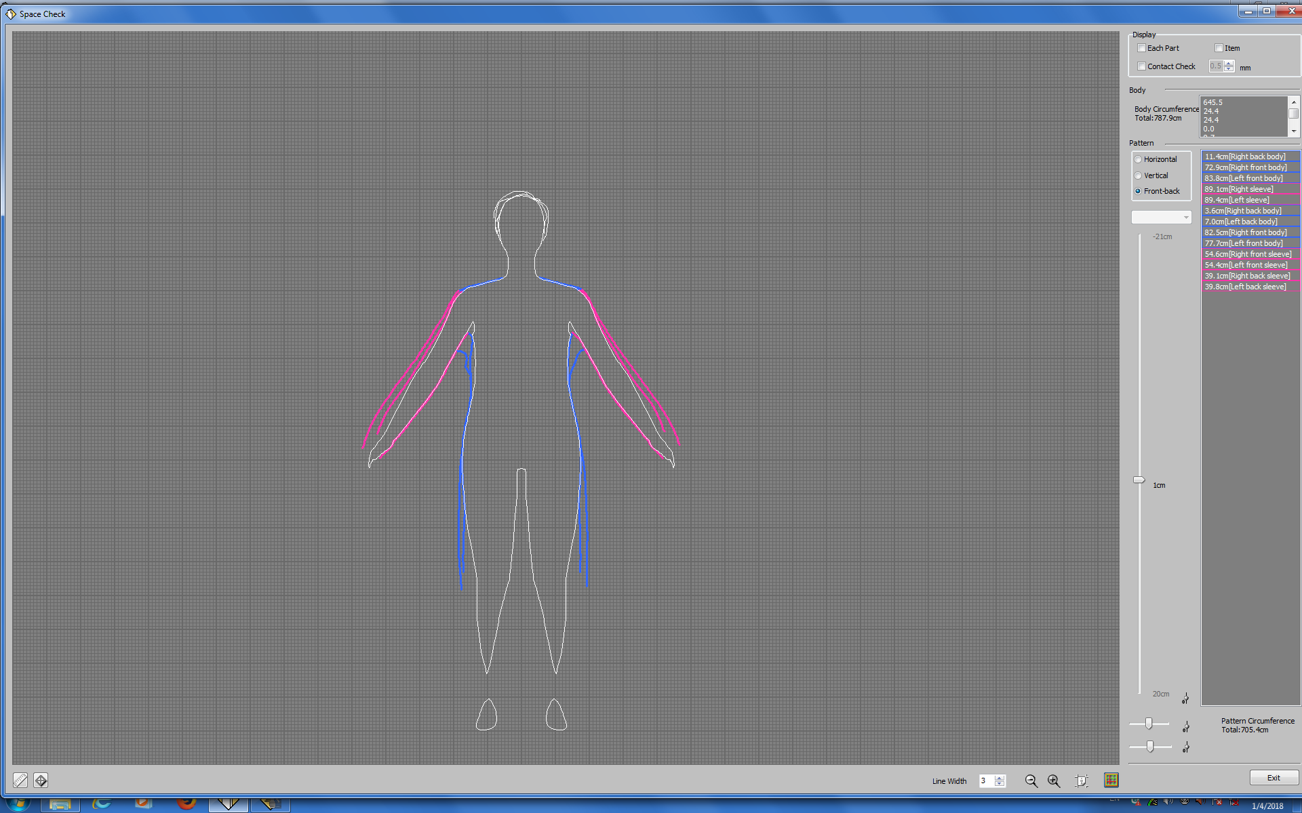

Slide 31
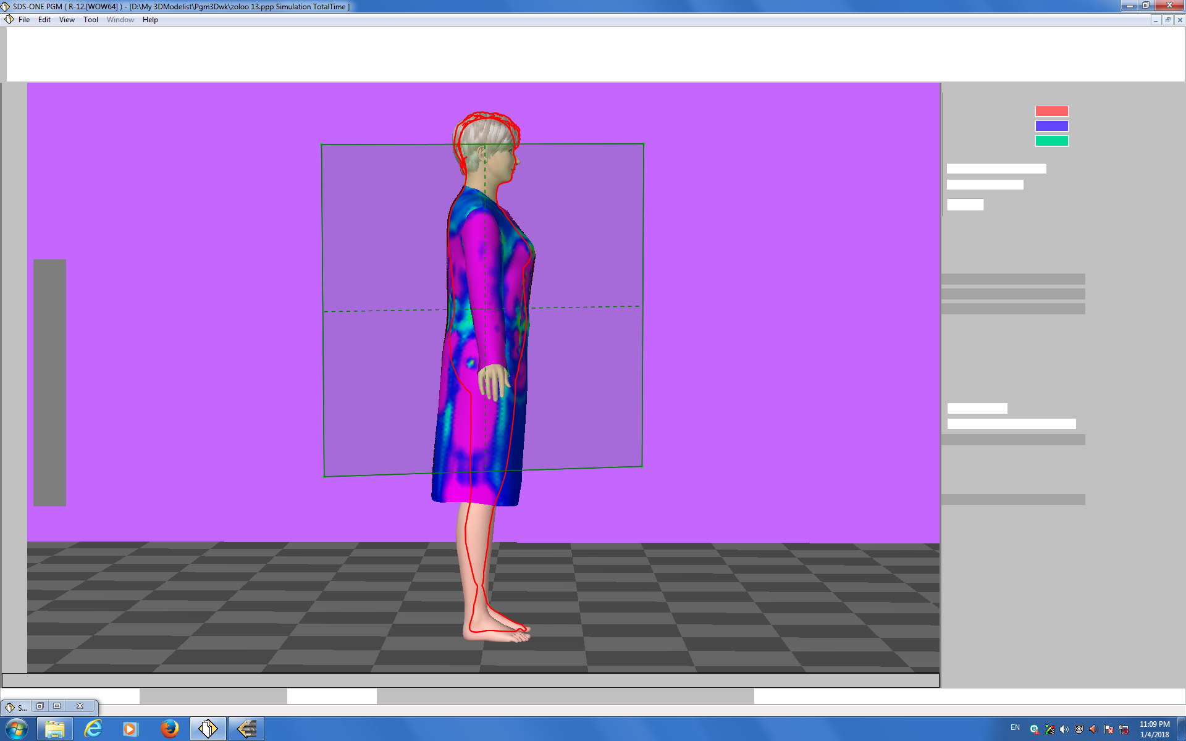

Slide 32
References
Shimaseiki training guide

