Slide 1
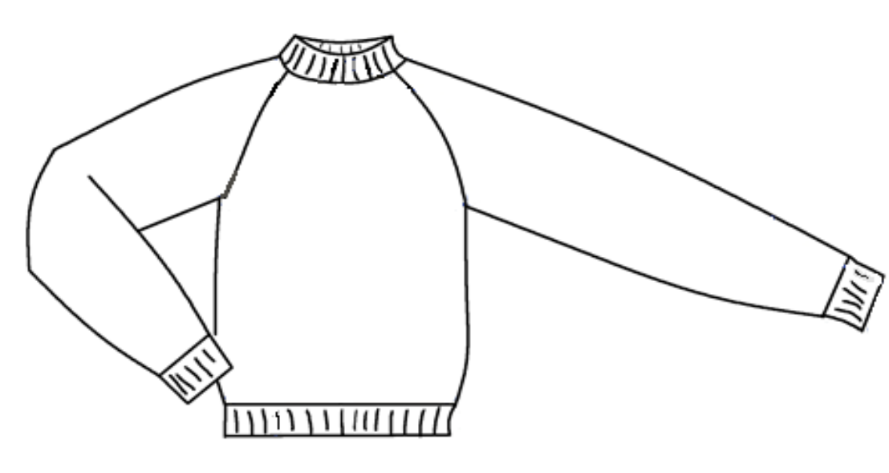
Pattern making
Raglan

Slide 2
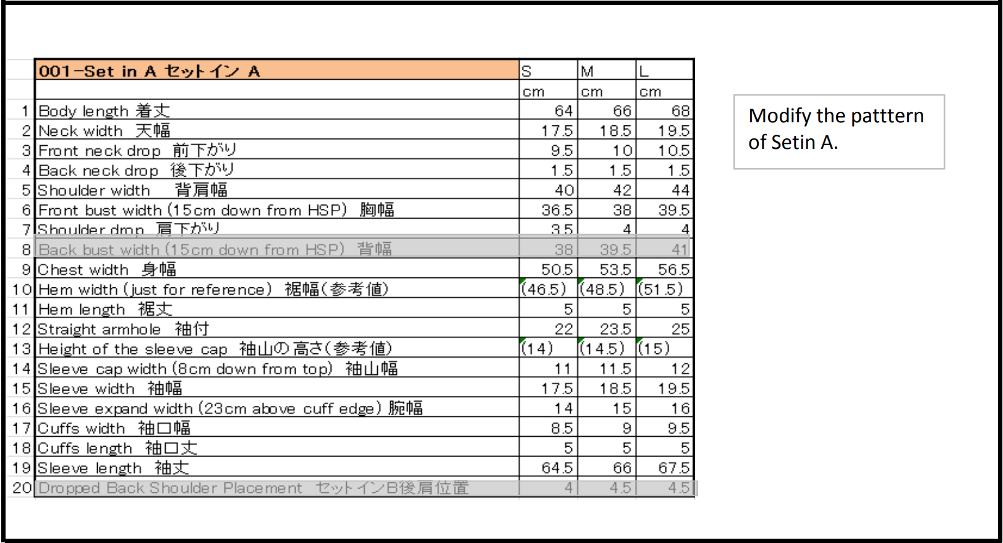

Slide 3
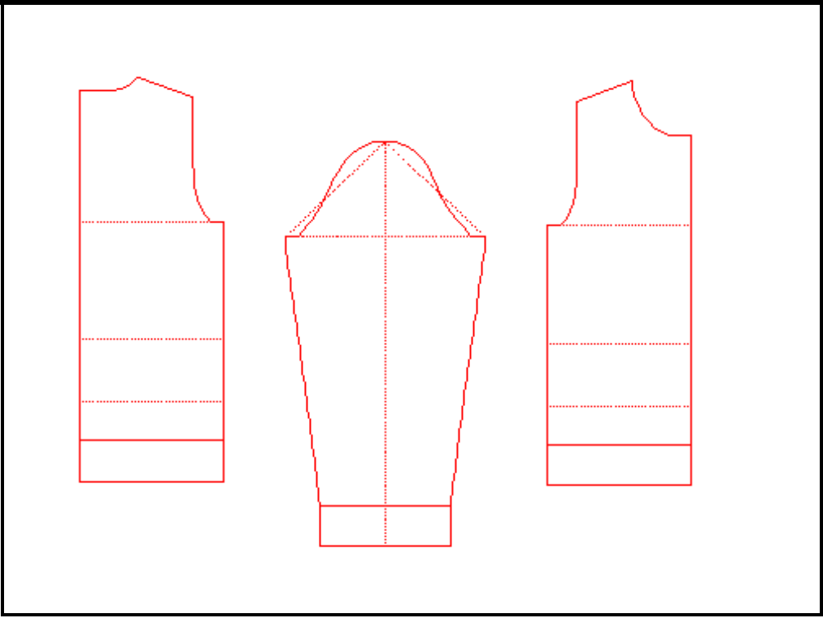
Raglan Modify the pattern of Setin A
Create the pattern of Set in A

Slide 4
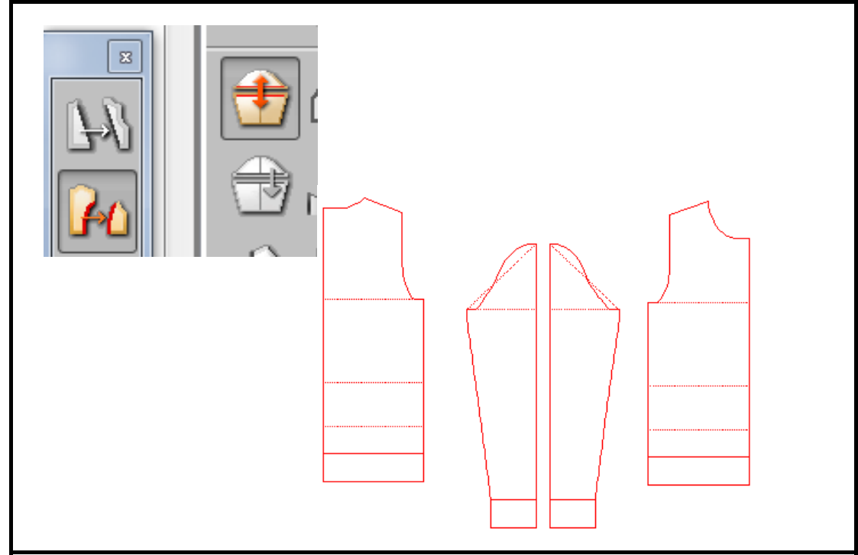
Divide/Line
Divide the pattern of sleeve into two parts.

Slide 5
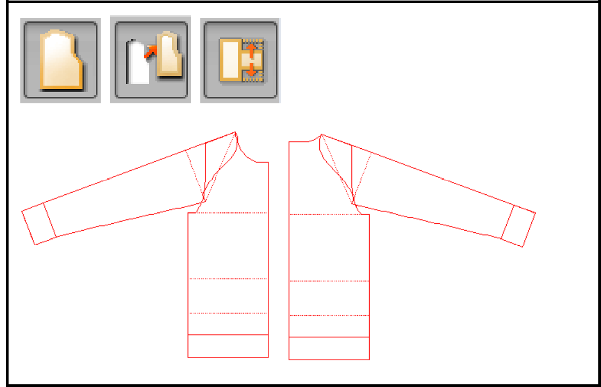
Pattern/Move/Point-Point
Move front sleeve to front body.
Overlap the center line of sleeve with shoulder line.
Move back sleeve to back body.

Slide 6
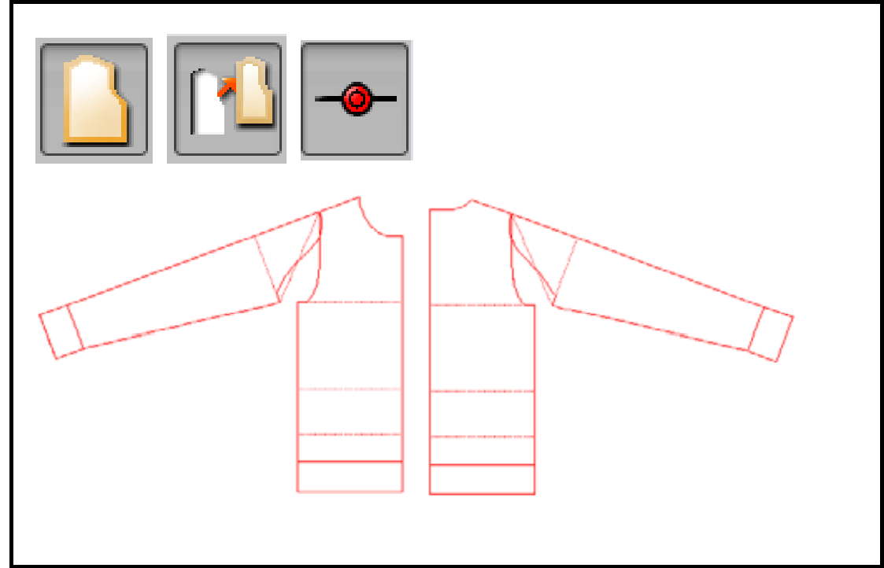
Pattern/Move/ Ovelap Poin Overlap sleeve top to shoulder point.

Slide 7
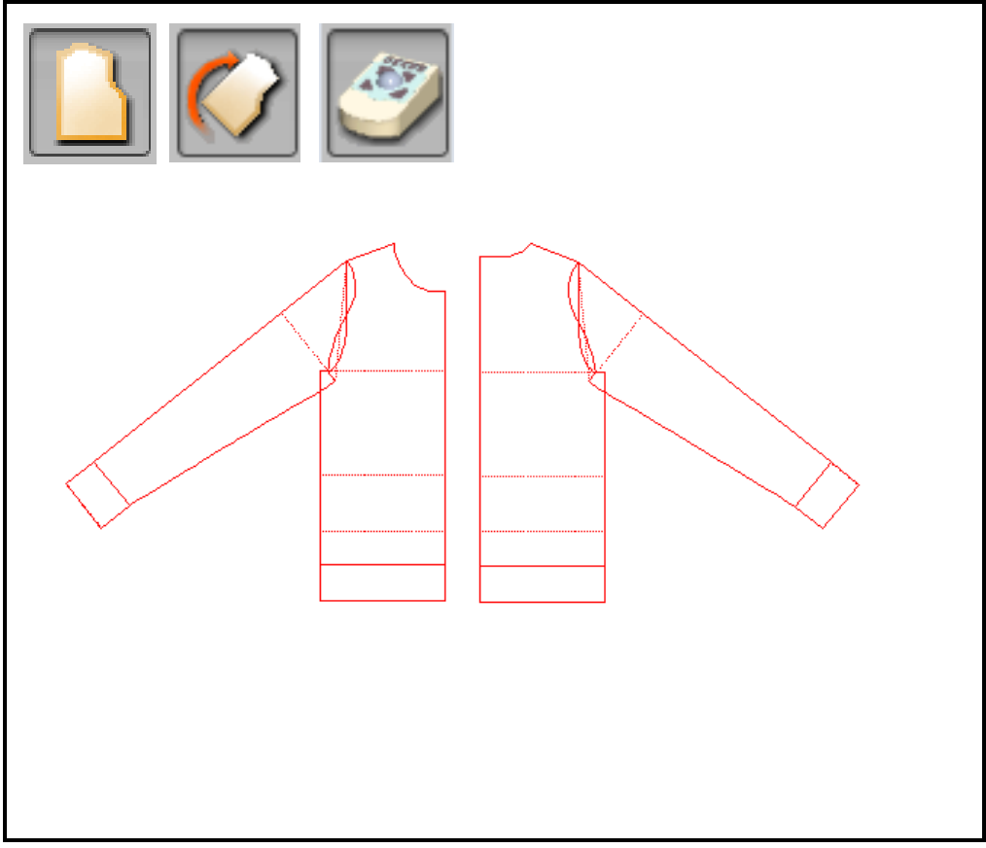
Pattern/Rotate/Track ball
Turn the sleeve and fix the angle.
Make less angle for the sleeve to give larger allowance around shoulder, upper arm, and chest.
When rotating the sleeve, the angle is displayed. Keep same angle for both of front/ back sleeve.

Slide 8
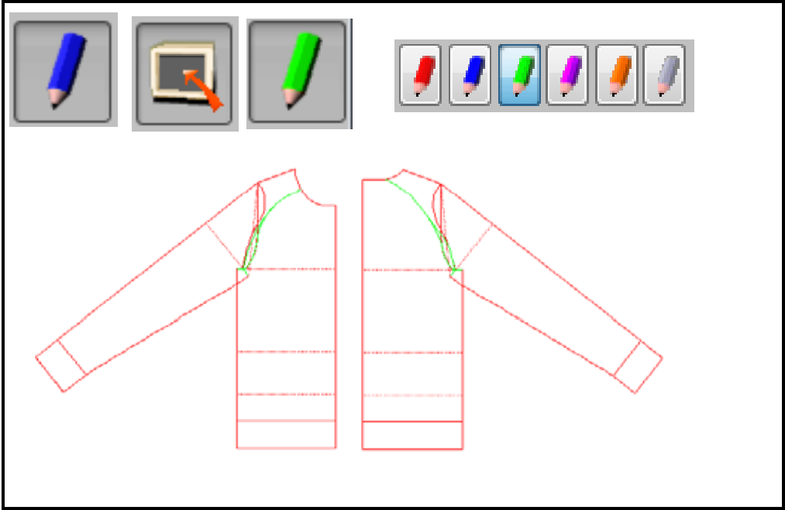
Draw raglan line for the body and sleeve with develop line.
Use different color of develop line for easier recognition.
Generally J-shaped curve for sleeve and S-shaped curve for body are drawn.

Slide 9
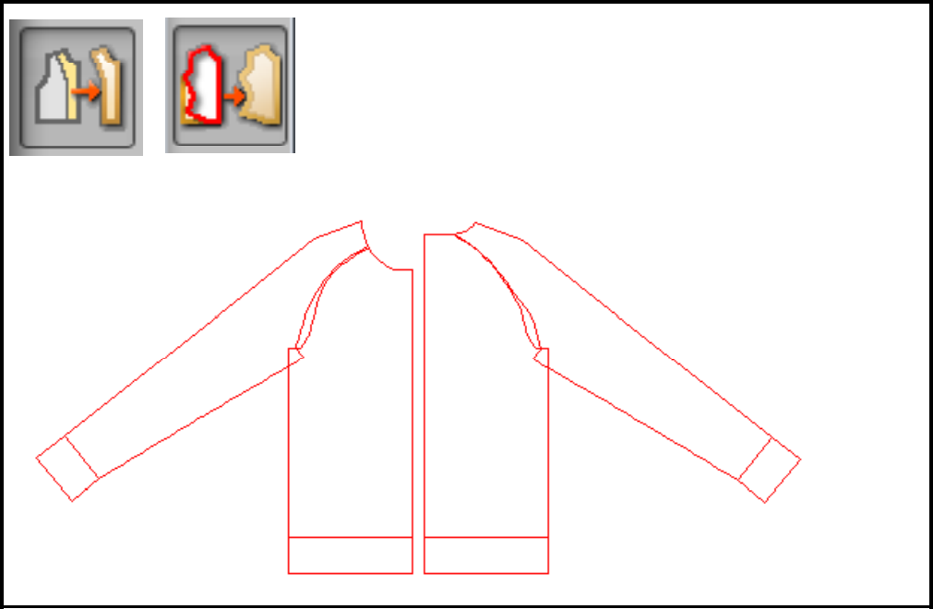
Trace/Extract

Slide 10
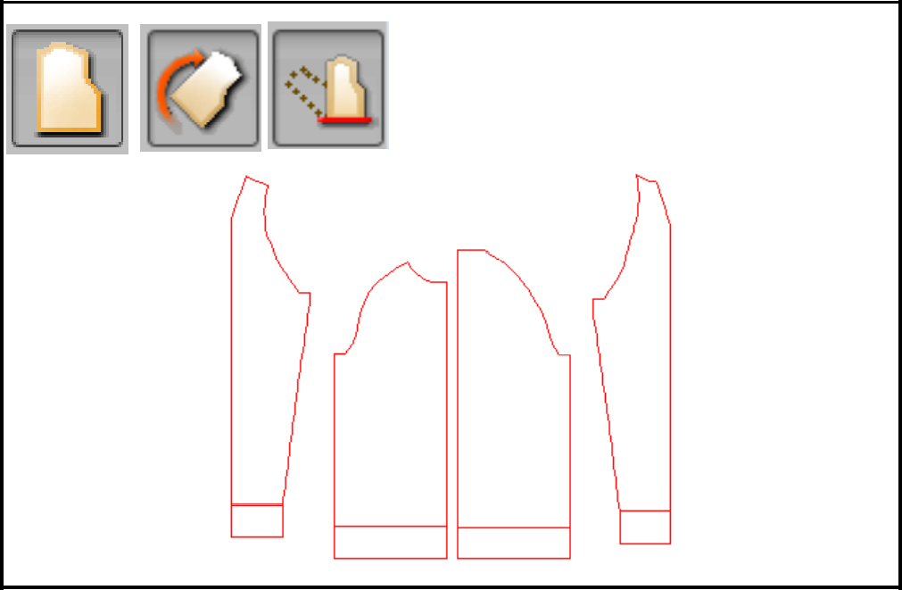
Pattern/Rotate/Horizontal
Rotate the sleeves to vertical position.

Slide 11
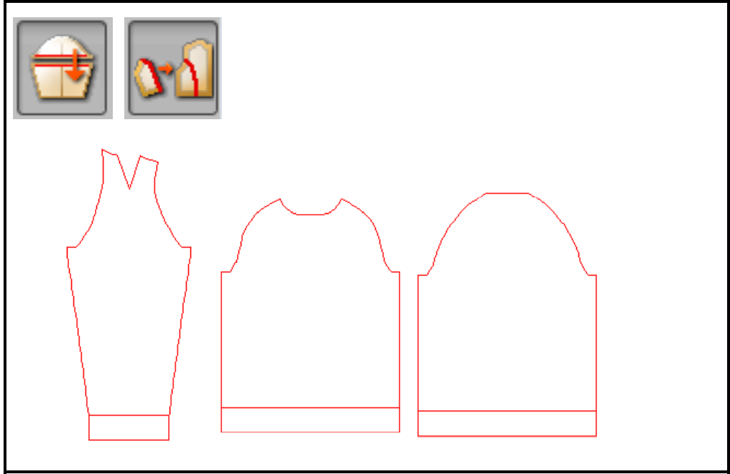
Merge/Line
Joint front /back sleeves.

Slide 12
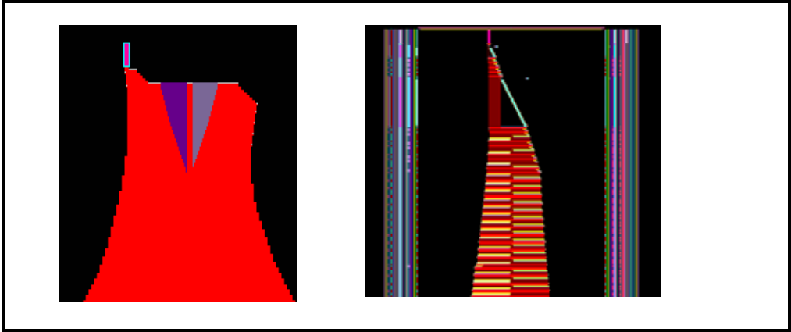
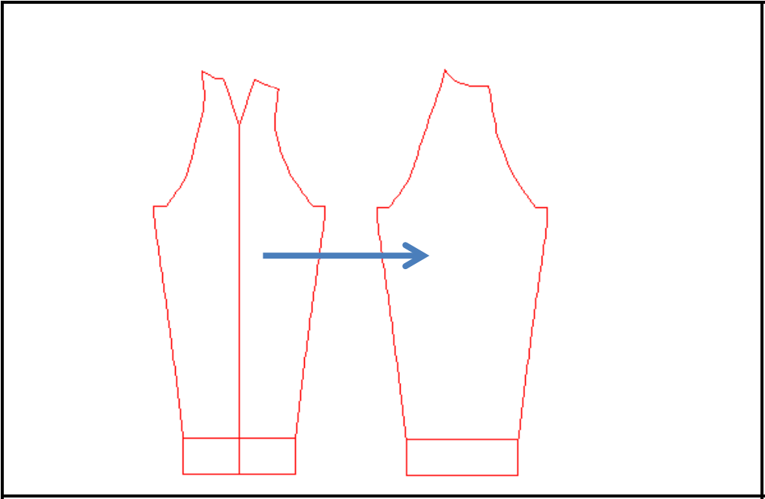
Shoulder dart is processed automatically for raglan in KnitPaint even if dart information is not assigned.
It is necessary t
o close the dart on the pattern if it is not required.

Slide 13
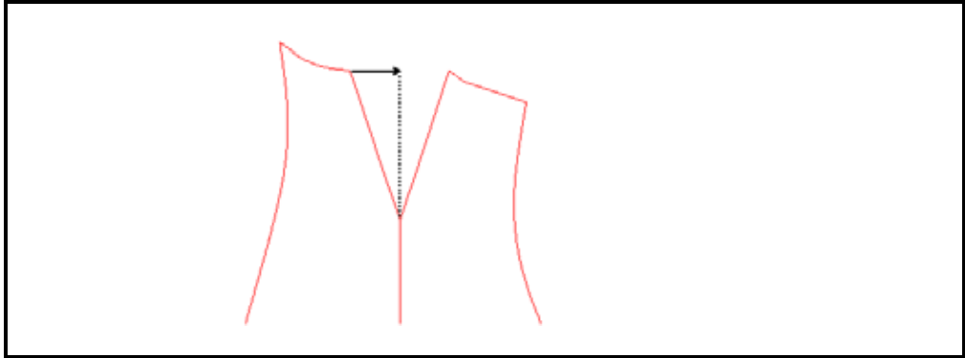
[An example of modification]
Measure the distance (X) from the corner point of dart to center line.

Slide 14
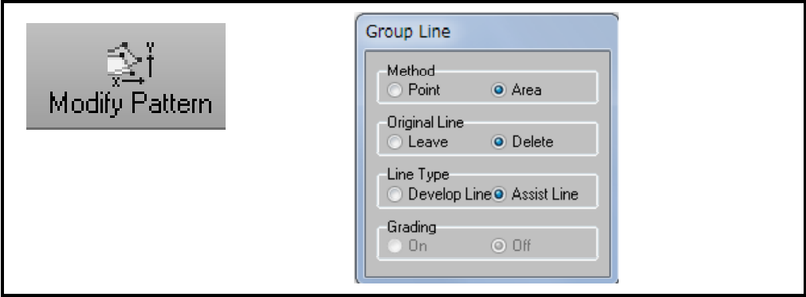
Use "Modify Pattern" on tool bar.
If the icon of "Modify Pattern" is not on tool bar, it is necessary to register in customize /Edit.
Select settings as shown in the figure on the left.

Slide 15
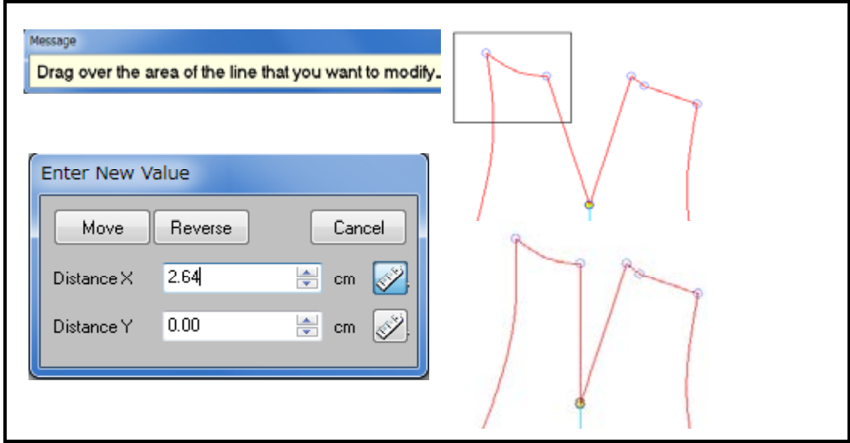
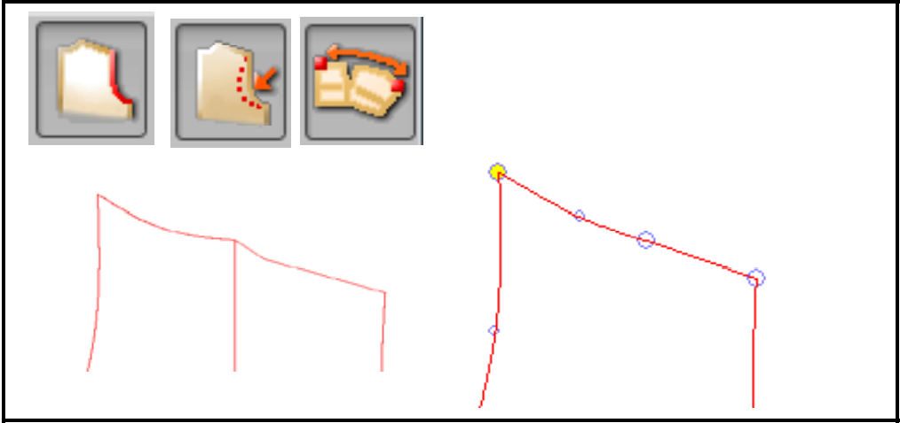
Take area including top 2 points.
Input the result of measurement in Distance X. Click Move.
Modify right side in the same way (Reverse).
Modify the top line to be connected smoothly with Pattern Line/Modify/Redraw Line.

Slide 16
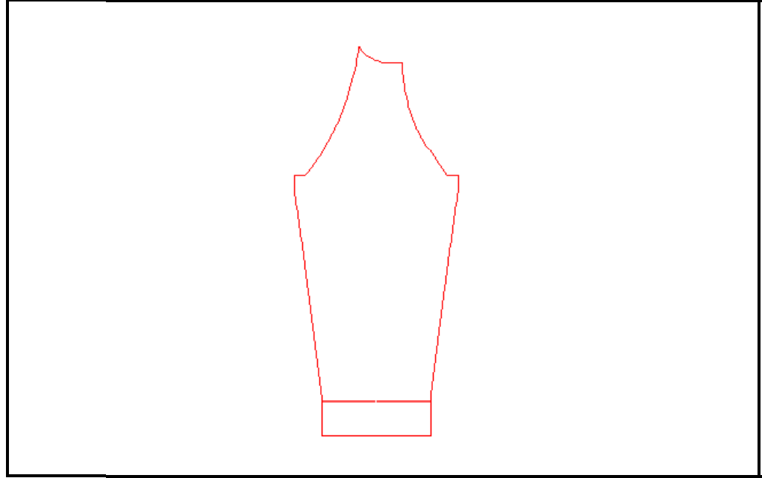
Check line for top part of sleeve.
Measure the length of sewn line of body and sleeve.
Modify the line if it is necessary.

Slide 17
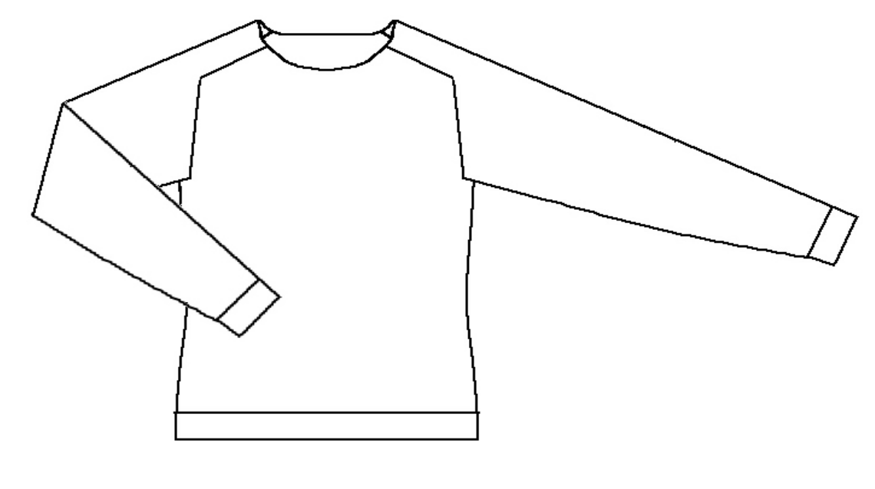
Epaulet
(Saddle shoulder)

Slide 18
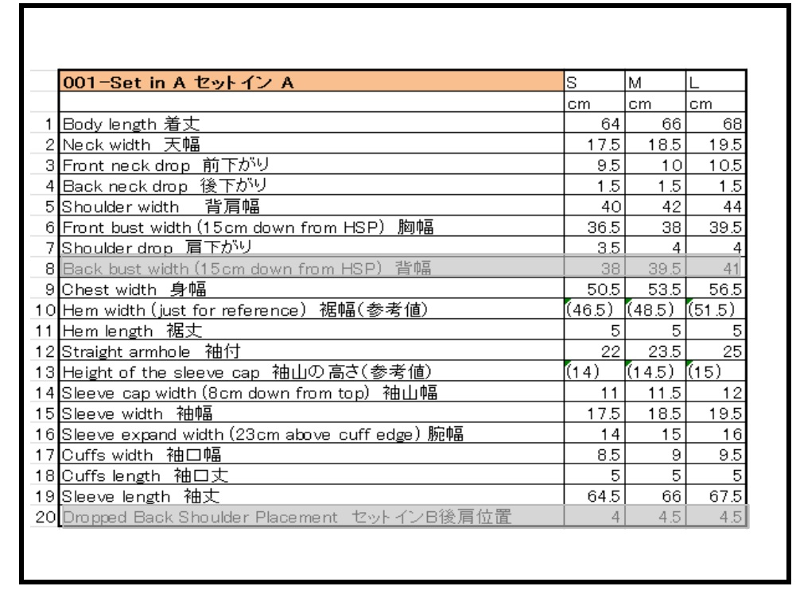
Modify the patttern of Setin A.

Slide 19
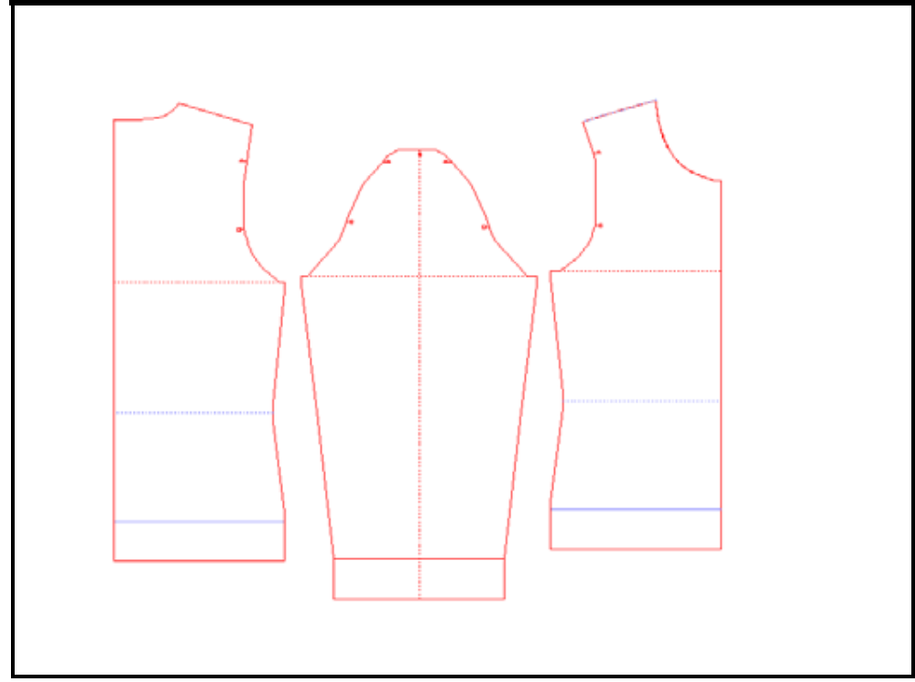
Epaulet© Modify the pattern of Setin A
Create the pattern setin A.

Slide 20
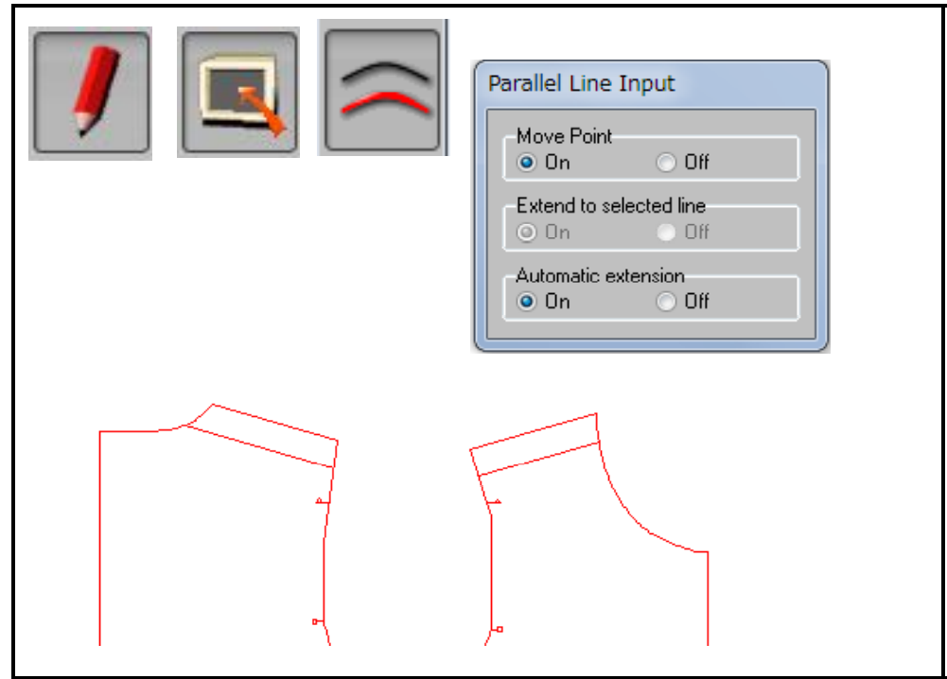
Assist Line/Input/Parallel Line
Input Assist Line for epaulet width. e.g.4cm … front, back 2cm for each

Slide 21
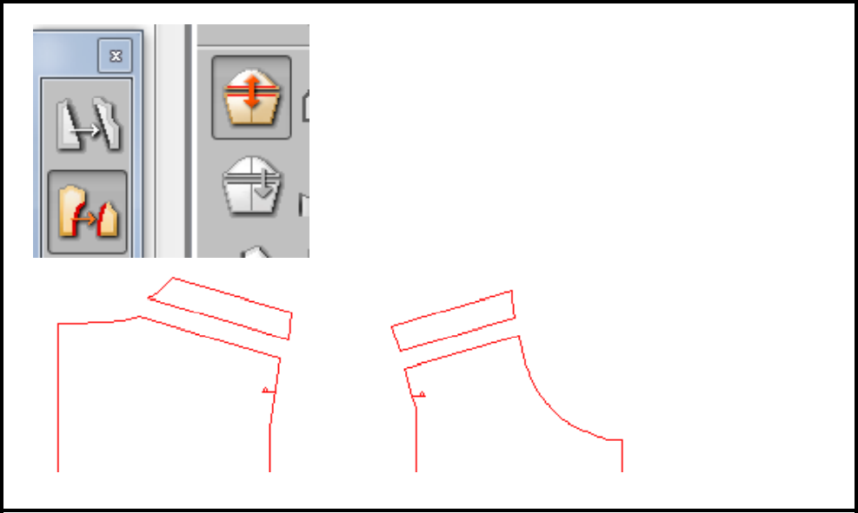
Divide/Line
Divide epaulet part and main part.

Slide 22
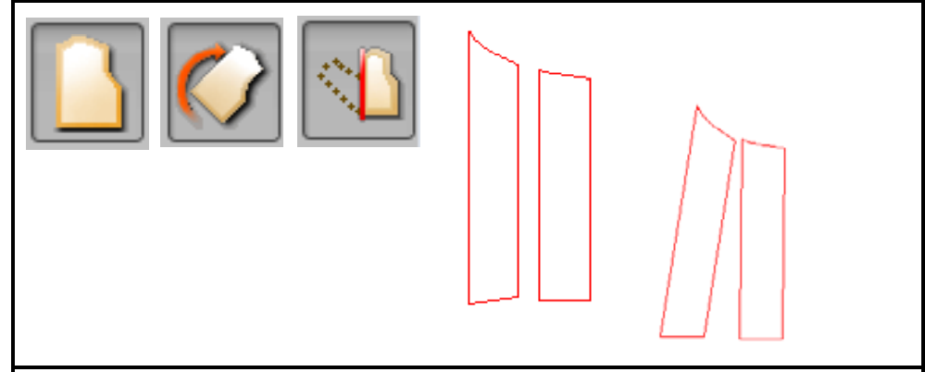
Pattern/Rotate/Vertical
Rotate epaulet part to vertical position.
The base of rotate is not bottom of epaulet because AH line-shoulder line doesn't make right angle.

Slide 23
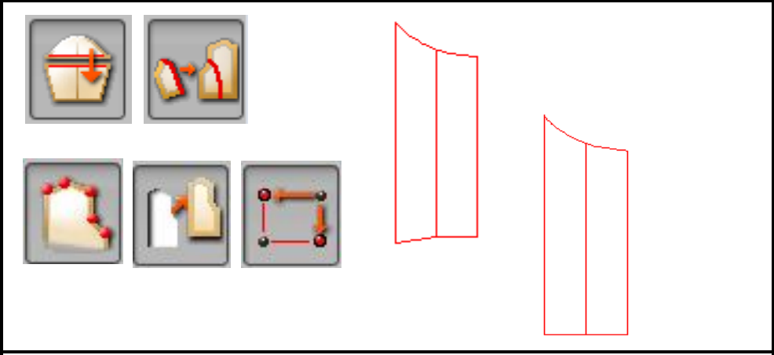
Merge/Line
Joint epaulet parts (Front/Back). Point/Move/Horizontal-Vertical Modify the bottom of the epaulet to horizontal line.

Slide 24
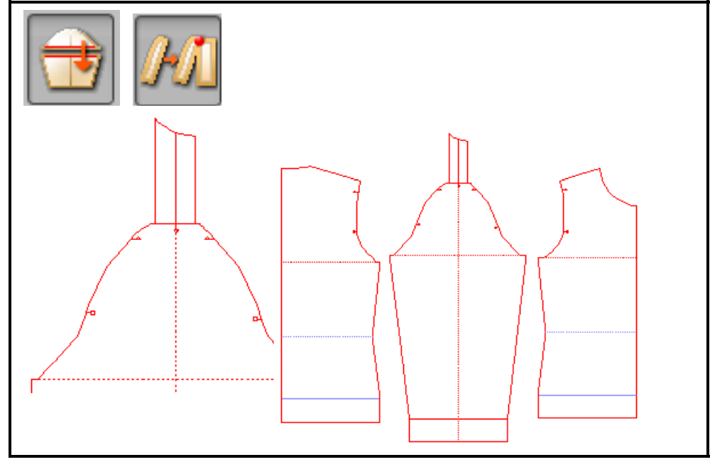
Merge/Point
Joint epaulet part to the sleeve.

Slide 25
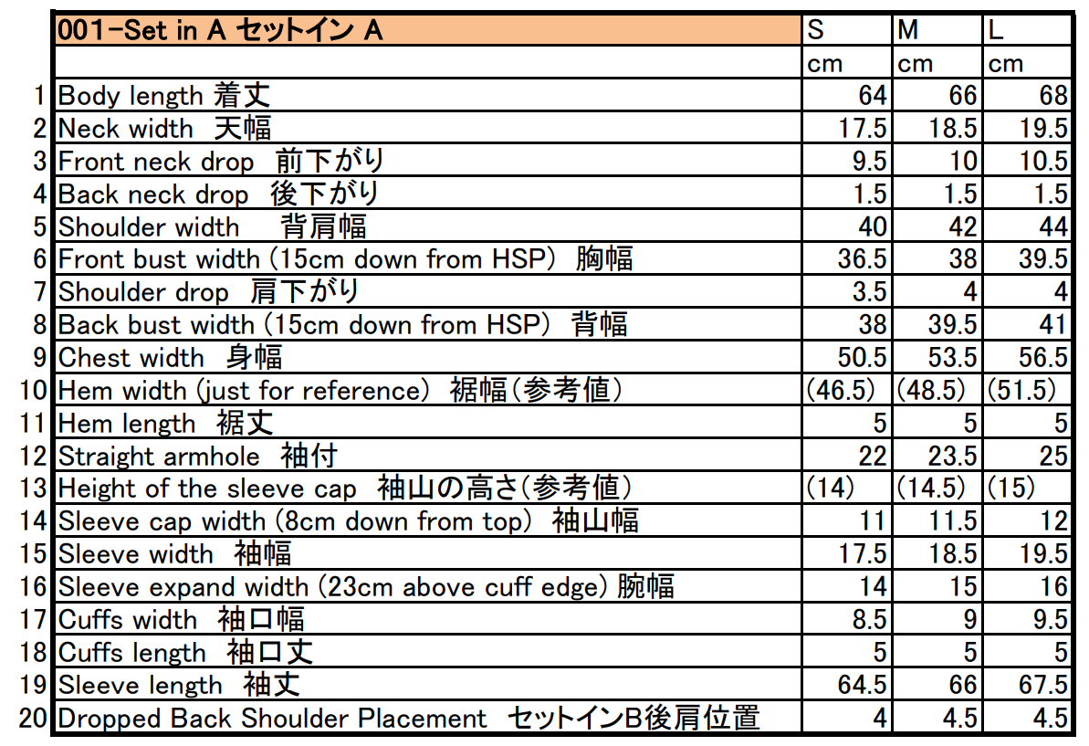

Slide 26
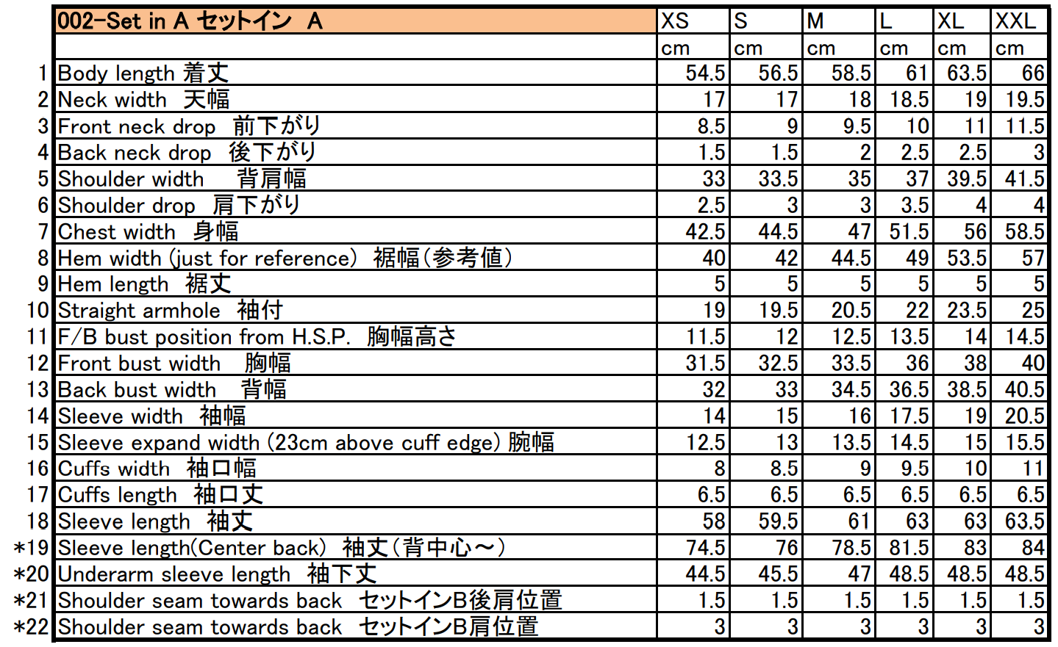

Slide 27
References
https://www.shimaseiki.com
Shimaseiki training guide

