Slide 1
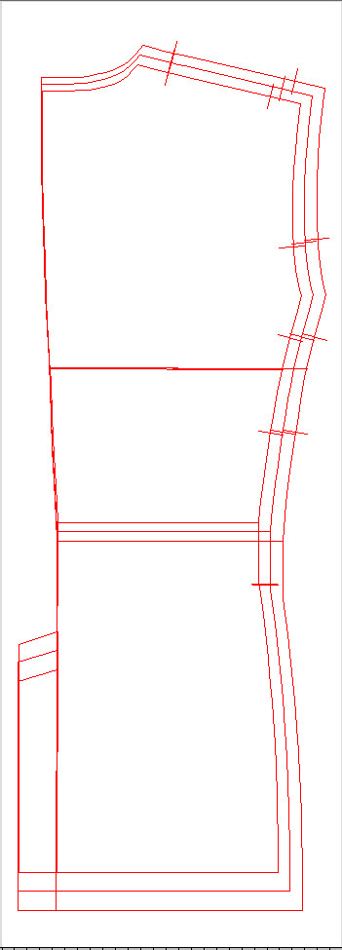
Grading

Slide 2
Correct sizing by use of grading software yields an optimum silhouette for each product size. Features as line-check and automatic pitch calculation allow accurate grading to be performed easily.
Measurements and information for each part can be arranged and output for use in instruction forms.

Slide 3
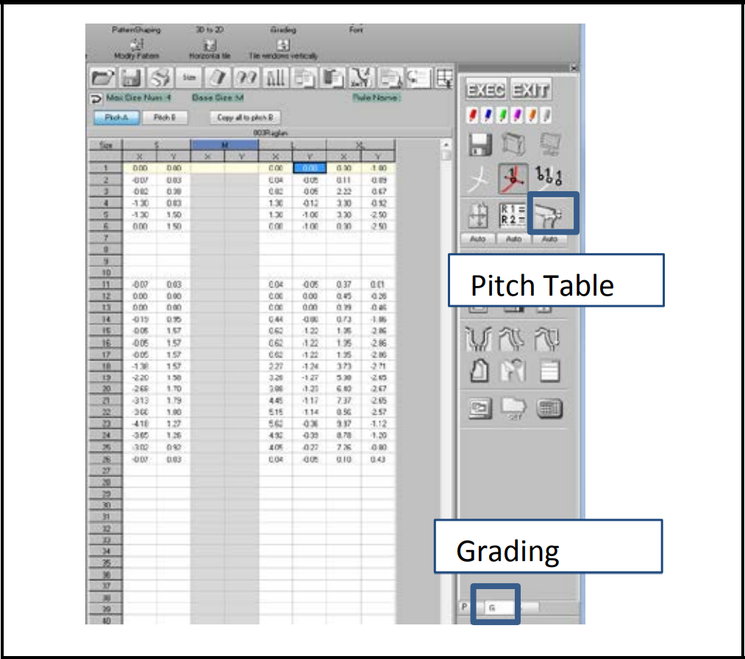
Grading (L size)
1.Grading - F & B body
Pitch table is used for Pitch Grading to develop each size from master size.

Slide 4
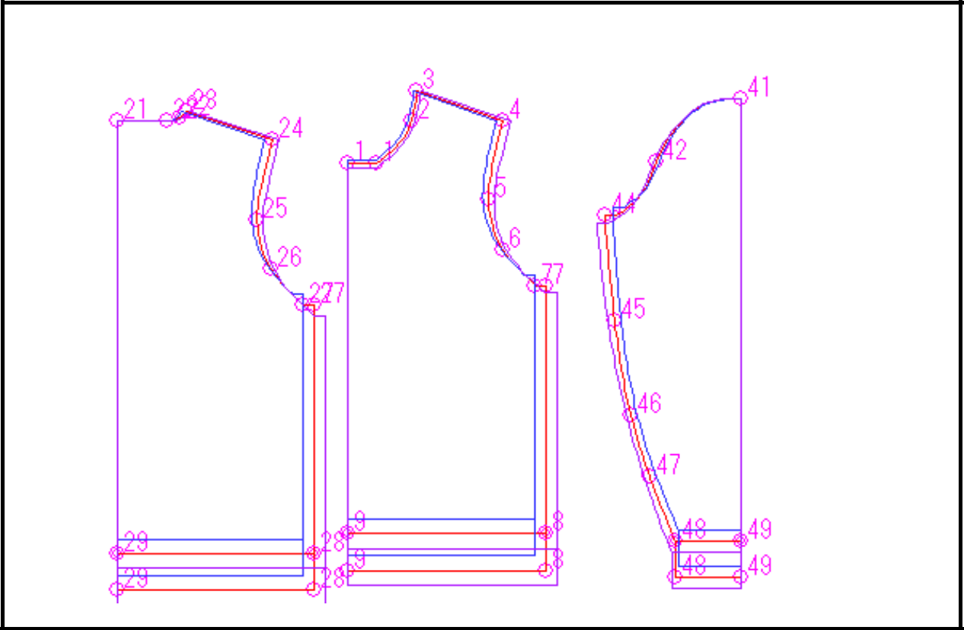
Pitch Grading
Give GP (grading point) to each point in the pattern and input the horizontal (X) and the vertical (Y) moving distances of each grading point for each size in the pitch table.

Slide 5
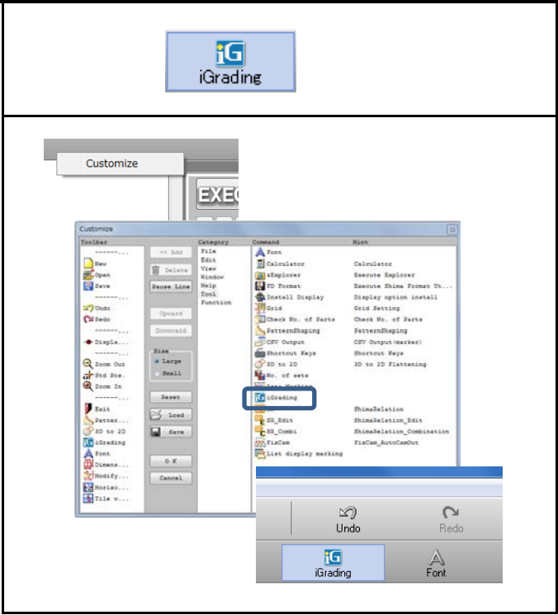
Grading Preparation and settings
Pitch table can be made easily by using iGrading menu (APEX3 and later).
Right click on tool bar and open the customize menu, then register iGrading in Tool.

Slide 6
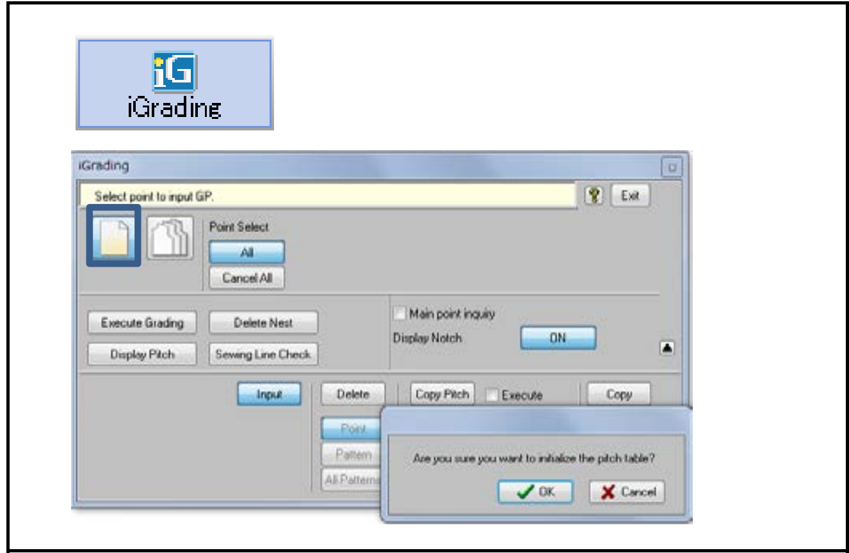
Open the menu for iGrading and select "New."
Answer "OK" for the message "Are you sure you want to initialize the pitch table" to delete the previous data in pitch table.

Slide 7
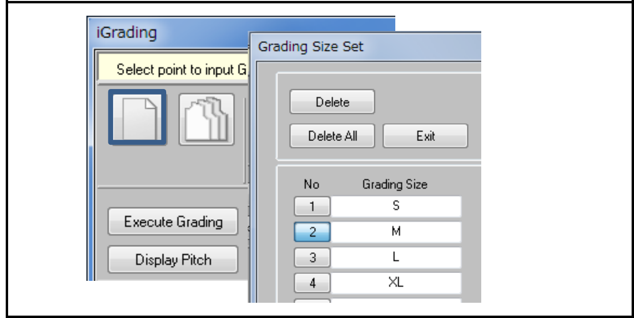
Select "Size" to open the menu for "Grading size set."
Input the sizes (7, 9, 11.. .S, M, L etc.) to create by grading.
Set the base size by clicking the number then the back ground of the number in the menu turns to blue.
Close the menu with "Exit.“

Slide 8
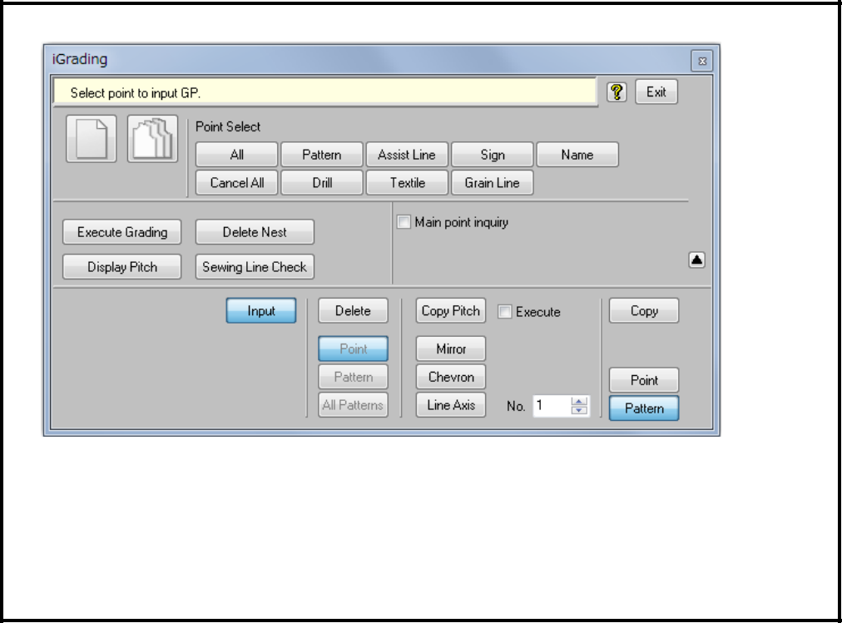
Select the targets to input GP in "Point Select." Select "Pattern" and "Assist Line" or "All.“
Make sure that "Input" is selected.
Click necessary points to input GP.

Slide 9
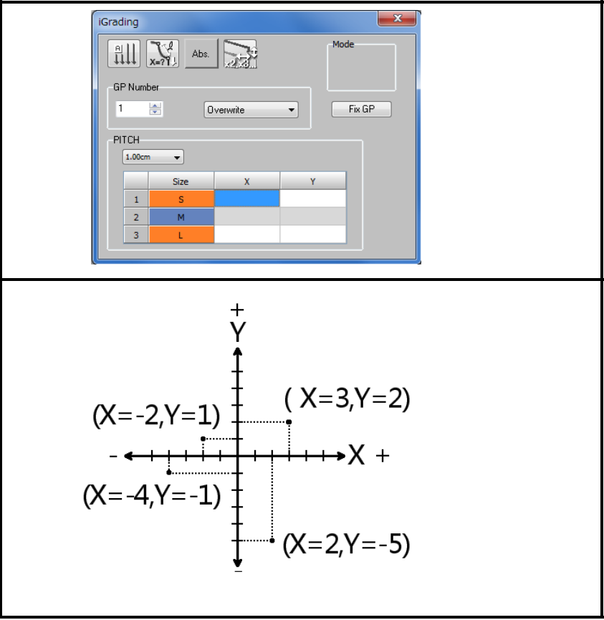
When a point is selected, the menu to input GP number opens.
And there is a table to decide X, Y pitch for each size.
Input X, Yposition of the points in each size from the same points in master pattern.

Slide 10
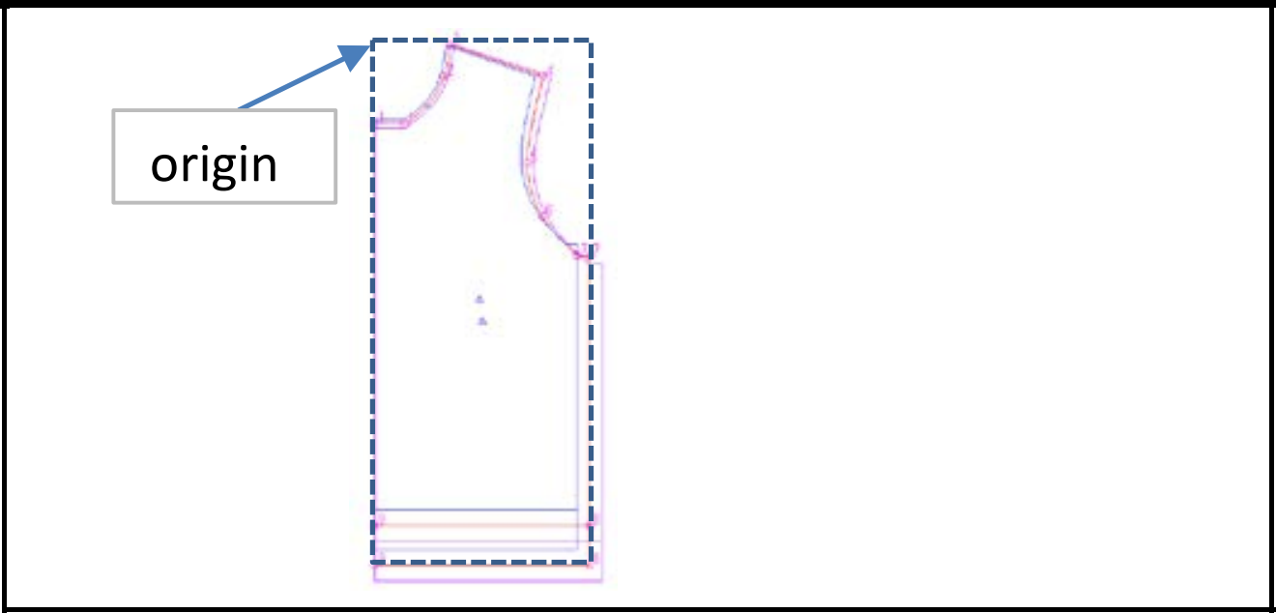
IGrading Input the information of each GP
Decide the base point.
This point becomes the origin (X=0, Y=0) to input the value for all GP (grading point).
Suppose there is the origin at left top in this example.

Slide 11
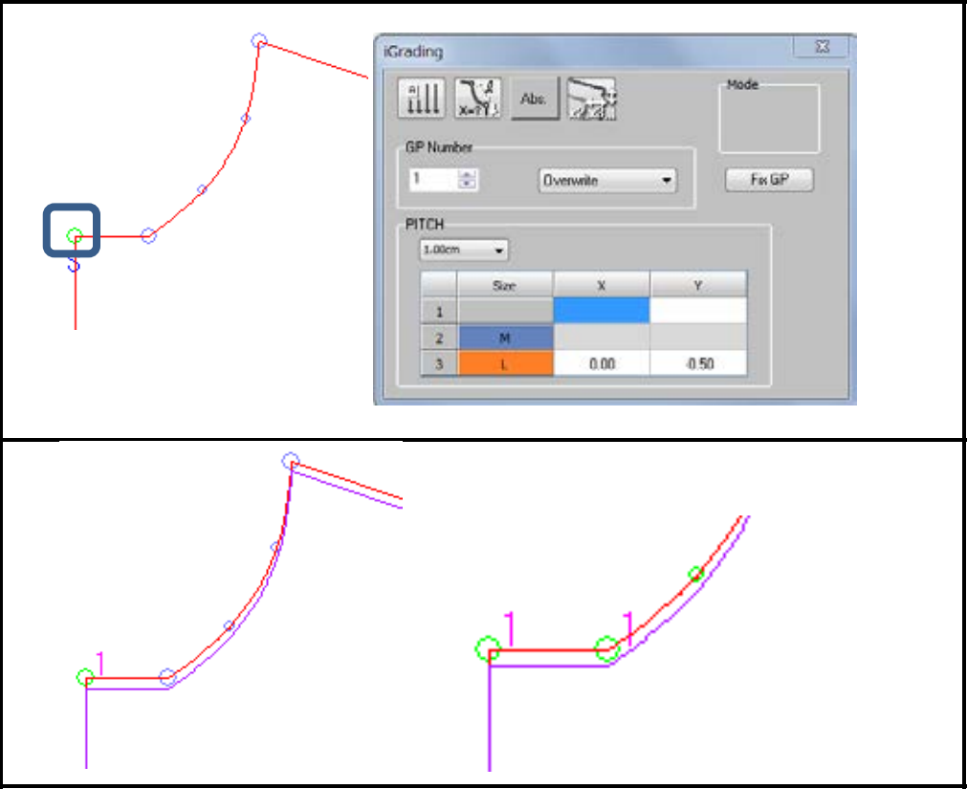
In this textbook the procedure is explained for L size.
Click the starting point of neck line.
Set "1" for GP Number in the menu. Specify the minimum unit for values.
The front drop for L size is larger than the one for M size by 0.5cm. Horizontal position is the same as M.
Input X=0 Y=-0.5 and click "Fix GP."
GP numbers and pitches are fixed and grading is executed.
When the same pitch is required for 2 points, it is possible to give the same GP like bottom line of neck.

Slide 12
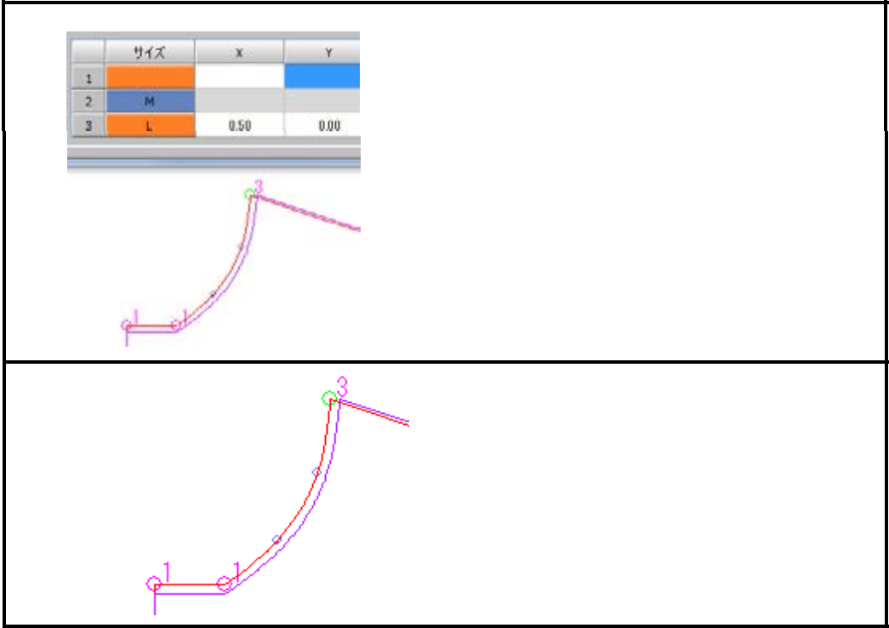
Input X=0.5,Y=0 for GP3 (neck point).
Because the difference of the neck width between M and L size is 1cm.
If GP is not set for the curve line of the neck, similar line is drawn between GP 1 and 3.

Slide 13
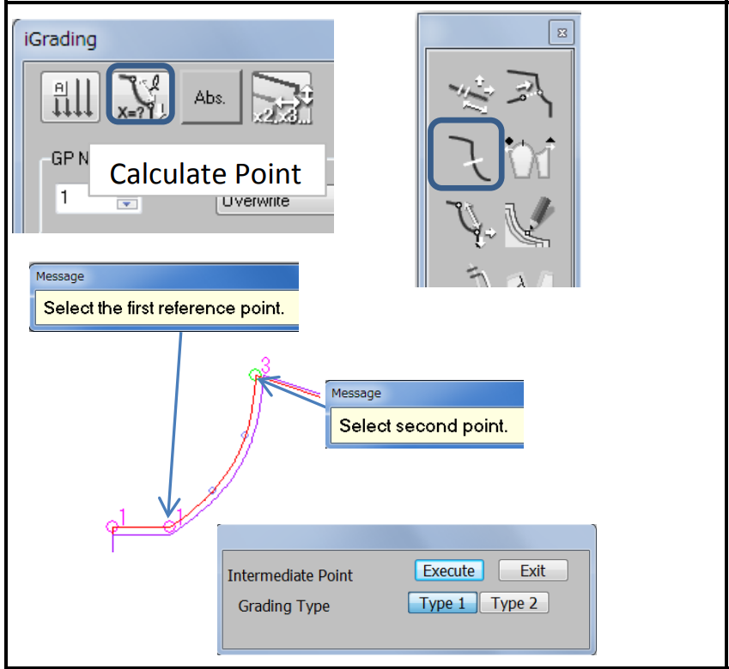
Or there is another way to figure out intermediate point between 2 points.
"Calculate Point" "Intermediate Point"
"Reference point"GP1
"Second Point" GP3
Type 1 and Type 2 give different curve.
GP is calculated automatically with "Execute.

Slide 14
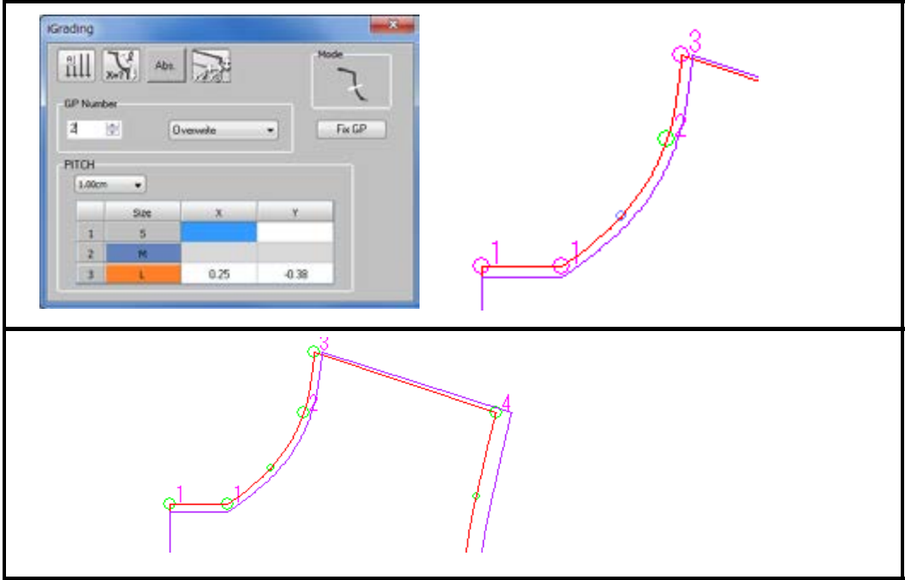
Click "Fix GP."
Refer to "Shoulder width" and "Shoulder drop" for GP4.

Slide 15
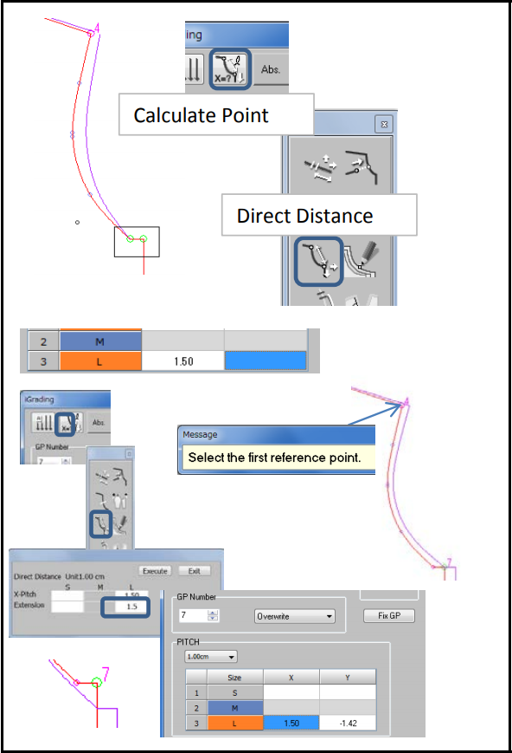
If it is necessary to give same GP for 2 points for bottom of arm hole, include the points with area and click one point to display GP number.
Pitch of X (width) is figured out by chest width, but there is no information for Y (length).
Calculate pitch using "Calculate Point" - "Direct Distance."
Input 1.5cm in X for the difference of chest width/2. "Calculate Point" - "Direct Distance" Select shoulder point as first reference point.
Input 1.5cm which is the difference of "Straight armhole."
Press "Execute."
Select GP7, then click "Fix GP."

Slide 16
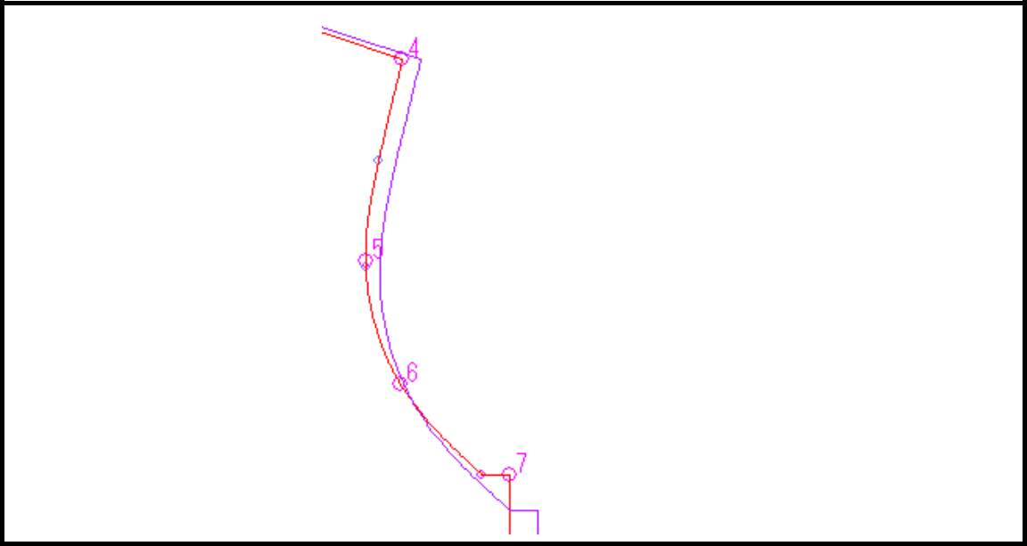
Gp5, 6 are the intermediate points between 4, 7.
GP5 is the reference point for "Front bust width.“ Then check if front bust width on the pattern is close to the indicated measurement or not. It is also possible to refer to "Front bust width (15cm down from HSP)" to figure out GP5. But be careful, because "15cm down" may be only about M size and it is not indicated for other sizes.

Slide 17
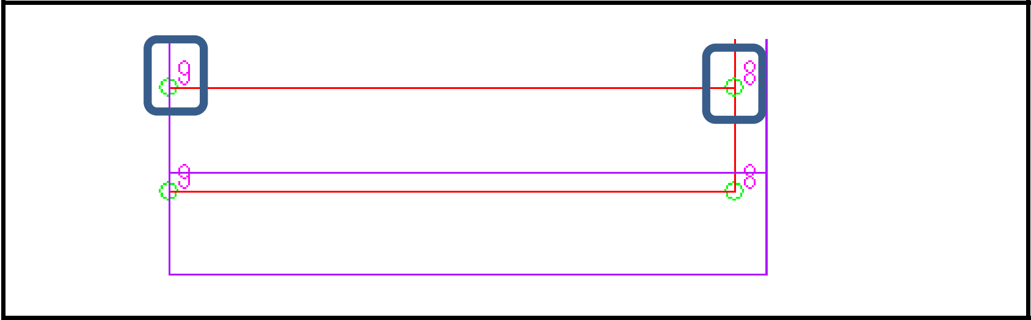
Input GP for hem. There are points at both ends of the hem assist line. And other points for pattern line may exist at the same part. So make area including both points then click on the point to set GP.

Slide 18
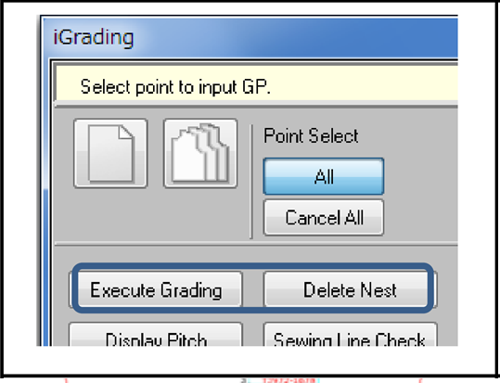
The grading line for each size is shown. Use "Delete Nest" to delete it.
When data is in the pitch table, nest is shown with "Execute Grading."
Click "Exit" to close the menu after GP is completed.

Slide 19
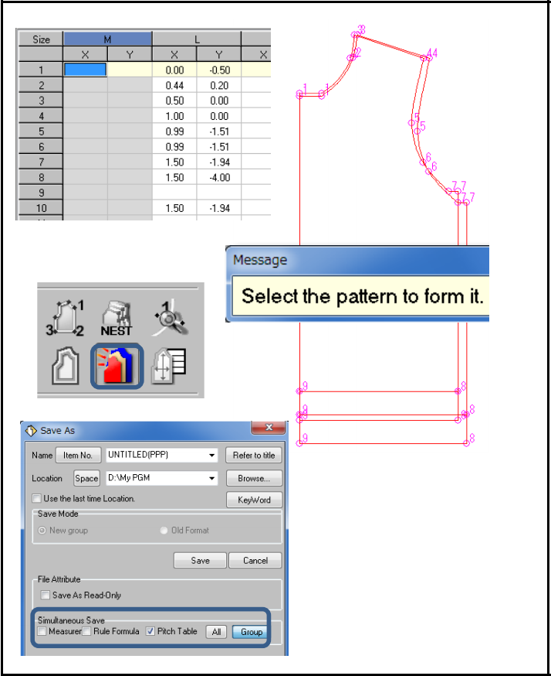
Pitch of GP is created in the grading table in Grading page.
The grading nest is converted to the actual pattern with "Embody."
Select "Pitch Table" when saving the pattern.
With "Group," pitch table can be loaded together with pattern.
Make grading for back body with the same procedure as front body.
If GP1-GP9 are used for front, use GP21-GP29 for back

Slide 20
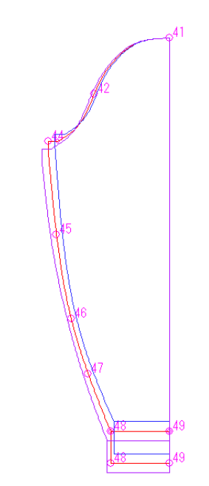
Grading-Sleeve
GP41
X=0 Y=0
There is no need to divide the measurement of width by 2 for sleeve pattern.
GP44
Input the pitch referring to "Height of the sleeve cap" and "Sleeve width."
Or it is also possible to use "Calculate Point" - "Direct Distance" referring to "Straight armhole" and "Sleeve width."
GP46 (Sleeve expand width)
Check the measurement after figuring out the pitch using "Intermediate Point."
Or input the pitch based on the measurement of Sleeve expand width considering the difference of the reference measurement (23cm) in each size.

Slide 21
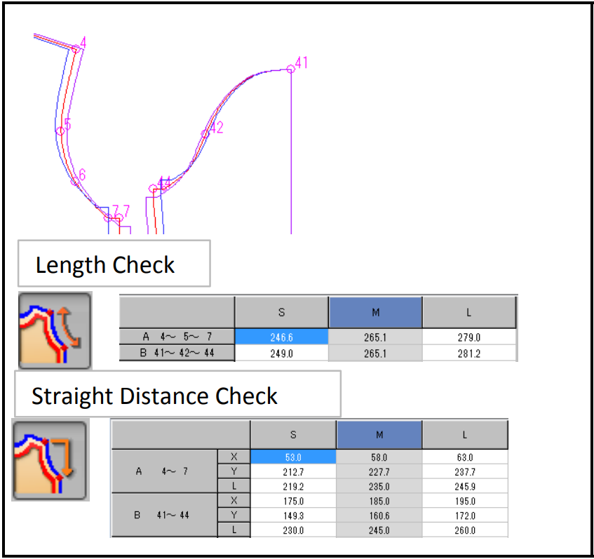
It is possible to compare the measurement of Arm hole and Sleeve cap in each size using "Length Check" and "Straight Distance Check" in Grading page.

Slide 22
References
https://www.shimaseiki.com
Shimaseiki training guide

