Slide 1
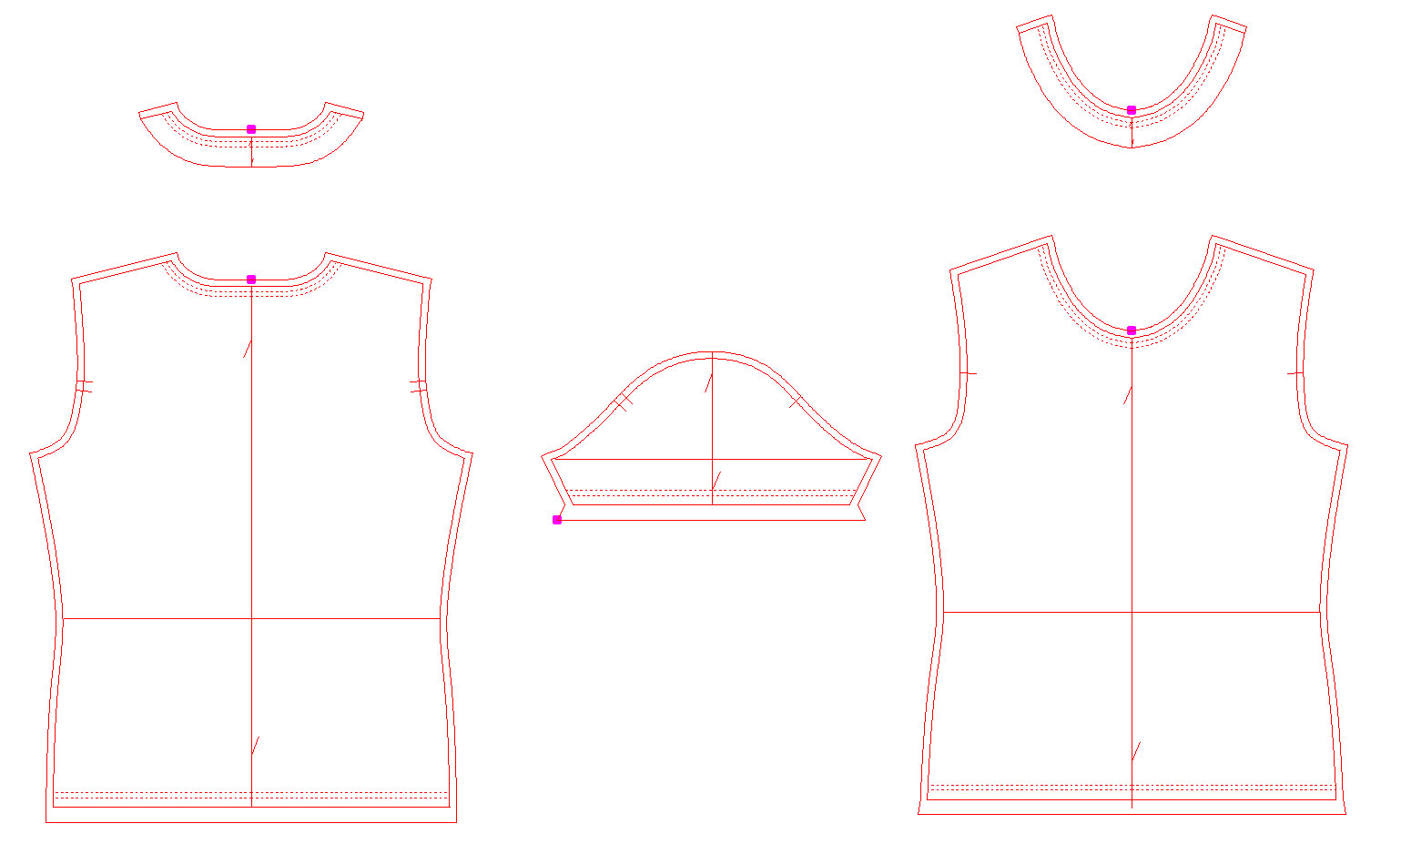
Seam allowance

Slide 2
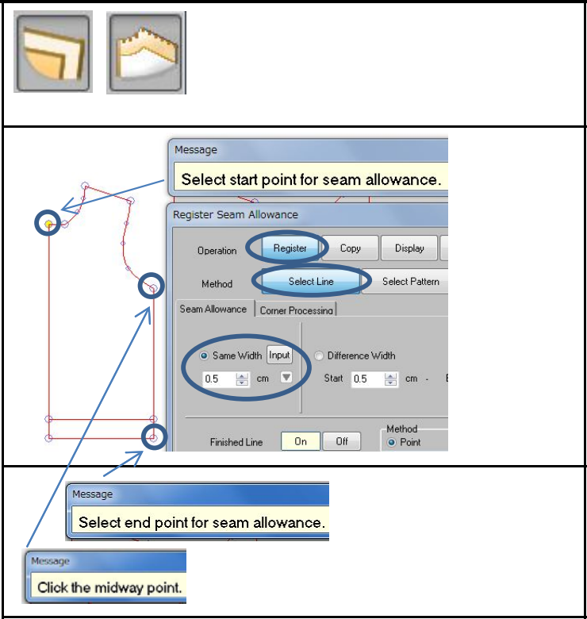
Add Seam allowance
Seam allowance/Register
Select "Register" and "Select Line." Input the width of seam allowance.
Select the point to start seam allowance.
Select end and midway points.

Slide 3
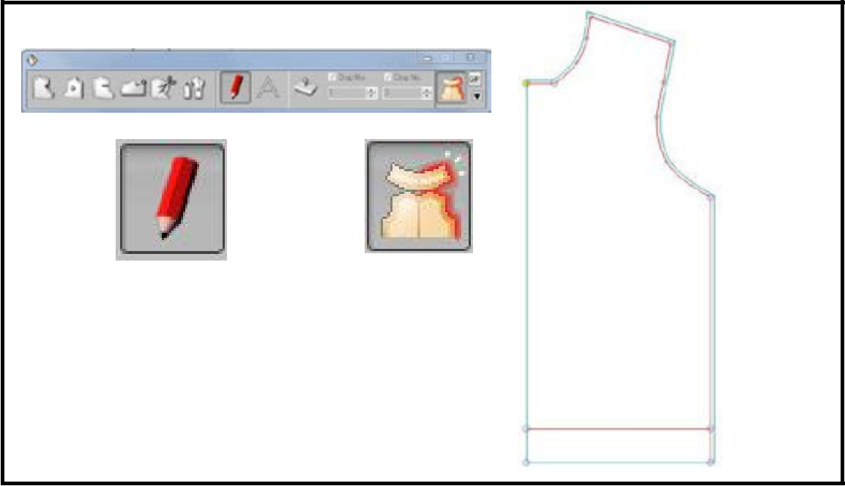
Press "F3" key on sub keyboard.
Seam allowance line is displayed when "Seam allowance/Fold Line Display" is selected.
* Assist line can be displayed with "Assist Line.“

Slide 4
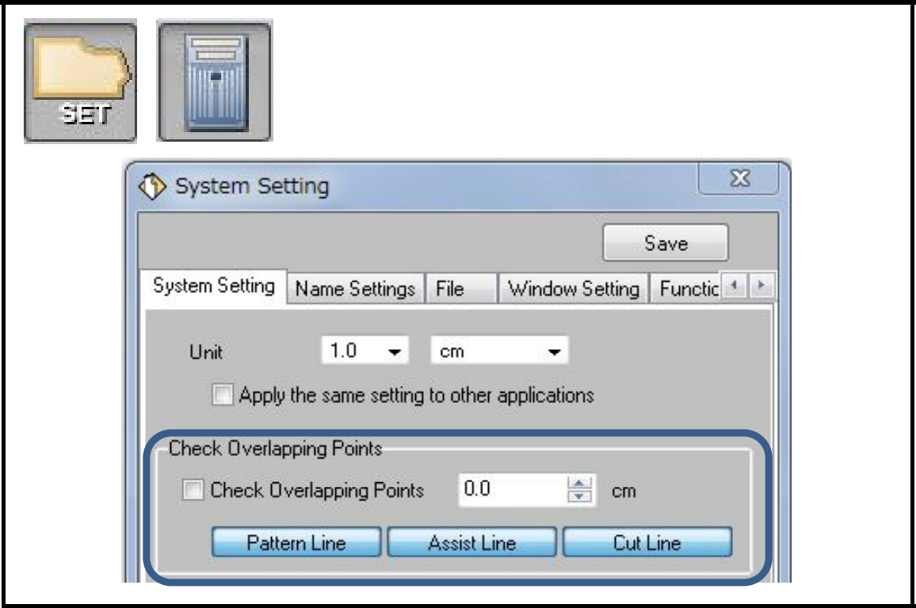
Save/load data
Before saving the data, go to "Set/System Setting/ System Setting."
Untick the function of "Check Overlapping Points." If not, pattern cannot be saved when the distance of points is short.

Slide 5
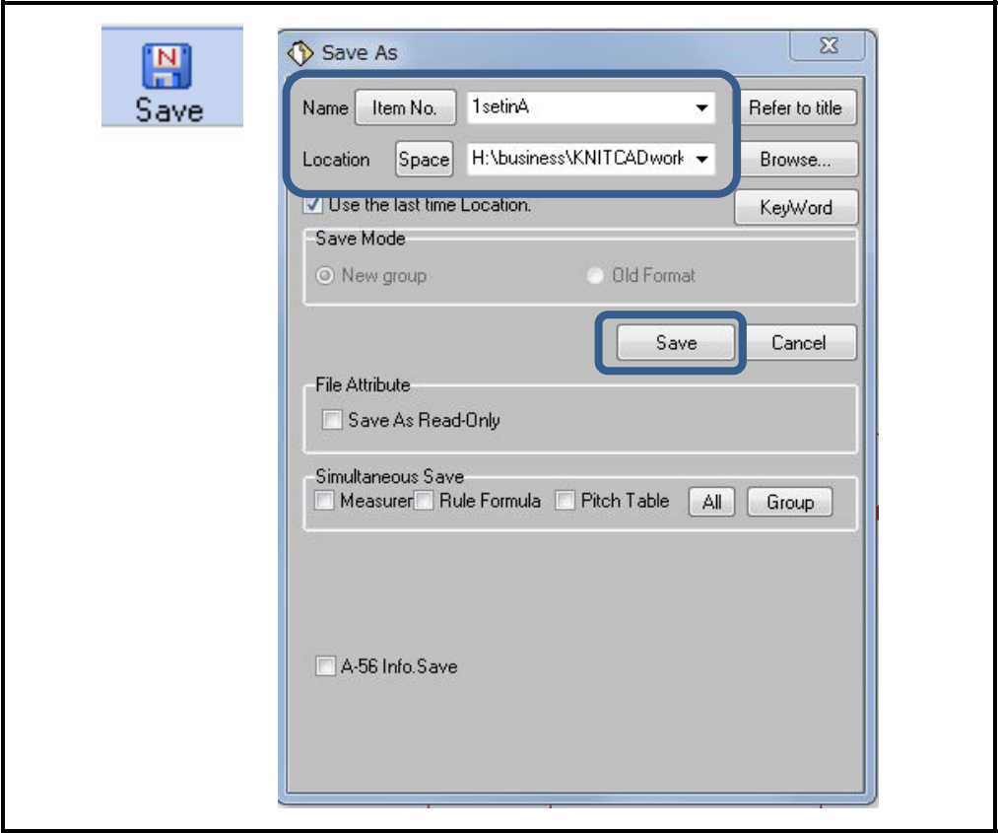
To save the data of whole page, click "Save." Then input data Name and select the location to save. Click "Save.“

Slide 6
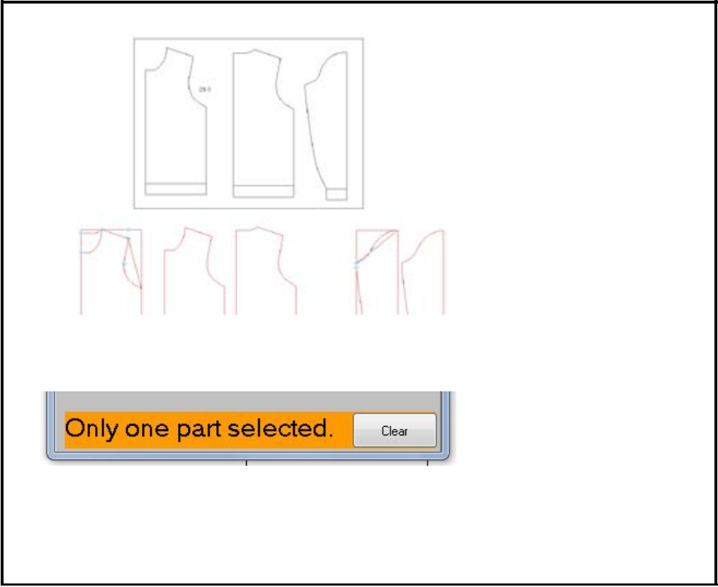
To save the selected data in one page, specify an area of the pattern & click "Save.“
The message "Only one part selected." appears in the menu.
The following procedure is the same as the steps mentioned above.

Slide 7
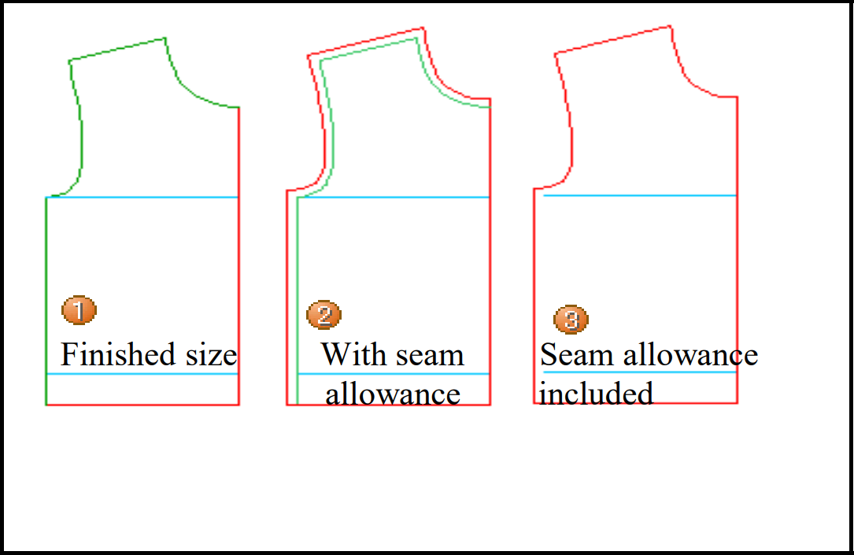
Seam allowance
To execute fitting simulation, seam allowance should be registered.
Here, following method is explained.
Creating a pattern with finished size in PGM and adding seam allowance.
Replacing the pattern with seam allowance and finished line by the pattern with registered seam allowance.
Replacing the pattern including seam allowance by the pattern with registered seam allowance

Slide 8
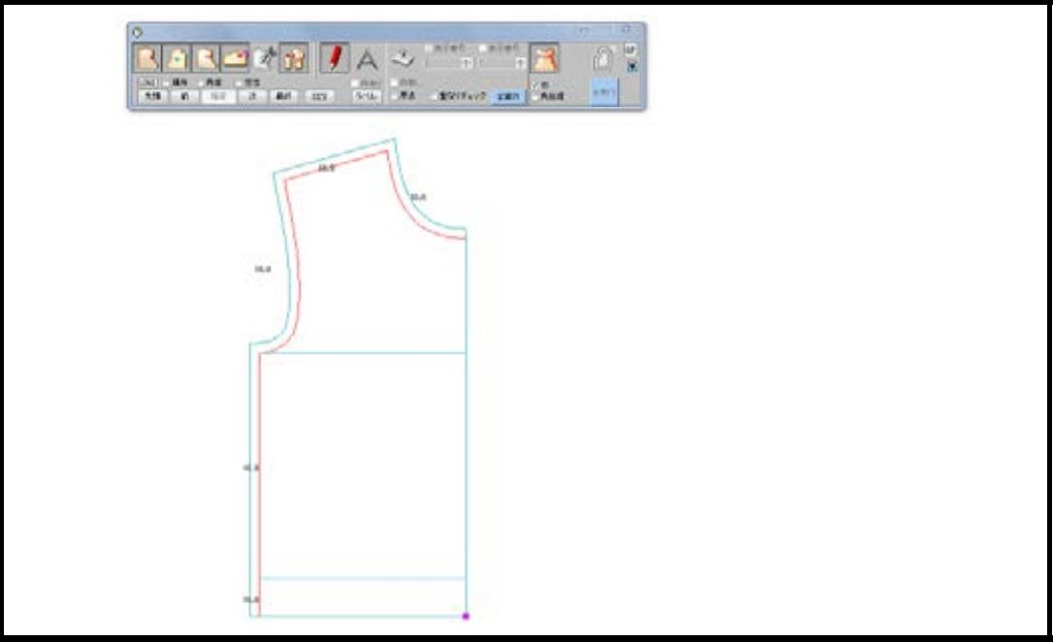
☆When seam allowance is registered, usually it is not displayed.
To confirm whether or not to register, use F3 (Constant Display Mode).

Slide 9
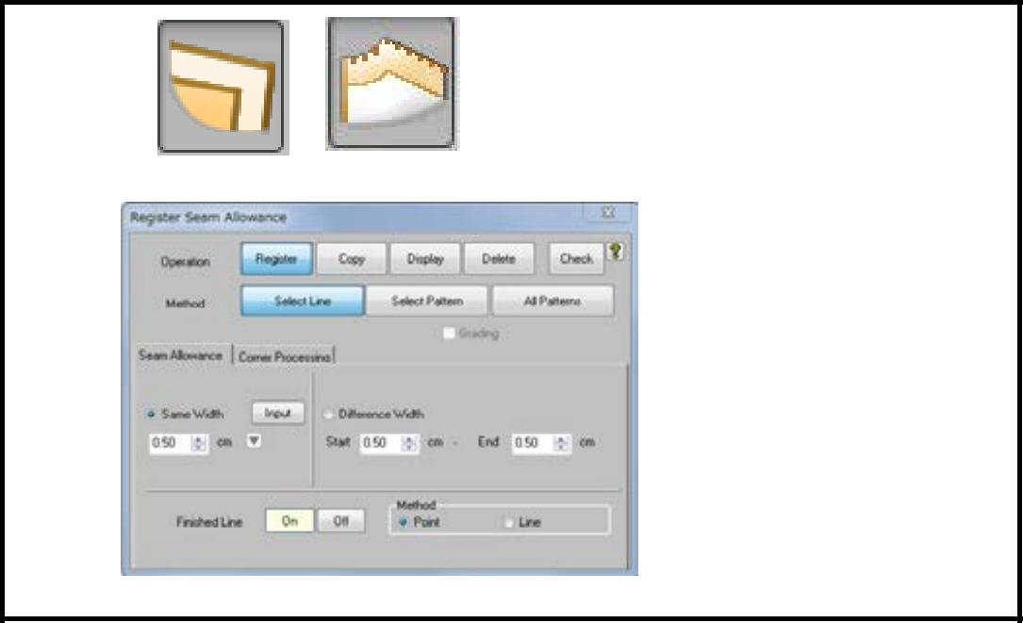
Creating a pattern with finished size in PGM and adding seam allowance (New registration)
Seam allowance - Register
Set the width and click the line to add seam allowance.

Slide 10
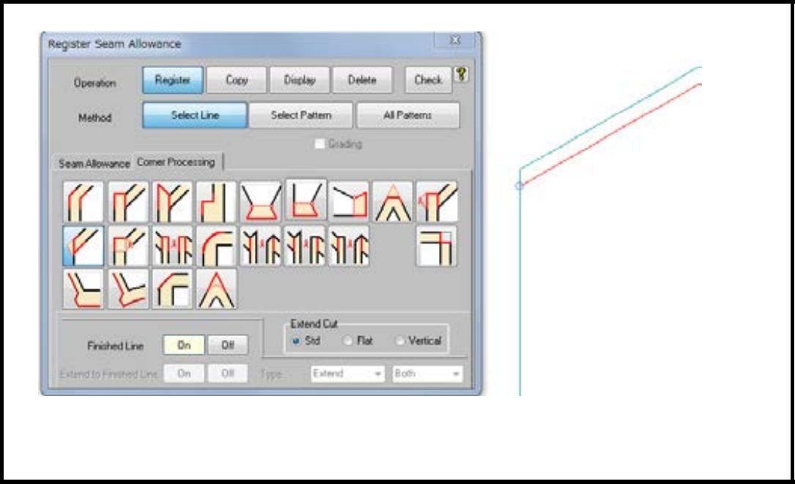
For the corner, switch to Corner Processing tab.
With seam allowance on both sides, select [Extend] and click the corner point.
With seam allowance on one side, select [Extension (Cut)] and click the corner point and then the point on seam allowance end.

Slide 11
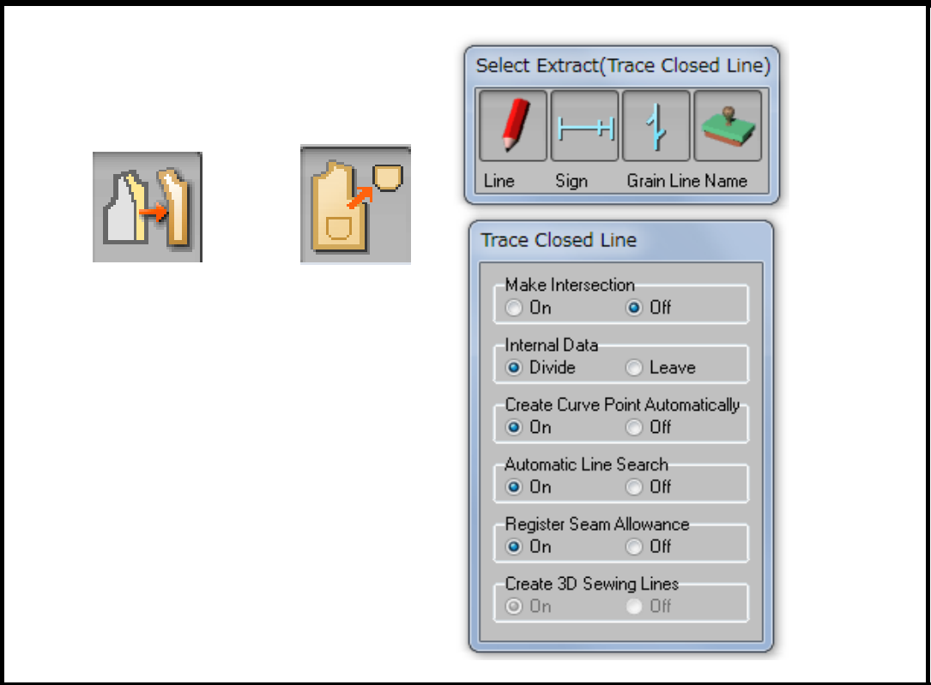
Replacing the pattern with seam allowance and finished line by the pattern with registered seam allowance
Line
Click Finishing line.
"Do you trace a pattern with a finishing line?" Click OK key.
☆Without recognition of finished line, the message above is not displayed. Select the entire finishing line for a continuous line with one stroke, and then press EXEC.
To confirm finished line recognition, use F3 (Constant Display Mode). Green line: recognized.

Slide 12
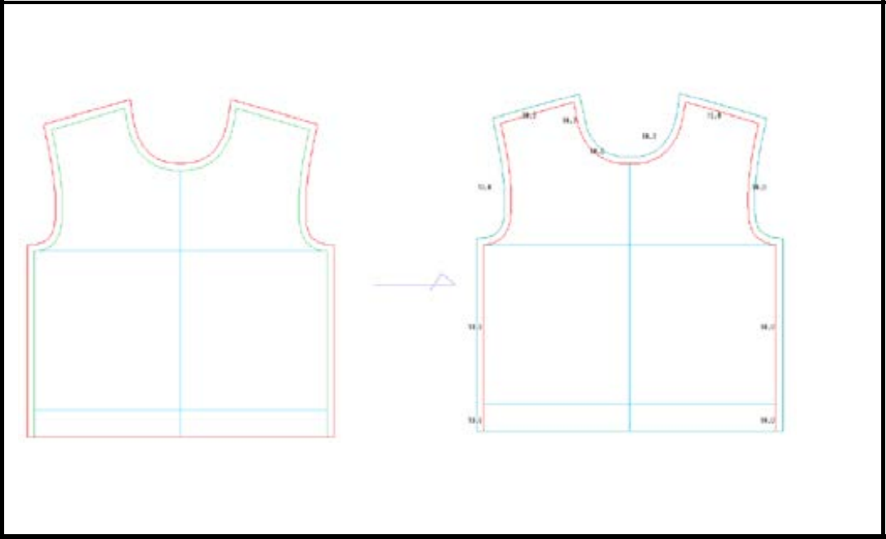
Confirtn seam allowance
Seam allowance - Register
By doing trace operation, seam allowance is automatically registered.
Confirm the width and corner shape. If necessary, modify them.

Slide 13
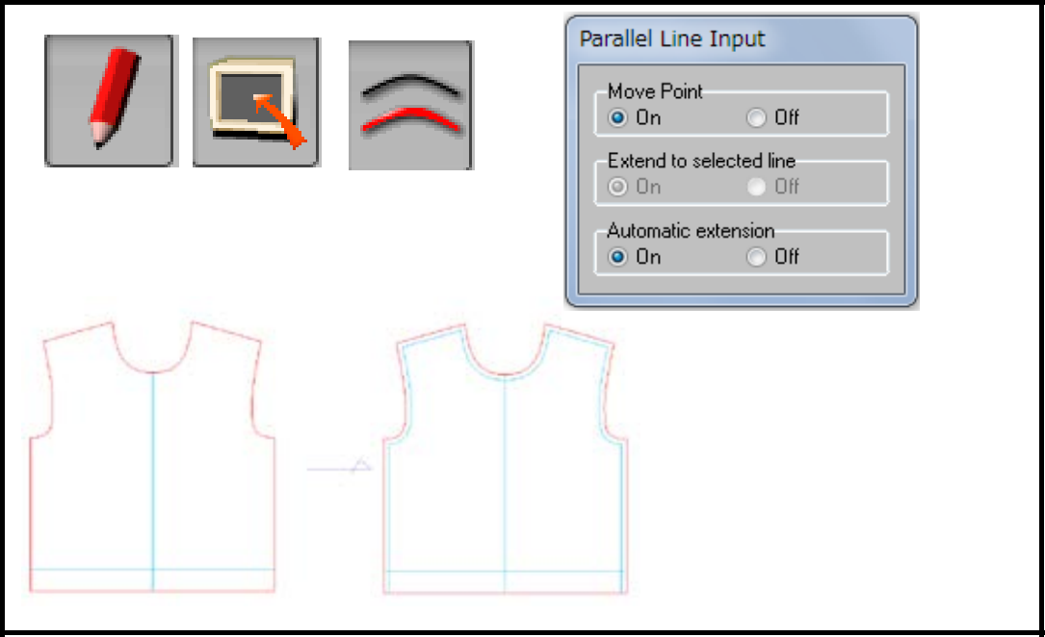
Replacing the pattern including seam allowance by the pattern with registered seam allowance
Removing seam allowance
Without Finished Line,
Add Finished Line by using
Assist line - Input - Parallel line.

Slide 14
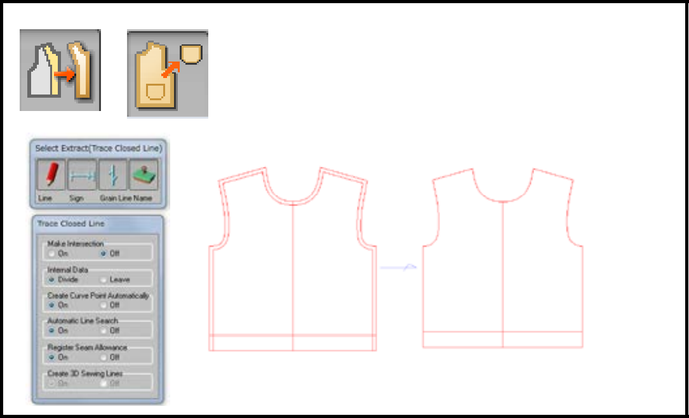
By using Trace - Closed line, select the entire Finished Line as a continuous line with one stroke.

Slide 15
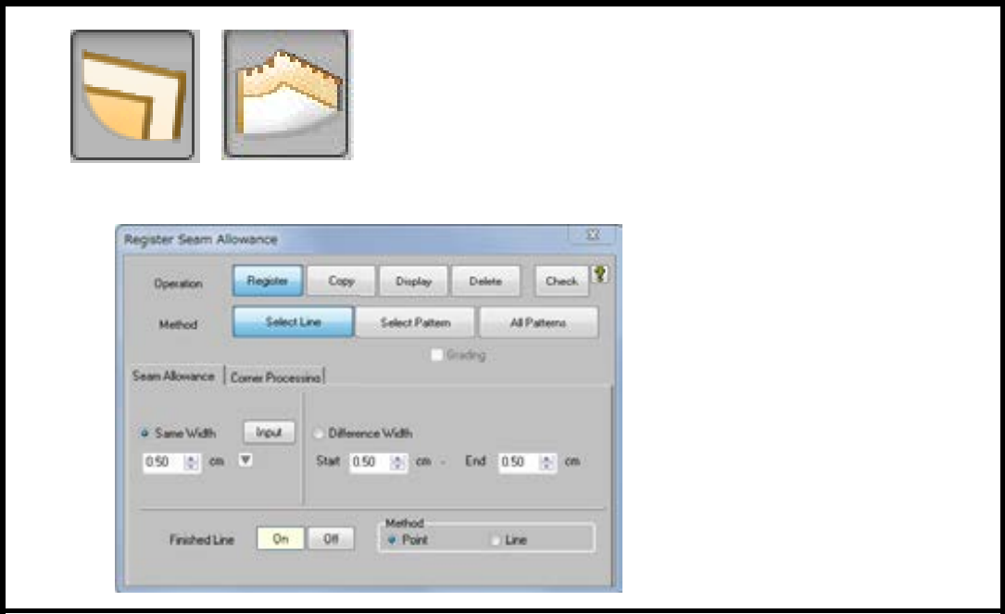
Adding seam allowance
Seam allowance register
Set the width and click the line to add seam allowance

Slide 16
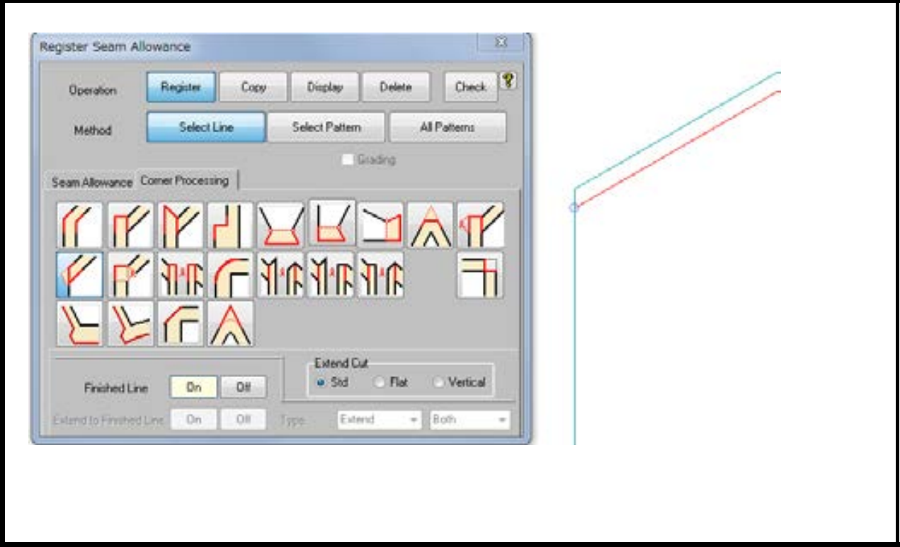
For the corner, switch to Corner Processing tab.
With seam allowance on both sides, select (extend) and click the corner point.
With seam allowance on one side, select (extension cut) and click the corner point and then the point on seam allowance end.

Slide 17
Armhole
Minimum measurement of Armhole. Men's (height 170cm) 25cm Women's (height 158cm) 21cm
(Reference)Shimaoriginal samples 1 8cm~20cm(General measurement of most samples.)

Slide 18
Shoulder drop
General idea of shoulder drop angle 20° (Japan) 28° (Eur./U.S)Back and Shoulder are thick.
Shoulder drop 3.2cm~3.5cm(Japan Men’s)
  2.8cm~3.0cm(Japan Women’s)
  3.8cm~4.5cm(Eur./U.S Men’s)
  3. 5cm~4.0cm (Eur./U.S Women's)
(Reference)Shimaoriginal samples angle 20° 15°
Shoulder drop 2~2. 5cm (General measurement of most samples.)

Slide 19
Sleeve width
Minimum measurement of Armhole.(Some samples have narrower width by the requirement of design.)
Men's 18cm
Women's14cm
14~ 14. 5cm(13. 5~18. 6)
(Reference)Shimaoriginal samples.14~14. 5cm(13. 5~18. 6) (General measurement of most samples.)

Slide 20
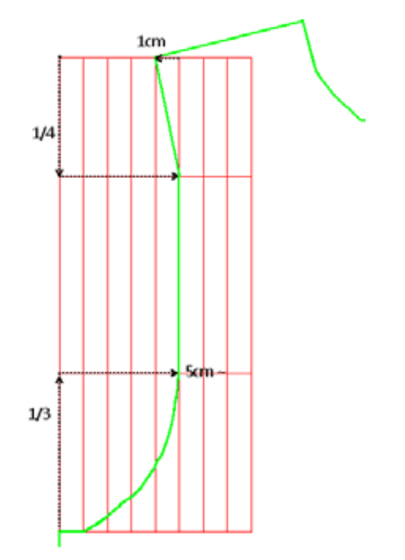
Armhole
Example of Set in front armhole line.
End of narrowing 1/3 of armhole hight from the bottom
Start of widening 1/4 of armhole from shoulder point narrowing width (X direction)^{-,-}5cm_{N} 5cm+a widening width (X direction)^{-,-}1 cm more or less(or straight)
Some samples has no straight part.
(SHIMA SEIKI original samples Women's size 9 )

Slide 21
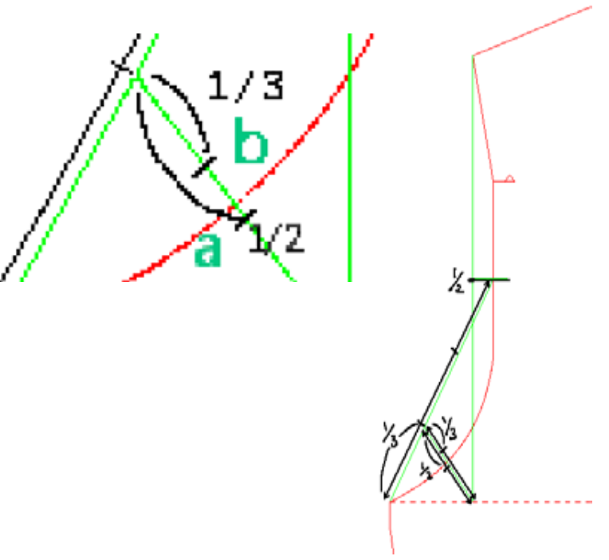
Example of front armhole line.
If the line goes inside of 1/2point (a), angle becomes too small to make narrowing.
* Standard measurement in Size input table on APEX3
Back bust width =Front bust width + 1cm Ease for A.H. (back body) = 1 cm

Slide 22
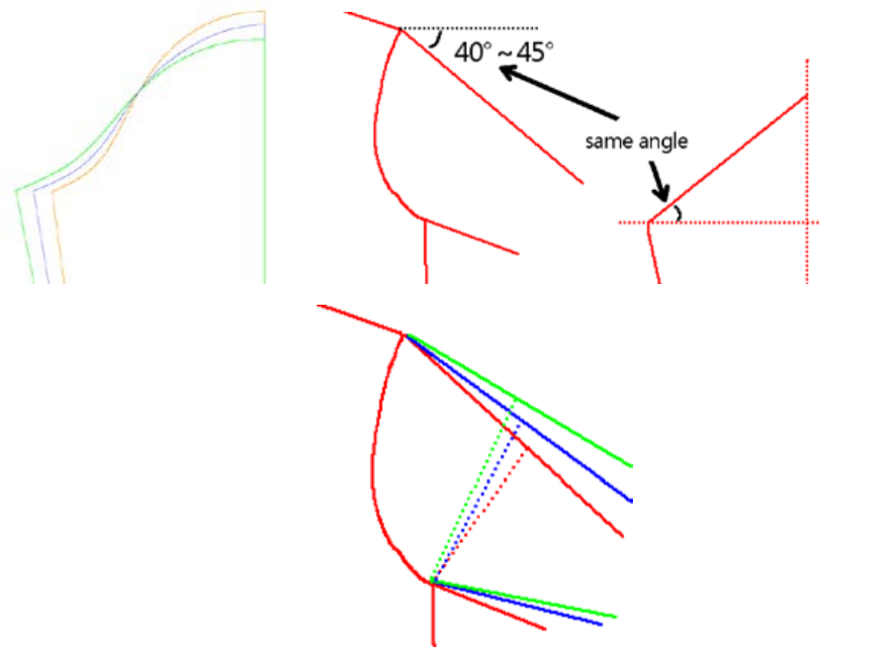
Sleeve cap and sleeve width
The sleeve cap hight tends 1 be inversely proportional to the sleeve cap width.
Sleeve cap High o Low
Sleeve width Narrowo Wide
Angle of sleeve Down o Up
Straight A.H. Small o Large
*Generally widen Chest width and Shoulder width when Straight A.H. is longer for looser silhouette.

Slide 23
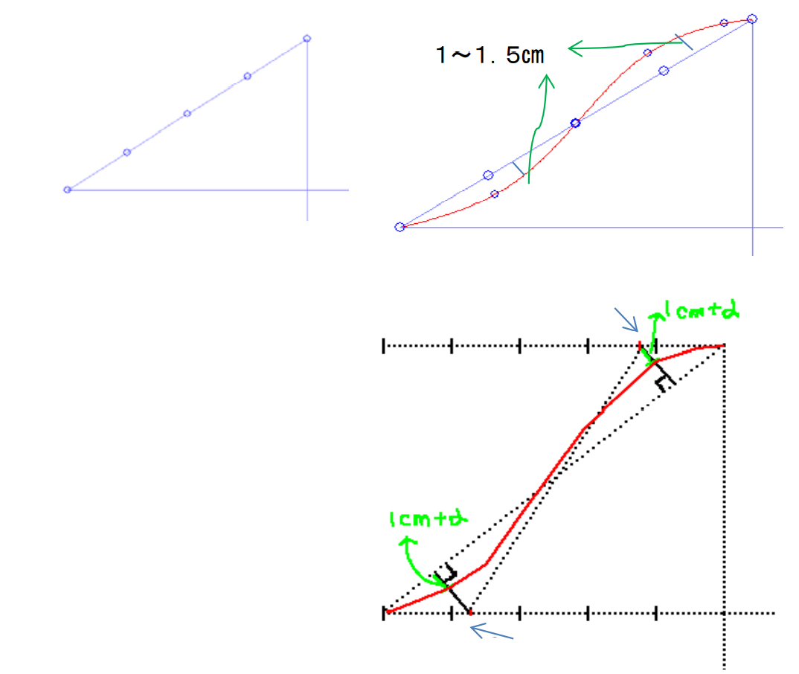
Example of sleeve cap
(Reference) Example to draw sleeve cap©(When sleeve cap is lower)
(Reference) Example to draw sleeve cap© (When sleeve cap is lower)
Make the top part of sleeve cap flat, otherwise it makes edge.
S curve passing at 2 points and go ing along straight line in the middle.

Slide 24
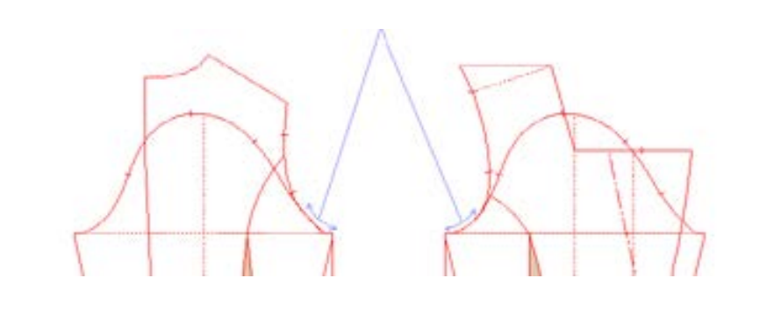
AH and Sleeve cap
The fitting of sleeve to the AH is better by drawing similar curve line for the beginning of AH and sleeve cap when sleeve cap is high.

Slide 25
References
https://www.shimaseiki.com
Shimaseiki training guide

