Slide 1

For better usage of PGM

Slide 2
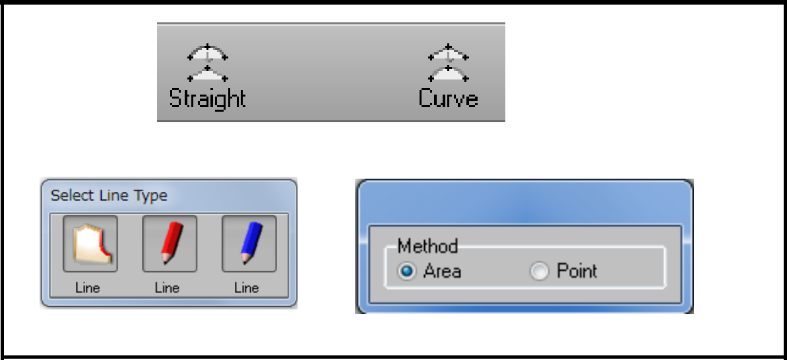
Switching straight and curve
Straight line point and curve line point can be switched alternately for the existing point.
You can use by adding [Straight] and [Curve] functions to toolbar or selecting [Straight] or [Curve] from [Change] for each line type.

Slide 3
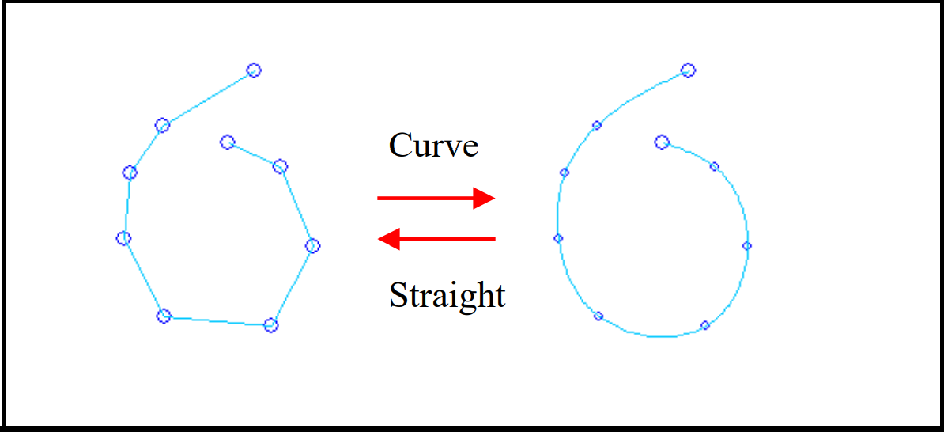
In either case, by selecting [Area] for [Method], you can change the point on drug part to straight or curve line point.
Only for curve line, some points cannot be changed. (end point of assist line, start point of pattern line, etc.)

Slide 4
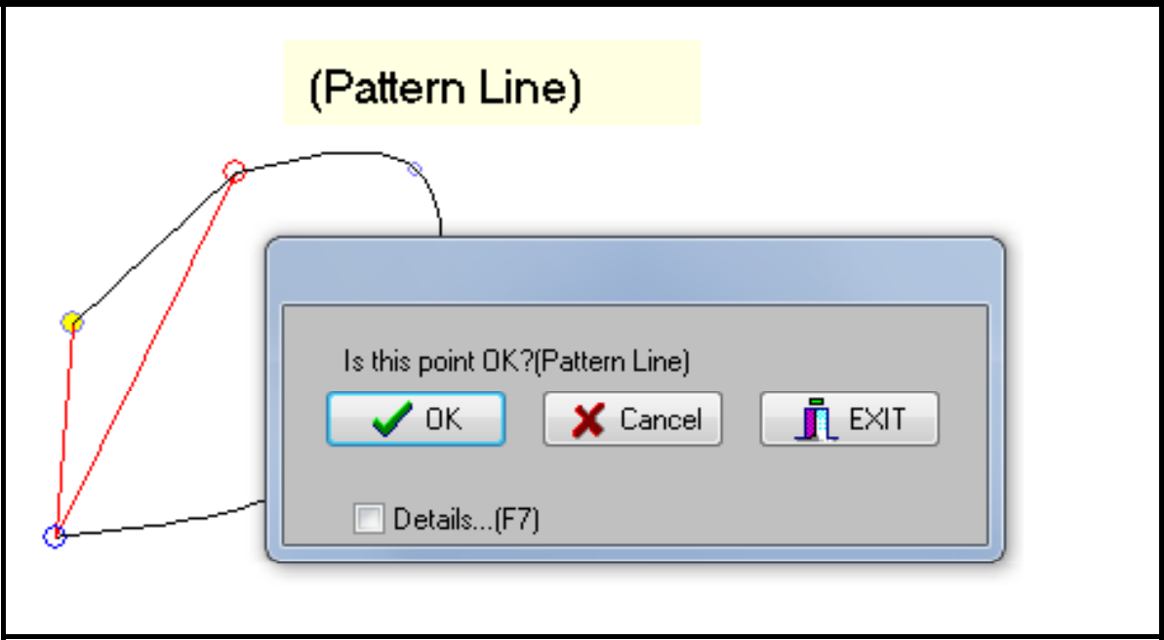
Inquiry for overlapped points, connected line/separate line
When using PGM functions, especially selecting point, inquiry as shown on the left may be displayed. This inquiry helps users to select the desired point when pattern line point, assist line point, and points consisting different assist lines are almost at the same position.
Click [Cancel] button to display other alternatives. Switch until the line to be selected becomes bold.

Slide 5
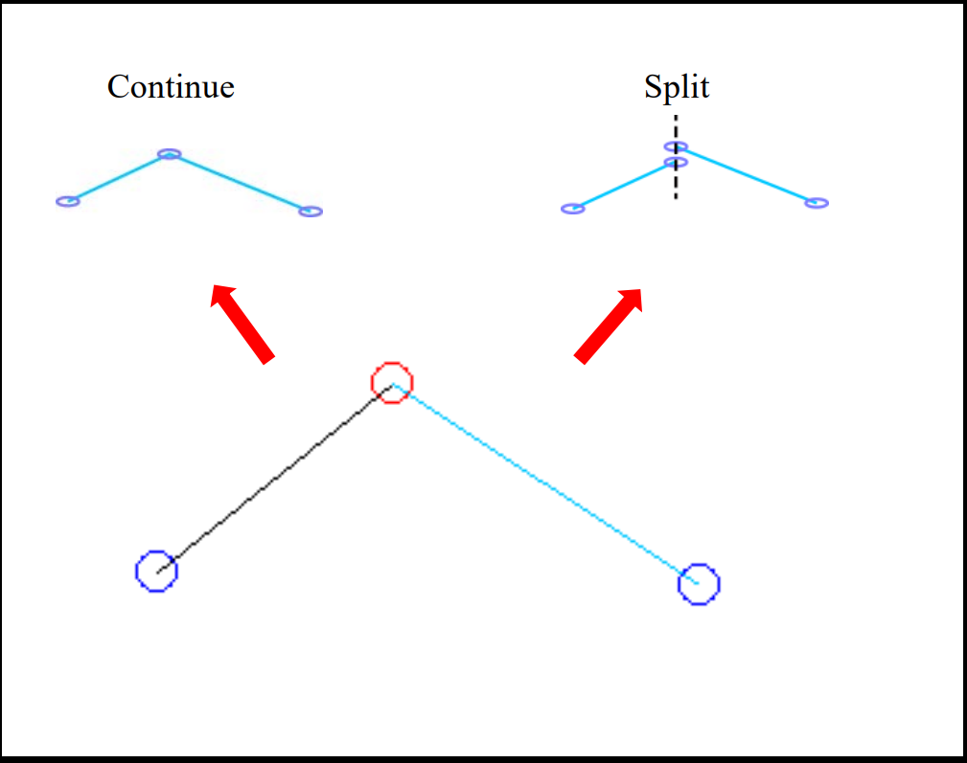
Even when the line seems to be connected, actual data may be separated. In this case, inquiry mentioned earlier is displayed or only the line on one side becomes bold across the point.
When using [Connect] or [Split] from [Change] for each line type, line can be connected or split at the desired straight line point.
To extract the figure enclosed with assist line or develop line by using [Trace] function, for example, connecting the line in advance may omit the operation.

Slide 6
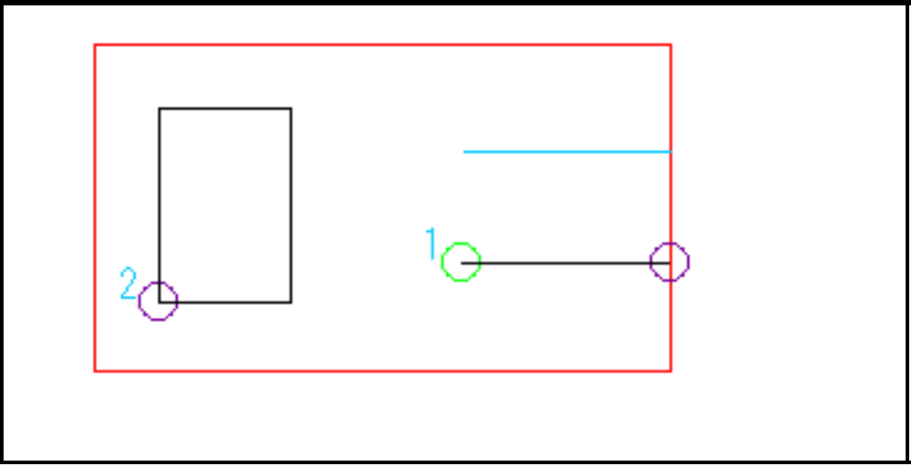
Cut line
The line is a kind of assist line. Unlike the usual assist line, the line is for cutting with the cutting machine. Use to hollow out the pattern or add cut line.
Red: Pattern line Cyan: Assist line
Black: Cutting assist line (Number shows the cutting order)

Slide 7
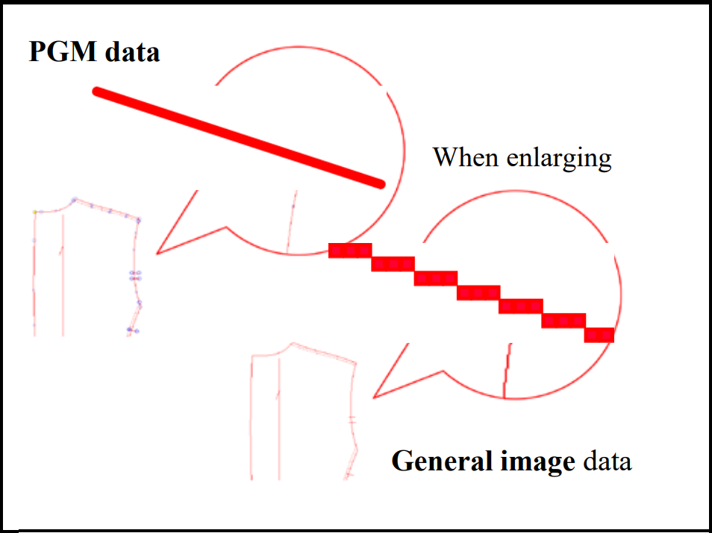
PGM data (Vector graphics)
Line information connecting the points.
Smooth even when enlarged or reduced.
Point and line have meaningful information as shape.
Data is processed as collection of figures. General image data
Collection of each individual picture element (pixel) when enlarged. Image is created with the colored pixel.
Combination of colors can create various data. •Identification of lines or points is not available.

Slide 8
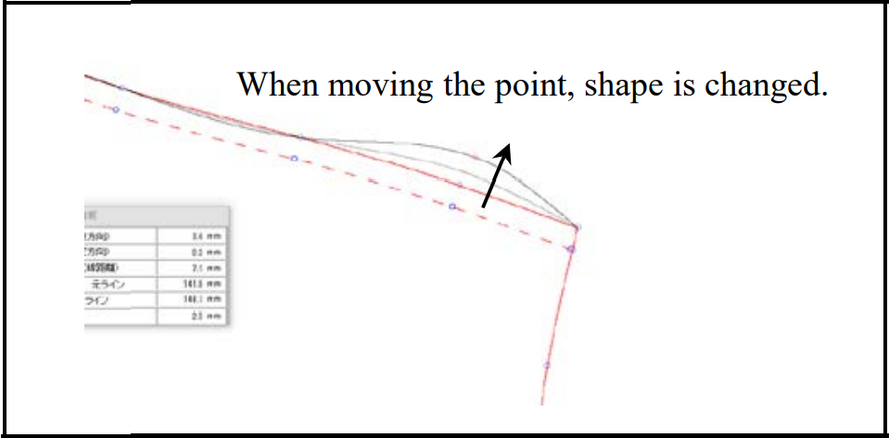
Reason why PGM data is processed with vector graphics. •Data should be processed as figure.
Activating cutting machine or plotter.
Keep the figure in easily editable condition.

Slide 9
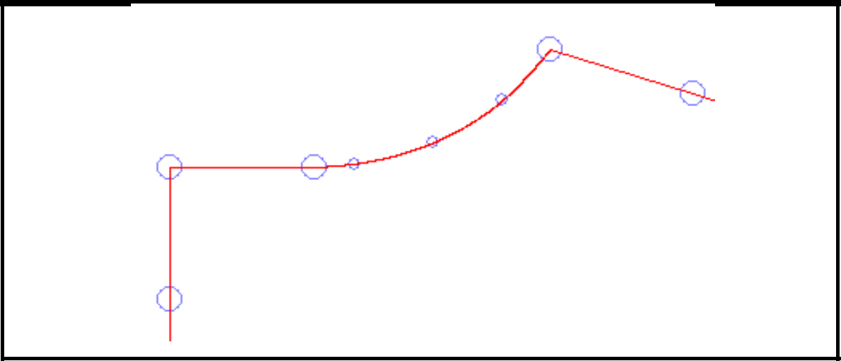
Stratight line point and curve line point
Straight line point (shown with large circle): Points are connected with straight line. Curve line point (shown with small circle): Points are connected with curve line. For curve line, points are smoothly connected via middle point.

Slide 10
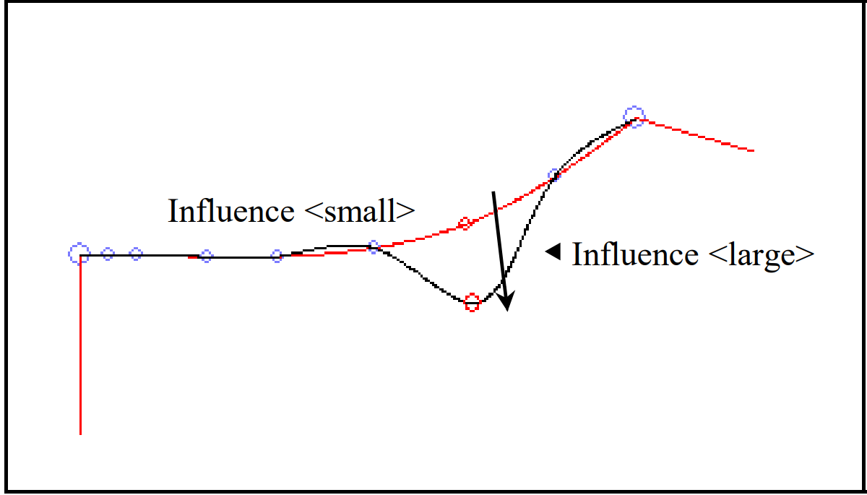
Curve line points are influenced each other.
Points which are successive in order have larger influence on line shape.
Depending on the positional relation between points, generally adjacent 3 points including the point to be moved have influence.
It does not influence on the straight line point and forward.

Slide 11
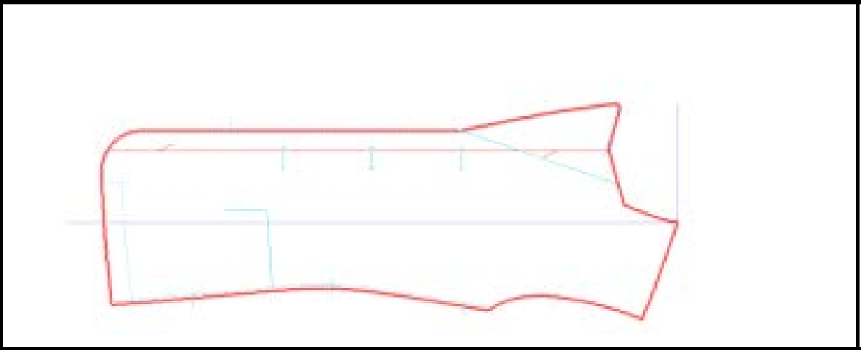
Pattern and line, and line type
In PGM, each line type has each role.
Pattern line (Red bold line in the figure)
Line to create outline
A continuous closed line with one stroke

Slide 12
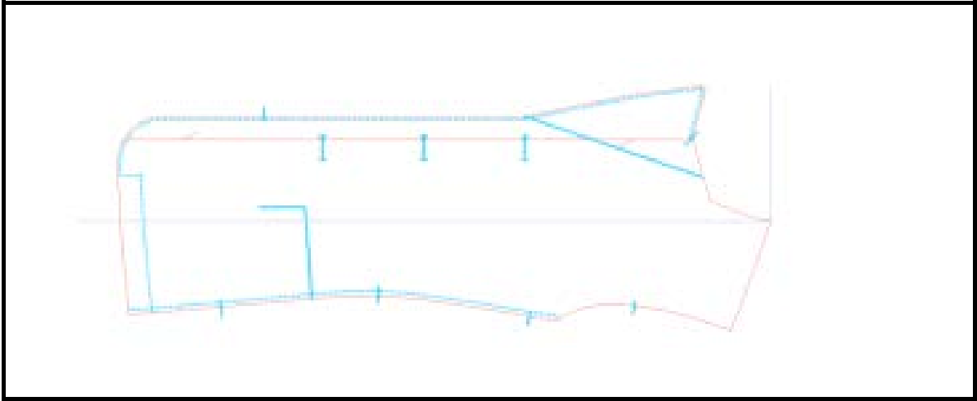
Assist line (Cyan line in the figure)
Internal line associated with pattern line
It consists of one line
Assist line moves as pattern moves.
Can be displayed with cyan for F3 (Constant Display Mode) and some functions.

Slide 13
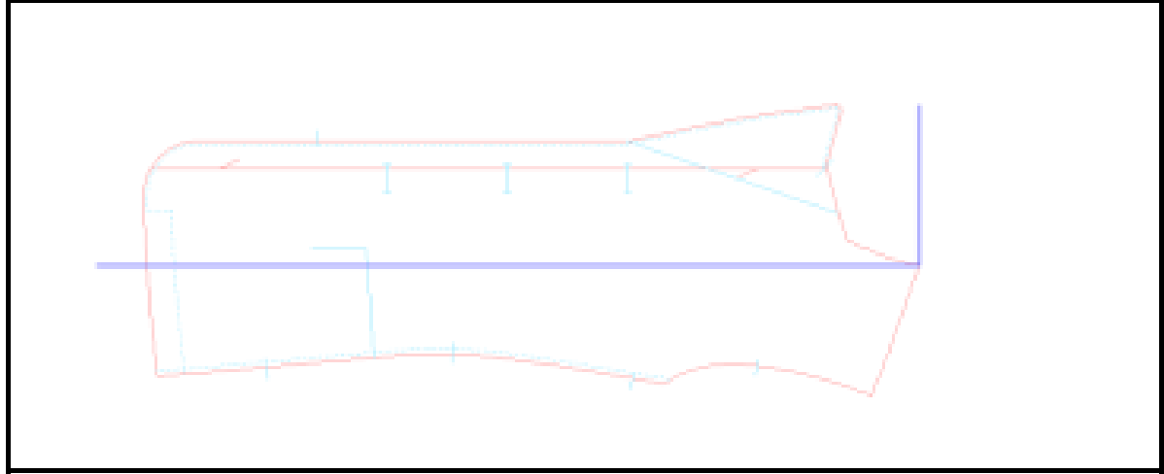
Develop line (Purple line in the figure)
Independent line from pattern
Use when drawing base line for making pattern from a rectangle frame and drawing cutting line across multiple patterns (figures).
It stays even when moving the pattern.

Slide 14
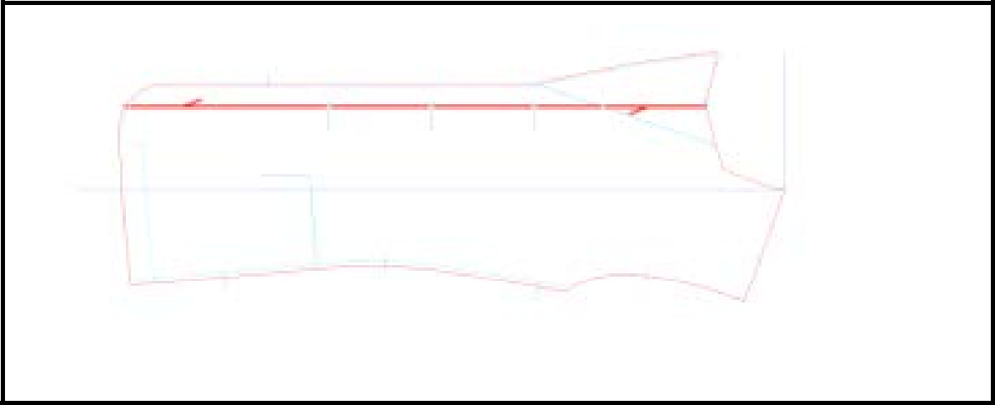
Grain line (Arrow in the figure)
The line showing the direction (knit, weave, and hair).
For the pattern used for knitting machine, knitting direction is shown with arrow with direction.

Slide 15
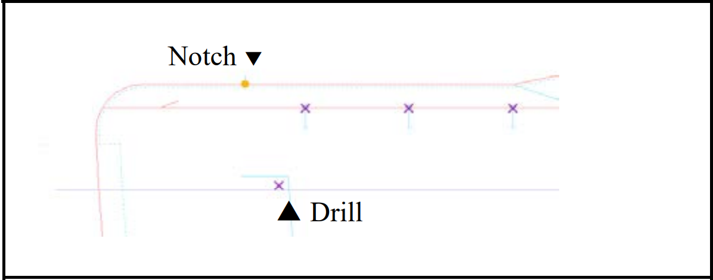
Information except for "line"
Information used for cutting with P-CAM
Notch
Drill
Additionally, special information such as knit point used for PatternShaping is contained.

Slide 16
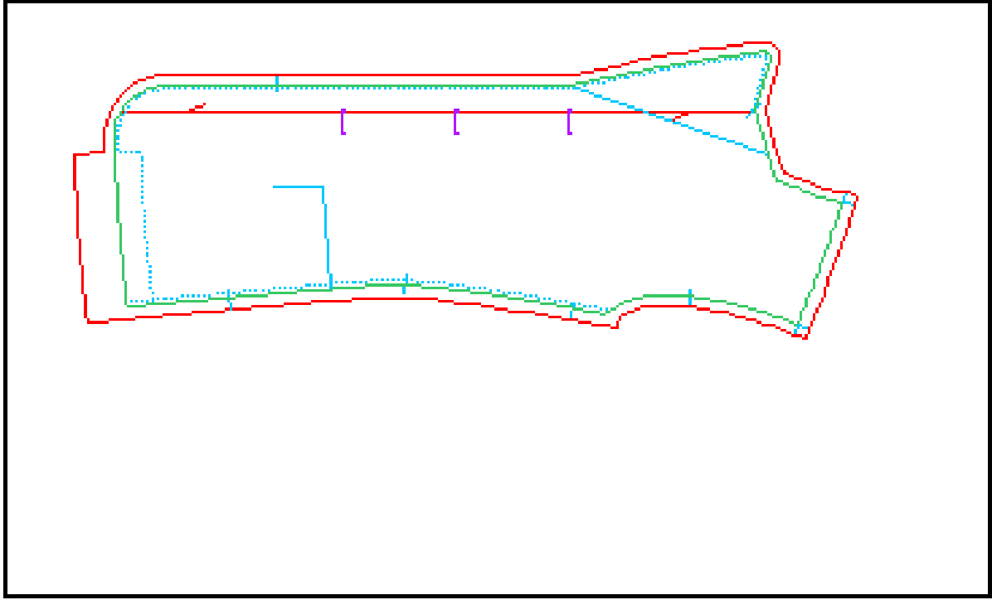
Finished line (Green line in the figure)
Seam allowance is required for sewing the product. The completed line except for seam allowance is finished line.
With seam allowance, outline of seam allowance is pattern line. Without seam allowance, finished line is pattern line.

Slide 17
APEX3 Pattern make basic commands
Basic operation with sub keyboard/ Keyboard
F2 Rotate pattern —Left 90 degrees
F3 Rotate pattern —Left 180 degrees
F4 Rotate pattern —Right 90 degrees
F7 Flip a pattern horizontally/ vertically(Set - System settings)
F9 Horizontal/ vertical line
F10 Temporarily pattern saving
CANCEL Curve/ straight line
DISP Display points/ move point with pen
OPTION Starting or end point comes just on other point.
OK Right angle

Slide 18
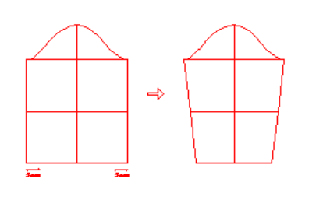
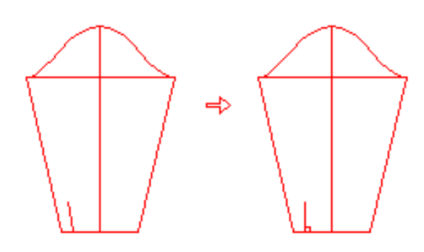
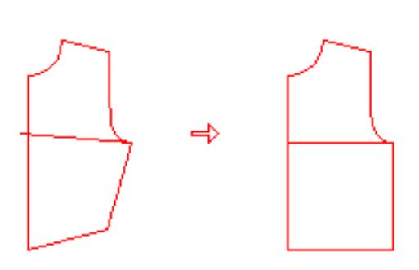
Pattern | Learning points | Functions to use
 | Modifying cuff width | Pattern Line > Modify > Numerical Assist Line > Modify > Extend/Shorten
 | Modifying slit line | Point > Move > Horizontal/Vertical
 | Modifying side line, hem line and bust line | Point > Move > Horizontal/Vertical Assist Line > Modify > Extend/Shorten Point > Move > Horizontal/Vertical (to make the slanted assist line horizontal)

Slide 19
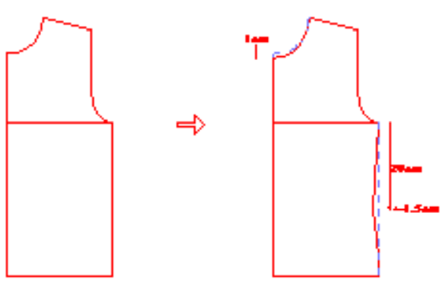
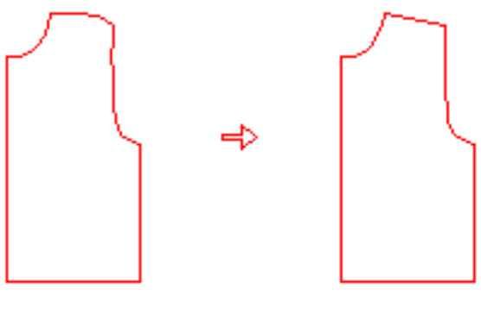
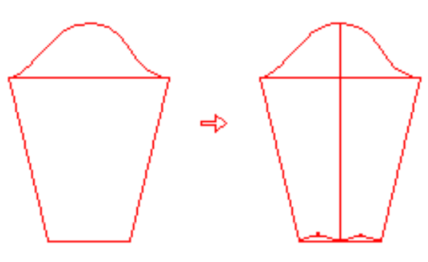
Pattern | Learning points | Functions to use
 | Modifying neck line and side line | Neck Line: Pattern Line > Modify > Numerical Side Line: Guide Point > Numerical Pattern Line > Modify > Redraw Line
 | Changing shoulder line to straight line | Pattern Line > Change > Straight
 | Drawing center line of sleeve | Guide Point > Divide (with [Input Point] On) Assist Line > Input > Right Angle (Assist Line > Modify > Extend/Shorten)

Slide 20
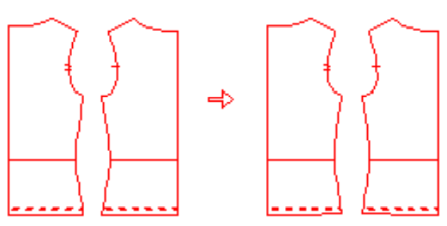
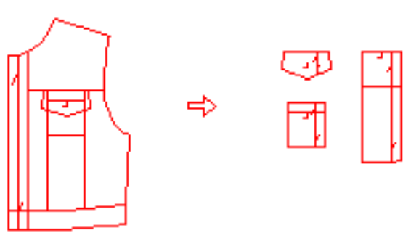
Pattern | Learning points | Functions to use
 | Correcting the connection between hem line and stitch line | Sewing Line Check > Modify 2-line Connection
 | Extracting a part of pattern | Trace > Trace Closed Line

Slide 21
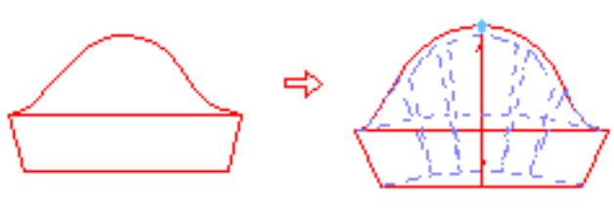
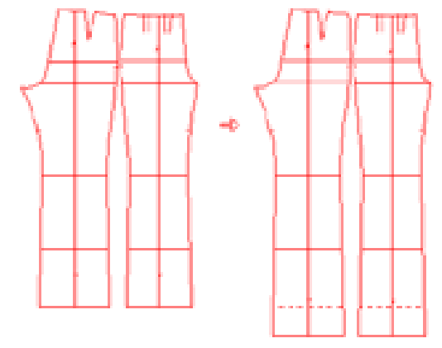
Pattern | Learning points | Functions to use
 | Creating pouffy(gathered) sleeve | Assist Line > Input > Equally Spaced Line Divide > Open Pattern Line > Modify > Redraw Line
 | Lengthening/Shortening pants | Point > Move > Group Points

Slide 22
References
https://www.shimaseiki.com
Shimaseiki training guide

