Slide 1
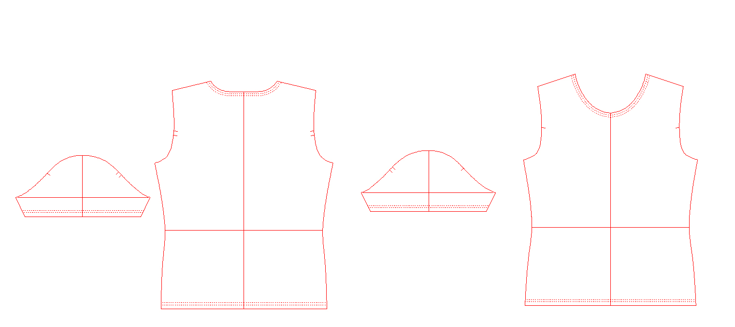
PGM
Pattern making

Slide 2
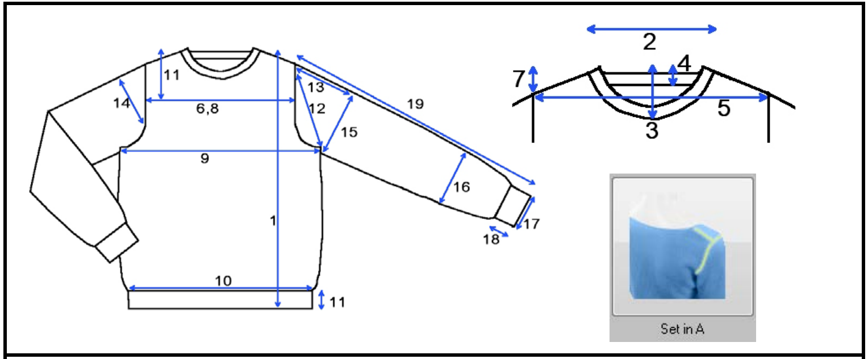

Slide 3
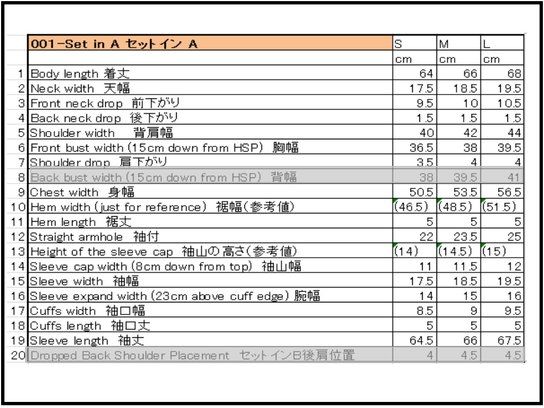
* Since we are only making half of the pattern, the measurements on the spec sheet for width have to be divided by 2.
(e.g.) Neck width 18.5 - 9.3
-Numbers are rounded off to first decimal place. (9.25 - 9.3)
For the sleeve, the measurements for width are already half on the spec sheet.

Slide 4
* Since we are only making half of the pattern, the measurements on the spec sheet for width have to be divided by 2.
(e.g.) Neck width 18.5 - 9.3
-Numbers are rounded off to first decimal place. (9.25 - 9.3)
For the sleeve, the measurements for width are already half on the spec sheet.

Slide 5
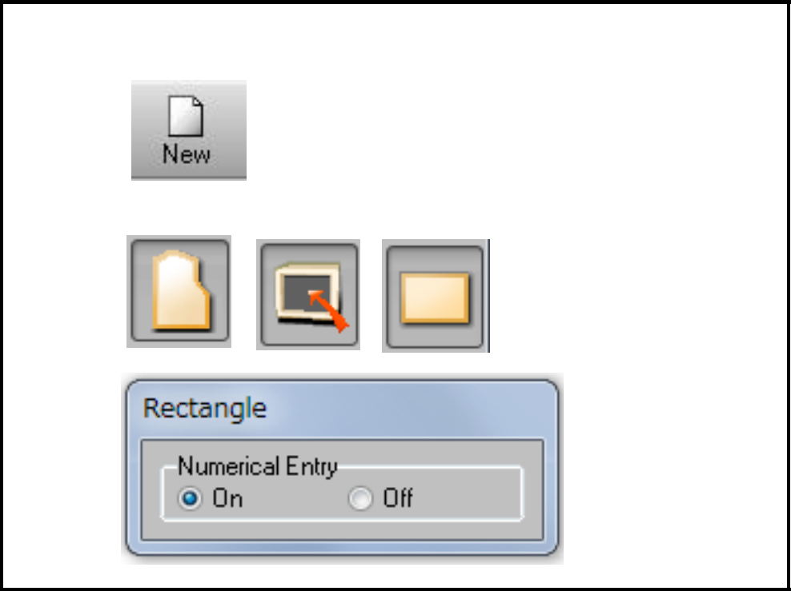
Pattern make - front & back body (M size)
1. Start making pattern from a rectangle frame
Open new window.
Pattern/Input/Rectangle

Slide 6
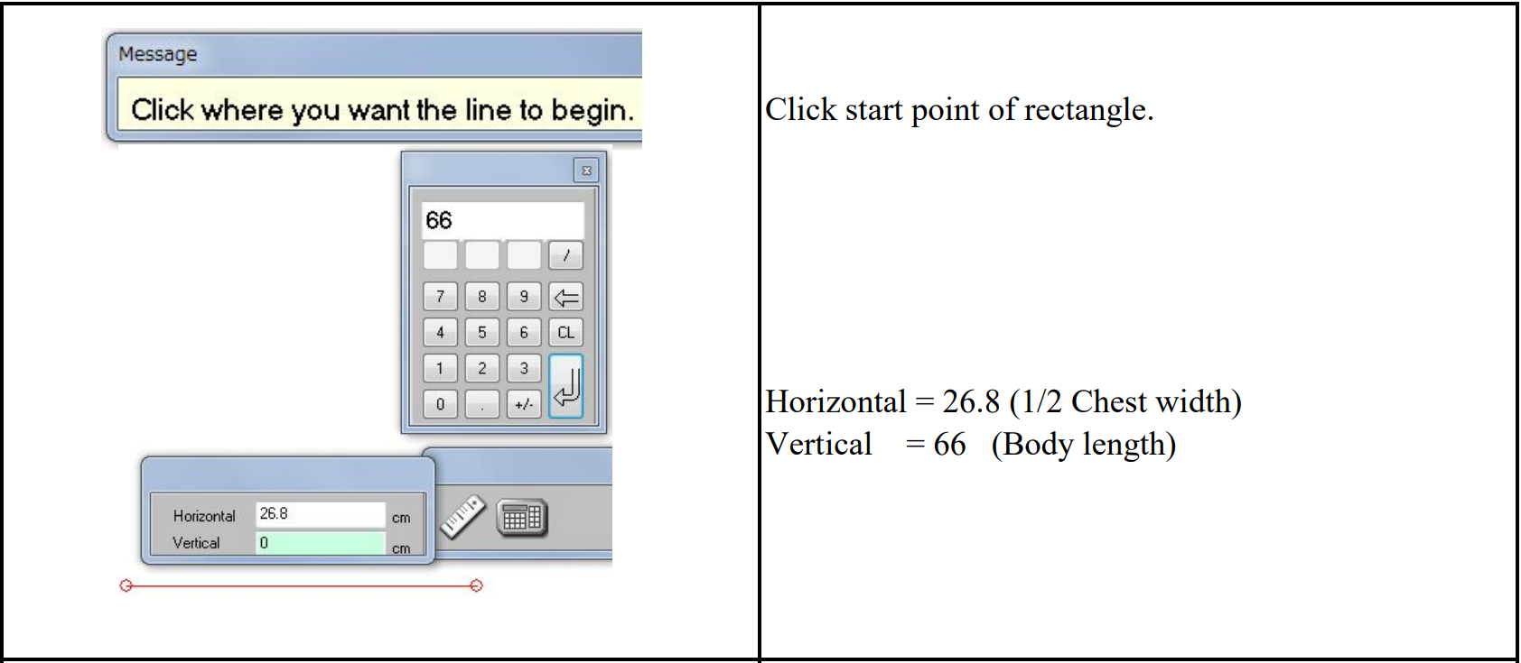
Press "EXEC." on sub keyboard or in the menu.
Press "CANCEL" on sub keyboard or click "EXIT" in the menu to close Pattern/Input/Rectangle.

Slide 7
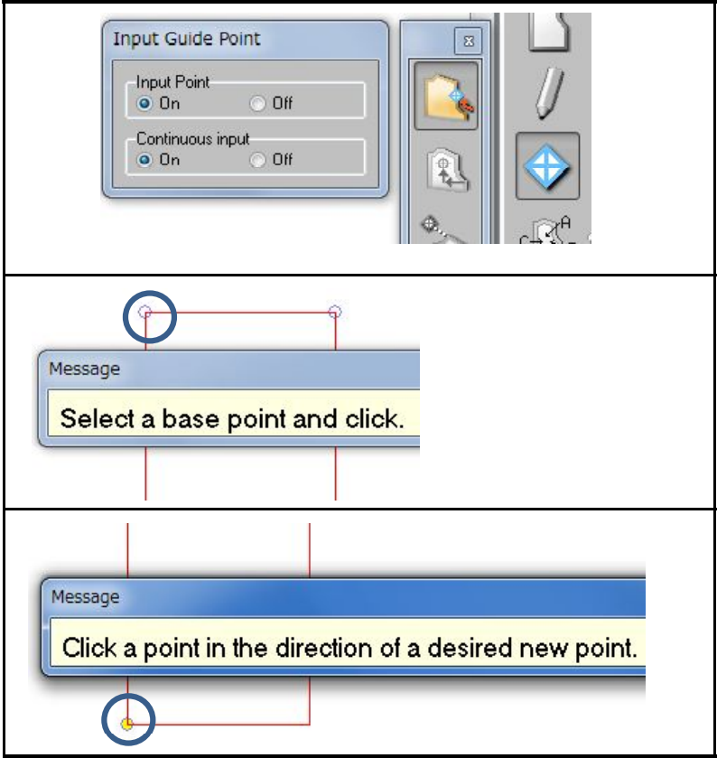
Input guide points for front/back neck drop, neck/shoulder width & shoulder drop
Guide Point/Perimeter
Select top left corner.
Select bottom left corner.

Slide 8
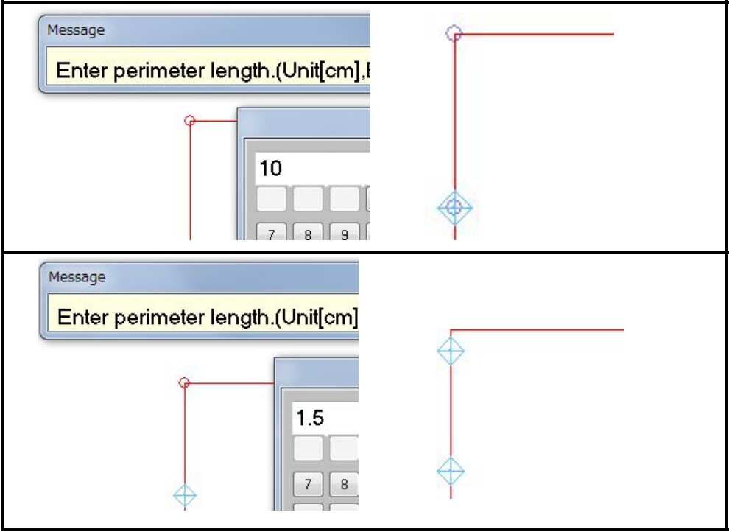
Input 10 (Front neck drop).
Repeat the same steps for back neck drop.
Input 1.5 (Back neck drop).

Slide 9
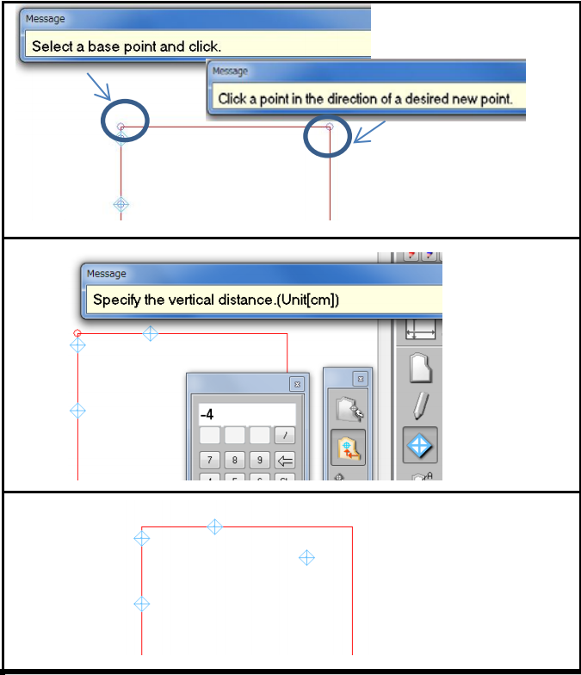
Repeat the same steps also for neck width. Input 9.3 (1/2 Neck width) for perimeter.
Guide Point/Numerical
Input the guide point for shoulder width and shoulder drop.
Base point = Top left corner
Horizontal 21cm (1/2 Shoulder width)
Vertical - 4cm (Shoulder drop)

Slide 10
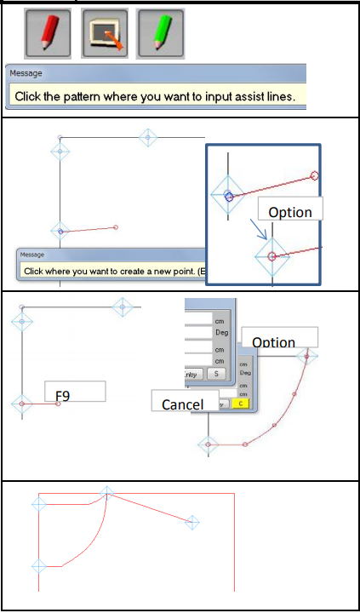
Input the neck/shoulder lines with assist line function
Assist Line/Input/Cursor
Select the pattern where assist line will be input.
Click on the front neck drop guide point, then press "OPTION" on sub keyboard to make sure that the point that you just input is overlapped on the guide point.
Press F9 on sub keyboard to make horizontal straight line for the first part of neck line.
Then press "CANCEL" key to change "S" (straight line) to "C" (curve line) for other neck points. Press "OPTION" after pressing neck end point.
Press "EXEC." to end the line.
Repeat the same steps for the back neck line.
Input another assist line from neck point to shoulder drop point.

Slide 11
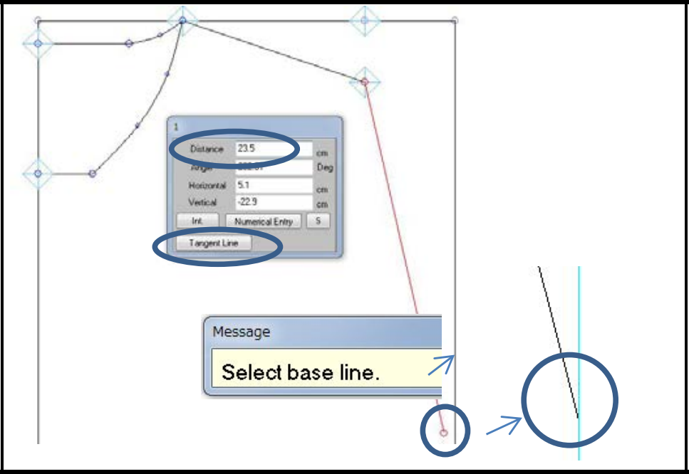
Input armhole measurement as a reference line
Input armhole measurement as an assist line. Assist Line/Input/Cursor
Input 23.5 (Straight armhole) to Distance in the menu.
Then click "Tangent Line" and click the base line.
By doing this way, the armhole line will be stuck to the outline automatically.

Slide 12
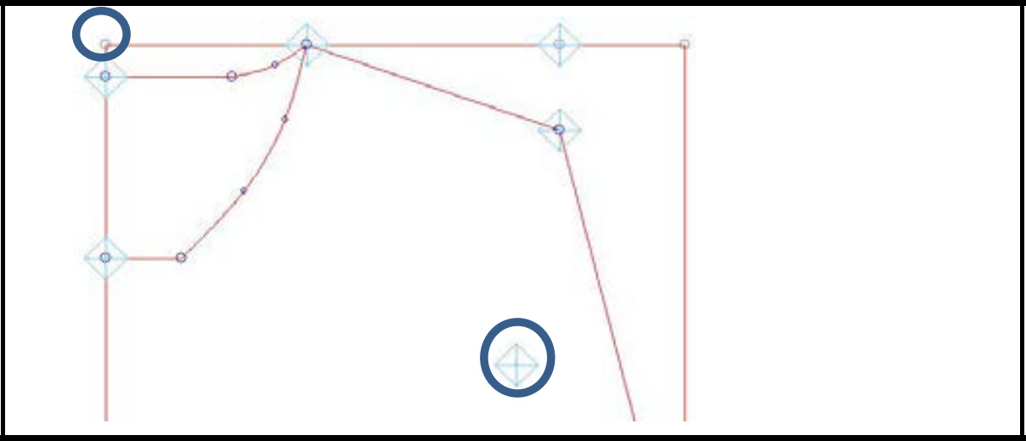
Input guide point for Front bust width
Guide Point/Numerical
Select the top left corner as base point
Input 19 (1/2 Front bust width) for horizontal distance and -15 (15cm down from HSP) for vertical distance.

Slide 13
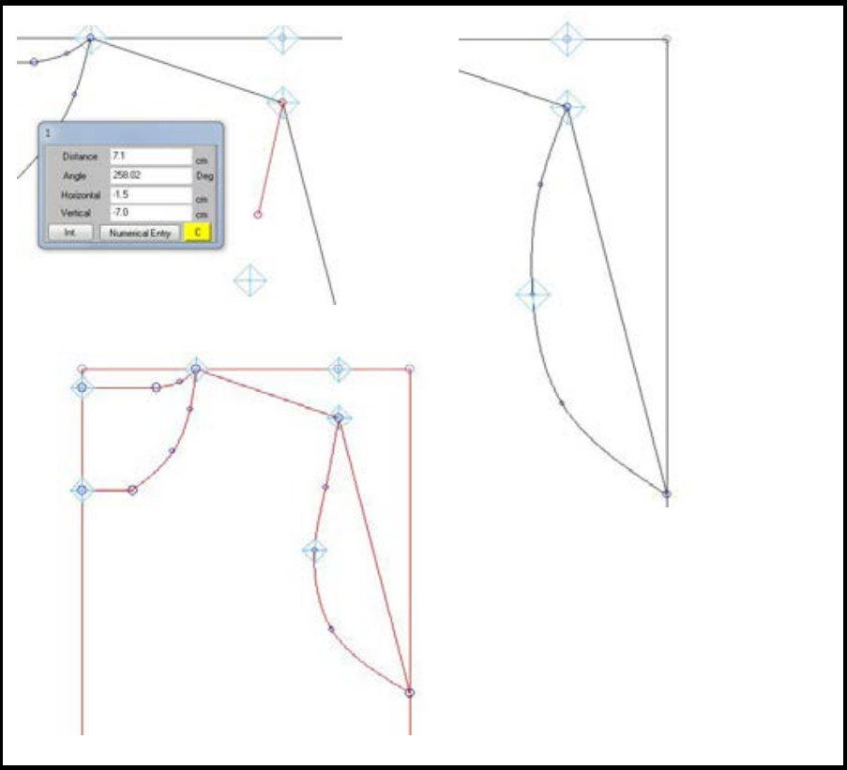
Input armhole line
Assist Line/Input/Cursor
Press "Cancel" to switch to curve line.
Line has to pass through "Bust width" guide point.
It doesn't matter how many points you input for the line as long as the line is smooth.
Repeat the same steps for back armhole. But this time use same measurement for back bust width as front to practice with simple pattern. Front & back armhole line is different in many cases.
* Refer to 4-1 and later in "Reference information for pattern making."

Slide 14
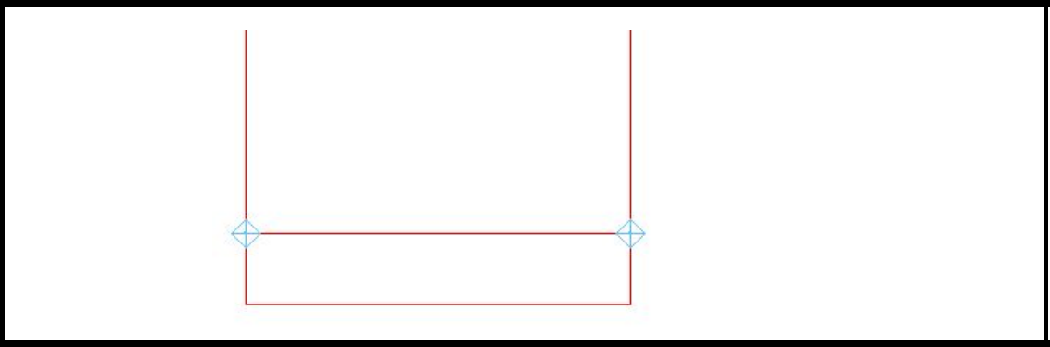
Input guide points & the line for hem length
Input two guide points for hem length (5cm)
Then draw an assist line between these two guide points.

Slide 15

Extract front & back body patterns
Trace - Extract
Choose the elements to be extracted.
In this case, only assist line needs to be extracted.
Select "On" for "Create Curve Point Automatically.

Slide 16
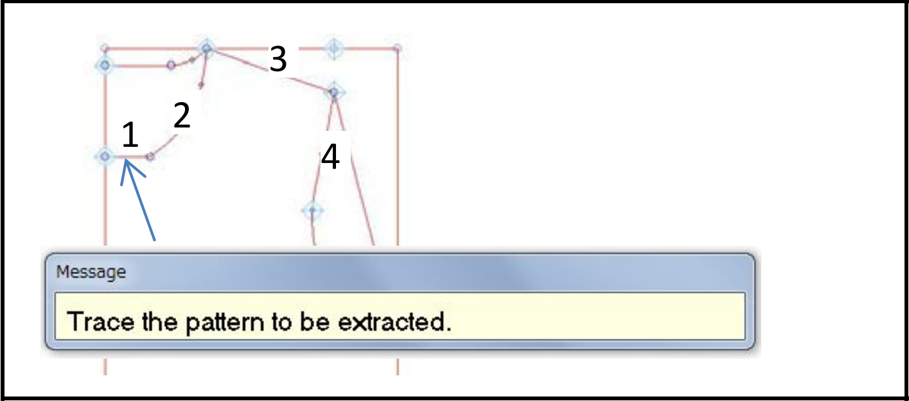
Select the first line to be extracted. Once the line is selected, they become black.
Trace in clockwise or counterclockwise direction.
For example select 1, neck bottom ^ 2, neck curve 3, shoulder line 4, armhole.

Slide 17
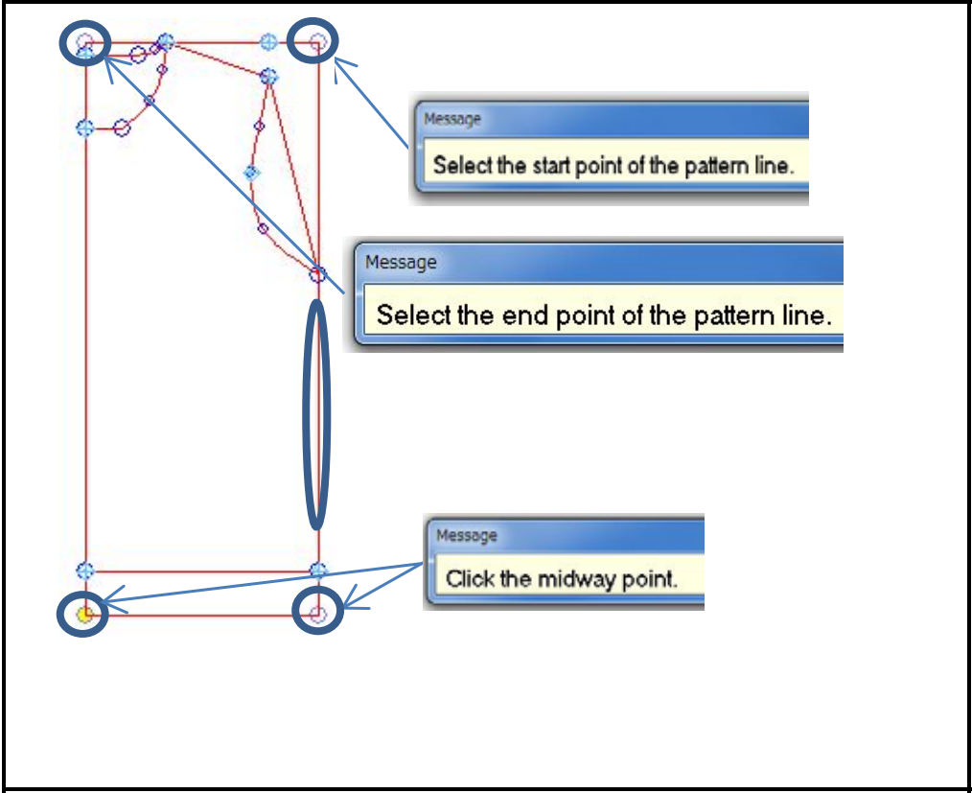
After the armhole line, click on the outline.
A message will come up to ask to select the start point of the pattern line.
Select the top right corner as start point.
Select top left point as end point.
Then select the bottom left or right corner as midway point.
The outline of the front body will be shown in black. If these are all the outlines for extracting, end the selection by pressing "EXEC." on sub keyboard.

Slide 18
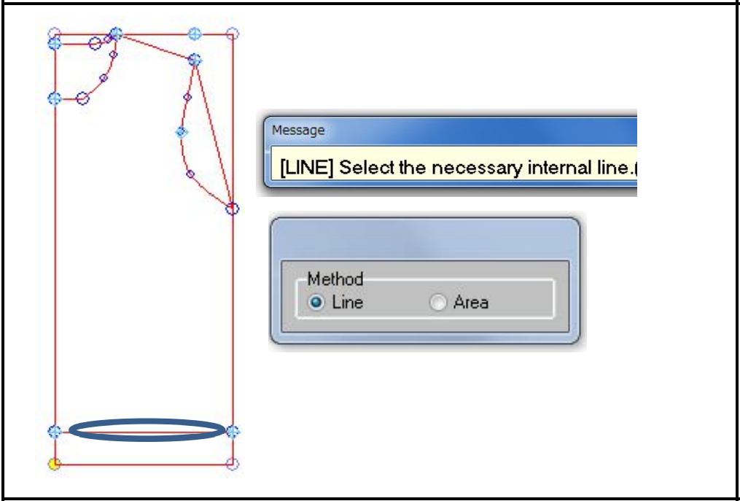
If the rib line needs to be extracted too, select it by clicking on it & it should become black.
The choice of the "Line" in the "Method" menu is required for this operation.
Press "EXEC." to end selection.

Slide 19
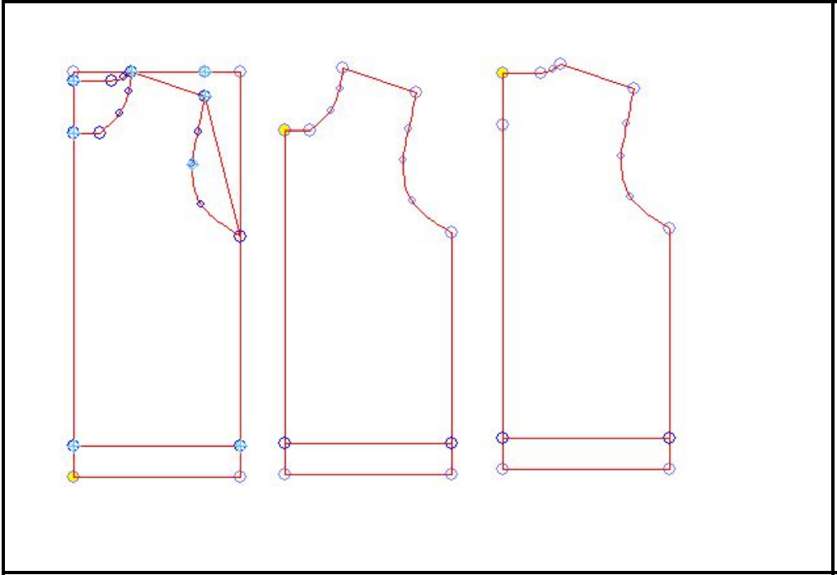
The pattern is extracted. Place it to desired position. Repeat the same steps to extract the back body pattern.

Slide 20
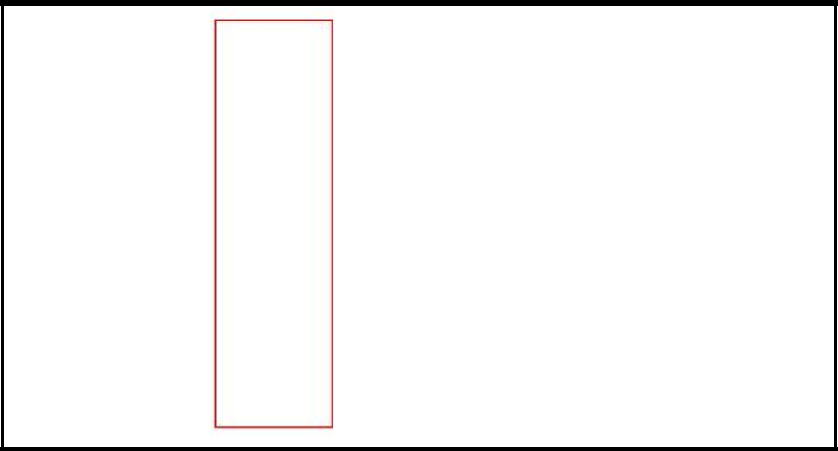
Pattern make - sleeve (M size)
2. Pattern make - sleeve (M size)
Start making pattern from a rectangle frame
Pattern/Input/Rectangle
Horizontal = 18.5 (Sleeve width) Vertical = 66 (Sleeve length)
The horizontal value is already half of the total width in sleeve pattern.

Slide 21
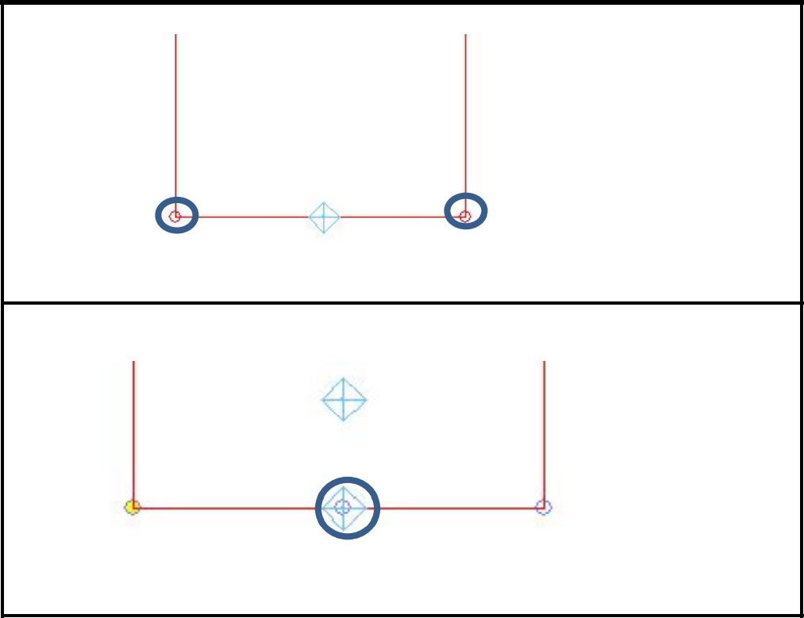
Input guide points for Cuff width, Cuff length and Sleeve expand width
Cuff width
Guide Point/Perimeter
Select right bottom corner as base point. Select left bottom corner as direction point. Perimeter length = 9 (Cuffs width)
Cuff length
Guide Point/Numerical
Select guide point for cuff width as base point.
Horizontal distance = 0
Vertical distance = 5 (Cuff length)

Slide 22
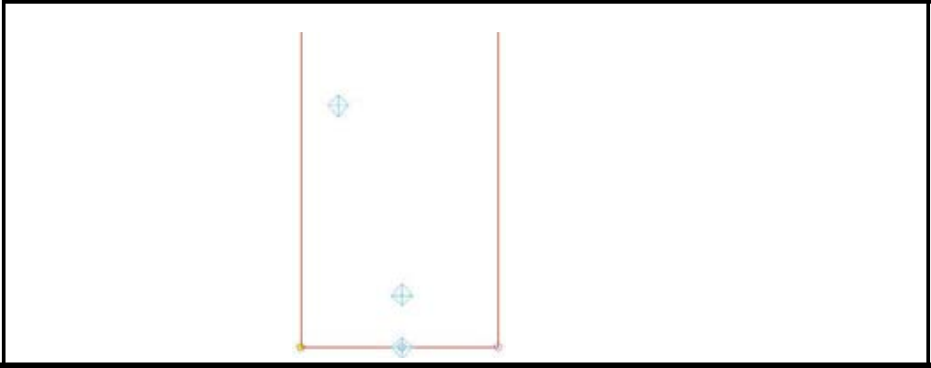
Sleeve expand width
Guide Point/Numerical
Select right bottom corner as base point. Horizontal distance = -15 (Sleeve expand width) Vertical distance = 23 (23cm above cuff edge)

Slide 23
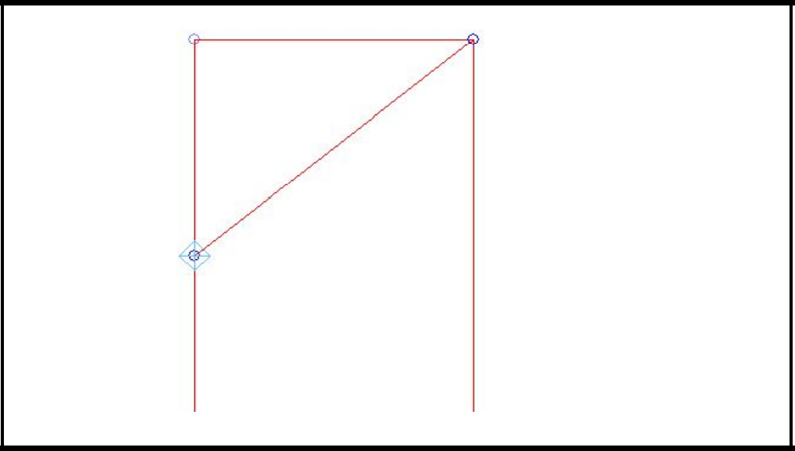
Reference line for sleeve cap
Guide Point/Perimeter
Input guide point 14.5 (height of the sleeve cap) below left top point.
The measurement of "straight armhole" also can be used to input guide point.
Assist Line/Input/Cursor
Draw straight armhole line from guide point to right top corner.

Slide 24
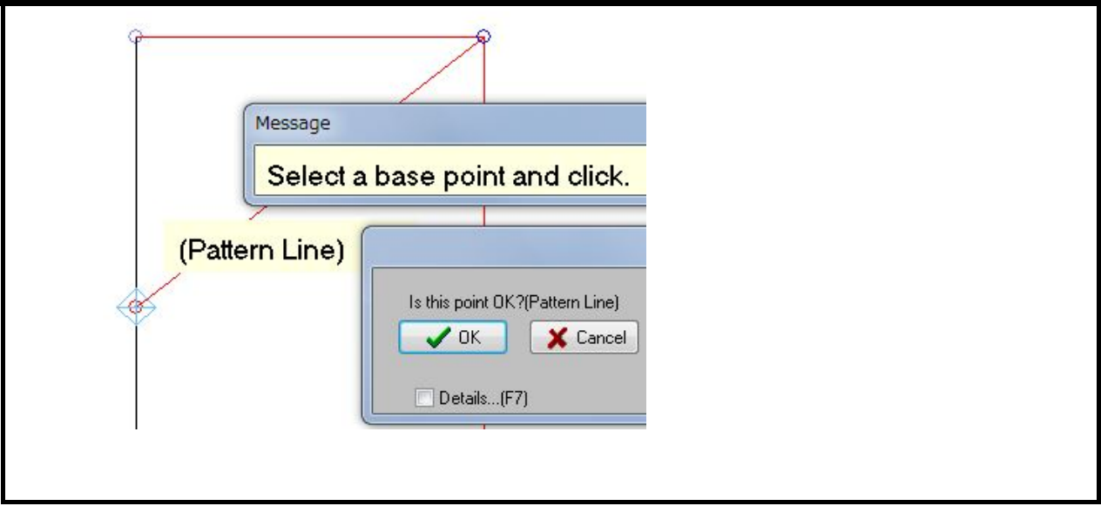
Input a guide point for 2cm below armhole
Give some straight part below the sleeve cap if necessary.
Draw straight line (2cm). Guide point/Perimeter
The message "Is this point OK?" is shown.
Select "OK" to give the guide point on the pattern line.

Slide 25
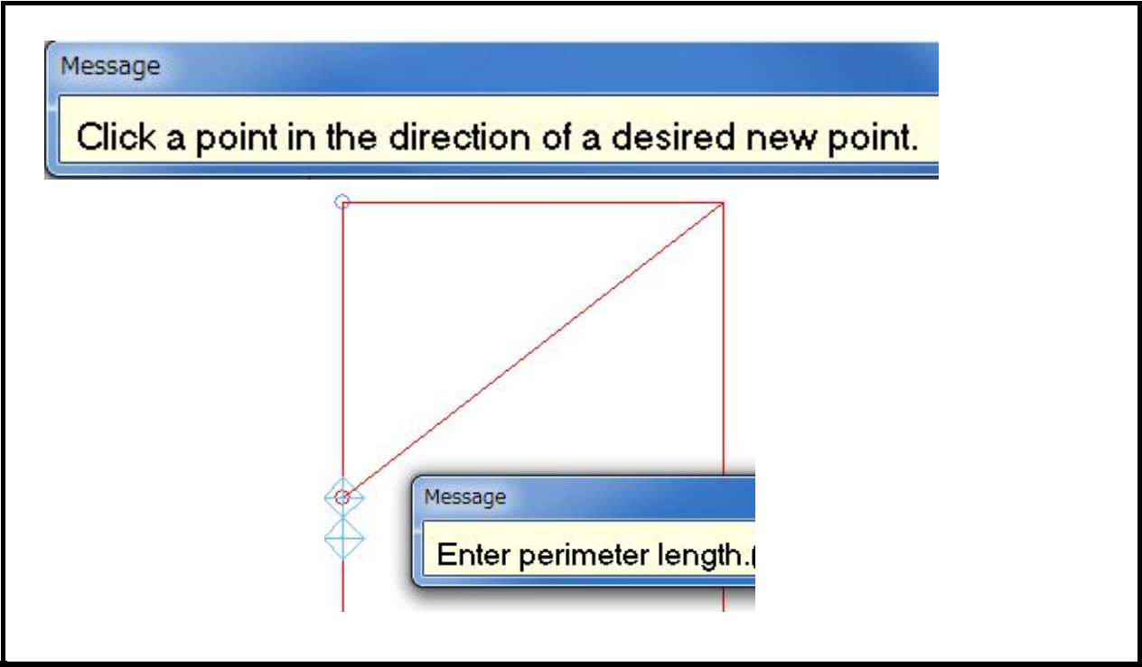
Press left bottom corner for the point to show the direction.
Input 2cm.

Slide 26
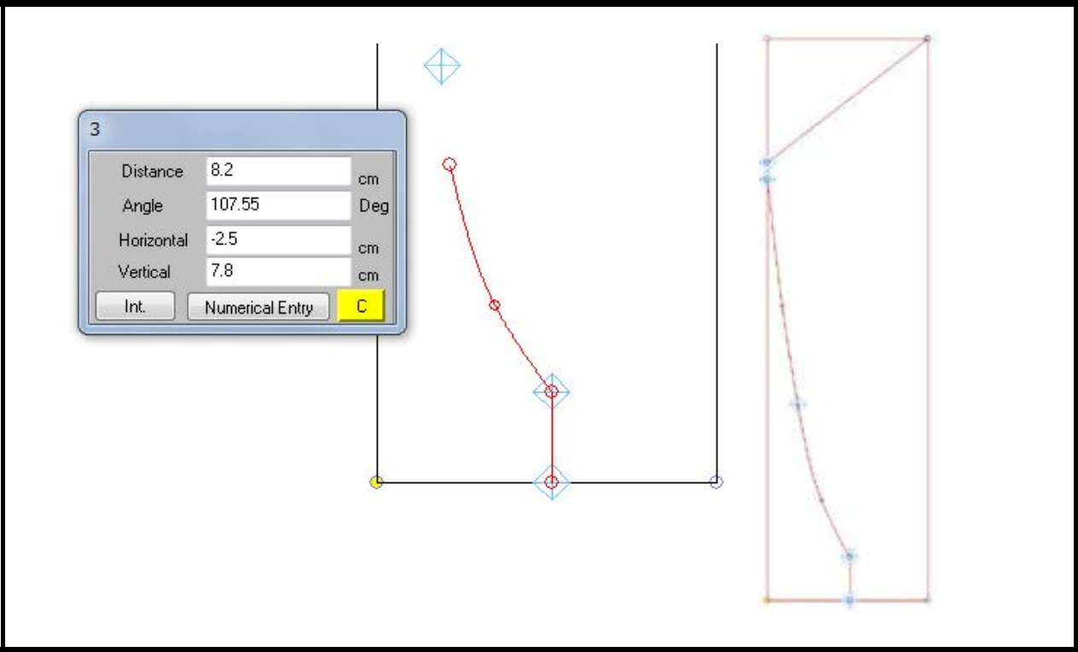
Input lines for the sleeve & sleeve cap
Assist Line/Input/Cursor
After pressing start point (with "OPTION"), input the straight line for cuff length.
Press "CANCEL" to switch to curve line for sleeve.

Slide 27
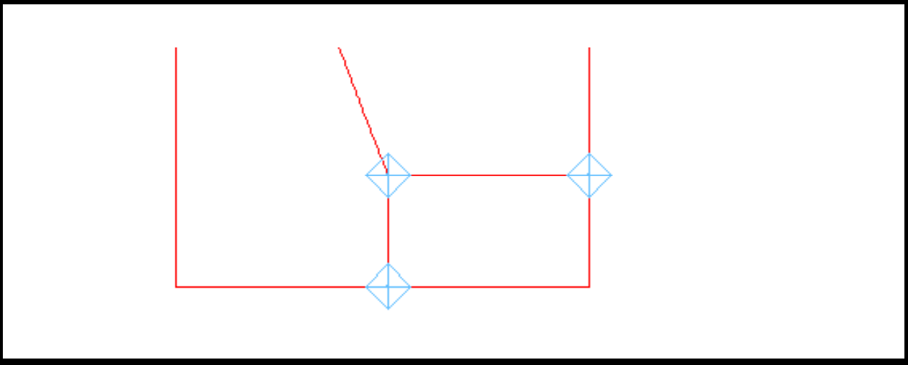
Input a guide point & line for cuff length
Guide Point/Perimeter
Input guide point 5cm (Cuffs length) above right bottom point.
Then draw assist line for cuff.

Slide 28
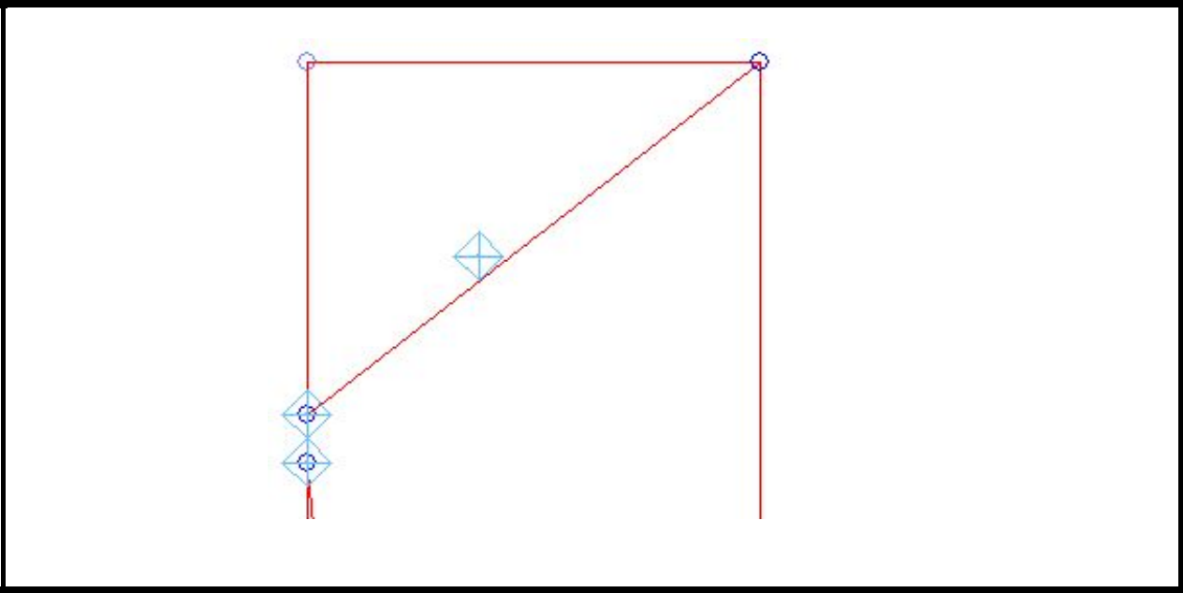
Input a guide point for sleeve cap width 8cm down from the top
Guide Point/Numerical
Select right top corner as base point.
Input -11.5 (Sleeve cap width) for horizontal and -8 (8cm down from top).

Slide 29
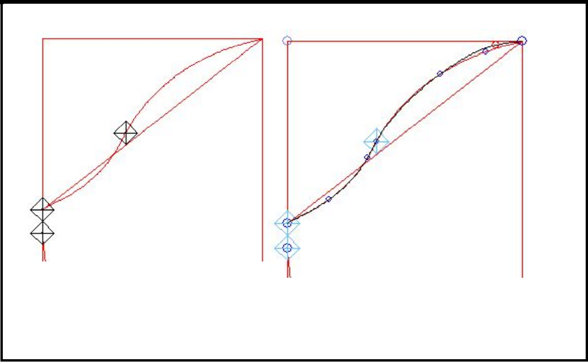
Input the line for sleeve cap
Assist Line/Input/Cursor
After pressing start point (with "OPTION"), press "CANCEL" to switch to curve line. The line has to pass the guide point. After completing the sleeve cap line, press "DISP" to display all the points & then adjust the points to smooth the line.
* Refer to 4-4 and later in "Reference information for pattern making.“

Slide 30
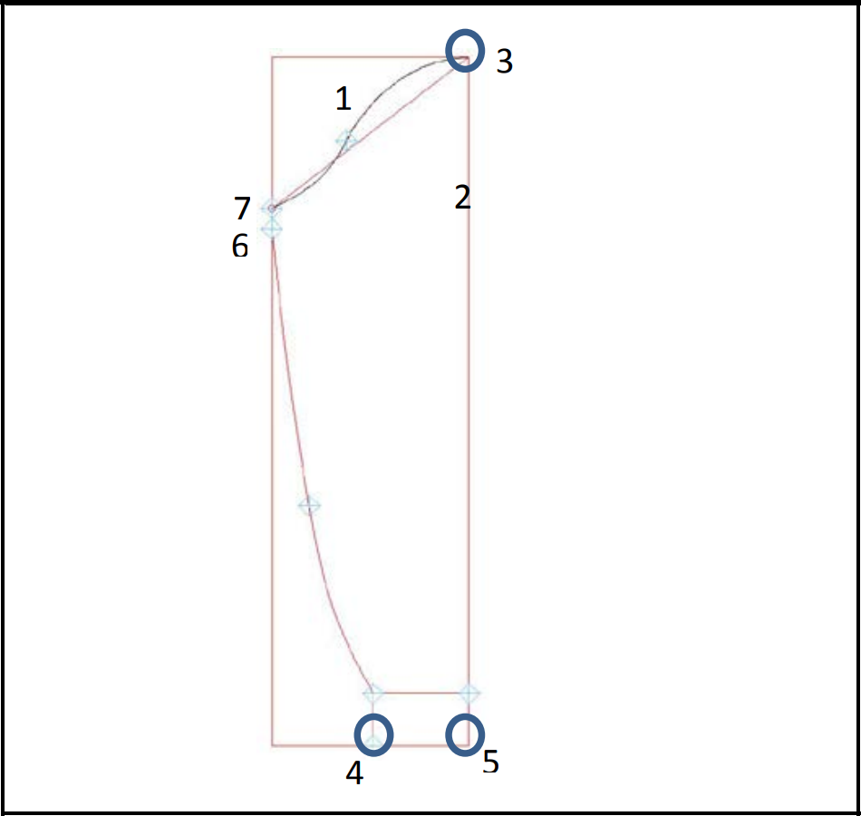
Extract sleeve pattern
The following steps are just one example. Messages and procedure may be different in each case.
Select sleeve cap. (1)
When pattern line (2) is selected the message is shown to ask "start point," "end point" and "midway point." Select point (3), (4) and (5) for each and then select the next lines continuously.

Slide 31
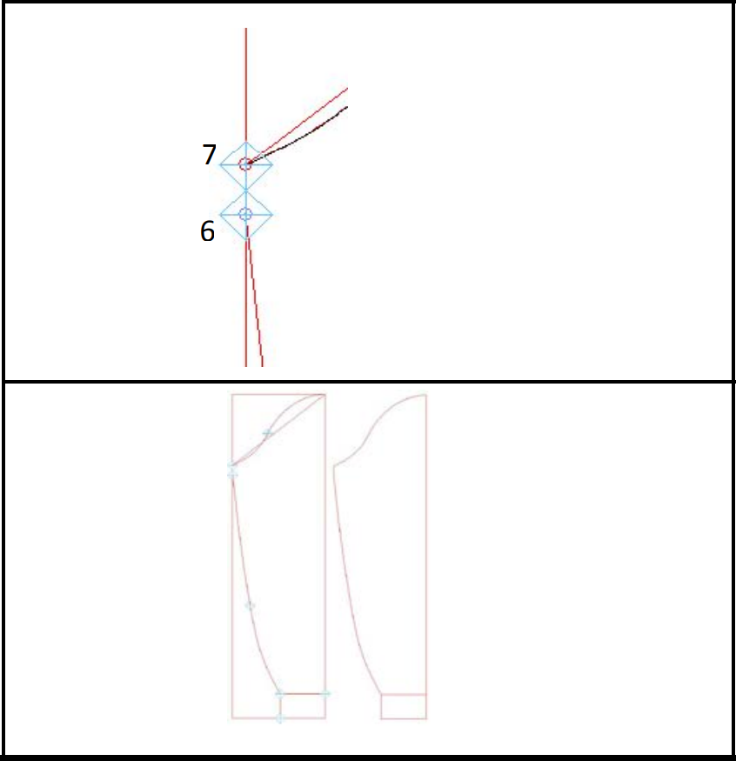
When pattern line between (6) and (7) is selected, same message is shown.
Select (6) and (7) for start and end points and then select (7) again for midway point.
Press "EXEC." after all the necessary lines are selected and select assist line for cuff (necessary internal line).
And press "EXEC." to end selection. Pattern is extracted. Place it to desired position.

Slide 32
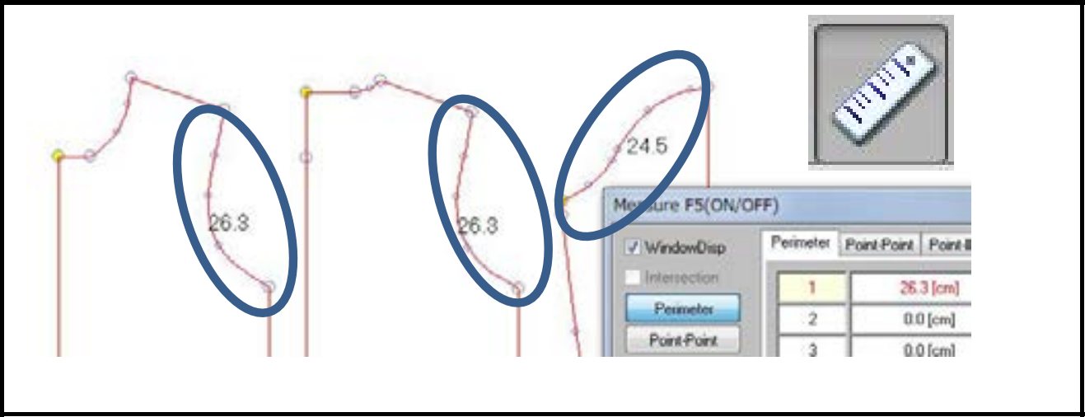
Adjust armhole & sleeve cap length
Measure/Perimeter
Check the measurement of armhole for front/back and sleeve cap.

Slide 33
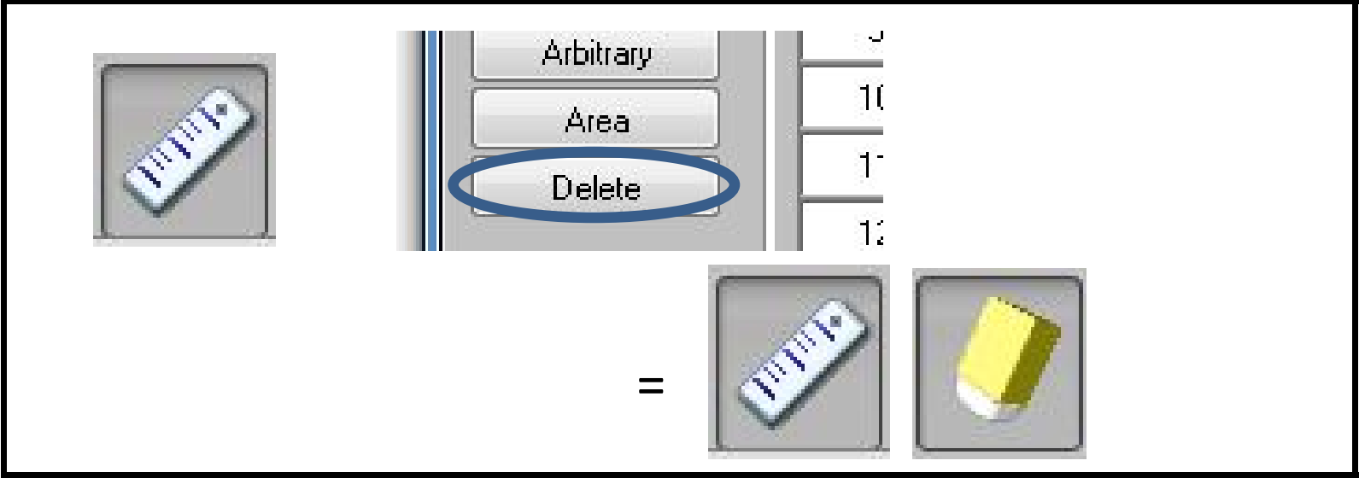
To delete the measurement data on the screen, open "Measure" menu and select "Delete."
Then specify area where the data needs to be deleted or just click on the data.
In this example, the perimeter for sleeve cap is shorter than that for armhole.
In this case the modification of sleeve cap line is recommended for linking or sewing.

Slide 34
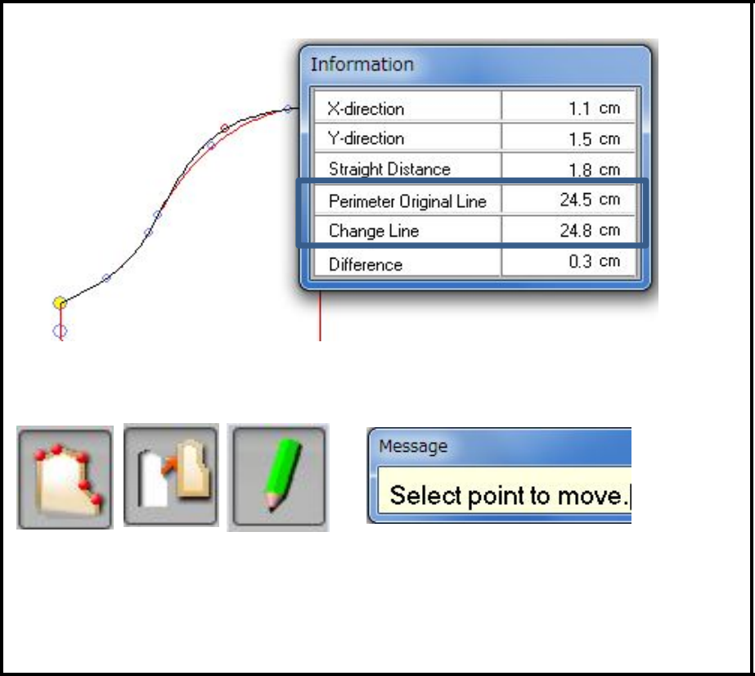
Method 1
Press "DISP" on sub keyboard to move points to modify sleeve cap line for better matching to armhole line.
Move the point by checking the measurement of "Perimeter Original Line" and "Change Line" in the information window.
Pay attention not to move the point marked with guide point for "Sleeve cap width."
In this way, both end points of curve line are fixed, then the range of movement is limited.
This method is same as using Point/Move/Cursor.

Slide 35
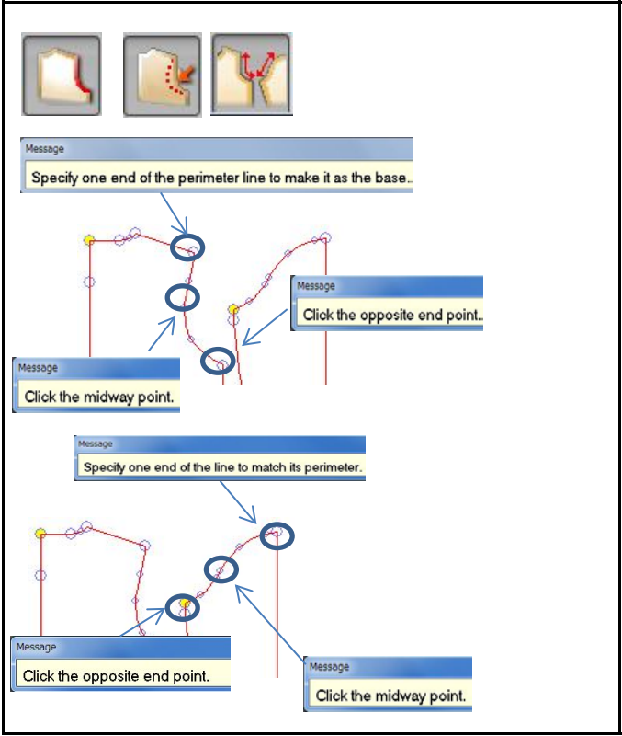
Method 2
Pattern Line/Modify/Perimeter Match

Slide 36
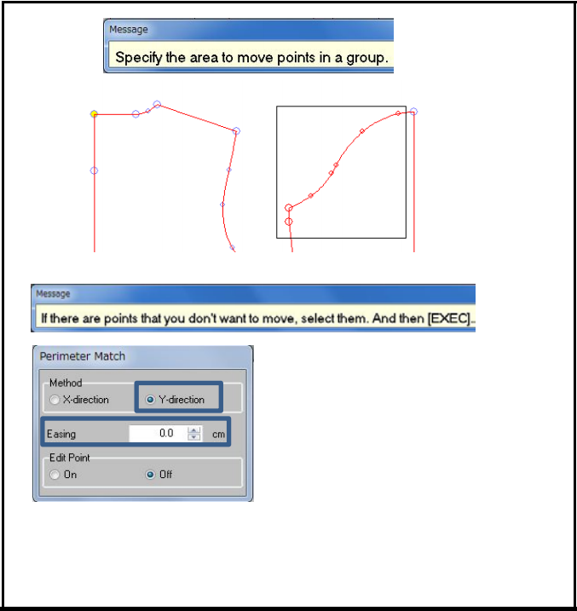
Specify the area including points to be moved. Then press "EXEC."
Select "Y-direction" to move whole sleeve cap points in the area downwards.
Sleeve width is kept same as original measurement.
To add more length to sleeve cap, give some value to "Easing."
Press "EXEC.“

Slide 37
References
https://www.shimaseiki.com
Shimaseiki training guide

