Slide 1

WRITE AND REVIEW
Lesson 3
https://observatory.tec.mx/edu-bits-2/top-3-writing-tools-that-help-students-write-assignments
Lecturer: M. Kurbonov

Slide 2
WRITE

Slide 3
This lesson explain show to flesh out the structure created in the previous step into a final draft. It discusses tried-and-true writing methods such as active voice, Plain English, verb-noun structure, the KISS principle, Five Ws (and One H), and the inverted pyramid. The chapter discusses how to work with - and get the most out of - your subject matter experts through a series of informal reviews, or collaborative co-authoring, to create a technically accurate, usable document. It shows how to apply simple graphic design rules such as contrast, alignment, repetition, and proximity to create highly polished, professional-looking documents.

Slide 4
Technical Writing Process
Steps
Plan
Structure
Write
Review
Publish
Activities
Define scope, stakeholders & process
Select techniques & tools
Review Doc. Plan with stakeholders
Schedule project
Check for templates or style guides
Gather information
Track progress
Create table of contents (if required)
Review table of contents with subject matter experts / stakeholders
Write first draft
Review draft with subject matter experts
Review & revise draft to final stage
Format / lay out draft
Edit & check draft
Define review team
Conduct stakeholder review
Collate feedback & revise draft
Obtain approval to publish
Finalise document (formatting, proofreading, etc.)
Establish document control
Publish final draft
Communicate with stakeholders
Tools / Outputs
Technical Writing Process
Documentation Plan
Documentation Timeline / Schedule
Deliverables Matrix / Worksheet*
Status Tracker*
Table of Contents
Drafts (First, Interim, Final)
Editing Checklist
Editing Sheet
Review Matrix
Message to Review Team
Review Log
Approved Draft
Controlled Document
Message to Stakeholders

Slide 5
Writing is where you convert your detailed planning and bare-bones table of contents into a series of drafts. You’ll usually progress from a first draft through any number of interim drafts until you get to a polished and formatted final draft.
Along the way, you should expect to have your document reviewed numerous times, and tested or workshopped if you’re documenting a product or procedure.
These days, writing is a team effort. The traditional image of a writer is of a rather solitary figure, but the reality is that technical writing is now often a highly collaborative process. Don’t be surprised if you end up more in the role of an editor rather than a writer - collating, assembling and editing chunks of documentation from subject matter experts into a coherent whole. That’s fine-you’re writing a technical document, not a novel!
The final stage of writing is to format and lay out your finished document into a professional-looking final draft. Writing concludes when you’re confident enough in your document’s technical accuracy, quality and state of completion to submit it for formal approval.

Slide 6
Write first draft
The hardest part of writing is often creating the first draft. However, if you’ve done your homework in the Plan and Structure steps, it should make the actual job of writing much easier.
Here are a number of methods you can use to create that critical first draft. You’ll probably find that a combination of these works best, depending on what you’re writing:
Interview subject matter experts, taking notes or screenshots as required. This may involve setting up an ongoing series of meetings over a period of time, in which you gradually flesh out a document. If you have multiple subject matter experts for the same topic, consider setting up a series of workshops to gather all their views at once. This is a good method for process and procedure documentation.

Slide 7
Learn the product being documented, and then use your own knowledge to write about it. This is a common method for creating product documentation. Ask for a working sample of the product, or (if software) a test area to be made accessible where you can experiment and learn without breaking anything. This is usually called a sandpit, development or UAT (user acceptance testing) environment. As you write, you should find yourself constantly returning to the product to test the procedures you have written, gather screenshots, and so on.
Farm out documents (or chunks of a large document) to various subject matter experts. With this method, you’ll be acting as curator, co-author and editor. It’s a great time saver for technical writers, particularly when your project involves large numbers of documents but needs to be managed carefully in order to succeed. To start, develop a hit list of the documents to be written and assign them to the various experts. Give them a template to work within and a best-practice example that you’ve written yourself. Use a tracker and I or schedule and timeline to manage the process so that your subject matter experts return the chunks to you in a timely manner, allowing you to collate, edit and assemble them into a coherent document or collection. You may need to prompt them frequently to ensure that they’re making progress.

Slide 8
Use existing documentation as the basis for your own document. Depending on how good the existing content is, you may need to perform only minor updates. At the other end of the spectrum, if the existing content isn’t up to scratch, you might be facing a complete rewrite. Be careful when you’re repurposing existing documentation - sometimes what seems like promising material can prove so out of date, technically inaccurate, or otherwise unsuitable that it creates more problems than it solves. If the intention is that you’ll repurpose existing information, make sure you perform a quality and technical accuracy check first, before expectations are set in stone.
Use your existing knowledge of the product or subject to create the first draft, if you’re a subject matter expert yourself. However, bear in mind that writers who are also subject matter experts can sometimes struggle to pitch their work to an audience less knowledgeable than themselves.

Slide 9
When writing, keep your style guide within easy reach so you can refer to it as required. Don’t wait till the editing stage to bring everything into line. Sticking to a style guide as you go along will help you maintain consistency in your writing and will generally bring a level of polish and professionalism to your work. Style guides are also great arbiters between writers or contributors if there are differences of opinion on style, grammar or punctuation.
You should always endeavor to do your best work no matter how unimportant you think a document is, as you never know who’s going to be reading it! I’ve found in my career that if you generally strive to do your best work on every job, sooner or later someone will notice, and that someone may keep you in mind for a future writing job. Think of every document as an opportunity to exercise and further hone your writing skills, and potentially build some valuable contacts who hold your work in high regard.
Once you’ve finished the first draft: congratulations! You’re about halfway there: in the Status Tracker, this stage counts as 45% complete. It might seem unfair to only be 45% complete when you’ve just written a document, but it’s important not to underestimate how much work is involved in bringing a document to the final draft stage, reviewing, editing, and publication.

Slide 10
Writing methods
This section discusses some of the common writing methods practiced by writers of all stripes, whether technical or non-technical. The first two are general principles which can be used in many different writing scenarios. The remainder are for use in specific writing scenarios, which I’ve identified. As this is a lesson on process rather than writing, I’ve just provided a brief overview on each rather than going into detail.
If you need help with writing, grammar or punctuation, invest in a style guide (whichever one is appropriate for your country or jurisdiction). Style guides provide guidelines on grammar, punctuation, layout and formatting, structure, and other stylistic aspects of writing.

Slide 11
KISS
KISS stands for ‘Keep it simple, stupid!’ This principle has its origins in the military, where it was used to ensure that complicated procedures such as aircraft maintenance could be carried out by the average technician equipped with standard tools (rather than requiring special training or expensive equipment).
The KISS principle of designing in simplicity is a good aim for technical writers. My interpretation of this principle is: think of your audience members as average technicians equipped with standard tools until you know otherwise. Don’t assume they have any prior knowledge or training. This ensures that your writing will be simple and informative for the majority rather than catering solely to the expert.

Slide 12
The following are some of the KISS assumptions I make about my audience before I get to know it better:
Hasn’t received training in the product, process or procedure
May be a new starter in the company
Doesn’t understand company jargon
Wants to read the minimum possible documentation in order to accomplish the task
Isn’t familiar with the document’s history and context (i.e. doesn’t know who wrote it, when it was written, why it was written)
Doesn’t know where to find supporting tools and documents

Slide 13
Don’t take the KISS principle to imply that your audience is stupid: that isn’t what KISS is about. As you can see from the list of assumptions, even the brightest amongst us have all been in one of those positions at some point, usually due to factors outside of our control.
Creating documentation about a product, process or technology can be a great usability test. If any of these are hard for a technical writer to explain (e.g. have logical inconsistencies or a very convoluted series of steps), then it’s likely that they will be difficult for customers or employees to understand and use as well. This should be a sign to the business that further investigation is required: Why is the product, process or technology so hard to document? Are there underlying problems that need to be addressed before launch? If you’re encountering these issues, consider raising them with your manager or the product manager so they’re aware that the difficulties you’re facing may stem from the product, process or technology design.

Slide 14
Plain English
Plain English is a philosophy of writing clearly, simply and unpretentiously. It encompasses a range of concepts such as the avoidance of pompous, complicated- sounding language intended merely to impress or baffle the audience (this is known as gobbledygook or corporatese in a business context); breaking long sentences down into sensible sizes; and using everyday words instead of complicated ones.
Plain English is a good general approach that technical writers should seek to apply as much as possible until it becomes second nature. It has its origins in the mid-1900s, when it arose as a reaction to the complicated, long-winded and pompous documents that were commonplace in the government. It’s still growing in uptake and popularity, particularly within government and the law.

Slide 15
Gobbledygook
The practice of stringing together long, impressive-sounding words into complicated sentences to baffle or impress the audience, or conceal the true meaning. Gobbledygook is often devoid of meaning or so convoluted that finding out the true meaning is impossible.

Slide 16
Corporatese
A form of gobbledygook peculiar to the corporate world, often laden with sporting or high-tech metaphors and acronyms. The intention of corporatese is to create an aura of impressive-sounding complexity around a product, company or project (or simply to fill space in a corporate template).

Slide 17
Five Ws (and One H)
The Five Ws stand for Who, What, When, Where and Why. The H is for How. This method is a staple of the journalistic world, used to make sure that news articles capture the essential elements of a story. It entails writing an article so that it addresses the Five Ws (and One H), traditionally within the first paragraph:
Who does this concern?
What is this about?
When did this happen?
Where did this take place?
Why did this occur?
How did this happen?

Slide 18
This venerable method traces its origins back to the Greek philosophers. It’s a simple, effective technique which I find useful in creating introductions and overviews, and as a means of analyzing and understanding already-written documents.
Here’s an example of a formula I often use for overviews, based on the Five Ws (the exact wording will vary depending on the scenario):
This <procedure, process etc.> is about <what>. It’s performed by <who> <when> to <why>.
For example:
This lesson is about the technical writing process. It’s performed by technical writers when creating technical documentation to save time, structure workflow, sharpen the focus on the end user, decrease friction between the writer and the business and so on.
In the example, I haven’t stated where, as this is immaterial to the example, but this W may be added if it’s an important factor. How is usually embedded in the procedural steps or process rather than the overview.

Slide 19
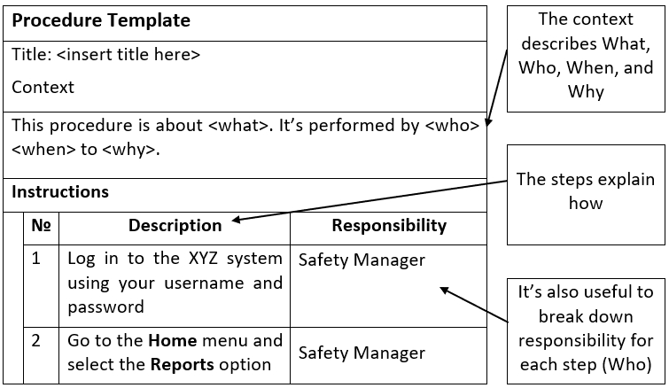
Here’s an example of a simple procedure template, which I’ve broken down using the Five Ws in order to understand it better:

Slide 20
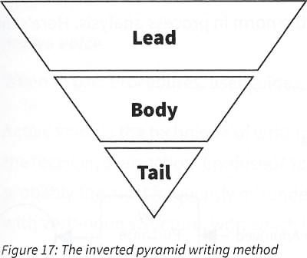
Inverted pyramid
The inverted pyramid is a venerable journalistic staple. It’s useful in news articles and blogs, and for explaining concepts. It involves presenting a summary of the most relevant information up front in the lead, followed by a fleshing-out of the details in the body, after which less important details are presented in the tail.
The lead contains the most critical information, e.g. a summary of the Five Ws.
The body is where the details are fleshed out.
The tail contains sundry, less important details.

Slide 21
By presenting the most relevant information (e.g. the Five Ws) in the lead, it allows the reader to quickly grasp the gist of the article without having to read the whole thing. As readers tend to scan technical documents instead of reading them from cover to cover, this technique can be used to improve the scannability of documentation.
You’ll notice that I use a similar technique in this lesson. I’ll usually introduce sections with a one-paragraph summary focusing on what that section is about and when /where it is relevant (the lead). I’ll then elaborate on who the section concerns and why it’s important, as well as detailed information on how to apply the concepts (the body). Finally, I’ll wrap up sections with an insight, tip, definition or caveat (the tail).

Slide 22
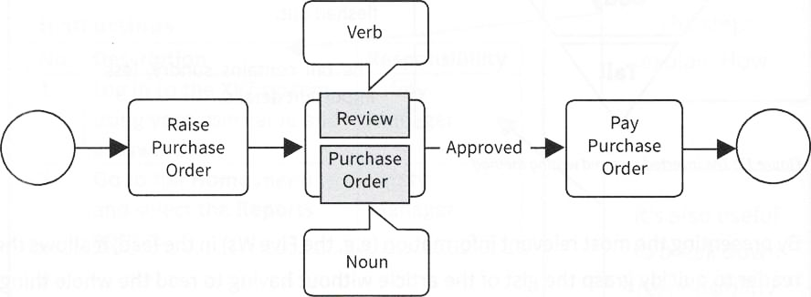
Verb-noun structure
When to use: Process names, headings in process-based documentation Verb-noun structure is common in process modelling and process-based documentation. It involves placing a verb in front of a noun to create the title of a process or activity, or a heading in a process-based document.
This method is widely accepted these days as the norm in process analysis. Here’s an example:

Slide 23
This method ensures that every activity box describes both an action (verb) and the object of that action (noun). This creates a standard, formulaic template for the naming of every process box, which allows the analyst to maintain logical consistency within the process model. It also invites the questions: Who performed this action (role)? What is the consequence (output) of that action? These questions are essential to the development of fully fleshed-out processes.
You’ll probably have noticed that the Technical Writing Process sections of this lesson use a verb-noun structure for the headings. This approach helps me structure the Technical Writing Process and keep it logical and consistent, and it allows me to draw a strong distinction between the activities and the tools/outputs of those activities.
Although very popular, this isn’t a one-size-fits-all solution. There are plenty of scenarios where this method is inappropriate, such as describing concepts, presenting background information, providing overviews, etc.

Slide 24
Active voice
Active voice is the technique of writing from the point of view of the doer, rather than the receiver, of an action. Confused? You’re not alone – in my experience, active voice is probably the most frequently misunderstood writing method. It’s frequently confused with verb-noun structure, with which it shares similarities.
However, whereas verb-noun structure is a method used in a particular writing scenario (processes), active voice is a more general approach to writing. Here’s an example:
Active voice: ‘The dog fetched the bone.’
Passive voice (the opposite of active voice): ‘The bone was fetched by the dog.’
Active voice lends itself naturally to technical writing, especially when describing steps in a procedure or process. Because it clearly focusses attention on the person performing an action, it tends to reduce ambiguity.
As with the other methods, active voice isn’t a solution for all occasions. It’s important to use active voice when documenting steps in a procedure or user guide, but it’s not essential when describing concepts or providing background information.

Slide 25
Review draft with SMEs
After finishing your first draft, it’s time for review with the subject matter experts. This is a fairly informal process at this stage, as the intention isn’t to get approval to publish (yet). What you want at this point is to get as much feedback as possible on the technical accuracy, structure and general usability of your documentation in order to bring it one big step closer to final draft.
Ideally, the gloves should be off for this review. This is no time to be thin-skinned: if something doesn’t work in your document, it’s better to deal with it now - before you’ve invested too much time in writing and polishing something that doesn’t work.
When approaching your subject matter experts for review, expect to do a little hand­holding. Guide them into giving you good, value-adding feedback by explaining the aim and mechanics of the review. The intention of the first subject matter expert review is to improve the technical accuracy, structure, and general usability of your documentation rather than to point out typos or formatting and grammatical errors. These should be addressed by you before anything is sent for review. This helps your subject matter experts focus on the areas where they can truly add value, and it avoids the perception that you’re asking them to do work that’s really your responsibility.

Slide 26
Reviews can take a number of forms, such as testing and workshopping, in addition to the more traditional method of sending out a manuscript and receiving written comments. Here are some of the common approaches:
Sending the document out and receiving written comments. This is the customary approach and, provided your subject matter experts are engaged and can spare enough time for a proper review, will result in better feedback. It’s usually performed using track changes, or written commentary on a printed copy. This is a good general method for soliciting feedback, but it doesn’t always result in consistent, high-quality feedback over every aspect of the documentation. Be prepared to follow up with your subject matter experts - reviewing someone else’s documentation doesn’t rate highly on most people’s to-do list.
Testing each step in the document yourself. See if you can follow your own instructions. If you can’t follow your own documentation, chances are no one else can. If you’re writing product documentation such as a user guide, this is essential before you proceed to the next step. Perform a thorough self-check before passing it to a subject matter expert or user for testing or review.

Slide 27
Testing the document with a subject matter expert or someone who fits the user I audience profile. This involves pulling your chair up to someone’s desk and watching as they attempt to follow each step in your documentation. This is one of my favorite methods for road-testing product­ based documentation, as errors are usually identified fairly quickly. Come to these sessions armed with a notepad and pen so you can record errors on the spot. You may want to schedule several short sessions, as this method usually takes a fair amount of time (and patience!).
Conducting a walk-through workshop. This is an excellent technique for dealing with time-poor subject matter experts. It involves scheduling a short (typically one- to four-hour; two is ideal) workshop with one or more subject matter experts and walking through the documentation on a shared screen or projector. Expect to take plenty of notes, and don’t be afraid to ask questions or challenge parts of the document that don’t seem to work. This technique is great for yielding first impressions and picking up obvious errors - but don’t expect an in-depth examination. It works best for shorter documents such as processes and brief procedures.

Slide 28
Reviews can take a lot of time out of someone’s busy schedule, so make the process as easy as possible and don’t make unreasonable demands. Consider making large review tasks smaller by breaking big documents into chunks (e.g. on a chapter-by-chapter basis) which can be reviewed independently.
Build relationships with your reviewers by remembering common courtesies such as saying thank you for their time. If you’re not planning on making a change someone has suggested, tell them about it. They need to know that you’re taking them seriously and respect their contribution. If you don’t respect their feelings, they won’t put in the effort the next time you ask.

Slide 29
Use a fresh pair of eyes
If you’ve tested your own documentation to within an inch of its life or worked very closely with the same subject matter expert on multiple versions of your document, be aware that you might be getting too close to the documentation. You and the subject matter expert may have read the same document so many times, you’re unable to recognize obvious mistakes. If you feel that might be the case, find someone new to take a look at the document. You might be surprised by what they spot!
It’s bad practice to let copies of draft documentation circulate freely around your company. At the very least, it reflects poorly on your ability as a writer if someone mistakes it for the finished version. In extreme cases, having someone mistakenly follow unfinished documentation can put lives at risk, e.g. operating instructions for heavy machinery. This is one reason why standards such as ISO 9001 have strict rules around document control and release.
When you distribute copies for review, emphasize that the document is a work in progress. If you think there’s a possibility that the document could end up being forwarded on to others, politely request that your subject matter experts refrain from distributing the document outside the team.

Slide 30
Relationship-building with subject matter experts
Building a good relationship with subject matter experts is a must for a technical writer. A good relationship is a two-way street. For the writer, it means more time with the expert, better quality reviews and ultimately better documentation. For the expert, it means the writer learns and understands what they’re doing and why they’re doing it, contributes feedback and insights during the development process, and assists with writing tasks on the project.

Slide 31
To establish good relationships, there are some important steps that writers can take:
Participate in the development process. Attend development meetings and learn the technical details from the design and development process, not just from late-in-the-game meetings with experts. Be involved in the process, not as an annoyance or hanger-on but as an asset to the development group who contributes his or her well-thought-out insights and experience.
Work with SMEs to do their jobs. Help them with their writing tasks, such as specifications, requirements, program comments, and messages. Work with them on the user interface. Volunteer to help them review design elements of the project; be a guinea pig for those features and characteristics that affect users. When you add value by making their lives easier, it enhances the working relationship and they will give you more of their time.

Slide 32
Don’t be someone who only takes from subject matter experts, giving nothing in return. If all you do is ask for information, take time for meetings, and submit content for review, you risk falling into this category. This is not a good way to build a strong relationship.
Writers who establish good relationships with subject matter experts make a positive contribution to the team. Sometimes it’s advice and help writing specifications, sometimes a comment on the user interface, other times a contribution to a design or code review.
Regardless of what you actually give back to the team, the idea that you want to participate and contribute to the development process (and help the subject matter experts do their jobs) makes your relationship stronger. The bottom line for establishing working relationships with anybody is to give as much as you get (if not more) - cooperation and collaboration are two-way streets.

Slide 33
Learn to spot a good reviewer
Different subject matter experts will inevitably differ in the quality and thoroughness of their review feedback, no matter how much guidance or relationship building you do with them. Some people are just more detail oriented or have a naturally analytical mindset. It pays to know which of your subject matter experts are going to give you the most comprehensive, insightful feedback. Make sure you establish especially good relationships with these people and include them on important reviews. Use their time strategically - you don’t want to wear out your welcome mat by making excessive demands on them.

Slide 34
Review and revise draft to final stage
It’s very rare to write a perfect first draft. In practice, most documents are written, reviewed, tested and revised numerous times. This may seem like a waste of time for those new to writing, but it’s an essential part of the process. The repeated cycles of review and revision improve your document’s technical accuracy, enhance the quality and clarity of the writing, address gaps and weak spots, and allow for enhancements and updates.

Slide 35
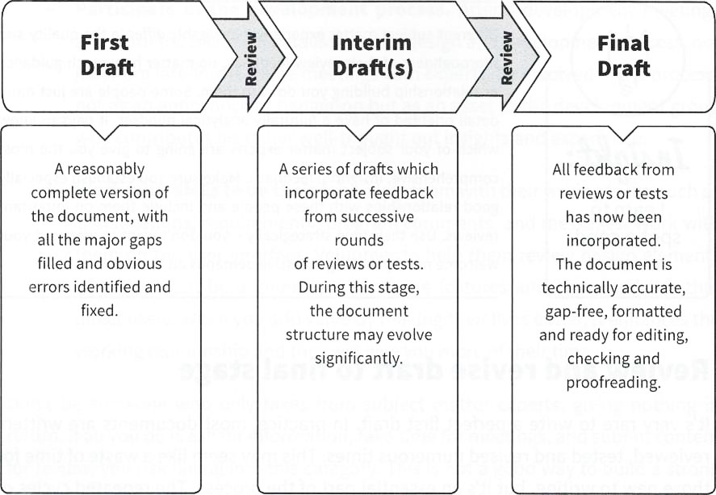
As the following diagram shows, documents usually go through three stages of drafts:
Make sure you check your Documentation Plan every so often to make sure your documents are on track to meet all the must-have criteria, such as coverage of key product functionality and compliance with regulatory requirements. As the project unfolds, it’s quite normal to find that the requirements will evolve from the original plan, so it’s important not to let your Documentation Plan become an impediment to proceeding with a sensible course of action - whilst not going too far off brief. Use your Status Tracker to track and report progress.
Don’t be surprised to find that your table of contents changes from the one you originally mapped out in the Structure step. As you go through review and revision, there are bound to be chunks of your document which are in the wrong place or no longer relevant, or new sections that need to be added.
There comes a point where there’s no more value to be added by more rounds of review and testing, either because your document has been reviewed to death already, it’s complete and you’re confident in it, or there’s no more time in the schedule. At this point, the draft is ready for layout, formatting and review.

Slide 36
The never-ending first draft
Sometimes you may find yourself locked into what seems like a never­-ending write-review-write cycle. This is when a document seems to never quite reach publication because no sooner have you gotten it close to final draft, something changes, requiring yet another update. This is very common. Here are a number of typical last-minute changes I’ve encountered in my career:
Changes to the product scope require a new feature to be added / removed, resulting in changes to the product documentation. These changes may be last-minute, or the result of scope creep: the common phenomenon where a product’s scope continues to evolve throughout the development life cycle.
Testing sheds a new light on a particular feature of the product (e.g. it doesn’t work as expected), requiring a change to the feature and a corresponding update to the product documentation. Although changes following testing are to be expected, sometimes there can be many more changes than anticipated.

Slide 37
Changes in the company’s systems, processes or organizational structure occur midway through the project, requiring updates to your process and procedure documentation. Companies are constantly evolving to stay competitive, and the changes can sometimes be abrupt.
Feedback from a subject matter expert who wasn’t part of the original review team now needs to be incorporated into your documentation. Along the same lines, sometimes a member of the review team will take a second look at your documentation (perhaps when they finally have time to take a proper look), resulting in a number of fresh, yet poorly timed insights.
This can be a very frustrating experience for the hapless technical writer, who is forced into a constant cycle of catch-up. If this sounds like you, take a breather: it’s a fairly common experience (and in fact, one to be anticipated). If it’s causing you to miss your deadlines, make sure the team is aware that their constant changes are the source of delay.
If the project has a change control board or other forum for evaluating changes to the project, try to get a seat on it so that any impacts on documentation can be assessed before going ahead with a change.

Slide 38
Version control
Version control is the process of tracking changes to documentation. This is usually done by assigning a sequential number to a document after each set of alterations. This makes it easy to track and manage changes that follow review and revision, editing, formal review and approval, post-publication updates, etc.
Version control is a common requirement under many company document control policies and standards such as ISO 9001. Even if not strictly required, version control is part of the good housekeeping that any technical writer should practice. Without proper version control, writing and review can quickly become unmanageable.
Check to see if your company has a version control or document numbering system in place already. Often (especially in larger companies) you’ll find that there are well- established policies, systems and procedures around version control. If there are no controls (or weak controls), you may need to implement your own system.

Slide 39
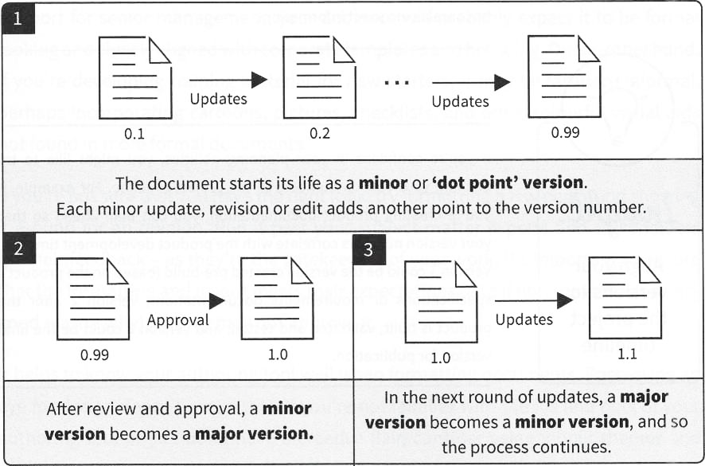
Here’s a simple model for version control in technical documentation:

Slide 40
Why bother with version control? Isn’t it overkill?
It may seem like overkill until you’ve experienced your first version control disaster, which most experienced writers have at some point in their career (myself included). A classic example of this is when a writer creates multiple copies of the same document without clearly marking the version numbers. As work continues and the document is reviewed and edited, the writer gets confused about which copy is the most current, and ends up editing both copies of the document separately, incorporating different changes into each. A good outcome in this scenario would be that the writer eventually realizes what’s happened, and is able to bring the copies back in sync - a tedious and laborious task. A far worse scenario would be that the writer doesn’t realize what’s happened, and ends up publishing a document that doesn’t make sense, or contains incorrect information!

Slide 41
Align your versions to the project timeline
If you’re confident in your planning abilities, you might like to try aligning your version numbers to the project timeline. For example, if you’re creating product documentation, you can plan ahead so that your version numbers correlate with the product development timeline. Version 1 could be the version created pre-build (based on the product’s specifications or requirements documentation); version 2 after the product is built, validated and tested; and version 3 could be the final version for publication.

Slide 42
Lay out / format draft
Once you’ve developed the draft to an acceptable level, it’s time to lay it out and format it. If you’re working in a corporate template, formatting will simply be a case of applying the styles in the template to your work. This is quite common and makes formatting decisions much more straightforward, although it does reduce your scope for creativity!
When formatting your draft, consider the expectations of your audience, as well as the document type. For example, if you’re working on a report for senior management, your audience will probably expect it to be formal looking and closely aligned with corporate templates and branding. On the other hand, if you’re developing training material for new starters, it may be far more informal, perhaps incorporating cartoons, pictures, checklists, and other colorful visual aids not found in more formal documents.

Slide 43
If you’re not sure that you have the right look, try formatting a few pages and showing it around for an opinion. Run it past your subject matter experts and stakeholders for their feedback - as they’re the gatekeepers of your work, it’s important to ensure that the formatting and layout meets their expectations (and if not, that there’s a very good reason why), or they may not approve it.
It helps to know your authoring tool well when formatting documents. Possessing an eye for design doesn’t hurt either. If you’re not familiar with the ins and outs of your authoring tool or you don’t have a creative flair, consider using inbuilt themes and styles, tapping your company’s marketing / communications team on the shoulder for assistance (they often have graphic design resources which can be borrowed), or purchasing and downloading a pre-prepared template (be careful to download from a trustworthy site).
Finally, make sure you have included all necessary sundry components of your document such as headers and footers, title page and page numbering.

Slide 44
Improve your layout with a few simple tricks
Here are some simple tricks to improve the layout of your documents:
Bullet points help break down long sentences into easy-to- read lists.
Tables and charts are great for presenting numerical or ordered information.
Diagrams can be used to illustrate concepts better than lengthy explanations. Use captions to explain the purpose of diagrams.
Callouts isolate information such as tips, notes and insights which don’t need to be in the main flow of the document.

Slide 45
Graphic design
For some documents, such as marketing collateral, layout is commonly performed by a graphic designer. Ideally, this should occur after the final draft is written. This is to avoid having to continually pass revisions back and forth between writer and designer, resulting in many small (and costly) changes.

Slide 46
Separate presentation from content with styles
The idea that presentation should be separated from content is a well-established concept in technical writing and publishing. Separating presentation from content involves using a stylesheet to apply formatting to the document rather than individually formatting every heading and paragraph. A stylesheet will store formatting information about pre-defined elements of the document such as headings, body text, tables and lists.
Stylesheets are independent of the document, which allows the writer to change the presentation of the styled elements in the document simply by changing the stylesheet rather than manually applying formatting to every single heading and paragraph. As you can imagine, this saves considerable time when formatting a lengthy document.
Just as importantly, the different levels of headings (heading 1, heading 2, etc.) create a hierarchy within the document, otherwise known as a structure. This allows the writer to automatically create a table of contents and to navigate the document with ease.

Slide 47
Save time using built-in styles
When writing the first draft of a new document, I’ll usually apply the built-in or default styles of whatever tool I’m using. They may not result in the look that I want, but that doesn’t matter in the early stages - what’s important is to add the structural elements such as heading 1, heading 2, etc. These allow me to reformat the document later on, using the stylesheet, and also to automatically create a table of contents.

Slide 48
Graphic design tips for writers: CARP it
Did you know that there are rules for graphic design? Although the creative process might seem to an outsider like an unruly and undefinable affair, most graphic designers are schooled in a fairly universal set of design rules or principles.
Following are four basic graphic design principles which you might like to experiment with in your documents, as expressed by Robin Williams in her brilliant book, The Non-Designer’s Design Book. Remember these principles by the acronym CARP: contrast, alignment, repetition, and proximity.
In the following example, I’ve taken an unformatted business card for a fictional technical writer and systematically applied each of the four CARP principles in turn to produce the final, designed version. I’ve used a business card rather than a technical document as my example because it’s a small, self-contained document that most will be familiar with.

Slide 49
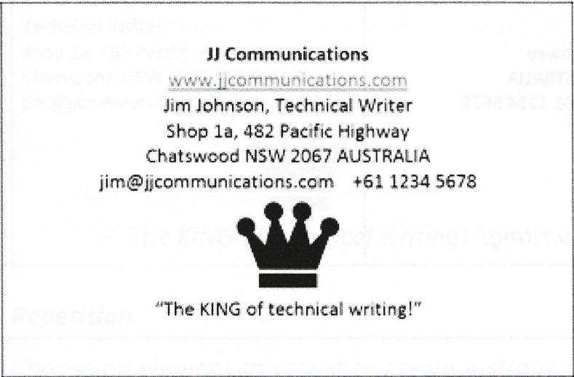
The original, unformatted version is depicted immediately following. As you can see, it has all the correct elements that a business card should have, but it’s almost entirely devoid of design. As a consequence, as a document it’s not very usable - it’s hard to visually distinguish between the different items on the page:

Slide 50
Contrast
Firstly, use contrasting fonts, sizes and colors to differentiate important parts of the document from the body text. Key parts of the document usually include items such as titles and headings. This makes these elements stand out visually, allowing the audience to easily navigate the document and pick out the most relevant information at a glance.
In the example, I’ve picked out a number of items to contrast from the body text: the title of Jim’s company, Jim’s name, his website URL, and his (extremely cheesy) slogan. These are the important details that Jim would presumably want people to notice immediately when they look at his card.

Slide 51
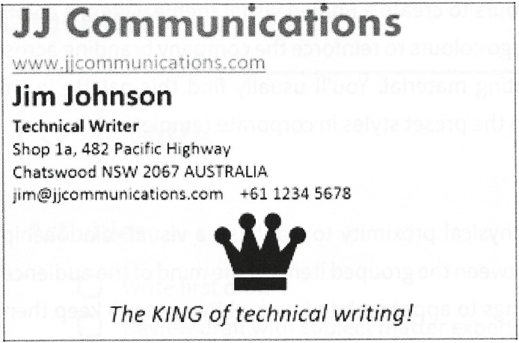
Alignment
Now, align items such as headings, text and tables to the same invisible line - left, right or center. Strong alignment creates a striking, neat-looking effect.
In the example, I’ve chosen to align most of the elements to the left side of the page, creating a strongly left-aligned document. I’ve stuck with center alignment for Jim’s logo and slogan, as I like the way the center alignment makes it stand in contrast with the other, factual information on the left.

Slide 52
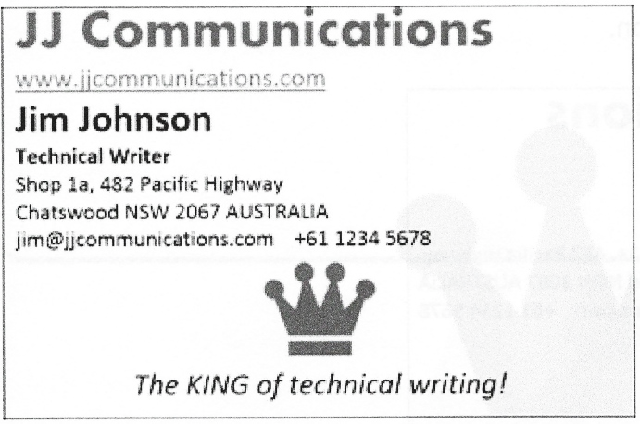
Repetition
Choose an element to repeat to create a strong visual theme. In the example, I’ve taken Jim’s logo and repeated it as a watermark (this is a common technique used in company templates and stationery). I’ve also changed the logo color to the same red as Jim’s company name to create a visual link between the company name and logo.
In corporate documents and templates, you’ll often see the company colors repeated in headings and background colors to create a unified visual theme. Often, a color palette will be built around the logo colors to reinforce the company branding across corporate templates and marketing material. You’ll usually find this palette in the brand guidelines or embedded in the preset styles in corporate templates.

Slide 53
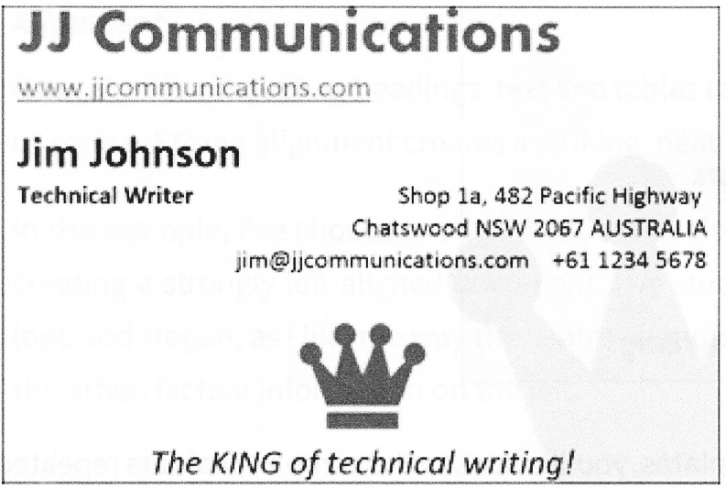
Proximity
Group related objects in close physical proximity to establish a visual relationship. This establishes a relationship between the grouped items in the mind of the audience. Conversely, if you don’t want things to appear related, use white space to keep them visually distant.
In the example, I’ve created four groups of related objects - the company name and URL, Jim’s name and title, Jim’s address and contact details, and Jim’s logo and slogan. I’ve brought the items within these groups into closer physical proximity to emphasize that they have a strong relationship with each other, and used white space to distance them from the other groups. I’ve also changed the alignment of the address block to flush right to create a contrast with Jim’s name and title.
In technical documentation, headings should be in close proximity to related text, diagrams with captions, and so on.

Slide 54
References:
Technical Writing, Serena Henning, JP Publishing, LLC, 2020
Technical Writing Process, Kieran Morgan, Better on Publications, 2015
Spring into Technical Writing for Engineers and Scientists, Barry J. Rosenberg, Pearson Education, Inc, 2005
Technical Writing A-Z, Trever M. Young, Asme Press, 2009

Slide 55
THANK YOU FOR YOUR ATTENTION!

