Slide 1

PUBLISH AND CONCLUSION
Lesson 4
http://sitecoreinfo.blogspot.com/2019/02/sitecore-publish-programmatically-not.html
Lecturer: M. Kurbonov

Slide 2
PUBLISH

Slide 3
This lesson explains how to prepare your document for publication, including performing final checks and establishing document control. It discusses common methods of publishing technical documents - from content management systems and intranets to commercial printing companies - and provides guidance on how to communicate with stakeholders following publication.

Slide 4
Technical Writing Process
Steps
Plan
Structure
Write
Review
Publish
Activities
Define scope, stakeholders & process
Select techniques & tools
Review Doc. Plan with stakeholders
Schedule project
Check for templates or style guides
Gather information
Track progress
Create table of contents (if required)
Review table of contents with subject matter experts / stakeholders
Write first draft
Review draft with subject matter experts
Review & revise draft to final stage
Format / lay out draft
Edit & check draft
Define review team
Conduct stakeholder review
Collate feedback & revise draft
Obtain approval to publish
Finalise document (formatting, proofreading, etc.)
Establish document control
Publish final draft
Communicate with stakeholders
Tools / Outputs
Technical Writing Process
Documentation Plan
Documentation Timeline / Schedule
Deliverables Matrix / Worksheet*
Status Tracker*
Table of Contents
Drafts (First, Interim, Final)
Editing Checklist
Editing Sheet
Review Matrix
Message to Review Team
Review Log
Approved Draft
Controlled Document
Message to Stakeholders

Slide 5
The publication process involves tying up all remaining loose ends in your documents, performing final checks and proofreading, and establishing document control. Once that’s done, your documents are ready to be released in final format to their intended audience.
The precise moment of publication will often be scheduled to coincide with a particular date, such as the launch of a new product, process or system, or the completion of a major milestone in a project. Publication will typically be accompanied by an announcement (crafted by you or a manager) informing the appropriate stakeholders that the documentation is now live.

Slide 6
The method of publication may be as simple as emailing the documents to a group of stakeholders or uploading them onto a content management system or company intranet. At the other end of the spectrum, publication can be a project in itself. For example, the publication of user guides for products that are shipped globally may involve arranging translation into multiple languages, proofreading and graphic design by external agencies or freelancers, printing by commercial printing houses, and the facilitation of logistical efforts such as catalogue numbers and production specifications.
The most common publication activities are discussed in this section, but keep in mind that the complexity of the publication process is highly variable, depending on the nature of the documents and the requirements of your project.

Slide 7
Communicate complexity with a picture
Many people are accustomed to thinking of documentation as a hasty afterthought, which can lead them to underestimate the complexity and duration of all steps in the technical writing process, not least of which is publication. Experienced writers understand that publication can be a complicated process, whereby we carefully manufacture and launch a final product. This is where visual tools such as the Documentation Timeline and Technical Writing Process come in handy. Use these big­ picture visual tools to communicate your project to others, without bogging them down in the details.

Slide 8
Finalize document
Once your document has been formally approved, it really shouldn’t change much from this point on (at least not without having another review-and- approval cycle). This stage is really about giving your document a final polish and making sure everything is in place to publish.
To perform the final checks, it often helps to print the document out, even if it’s only going to be published on an electronic medium (remember that your audience may want to print it out too). If you’ve gotten used to reading it on the screen, looking at a printed copy will give you a fresh perspective.

Slide 9
Check the formatting and layout. Are the styles and fonts correctly applied? Do the pages break in the right place? Check headers and footers, and make sure the table of contents has been updated so it shows the correct headings and page numbers. Make sure all images are appropriately captioned and labelled.
Perform a final proofread of the document to make sure the version to be published matches the approved final draft. Depending on the error tolerance of the document, a professional proofreader may be engaged for this task. This is common in documents where it’s difficult to fix errors after publication, such as commercially printed user guides, reports, annual statements and books.

Slide 10
Establish document control
Document control is a record of the document’s history of updates, review and approval. Using document control, anyone who isn’t familiar with the document should be able to track down who wrote the document, when it was written, and who reviewed and approved it. Once you have established document control, your document is said to be controlled.
There are typically two aspects to document control:
Revision history. This includes the version number of the published draft, document ID, author’s name, a list of previous published versions going back to the very first version, and a summary of the changes from version to version. In some documents, this section may include a scheduled next-revision date.
Approval. This includes the review team members who reviewed and approved the current version, their job titles, and when it was approved.

Slide 11
The complete revision history and record of approval are often not specifically included on the document itself. Instead, the document will typically have a unique document ID located on it, which can be used to search the company content management system for the document’s full record of review, update and approval. This is especially true of customer-facing documents, where this type of information isn’t relevant to the audience (and may be advantageous to competitors), or where there simply isn’t enough space in the document to include lengthy records.
Many companies have formal document control policies, which may be mandated by laws, regulations or standards such as ISO 9001, or motivated by the desire to establish good corporate housekeeping. When you’re setting up document control on your documentation, make sure you check your company’s document control policy. If company controls are weak or non-existent, you may need to establish your own system, such as the one shown next.

Slide 12
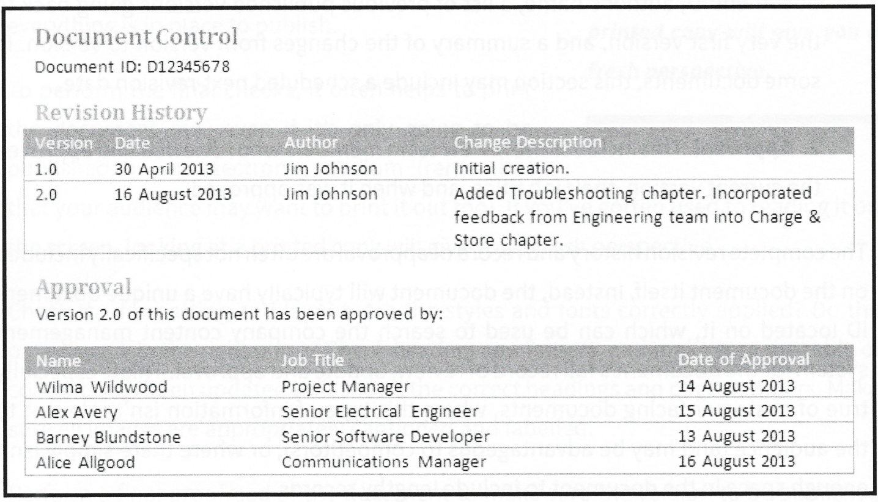
Document ID
A unique combination of numbers or letters which identify your document. No two documents share the same ID. This is a very common feature of document control systems, and is a requirement of standards such as ISO 9001.
Here’s a sample document control table which caters for many scenarios - this can go into the front of a document:

Slide 13
Publish final draft
Once formatting has been finalized, proofreading performed and document control put in place, it’s time to publish. How you accomplish this will depend very much on the type of document and the systems in place at your company. Here are some of the typical possibilities:
Documents attached to an email and sent to stakeholders
Documents published on the company intranet or content management system
Documents printed on an office printer and distributed in hardcopy to relevant employees or pinned up in strategic locations in the office (e.g. next to a machine or assembly line)
Documents sent to a commercial printing company to be printed and distributed to customers
These days, it’s very common to find documents created from a single source and published into multiple formats. For example, a user guide might be published as a printed booklet, uploaded to the company website as a series of web pages, and emailed to relevant stakeholders as a PDF file.

Slide 14
Try an old-fashioned touch to make an impression
It has become the norm for documents to be emailed or uploaded to an intranet or content management system. If this is the case for your documentation, consider creating a printed-and-bound copy of key documents for your manager or important stakeholders. Use a wire or plastic-comb binding machine - there’s no need to go to a commercial printing company. This technique adds a personal touch and creates a nice presentation piece. Create a copy for yourself as well, for your professional library.

Slide 15
Communicate with stakeholders
Once the documentation has been published, it’s good practice to follow up with an announcement. This may be as simple as an email to your manager and key stakeholders, but it can be a more complicated affair. For example, if your documents are going to be printed and shipped to customers, you may have to coordinate with printing companies, your company’s logistics team, and others.
Before you send your announcement, consider who needs to be notified, how the announcement will be made (email, notification on company website?) and who the announcement should come from (you or a higher authority?). It’s not a great career move to pre-empt an official communication that your manager was intending to send.
If it’s your responsibility to make the announcement, ensure you put the appropriate effort into crafting it. Run it by your manager or a colleague for their opinion before you send it out. Remember, once an announcement has been sent, it’s very hard to un-send!

Slide 16
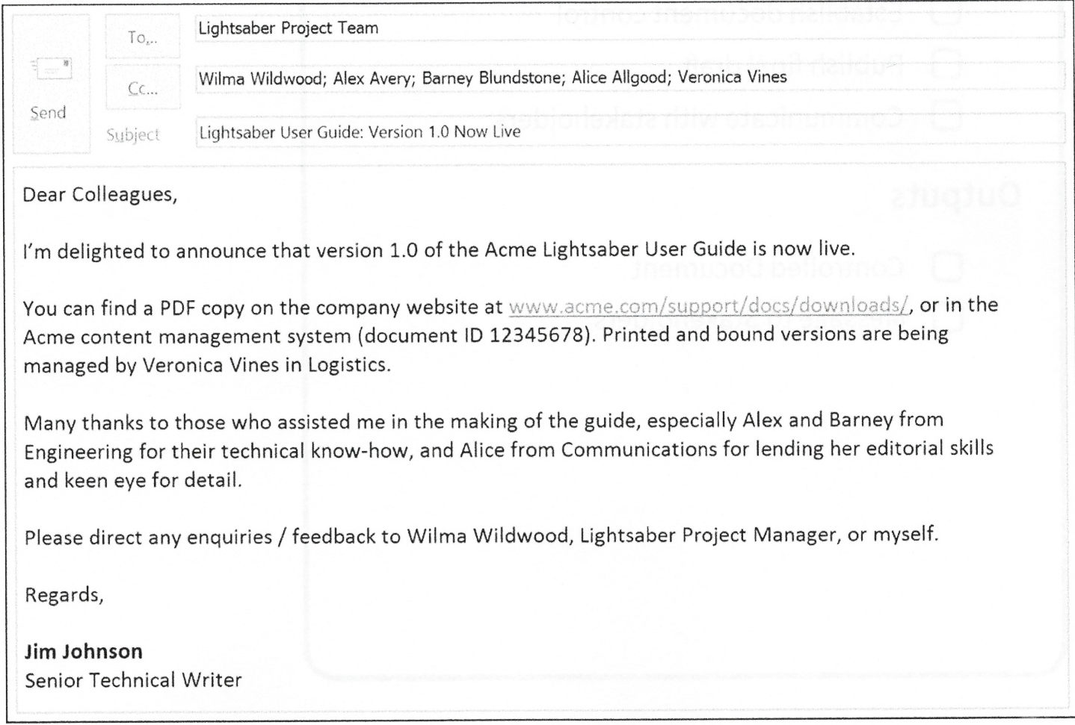
Here’s an example of an email announcing the release of a fictional user guide:

Slide 17
CONCLUSION

Slide 18
Once your document has been published and you’ve let the relevant people know about it, take a moment to congratulate yourself. Planning and writing a technical document can be a major undertaking, consuming weeks, months or even years of effort.
Remember that it’s always worth putting the effort in to craft a great document, as this will reflect well on you, your managers and your company. A well- crafted document should be a pleasure to read and use rather than causing frustration for its audience.

Slide 19
Although many technical documents are created as once-off deliverables, this may not be the end of your documentation’s journey. Documents about products or processes that are continually evolving (e.g. frequently updated software or products that have a regular upgrade cycle) will need to be regularly updated and maintained.
For small, frequent updates, this may be as simple as going through the Write, Review and Publish steps again. For a comprehensive update, or where a process or product has evolved significantly since the original document was written, this may involve going through the entire process again, beginning with the Plan step. Be careful not to underestimate the complexity of a document update, particularly if it’s been a while since the initial creation!

Slide 20
Recap
Here’s a brief recap of the Technical Writing Process’s five steps.
Plan – Planning is where you define the scope of your documentation project (i.e. the documents, or deliverables, which you or your team will create), modify the Technical Writing Process to show how the deliverables will be created, and identify the key players in your project and the roles they will play. This is embodied in a Documentation Plan.
The scope should be fleshed out through a series of workshops with your stakeholders to clearly identify every deliverable and their individual attributes (assuming there’s more than one deliverable in your project). To achieve this, use a Deliverables Worksheet to record discussions during the workshops and a Deliverables Matrix to list all the deliverables alongside their attributes.

Slide 21
You may also need to work out the timing of your project, using a Documentation Timeline or Documentation Schedule, if it hasn’t been done for you by your manager or the project manager.
Other activities that occur during planning include: selecting the appropriate technical writing techniques and tools, gathering up any potentially useful existing information such as requirements documentation or previous versions of deliverables, and checking for company templates or style guides which you may need to use. Once scope, resources and timing are defined, the final stage in planning is initiating the tracking each deliverable’s status in a Status Tracker.

Slide 22
Structure – In this step, you create the bare bones, or information architecture, of your document: an outline of the document’s headings, to be filled in with text during the writing step. This structure is usually known as a table of contents.
There are a number of approaches to structure: narrative, process based, library and system based. It’s common to use a combination of these approaches in your documents. You will need to work closely with your subject matter experts to develop the structure, for example by holding a series of workshops.
The final stage in structuring is a review of the table of contents with your stakeholders to make sure it’s sufficiently developed to proceed to writing.
Depending on the complexity and quantity of your deliverables, the amount of effort in this step can vary considerably, from very little (e.g. you have been provided with a template which you will simply populate with text) to considerable (e.g. you are documenting a new, complex product for which no previous documentation or template exists, requiring you to develop a structure from scratch).

Slide 23
Write – Writing is where you flesh out the table of contents to create a first draft. The first draft is then refined and improved through a process of informal review with your subject matter experts, testing and walk-throughs.
Version control is implemented on your document to manage the write / review cycle. This cycle of revision creates a series of interim drafts that are continually refined until you reach a draft that’s ready for editing, formal review and approval, i.e. the review step. This is known as the final draft.
The last stage in writing is to lay out and format your final draft.

Slide 24
Review – Review focusses on polishing your document through checks such as editing, testing and peer review until it’s ready to be submitted for formal approval.
Once checking is complete, you will need to formally define the review team, send your document to the review team for formal review, and record any resulting feedback in a Review Log. You should consider each feedback item carefully before implementing it and provide a brief rationale if you choose not to implement it.
The final stage in reviewing is when your stakeholder team approves your updated final draft for publication.

Slide 25
Publish - Publication is where you finalize your document by tying up any loose ends, perform final proofreading, and double­check the formatting and layout. Document control is then established, typically using a table at the front of the document to identify the current version, changes from the previous version, and who’s approved the current version.
Once document control is in place and you’re satisfied that the document is finalized and technically accurate, it’s time to publish. Publication may involve emailing the document to a group of stakeholders, uploading it to a company intranet, or (at the more complex end of the spectrum) sending it off to a commercial printing company for printing and binding.
The final stage in publishing is sending an announcement to the relevant stakeholders to notify them that your document has now gone live.

Slide 26
Deliverables Matrix: Description – A list of every document to be written in the project and its key attributes (e.g. publication format, desired word count). Only quantifiable metrics are shown in the Deliverables Matrix (i.e. no longhand explanations). Used in projects where there are multiple deliverables.
Purpose – Allows the writer to see the deliverables of the project at a glance, without having to wade through lots of text. Provides a definitive list of the project’s scope which is easy for everyone to understand.

Slide 27
Deliverables Worksheet: Description – A worksheet which is used during planning to capture discussion about the deliverables. Used in projects where there are multiple deliverables.
Purpose – Allows the understanding oi the deliverables to be refined during a process of discussion with the stakeholders. Useful if the scope of the project / nature of the deliverables is unclear in the early stages.

Slide 28
Documentation Plan: Description – A key planning document which sums up a technical documentation project. It defines the project scope - the documents to be written, the intended audience, key dates, roles and responsibilities, etc. - and the process the writer intends to follow to execute the project. Documentation plans should aim to be concise.
Purpose – Increases understanding of the scope of the documentation project for both the writer and the stakeholders. Acts as a reminder to the writer of what they’ve agreed to write. Allows the writer to prove that they’ve done what’s been asked at the completion of the project. Facilitates consensus seeking amongst the project team on the project scope and expectations.

Slide 29
Documentation Schedule: Description – A detailed breakdown of a documentation project’s steps, activities and milestones. Requires a high degree of knowledge, experience and the use of specialized tools such as Microsoft Project. Often the responsibility of the project manager, but may fall to the technical writer.
Purpose – Provides a high level of control over the timing of the technical documentation project, allowing the writer to make sophisticated plans that take into account numerous variables. Great internal planning tools that can be used to plan the writer’s or the team’s work.

Slide 30
Documentation Timeline: Description – A high-level picture of the key steps, milestones or activities in a technical documentation project. Often the responsibility of the project manager, but may fall to the technical writer.
Purpose – Can be created by anyone (even those with little experience in project management) using commonplace tools such as Microsoft PowerPoint. Great visual summaries which can be easily understood by time-poor managers and stakeholders.

Slide 31
Editing Checklist: Description – A list of items to be checked by a writer or editor when editing technical documents.
Purpose – Ensures documents undergo a rigorous and consistent series of checks prior to publication.

Slide 32
Editing Sheet: Description – A list of documents-­specific editing rules and terminology (e.g. acronyms, technical jargon, product names, user interface elements, trademarks, etc.). The list is built by the writer or editor whilst editing a document.
Purpose – Allows the writer or editor to maintain consistency in style and terminology across the document. Saves the writer or editor from having to re­validate a term every time they encounter it.

Slide 33
Review Log: Description – A spreadsheet which collates the comments received from each member of the review team with the corresponding actions the writer makes to close out the comments.
Purpose – Allows the writer to consolidate feedback from numerous people into a single document, making the process of review more manageable. Allows the writer to keep track of the feedback items actioned vs. those yet to be implemented. Allows the writer to prioritize feedback items. Makes it easier to respond to reviewers with an explanation of how the writer has closed out their feedback.

Slide 34
Review Matrix: Description – A table which sets out the names and job titles of reviewers and what the writer wants each one to concentrate on in the review.
Purpose – Allows the writer to limit the review team’s responsibilities to what the writer really wants them to focus on (e.g. technical accuracy) and guide them away from areas which are other people’s specialties.

Slide 35
Status Tracker: Description – A spreadsheet used to monitor the progress of each deliverable. Progress is defined by percentage complete. For example, ‘First Draft Completed’ is defined as 45% complete in the template provided. Often the responsibility of the project manager, but may fall to the technical writer or be provided as a template for the technical writer to update.
Purpose – Allows the writer to quickly track progress of each deliverable. Allows the writer to express the progress of the overall project as a percentage. Allows the writer to flag risks to the completion of any of the deliverables

Slide 36
Now you know how to establish yourself as a writer, the next step is how to establish your work. This is the part of technical writing where you work out the what’s, why’s, who’s and how’s. For example, you will need to adapt your email if you are writing to a politic figure versus an academic.
A useful way of thinking about the design of your work is the Audience, Purpose, Tone, Content triangle (Lumen, 2020). Think of the audience, purpose, and tone of your work as integral to shaping the content that your produce.
These key steps to establishing the design of your work are outlined in the next sections.

Slide 37
Outlining your purpose
The first thing when writing anything is to outline your purpose; the reason that you are writing a piece. Works without a focus do not translate well to an audience. Why am I writing this piece and what do I hope to achieve? What is the purpose of my piece?
Here are some starter questions to get some of your technical juices flowing (Naas, 2020):
What are you trying to do with your piece? Inform? Persuade? Instruct?
How many purposes do you have and how many can you manage? If your text needs to be brief, you may need to cut down what you are trying to convey.

Slide 38
Identifying your audience
Another important question to ask when approaching technical writing is "who am I writing for?". This is the audience of your piece - the individual or group that you are intending to address (Lumen, 2020). A policy recommendation, for example, will most likely be geared towards those in the political sphere. Differently an instruction manual on how to train a cat should be aimed at as wide an audience as possible.
It is essential, therefore, that you conduct an audience analysis before constructing your piece. An audience analysis involves the following considerations (Lumen, 2020):

Slide 39
Demographics
This covers the core identity aspects about an audience - the data that would often be used to measure them. This may include age, gender, ethnicity, religious beliefs, class, or ability. Demographics will be important depending on how targeted your work is.

Slide 40
Existing knowledge
It is also important to think about what your audience already knows. For example, writing a proposal to your manager will not require you to outline all of your existing qualifications - something which they hopefully already know!

Slide 41
Expectations
What will your audience expect from your piece? Is there a general structure and layout to what you are writing? Think about appearance conventions, such as proper grammar and spelling, font type and font size.

Slide 42
Education
Finally, education can also be an important factor when considering your target audience. For example, if you are writing correspondence with someone trained at a doctorate level, you may want to opt for more formal language than if you are writing to someone still completing their undergraduate degree.
One way to visualize your audience is to imagine writing your piece as giving a presentation. If you were giving training on public speaking to a corporate office, you would probably opt to wear conventional suit attire. Differently, if you were giving this training to a hip start-up, you might opt to whack out the Converse.

Slide 43
Finding the right tone
The way that you write is very much a reflection of your purpose and audience; it is the attitude that you are conveying towards a subject (Lumen, 2020). In everyday language, we use a variety of tones to communicate how we feel - conveyed through pitch, timing and what we are actually saying. All of this comes fairly intuitively but can be slightly more difficult to get across in writing.

Slide 44
There are a number of ways that you can set and adjust your tone in technical writing. Though technical communication is typically factual and serious, tone does vary when writing technically (ACS, 2020). For example, a non-profit annual report may go for a lighter tone than a CV. Here are some devices that you can adjust your tone:
Sentence structure
Word choice
Punctuation
Formal/informal language
Pace (influenced by the length of paragraphs, and use of lists and graphics)

Slide 45
Constructing your piece
Now that you have a basic idea of how to design your technical writing, it is important to have an understanding of how you are going to write it. There are a number of general stages that should be followed when constructing a piece of work, which will ensure that your piece is well-researched and rigorous. Though this may not be applicable to shorter forms of technical writing, these stages may be useful to think about. Here are the distinct steps when writing:

Slide 46
Prewriting
This is the part of the writing process that doesn't actually writing your piece. It is when you organize your ideas and build the foundations of your work. Prewriting is essentially the stage where you lay out your ideas and develop a sound reasoning to them. Strategies include:
Listing: Generate a list of broad ideas and then reduce these down to smaller lists (University of Kansas, 2019). This is particularly useful when you need to narrow down your topic. You should try to thematically arrange your lists and then label groups of ideas which come together. In technical writing, you should also focus on your purpose, tone, and audience as central topic areas.
Mind mapping: This is when you begin to infer the relationship between different groups of ideas. From your list, you should have some central subjects or themes emerge. Put these in the center of a page and write new ideas around the center, linking these with lines.
Free writing: write non-stop for a certain amount of time to generate ideas. This allows you to develop your ideas on a topic without second-guessing yourself. Try to free write for around 5 or 10 minutes on a particular topic and then look over what you have written, highlighting the most prominent and interesting ideas.

Slide 47
Drafting
When drafting your piece, you are beginning to develop more cohesive work. Here you will begin to sketch out your ideas in writing. Don't worry about your spelling, grammar, or organization at this stage - these bits will be ironed out later!

Slide 48
Editing
This is the first stage of improving your draft - where you will identify some of the major errors or faults in reasoning. Identify the biggest problems in your work and make the necessary adjustments.

Slide 49
Redrafting
So, we're editing again? Didn't I just do that? There is a subtle difference between editing and redrafting. Whilst editing involves finding and fixing specific errors, redrafting is editing on a more fundamental level. This involves taking a step back and reviewing the cohesion of your entire piece. At this point, you may want to move around important parts or integrate an introduction or conclusion if you haven't already. Re-drafting often involves an entire re-write of the original piece and doing so will ultimately result in a higher quality piece of work.

Slide 50
Proofreading
Unlike redrafting, proofreading focusses on surface level errors such as spelling, grammar and referencing. This is the final stage in writing and should be done only when all other editing revisions have been made.

Slide 51
References:
Technical Writing, Serena Henning, JP Publishing, LLC, 2020
Technical Writing Process, Kieran Morgan, Better on Publications, 2015
Spring into Technical Writing for Engineers and Scientists, Barry J. Rosenberg, Pearson Education, Inc, 2005
Technical Writing A-Z, Trever M. Young, Asme Press, 2009

Slide 52
THANK YOU FOR YOUR ATTENTION!

