Slide 1
Programing Methodology in C
Lecture 5 – Operators and Input/Output Functions
By Elubu Joseph
josebulinga@gmail.com

Slide 2
Agenda
Operators in C Language
C Input / Output

Slide 3
Operators in C Language
An operator is a symbol that tells the compiler to perform a certain mathematical or logical manipulation based on the operands provide produce desired result.
An operand is a value on which any operator works. E.g. when we say 10+5, here, numbers 10 and 5 are operands whereas + is an operator.
C supports a rich set of built-in operators.

Slide 4
C operators can be classified into following types:
Assignment operators
Conditional operators and
Special operators
Studytonight.com. (n.d.).
Arithmetic operators
Relational operators
Logical operators
Bitwise operators

Slide 5
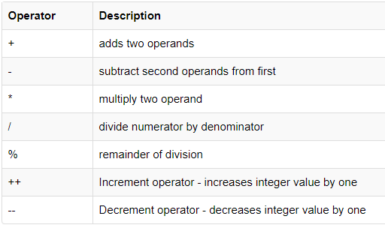
1. Arithmetic operators
C supports all the basic arithmetic operators. As shown on the table below.
Example
3 + 3 = 6
3 - 3 = 0
3 * 3 = 9
3 / 3 = 1
3 % 2 = 1
Adds 1 to a value after every round
Subtracts 1 from a value after every round

Slide 6
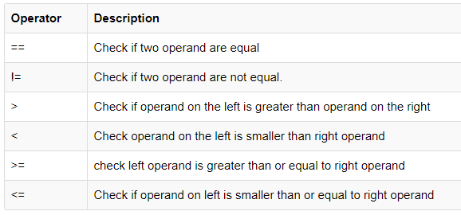
2. Relational operators
The following table shows all relation operators supported by C.
Example
3 == 3 True
3 != 3 False
3 > 3 False
3 < 3 False
3 >= 3 True
3 <= 3 True

Slide 7
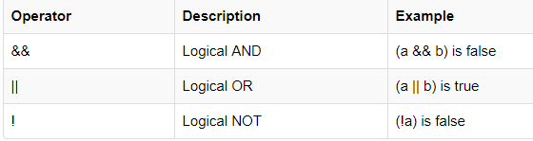
3. Logical operators
C supports following 3 logical operators. Suppose a = 1 and b = 0,

Slide 8
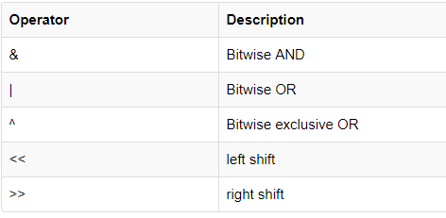
4. Bitwise operators
Bitwise operators perform manipulations of data at bit level. These operators also perform shifting of bits from right to left.
Note! Bitwise operators are not applied to float or double. Be sure to learn about data types in next lectures.

Slide 9
Interpreting Bitwise &, | and ^ operations
The table on the next slide shows the input terminals at ‘a’ and ‘b’ the output terminal is at each of the arguments given by each operator above, such as a & b, a | b and a ^ b.
For a & b The output is "true" when both inputs are "true." Otherwise, the output is "false.“
For a | b The output is "true" when either or both of the inputs are "true." Otherwise, the output is "false.“
For a ^ b The output is "true" when either of the inputs are “False.“, Otherwise, the output is "false.“

Slide 10
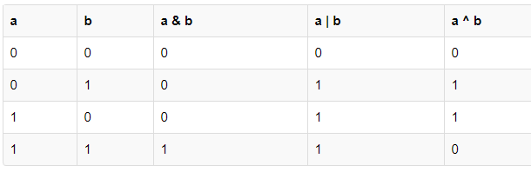
Now lets see truth table for bitwise &, | and ^

Slide 11
For a & b The output is "true" when both inputs are "true." Otherwise, the output is "false.“

Slide 12
For a | b The output is "true" when either or both of the inputs are "true.“ Otherwise, the output is "false.“

Slide 13
For a ^ b The output is "true" when either of the inputs are “False.“, Otherwise, the output is "false.“

Slide 14
Bitwise operators Left-Shift << and Right-Shift >>
The bitwise shift operator, shifts the bit value. The left operand specifies the value to be shifted and the right operand specifies the number of positions that the bits in the value have to be shifted. Both operands have the same precedence

Slide 15
Example
Left-Shift symbol << and Right-shift>> Symbol
a = 0001000
b = 2
a << b = 0100000
a >> b = 0000010

Slide 16
Examples of left and right-shifts operations
a | b | a<<b | a>>b
0001000 | 2 | 0100000 | 0000010
00001000 | 2 | 00100000 | 00000010
00010000 | 2 | 01000000 | 00000100

Slide 17
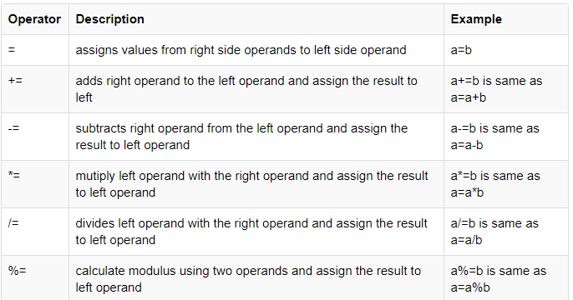
5. Assignment Operators
Assignment operators supported by C language are as follows.

Slide 18
Using Assignment Operators
#include<stdio.h>
int main(){
int a=10, b=5, sum;
printf("The product = %d \n",a*=b);
return 0;
}
//Output=50

Slide 19
6. Conditional operator
The conditional operators in C language are known by two more names
Ternary Operator ? : Operator
It is actually the if condition that we use in C language decision making, but using conditional operator, we turn the if condition statement into a short and simple operator.
The syntax of a conditional operator is :
Expression 1 ? expression 2: expression 3

Slide 20
Explanation:
The question mark "?" in the syntax represents the if part.
The first expression (expression 1) generally returns either true or false, based on which it is decided whether (expression 2) will be executed or (expression 3)
If (expression 1) returns true then the expression on the left side of " : " i.e (expression 2) is executed.
If (expression 1) returns false then the expression on the right side of " : " i.e (expression 3) is executed.

Slide 21
Using ternary Operator (?:)
#include<stdio.h>
int main(){
int k=5, l=10;
l>k? printf("Yeah %d>%d",l,k):printf("No %d<%d",l,k);
return 0;
}
Output: Yeah 10>5

Slide 22
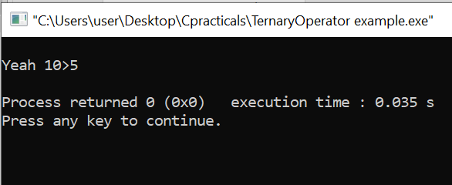
Output

Slide 23
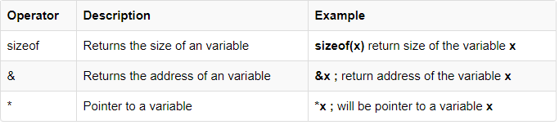
7. Special operator

Slide 24
Input & Output Functions in C programing Language

Slide 25
C Input and Output
Input means to provide the program with some data to be used in the program and
Output means to display data on screen or write the data to a printer or a file.
C programming language provides many built-in functions to read any given input and to display data on screen when there is a need to output the result.

Slide 26
Where to find input/output functions
The section will help us learn about such functions, which can be used in our program to take input from user and to output the result on screen.
We get these functions in stdio.h C header file and they include
1. Input functions are: scanf(), getchar() & gets()
2. Output functions: printf(), putchar() & puts()

Slide 27
The standard input-output header file, named stdio.h contains the definition of the functions printf() and scanf(), which are used to display output on screen and to take input from user respectively
When we use scanf() or printf() function, we need to specify the data type we expect as input or output. Refer to our lecture 4 for the list of specifiers.

Slide 28
Like others, the %d inside the scanf() or printf() functions is known as format string or specifier and this informs the scanf() function, what type of input to expect and in printf() it is used to give a heads up to the compiler, what type of output to expect.

Slide 29
Some specifiers
Format String | Meaning
%d | Scan or print an integer as signed decimal number
%f | Scan or print a floating point number
%c | To scan or print a character
%s | To scan or print a character string. The scanning ends at whitespace.

Slide 30
Sample Code Explanation
When you build and run the code below, it will ask you to enter a value. When you enter the value, it will display the value you have entered on screen.

Slide 31
Sample Code for Input/Output Functions
#include<stdio.h>
void main() {
// declaring a variable
int i;
/* displaying message on the screen asking the user to input a value */
printf("Please enter a value...");
/* reading the value entered by the user */
scanf("%d", &i);
/* displaying the number as output */
printf( "\nYou entered: %d", i);
}

Slide 32
limit the number of digits or characters
We can also limit the number of digits or characters that can be input or output, by adding a number with the format string specifier, like "%1d" or "%3s", the first one means a single numeric digit and the second one means 3 characters, hence if you try to input 56, while scanf() has "%1d", it will take only 5 as input. Same is the case for output.
In C Language, computer monitor, printer etc output devices are treated as files and the same process is followed to write output to these devices as would have been followed to write the output to a file.

Slide 33
getchar() & putchar() functions
The getchar() function reads a character from the terminal and returns it as an integer. This function reads only single character at a time.
The putchar() function displays the character passed to it on the screen and returns the same character. This function too displays only a single character at a time. In case you want to display more than one characters, use putchar() method in a loop.

Slide 34
getchar(); & putchar() sample code
#include<stdio.h>
void main( ) {
int c;
printf("Enter a character");
/* Take a character as input and store it in variable c */
c = getchar();
/* display the character stored in variable c */
putchar(c);
}

Slide 35
gets() & puts() functions
The gets() function reads a line from stdin(standard input) into the buffer pointed to by ds pointer, until either a terminating newline or EOF (end of file) occurs. The puts() function writes the string ds and a trailing newline to stdout.
ds → This is the pointer to an array of chars where the C string is stored.
We will talk about pointers later.

Slide 36
gets() & puts() Sample code
#include<stdio.h>
void main() {
/* character array of length 200 */
char ds[200];
printf("Enter your name: ");
gets( ds );
puts( ds );
getch();
}
Lets see it code blocks

Slide 37
Difference between scanf() and gets()
The main difference between these two functions is that scanf() stops reading characters when it encounters a space, but gets() reads space as character too.
If you enter name as JOIN Kumu using scanf() it will only read and store JOIN and will leave the part after space. But gets() function will read it completely.

Slide 38
Summary
In summary therefore, we learnt about: -
1. Operators in C Language
Defined, talked vavious e.gs(Arismetic,Assignment,Relational, Bitwise etc.)
2. C Input / Output
Intputs: Scanf(), gets(), getchar()
Outputs: printf(); puts, putchar etc.

Slide 39
Thank you for you attention

Slide 40
References
C operators (with live examples). Studytonight.com. (n.d.). Retrieved October 3, 2021, from https://www.studytonight.com/c/operators-in-c.php.

