Slide 1
SYSTEMS DEVELOPMENT PROJECT
Chapter 4
Domain Modeling
Lecturer:
Dr. Joshua Okemwa. PHD.

Slide 2
THE SCOPE OF THE STUDY
The Information Model
Structural Modeling
Information Modeling in the UML

Slide 3
Definition
A domain model is a visual representation of conceptual classes or real-world objects in a domain of interest.”[1]
A Domain Model creates a web of interconnected objects, where each object represents some meaningful individual, whether as large as a corporation or as small as a single line on an order form.” [2]
“… a conceptual model of the domain that incorporates both behavior and data.” [3]

Slide 4
Note:
Some software development processes address this by using written specifications or requirements document to try to capture all the details of a problem. Unfortunately, this approach often creates distance between the people who understand the problem best and the people who will implement the solution.

Slide 5
Domain driven design
Before attempting to solve a problem it’s important that we understand the problem correctly.
How can we ensure that we, as developers, do understand the problem?
Approach 1: Some software development processes address this by using written specifi- cations or requirements documents to try to capture all the details of a problem.
Unfortunately, this approach often creates distance between the people who understand the problem best and the people who will implement the solution.

Slide 6
APPROACH 2
A much better solution is to eliminate the intermediaries and encourage the domain experts to be intimately involved with the development process, introducing a feedback loop between the development team and the domain expert.
The development team regularly delivers something to the domain expert, who can quickly correct any misunderstandings for the next iteration.

Slide 7
Cont.
This kind of iterative process is at the core of “agile” development processes. However, even this approach has its problems. The developer acts as a translator, translating the domain expert’s mental model into code.
But as in any translation, this process can result in distortion and loss of important subtleties. If the code doesn’t quite correspond to the concepts in the domain, then future developers working on the codebase without input from a domain expert can easily misunderstand what’s needed and introduce errors.

Slide 8
APPROACH 3
But there is a third approach. What if the domain experts, the development team, other stakeholders, and (most importantly) the source code itself all share the same model?
In this case, there is no translation from the domain expert’s requirements to the code. Rather, the code is designed to reflect the shared mental model directly. And that is the goal of domain-driven design

Slide 9
Aligning the software model with the business domain has a number of benefits:
Faster time to market. When the developer and the codebase share the same model as the person who has the problem, the team is more likely to develop an appropriate solution quickly.
More business value. A solution that is accurately aligned with the problem means happier customers and less chance of going off track.

Slide 10
Cont.
Less waste. Clearer requirements means less time wasted in misunderstanding and rework. Furthermore, this clarity often reveals which components are high value so that more development effort can be focused on them and less on the low-value components.
Easier maintenance and evolution. When the model expressed by the code closely matches the domain expert’s own model, making changes to the code is easier and less error-prone. Furthermore, new team members are able to come up to speed faster.

Slide 11
DOMAIN MODELING
Why:
Domain modeling helps us to identify the relevant concepts and ideas of a domain
When:
Domain modeling is done during object-oriented analysis
Guideline:
Only create a domain model for the tasks at hand

Slide 12
Note:
The domain model is created during object-oriented analysis to decompose the domain into concepts or objects in the real world
The model should identify the set of conceptual classes. (The domain model is iteratively completed.)
It is the basis for the design of the software.

Slide 13
INFORMATION MODEL
An Information Model provides the framework for organizing content so that it can be delivered and reused in a variety of innovative ways.
Once created an Information Model for the content repository, then label information in ways to enhance search and easy identification by users who are in a particular domain.
The Information Model is the ultimate content-management tool.

Slide 14
Cont.
Creating your Information Model requires analysis, careful planning, and a lot of feedback from your user community.
The analysis takes you into the world of those who need and use information resources every day.
The planning means talking to a wide range of stakeholders, including both individuals and groups who have information needs and who would profit from collaboration in the development of information resources.
Getting feedback requires that you test your Information Model with members of your user community to ensure that you haven't missed some important perspectives.

Slide 15
An Information Model
An Information Model is an organizational framework that you use to categorize your information resources.
The framework assists authors and users in finding what they need, even if their needs are significantly different and personal.

Slide 16
Example
Information Model might provide a framework for categorizing your corporate training materials or the technical and sales information that accompanies your products
Your Information Model might include engineering information produced during product development, policies and procedures used internally in the day-to-day conduct of business, information about customers used in your sales cycle or about vendors used in your supply chain.

Slide 17
METADATA | VALUE
AUTHOR | INDIVIDUAL NAME
EDITOR | INDIVIDUAL NAME
ACTIVITY | INITIAL CREATION
 | EDITING
 | APPROVAL
 | REVISION
ACTIVITY DATE | DATE

Slide 18
STRUCTURE
A domain model is a visual representation of conceptual classes or real-world objects in a domain of interest.
Domain models are also called conceptual models, domain object models, and analysis object models.
UP defines a Domain Model as one of the artifacts that may be created in the Business Modeling discipline.
Using UML notation, a domain model is illustrated with a set of class diagrams in which no operations are defined.

Slide 19
It may show:
Domain objects or conceptual classes
Associations between conceptual classes
Attributes of conceptual classes
e.g. a partial domain model
conceptual class of Payment and Sale are significant in this domain,
Payment is related to a Sale in a way that is meaningful to note
Sale has a date and time.

Slide 20
Statement on a course System Development Project
During a semester a lecturer reads one or more lectures
Sometimes the lecturer is on leave to focus on doing research, in this case (s)he does not give a lecture
A student usually attends one or more lectures, unless an option is available.
During the semester there will be several exercises which are meant to be solved by small study groups
Each student is assigned to one particular study group for the whole semester
A study group consists of two to three students
After submission of a solution by a study group it is graded by a tutor

Slide 21
A class describes a set of objects with the same semantics, properties and behavior.
TUTOR
EXERCISE
During a semester a lecturer reads one or more lectures
A student usually attends one or more lectures, ...
During the semester there will be several exercises...
Each student is assigned to one particular study group for the whole semester
... it is graded by a tutor
SEMISTER
STUDENT
STUDY GROUP
GRADE
LECTURER

Slide 22
Attributes are logical data values of an object.
It is useful to identify those attributes of conceptual classes that are needed to satisfy the information requirements of the current scenarios under development.
... After submitting a solution it is graded by a tutor
The bonus is a relative bonus that reﬂects the relative number of exercise points gained during the semester
The bonus is derived
Student
Name\bonus:
percentage
Attributes
Derived attribute (/)

Slide 23
An association is a relationship between classes.
The ends of an association are called roles. Roles optionally have a multiplicity, name and navigability.
A student usually attends one or more lectures...
A study group consists of two to three students...
During the semester there will be several exercises

Slide 24
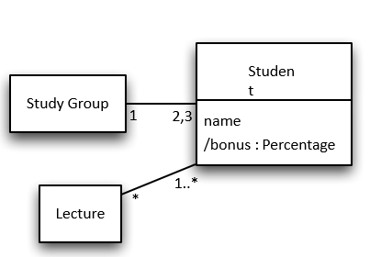
The multiplicity defines how many instances of a class A can be associated with one instance of a class B at any particular moment. (e.g., * ≙ zero or more; 1..10 between 1 and 10; 1,2 one or two)
A student usually attends one or more lectures, unless (s)he has something better to do
A study group consists of two to three students.

Slide 25
Two classes can have multiple associations.
A student usually attends one or more lectures, unless the student has something better to do
A study group consists of two to three students; after submitting a solution it is graded by a tutor who is also a student
Note: The preliminary domain model for a course system Development Project will contain all classes and their associations.

Slide 26
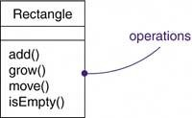
BASIC CONSTRUCTORS
A class is a description of a set of objects that share the same attributes, operations, relationships, and semantics. Graphically, a class is rendered as a rectangle.
A name is a textual string.
An attribute is a named property of a class that describes a range of values that instances of the property may hold.
An operation is the implementation of a service that can be requested from any object of the class to affect behavior.

Slide 27
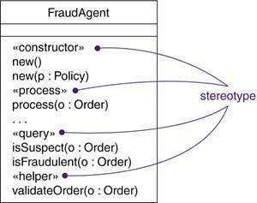
Organizing Attributes and Operations
When drawing a class, you don't have to show every attribute and every operation at once.
In fact, in most cases, you can't (there are too many of them to put in one figure).
You can indicate that there are more attributes or properties than shown by ending each list with an ellipsis ("...").

Slide 28
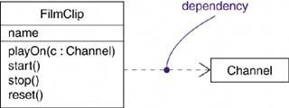
RELATIONSHIPS
A relationship is a connection among things. In object-oriented modeling, the three most important relationships are dependencies, generalizations, and associations.
A dependency is a relationship that states that one thing (for example, class Window) uses the information and services of another thing (for example, class Event), but not necessarily the reverse.
A generalization is a relationship between a general kind of thing (called the superclass or parent) and a more specific kind of thing (called the subclass or child). "is-a-kind-of" relationship

Slide 29
An association is a structural relationship that specifies that objects of one thing are connected to objects of another. Given an association connecting two classes, you can relate objects of one class to objects of the other class.
Although it's not as common, you can have associations that connect more than two classes; these are called n-ary association
There are four adornments that apply to associations.

Slide 30
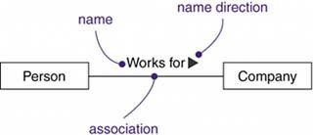
NAME: An association can have a name, and you use that name to describe the nature of the relationship. So that there is no ambiguity about its meaning, you can give a direction to the name by providing a direction triangle that points in the direction you intend to read the name.

Slide 31
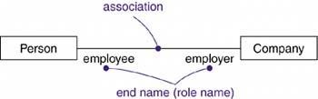
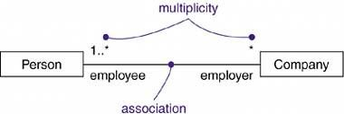
ROLE: When a class participates in an association, it has a specific role that it plays in that relationship
MULITIPLICITY: An association represents a structural relationship among objects. The number of objects must be in the given range. You can show a multiplicity of exactly one (1), zero or one (0..1), many (0..*), or one or more (1..*).

Slide 32
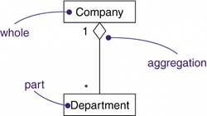
AGGREGATION: A plain association between two classes represents a structural relationship between peers, meaning that both classes are conceptually at the same level, no one more important than the other.

Slide 33
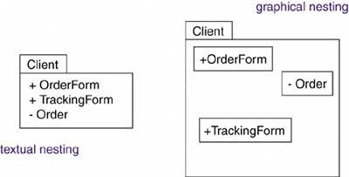
PACKAGE
A package is a general-purpose mechanism for organizing the model itself into a hierarchy; it has no meaning to the execution. Graphically, a package is rendered as a tabbed folder.
Every package must have a name that distinguishes it from other packages. A name is a textual string. A double colon (::) separates package names.
OWN PACKAGE: A package may own other elements, including classes, interfaces, components, nodes, collaborations, use cases, diagrams, and even other packages. Every element is uniquely owned by exactly one package.

Slide 34
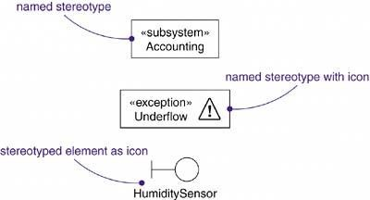
Cont.

Slide 35
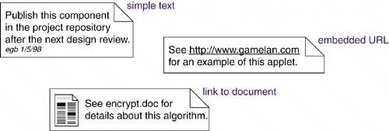
Common Mechanisms:
A note a graphical symbol for rendering constraints or comments attached to an element or a collection of elements.
A stereotype is an extension of the vocabulary of the UML, allowing you to create new kinds of building blocks similar to existing ones but specific to your problem.
The UML provides a language for structural things, behavioral things, grouping things, and notational things.

Slide 36
REFERENCES
Brown, Philip. (2014) What is the Domain Model in Domain Driven Design? Culttt Retrieved from: https://goo.gl/cLDiTT
Fowler, Martin. (2009) Framework Design Guidelines: Domain Logic Patterns. Retrieved from: https://goo.gl/mWsL5R
Scott Wlaschin (2018) Domain Modeling Made Functional: Tackle Software Complexity with Domain-Driven Design
Craig Larman 2001 Applying UML and Patterns: An Introduction to Object-Oriented Analysis and Design and the Uniﬁed Process; Prentice Hall,
Addison-Wesley 2015 Implementing domain-driven design

