Slide 1
SYSTEMS DEVELOPMENT PROJECT
Chapter 4
Domain Modeling
PART 2
Lecturer:
Dr. Joshua Okemwa. Ph.D.

Slide 2
THE SCOPE OF THE STUDY
Information Modeling in the UML
  Basic Constructs
  Relationships
  Stereotypes

Slide 3
Basic Constructs
A class is a description of a set of objects that share the same attributes, operations, relationships, and semantics. Graphically, a class is rendered as a rectangle.
Name: Every class must have a name that distinguishes it from other classes. A name is a textual string
Attribute: An attribute is a named property of a class that describes a range of values that instances of the property may hold. A class may have any number of attributes or no attributes at all. An attribute represents some property of the thing you are modeling that is shared by all objects of that class.

Slide 4
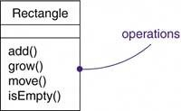
Operation: An operation is the implementation of a service that can be requested from any object of the class to affect behavior. In other words, an operation is an abstraction of something you can do to an object that is shared by all objects of that class.
Note: You can specify an operation by stating its signature, which includes the name, type, and default value of all parameters and (in the case of functions) a return type

Slide 5
Organizing Attributes and Operations
When drawing a class, you don't have to show every attribute and every operation at once.
In fact in some cases there are too many of them to put in one figure and mostly only a subset of these attributes and operations are likely to be relevant to a specific view.
For these reasons, you can choose to show only some
You can indicate that there are more attributes or properties than shown by ending each list with an ellipsis ("...").

Slide 6
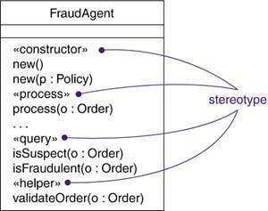
Diagram
Below is a diagram of the class Fraud Agent a few of attributes are shown and the list ending with an ellipsis ("..."). Meaning there are more attributes.

Slide 7
Responsibilities
A responsibility is a contract or an obligation of a class. When you create a class, you are making a statement that all objects of that class have the same kind of state and the same kind of behavior. At a more abstract level, these corresponding attributes and operations are just the features by which the class's responsibilities are carried out.
Examples
FraudAgent class, as you might find in a credit card application, is responsible for processing orders and determining if they are legitimate, suspect, or fraudulent
TemperatureSensor class is responsible for measuring temperature and raising an alarm if the temperature reaches a certain point.

Slide 8
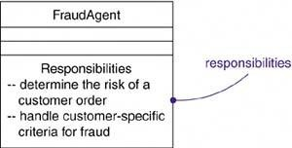
Diagram
The diagram indicates the responsibilities held by the class FraudAgent.

Slide 9
Common Modeling Techniques
Modeling the Vocabulary of a System
You'll use classes most commonly to model abstractions that are drawn from the problem you are trying to solve or from the technology you are using to implement a solution to that problem.
Each of these abstractions is a part of the vocabulary of your system, meaning that, together, they represent the things that are important to users and to implementers.

Slide 10
In order to model vocabulary we need.
Identify those things that users or implementers use to describe the problem or solution.
Use Class-responsibility-collaboration (CRC) cards and use case-based analysis to help find these abstractions.
For each abstraction, identify a set of responsibilities. Make sure that each class is crisply defined and that there is a good balance of responsibilities among all your classes.
Provide the attributes and operations that are needed to carry out these responsibilities for each class

Slide 11
Example
A set of classes drawn from a retail system, including Customer, Order, and Product. They include a few other related abstractions drawn from the vocabulary of the problem, such as Shipment (used to track orders), Invoice (used to bill orders), and Warehouse (where products are located prior to shipment).

Slide 12
Modeling the Distribution of Responsibilities in a System
Once you start modeling a number of classes, it is necessary to ensure a balanced set of responsibilities.
To model the distribution of responsibilities in a system,
Identify a set of classes that work together closely to carry out some behavior.
Identify a set of responsibilities for each of these classes.

Slide 13
Look at this set of classes as a whole, split classes that have too many responsibilities into smaller abstractions, collapse tiny classes that have trivial responsibilities into larger ones, and reallocate responsibilities so that each abstraction reasonably stands on its own.
Consider the ways in which those classes collaborate with one another, and redistribute their responsibilities accordingly so that no class within a collaboration does too much or too little.

Slide 14
Relationship
A relationship is a connection among things.
In object-oriented modeling, the three most important relationships are dependencies, generalizations, and associations.
Graphically, a relationship is rendered as a path, with different kinds of lines used to distinguish the kinds of relationships.

Slide 15
Generalization: is a relationship between a general kind of thing (parent class) and a more specific kind of thing (child class). Generalization is sometimes called an "is-a-kind-of" relationship: Example (like the class BayWindow) is-a-kind- of a more general thing (for example, the class Window).
Dependency: is a relationship that states that one thing (for example, class Window) uses the information and services of another thing (for example, class Event), but not necessarily the reverse.
Associations: is a structural relationship that specifies that objects of one thing are connected to objects of another. Given an association connecting two classes, you can relate objects of one class to objects of the other class.

Slide 16
Beyond this basic form, there are four adornments that apply to associations.
Name: An association can have a name, and you use that name to describe the nature of the relationship.
you can give a direction to the name by providing a direction triangle that points in the direction you intend to read the name. e,g A person works for a company
Role: When a class participates in an association, it has a specific role that it plays in that relationship; a role is just the face the class at the far end of the association presents to the class at the near end of the association.

Slide 17
A person (employee) is employed by a company (employee)
Multiplicity: An association represents a structural relationship among objects.
it's important for you to state how many objects may be connected across an instance of an association.
Example: one (1), zero or one (0..1), many (0..*), or one or more (1..*).

Slide 18
Aggregation: A plain association between two classes represents a structural relationship between peers, meaning that both classes are conceptually at the same level, no one more important than the other.
For instance when modeling a "whole/part" relationship, in which one class represents a larger thing (the "whole"), which consists of smaller things (the "parts")
This kind of relationship is called aggregation, which represents a "has-a" relationship
Example a company with different departments on the same level.

Slide 19
Common Modeling Techniques
Modeling Simple Dependencies
A common kind of dependency relationship is the connection between a class that uses another class as a parameter to an operation.
To model this using relationship
Create a dependency pointing from the class with the operation to the class used as a parameter in the operation

Slide 20
Example:
Consider a set of classes drawn from a system that manages the assignment of students and instructors to courses in a university.
We can shows a dependency from CourseSchedule to Course.
Because Course is used in both the add and remove operations of Course Schedule.

Slide 21
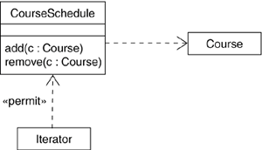
Diagram
The diagram shows a dependency from CourseSchedule to Course.

Slide 22
Modeling Single Inheritance
When modeling the vocabulary of your system, often you can get classes that are structurally or behaviorally similar to others.
They can be modeled as distinct and unrelated abstractions.
Though a better way would be to extract any common structural and behavioral features and place them in more-general classes from which the specialized ones inherit.

Slide 23
Steps to follow
Given a set of classes, look for responsibilities, attributes, and operations that are common to two or more classes.
Elevate these common responsibilities, attributes, and operations to a more general class. If necessary, create a new class to which you can assign these elements (but be careful about introducing too many levels)
Specify that the more-specific classes inherit from the more-general class by placing a generalization relationship that is drawn from each specialized class to its more-general parent.

Slide 24
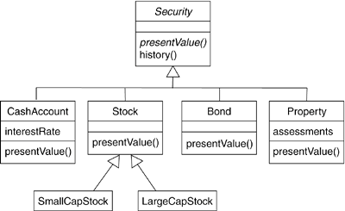
Diagram

Slide 25
Stereotype
A stereotype is an extension of the vocabulary of the Universal Modelling Language,
Allowing you to create new kinds of building blocks similar to existing ones but specific to your problem. Graphically, a stereotype is rendered as a name enclosed by guillemets (French quotation marks of the form « »).
The French marks are placed above the name of another element.
Also stereotyped element may be rendered by using a new icon associated with that stereotype.

Slide 26
The UML provides a language for structural things, behavioral things, grouping things, and notational things. These four basic kinds of things address the overwhelming majority of the systems you'll need to model.
In its simplest form, a stereotype is rendered as a name enclosed by guillemets (for example,
«name») and placed above the name of another element.

Slide 27
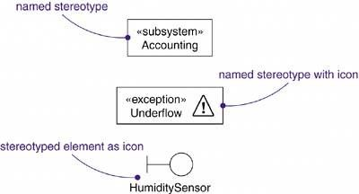

Slide 28
Common Modeling Techniques
Modeling Comments
The most common purpose for which you'll use notes is to write down free-form observations,reviews, or explanations.
To model a comment,
Put your comment as text in a note and place it adjacent to the element to which it refers.

Slide 29
Remember that you can hide or make visible the elements of your model as you see fit.
If your comment is lengthy or involves something richer than plain text, consider putting your comment in an external document and linking or embedding that document in a note attached to your model.
As your model evolves, keep those comments that record significant decisions that cannot be inferred from the model itself

Slide 30
Modeling New Properties
First, make sure there's not already a way to express what you want by using basic UML.
If you re convinced there's no other way to express these semantics, define a stereotype and add the new properties to the stereotype.

Slide 31
Modeling New Semantics
First, make sure there's not already a way to express what you want by using basic
UML. If you re convinced there's no other way to express these semantics, write your new semantics in a constraint placed near the element to which it refers. You can show a more explicit relationship by connecting a constraint to its elements using a dependency relationship.
If you need to specify your semantics more precisely and formally, write your new semantics using OCL.

Slide 32
REFERENCES
Scott Wlaschin (2018) Domain Modeling Made Functional: Tackle Software Complexity with Domain-Driven Design
L Jacobson (2021) The unified modeling language reference manual
https://www.tutorialspoint.com/uml/index.htm
David C. Hay (2011) UML and Data Modeling: A Reconciliation First Edition

