Slide 1
SYSTEMS DEVELOPMENT PROJECT
Chapter 5
Use Case and the Behavior Model
Lecturer:
Dr. Joshua Okemwa. Ph.D.

Slide 2
THE SCOPE OF THE STUDY
Use Case Model
Use Case Diagram
Use Case Description
Use Case Extensions

Slide 3
Use Case Model
To model a system, the most important aspect is to capture the dynamic behavior.
Dynamic behavior means the behavior of the system when it is running/operating.
Only static behavior is not sufficient to model a system rather dynamic behavior is more important than static behavior.
Hence to model the entire system, a number of use case diagrams are used.

Slide 4
Use case description
A use case is a methodology used in system analysis to identify, clarify and organize system requirements. The use case is made up of a set of possible sequences of interactions between systems and users in a particular environment and related to a particular goal. The method creates a document that describes all the steps taken by a user to complete an activity.

Slide 5
When to apply use case diagrams
A use case diagram does not provide detail.
Example, don't expect it to model the order in which steps are performed.
Instead, a proper use case diagram depicts a high-level overview of the relationship between use cases, actors, and systems.
Experts recommend that use case diagrams be used to supplement a more descriptive textual use case.
To depict the system boundary, draw a box around the use case itself.

Slide 6
Cont.
UML use case diagrams are ideal for:
Representing the goals of system-user interactions
Defining and organizing functional requirements in a system
Specifying the context and requirements of a system
Modeling the basic flow of events in a use case

Slide 7
The purposes of use case diagrams
Used to gather the requirements of a system.
Used to get an outside view of a system.
Identify the external and internal factors influencing the system.
Show the interaction among the requirements are actors.

Slide 8
Use case diagram components
Actors: The users that interact with a system. An actor can be a person, an organization, or an outside system that interacts with your application or system. They must be external objects that produce or consume data.
System: A specific sequence of actions and interactions between actors and the system. A system may also be referred to as a scenario.
Goals: The end result of most use cases. A successful diagram should describe the activities and variants used to reach the goal.

Slide 9
Steps to draw a use case diagram
Identify the Actors (role of users) of the system.
For each category of users, identify all roles played by the users relevant to the system.
Identify what are the users required the system to be performed to achieve these goals.
Create use cases for every goal.
Structure the use cases.
Prioritize, review, estimate and validate the users.

Slide 10
Use case diagram
Book publishing use case diagram
This use case diagram is a visual representation of the process required to write and publish a book. Whether you’re an author, an agent, or a bookseller, inserting this diagram into your use case scenario can help your team publish the next big hit.

Slide 11
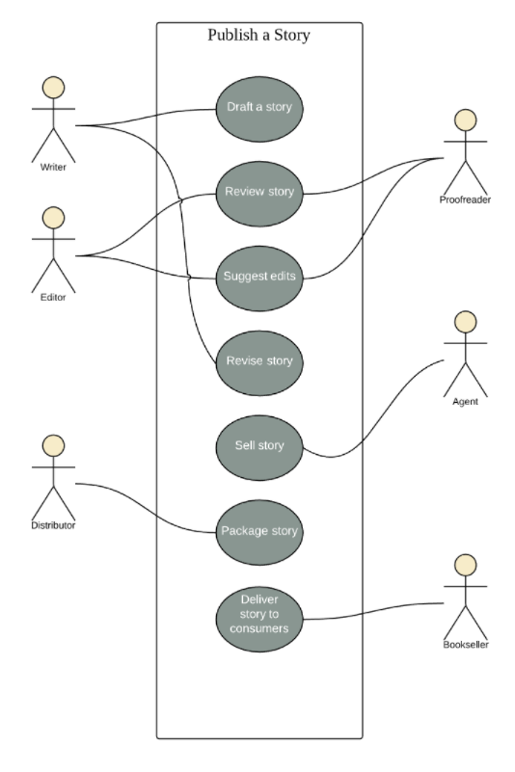
Diagram
The diagram of use case to write and publish a book.

Slide 12
use cases of a pager system
Use cases are often shown in a use case diagram.
A use case diagram shows several use cases from the same application.
The actors for the use cases are shown connected to the use cases in which they are involved.
The figure below shows four use cases of the pager system as well as two actors: the host and the dining party. The host is an actor for all four use cases, and the dining party is an actor for one, the Send Alert use case.

Slide 13
Cont.
In the Assign Pager use case the host records the name of the dining party and assigns a pager to them.
In the Send Alert use case the host signals to the dining party that a table is available, and the diner's pager buzzes.
This use case includes the dining party as an actor since they see and hear the alert.
In the Return Pager use case the diners return a pager to the host after it buzzes.
In the Cancel Pager use case the diners return a pager when they decide not to wait for a table.

Slide 14
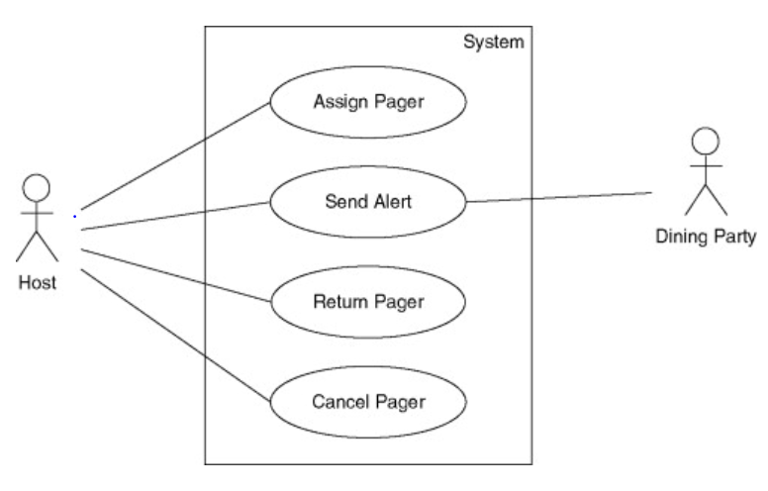
Diagram
The figure below shows four use cases of the pager system as well as two actors.

Slide 15
Use Case Description
A text-based use case description can be used to provide additional information to support the use case definition.
This description can contribute significantly to the use case’s value.
The description text can be captured in the model as a single or multiple comments.
It is also possible to treat each step in a use case description as a SysML requirement.

Slide 16
Cont.
A typical use case description may include the following:
  Main Success Scenario
  Alternate Paths
  Preconditions and Post-Conditions
  Exception Paths

Slide 17
Main success scenario
These writes the action steps of a typical scenario in which the goal is delivered. The first step is the trigger that initiates the use case. Each following step describes an action that the user or the system takes in reaction to the previous step to accomplish the use case goal. The scenarios includes all use case activities in which nothing goes wrong. It basically include all the steps of the use case that brought up the intended results

Slide 18
The steps should be labelled example:
The user connects to the system.
The user enters his/her username and password.
The system validates the username and password.
The system determines the user's role.
The system displays a list of actions the user can perform based on the user's role.

Slide 19
Preconditions
They specify what the system will ensure is true before letting the use case start. It simply indicates that some other use case has been run to set it up. The preconditions generally include what will happen before the use case runs. For example, when signing in in a system one has to present his/her details before the system runs.

Slide 20
Postcondition
It is a predicate that must always be true just after execution or running of the use case. It is the opposite of preconditions since it includes what will happen after the use case runs. An example is, when one logs in a system, the system takes him/her to another window.

Slide 21
Alternate paths
Alternate paths describe a scenario other than the basic flow that results in a user completing his or her goal. It is always considered as an optional path that still leads to the conclusion of the use case. An example is a person using a computer can enter as the user or administrator to use the computer but it also has an alternate path in which one can enter as a guest and still navigate the computer.

Slide 22
Exception paths.
These is unintended path through the system as a result of missing information or system availability issues. It also represents undesirable path to the user. This occurs when a user chooses a path other than expected or a use case loses the intended flow and end up using another unintended flow.

Slide 23
Use case Relationships
Describes the situation in which a use case contains behavior that is common to more than one use case that is common use cases is included in other use cases.
In UML, a relationship is a connection between model elements
A UML relationship is a type of model element that adds semantics to a model by defining the structure and behavior between the model elements.

Slide 24
There can be five relationship types
Association between an actor and use case
Generalization of an actor
Extend between two use cases
Include between two use cases
Generalization of a use case

Slide 25
Association between an actor and use case
This one is straightforward and present in every use case diagram. An actor must be associated with at least one use case. An actor can be associated with multiple use cases and multiple actors can be associated with a single use case

Slide 26
Generalization of an actor
This means that one actor can inherit the role of the other actor. The descendant inherits all the use cases of the ancestor. The descendant has one or more use cases that are specific to that role.

Slide 27
Extend Relationship Between Two Use Cases
As the name implies, it extends the base use case and adds more functionality to the system. Here are some things to consider when using extend Relationship.
The extending use case is dependent on the extended(base) use case
In the below diagram, the ‘calculate bonus’ use case doesn’t make sense without the ‘deposit funds’ use case

Slide 28
The extending use case is usually optional and can be triggered conditionally. In the diagram below, you can see that the extending use case is triggered only for deposits over 10,000 or when the age is over 55.
The extended(base) use case must be meaningful on its own. This means it should be independent and must not rely on the behavior of the extending use case
Although extending use case is optional, it can have a non-optional behavior. This mostly happens when you are modelling complex behaviors.

Slide 29
Include relationship between two use cases
Include relationship show that the behavior of the included use case is part of the including (base) use case. The main reason for this is to reuse common actions across multiple use cases. In some situations, this is done to simplify complex behaviors.
Things to consider when using <<include>> relationship
The base use case is incomplete without the included use case
The included use case is mandatory and not optional

Slide 30
Generalization of use case
This is similar to generalization of actor. The behavior of the ancestor is inherited by the descendant. This is used where there is common behavior between two use cases and also specialized behavior specific to each use case.

Slide 31
Benefits of use cases
Use cases are traceable
Use cases discourage premature design
Use cases can serve as the basis for the estimating, scheduling and validating effort
Use case modeling(include the use case specifications) is generally regarded as an excellent technique for capturing the functional requirements of a system

Slide 32
Use cases are useful for scoping. Use cases make it easy to take a staged delivery approach to projects; they can be relatively easily added and removed from a software project as priorities change
Use cases have proved to be easily understandable by business users and so have proven an excellent bridge between software developers and end users
Use case specifications don’t use a specific language. They can be written in a variety of styles to suit the particular needs of the project

Slide 33
Cont.
Use cases are reusable within a project. The use case can evolve at each iteration from a method of capturing requirements, to development guideline to programmers, to a test case and finally into user documentation
Use cases are concerned with the interactions between the user and the system. They make it possible for the user interface designers to become involved.
Use cases allow us to tell stories. It is very easy to describe a use case in a concrete way by turning it into a story or a scenario

Slide 34
REFERENCES
https://www.lucidchart.com/pages/uml-use-case-diagram
https://www.tutorialspoint.com/uml/uml_use_case_diagram.htm
David C. Hay (2011) UML and Data Modeling: A Reconciliation First Edition
Kurt Bittner (2002) use case modeling

