Slide 1
SYSTEMS DEVELOPMENT PROJECT
Chapter 6
The Analysis Phase
PART 1
Lecturer:
Dr. Joshua Okemwa. Ph.D.

Slide 2
THE SCOPE OF THE STUDY
ANALYSIS PHASE
Modeling Process
Activity diagrams

Slide 3
Process modeling
Process modeling is the graphical representation of business processes or workflows. Like a flow chat, individual steps of the process are drawn out so there is an end-to-end overview of the tasks in the process within the context of the business environment.
Modeling allows visualization of business processes so organizations can better understand their internal business procedures so that they can be managed and made more efficient. This is usually an agile exercise for continuous improvement.

Slide 4
Cont.
Process modeling is a vital component of process automation, as a process model needs to be created first to define tasks and optimize the workflow before it is automated.
The act of process modeling provides a visualization of business processes, which allows them to be inspected more easily, so users can understand how the processes work in their current state and how they can be improved.

Slide 5
Benefits of using process modeling
Improve efficiency – process modeling helps to improve the process, helping business workers to be more productive by saving time
Gain transparency – modeling provides a clear overview of the process, identifying the start and end point and all the steps in between
Ensure best practice – using process models ensures consistency and standardization across the organization
Create understanding – by using the common language of process, it makes it easier for users across the organization to communicate with each other

Slide 6
Modelling of system process
Modeling Systems is the process of developing abstract models of a system, with each model presenting a different view or perspective of that system.
It is about representing a system using some kind of graphical notation, which is now almost always based on notations in the Unified Modeling Language (UML).
Models help the analyst to understand the functionality of the system; they are used to communicate with customers.

Slide 7
Models define systems from different perspective
An external perspective, where you model the context or environment of the system.
An interaction perspective, where you model the interactions between a system and its environment, or between the components of a system.
A structural perspective, where you model the organization of a system or the structure of the data that is processed by the system.
A behavioral perspective, where you model the dynamic behavior of the system and how it responds to events.

Slide 8
There are four types of UML diagrams that are the most useful for system modeling.
The Diagrams are used in the analysis phase, they include.
Activity Diagrams
State machines
Sequence Diagrams
Collaboration Diagram

Slide 9
ACTIVITY DIAGRAMS
Activity Diagrams are used to illustrate the flow of control in a system and refer to the steps involved in the execution of a use case.
We model sequential and concurrent activities using activity diagrams.
The workflows are visually depicted using an activity diagram.
An activity diagram focuses on condition of flow and the sequence in which it happens.
We describe or depict what causes a particular event using an activity diagram.

Slide 10
Cont.
UML models basically three types of diagrams they include:
structure diagrams,
interaction diagrams
behavior diagrams.
An activity diagram is a behavioral diagram i.e. it depicts the behavior of a system.
An activity diagram portrays the control flow from a start point to a finish point showing the various decision paths that exist while the activity is being executed.
We can depict both sequential processing and concurrent processing of activities using an activity diagram.

Slide 11
Difference between an Activity diagram and a Flowchart
An activity diagram is very similar to a flowchart, though they still pose some differences.
Flowcharts were typically invented earlier than activity diagrams.
Non-programmers use Flow charts to model workflows.
Example:
A manufacturer uses a flow chart to explain and illustrate how a particular product is manufactured. We can call a flowchart a primitive version of an activity diagram. Business processes where decision making is involved is expressed using a flow chart.

Slide 12
Cont.
So, programmers use activity diagrams to depict workflows.
An activity diagram is used by developers to understand the flow of programs on a high level.
It also enables them to figure out constraints and conditions that cause particular events.
For instance Businessmen and Developers to interact and understand systems.

Slide 13
Example.
An activity diagram for an emotion-based music player
The figure below depicts an activity diagram for an emotion-based music player which can also be used to change the wallpaper.
Explanation for various components used in the diagram and the standard notations are also given.

Slide 14
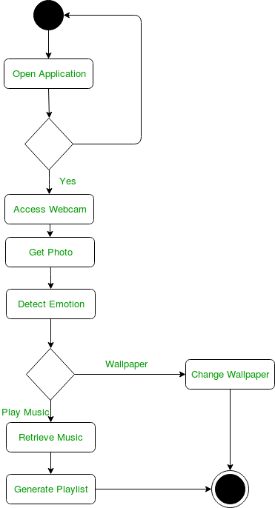
Diagram

Slide 15
Explanation
Initial State
The starting state before an activity takes place is depicted using the initial state.
Notation for initial state or start state
A process can have only one initial state unless we are depicting nested activities.
We use a black filled circle to depict the initial state of a system.
For objects, this is the state when they are instantiated.
The Initial State from the UML Activity Diagram marks the entry point and the initial Activity State.

Slide 16
Action or Activity State
An activity represents execution of an action on objects or by objects.
We represent an activity using a rectangle with rounded corners.
Basically any action or event that takes place is represented using an activity.
Below is a notation for an activity state
Action or Activity State

Slide 17
Action Flow or Control flows
Action flows or Control flows are also referred to as paths and edges.
They are used to show the transition from one activity state to another.
An activity state can have multiple incoming and outgoing action flows. We use a line with an arrow head to depict a Control Flow.
If there is a constraint to be adhered to while making the transition it is mentioned on the arrow

Slide 18
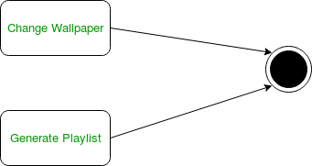
Here both the states transit into one final state using action flow symbols which are generally arrows.

Slide 19
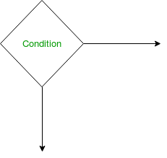
Decision node and Branching
When we need to make a decision before deciding the flow of control, we use the decision node.
The outgoing arrows from the decision node can be labelled with conditions or guard expressions.
It always includes two or more output arrows.
Below is a notation for decision node

Slide 20
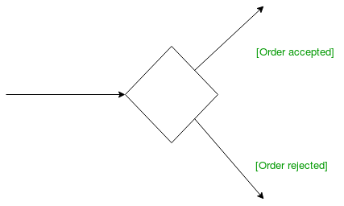
Guards
A Guard refers to a statement written next to a decision node on an arrow sometimes within square brackets.
Guards being used next to a decision node

Slide 21
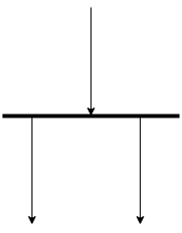
Fork Node
Fork nodes are used to support concurrent activities.
Splits a single activity flow into two concurrent activities. Symbolized with multiple arrowed lines from a join.
Combines two concurrent activities and re-introduces them to a flow where only one activity occurs at a time. Represented with a thick vertical or horizontal line.
Fork nodes
Fork notation

Slide 22
Cont.
When we use a fork node when both the activities get executed concurrently i.e. no decision is made before splitting the activity into two parts.
Both parts need to be executed in case of a fork statement.
We use a rounded solid rectangular bar to represent a Fork notation with incoming arrow from the parent activity state and outgoing arrows towards the newly created activities.

Slide 23
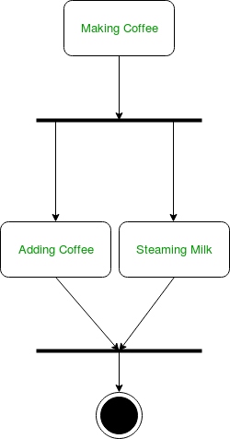
Example
The activity of making coffee can be split into two concurrent activities and hence we use the fork notation.

Slide 24
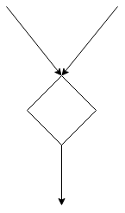
Merge or Merge Event
Scenarios arise when activities which are not being executed concurrently have to be merged.
We use the merge notation for such scenarios.
We can merge two or more activities into one if the control proceeds onto the next activity irrespective of the path chosen.

Slide 25
Cont.
Example
In the diagram below we can not have both sides being executed concurrently, but they finally merge into one.
For instance a number can not be both odd and even at the same time.

Slide 26
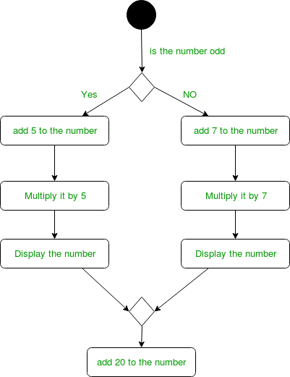
Diagram

Slide 27
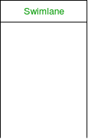
Swimlanes
We use swimlanes for grouping related activities in one column. Swimlanes group related activities into one column or one row. Swimlanes can be vertical and horizontal.
Swimlanes are used to add modularity to the activity diagram. It is not mandatory to use swimlanes. They usually give more clarity to the activity diagram. It’s similar to creating a function in a program. It’s not mandatory to do so, but, it is a recommended practice.

Slide 28
Cont.
Using the metaphor of lanes in a pool, a swimlane diagram provides clarity and accountability by placing process steps within the horizontal or vertical “swimlanes” of a particular employee, work group or department.
It shows connections, communication and handoffs between these lanes, and it can serve to highlight waste, redundancy and inefficiency in a process.

Slide 29
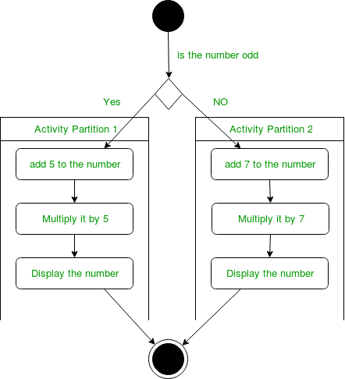
Diagram
Here different set of activities are executed based on if the number is odd or even. These activities are grouped into a swimlane.

Slide 30
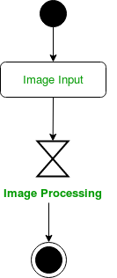
Time event.
We can have a scenario where an event takes some time to complete. We use an hourglass to represent a time event.
For example: Let us assume that the processing of an image takes takes a lot of time. Then it can be represented as shown below.

Slide 31

Final State or End State
The state which the system reaches when a particular process or activity ends is known as a Final State or End State.
We use a filled circle within a circle notation to represent the final state in a state machine diagram.
A system or a process can have multiple final states.
The notation of final state is show below.
notation for final state

Slide 32
Steps followed in drawing an activity diagram
Identify the initial state and the final states.
Identify the intermediate activities needed to reach the final state from he initial state.
Identify the conditions or constraints which cause the system to change control flow.
Draw the diagram with appropriate notations.

Slide 33
Uses of an Activity Diagram
Dynamic modelling of the system or a process.
Illustrate the various steps involved in a UML use case.
Model software elements like methods, operations and functions.
We can use Activity diagrams to depict concurrent activities easily.
Show the constraints, conditions and logic behind algorithms.

Slide 34
REFERENCES
Unified Modeling Language User Guide, The (Addison-Wesley Object Technology Series) Grady Booch , 2017
Object-Oriented Analysis and Design with Applications (3rd Edition) Grady Booch, 2012
https://cs.ccsu.edu/~stan/classes/CS410/Notes16/05-SystemModeling.html
https://www.lucidchart.com/pages/uml-activity-diagram

