Slide 1
SYSTEMS DEVELOPMENT PROJECT
Chapter 6
The Analysis Phase
PART 2
Lecturer:
Dr. Joshua Okemwa. Ph.D.

Slide 2
THE SCOPE OF THE STUDY
Analysis Phase
Sequence Diagram
State chart diagram

Slide 3
STATE CHART DIAGRAM
A State chart diagram describes a state machine.
A State machine can be defined as a machine which defines different states of an object and these states are controlled by external or internal events.
They define different states of an object during its lifetime and these states are changed by events. Statechart diagrams are useful to model the reactive systems.

Slide 4
Cont.
Reactive systems can be defined as a system that responds to external or internal events.
State chart diagram describes the flow of control from one state to another state.
States are defined as a condition in which an object exists and it changes when some event is triggered.
The most important purpose of State chart diagram is to model lifetime of an object from creation to termination.

Slide 5
Purposes of State chart diagrams
To model the dynamic aspect of a system.
To model the life time of a reactive system.
To describe different states of an object during its life time.
Define a state machine to model the states of an object.

Slide 6
Important points to consider
State chart diagram is used to describe the states of different objects in its life cycle.
Before drawing a State chart diagram we should clarify the following points.
Identify the important objects to be analyzed.
Identify the states.
Identify the events.

Slide 7
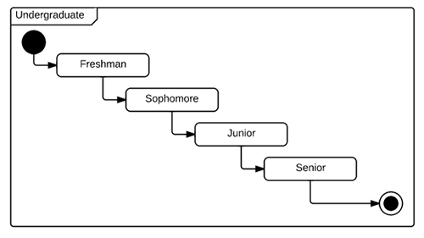
Diagram
The diagram below explains the simple classification of students transition while pursing undergraduate course in university.

Slide 8

STATE CHART DIAGRAM NOTATIONS
Choice pseudo state
A diamond symbol that indicates a dynamic condition with branched potential results.
Event
An instance that triggers a transition, labeled above the applicable transition arrow. In this case, “classes end” is the event that triggers the end of the “Being taught” state and the beginning of the “Final exams” state.

Slide 9
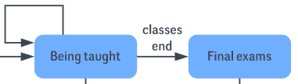
Exit point
The point at which an object escapes the composite state or state machine, denoted by a circle with an X through it. The exit point is typically used if the process is not completed but has to be escaped for some error or other issue.

Slide 10


First state
A marker for the first state in the process, shown by a dark circle with a transition arrow.
Guard
A Boolean condition that allows or stops a transition, written above the transition arrow.

Slide 11

State
A rectangle with rounded corners that indicates the current nature of an object.
Substate
A state contained within a composite state's region. For instance a university can Open for enrollment as a substate in the larger “Enrollment” composite state.

Slide 12


Transition
An arrow running from one state to another that indicates a changing state.
Terminator
A circle with a dot in it that indicates that a process is terminated.

Slide 13
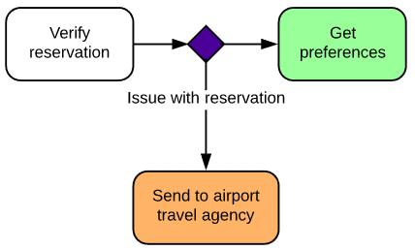
Trigger
A type of message that actively moves an object from one state to another state, written above the transition arrow.
In this example, “Issue with reservation” is the trigger that would send the person to the airport travel agency instead of the next step in the process.

Slide 14
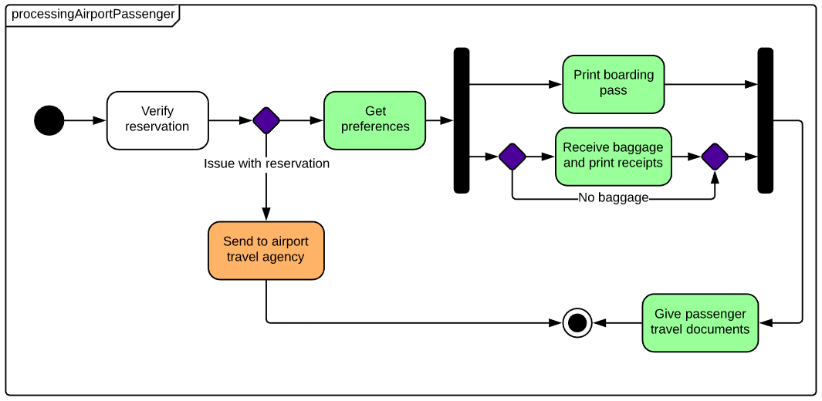
Diagram

Slide 15
Application of state chart diagrams
To model the object states of a system.
To model the reactive system. Reactive system consists of reactive objects.
To identify the events responsible for state changes.
Forward and reverse engineering.

Slide 16
SEQUENCE DIAGRAM
Sequence diagrams used in universal modeling, models the interactions between objects in a single use case.
They illustrate how the different parts of a system interact with each other to carry out a function and the order in which the interactions occur when a particular use case is executed.
In simpler words, a sequence diagram shows different parts of a system work in a ‘sequence’ to get something done.

Slide 17
Cont.
It helps in envisioning several dynamic scenarios.
Also portrays the communication between any two lifelines as a time-ordered sequence of events, such that these lifelines took part at the run time.
In UML, the lifeline is represented by a vertical bar, whereas the message flow is represented by a vertical dotted line that extends across the bottom of the page.
It incorporates the iterations as well as branching.

Slide 18
Purpose of a Sequence Diagram
To model high-level interaction among active objects within a system.
To model interaction among objects inside a collaboration realizing a use case.
It either models generic interactions or some certain instances of interaction.

Slide 19
Notations of a Sequence Diagram
Lifeline
An individual participant in the sequence diagram is represented by a lifeline. It is positioned at the top of the diagram.
Lifeline

Slide 20
Actor
A role played by an entity that interacts with the subject is called as an actor.
It is out of the scope of the system. It represents the role, which involves human users and external hardware or subjects.
An actor may or may not represent a physical entity, but it purely depicts the role of an entity. Several distinct roles can be played by an actor or vice versa.

Slide 21
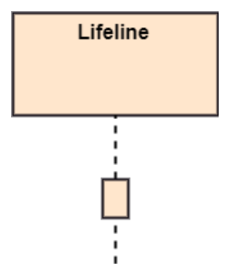
Activation
It is represented by a thin rectangle on the lifeline. It describes that time period in which an operation is performed by an element, such that the top and the bottom of the rectangle is associated with the initiation and the completion time, each respectively.

Slide 22
Messages
The messages depict the interaction between the objects and are represented by arrows.
They are in the sequential order on the lifeline. The core of the sequence diagram is formed by messages and lifelines.
A message can flow in any direction; from left to right, right to left or back to the Message Caller itself.
While you can describe the message being sent from one object to the other on the arrow, with different arrowheads you can indicate the type of message being sent or received.

Slide 23
Types of messages
Call Message: It defines a particular communication between the lifelines of an interaction, which represents that the target lifeline has invoked an operation.
Return Message: It defines a particular communication between the lifelines of interaction that represent the flow of information from the receiver of the corresponding caller message.
Self Message: It describes a communication, particularly between the lifelines of an interaction that represents a message of the same lifeline, has been invoked.

Slide 24
Cont.
Recursive Message: A self message sent for recursive purpose is called a recursive message. In other words, it can be said that the recursive message is a special case of the self message as it represents the recursive calls.
Create Message: It describes a communication, particularly between the lifelines of an interaction describing that the target (lifeline) has been instantiated.
Destroy Message: It describes a communication, particularly between the lifelines of an interaction that depicts a request to destroy the lifecycle of the target.

Slide 25
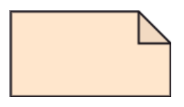
Cont.
Duration Message: It describes a communication particularly between the lifelines of an interaction, which portrays the time passage of the message while modeling a system.
Note: A note is the capability of attaching several remarks to the element. It basically carries useful information for the modelers.

Slide 26
Sequence Fragments
Sequence fragments were introduced in UML to makes it easy for creation and maintenance of an accurate sequence diagram.
A box called combined fragment is used to represent, enclosed part of interaction inside a sequence diagram.
Fragment type is shown by a fragment operator.

Slide 27
Operators and fragment types
Loop: Loop- Fragments are run multiple times, and the basis of interaction is shown by the guard.
Region: Critical region- Only one thread can execute a fragment at once.
Neg: Negative- A worthless communication is shown by the fragment.
Alt: Alternative multiple fragment- The only fragment for which the condition is true, will execute.
opt: Optional- If the supplied condition is true, only then the fragments will execute. It is similar to alt with only one trace.
Par: Parallel- Parallel executes fragments.

Slide 28
Cont.
Ref: Reference-An interaction portrayed in another diagram. In this, a frame is drawn so as to cover the lifelines involved in the communication. The parameter and return value can be explained.
Sd: Sequence Diagram- It is used to surround the whole sequence diagram.

Slide 29
Example
An of a high-level sequence diagram for online bookshop is given below.
Any online customer can search for a book catalog, view a description of a particular book, add a book to its shopping cart, and do checkout.

Slide 30
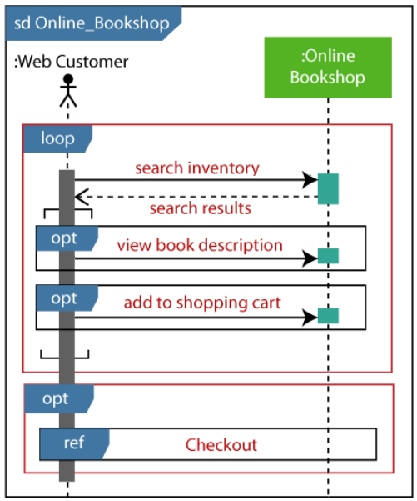
Diagram

Slide 31
Benefits of a Sequence Diagram
It explores the real-time application.
It depicts the message flow between the different objects.
It has easy maintenance.
It is easy to generate.
Implement both forward and reverse engineering.
It can easily update as per the new change in the system.

Slide 32
The drawback of a Sequence Diagram
In the case of too many lifelines, the sequence diagram can get more complex.
The incorrect result may be produced, if the order of the flow of messages changes.
Since each sequence needs distinct notations for its representation, it may make the diagram more complex.
The type of sequence is decided by the type of message.

Slide 33
REFERENCES
Unified Modeling Language User Guide, The (Addison-Wesley Object Technology Series) Grady Booch , 2017
Object-Oriented Analysis and Design with Applications (3rd Edition) Grady Booch, 2012
https://www.tutorialspoint.com/uml/uml_statechart_diagram.htm
https://www.javatpoint.com/uml-sequence-diagram

