Slide 1
SYSTEMS DEVELOPMENT PROJECT
Chapter 6
The Analysis Phase
PART 3
Lecturer:
Dr. Joshua Okemwa. Ph.D.

Slide 2
THE SCOPE OF THE STUDY
ANALYSIS PHASE
Collaboration Diagram

Slide 3
UML Collaboration Diagram
The collaboration diagram is used to show the relationship between the objects in a system.
Both the sequence and the collaboration diagrams represent the same information but differently.
Instead of showing the flow of messages, it depicts the architecture of the object residing in the system as it is based on object-oriented programming.
Multiple objects present in the system are connected to each other.

Slide 4
Notations of a Collaboration Diagram
The components of a component diagram include the following:
Objects: The representation of an object is done by an object symbol with its name and class underlined, separated by a colon.
In the collaboration diagram, objects are utilized in the following ways:
  The object is represented by specifying their name and class.
  It is not mandatory for every class to appear.

Slide 5
Cont.
  A class may constitute more than one object.
  In the collaboration diagram, firstly, the object is created, and then its class is specified.
  To differentiate one object from another object, it is necessary to name them.
2. Actors: In the collaboration diagram, the actor plays the main role as it invokes the interaction.
Each actor has its respective role and name. In this, one actor initiates the use case.

Slide 6
Cont.
3. Links: The link is an instance of association, which associates the objects and actors. It portrays a relationship between the objects through which the messages are sent. The link helps an object to connect with or navigate to another object,
4. Messages: It is a communication between objects which carries information and includes a sequence number, so that the activity may take place. It is represented by a labeled arrow, which is placed near a link. The receiver must understand the message.

Slide 7
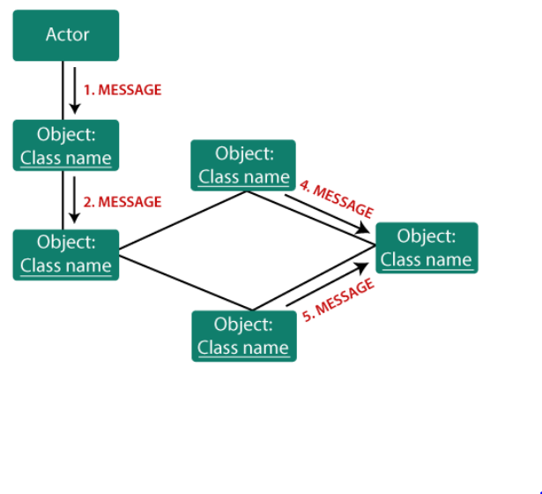
Components of a collaboration diagram
The diagram below shows the components contained in a collaboration diagram.

Slide 8
When to use a Collaboration Diagram?
The collaborations are used when it is essential to depict the relationship between the object. Both the sequence and collaboration diagrams represent the same information.
To model collaboration among the objects or roles that carry the functionalities of use cases and operations.
To model the mechanism inside the architectural design of the system.

Slide 9
Cont.
3.To capture the interactions that represent the flow of messages between the objects and the roles inside the collaboration.
4.To model different scenarios within the use case or operation, involving a collaboration of several objects and interactions.
5.To support the identification of objects participating in the use case.
6.In the collaboration diagram, each message constitutes a sequence number, such that the top-level message is marked as one and so on. The messages sent during the same call are denoted with the same decimal prefix, but with different suffixes of 1, 2, etc. as per their occurrence.

Slide 10
Steps for creating a Collaboration Diagram
1. Determine the behavior for which the realization and implementation are specified.
2. Discover the structural elements that are class roles, objects, and subsystems for performing the functionality of collaboration. Choose the context of an interaction: system, subsystem, use case, and operation.

Slide 11
Cont.
3. Think through alternative situations that may be involved.
  Implementation of a collaboration diagram at an instance level, if needed.
  A specification level diagram may be made in the instance level sequence diagram for summarizing alternative situations.

Slide 12
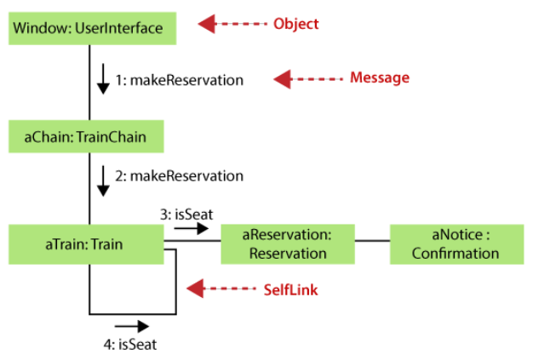
Example of a Collaboration Diagram
The figure below shows an example of a collaboration diagram

Slide 13
Benefits of a Collaboration Diagram
The collaboration diagram is also known as Communication Diagram.
It mainly puts emphasis on the structural aspect of an interaction diagram, i.e., how lifelines are connected.
The syntax of a collaboration diagram is similar to the sequence diagram; just the difference is that the lifeline does not consist of tails.
The messages transmitted over sequencing is represented by numbering each individual message.
The collaboration diagram is semantically weak in comparison to the sequence diagram.

Slide 14
Cont.
6. The special case of a collaboration diagram is the object diagram.
7. It focuses on the elements and not the message flow, like sequence diagrams.
8. Since the collaboration diagrams are not that expensive, the sequence diagram can be directly converted to the collaboration diagram.
9. There may be a chance of losing some amount of information while implementing a collaboration diagram with respect to the sequence diagram.

Slide 15
The drawback of a Collaboration Diagram
Multiple objects residing in the system can make a complex collaboration diagram, as it becomes quite hard to explore the objects.
It is a time-consuming diagram.
After the program terminates, the object is destroyed.
As the object state changes momentarily, it becomes difficult to keep an eye on every single that has occurred inside the object of a system.

Slide 16
Unit 7: Design Phase
The scope of the study.
Moving to Code
Design for Reuse
Design Class Diagrams
Designing Quality into Modules

Slide 17
Moving to the code
In Object Oriented Design the technology-independent concepts in the analysis model are mapped onto implementing classes.
Constraints are identified and interfaces are designed, resulting in a model for the solution domain.
In a nutshell, a detailed description is constructed specifying how the system is to be built on concrete technologies

Slide 18
The stages for object–oriented design
Definition of the context of the system (circumstances that form the setting for an event)
Designing system architecture.
Including the conceptual model that define the structure and more view of the a system.

Slide 19
Identification of the objects in the system
Construction of design models - means to describe a system's implementation and source code in a diagrammatic fashion.
Specification of object interfaces- An interface is a description of the actions that an object can do.

Slide 20
Software reuse
In most engineering disciplines, systems are designed by composing existing components that have been used in other systems.
Software engineering has focused on original development but it is now recognized that to achieve better software, more quickly and at lower cost,
we need to adopt a design process that is based on systematic reuse

Slide 21
Reuse based software development
• Application system reuse – The whole of an application system may be reused either by incorporating it without change into other systems. COTS (Commercial Off The Shelf)
• Component reuse – Components of an application from sub-systems to single objects may be reused
• Function reuse – Software components that implement a single well-defined function may be reused

Slide 22
Benefits of reuse
Increased reliability – Components exercised in working systems
Reduced process risk – Less uncertainty in development costs.
Effective use of specialists – Reuse components instead of people
Standards compliance – Embed standards in reusable components.
Accelerated development – Avoid original development and hence speed-up production

Slide 23
DESIGN CLASS DIAGRAMS
After the completion of interaction diagrams for use-case realizations, it is possible to identify the specification for the software classes (and interfaces) that participate in the software solution, and annotate them with design details, such as methods.

Slide 24
When to Create DCDs
DCDs are usually created in parallel with interaction diagrams. Many classes, method names and relationships may be sketched out very early in design by applying responsibility assignment patterns, prior to the drawing of interaction diagrams.
It is possible and desirable to do a little interaction diagramming, then update the DCDs, then extend the interaction diagrams some more, and so on

Slide 25
Example
Here is an example of DCD with Register and Sale. The diagram consists of the methods of each class, attribute type information, and attribute visibility and navigation between objects along with the basic associations and attributes, which are created during Domain Modeling.

Slide 26
Terminology related to DCD
classes, associations and attributes
interfaces, with their operations and constants
methods
attribute type information
navigability
dependencies

Slide 27
Steps in creating DCD
Identify software classes
Illustrate them by Class Diagrams
Add Method names
Add Type information
Add Association and Navigability
Add Dependency relationship

Slide 28
Designing Quality into Modules
  When designing quality in the modules can be achieved through the following approaches:
  Iterating the Design
  Refactoring
  Design Best Practices

Slide 29
  Iterating the Design
The iterative process is an approach that designers, developers, educators, and others use to continually improve a design or product.
People create a prototype and test it, then tweak and test the revised prototype, and repeat this cycle until they reach a solution.
The goal of iteration is to get closer to the answer, solution, or discovery with each repetition.

Slide 30
Refactoring
Programming team look for possible software improvements and make these improvements even where there is no immediate need for them.
This improves the understandability of the software and so reduces the need for documentation.
Changes are easier to make because the code is well-structured and clear.
However, some changes requires architecture refactoring and this is much more expensive.

Slide 31
Design Best Practices
Design of User-centered systems
Use well Established design patterns
Consistent of actions in the system
correctness of the content in the diagrams
Consistency in coordination among components

Slide 32
REFERENCES
Unified Modeling Language User Guide, The (Addison-Wesley Object Technology Series) Grady Booch , 2017
Object-Oriented Analysis and Design with Applications (3rd Edition) Grady Booch, 2012
https://www.javatpoint.com/uml-collaboration-diagram
https://www.infoworld.com/article/2949579/design-for-change-coupling-and-cohesion-in-object-oriented-systems.html

