Slide 1
SYSTEMS DEVELOPMENT PROJECT
Chapter 8
Physical Design
Lecturer:
Dr. Joshua Okemwa. Ph.D.

Slide 2
THE SCOPE OF THE STUDY
Physical Design (Implementation) Diagrams
•UML component diagrams
•UML deployment diagrams

Slide 3
Component diagrams
Component diagrams are different in terms of nature and behavior.
Component diagrams are used to model the physical aspects of a system.
Physical aspects are the elements such as executables, libraries, files, documents, etc.
which reside in a node.
Component diagrams are used to visualize the organization and relationships among components in a system.

Slide 4
purpose of the component diagram
Visualize the components of a system.
Construct executables by using forward and reverse engineering.
Describe the organization and relationships of the components.

Slide 5
How to draw component diagrams
Component diagrams are used to describe the physical artifacts of a system. This artifact includes files, executables, libraries, etc
The purpose of this diagram is different. Component diagrams are used during the implementation phase of an application.
The system is designed using different UML diagrams and then when the artifacts are ready, component diagrams are used to get an idea of the implementation.

Slide 6
Cont.
Before drawing a component diagram, the following artifacts are to be identified clearly:
Files used in the system.
Libraries and other artifacts relevant to the application.
Relationships among the artifacts.

Slide 7
Cont.
After identifying the artifacts, the following points need to be kept in mind.
Use a meaningful name to identify the component for which the diagram is to be drawn.
Prepare a mental layout before producing the using tools.
Use notes for clarifying important points.

Slide 8
Why model components?
Clients can see the structure of the finished system
Developers have a structure to work towards
Technical writers who have to provide documentation and help files can understand what they're writing about
The team is ready for reuse

Slide 9
Component diagrams can be used to:
Model the components of a system.
Model the database schema.
Model the executables of an application.
Model the system's source code.

Slide 10
Cont.
A component diagram contains components, interfaces and relationships.
Also other types of UML symbols can also appear in a component diagram.
The component diagram's main icon is a rectangle that has two rectangles overlaid on its left side.
You put the name of the component inside the icon.

Slide 11

Cont.
The name is string. If the component is a member of a package, you can prefix the component's name with the name of the package.

Slide 12
Example
Suppose that we need to build up a software for playing a music from a CD-ROM Drive.
A visual programming language might be used (Visual Basic or Delphi for example).
If language supports multimedia controls, than we can use its components and reprogram them if necessary, or we can program new components. One possible graphical design for our player might be:

Slide 13
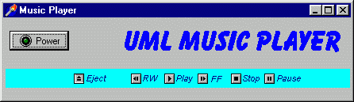
Cont.
The diagram below shows an example of a music player.

Slide 14
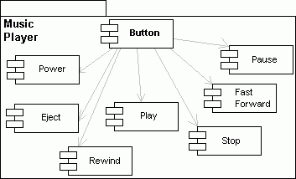
Component diagram of a music player

Slide 15
Explanation
These controls will be realized by buttons, thus we'll have a button performing these controls.
If we look at buttons as separate components, we can draw out a component UML diagram.
All the components shown on the previous diagram belongs to one global component – Button, but actions they perform are different. We must obtain these actions by programming them.

Slide 16
Deployment diagrams
Deployment diagrams are used to visualize the topology of the physical components of a system, where the software components are deployed.
Deployment diagrams are typically used to visualize the physical hardware and software of a system
Deployment diagrams are used to describe the static deployment view of a system.
Deployment diagrams consist of nodes and their relationships.

Slide 17
Purpose of Deployment Diagrams
The term Deployment itself describes the purpose of the diagram. Deployment diagrams are used for describing the hardware components, where software components are deployed.
Component diagrams and deployment diagrams are closely related.
Component diagrams are used to describe the components and deployment diagrams shows how they are deployed in hardware.

Slide 18
Cont.
The core purpose of deployment diagrams is to:
Visualize the hardware topology of a system.
Describe the hardware components used to deploy software components.
Describe the runtime processing nodes.

Slide 19
How to Draw a Deployment Diagram
Deployment diagram represents the deployment view of a system.
It is related to the component diagram because the components are deployed using the deployment diagrams.
A deployment diagram consists of nodes.
Nodes are nothing but physical hardware used to deploy the application.

Slide 20
Cont.
Deployment diagrams are useful for system engineers.
An efficient deployment diagram controls the following parameters:
      Performance
      Scalability
      Maintainability
      Portability

Slide 21

Cont.
When drawing a deployment diagram, the following artifacts should be first identified:
      Nodes
      Relationships among nodes

Slide 22
Example 1
Following is a sample deployment diagram to provide an idea of the deployment view of order management system.
Here nodes are shown as:
    Monitor
    Modem
    Caching server
    Server

Slide 23
Cont.
The application is assumed to be a web-based application, which is deployed in a clustered environment using server 1, server 2, and server 3.
The user connects to the application using the Internet.
The control flows from the caching server to the clustered environment.

Slide 24
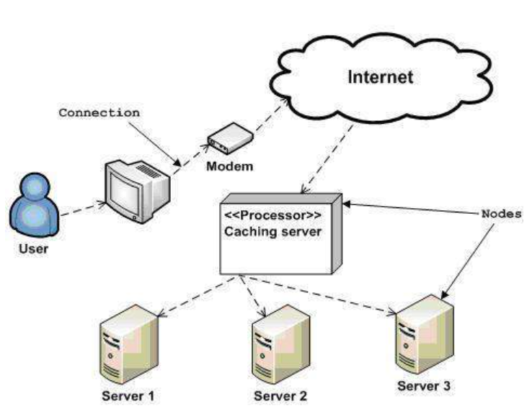
Diagram

Slide 25
Example 2
A Computer consists of these hardware elements: CPU, monitor, printer, mouse, keyboard.
And installed software components: Windows98, Office98, InternetExplorer4, FrontPage, DOS, NortonCommander, TurboPascal.

Slide 26
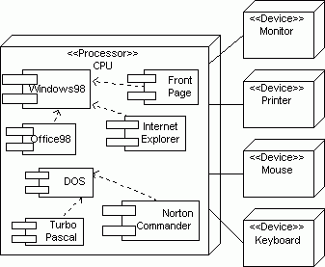
Diagram

Slide 27
Cont.
The main node is CPU which consists of all the software components with their relationships.
Other hardware elements are devices connected to the main processor unit.
The UML deployment diagram provides a picture of how the physical system will look when it's all put together.

Slide 28
Cont.
A system consists of nodes (represented by a cube) with line connecting them, called connections.
There are two types of nodes: a processor (can execute a component) and a device (interface with the real world).
Deployment diagrams are useful for modeling networks.

Slide 29
Use of Deployment Diagrams?
Deployment diagrams are mainly used by system engineers.
These diagrams are used to describe the physical components (hardware), their distribution, and association.
Deployment diagrams can be visualized as the hardware components/nodes on which the software components reside.
Software applications are developed to model complex business processes. Efficient software applications are not sufficient to meet the business requirements.

Slide 30
Where deployment diagrams can be used.
To model the hardware topology of a system.
To model the embedded system.
To model the hardware details for a client/server system.
To model the hardware details of a distributed application.
For Forward and Reverse engineering.

Slide 31
REFERENCES
Unified Modeling Language User Guide, The (Addison-Wesley Object Technology Series) Grady Booch , 2017
Janis Osis et al. Components and Deployment Design. 2017
https://www.tutorialspoint.com/uml/uml_component_diagram.htm
http://agilemodeling.com/style/componentDiagram.htm

