Slide 1
Evaluation of start-up projects
Chapter 2
Start-up ecosystem. Its key aspects
Lecturer: doc. Polishchuk Volodymyr, PhD.

Slide 2
Subjects of the IT start-up ecosystem
Lecture content
Phases of start-up development
Phases of development of a start-up in the IT industry

Slide 3

Subjects of the IT start-up ecosystem
01

Slide 4
The main subjects of the IT start-up ecosystem in addition to the start-up itself are business incubators, business accelerators, technology parks, venture funds, business angels, development institutes, research institutions, idea banks, consultants, “project packers”, technology blogs, users, business partners fig. 1.
4

Slide 5
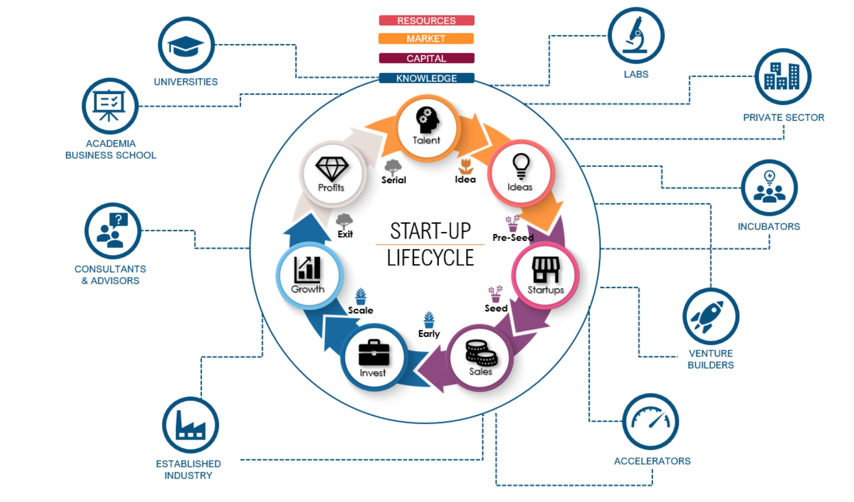
Fig. 1. Subjects of the IT start-up ecosystem.
5

Slide 6
Venture fund — an investment fund focused on working with innovative enterprises and projects (start-ups). Venture funds invest in securities or shares of companies with a high or relatively high degree of risk in anticipation of extremely high returns.
6

Slide 7
A business angel (also known as an informal investor) is a private investor who invests in innovative projects (start-ups), usually in exchange for a return on investment and a stake in the company. There is a tendency to organize such business angels into angel groups or angel networks in order to exchange research and form investment capital pools to share risks, as well as to provide advice to companies from their portfolios.
.
7

Slide 8
Given that they invest at the earliest stage project (after the founders), business angels invest resources in projects that have the opportunity to make a higher profit than that which can be obtained from traditional investments. They are usually the link between the stage of business self-financing and the stage when the company needs the amount of financing that a venture investor can offer.
.
8

Slide 9
A business incubator is an organization that provides, under certain conditions and for a certain period of time, specially equipped premises and other property to small and medium-sized enterprises that are starting their activities in order to assist them in acquiring financial independence. A separate type of business incubator is innovative business incubators.
9

Slide 10
Functions of business incubators:
1. providing premises for offices/workshops on lease terms, often (in some cities/centers) at below-market prices and with flexible conditions for obtaining additional space on demand;
2. administrative and technical services (telephone, copying, conference/meeting facilities, secretariat, etc.);
3. consulting / business planning for start-ups and potential entrepreneurs. It is also possible a wide range of other (consulting) services, technology transfer, proposals for seminars and training, etc.
10

Slide 11
Business accelerator — an organization engaged in an intensive program for the development of start-ups and rapid training of its authors. Provides start-ups with expert support, media coverage provides pre-sowing investments in exchange for a share in the project for the investor, as well as brings them to the stage of presentation to investors.
11

Slide 12
Techno park is a research and innovation center, a territorially allocated complex that unites organizations, firms, associations that cover the entire cycle of innovation from the generation of new ideas to the production and sale of knowledge-intensive products.
The technology park is usually based on leading universities and other scientific organizations, including service and exhibition complexes, firms.
12

Slide 13
Techno parks are large-scale innovation and technology centers in which they are provided conditions most favorable for scientific and technical innovation projects carried out by the joint efforts of research centers and industry. Techno parks are created by large research centers in specially designated areas, saturated with first-class engineering, research and production, information, and social infrastructure.
13

Slide 14
Development institutions are usually non-profit organizations, the main purpose of which is to promote the development of a particular area. The main activities are the implementation and support of training programs, support for the effective exchange of information, cooperation with public authorities, development of proposals for regulatory policy in this area, legal support, etc.
14

Slide 15
“Project packers” — organizations or individuals who provide services for the examination and design of an innovative project package, development, and support of presentations of business ideas to potential investors. They act as intermediaries between the start-up team and the potential investor.
15

Slide 16

Phases of start-up development
02

Slide 17
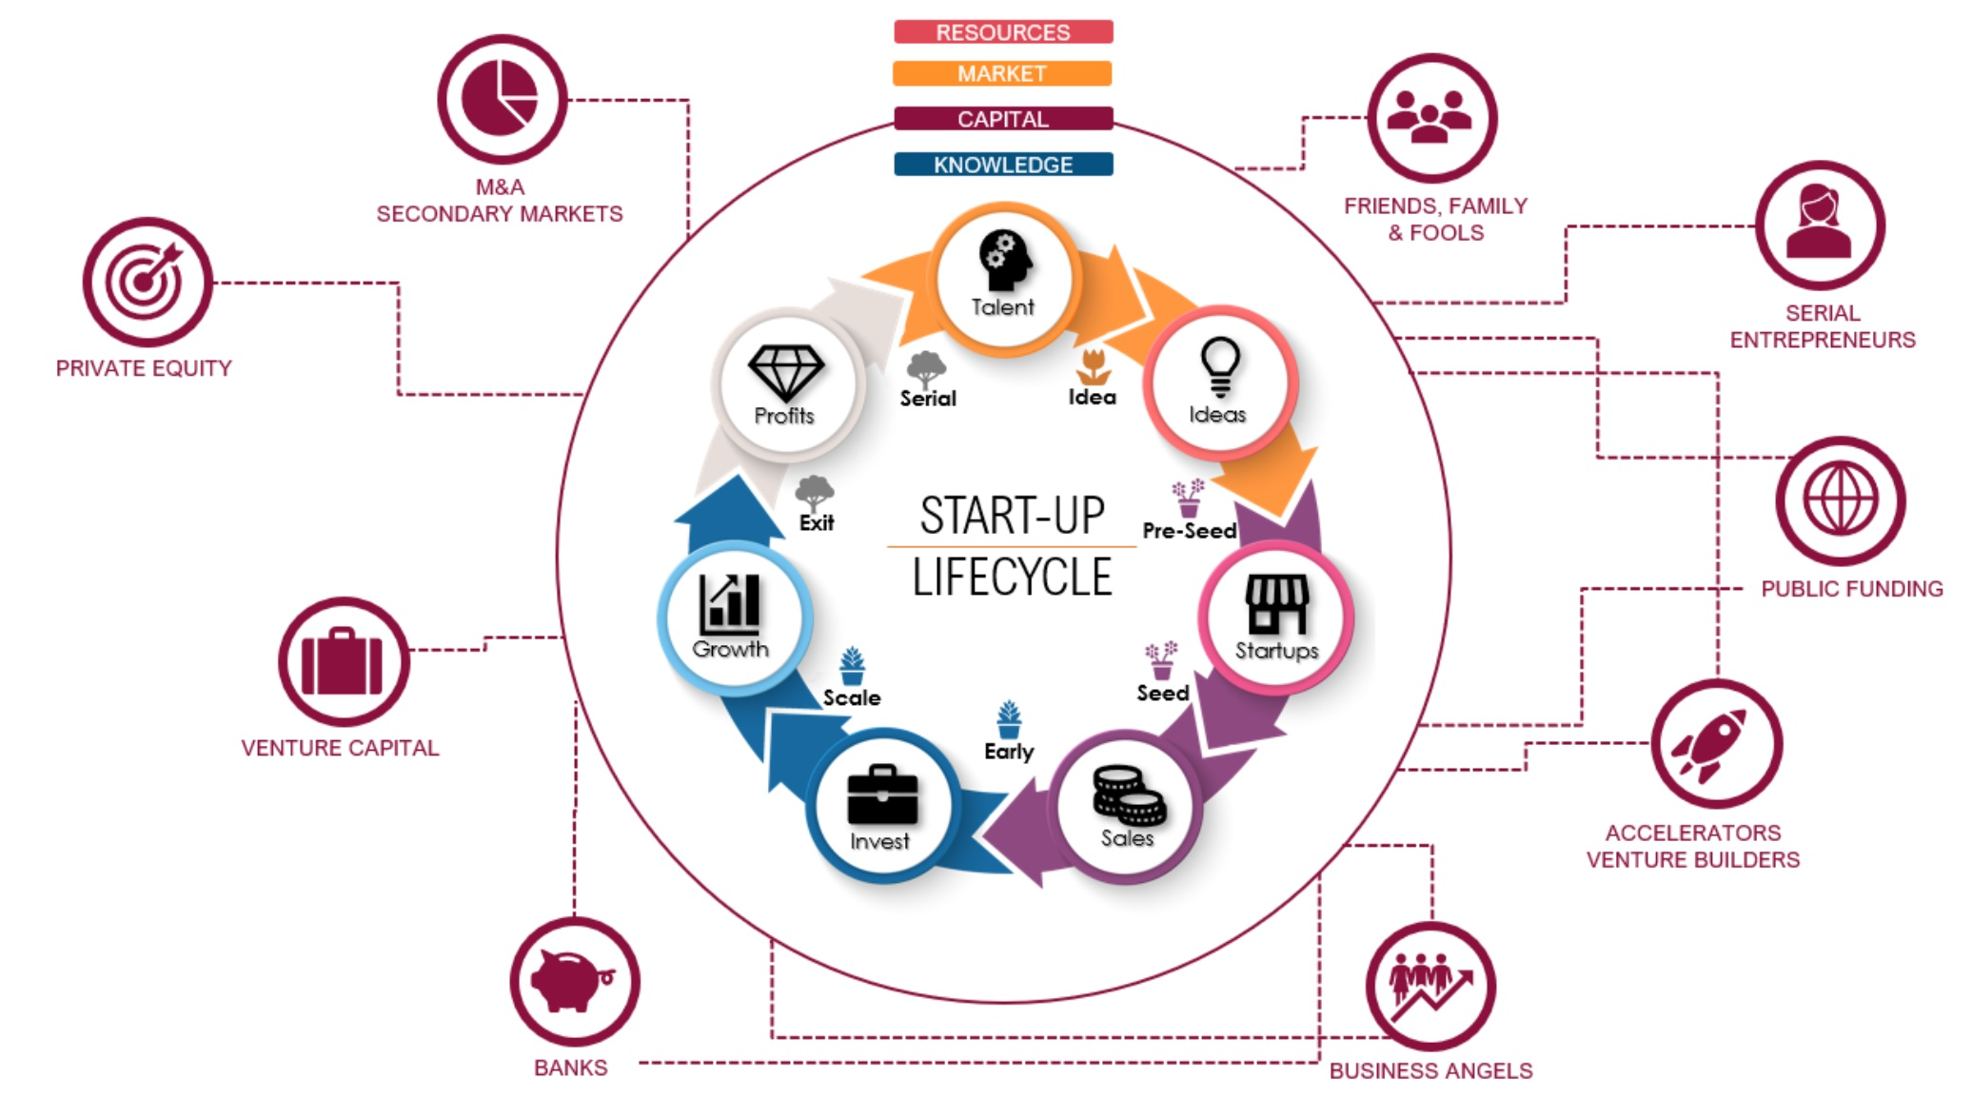
17

Slide 18
The most frequently mentioned abbreviated classification of stages of development of a start-up, according to which it undergoes 5 stages in its development:
a) passive stage (seed stage),
b) start-up stage,
c) growth stage,
d) expansion stage (expansion stage),
e) the stage of "exit" (exit stage).
18

Slide 19
Passive stage
The passive stage is dedicated to finding and defining the idea of a start-up and the forms of its implementation. It is here that the search for an entrepreneurial idea is carried out, initial information about the product, market, industry, consumers is collected; there is an informal discussion of the possibility of implementing the idea with friends and acquaintances. By the way, at this stage, the volumes and possible sources of financing are approximately determined. Most of the work here is informal.
19

Slide 20
The passive stage is a complete analog of the pre-project phase in project management, despite the fact that the start-up itself is one of the varieties of the project.
In order to consider this stage completed, it is necessary to meet the criteria for completion of the pre-project phase in project management, namely:
a) Have a clear business idea, which provides for one or another type of value innovation, the use of innovative technologies, which in turn promises rapid business growth.
20

Slide 21
b) Have a start-up implementation plan (business plan), which in turn requires a clear goal that meets the conditions of SMART (specific, specific, measurable, achievable, defined over time).
c) Formalized and registered business organization.
21

Slide 22
Key management decisions of this stage: forming a management team, finding employees, and drawing up a business plan, including the project implementation schedule. It is at this stage that it is necessary to make forecasts of financial indicators, make a plan of operational activities (production organization), find and provide the necessary production capacity (as in the case of a service company), premises, and infrastructure - in short, prepare everything for the main production activity. Sometimes at this stage, a prototype or a detailed technical task for its creation and specification is created.
22

Slide 23
Start-up stage
At the start-up stage, the business idea materializes. Until now, there could be employees, premises, machinery, and equipment, but right now all this is starting to work together to create the product for which the start-up was started. At the launch stage, the main challenge is the need to closely monitor the production and sales processes of the product and quickly correct the identified problems. At the start-up stage, there are gaps in planning and various unforeseen circumstances. The management team is required in the first place to quickly and effectively correct these problems without creating new ones and acting within the company's resources.
23

Slide 24
Growth stage
The growth stage is key: no growth - no start-up. At this stage, there should be an avalanche increase in sales and the resulting increase in cash flow. It is difficult to determine the exact quantitative criteria that separate slow growth from fast growth, but some benchmarks do exist. First, the growth rate must clearly be higher than the average economic growth rate. Second, a start-up company must be able to switch to internal financing no later than five years after launch - that is, to feed its development at its own expense. The amount of net profit at this stage is a secondary indicator.
24

Slide 25
As will be shown later, the investor, especially the venture, expects primarily to increase capital (growth of positive cash flow), rather than profit. The main management decisions at the start-up stage are to ensure uninterrupted and high-quality production, delivery to distribution channels, and sales of products. Sales and rapid growth of turnover and money turnover are the subject of priority interest for the management team of the start-up.
25

Slide 26
Stage of expansion
At the stage of expansion, a start-up actually ceases to be a start-up and becomes a regular company that solves the natural problem of any business - expansion. A company that has demonstrated viability in previous stages of development already has some achievements, a successful history (otherwise it simply would not exist), and has access to various sources of funding.
.
26

Slide 27
Exit stage
The exit stage means that investors have the opportunity to recover once invested investments by increasing the value of the company, which is a consequence of increased cash flow.
27

Slide 28
Phases of development of a start-up in the IT industry
03

Slide 29
For start-ups that are involved in the use or creation of information technology, which is common, a more broad classification of developmental stages can be used, covering the various stages combined into phases, namely:
Pre-design phase
1. Generation of the idea (pre-seed stage);
2. Definition of the idea and possibilities of its realization (seed stage);
3. Layout (design) (prototyping);
29

Slide 30
4. Creating a working prototype (working prototype) - a working sample that embodies the basic properties and generally meets the product specification defined in the first two stages;
5. Alpha version of the project or product (alpha) - "raw" product, which is intended for testing in the laboratory;
6. Closed beta version of a project or product (private beta) - a product that is intended for testing in real conditions of its use or in conditions close to real ones;
30

Slide 31
7. A public beta of a project or product (public beta) is a product that is distributed to certain categories of users, who are usually sufficiently qualified to use and evaluate strengths and weaknesses. Feedback from these users serves as the ultimate proof of a product suitable for successful mass use.
8. Launch of the project into operation or product into production.
31

Slide 32
Start-up stage
1. Start of production or customer service, (early start-up stage, launch, or early start-up stage).
2. Work with first clients or late start-up stage.
The final phase
1. Growth stage (growth stage).
2. Expansion stage.
3. Exit stage.
32

Slide 33
There are many approaches to determining the stages of development of companies. From an investment point of view, there are five stages:
1) Creation;
2) Expansion;
3) The moment of liquidity, in Western companies often - IPO;
4) Maturity;
5) Decline.
33

Slide 34
The first stage is critical for a start-up: creation. Of course, this stage does not exceed five years.
Funding at the initial stage.
At the initial stage, the company does not receive any income. In fact, the founder has only the concept of a potentially profitable business, which still needs to be developed and tested in practice.
34

Slide 35
Then the company begins to hire employees, buy the equipment and premises needed to produce the product and start selling. As a rule, such companies are private and financed by the entrepreneur or his relatives and friends. Sometimes you can count on borrowing resources, although banks clearly prefer to lend to liquid assets that can be pledged.
35

Slide 36
Financing at the expansion stage
Being a start-up in the expansion phase means that it has successfully overcome many growth challenges and proved viability. Typically, the expansion phase begins when a start-up company manages to gain a foothold in the market, although it is possible that it is not yet making a net profit.
36

Slide 37
That is, the company sells its products and covers daily operating expenses, but still often cannot recoup the costs associated with creating a product or starting a business. The short history and, of course, the small size of the company close to it the possibility of obtaining financing in the stock markets, and the only way out is to obtain direct investment. The lion's share of start-up financing at this stage falls on venture capitalists.
37

Slide 38
References
Polishchuk V. Evaluation of start-up projects in conditions of risk and uncertainty. – Uzhhorod: Publishing house "FOP Sabov AM", 2021. – 120 p. ISBN 978-617-7798-49-0.
Polishchuk, V.; Kelemen, M.; Gavurová, B.; Varotsos, C.; Andoga, R.; Gera, M.; Christodoulakis, J.; Soušek, R.; Kozuba, J.; Blišťan, P.; Szabo Jr., S. A Fuzzy Model of Risk Assessment for Environmental Start-up Projects in the Air Transport Sector. Int. J. Environ. Res. Public Health 2019, 16, 3573. https://doi.org/10.3390/ijerph16193573
Kelemen, M.; Polishchuk, V.; Gavurová, B.; Szabo, S.; Rozenberg, R.; Gera, M.; Kozuba, J.; Andoga, R.; Divoková, A.; Bliš’an, P. Fuzzy Model for Quantitative Assessment of Environmental Start-up Projects in Air Transport. Int. J. Environ. Res. Public Health 2019, 16, 3585. https://doi.org/10.3390/ijerph16193585
38

Slide 39
Thank you!
WWW.SITE2MAX.PRO

