Slide 1
Evaluation of start-up projects
Chapter 3
Tools for financing start-up projects
Lecturer: doc. Polishchuk Volodymyr, PhD.

Slide 2
Financial instruments
Lecture content
Crowdfunding
Models of crowdfunding platforms
Crowd investing

Slide 3

Financial instruments
01

Slide 4
The main method of financing at the initial stage is bootstrapping. This term refers to creative and non-standard methods of finding money in combination with minimizing funding needs. This can be the use of personal credit cards or mortgage lending to finance the development of their own business, the use of their own housing, country house, or garage, obtaining a loan secured by personal movable and immovable property or savings.
4

Slide 5
In order to minimize the need for assets, leasing of assets can be used instead of their purchase, purchase of used equipment instead of new ones, deferral of remuneration, renting premises together with other companies or individuals, as well as involving acquaintances or relatives with their work significantly lower than the market average.
5

Slide 6
Bootstrapping is popular among start-up entrepreneurs in all countries and in all industries, however, over time, its opportunities quickly run out. The intense growth that is so characteristic of a start-up business almost always requires additional funding, and with the few exceptions when the business becomes profitable so quickly that it can finance further development at its own expense.
6

Slide 7
In most cases, too long a bootstrapping phase puts a start-up company at a disadvantage compared to competitors, depriving it of the opportunity to increase sales, increase market share and form a strong competitive position in the target market. The transition to the next level requires the attraction of external capital, usually in the form of direct investment.
7

Slide 8
The most common source of direct investment at this stage are venture capitalists and so-called business angels.
Although it is difficult to draw a clear line between them, there are some important differences.
Business angels are individuals, or associations of individuals, while venture capitalists operate through specialized venture firms that raise funds from third parties.
.
8

Slide 9
In other words, if the angels of business invest their own money, the venture capitalists are strangers.
The third important difference is the amount of investment - business angels invest less than venture capitalists.
Typical investments from individuals range from $ 25 to $ 250,000, while venture funds often invest several million dollars.
9

Slide 10
Restrictions on funding by business angels combined with the criteria for selecting venture capitalists often lead to delays in funding.
This term refers to the amount of investment that is unaffordable for private investors and too small for venture funds.
The fact is that venture funds incur high costs associated with assessing the risk of investments and monitoring their use.
.
10

Slide 11
Therefore, investing less than a certain threshold is not of practical interest to them.
In the case of successful business development, when there is an objective need for additional financing, and the start-up begins to increase sales and enters a stage of rapid growth, it is time to turn to venture capitalists.
Because much larger amounts are required, the due diligence procedure is usually more thorough, more formalized, and more time-consuming than working with business angels.
.
11

Slide 12
Financing contracts are usually more detailed - venture capitalists pay much more attention to determining the mechanisms of return on investment (exit from the investment project).
Although venture capitalists receive a lot of media attention, every year the angels of business in the world as a whole finance 30 to 40 times more projects than venture funds.
12

Slide 13
We should not forget that many of the angels of business have achieved commercial success in their time and have a wealth of experience that they are ready to put at the service of new start-ups in which they participate. In this context, it is necessary to mention the inherent specialization of angels by industry: their investments are usually focused on projects arising in certain sectors or sectors of the economy and therefore, angels can also be seen as business development experts in these industries or sectors.
13

Slide 14

02
Crowdfunding

Slide 15
The potential of crowdfunding is huge. In every country and in the world in general lies a huge amount of dead luggage. The average person usually has little free money to think about traditional investing. People do not invest small free funds but spend them. But the world economy can gain much more if, through crowdfunding platforms, small free funds of ordinary people begin to flow into the development of the entire economy. The more start-up projects funded, the more jobs, products, and services they create.
15

Slide 16

Crowdfunding - is public funding, the other - the collective cooperation of people who voluntarily combine their money or other resources together, usually through the Internet to support efforts of other people or organizations.
16

Slide 17
First, the goal must be stated, the required amount of money must be determined, a calculation of all costs must be made, and information on the course of fundraising must be open to all.
17

Slide 18
Reasons to use crowdfunding to raise funds for your project:
- the opportunity to raise funds for your project without loans for business development and copyright transfer;
- the opportunity to tell about the project without additional costs;
- the ability to collect pre-orders and test ideas before their implementation;
- informing the audience about new products.
.
18

Slide 19
The crowdfunding model is based on three components:
1) The initiator of the project - the one who offers his idea for funding - a crowdfunding.
2) Officials or a group of people who financially support the idea - a shareholder.
3) The administration of the platform that connects the two parties to run the project/idea - the administrator.
19

Slide 20
Motives of the participant of financing in crowdfunding:
- is interested in innovations;
- looking for new ways to interact with growing firms;
- wants to be part of something bigger;
expectation of winning.
Thus, it is generally clear the purpose of crowds for projects and the audience of crowdfunding platforms.
20

Slide 21

Models of crowdfunding platforms
03

Slide 22

1. Lack of reward (donation)
Donations are usually voluntary acts made on the basis of altruism and without any obligation to the recipient.
.
22

Slide 23

2. Crowdfunding (non-financial reward)
Currently, it is the most common crowdfunding model in terms of the number of platforms. It has proven itself as an effective tool for raising funds for any project, from creative to complex technological products. The main feature of this model is to receive sponsors in return for their support of non-financial rewards.
23

Slide 24

3. Model of pre-orders.
In this concept, the reward can be the funded product itself. For example, a book, a movie, a music album, software, a new gadget.
4. Financial reward (Crowd investing).
24

Slide 25

Crowd investing
04

Slide 26
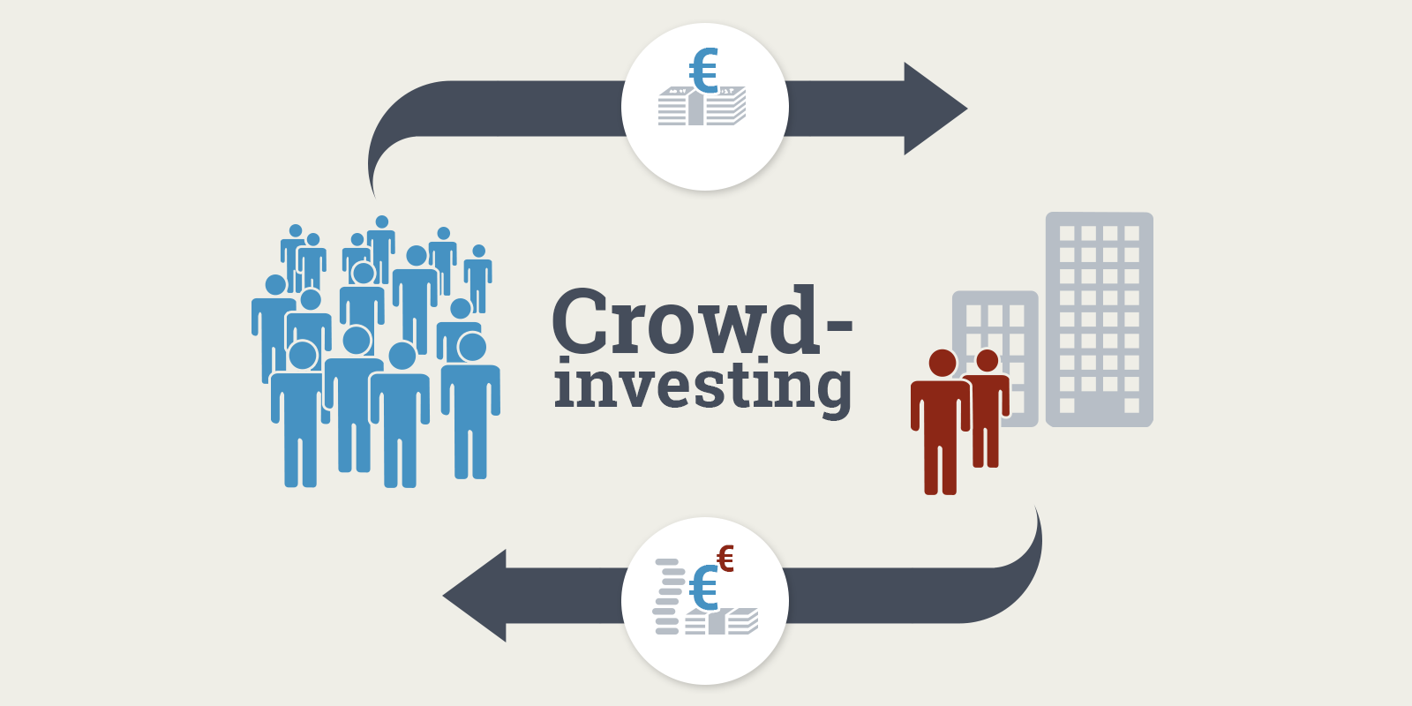
Crowd investing is an integral part of crowdfunding. Its main characteristic and distinctive feature from other forms is the presence of a financial reward that the sponsor (in this case, the investor) receives in exchange for his support. After all, what is an investment that is not an investment with the expectation of financial gain?
26

Slide 27
The disadvantages of crowdfunding include:
1. Risks of fraud: perhaps under the guise of a start-up, capital is raised by a financial pyramid, or the platform itself is created by fraudsters to extort money.
2. Risks that the required amount of investment will not be collected, and the project will not be implemented.
3. The risk that the project will be unprofitable and close, the investment will disappear.
27

Slide 28
4. In many cases, crowdfunding schemes do not comply with national law, which does not make it possible to prove disputes in court.
5. Unprofitability - many platforms close sometime after opening.
Both the platform that attracts investments for non-existent projects and the start-up projects themselves, presented in the form of financial pyramids, can be fraudulent. Therefore, it is necessary to systematically reduce the risks of fraud.
28

Slide 29
For the platform, the main security means we see:
1. Accreditation - the platform must meet legal requirements, be registered, and obtain a state license.
2. Rating system - a unified assessment obtained on the basis of a system of indicators. Such indicators include the following: assessment of platform owners; rating of start-up projects on the platform; investor valuation; indicators of successfully implemented projects.
29

Slide 30
The rating of the platform should be assigned automatically during its operation and updated in real-time, and the system of indicators for determining the rating should be dynamic. To do this, it is necessary to develop a mathematical model for calculating the rating and information technology.
30

Slide 31
For start-up projects, the main means of increasing security and reducing the risk of fraud are the following:
1. Evaluate start-up projects to select them for the platform to prevent admission to the platform of fraudulent financial pyramids.
2. Risk assessment of start-up projects in relation to the level of security of their financing, using fuzzy mathematics.
31

Slide 32
The development of technologies of this type will provide an opportunity to adequately approach the consideration of projects, increase the degree of validity of investment decisions and, most importantly, increase economic and managerial security. This will make it possible to evaluate projects registered on the platform. Investors will be able to make informed investment decisions.
32

Slide 33
The disadvantages of items 2-3 can be solved as follows. The platform should be able for the investor to resell his investment in a secondary auction. If for some reason there is a desire to return their investment before the launch of the project, or vice versa to get the maximum return at the peak of the popularity of the project, it should be possible to sell investment shares at a secondary auction.
33

Slide 34
Thus successful trade in investment shares will allow receiving additional profit. The platform must be able to refund. In case the investment project has not collected the amount of money declared for launch, the investment must be returned to the accounts of investors minus the commission of the platform.
34

Slide 35
Item 4 needs to be addressed systematically, developing legislation for a new type of IT business that has great prospects. Laws should be simple, clear, and aimed at supporting start-ups and investors. Investors should not be afraid that they will not be able to prove their investment in projects at the stage of the successful launch.
35

Slide 36
And start-ups must be sure that if the project is successfully launched, their business will not pass into the hands of investors. There must be a clear law that regulates the latest business and prevents fraud.
If you systematically address the existing shortcomings 1-4, the unprofitability of platforms will automatically decrease.
36

Slide 37
References
Polishchuk V. Evaluation of start-up projects in conditions of risk and uncertainty. – Uzhhorod: Publishing house "FOP Sabov AM", 2021. – 120 p. ISBN 978-617-7798-49-0.
Polishchuk, V.; Kelemen, M.; Gavurová, B.; Varotsos, C.; Andoga, R.; Gera, M.; Christodoulakis, J.; Soušek, R.; Kozuba, J.; Blišťan, P.; Szabo Jr., S. A Fuzzy Model of Risk Assessment for Environmental Start-up Projects in the Air Transport Sector. Int. J. Environ. Res. Public Health 2019, 16, 3573. https://doi.org/10.3390/ijerph16193573
Kelemen, M.; Polishchuk, V.; Gavurová, B.; Szabo, S.; Rozenberg, R.; Gera, M.; Kozuba, J.; Andoga, R.; Divoková, A.; Bliš’an, P. Fuzzy Model for Quantitative Assessment of Environmental Start-up Projects in Air Transport. Int. J. Environ. Res. Public Health 2019, 16, 3585. https://doi.org/10.3390/ijerph16193585
37

Slide 38
Thank you!
WWW.SITE2MAX.PRO

