Slide 1
Evaluation of start-up projects
Chapter 4
Definitions and main characteristics of fuzzy sets
Lecturer: doc. Polishchuk Volodymyr, PhD.

Slide 2
History of fuzzy sets
Lecture content
The concept of fuzzy sets

Slide 3

History of fuzzy sets
01

Slide 4

History of fuzzy sets
Fuzzy sets theory dates back to 1965, when Professor Lotfi Zadeh of the University of Berkeley published his major work, Fuzzy Sets, in the journal Information and Control.
Lotfi Zadeh
4

Slide 5
History of fuzzy sets
The adjective "fuzzy" (fuzzy) is introduced into the name of a new theory in order to separate it from traditional clear mathematics and Aristotelian logic, which operate with clear concepts: "belongs - does not belong", "truth - falsehood".
5

Slide 6
History of fuzzy sets
The concept of the fuzzy set originated in Zade "as dissatisfaction with the mathematical methods of classical systems theory, which forced to achieve artificial accuracy, inappropriate in many real-world systems, especially in the so-called humanistic systems that include people."
6

Slide 7

History of fuzzy sets
The beginning of the practical application of the theory of fuzzy sets can be considered 1975, when E. Mamdani (E. Mamdani) built the first fuzzy controller.
E. Mamdani
7

Slide 8
History of fuzzy sets
The success of the first industrial controller based on fuzzy linguistic rules "If - then" led to a surge of interest in fuzzy set theory among mathematicians and engineers.
8

Slide 9

History of fuzzy sets
The ability to use fuzzy logic is based on the following results.
In 1992, B. Kosko proved the Fuzzy Approximation Theorem, according to which any mathematical system can be approximated by a system based on fuzzy logic.
B. Kosko
9

Slide 10
History of fuzzy sets
In other words, with the help of natural-linguistic statements-rules "If - then", with their subsequent formalization by means of fuzzy set theory, you can accurately reflect the arbitrary relationship "input - output" without using a complex apparatus of differential and integral numbers, traditionally used in management and identification.
10

Slide 11

History of fuzzy sets
In 1992, Wang (L. Wang) showed that a fuzzy system is a universal approximate, i.e. it can approximate any continuous function. with arbitrary accuracy, if it uses a set of n (n → ∞) rules of the form "If - that", Gaussian membership functions, compositions in the form of a product, implications in the form of Larsen and a centroid method of clarity.
11
L. Wang

Slide 12

History of fuzzy sets
In 1995, Castro (J. Castro) showed that the logical controller is Mamdani is also a universal approximate for symmetrical triangular membership functions, compositions using minimum operation, implications in the form of Mamdana and the centroid method of clarity.
J. Castro
12

Slide 13
History of fuzzy sets
Fuzzy logic systems should be used for complex processes when there is no simple mathematical model, and if expert knowledge of the object or process can be formulated only in linguistic form.
13

Slide 14
History of fuzzy sets
Systems based on fuzzy logic should not be used if the desired result can be obtained in some other (standard) way, or if an adequate and easily researched mathematical model has already been found for the object or process.
14

Slide 15
History of fuzzy sets
The main disadvantages of systems with fuzzy logic: the original set of fuzzy rules that are postulated, formulated by a human expert and may be incomplete or contradictory; the type and parameters of the membership functions that describe the input and output variables of the system are chosen subjectively and may be such that they do not fully reflect reality.
15

Slide 16

The concept of fuzzy sets
02

Slide 17
The concept of fuzzy sets
A fuzzy set is a set of elements of arbitrary nature for which it cannot be stated exactly whether these elements have some characteristic property that is used to specify a fuzzy set.
17

Slide 18
The concept of fuzzy sets
Let X – be a universal (basic) set, x – an element X, and R – some property. A common (clear) subset A of a universal set X whose elements satisfy the properties R is defined as a set of ordered pairs A={μA (x)/x}, where μA (x) – is a characteristic function that takes the value 1 if x satisfies the properties R, and 0 otherwise.
18

Slide 19
The concept of fuzzy sets
Fuzzy subset differs in that for elements x with X there is no unambiguous answer "yes-no" to the property R. In this regard, fuzzy subset A of the universal set X is defined as the set of ordered pairs A={μA(x)/x}, where μA(x) – is a characteristic membership function (or simply a membership function), taking a value in some set M = [0; 1].
19

Slide 20
The concept of fuzzy sets
The membership function indicates the degree (or level) of membership of an element x in the subset A. The set M is called the membership set. If M = {0; 1}, then the fuzzy subset A can be considered as a regular or clear set. The degree of belonging μA(x) is a subjective measure of the extent to which the element x∈X corresponds to a concept whose meaning is formalized by the fuzzy set A.
20

Slide 21
The concept of fuzzy sets
Definition 1.
The carrier of the fuzzy set A is a clear subset SA of the universal set X with property μA(x)>0, i.e. SA={x|x∈X∧μ_A (x)>0}. In other words, the carrier of the fuzzy set A is a subset SA of the universal set X, for the elements of which the membership function μA(x)>0 is greater than zero. Sometimes the carrier of a fuzzy set is denoted support(A).
21

Slide 22
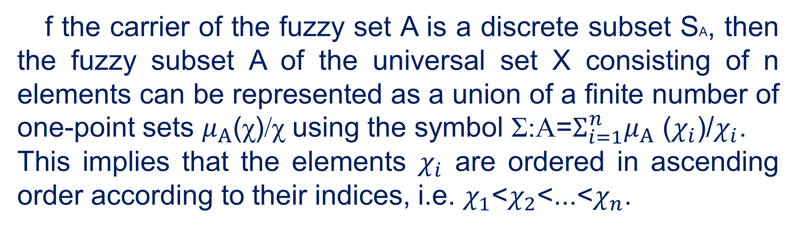
The concept of fuzzy sets
f the carrier of the fuzzy set A is a discrete subset SA, then the fuzzy subset A of the universal set X consisting of n elements can be represented as a union of a finite number of one-point sets $μ_{Α}$(χ)/χ using the symbol Σ:A=$Σ_{i=1}^{n}μ_{Α}$ ($χ_{i}$)/$χ_{i}$.
This implies that the elements $χ_{i}$ are ordered in ascending order according to their indices, i.e. $χ_{1}$<$χ_{2}$<...<$χ_{n}$.
22

Slide 23
The concept of fuzzy sets
Example 1.
Let the universal set X correspond to the set of possible values of the thickness of the product from 10 mm to 40 mm with a discrete step of 1 mm. The fuzzy set A, which corresponds to the fuzzy concept of "small thickness of the product", can be represented as follows:
A={1/10;0,9/11;0,8/12;0,7/13;0,5/14;0,3/15;0,1/16;0/17;...;0/40}, A=1/10+0,9/11+0,8/12+0,7/13+0,5/14+0,3/15+0,1/16+0/17+...+0/40,
where the sum sign denotes not the operation of arithmetic addition, but the combination of elements into one set.
23

Slide 24
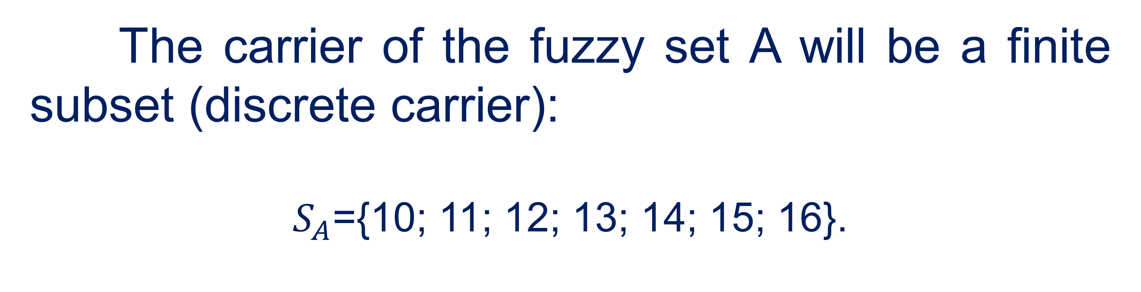
The concept of fuzzy sets
The carrier of the fuzzy set A will be a finite subset (discrete carrier):
$S_{A}$={10; 11; 12; 13; 14; 15; 16}.
24

Slide 25
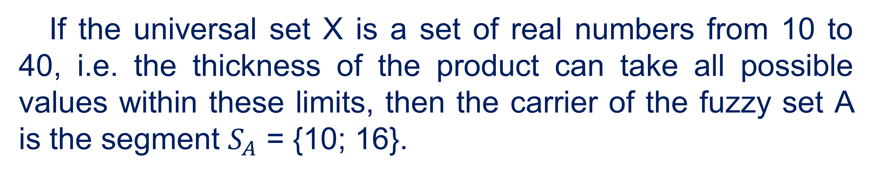
The concept of fuzzy sets
If the universal set X is a set of real numbers from 10 to 40, i.e. the thickness of the product can take all possible values within these limits, then the carrier of the fuzzy set A is the segment $S_{A}$ = {10; 16}.
25

Slide 26
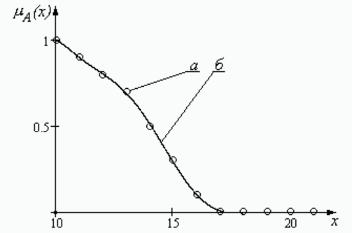
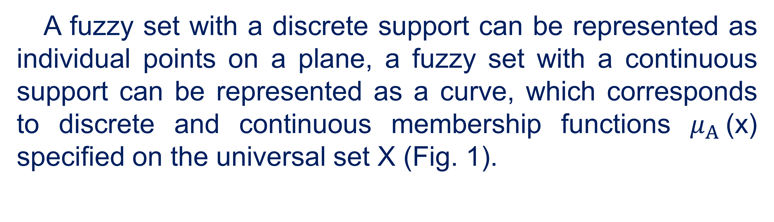
The concept of fuzzy sets
A fuzzy set with a discrete support can be represented as individual points on a plane, a fuzzy set with a continuous support can be represented as a curve, which corresponds to discrete and continuous membership functions $μ_{Α}$(x) specified on the universal set X (Fig. 1).
Fig. 1. Membership functions of fuzzy sets with
(a) -discrete and (b) -continuous carriers
26

Slide 27
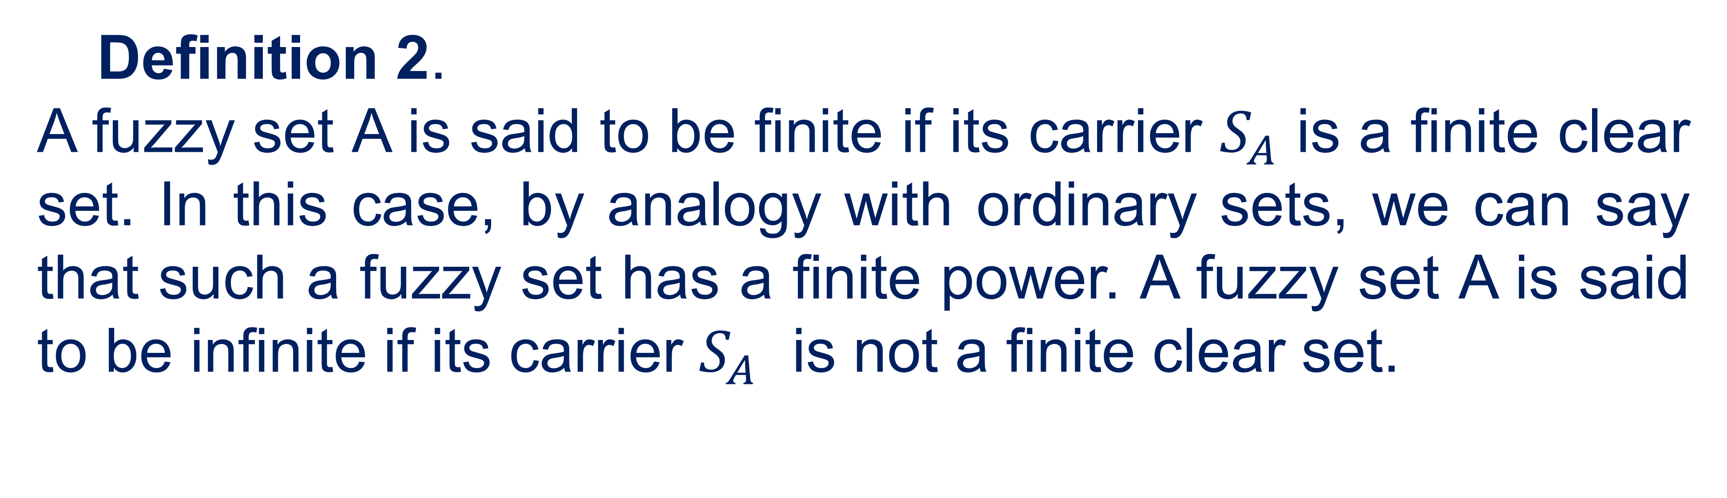
The concept of fuzzy sets
Definition 2.
A fuzzy set A is said to be finite if its carrier $S_{A}$ is a finite clear set. In this case, by analogy with ordinary sets, we can say that such a fuzzy set has a finite power. A fuzzy set A is said to be infinite if its carrier $S_{A}$ is not a finite clear set.
27

Slide 28
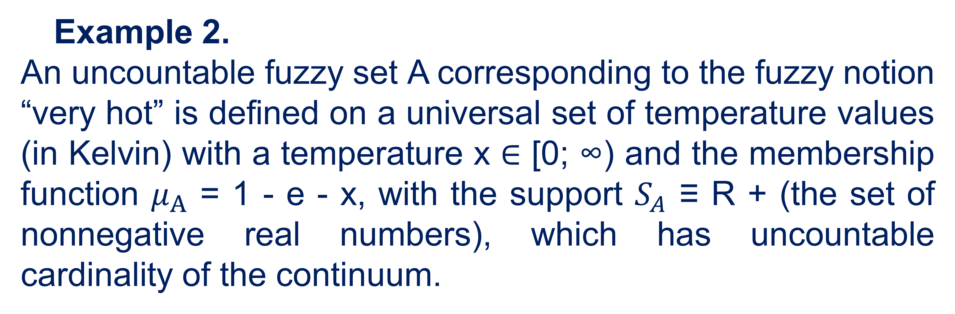
The concept of fuzzy sets
Example 2.
An uncountable fuzzy set A corresponding to the fuzzy notion “very hot” is defined on a universal set of temperature values (in Kelvin) with a temperature x ∈ [0; ∞) and the membership function $μ_{Α}$ = 1 - e - x, with the support $S_{A}$ ≡ R + (the set of nonnegative real numbers), which has uncountable cardinality of the continuum.
28

Slide 29
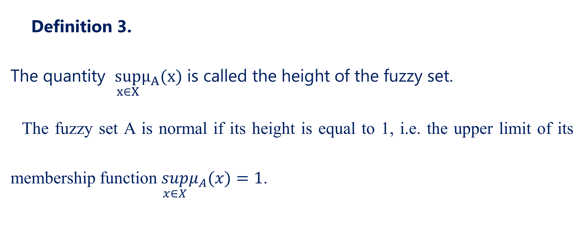
The concept of fuzzy sets
Definition 3.
The quantity $\sup_{x∈X}μ_{A}(x)$ is called the height of the fuzzy set.
The fuzzy set A is normal if its height is equal to 1, i.e. the upper limit of its membership function $\sup_{x∈X}μ_{A}(x)=1$.
29

Slide 30
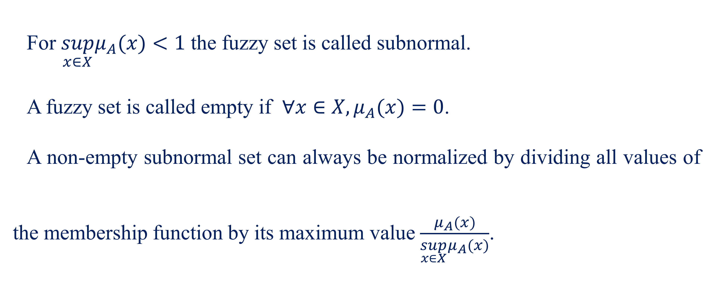
The concept of fuzzy sets
For $\sup_{x∈X}μ_{A}(x)<1$ the fuzzy set is called subnormal.
A fuzzy set is called empty if $∀x∈X,μ_{A}(x)=0$.
A non-empty subnormal set can always be normalized by dividing all values of the membership function by its maximum value $\frac{μ_{A}(x)}{\sup_{x∈X}μ_{A}(x)}$.
30

Slide 31
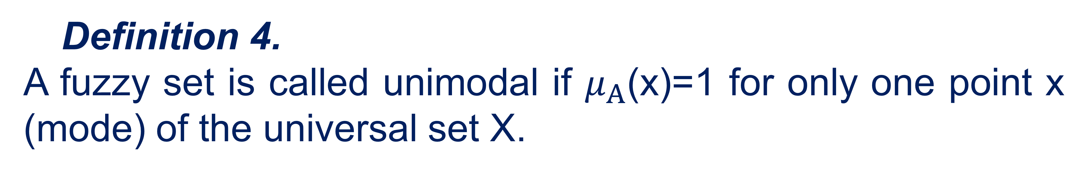

The concept of fuzzy sets
Definition 4.
A fuzzy set is called unimodal if $μ_{Α}$(x)=1 for only one point x (mode) of the universal set X.
Definition 5.
A fuzzy set is called a point set if $μ_{Α}$(x)>0 for only one point x of the universal set X.
31

Slide 32
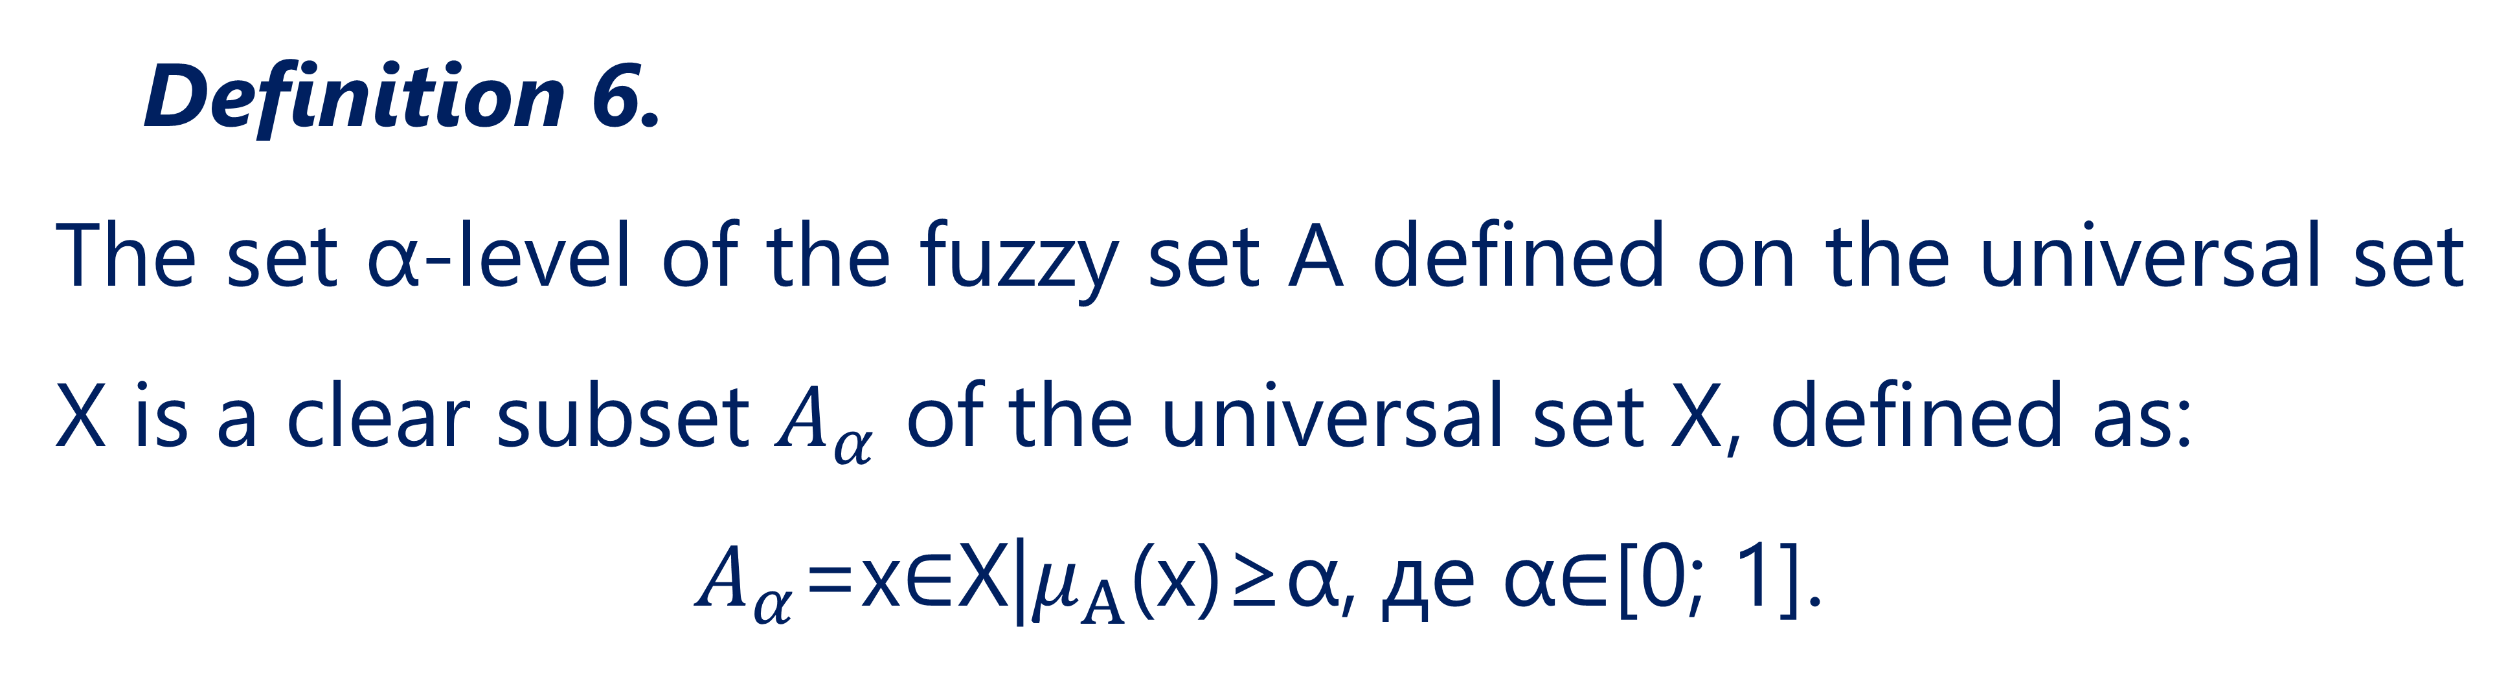
The concept of fuzzy sets
Definition 6.
The set α-level of the fuzzy set A defined on the universal set X is a clear subset $A_{α}$ of the universal set X, defined as:
$A_{α}$=x∈X|$μ_{Α}$(x)≥α, де α∈[0; 1].
32

Slide 33
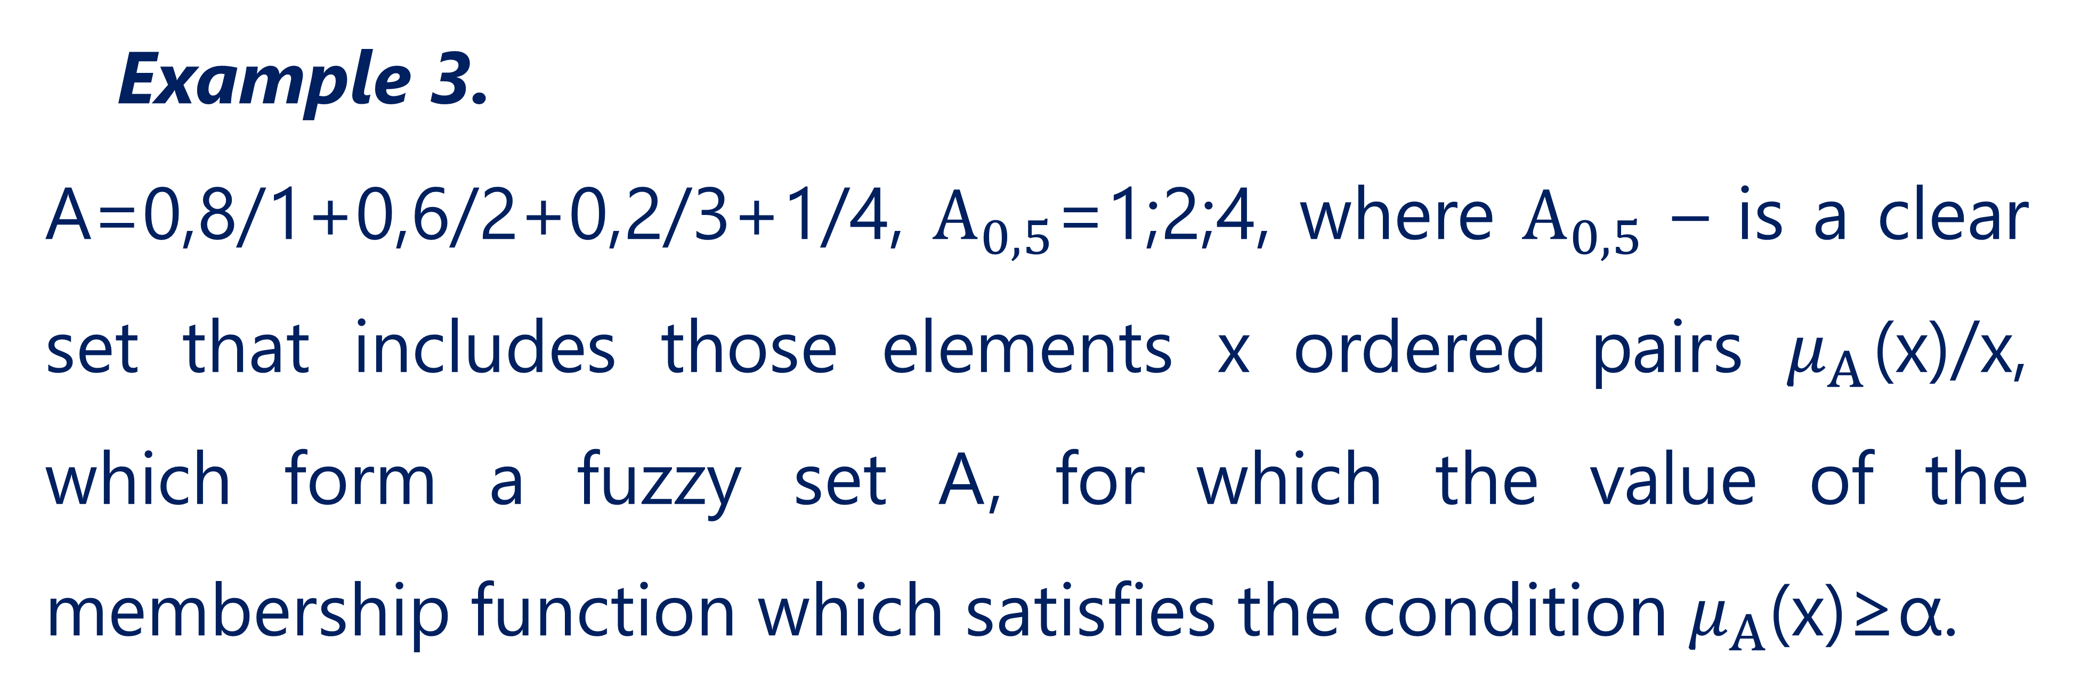
The concept of fuzzy sets
Example 3.
A=0,8/1+0,6/2+0,2/3+1/4, $Α_{0,5}$=1;2;4, where $Α_{0,5}$ – is a clear set that includes those elements x ordered pairs $μ_{Α}$(x)/x, which form a fuzzy set A, for which the value of the membership function which satisfies the condition $μ_{Α}$(x)≥α.
33

Slide 34
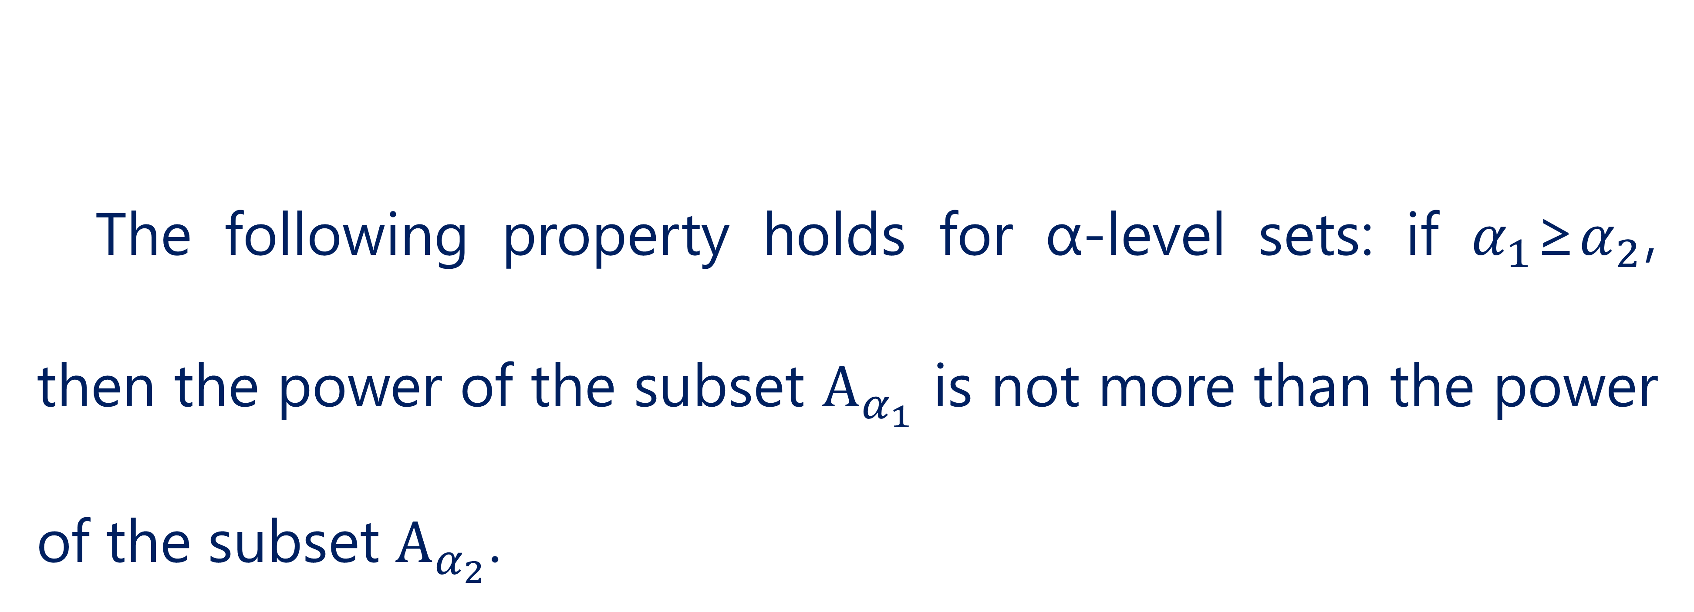
The concept of fuzzy sets
The following property holds for α-level sets: if $α_{1}$≥$α_{2}$, then the power of the subset $Α_{α_{1}}$ is not more than the power of the subset $Α_{α_{2}}$.
34

Slide 35
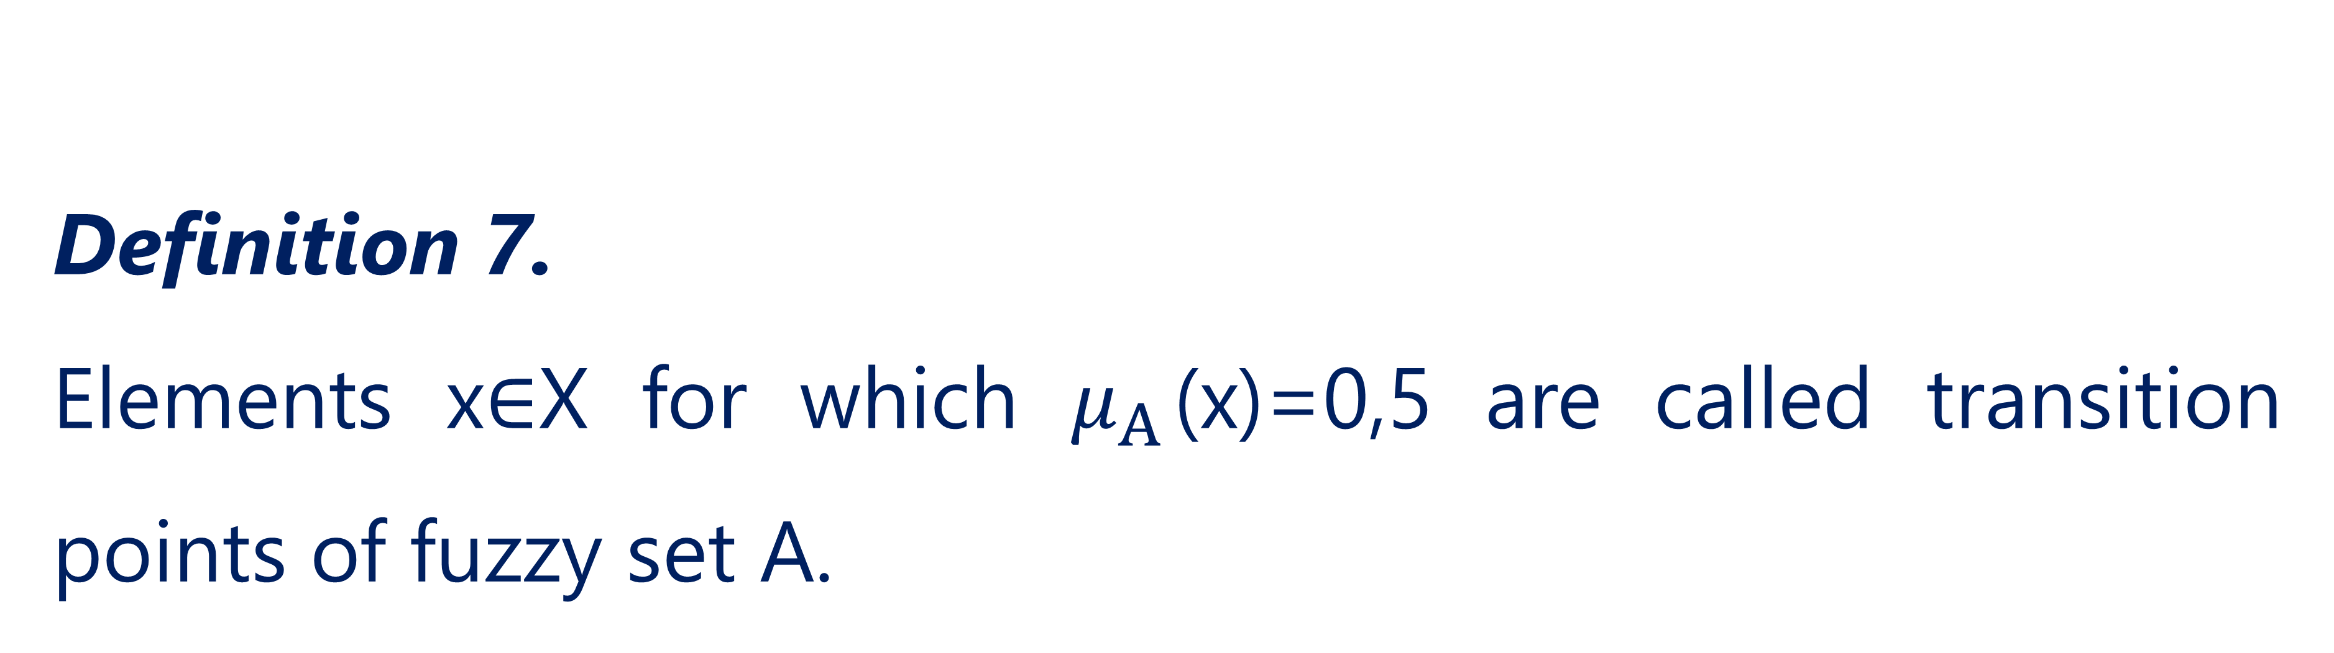
The concept of fuzzy sets
Definition 7.
Elements x∈X for which $μ_{Α}$(x)=0,5 are called transition points of fuzzy set A.
35

Slide 36
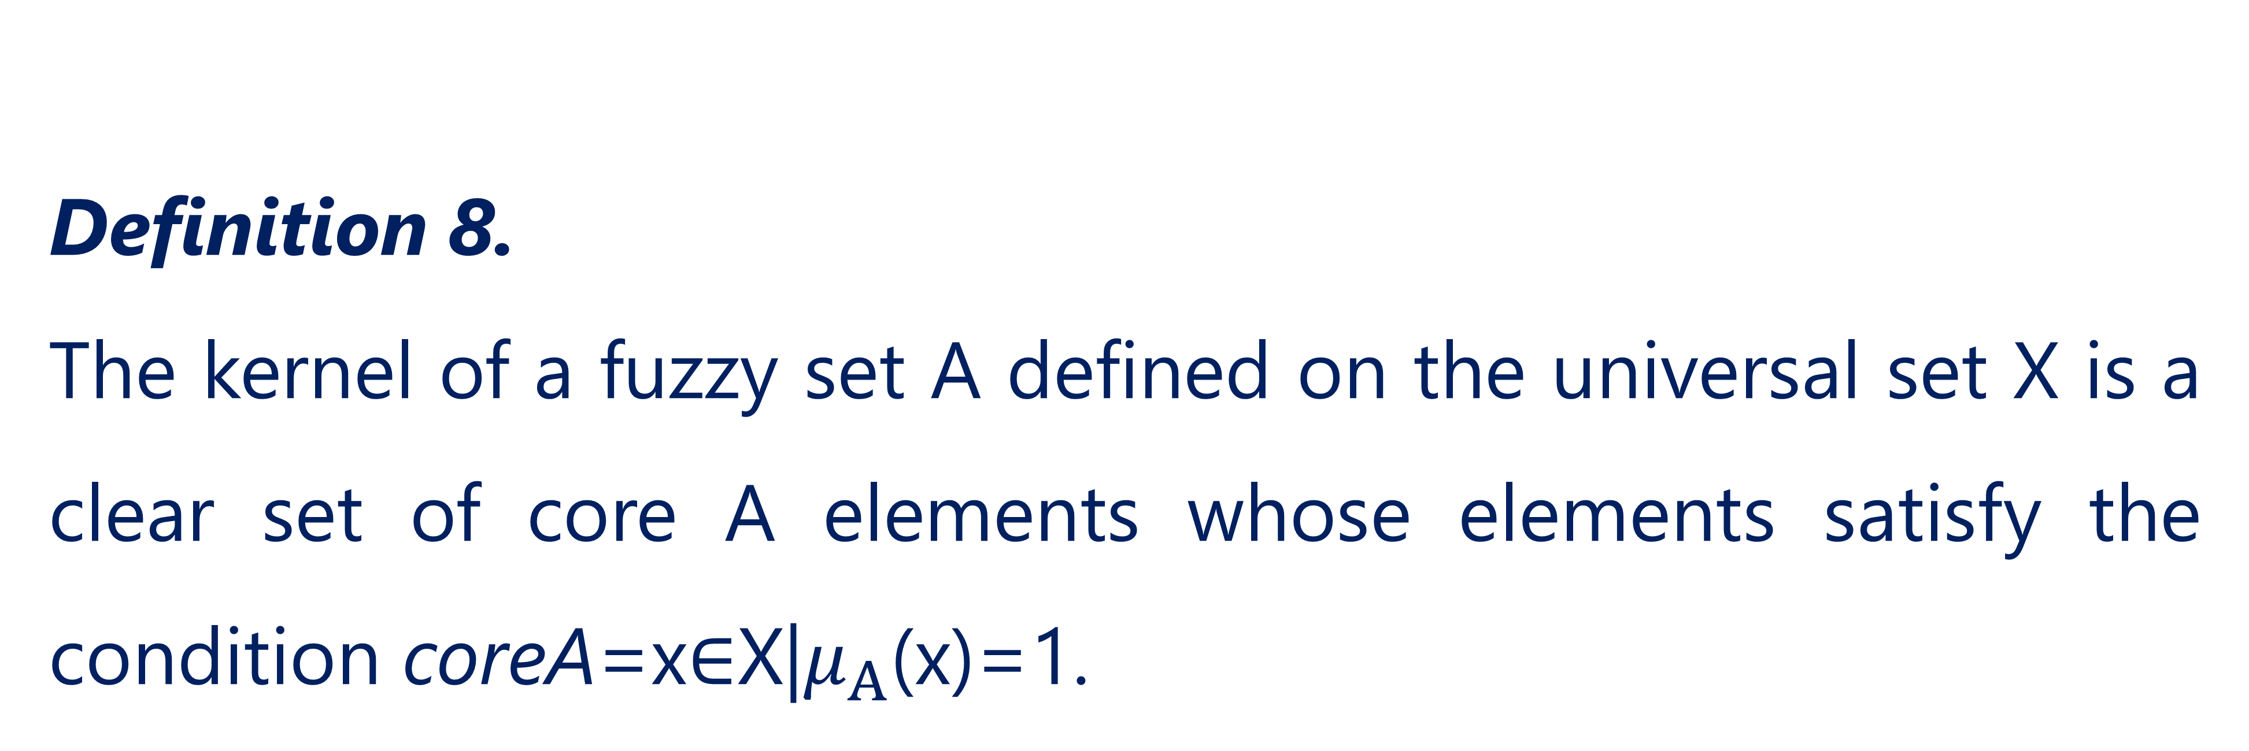
The concept of fuzzy sets
Definition 8.
The kernel of a fuzzy set A defined on the universal set X is a clear set of core A elements whose elements satisfy the condition coreA=x∈X|$μ_{Α}$(x)=1.
36

Slide 37
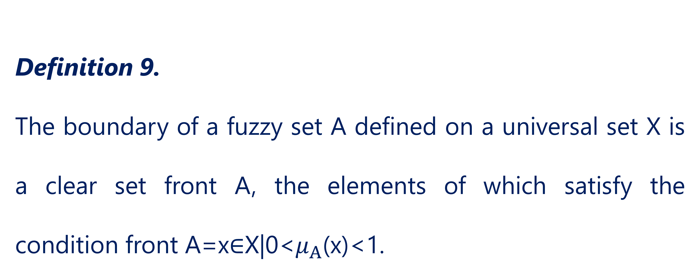
The concept of fuzzy sets
Definition 9.
The boundary of a fuzzy set A defined on a universal set X is a clear set front A, the elements of which satisfy the condition front A=x∈X|0<$μ_{Α}$(x)<1.
37

Slide 38
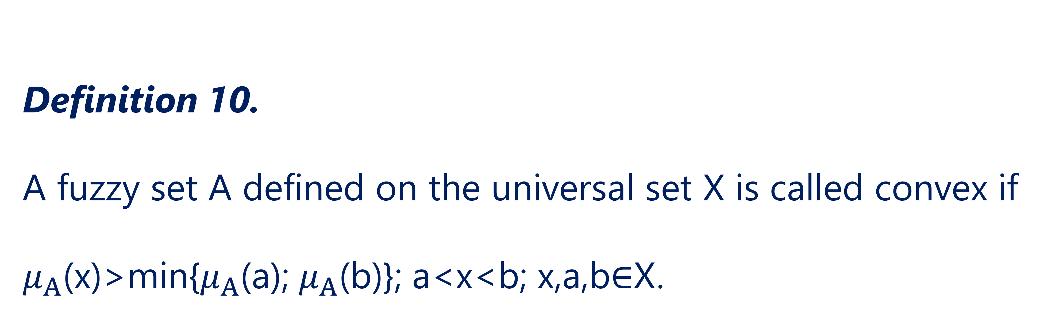
The concept of fuzzy sets
Definition 10.
A fuzzy set A defined on the universal set X is called convex if $μ_{Α}$(x)>min⁡{$μ_{Α}$(a); $μ_{Α}$(b)}; a<x<b; x,a,b∈X.
38

Slide 39
References
Polishchuk, V. (2021). Evaluation of start-up projects in conditions of risk and uncertainty. FOP Sabov AM.
Zaychenko, Y. (2008). Nechitki modeli i metody v intelektualʹnykh systemakh: Navchalʹnyy posibnyk. Slovo.
Rotshteyn, O. (1999). Intelektualʹni tekhnolohiyi identyfikatsiyi: Nechitki mnozhyny, henetychni alhorytmy, neyronni merezhi. UNIVERSUM-Vinnytsy.
39

Slide 40
Thank you!
WWW.SITE2MAX.PRO

