Slide 1
Evaluation of start-up projects
Chapter 5
Functions of belonging to one variable and methods of their constructions
Lecturer: doc. Polishchuk Volodymyr, PhD.

Slide 2
Membership (belonging) function
Triangular membership functions
Lecture content
Z-shaped membership functions
S-shaped membership functions
U-shaped membership functions
Methods of constructing membership functions

Slide 3

Membership (belonging) function
01

Slide 4
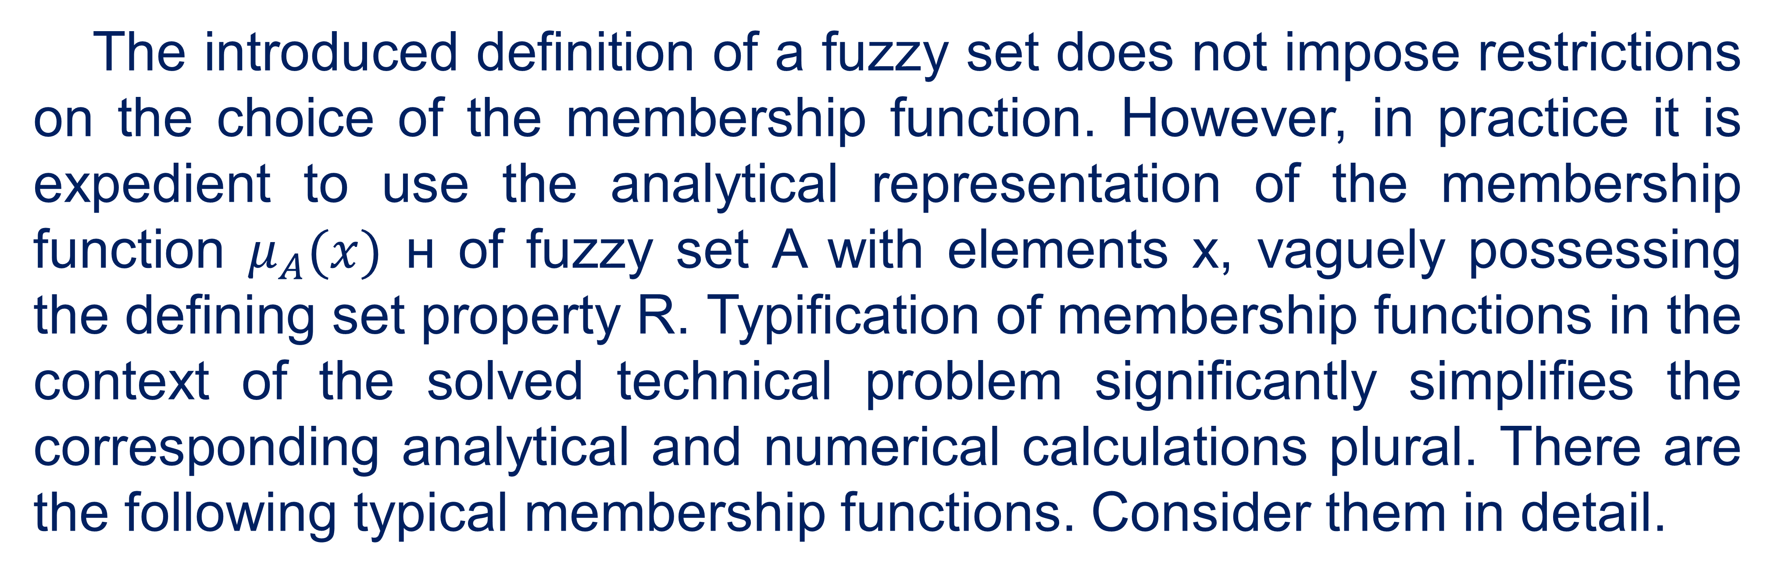
Membership function
The introduced definition of a fuzzy set does not impose restrictions on the choice of the membership function. However, in practice it is expedient to use the analytical representation of the membership function $μ_{A}(x)$ н of fuzzy set A with elements x, vaguely possessing the defining set property R. Typification of membership functions in the context of the solved technical problem significantly simplifies the corresponding analytical and numerical calculations plural. There are the following typical membership functions. Consider them in detail.
4

Slide 5
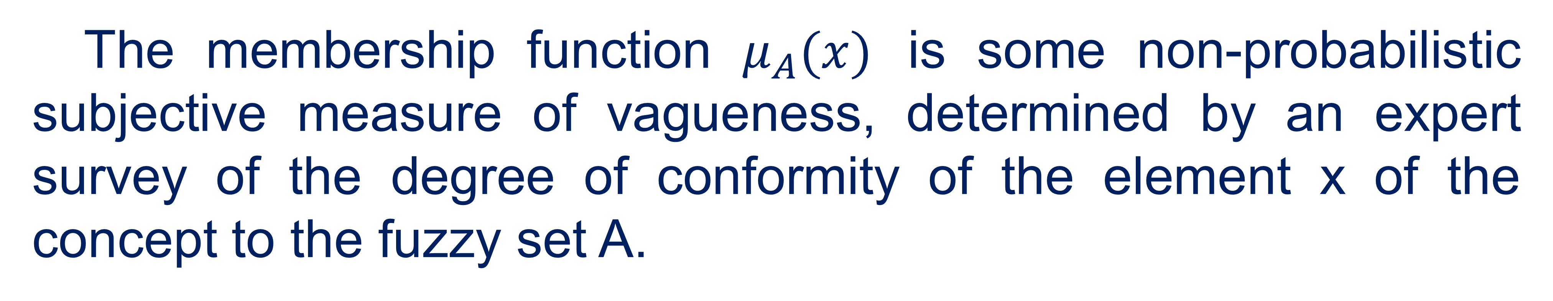
Membership function
The membership function $μ_{A}(x)$ is some non-probabilistic subjective measure of vagueness, determined by an expert survey of the degree of conformity of the element x of the concept to the fuzzy set A.
5

Slide 6
Membership function
In contrast to the probabilistic measure, which is an estimate of stochastic uncertainty, the occurrence of an event at different points in time, a fuzzy measure is a numerical estimate of the linguistic uncertainty associated with the ambiguity and vagueness of the categories of human thinking.
6

Slide 7
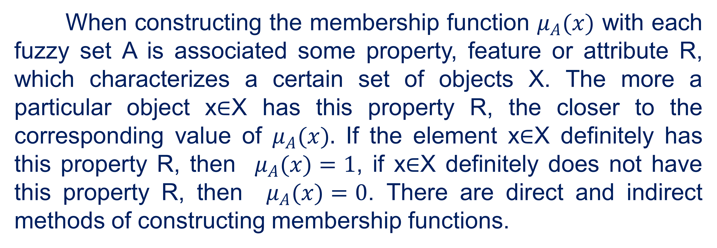
Membership function
When constructing the membership function $μ_{A}(x)$ with each fuzzy set A is associated some property, feature or attribute R, which characterizes a certain set of objects X. The more a particular object x∈X has this property R, the closer to the corresponding value of $μ_{A}(x).$ If the element x∈X definitely has this property R, then $μ_{A}(x)=1$, if x∈X definitely does not have this property R, then $μ_{A}(x)=0$. There are direct and indirect methods of constructing membership functions.
7

Slide 8

Triangular membership functions
02

Slide 9
Triangular membership functions
Triangular membership functions used for uncertainty problems of the type: "approximately equal to", "average value", "located in the interval", "similar to the object", "similar to the object", etc.
9

Slide 10
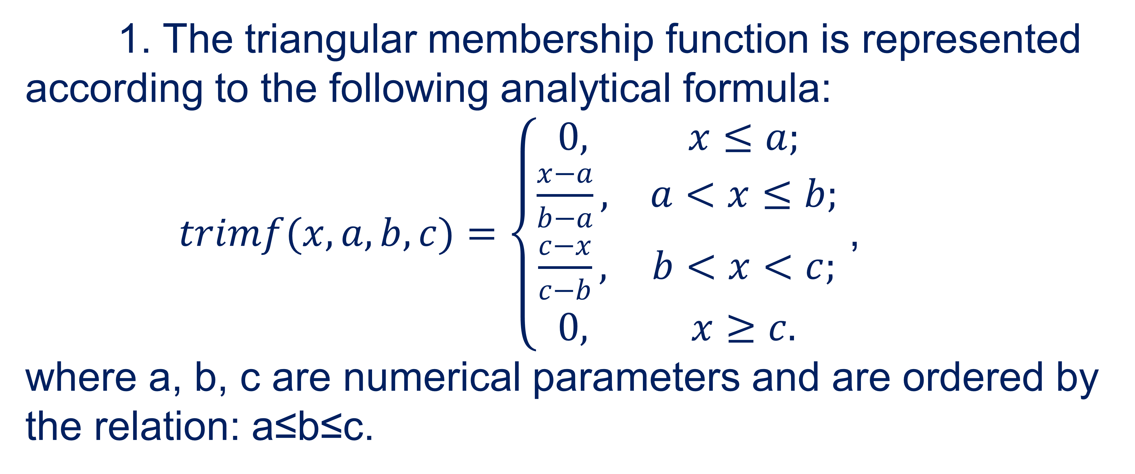
Triangular membership functions
1. The triangular membership function is represented according to the following analytical formula:
$trimf(x,a,b,c)=\left\{\begin{matrix}0, & x≤a; \\ \frac{x−a}{b−a}, & a<x≤b; \\ \frac{c−x}{c−b}, & b<x<c; \\ 0, & x≥c.\end{matrix}\right.$ ,
where a, b, c are numerical parameters and are ordered by the relation: a≤b≤c.
10

Slide 11
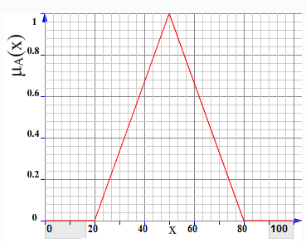
Triangular membership functions
Parameters a and c characterize the base of a triangle, and parameter b its vertex. The graph of the triangular membership function in the case when a = 20, b = 50, c = 80 will look like.
11

Slide 12
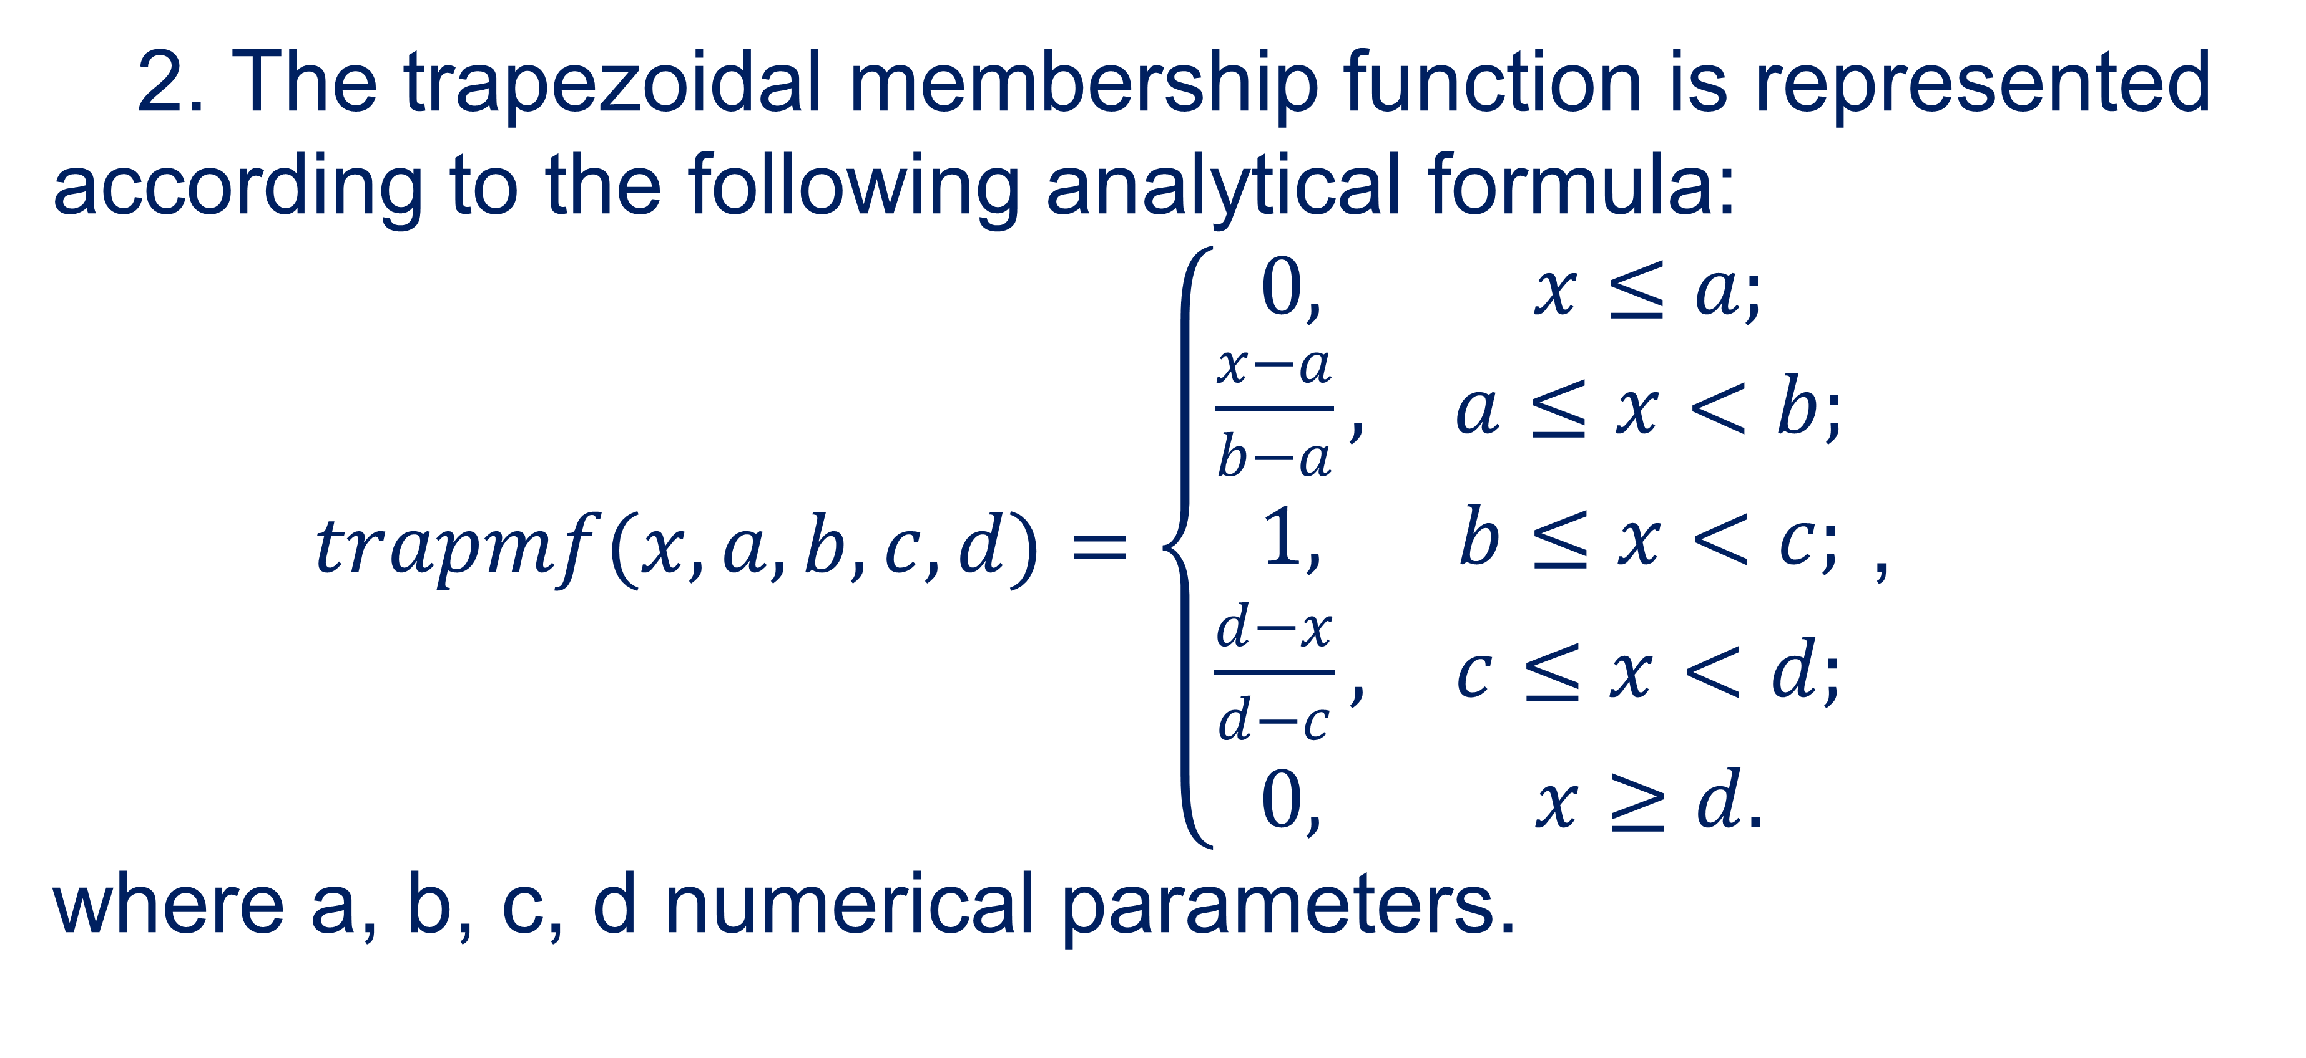
Triangular membership functions
2. The trapezoidal membership function is represented according to the following analytical formula:
$trapmf(x,a,b,c,d)=\left\{\begin{matrix}0, & x≤a; \\ \frac{x−a}{b−a}, & a≤x<b; \\ 1, & b≤x<c; \\ \frac{d−x}{d−c}, & c≤x<d; \\ 0, & x≥d.\end{matrix}\right.$ ,
where a, b, c, d numerical parameters.
12

Slide 13
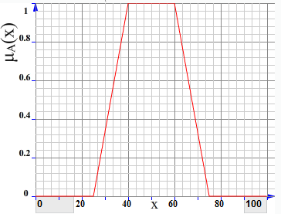
Triangular membership functions
Parameters a and d characterize the base of the trapezoid, and parameters b and c its vertex. The graph of the trapezoidal membership function in the case when a = 25, b = 40, c = 60, d = 75 will have the form.
13

Slide 14

Z-shaped membership functions
03

Slide 15
Z-shaped membership functions
Z-shaped membership functions used for uncertainty problems such as "small number", "small value", "small value", "low level", etc.
15

Slide 16
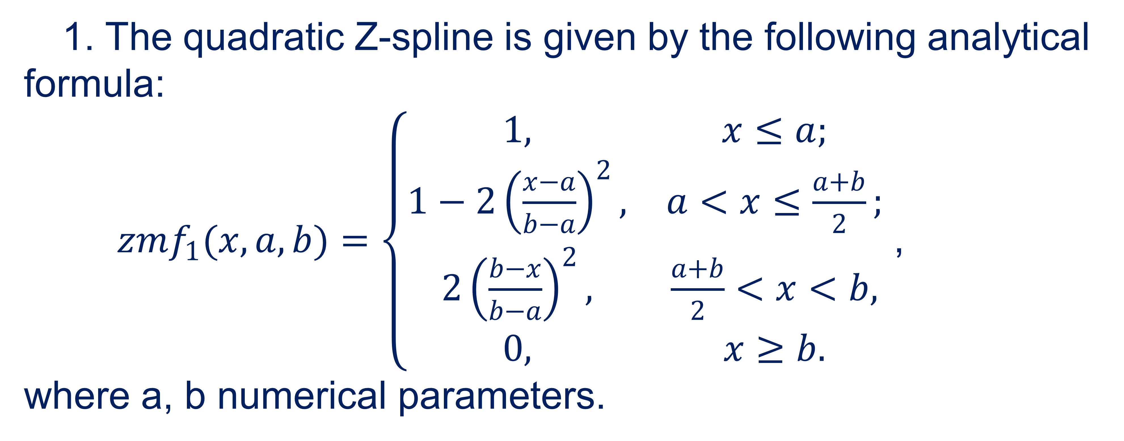
Z-shaped membership functions
1. The quadratic Z-spline is given by the following analytical formula:
$zmf_{1}(x,a,b)=\left\{\begin{matrix}1, & x≤a; \\ 1−2{\left(\frac{x−a}{b−a}\right)}^{2}, & a<x≤\frac{a+b}{2}; \\ 2{\left(\frac{b−x}{b−a}\right)}^{2}, & \frac{a+b}{2}<x<b, \\ 0, & x≥b.\end{matrix}\right.$ ,
where a, b numerical parameters.
16

Slide 17
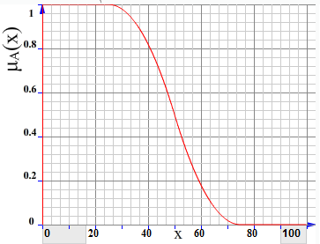
Z-shaped membership functions
The function decreases from parameter a to parameter b. The graph of the quadratic Z-spline membership function in the case when a = 25, b = 75 will look like.
17

Slide 18
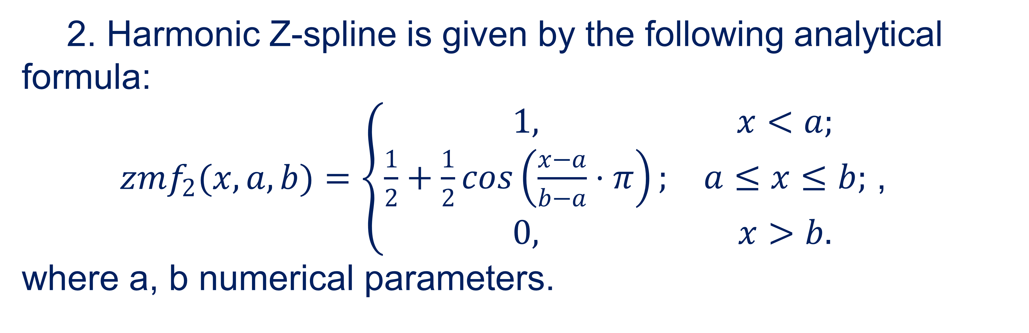
Z-shaped membership functions
2. Harmonic Z-spline is given by the following analytical formula:
$zmf_{2}(x,a,b)=\left\{\begin{matrix}1, & x<a; \\ \frac{1}{2}+\frac{1}{2}\cos\left(\frac{x−a}{b−a}⋅π\right); & a≤x≤b; \\ 0, & x>b.\end{matrix}\right.$ ,
where a, b numerical parameters.
18

Slide 19
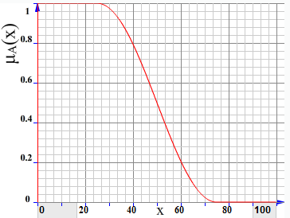
Z-shaped membership functions
The function decreases from parameter a to parameter b. The graph of the harmonic Z-spline membership function in the case when a = 25, b = 75 will have the form.
19

Slide 20
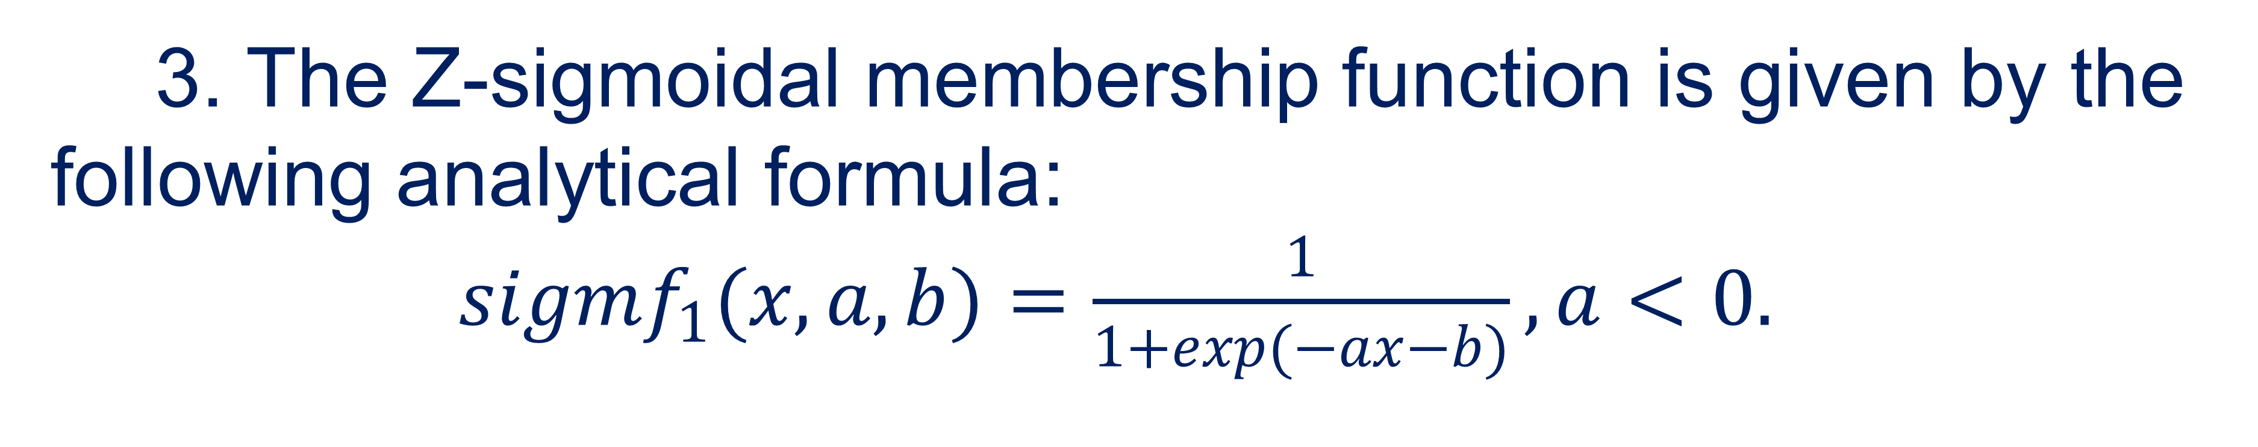
Z-shaped membership functions
3. The Z-sigmoidal membership function is given by the following analytical formula:
$sigmf_{1}(x,a,b)=\frac{1}{1+\exp{(}−ax−b)},a<0.$
20

Slide 21
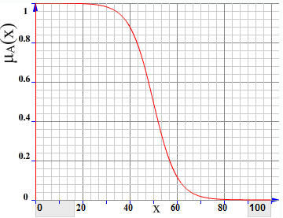
Z-shaped membership functions
The graph of the Z-sigmoidal membership function in the case when a = -0.2, b = 50 will look like.
21

Slide 22
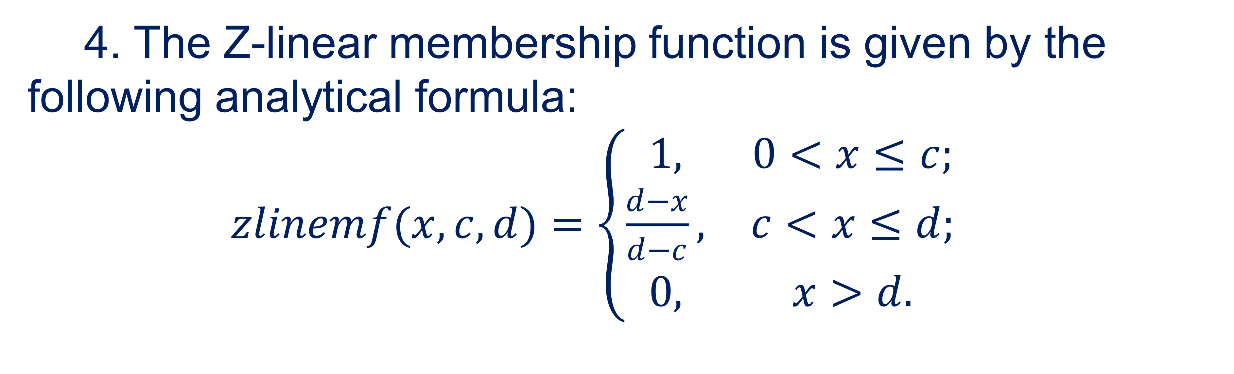
Z-shaped membership functions
4. The Z-linear membership function is given by the following analytical formula:
$zlinemf(x,c,d)=\left\{\begin{matrix}1, & 0<x≤c; \\ \frac{d−x}{d−c}, & c<x≤d; \\ 0, & x>d.\end{matrix}\right.$
22

Slide 23
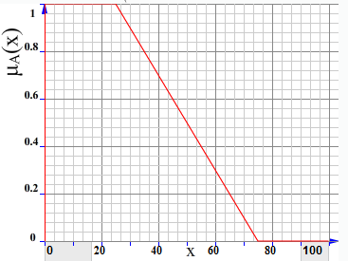
Z-shaped membership functions
The graph of the Z-linear membership function in the case when c = 25, d = 75 will have the form.
23

Slide 24

S-shaped membership functions
04

Slide 25
S-shaped membership functions
S-shaped membership functions used for uncertainty problems such as: "large number", "large value", "significant value", "high level", etc .:
25

Slide 26
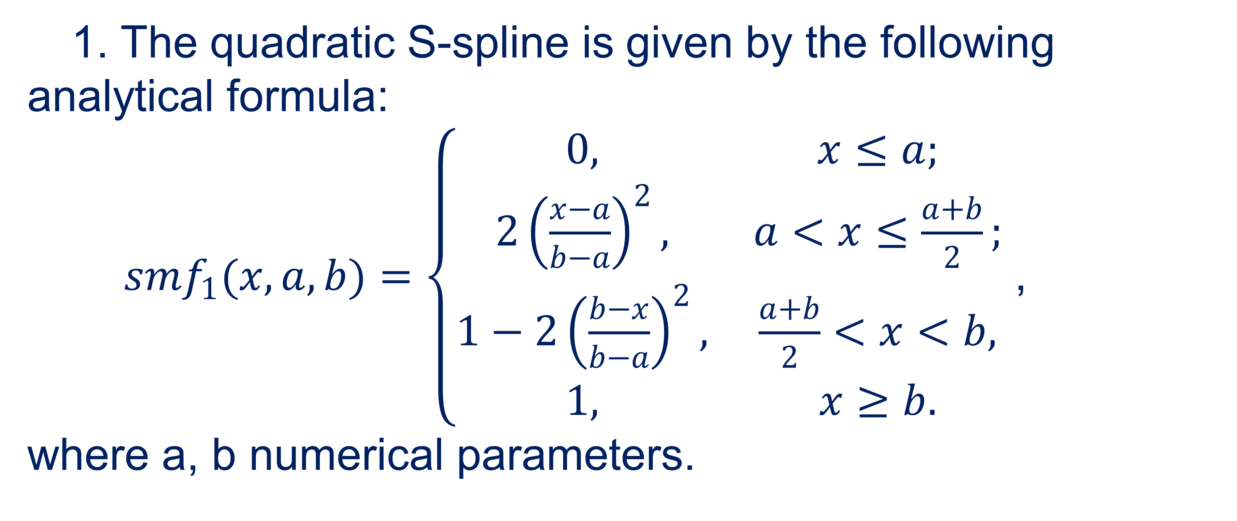
S-shaped membership functions
1. The quadratic S-spline is given by the following analytical formula:
$smf_{1}(x,a,b)=\left\{\begin{matrix}0, & x≤a; \\ 2{\left(\frac{x−a}{b−a}\right)}^{2}, & a<x≤\frac{a+b}{2}; \\ 1−2{\left(\frac{b−x}{b−a}\right)}^{2}, & \frac{a+b}{2}<x<b, \\ 1, & x≥b.\end{matrix}\right.$ ,
where a, b numerical parameters.
26

Slide 27
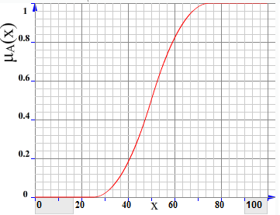
S-shaped membership functions
The function increases from parameter a to parameter b. The graph of the quadratic S-spline membership function in the case when a = 25, b = 75 will look like.
27

Slide 28
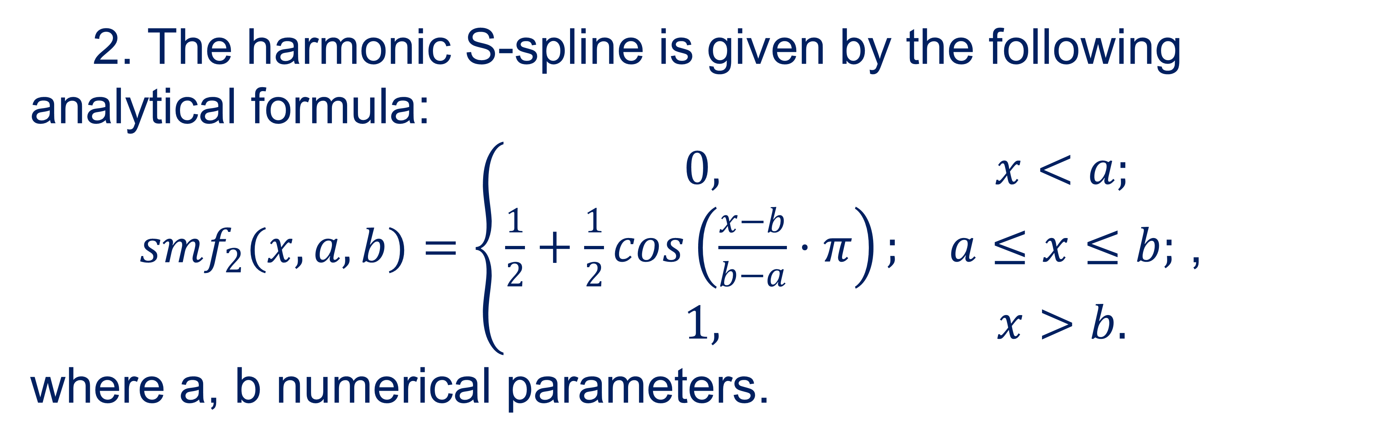
S-shaped membership functions
2. The harmonic S-spline is given by the following analytical formula:
$smf_{2}(x,a,b)=\left\{\begin{matrix}0, & x<a; \\ \frac{1}{2}+\frac{1}{2}\cos\left(\frac{x−b}{b−a}⋅π\right); & a≤x≤b; \\ 1, & x>b.\end{matrix}\right.$ ,
where a, b numerical parameters.
28

Slide 29
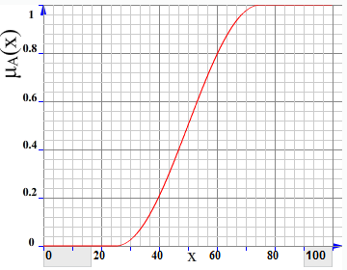
S-shaped membership functions
The function increases from parameter a to parameter b. The graph of the harmonic S-spline membership function in the case when a = 25, b = 75 will have the form.
29

Slide 30
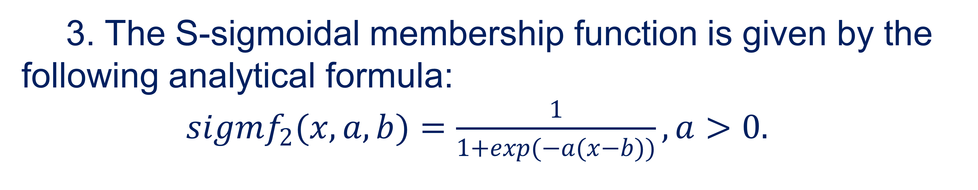
S-shaped membership functions
3. The S-sigmoidal membership function is given by the following analytical formula:
$sigmf_{2}(x,a,b)=\frac{1}{1+\exp{(}−a(x−b))},a>0.$
30

Slide 31
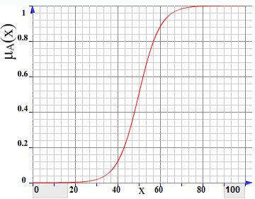
S-shaped membership functions
The graph of the S-sigmoidal membership function in the case when a = 0.2, b = 50 will look like.
31

Slide 32
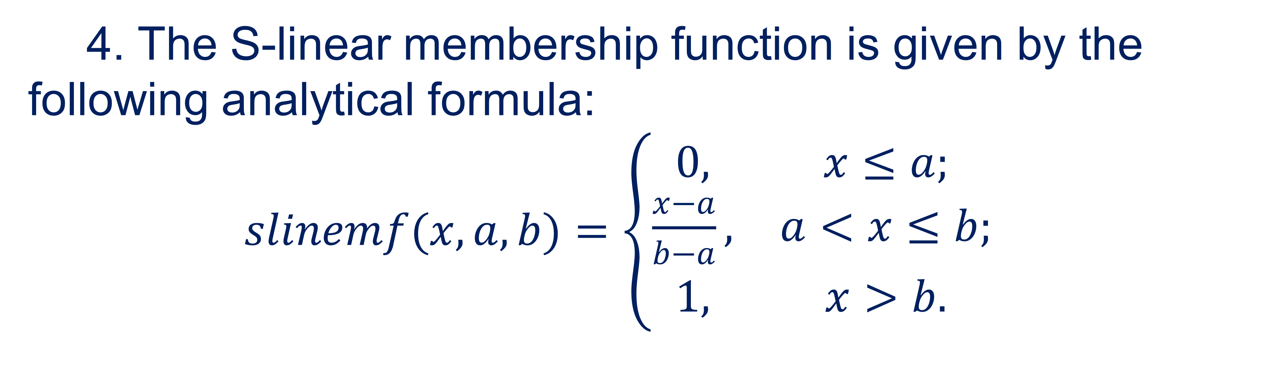
S-shaped membership functions
4. The S-linear membership function is given by the following analytical formula:
$slinemf(x,a,b)=\left\{\begin{matrix}0, & x≤a; \\ \frac{x−a}{b−a}, & a<x≤b; \\ 1, & x>b.\end{matrix}\right.$
32

Slide 33
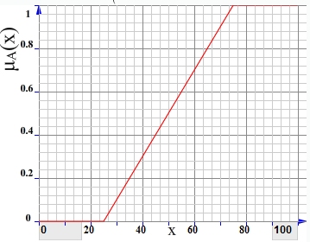
S-shaped membership functions
The graph of the S-linear membership function in the case when a = 25, b = 75 will have the form.
33

Slide 34
U-shaped membership functions
05

Slide 35
U-shaped membership functions
U-shaped membership functions used for uncertainty problems of the type: "approximately in the range from and to", "approximately", "approximately", etc.
35

Slide 36
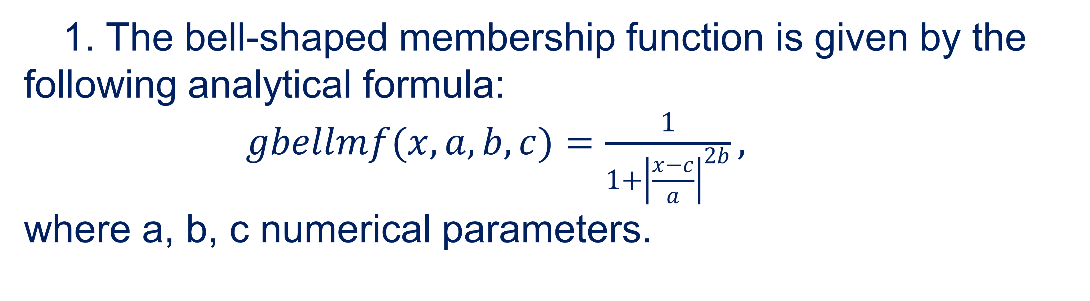
U-shaped membership functions
1. The bell-shaped membership function is given by the following analytical formula:
$gbellmf(x,a,b,c)=\frac{1}{1+{\left|\frac{x−c}{a}\right|}^{2b}},$
where a, b, c numerical parameters.
36

Slide 37
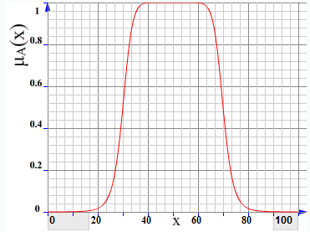
U-shaped membership functions
The graph of the bell-shaped membership function in the case when a = 2, b = 5, c = 50 will look like.
37

Slide 38
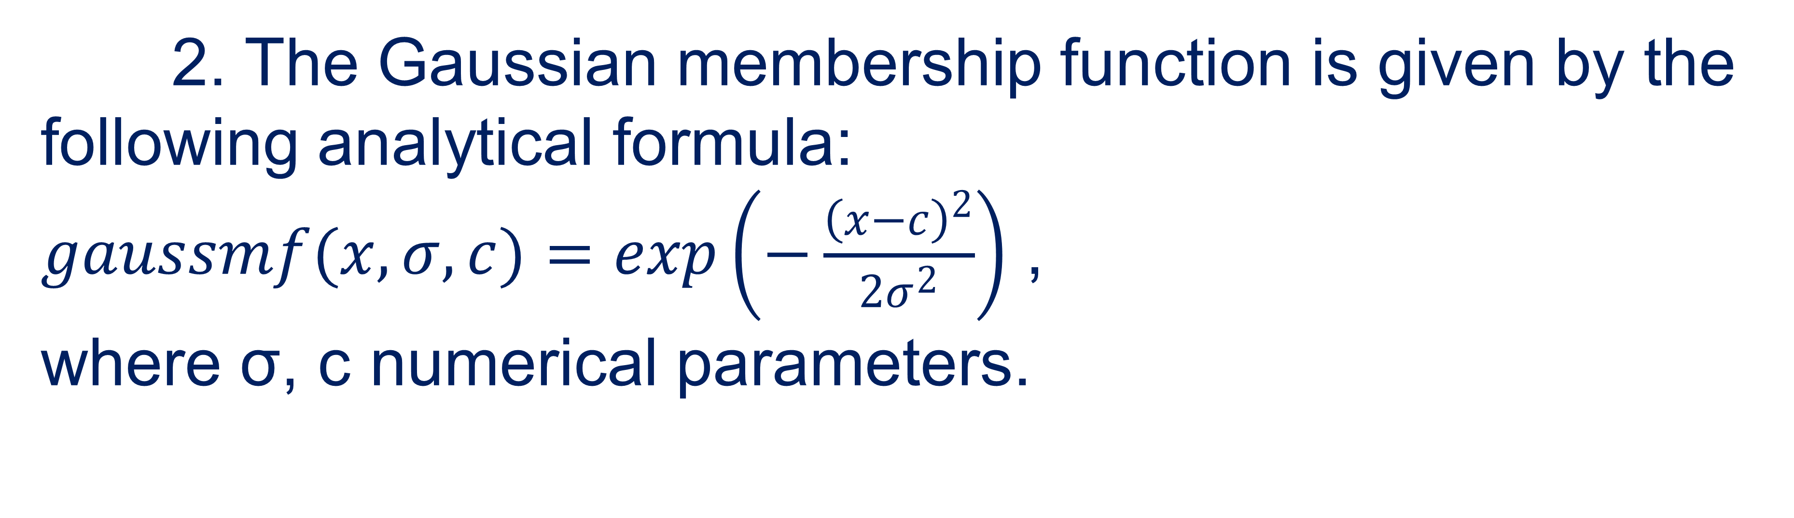
U-shaped membership functions
2. The Gaussian membership function is given by the following analytical formula:
$gaussmf(x,σ,c)=\exp\left(−\frac{{\left(x−c\right)}^{2}}{2σ^{2}}\right)$ ,
where σ, c numerical parameters.
38

Slide 39
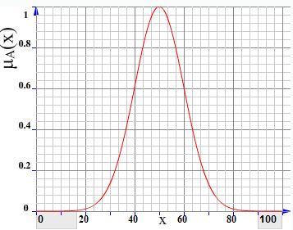
U-shaped membership functions
The graph of the Gaussian membership function in the case when σ = 10, c = 50 will have the form.
39

Slide 40

Methods of constructing membership functions
06

Slide 41
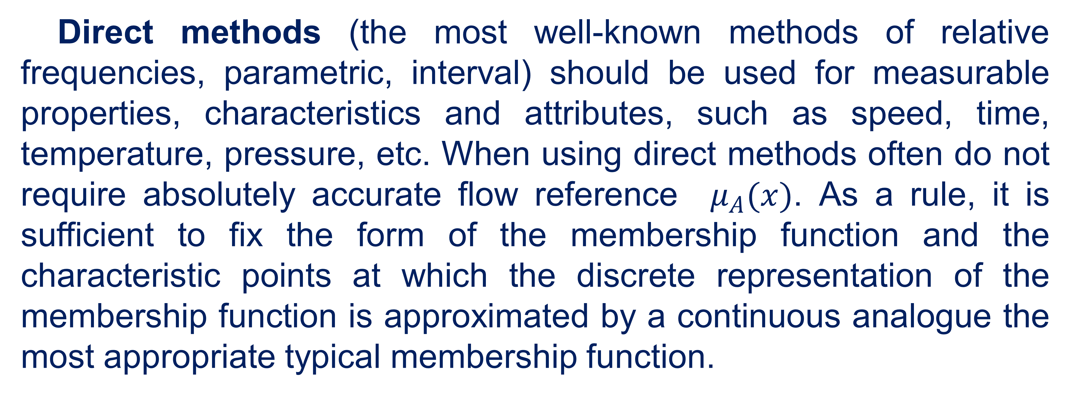
Methods of constructing membership functions
Direct methods (the most well-known methods of relative frequencies, parametric, interval) should be used for measurable properties, characteristics and attributes, such as speed, time, temperature, pressure, etc. When using direct methods often do not require absolutely accurate flow reference $μ_{A}(x)$. As a rule, it is sufficient to fix the form of the membership function and the characteristic points at which the discrete representation of the membership function is approximated by a continuous analogue the most appropriate typical membership function.
41

Slide 42
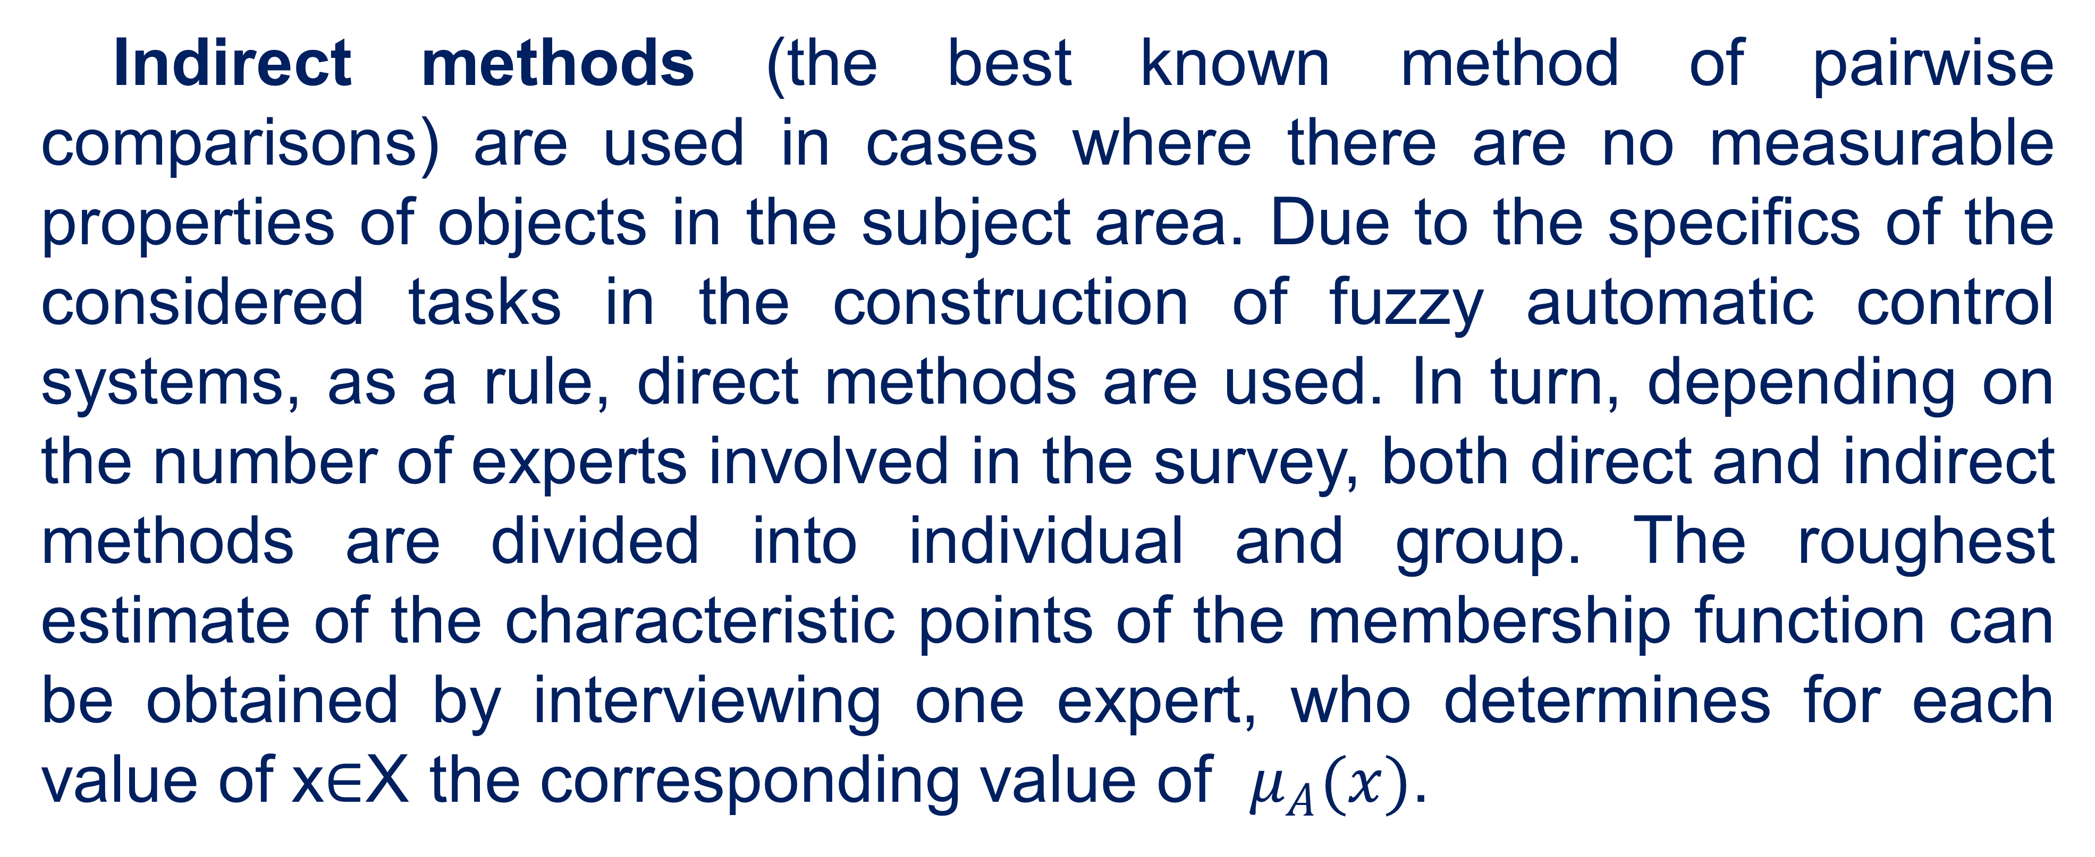
Methods of constructing membership functions
Indirect methods (the best known method of pairwise comparisons) are used in cases where there are no measurable properties of objects in the subject area. Due to the specifics of the considered tasks in the construction of fuzzy automatic control systems, as a rule, direct methods are used. In turn, depending on the number of experts involved in the survey, both direct and indirect methods are divided into individual and group. The roughest estimate of the characteristic points of the membership function can be obtained by interviewing one expert, who determines for each value of x∈X the corresponding value of $μ_{A}(x)$.
42

Slide 43
References
Polishchuk, V. (2021). Evaluation of start-up projects in conditions of risk and uncertainty. FOP Sabov AM.
Zaychenko, Y. (2008). Nechitki modeli i metody v intelektualʹnykh systemakh: Navchalʹnyy posibnyk. Slovo.
Rotshteyn, O. (1999). Intelektualʹni tekhnolohiyi identyfikatsiyi: Nechitki mnozhyny, henetychni alhorytmy, neyronni merezhi. UNIVERSUM-Vinnytsy.
Osnovnyye printsipy postroyeniya intellektual'nykh SAU. http://nrsu.bstu.ru/contents.html
43

Slide 44
Thank you!
WWW.SITE2MAX.PRO

