Slide 1
Evaluation of start-up projects
Chapter 6
Operations on fuzzy sets
Lecturer: doc. Polishchuk Volodymyr, PhD.

Slide 2
Logical operations
Lecture content
Triangular norm and conorm
Algebraic operations on fuzzy sets
Fuzzy implication

Slide 3

Logical operations
01

Slide 4
Logical operations
Let A and B be fuzzy sets on the universal set X. For fuzzy sets A and B we introduce the following operations.
4

Slide 5
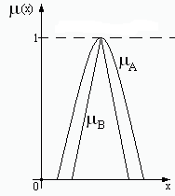
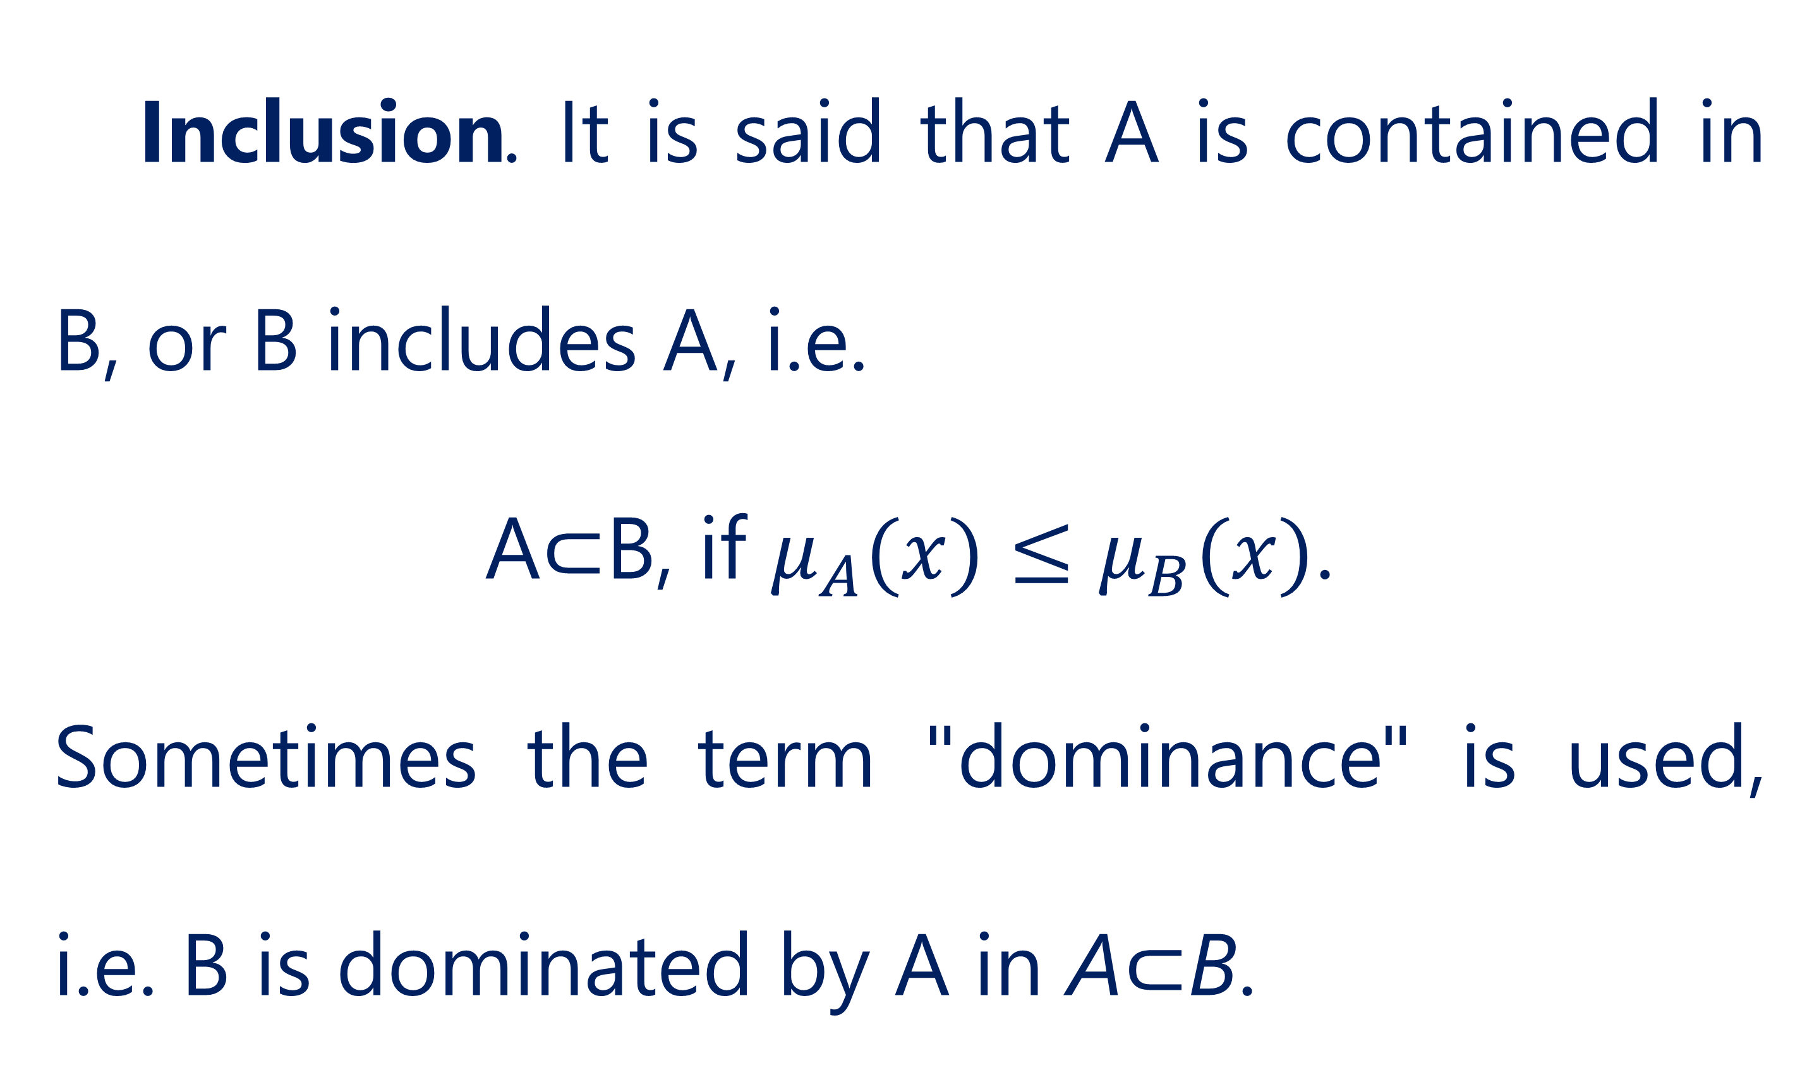
Logical operations
Inclusion. It is said that A is contained in B, or B includes A, i.e.
A⊂B, if $μ_{A}(x)≤μ_{B}(x)$.
Sometimes the term "dominance" is used, i.e. B is dominated by A in A⊂B.
5

Slide 6
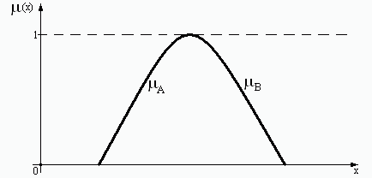
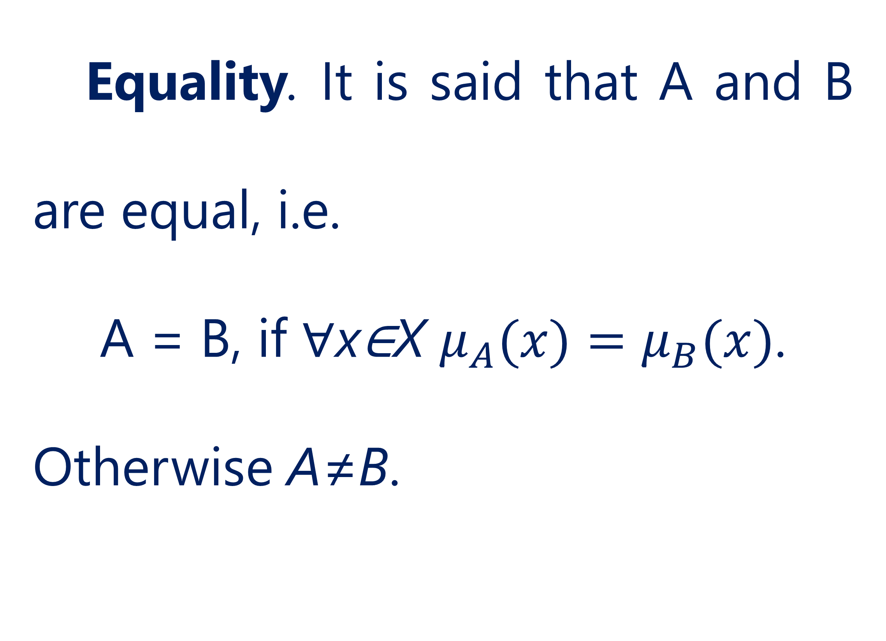
Logical operations
Equality. It is said that A and B are equal, i.e.
A = B, if ∀x∈X $μ_{A}(x)=μ_{B}(x)$.
Otherwise A≠B.
6

Slide 7
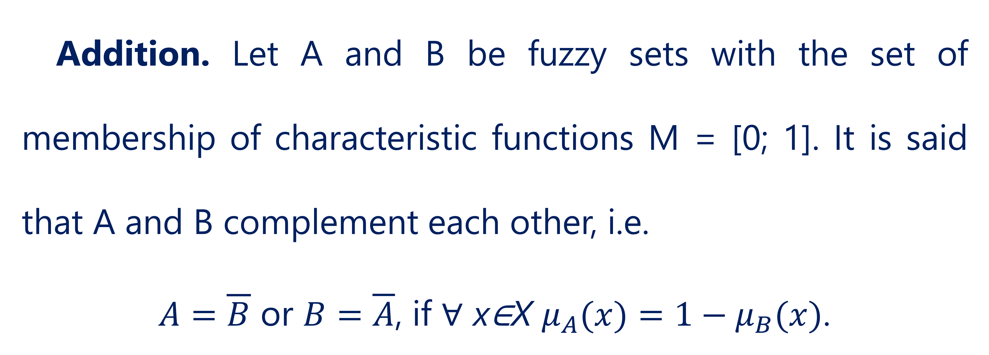
Logical operations
Addition. Let A and B be fuzzy sets with the set of membership of characteristic functions M = [0; 1]. It is said that A and B complement each other, i.e.
$A=\overline{B}$ or $B=\overline{A}$, if ∀ x∈X $μ_{A}(x)=1−μ_{B}(x)$.
7

Slide 8
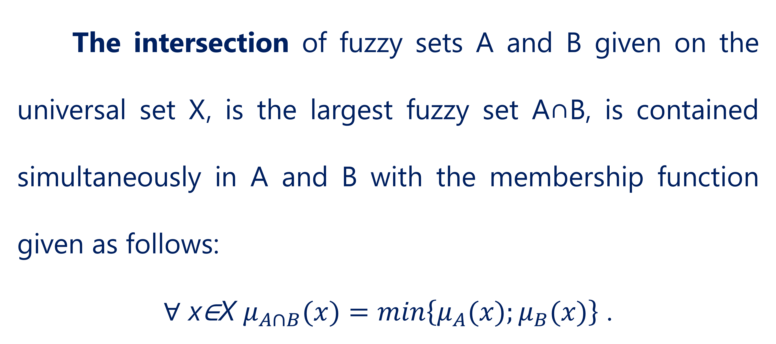
Logical operations
The intersection of fuzzy sets A and B given on the universal set X, is the largest fuzzy set A∩B, is contained simultaneously in A and B with the membership function given as follows:
∀ x∈X $μ_{A∩B}(x)=\min\left\{μ_{A}(x);μ_{B}(x)\right\}$ .
8

Slide 9
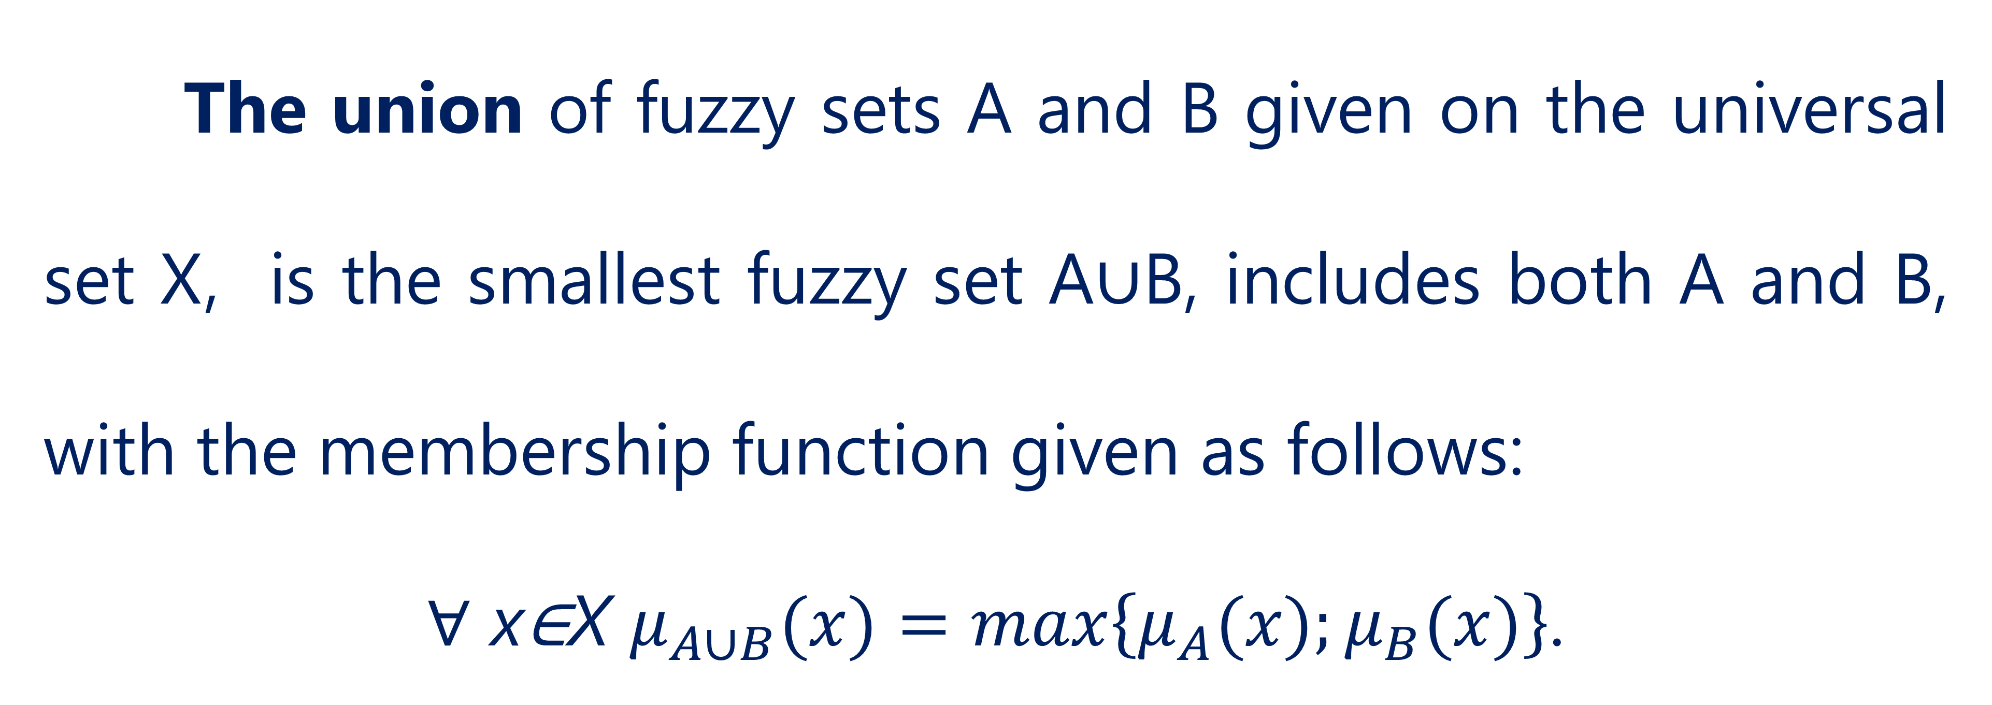
Logical operations
The union of fuzzy sets A and B given on the universal set X, is the smallest fuzzy set A∪B, includes both A and B, with the membership function given as follows:
∀ x∈X $μ_{A∪B}(x)=\max\left\{μ_{A}(x);μ_{B}(x)\right\}$.
9

Slide 10
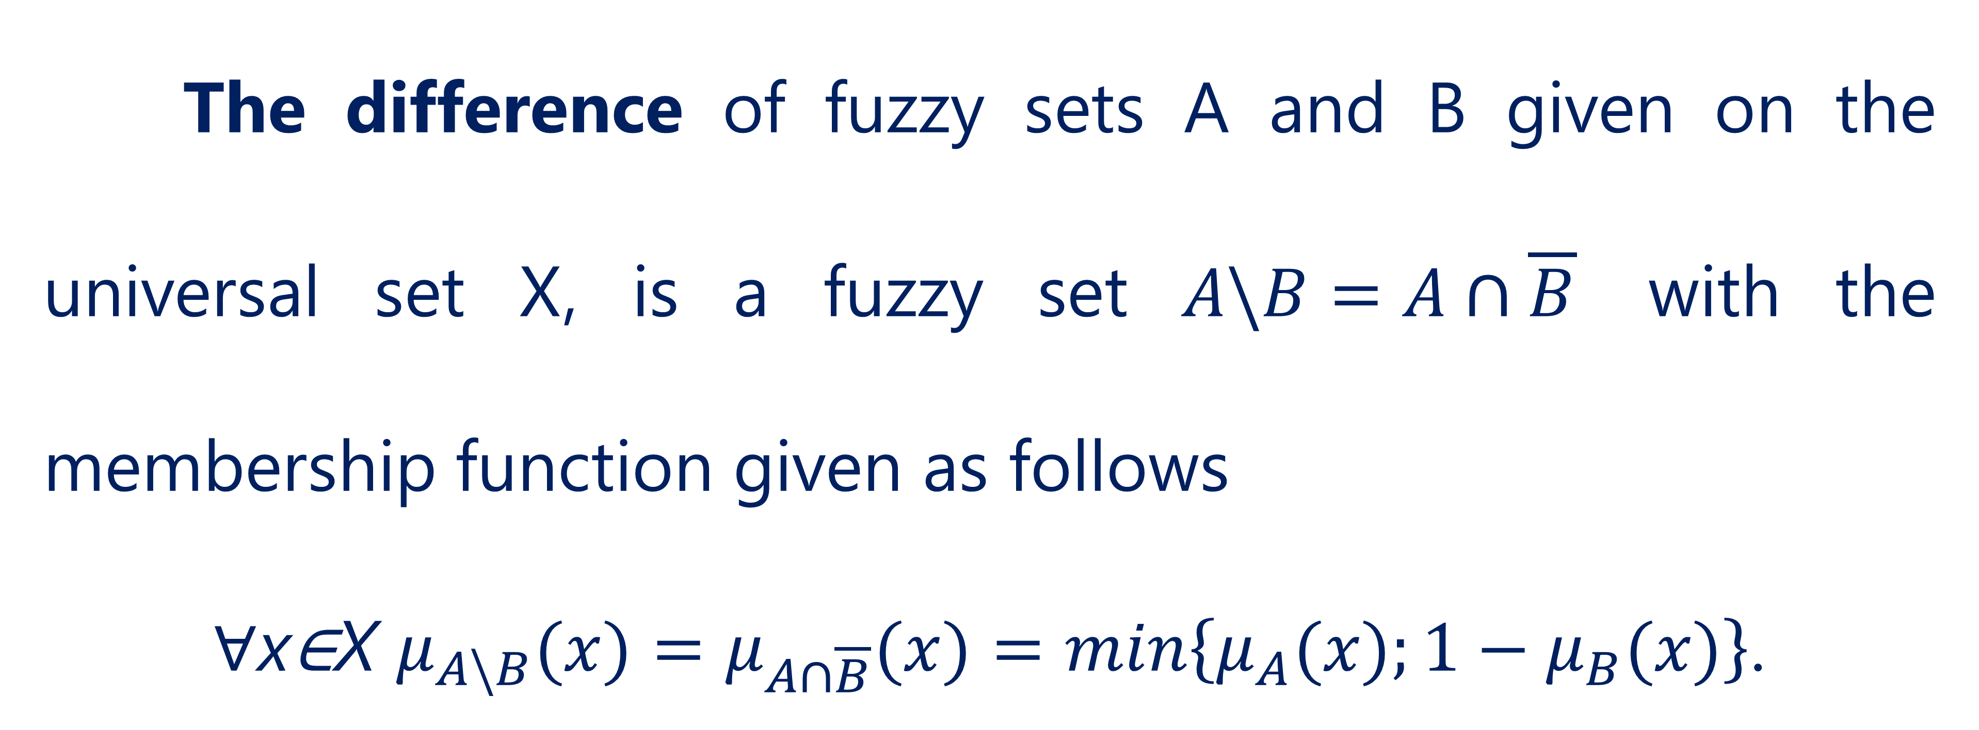
Logical operations
The difference of fuzzy sets A and B given on the universal set X, is a fuzzy set $A\backslash B=A∩\overline{B}$ with the membership function given as follows
∀x∈X $μ_{A\backslash B}(x)=μ_{A∩\overline{B}}(x)=\min\left\{μ_{A}(x);1−μ_{B}(x)\right\}$.
10

Slide 11
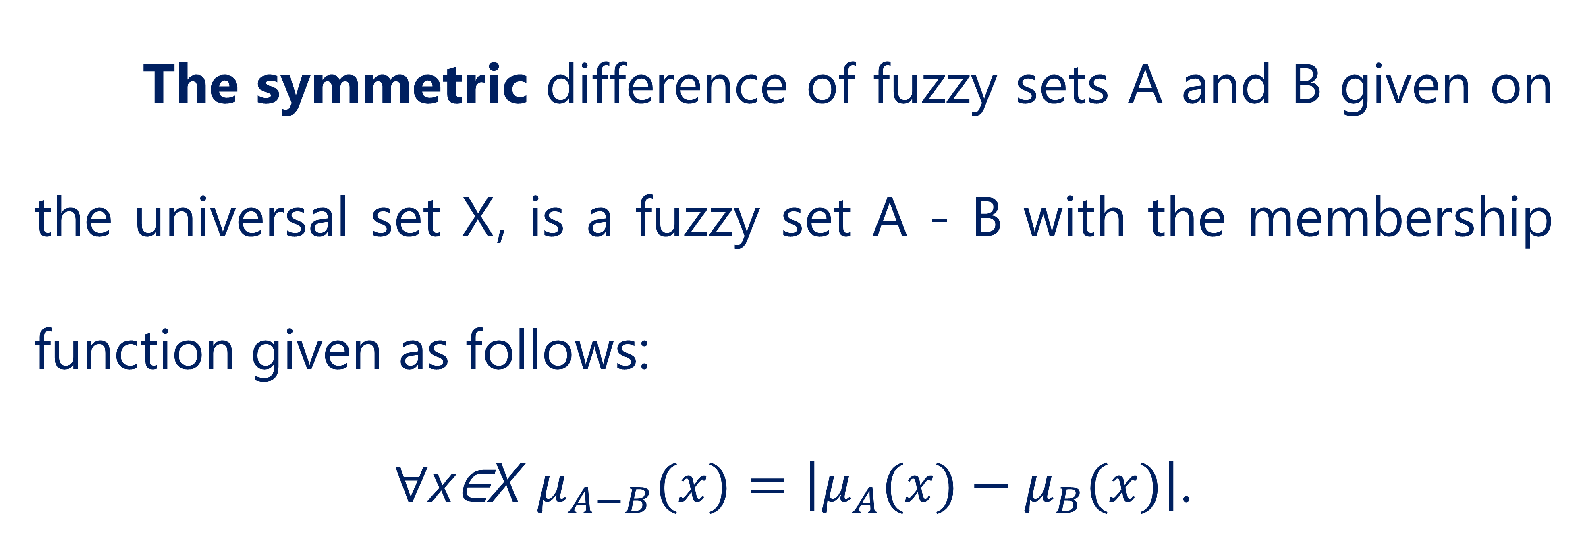
Logical operations
The symmetric difference of fuzzy sets A and B given on the universal set X, is a fuzzy set A - B with the membership function given as follows:
∀x∈X $μ_{A−B}(x)=\left|μ_{A}(x)−μ_{B}(x)\right|$.
11

Slide 12
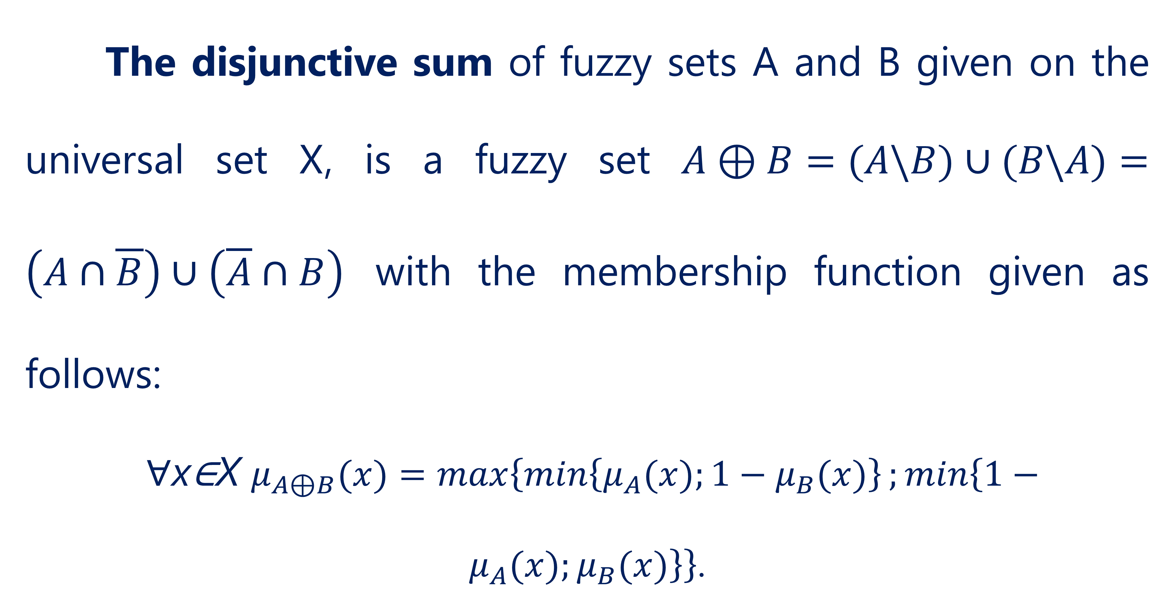
Logical operations
The disjunctive sum of fuzzy sets A and B given on the universal set X, is a fuzzy set $A⊕B=(A\backslash B)∪(B\backslash A)=\left(A∩\overline{B}\right)∪\left(\overline{A}∩B\right)$ with the membership function given as follows:
∀x∈X $μ_{A⊕B}(x)=\max\left\{\min\left\{μ_{A}(x);1−μ_{B}(x)\right\};\min\left\{1−μ_{A}(x);μ_{B}(x)\right\}\right\}$.
12

Slide 13
Logical operations
The above operations on fuzzy sets are based on the use of operations max and min. In the theory of fuzzy sets, questions of constructing generalized, parametrized operators of intersection, union, and complement are developed, which allow taking into account various semantic nuances of the corresponding linguistic connections of natural language "and", "or", "no".
13

Slide 14
Logical operations
One approach to intersection and union operators is to define them using fuzzy operators, so-called triangular norms and conforms.
14

Slide 15
Logical operations
It should be noted that the above operations of intersection and union, used both independently and when introducing operations of difference, symmetric difference and disjunctive sum this is only one of the possible options for determining these operations, introduced by the founder of the theory of fuzzy plural L. Zade.
15

Slide 16

Triangular norm and conorm
02

Slide 17
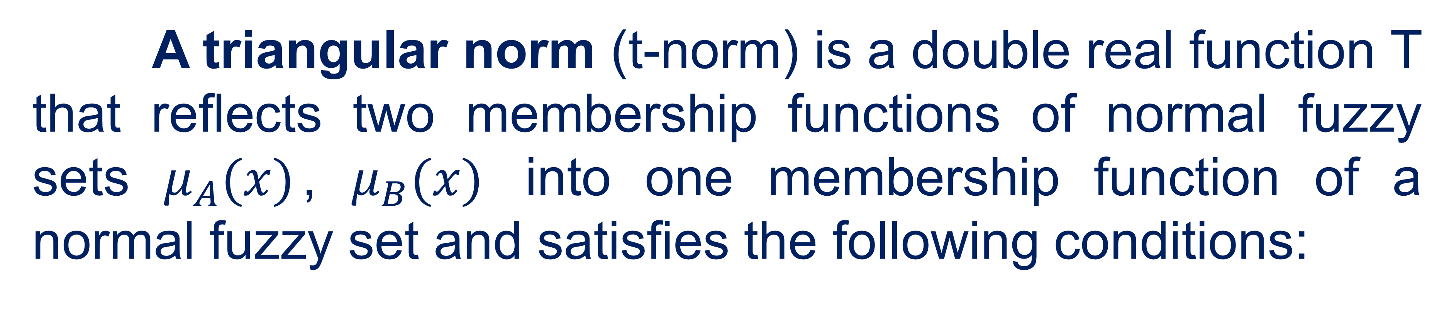
Triangular norm and conorm
A triangular norm (t-norm) is a double real function T that reflects two membership functions of normal fuzzy sets $μ_{A}(x)$, $μ_{B}(x)$ into one membership function of a normal fuzzy set and satisfies the following conditions:
17

Slide 18
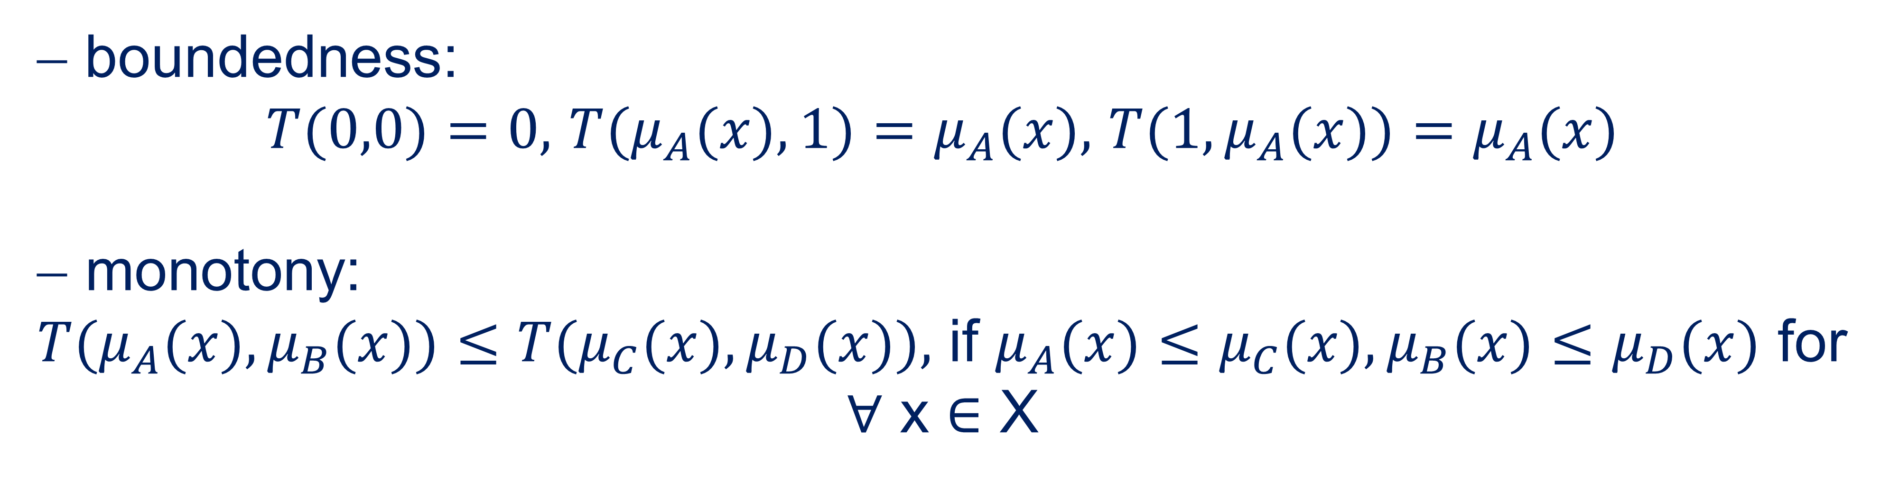
Triangular norm and conorm
− boundedness:
$T(0,0)=0,$ $T(μ_{A}(x),1)=μ_{A}(x),$ $T(1,μ_{A}(x))=μ_{A}(x)$
$\text{} \text{monotony}$:
$T(μ_{A}(x),μ_{B}(x))≤T(μ_{C}(x),μ_{D}(x)),$ if $μ_{A}(x)≤μ_{C}(x),μ_{B}(x)≤μ_{D}(x)$ for ∀ x ∈ X
18

Slide 19
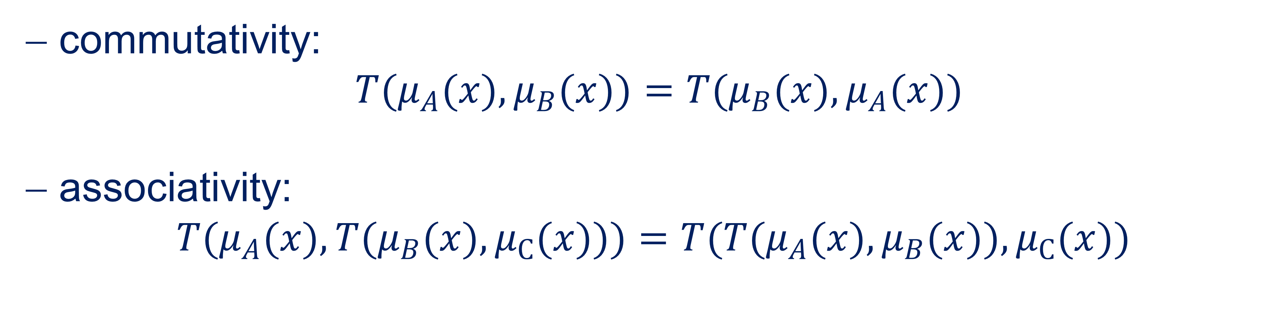
Triangular norm and conorm
− commutativity:
$T(μ_{A}(x),μ_{B}(x))=T(μ_{B}(x),μ_{A}(x))$
− associativity:
$T(μ_{A}(x),T(μ_{B}(x),μ_{С}(x)))=T(T(μ_{A}(x),μ_{B}(x)),μ_{С}(x))$
19

Slide 20
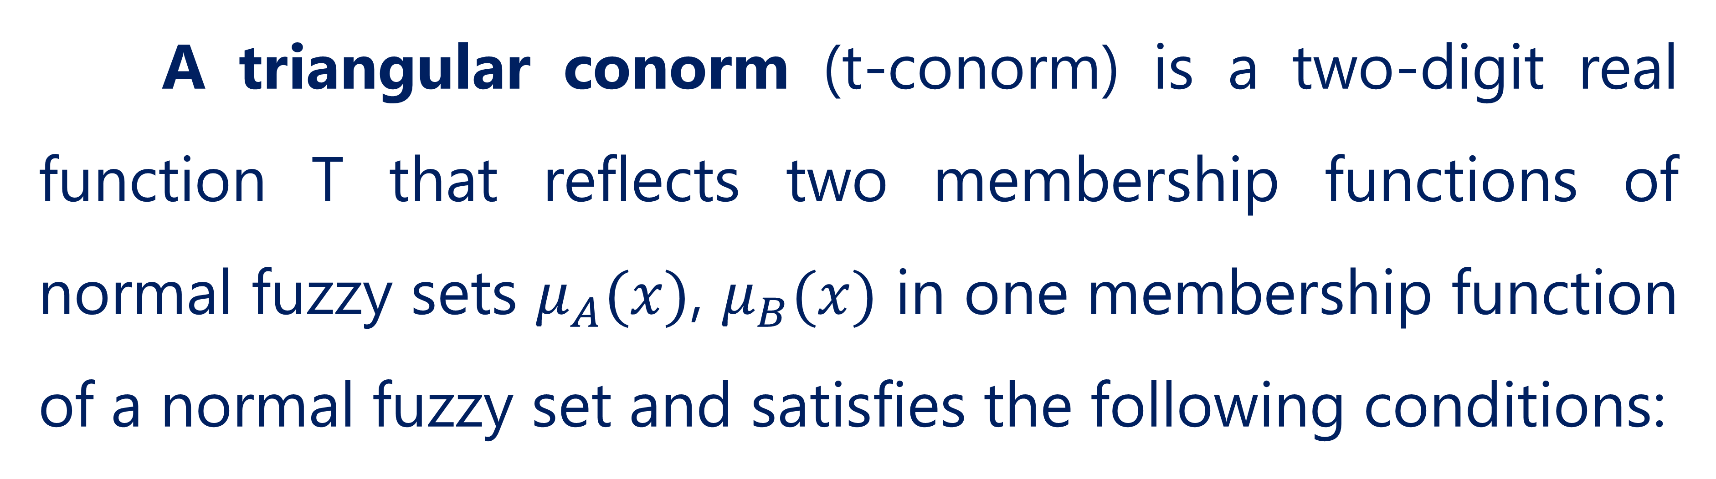
Triangular norm and conorm
A triangular conorm (t-conorm) is a two-digit real function T that reflects two membership functions of normal fuzzy sets $μ_{A}(x)$, $μ_{B}(x)$ in one membership function of a normal fuzzy set and satisfies the following conditions:
20

Slide 21
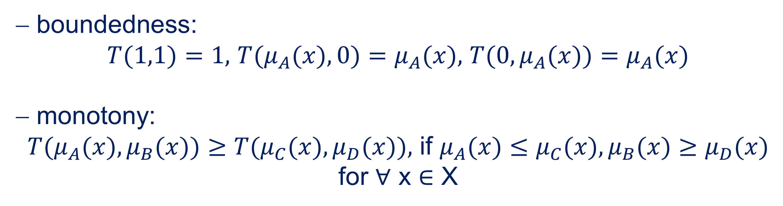
Triangular norm and conorm
− boundedness:
$T(1,1)=1,$ $T(μ_{A}(x),0)=μ_{A}(x),$ $T(0,μ_{A}(x))=μ_{A}(x)$
− monotony:
$T(μ_{A}(x),μ_{B}(x))≥T(μ_{C}(x),μ_{D}(x)),$ if $μ_{A}(x)≤μ_{C}(x),μ_{B}(x)≥μ_{D}(x)$ for ∀ x ∈ X
21

Slide 22
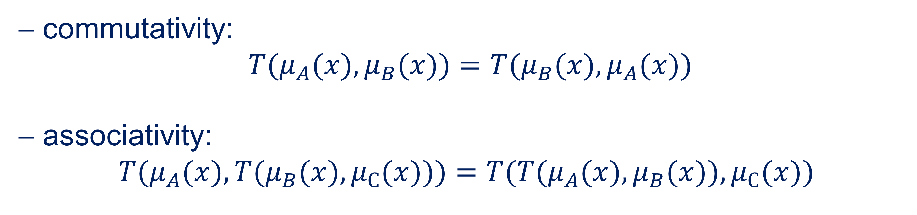
Triangular norm and conorm
− commutativity:
$T(μ_{A}(x),μ_{B}(x))=T(μ_{B}(x),μ_{A}(x))$
− associativity:
$$T(μ_{A}(x),T(μ_{B}(x),μ_{С}(x)))=T(T(μ_{A}(x),μ_{B}(x)),μ_{С}(x))$$
22

Slide 23
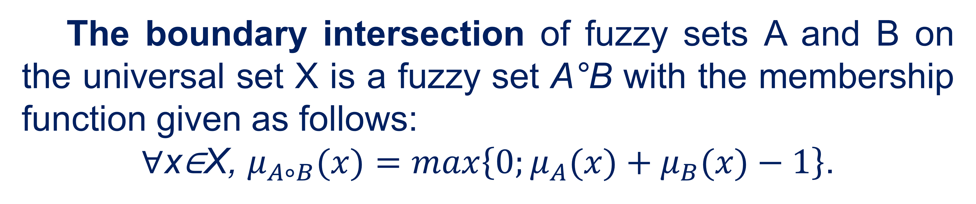
Triangular norm and conorm
The boundary intersection of fuzzy sets A and B on the universal set X is a fuzzy set A°B with the membership function given as follows:
∀x∈X, $μ_{A∘B}(x)=\max\left\{0;μ_{A}(x)+μ_{B}(x)−1\right\}$.
23

Slide 24
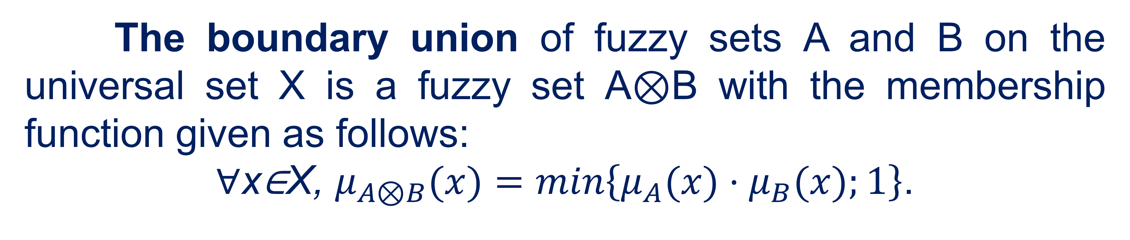
Triangular norm and conorm
The boundary union of fuzzy sets A and B on the universal set X is a fuzzy set A⊗B with the membership function given as follows:
∀x∈X, $μ_{A⊗B}(x)=\min\left\{μ_{A}(x)⋅μ_{B}(x);1\right\}$.
24

Slide 25

Algebraic operations on fuzzy sets
03

Slide 26

Algebraic operations on fuzzy sets
Algebraic product (algebraic intersection) A$⋅$ּB:
∀ x ∈ Е: µАB(x) = µА(x)µB(x).
Algebraic sum (algebraic union) А + В:
∀x∈ E : μ A+ B(x) = μ A(x) + μB(x) −μ A(x)⋅μB(x).
26

Slide 27
Algebraic operations on fuzzy sets
Properties of operations of algebraic sum and algebraic product:
− commutativity:
A⋅ B = B⋅ A, A+ B = B + A ;
− associativity:
(А⋅ В)⋅С = А⋅(В ⋅С),(А + В) + С = А + (В + С) ;
− universal upper and lower limits:
A + ∅ = A , A⋅∅=∅, A⋅ E = A, A+ E = E;
27

Slide 28
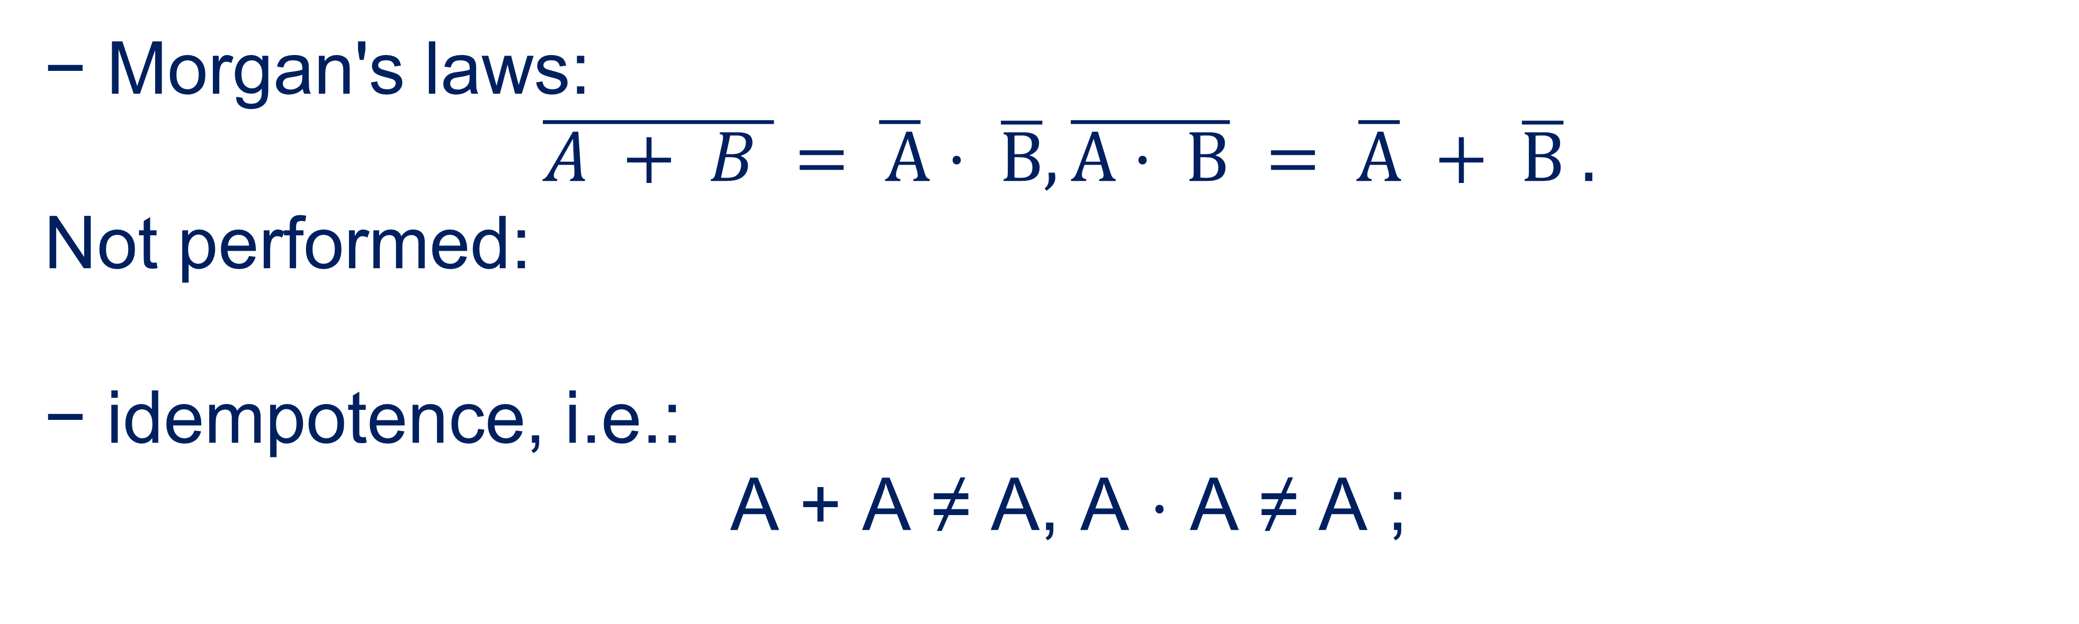
Algebraic operations on fuzzy sets
− Morgan's laws:
$\overline{A + B }=\overline{ A}⋅ \overline{B}, \overline{A⋅ B} = \overline{A} + \overline{B} .$
Not performed:
− idempotence, i.e.:
А + А ≠ А, А ⋅ А ≠ А ;
28

Slide 29
Algebraic operations on fuzzy sets
− distributivity, i.e.:
A ⋅ (B + C) ≠ ( A ⋅ B) + ( A ⋅C), A + (B ⋅C) ≠ ( A + B) ⋅ ( A + C) ;
− absorption, i.e.:
A ⋅( A + B) ≠ A, A + ( A ⋅ B) ≠ A ;
− the law of exclusion of the third and the law of identity, i.e.:
A ⋅ A ≠ ∅ , A + A ≠ E .
29

Slide 30
Algebraic operations on fuzzy sets
Limited amount (marginal pool) A|+|B:
µA|+|B(x) = min {1, µA(x)+µB(x)}.
The limited difference A|–|B:
µA|–|B = max {0, µA(x) – µB(x)}.
Limited product (boundary intersection) A|·|B:
µA|·|B(x) = max {0, µA(x)+µB(x)–1}.
30

Slide 31

04
Fuzzy implication

Slide 32
Fuzzy implication
The fuzzy implication A → B determines the causal relationship between the conditions and consequences of the rules.
32

Slide 33
Fuzzy implication
Fuzzy implication operations can be divided into three main classes:
S- implication: µА→B(x) = S{1–µА(x), 1–µB(x)}, where S is the S-norm operator;
R- implication: µА→B(x) = sup{z∈ [0, 1]| T(µА(x), z) ≤ µB(x)},
T- implication: µА→B(x) = T{µА(x), µB(x)}, where Т is the operator of the T-norm.
33

Slide 34
Fuzzy implication
Separately distinguish fuzzy implications, which are determined by:
for Zade: µА→B(x) = max{min{µА(x), µB(x)}, (1–µА(x))},
according to Kline-Dayenis: µА→B(x) = max{(1–µА(x)), µB(x)},
according to Mamdani: µА→B(x) = min{µА(x), µB(x)}.
34

Slide 35
References
Polishchuk, V. (2021). Evaluation of start-up projects in conditions of risk and uncertainty. FOP Sabov AM.
Zaychenko, Y. (2008). Nechitki modeli i metody v intelektualʹnykh systemakh: Navchalʹnyy posibnyk. Slovo.
Rotshteyn, O. (1999). Intelektualʹni tekhnolohiyi identyfikatsiyi: Nechitki mnozhyny, henetychni alhorytmy, neyronni merezhi. UNIVERSUM-Vinnytsy.
Osnovnyye printsipy postroyeniya intellektual'nykh SAU. http://nrsu.bstu.ru/contents.html
35

Slide 36
Thank you!
WWW.SITE2MAX.PRO

