Slide 1
Evaluation of start-up projects
Chapter 7
Fuzzy numbers, fuzzy mappings, and fuzzy functions, linguistic variables
Lecturer: doc. Polishchuk Volodymyr, PhD.

Slide 2
Fuzzy numbers
Lecture content
Fuzzy statements and fuzzy functions
Linguistic variables

Slide 3

01
Fuzzy numbers

Slide 4
Fuzzy numbers
Fuzzy numbers are widely used in everyday life. When we say "about three", "about twenty-five", etc., we thus assume the use of a fuzzy number.
4

Slide 5
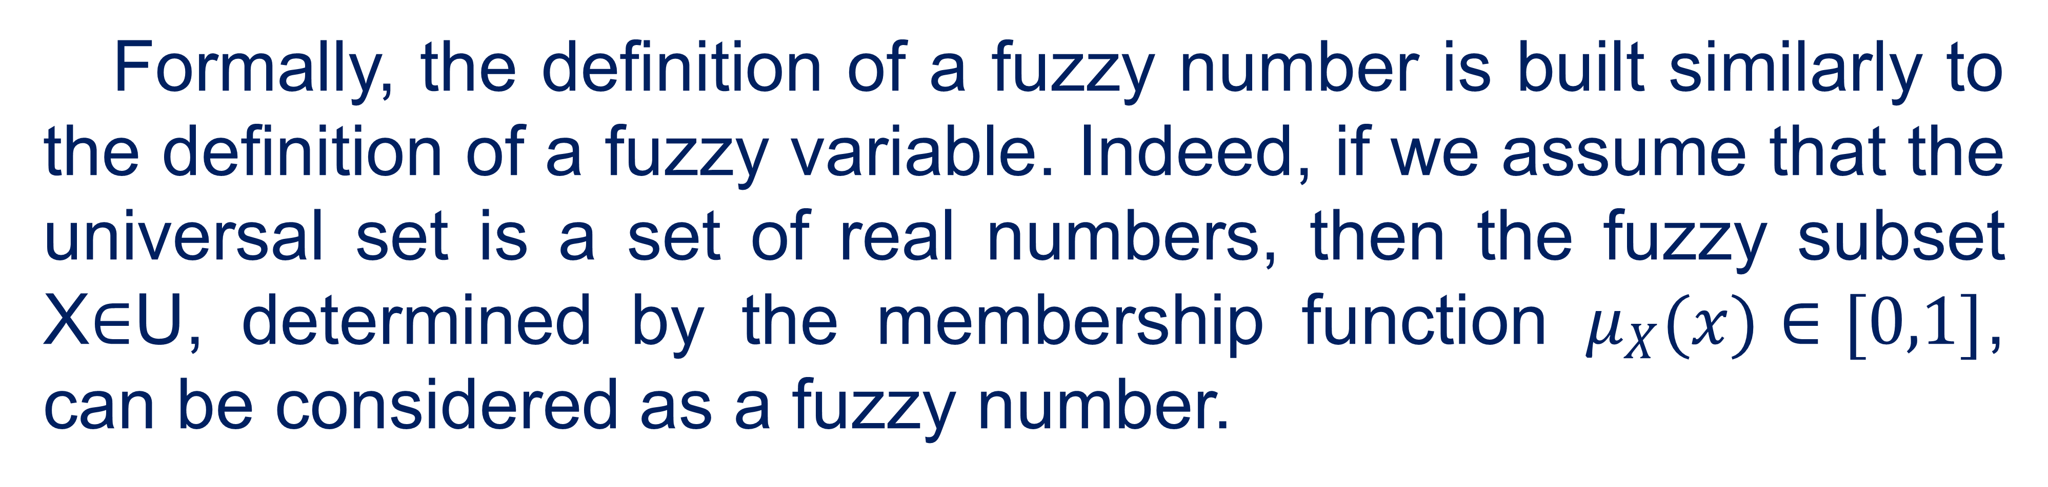
Fuzzy numbers
Formally, the definition of a fuzzy number is built similarly to the definition of a fuzzy variable. Indeed, if we assume that the universal set is a set of real numbers, then the fuzzy subset X∈U, determined by the membership function $μ_{X}(x)∈[0,1]$, can be considered as a fuzzy number.
5

Slide 6
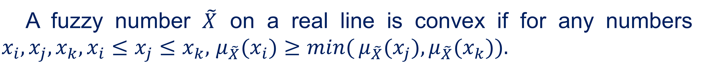
Fuzzy numbers
A fuzzy number $\tilde{X}$ on a real line is convex if for any numbers $x_{i},x_{j},x_{k},x_{i}≤x_{j}≤x_{k},$ $μ_{\tilde{X}}(x_{i})≥\min{(}μ_{\tilde{X}}(x_{j}),μ_{\tilde{X}}(x_{k})).$
A fuzzy number $\tilde{X}$ on a real line is called normal if $\max{μ_{\tilde{X}}}(x)=1$.
6

Slide 7
Fuzzy numbers
Introducing the concept of fuzzy number (fuzzy numbers), we, of course, must define some, at least the simplest, mathematical operations on these numbers. It should be noted at once that this is not a trivial task, which, moreover, in some respects has not yet been solved.
7

Slide 8
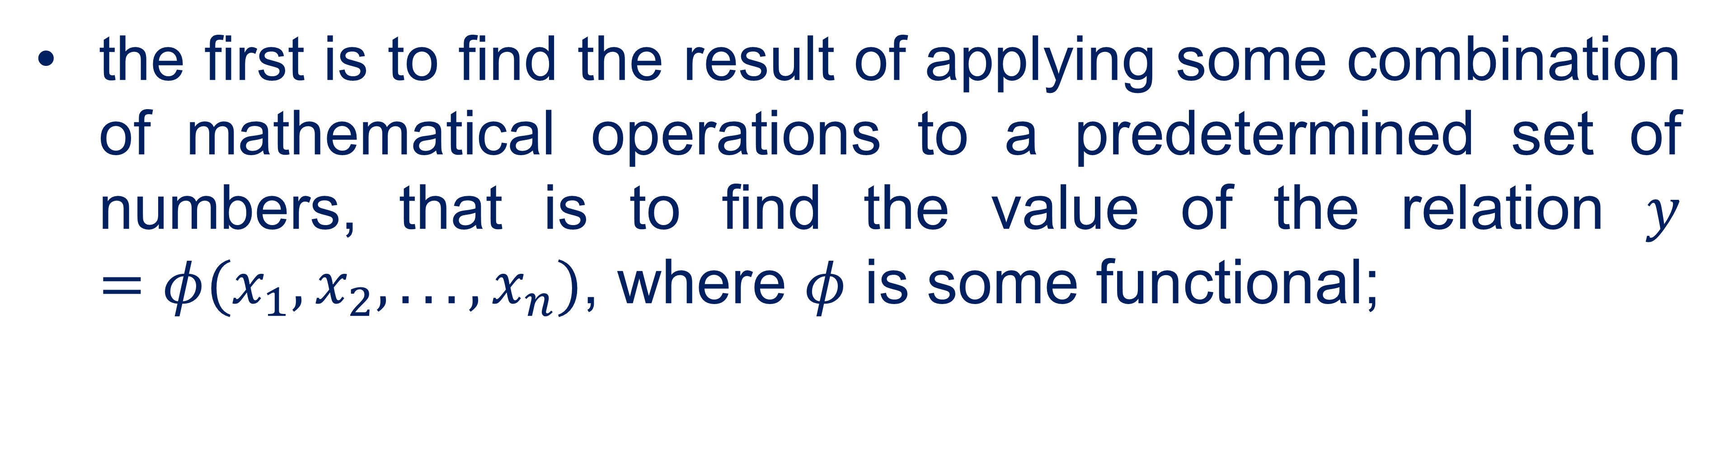
Fuzzy numbers
Mathematical operations introduced for fuzzy numbers, however, as for fuzzy ones, must solve at least two problems:
the first is to find the result of applying some combination of mathematical operations to a predetermined set of numbers, that is to find the value of the relation $y=φ(x_{1},x_{2},...,x_{n})$, where $φ$ is some functional;
8

Slide 9
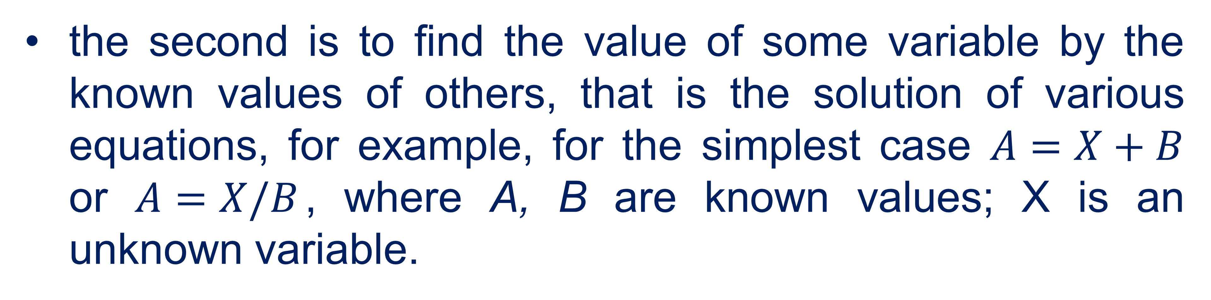
Fuzzy numbers
the second is to find the value of some variable by the known values of others, that is the solution of various equations, for example, for the simplest case $A=X+B$ or $A=X/B$, where А, В are known values; X is an unknown variable.
9

Slide 10
Fuzzy numbers
It is obvious that the condition must be met, if Х=А-В or X =АВ, then:
А=(А-В)+В=А, А=(АВ)/В=А. (1)
10

Slide 11
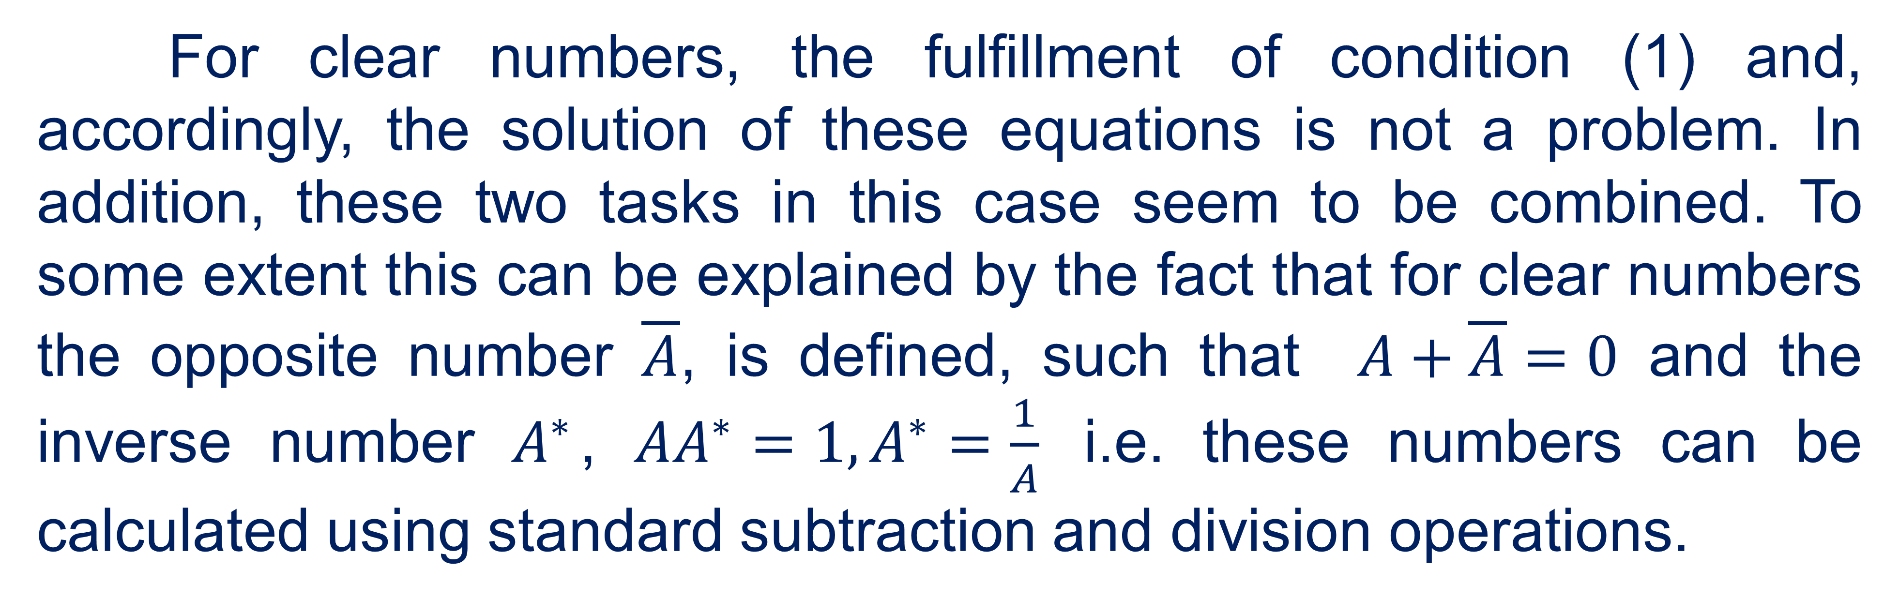
Fuzzy numbers
For clear numbers, the fulfillment of condition (1) and, accordingly, the solution of these equations is not a problem. In addition, these two tasks in this case seem to be combined. To some extent this can be explained by the fact that for clear numbers the opposite number $\overline{A}$, is defined, such that $A+\overline{A}=0$ and the inverse number $A^{∗}$, $AA^{∗}=1,A^{∗}=\frac{1}{A}$ i.e. these numbers can be calculated using standard subtraction and division operations.
11

Slide 12
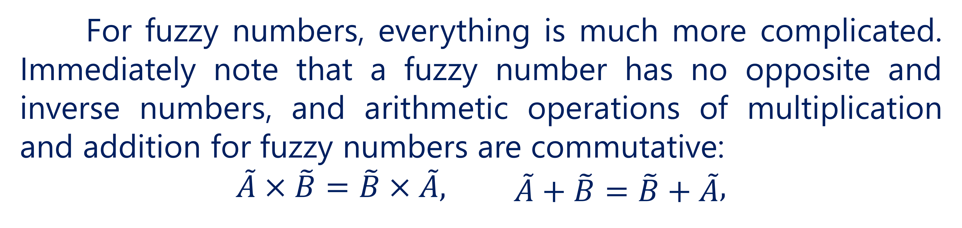
Fuzzy numbers
For fuzzy numbers, everything is much more complicated. Immediately note that a fuzzy number has no opposite and inverse numbers, and arithmetic operations of multiplication and addition for fuzzy numbers are commutative:
$$\tilde{A}×\tilde{B}=\tilde{B}×\tilde{A},\begin{matrix} & \tilde{A}+\tilde{B}=\tilde{B}+\tilde{A}\end{matrix},$$
12

Slide 13
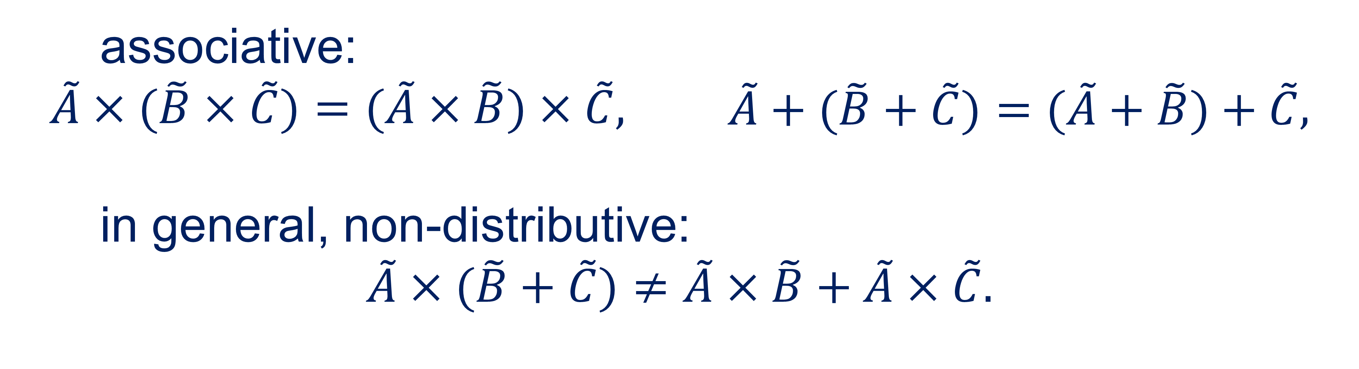
Fuzzy numbers
associative:
$$\tilde{A}×(\tilde{B}×\tilde{C})=(\tilde{A}×\tilde{B})×\tilde{C},\begin{matrix} & \tilde{A}+(\tilde{B}+\tilde{C})=(\tilde{A}+\tilde{B})+\tilde{C}\end{matrix},$$
in general, non-distributive:
$$\tilde{A}×(\tilde{B}+\tilde{C})≠\tilde{A}×\tilde{B}+\tilde{A}×\tilde{C}.$$
13

Slide 14
Fuzzy numbers
In this regard, the first and second problems for fuzzy numbers become somewhat incoherent. The problem is that the methods relating to the first problem do not give an exact solution to the second, while the methods used in solving the second problem can be applied to the first with very significant limitations.
14

Slide 15
Fuzzy numbers
To solve the first problem, we need to define algorithms for performing arithmetic operations on fuzzy numbers, to solve the second - algorithms for solving fuzzy equations.
15

Slide 16
Fuzzy numbers
The ultimate goal of any algorithm for performing arithmetic operations on fuzzy numbers is to calculate the membership function for any point of the carrier of the result of performing a given arithmetic operation on the original fuzzy numbers.
16

Slide 17
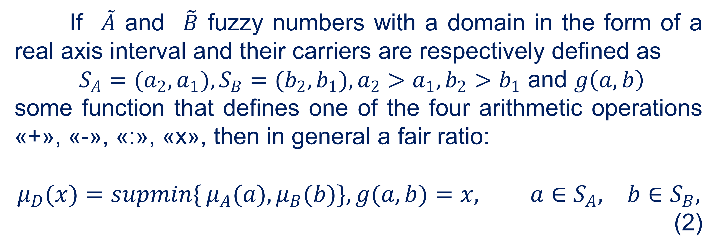
Fuzzy numbers
If $\tilde{A}$ and $\tilde{B}$ fuzzy numbers with a domain in the form of a real axis interval and their carriers are respectively defined as
$S_{A}=(a_{2},a_{1}),S_{B}=(b_{2},b_{1}),a_{2}>a_{1},b_{2}>b_{1}$ and $g\left(a,b\right)$
some function that defines one of the four arithmetic operations «+», «-», «:», «х», then in general a fair ratio:
$$μ_{D}(x)=\operatorname{supmin}{\{}μ_{A}(a),μ_{B}(b)\},g(a,b)=x,\begin{matrix} & a∈S_{A}, & b∈S_{B},\end{matrix}$$
(2)
17

Slide 18
Fuzzy numbers
which reflect the principle of generalization, first formulated by L. Zade. If the function g is a function of a larger number of arguments, then the principle of generalization is written similarly.
18

Slide 19
Fuzzy numbers
Relation (2) is to some extent the basis of various arithmetic algorithms for fuzzy numbers. A significant number of them can be explained by the different accuracy of the calculation of the membership function and computational costs. Below are some of the simplest, but at the same time have the most practical application of algorithms.
19

Slide 20
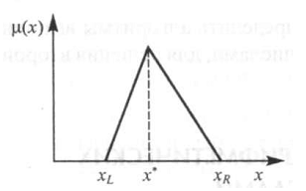
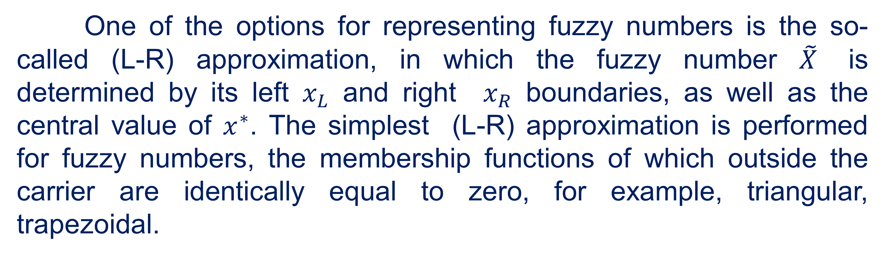
Fuzzy numbers
One of the options for representing fuzzy numbers is the so-called (L-R) approximation, in which the fuzzy number $\tilde{X}$ is determined by its left $x_{L}$ and right $x_{R}$ boundaries, as well as the central value of $x^{∗}$. The simplest (L-R) approximation is performed for fuzzy numbers, the membership functions of which outside the carrier are identically equal to zero, for example, triangular, trapezoidal.
20

Slide 21
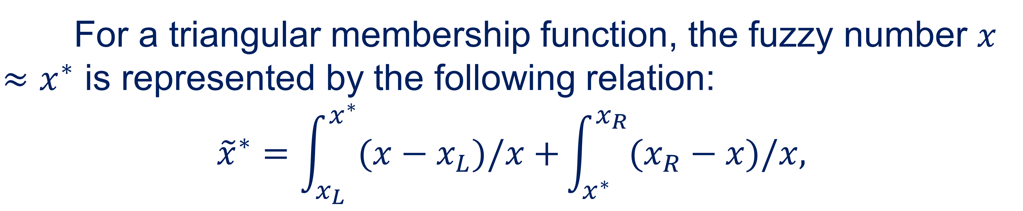
Fuzzy numbers
For a triangular membership function, the fuzzy number $x≈x^{∗}$ is represented by the following relation:
$${\tilde{x}}^{∗}=\int_{x_{L}}^{x^{∗}}{(x−x_{L})/x+}\int_{x^{∗}}^{x_{R}}{(x_{R}−x)/x,}$$
means the union of all $x∈[x_{L},x^{∗}]$ and $x∈[x^{∗},x_{R}]$respectively.
21

Slide 22
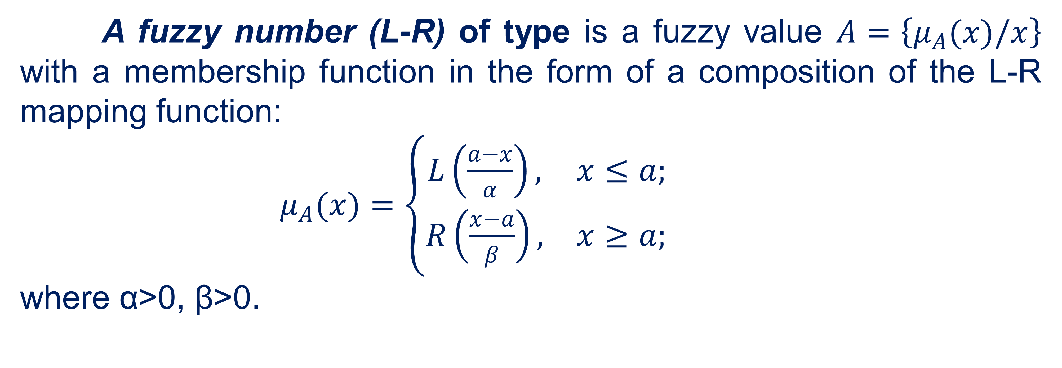
Fuzzy numbers
A fuzzy number (L-R) of type is a fuzzy value $A=\left\{μ_{A}(x)/x\right\}$ with a membership function in the form of a composition of the L-R mapping function:
$μ_{A}(x)=\left\{\begin{matrix}L\left(\frac{a−x}{α}\right), & x≤a; \\ R\left(\frac{x−a}{β}\right), & x≥a;\end{matrix}\right.$
where α>0, β>0.
22

Slide 23

Fuzzy statements and fuzzy functions
02

Slide 24
Fuzzy statements and fuzzy functions
A vague statement is a sentence in relation to which one can judge the degree of its truth or complexity at present. The degree of truth or the degree of complexity of each fuzzy statement takes values ​​from a closed interval [0,1], and 0 and 1 are the limit values ​​of the degree of truth and coincide with the concepts of "false" and "true" for clear statements.
24

Slide 25
Fuzzy statements and fuzzy functions
The truth of a vague statement, in general, is a subjective characteristic and depends on many factors, including the use of a vague statement. In the theory of fuzzy sets, fuzzy conditional statements and rules of fuzzy inference have become widespread.
25

Slide 26
Fuzzy statements and fuzzy functions
This circumstance is due to the fact that in the semantics of ordinary language there is a certain number of fuzzy concepts and conditional rules in which the causes of the investigation include such concepts. Practice shows that the formalization of rules for fuzzy conditional conclusions can be extremely diverse and should be based on the use of multivalued logic circuits.
26

Slide 27
Fuzzy statements and fuzzy functions
The study of the rules of conditional inference covers mainly three types of conditional sentences:
Р1: if х is А, then у is В;
Р2: if х is А, then у is В, else у є С;
Р3: if х1 is А1 and х2 is А2, and ... хn is Аn, then у є В.
27

Slide 28
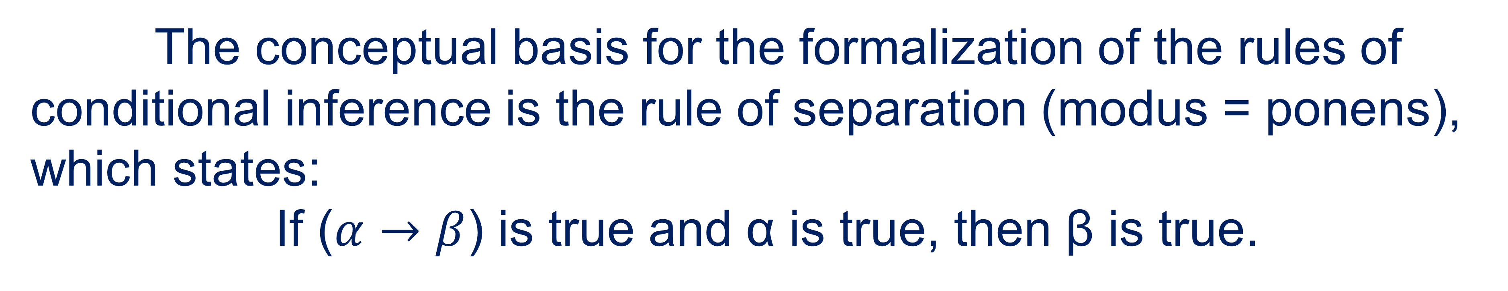
Fuzzy statements and fuzzy functions
The conceptual basis for the formalization of the rules of conditional inference is the rule of separation (modus = ponens), which states:
If ($α→β$) is true and α is true, then β is true.
28

Slide 29
Fuzzy statements and fuzzy functions
In turn, the methodological basis of such formalization is the compositional rule proposed by L. Zade. Using this rule, he formulated some rules of inference, in which the logical reasons for the investigation are conditional sentences that include a vague concept.
29

Slide 30
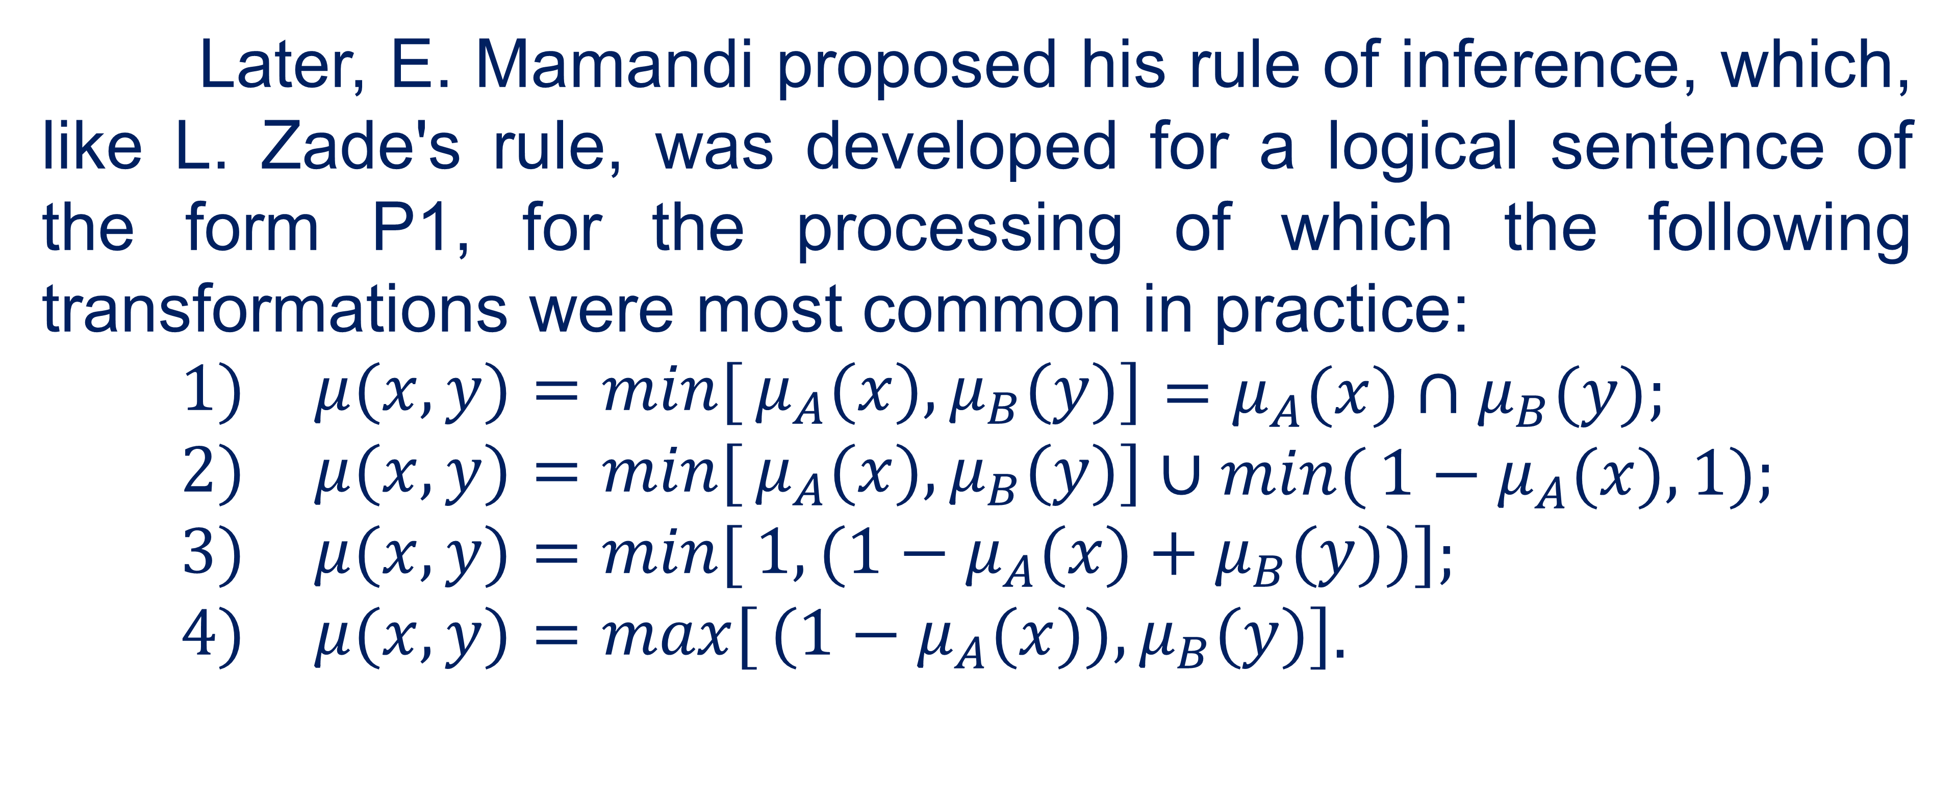
Fuzzy statements and fuzzy functions
Later, E. Mamandi proposed his rule of inference, which, like L. Zade's rule, was developed for a logical sentence of the form Р1, for the processing of which the following transformations were most common in practice:
$$\begin{matrix}1) & μ(x,y)=\min{[}μ_{A}(x),μ_{B}(y)]\end{matrix}=μ_{A}(x)∩μ_{B}(y); \\ \begin{matrix}2) & μ(x,y)=\min{[}μ_{A}(x),μ_{B}(y)]\end{matrix}∪\min{(}1−μ_{A}(x),1); \\ \begin{matrix}3) & μ(x,y)=\min{[}1,(1−μ_{A}(x)+μ_{B}(y))]\end{matrix}; \\ \begin{matrix}4) & μ(x,y)=\max{[}(1−μ_{A}(x)),μ_{B}(y)]\end{matrix}.$$
30

Slide 31
Fuzzy statements and fuzzy functions
The first formula is convenient because it preserves the width of the values ​​of membership functions and allows you to select each rule and the process of changing it, even from the information in tabular form.
31

Slide 32
Fuzzy statements and fuzzy functions
Among the disadvantages of this formula are commutativity, lack of difference between expressions of type (A∩B) → C and A → (B → C) and the inability to use the connection OR instead of I to interpret the connection OTHER to obtain a protocol for applying the rules:
RULE 1, OTHERWISE RULE 2, OTHERWISE ....
32

Slide 33
Fuzzy statements and fuzzy functions
Other ratios are devoid of this drawback due to the fact that each rule can not compare its area of ​​influence. For example, the arithmetic relationships in the third formula lead to new values ​​of membership functions and require some approximation. Note that this relation corresponds to the operation of implication for Lukasevich's multivalued logic.
33

Slide 34
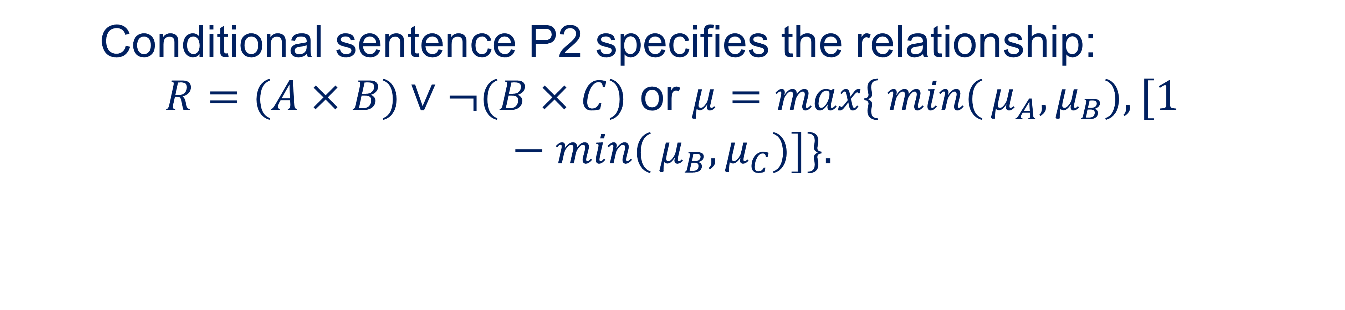
Fuzzy statements and fuzzy functions
Formula four is devoid of all these shortcomings and is the most "human" in nature, because if condition A gives consequence B, then condition A ', close to A, gives consequence B', close to B. This property is especially important for systems involving "Human factor", where not all situations can be specified using a set of rules.
Conditional sentence Р2 specifies the relationship:
$R=(A×B)∨¬(B×C)$ or $μ=\max{\{}\min{(}μ_{A},μ_{B}),[1−\min{(}μ_{B},μ_{C})]\}.$
34

Slide 35
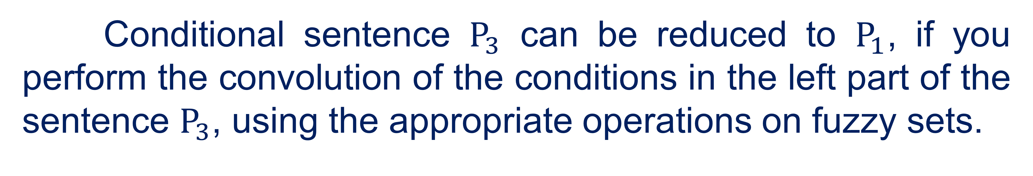
Fuzzy statements and fuzzy functions
Conditional sentence $P_{3}$ can be reduced to $P_{1}$, if you perform the convolution of the conditions in the left part of the sentence $P_{3}$, using the appropriate operations on fuzzy sets.
35

Slide 36
Fuzzy statements and fuzzy functions
In systems based on the processing of fuzzy conditional sentences, there are usually three stages:
fuzzyfication;
search for the appropriate conditional sentence and its processing;
making final decisions - defuzzyfication
36

Slide 37
Fuzzy statements and fuzzy functions
At the stage of fuzzyfication, the linguistic meanings of process variables are determined. In this case, depending on the nature of the problem, linguistic values ​​can be determined by an expert (experts) or by comparing a specific value of the variable with possible linguistic.
37

Slide 38
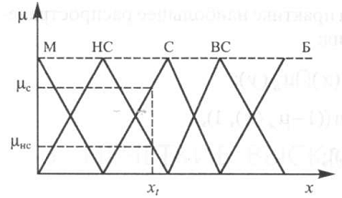
Fuzzy statements and fuzzy functions
In the second stage, a suitable rule is either formed by an expert, or according to the linguistic meaning obtained during fasification, it is extracted from the knowledge base, which contains different variants of conditional sentences. The selection of a suitable proposal is performed according to the content of the conditional part of the fuzzy proposal.
38

Slide 39
Fuzzy statements and fuzzy functions
At the same time, it may be necessary to take into account the second linguistic significance. Fuzzyfication is performed for all process variables involved in the conditional part of fuzzy sentences.
39

Slide 40
Fuzzy statements and fuzzy functions
In the second stage, a suitable rule is either formed by an expert, or according to the linguistic meaning obtained during fuzzyfication, it is extracted from the knowledge base, which contains different variants of conditional sentences. The selection of a suitable proposal is performed according to the content of the conditional part of the fuzzy proposal.
40

Slide 41
Fuzzy statements and fuzzy functions
If a decision is made on the need to take into account both linguistic meanings, then at least two relevant conditional sentences may appear in the knowledge base. In more complex situations, the number of such proposals may be greater. When taking into account several relevant rules can be used algorithms Mamandi, Sukamoto, Larsen, etc.
41

Slide 42

Linguistic variables
03

Slide 43
Linguistic variables
Linguistic variable is defined as <B, T, X, G, M>, where B is the name of the variable, T is the set of its values ​​(basic term set), consisting of the names of fuzzy variables, the domain of each of which is the set X; G - syntactic procedure (grammar), which allows you to operate on the elements of the term set T, in particular - to generate new meaningful terms; T= T ∪ G (T) specifies an extended term set (∪ is a union sign); M is a semantic procedure that allows assigning fuzzy semantics to each new value of a linguistic variable by forming a new fuzzy set.
43

Slide 44
Linguistic variables
A linguistic variable is a set of fuzzy variables, it is used to give a verbal description of some fuzzy number obtained as a result of some operations.
A term set is a set of all possible values ​​of a linguistic variable.
A term is any element of a term set. In fuzzy set theory, a term is formalized by a fuzzy set using the membership function.
A fuzzy term is a fuzzy set that has a property that corresponds to a certain concept.
44

Slide 45
References
Polishchuk, V. (2021). Evaluation of start-up projects in conditions of risk and uncertainty. FOP Sabov AM.
Zaychenko, Y. (2008). Nechitki modeli i metody v intelektualʹnykh systemakh: Navchalʹnyy posibnyk. Slovo.
Rotshteyn, O. (1999). Intelektualʹni tekhnolohiyi identyfikatsiyi: Nechitki mnozhyny, henetychni alhorytmy, neyronni merezhi. UNIVERSUM-Vinnytsy.
Osnovnyye printsipy postroyeniya intellektual'nykh SAU. http://nrsu.bstu.ru/contents.html
45

Slide 46
Thank you!
WWW.SITE2MAX.PRO

