Slide 1
Evaluation of start-up projects
Chapter 9
Fuzzy evaluation model of start-up projects
Lecturer: doc. Polishchuk Volodymyr, PhD.

Slide 2
Information model
Lecture content
Mathematical model
Example
Questionnaire-evaluation of startup projects

Slide 3

Information model
01

Slide 4
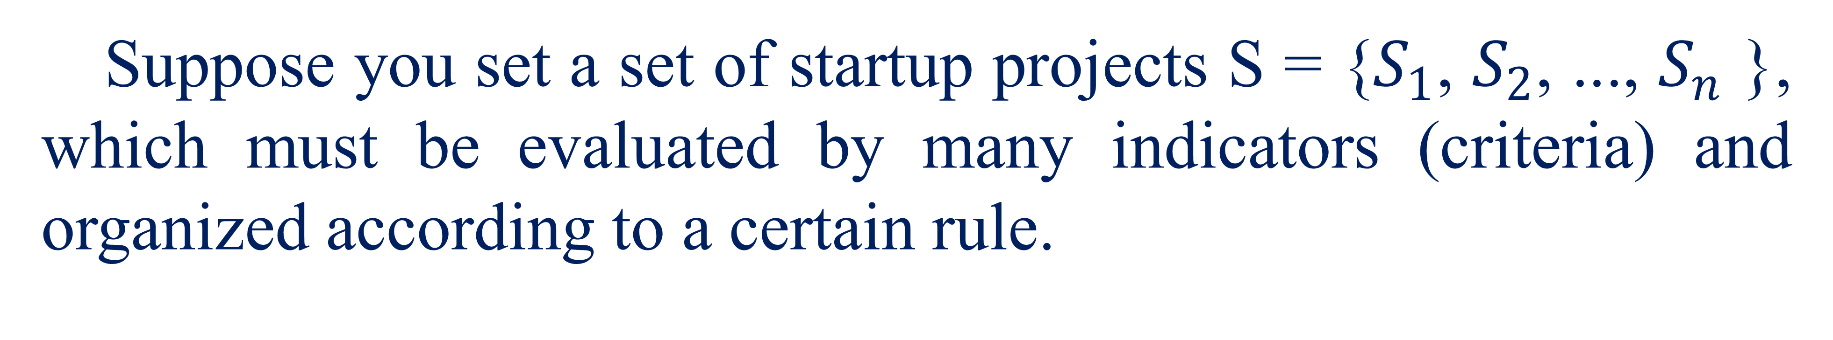
Information model
Suppose you set a set of startup projects S = {$S_{1}$, $S_{2}$, ..., $S_{n}$ }, which must be evaluated by many indicators (criteria) and organized according to a certain rule.
4

Slide 5
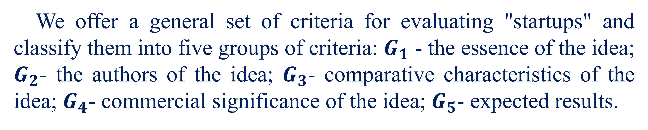
Information model
We offer a general set of criteria for evaluating "startups" and classify them into five groups of criteria: $G_{1}$ - the essence of the idea; $G_{2}$- the authors of the idea; $G_{3}$- comparative characteristics of the idea; $G_{4}$- commercial significance of the idea; $G_{5}$- expected results.
5

Slide 6
Information model
To obtain a score for each criterion, present it as a question and describe the corresponding gradation scale. For evaluation it is necessary to choose the option that is close to the truth.
6

Slide 7

Mathematical model
02

Slide 8
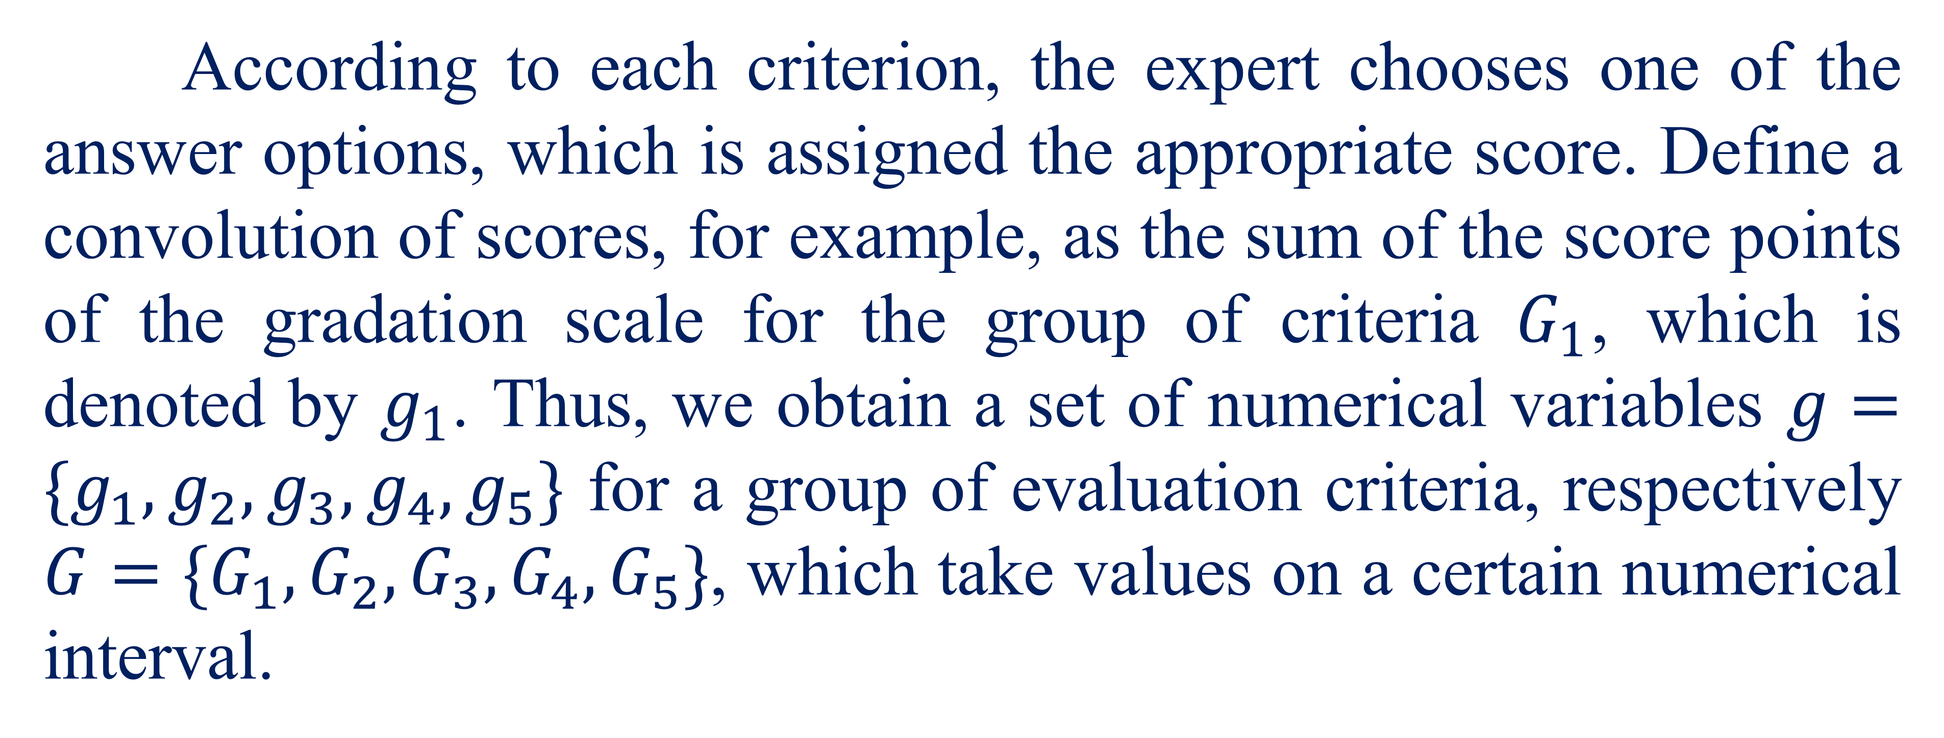
Mathematical model
According to each criterion, the expert chooses one of the answer options, which is assigned the appropriate score. Define a convolution of scores, for example, as the sum of the score points of the gradation scale for the group of criteria $G_{1}$, which is denoted by $g_{1}$. Thus, we obtain a set of numerical variables $g=\{g_{1},g_{2},g_{3},g_{4},g_{5}\}$ for a group of evaluation criteria, respectively $G=\{G_{1},G_{2},G_{3},G_{4},G_{5}\}$, which take values ​​on a certain numerical interval.
8

Slide 9
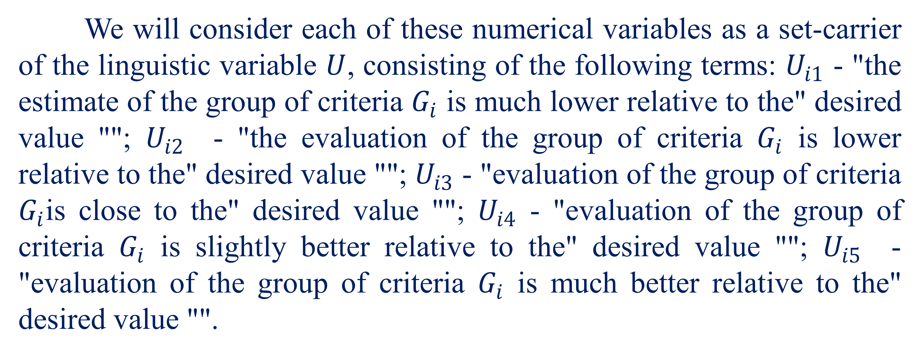
Mathematical model
We will consider each of these numerical variables as a set-carrier of the linguistic variable $U$, consisting of the following terms: $U_{i1}$ - "the estimate of the group of criteria $G_{i}$ is much lower relative to the" desired value ""; $U_{i2}$ - "the evaluation of the group of criteria $G_{i}$ is lower relative to the" desired value ""; $U_{i3}$ - "evaluation of the group of criteria $G_{i}$is close to the" desired value ""; $U_{i4}$ - "evaluation of the group of criteria $G_{i}$ is slightly better relative to the" desired value ""; $U_{i5}$ - "evaluation of the group of criteria $G_{i}$ is much better relative to the" desired value "".
9

Slide 10
Mathematical model
«Desired valuesis» a conditional convolution of points that satisfies the decision maker in considering, evaluating and selecting startups.
Gradation scales and convolutions of points on other considered groups of criteria are similarly defined.
10

Slide 11
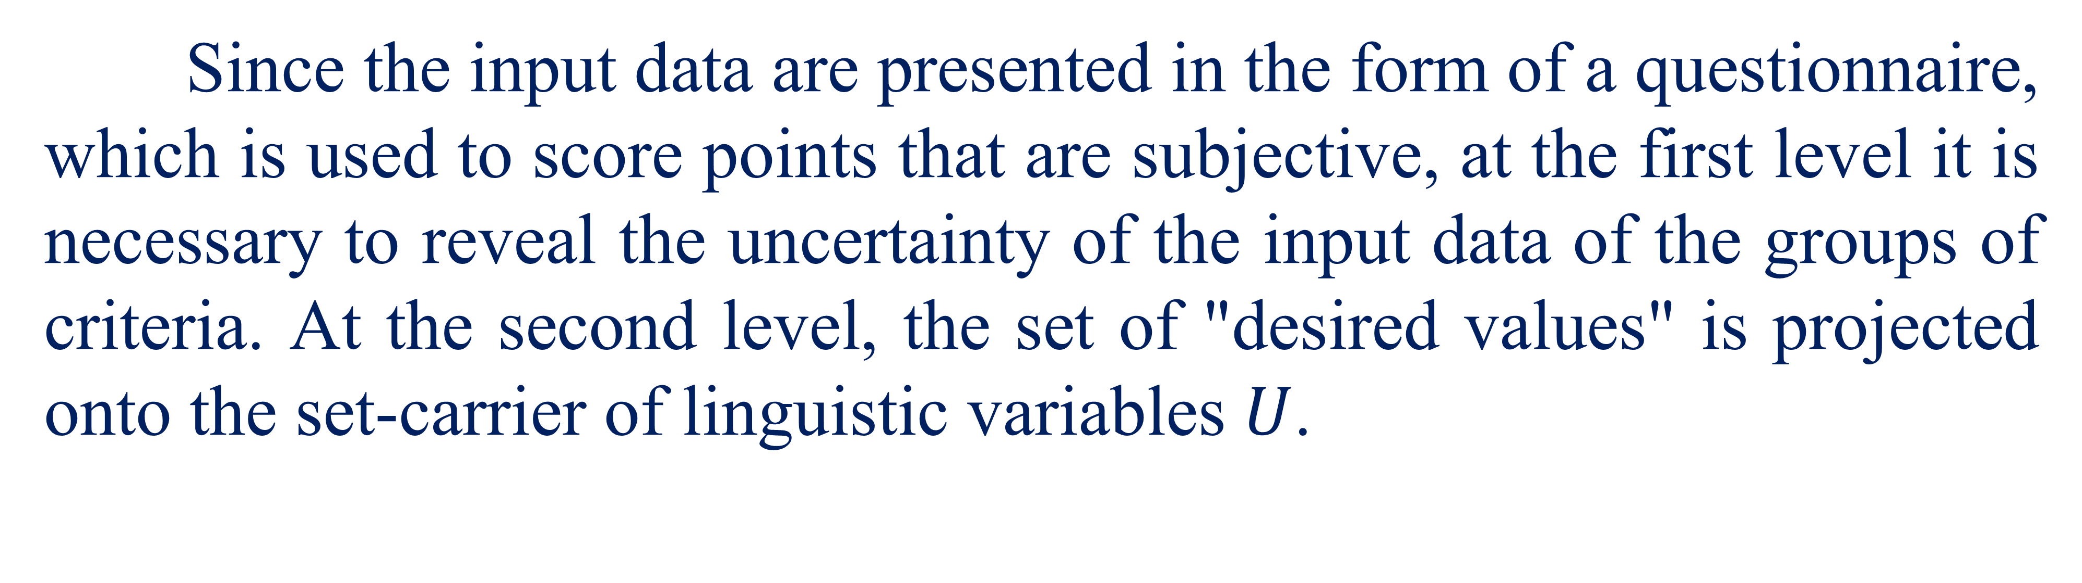
Mathematical model
Since the input data are presented in the form of a questionnaire, which is used to score points that are subjective, at the first level it is necessary to reveal the uncertainty of the input data of the groups of criteria. At the second level, the set of "desired values" is projected onto the set-carrier of linguistic variables $U$.
11

Slide 12
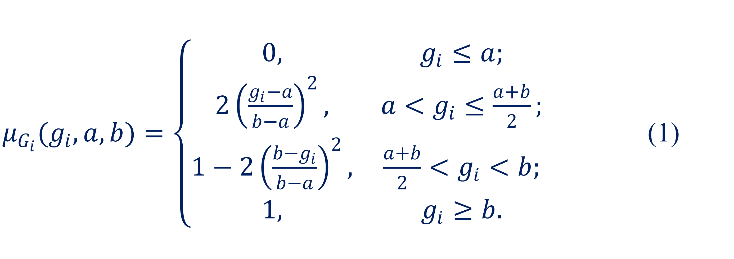
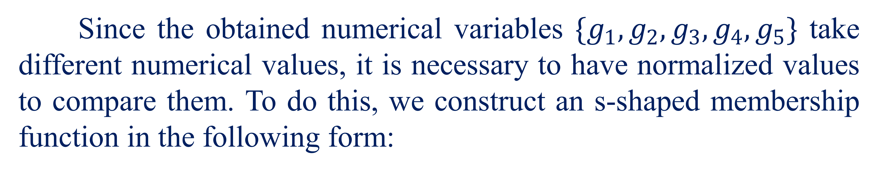
Mathematical model
Consider the first level - the fassification of input data.
Since the obtained numerical variables $\{g_{1},g_{2},g_{3},g_{4},g_{5}\}$ take different numerical values, it is necessary to have normalized values to compare them. To do this, we construct an s-shaped membership function in the following form:
$μ_{G_{i}}(g_{i},a,b)=\left\{\begin{matrix}0, & g_{i}≤a; \\ 2{\left(\frac{g_{i}−a}{b−a}\right)}^{2}, & a<g_{i}≤\frac{a+b}{2}; \\ 1−2{\left(\frac{b−g_{i}}{b−a}\right)}^{2}, & \frac{a+b}{2}<g_{i}<b; \\ 1, & g_{i}≥b.\end{matrix}\right.$ (1)
12

Slide 13
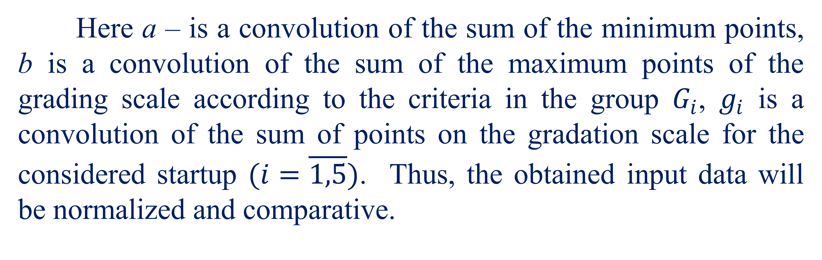
Mathematical model
Here а – is a convolution of the sum of the minimum points, b is a convolution of the sum of the maximum points of the grading scale according to the criteria in the group $G_{i}$, $g_{i}$ is a convolution of the sum of points on the gradation scale for the considered startup $(i=\overline{1,5})$. Thus, the obtained input data will be normalized and comparative.
13

Slide 14
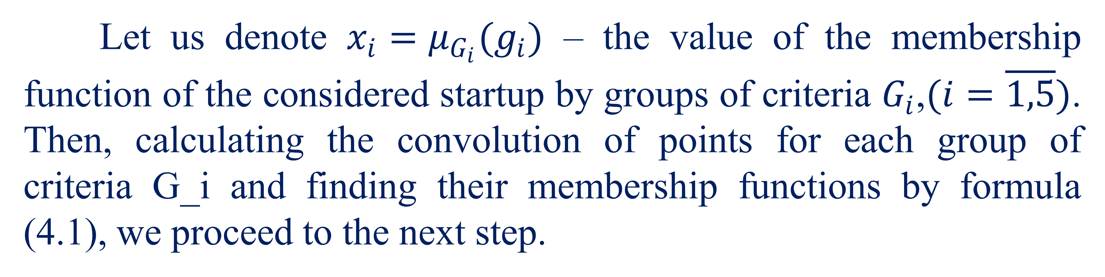
Mathematical model
Let us denote $x_{i}=μ_{G_{i}}(g_{i})$ – the value of the membership function of the considered startup by groups of criteria $G_{i}$,$(i=\overline{1,5})$. Then, calculating the convolution of points for each group of criteria G_i and finding their membership functions by formula (4.1), we proceed to the next step.
14

Slide 15
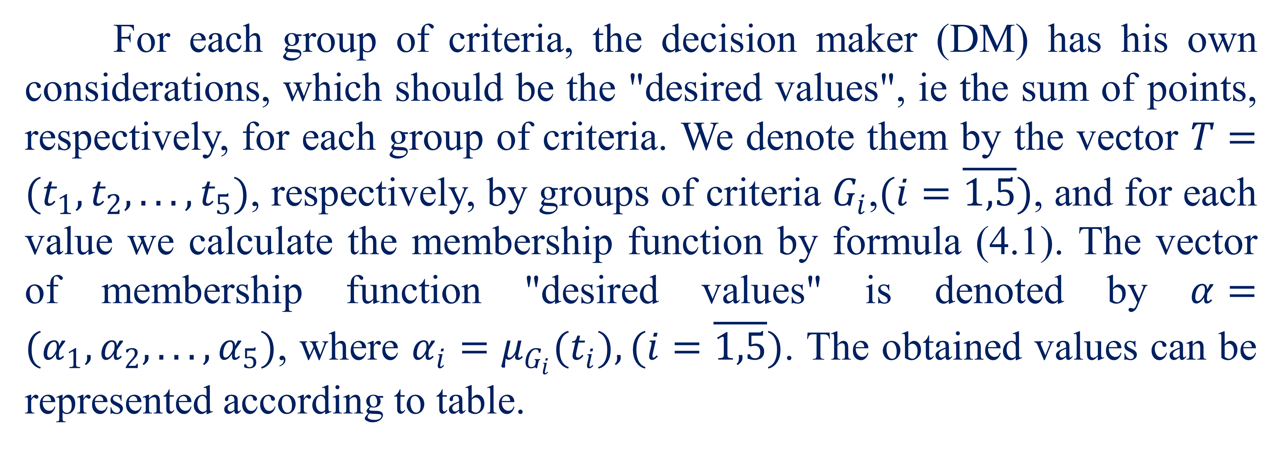
Mathematical model
For each group of criteria, the decision maker (DM) has his own considerations, which should be the "desired values", ie the sum of points, respectively, for each group of criteria. We denote them by the vector $T=(t_{1},t_{2},...,t_{5})$, respectively, by groups of criteria $G_{i}$,$(i=\overline{1,5})$, and for each value we calculate the membership function by formula (4.1). The vector of membership function "desired values" is denoted by $α=(α_{1},α_{2},...,α_{5})$, where $α_{i}=μ_{G_{i}}(t_{i}),(i=\overline{1,5})$. The obtained values can be represented according to table.
15

Slide 16
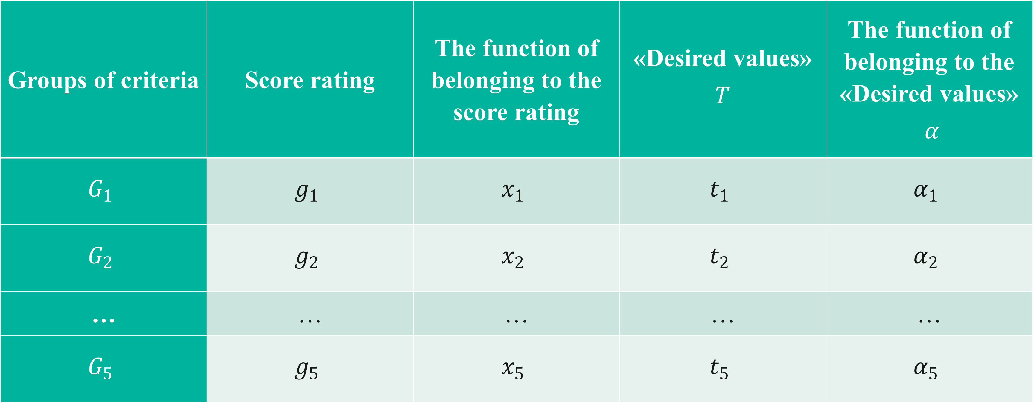
Mathematical model
Groups of criteria | Score rating | The function of belonging to the score rating | «Desired values» $$T$$ | The function of belonging to the «Desired values» $α$
$$G_{1}$$ | $$g_{1}$$ | $$x_{1}$$ | $$t_{1}$$ | $$α_{1}$$
$$G_{2}$$ | $$g_{2}$$ | $$x_{2}$$ | $$t_{2}$$ | $$α_{2}$$
… | … | … | … | …
$$G_{5}$$ | $$g_{5}$$ | $$x_{5}$$ | $$t_{5}$$ | $$α_{5}$$
16

Slide 17
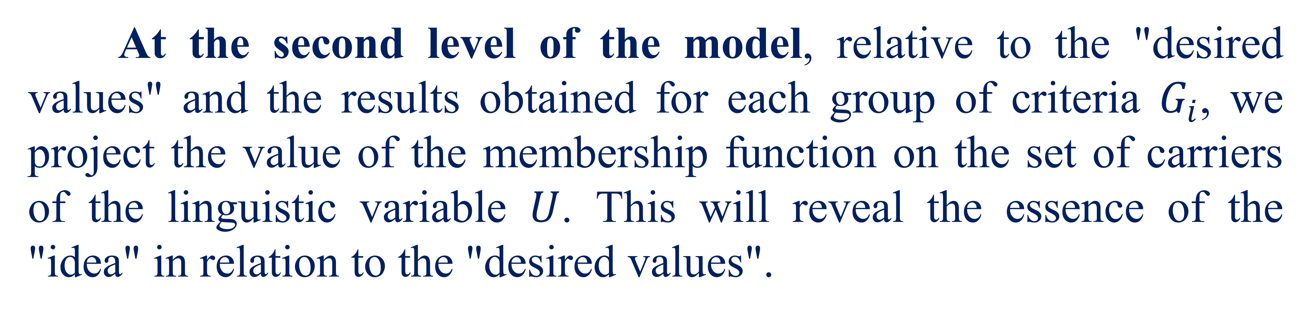
Mathematical model
At the second level of the model, relative to the "desired values" and the results obtained for each group of criteria $G_{i}$, we project the value of the membership function on the set of carriers of the linguistic variable $U$. This will reveal the essence of the "idea" in relation to the "desired values".
17

Slide 18
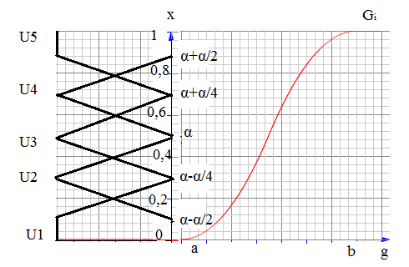
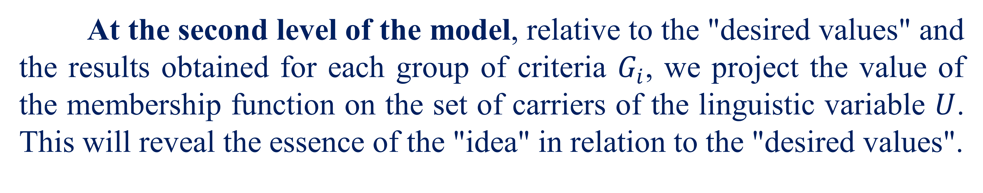
Mathematical model
At the second level of the model, relative to the "desired values" and the results obtained for each group of criteria $G_{i}$, we project the value of the membership function on the set of carriers of the linguistic variable $U$. This will reveal the essence of the "idea" in relation to the "desired values".
Fig. 1. Graph of s-shaped membership function and linguistic variable U
18

Slide 19
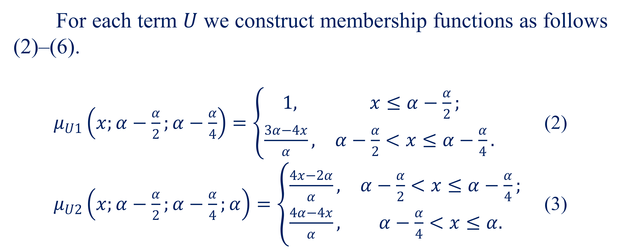
Mathematical model
For each term $U$ we construct membership functions as follows (2)–(6).
$μ_{U1}\left(x;α−\frac{α}{2};α−\frac{α}{4}\right)=\left\{\begin{matrix}1, & x≤α−\frac{α}{2}; \\ \frac{3α−4x}{α}, & α−\frac{α}{2}<x≤α−\frac{α}{4}.\end{matrix}\right.$ (2)
$μ_{U2}\left(x;α−\frac{α}{2};α−\frac{α}{4};α\right)=\left\{\begin{matrix}\frac{4x−2α}{α}, & α−\frac{α}{2}<x≤α−\frac{α}{4}; \\ \frac{4α−4x}{α}, & α−\frac{α}{4}<x≤α.\end{matrix}\right.$ (3)
19

Slide 20
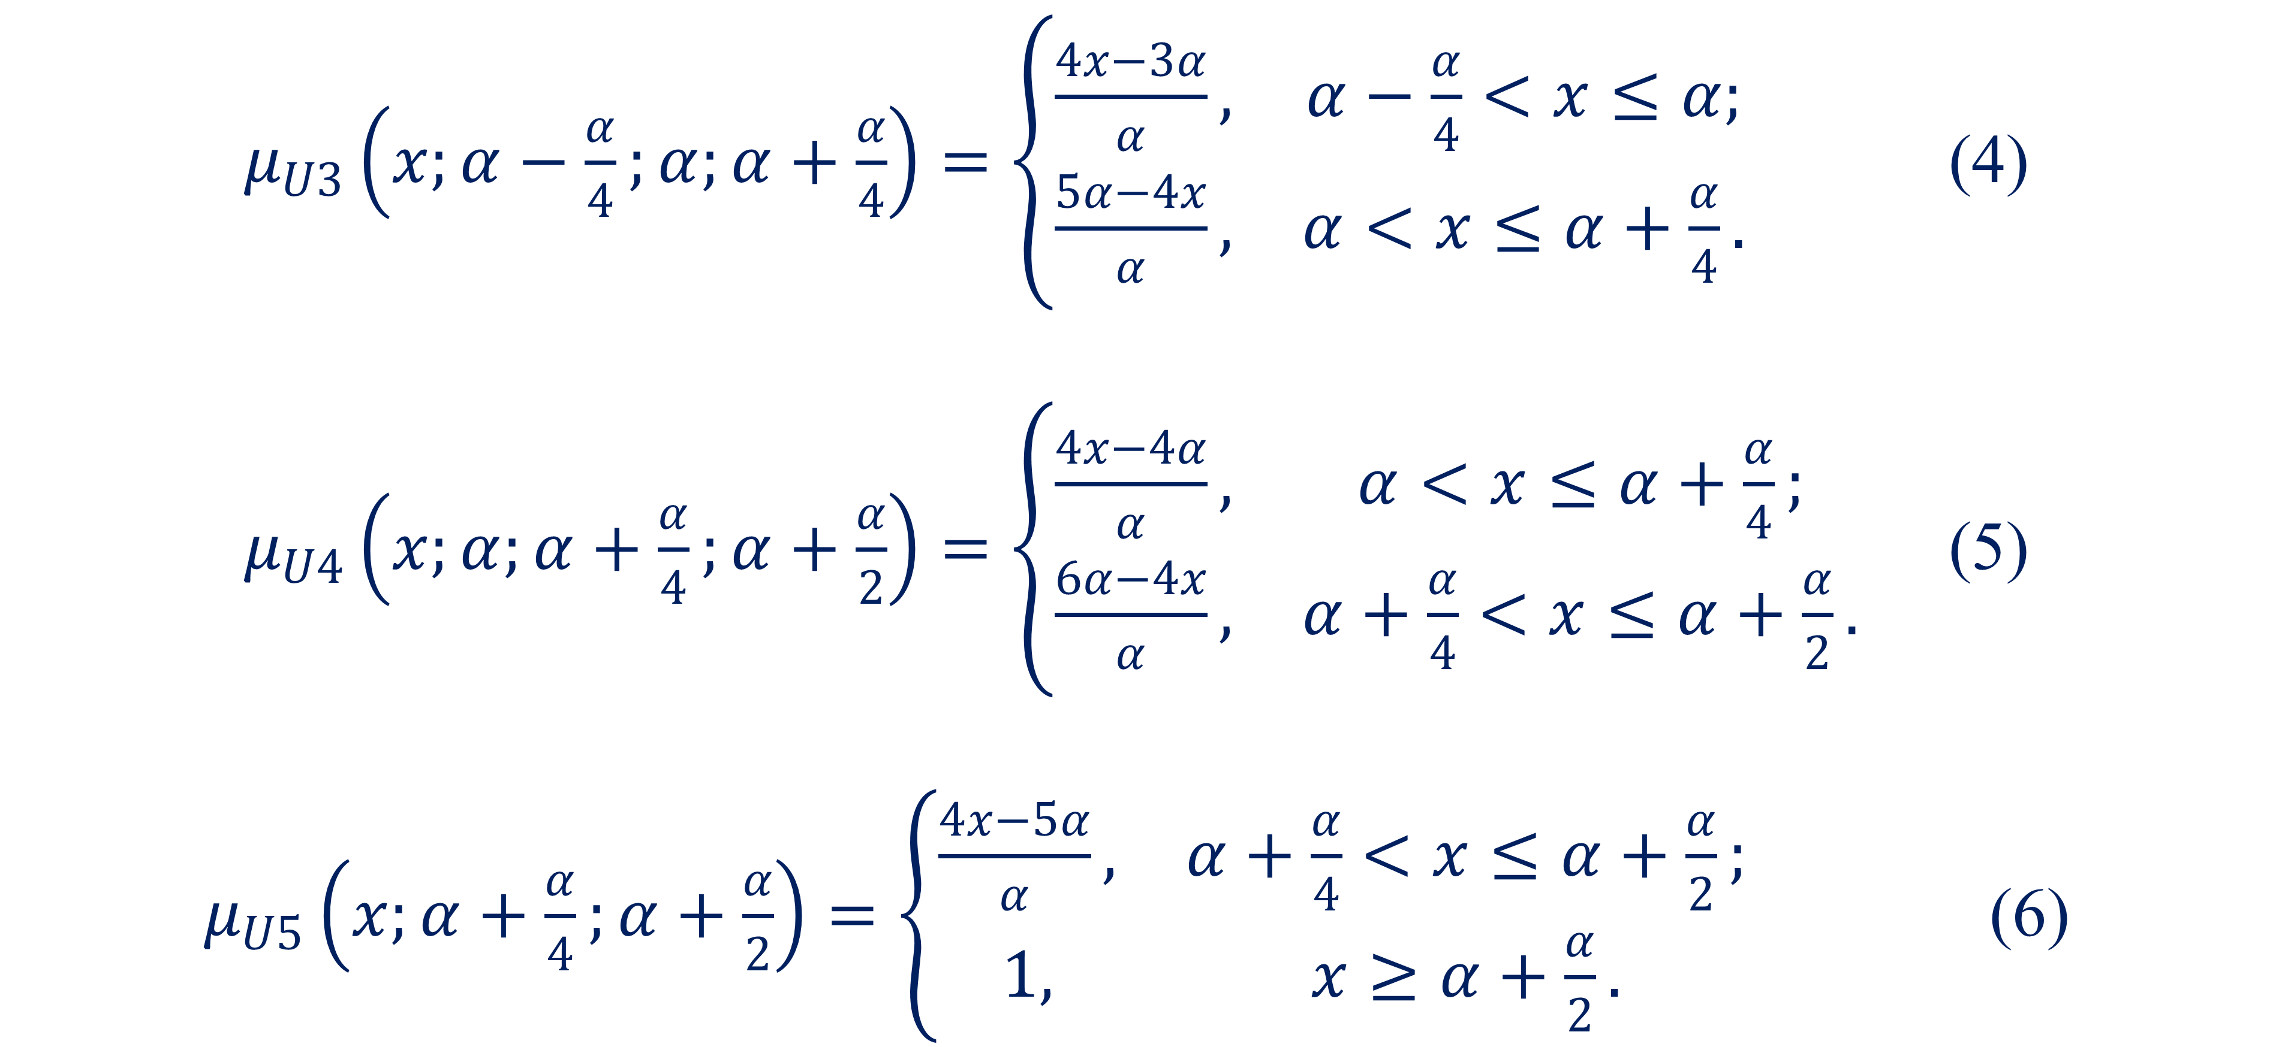
Mathematical model
$μ_{U3}\left(x;α−\frac{α}{4};α;α+\frac{α}{4}\right)=\left\{\begin{matrix}\frac{4x−3α}{α}, & α−\frac{α}{4}<x≤α; \\ \frac{5α−4x}{α}, & α<x≤α+\frac{α}{4}.\end{matrix}\right.$ (4)
$μ_{U4}\left(x;α;α+\frac{α}{4};α+\frac{α}{2}\right)=\left\{\begin{matrix}\frac{4x−4α}{α}, & α<x≤α+\frac{α}{4}; \\ \frac{6α−4x}{α}, & α+\frac{α}{4}<x≤α+\frac{α}{2}.\end{matrix}\right.$ (5)
$μ_{U5}\left(x;α+\frac{α}{4};α+\frac{α}{2}\right)=\left\{\begin{matrix}\frac{4x−5α}{α}, & α+\frac{α}{4}<x≤α+\frac{α}{2}; \\ 1, & x≥α+\frac{α}{2}.\end{matrix}\right.$ (6)
20

Slide 21
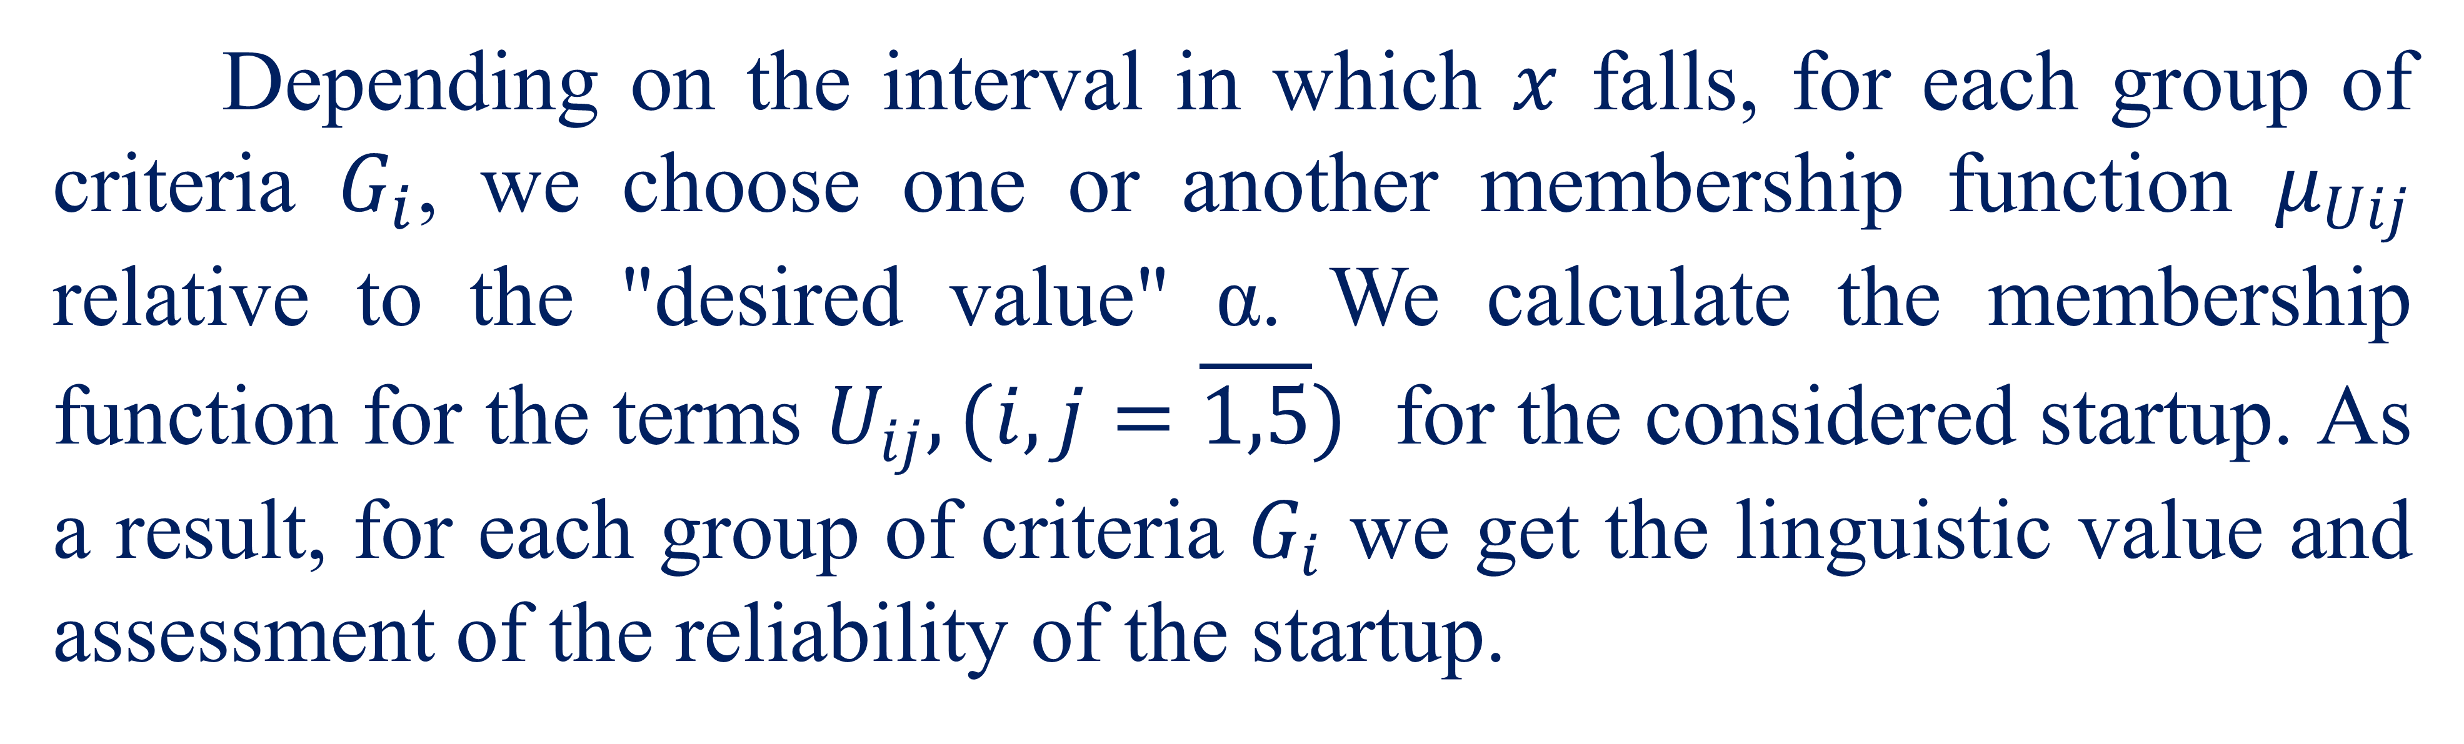
Mathematical model
Depending on the interval in which $x$ falls, for each group of criteria $G_{i}$, we choose one or another membership function $μ_{Uij}$ relative to the "desired value" α. We calculate the membership function for the terms $U_{ij},(i,j=\overline{1,5})$ for the considered startup. As a result, for each group of criteria $G_{i}$ we get the linguistic value and assessment of the reliability of the startup.
21

Slide 22
Mathematical model
That is the reliability of the fact that the evaluation of a group of criteria belongs to one or another term. This will provide an opportunity to get an interpretation of the scores, revealing their subjectivity and understanding of what the startup is.
22

Slide 23
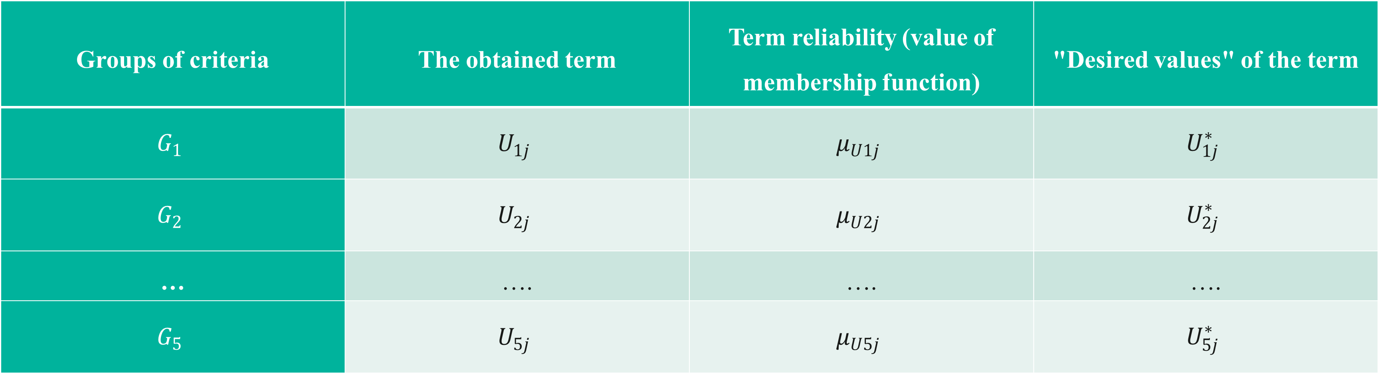

Mathematical model
Let the evaluation expert have his or her views on what the terms for the groups of criteria $G_{i}$ should be. Such terms are denoted by $U_{}^{∗}$ table. 2.
Table 2. The obtained data according to the second level
Groups of criteria | The obtained term | Term reliability (value of membership function) | "Desired values" of the term
$$G_{1}$$ | $$U_{1j}$$ | $$μ_{U1j}$$ | $$U_{1j}^{∗}$$
$$G_{2}$$ | $$U_{2j}$$ | $$μ_{U2j}$$ | $$U_{2j}^{∗}$$
… | …. | …. | ….
$$G_{5}$$ | $$U_{5j}$$ | $$μ_{U5j}$$ | $$U_{5j}^{∗}$$
23

Slide 24
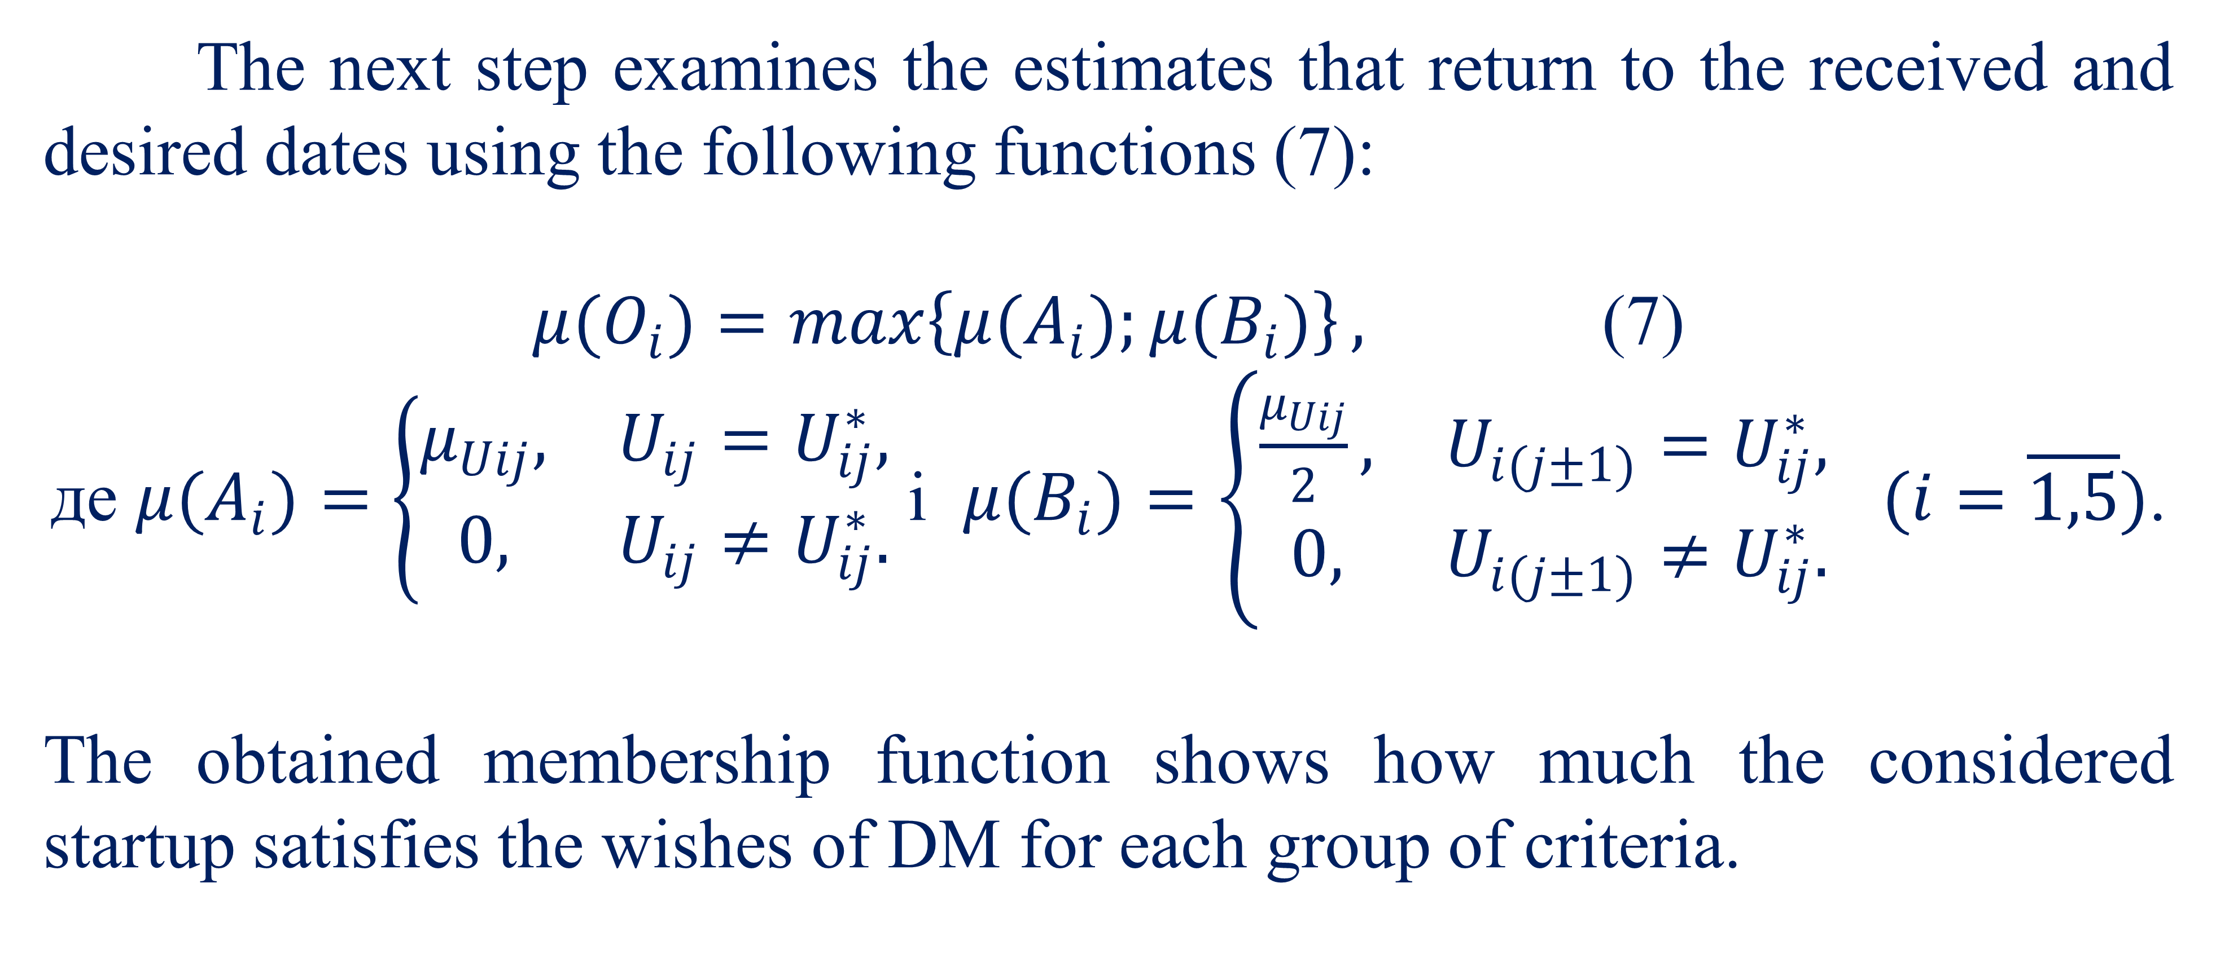
Mathematical model
The next step examines the estimates that return to the received and desired dates using the following functions (7):
$μ(O_{i})=\max\left\{μ(A_{i});μ(B_{i})\right\},$ (7)
де $μ(A_{i})=\left\{\begin{matrix}μ_{Uij}, & U_{ij}=U_{ij}^{∗}, \\ 0, & U_{ij}≠U_{ij}^{∗}.\end{matrix}\right.$ і $μ(B_{i})=\left\{\begin{matrix}\frac{μ_{Uij}}{2}, & U_{i(j±1)}=U_{ij}^{∗}, \\ 0, & U_{i(j±1)}≠U_{ij}^{∗}.\end{matrix}\right.$ $(i=\overline{1,5})$.
The obtained membership function shows how much the considered startup satisfies the wishes of DM for each group of criteria.
24

Slide 25
Mathematical model
Given the called functions, abilities (2) - (6) have transformations so that we obtain either one or two terms for the group criteria and correspond to such several validities for them. Therefore, if we can make two estimates according to a group of criteria, it causes the functionality of correspondence (7) for the next stage, which chooses most of them.
25

Slide 26
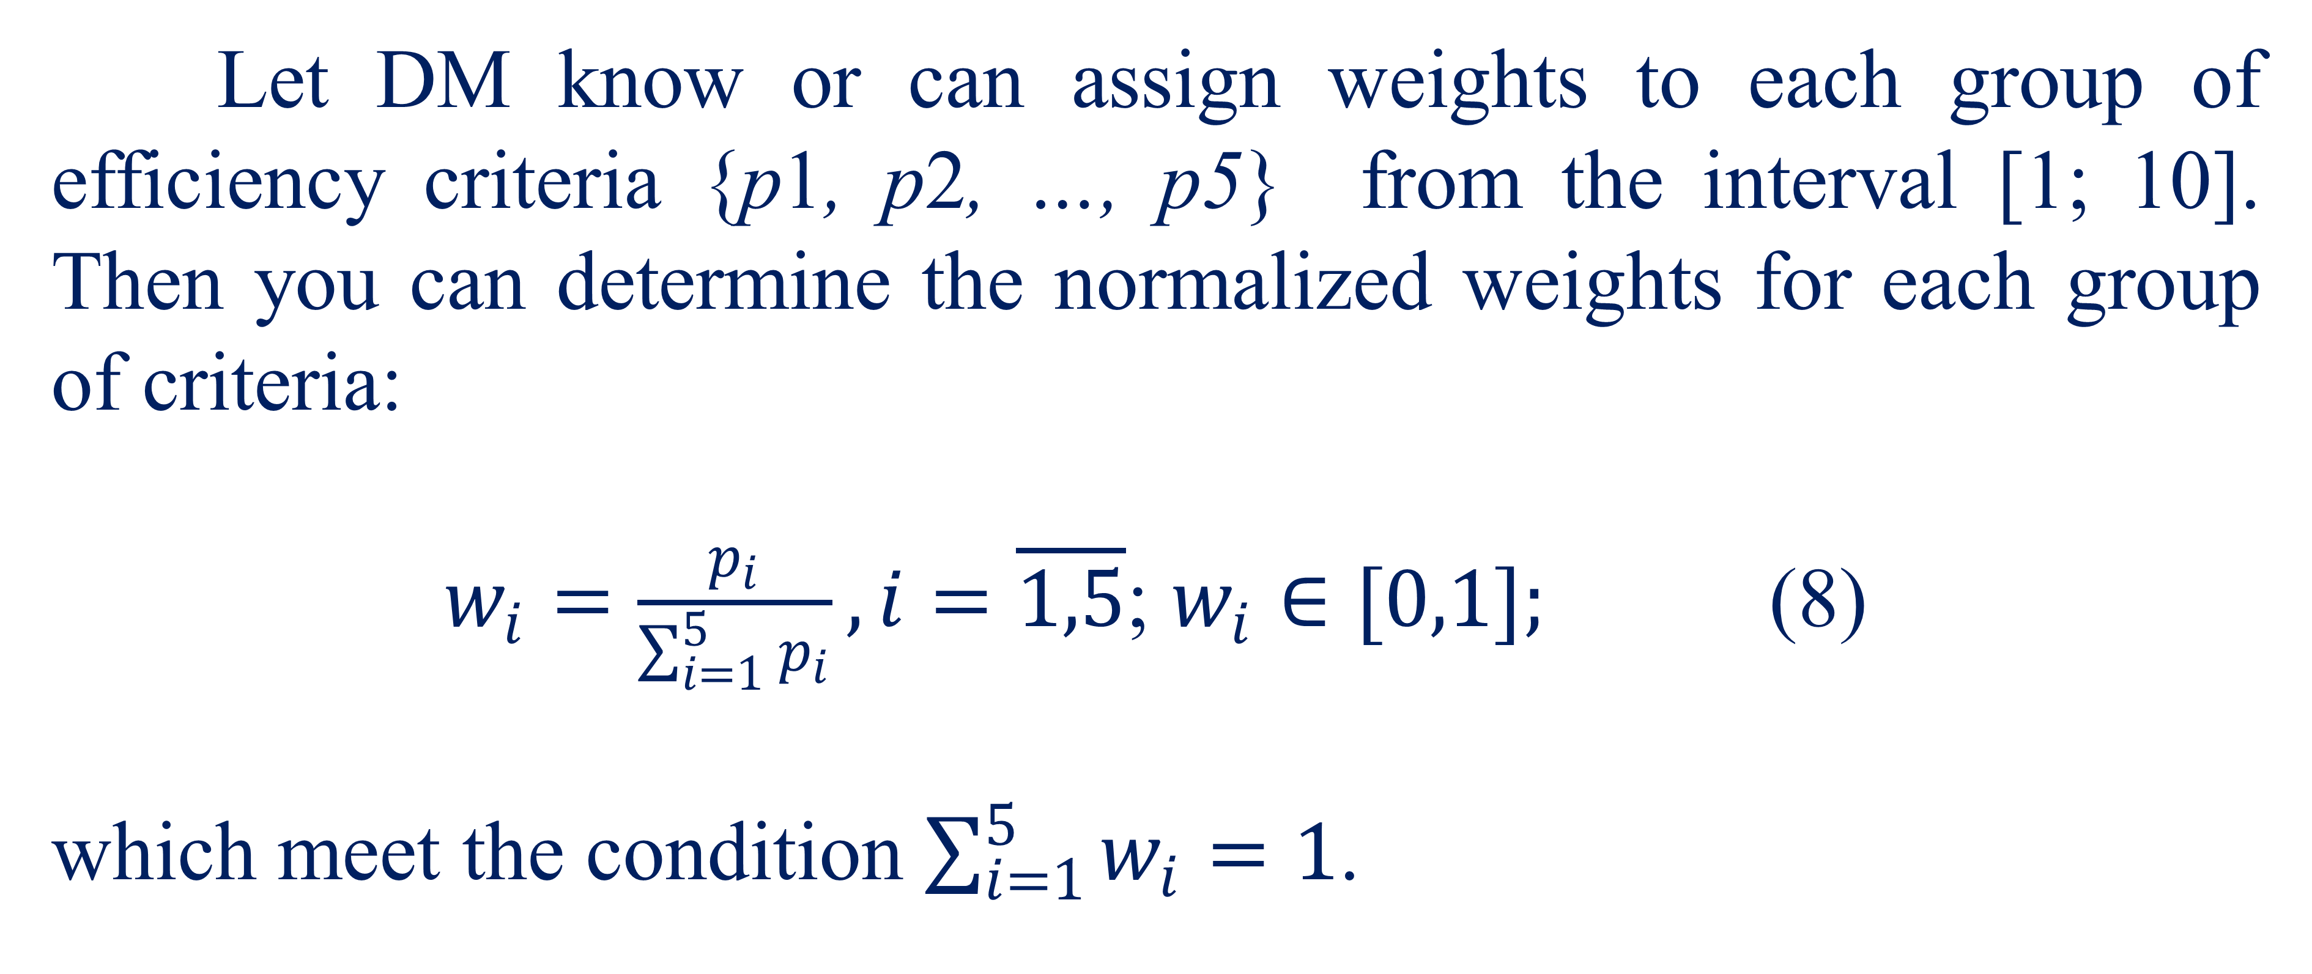
Mathematical model
Let DM know or can assign weights to each group of efficiency criteria {p1, p2, …, p5} from the interval [1; 10]. Then you can determine the normalized weights for each group of criteria:
$w_{i}=\frac{p_{i}}{\sum_{i=1}^{5}{p_{i}}}, i=\overline{1,5}$; $w_{i}∈[0,1];$ (8)
which meet the condition $\sum_{i=1}^{5}{w_{i}}=1$.
26

Slide 27
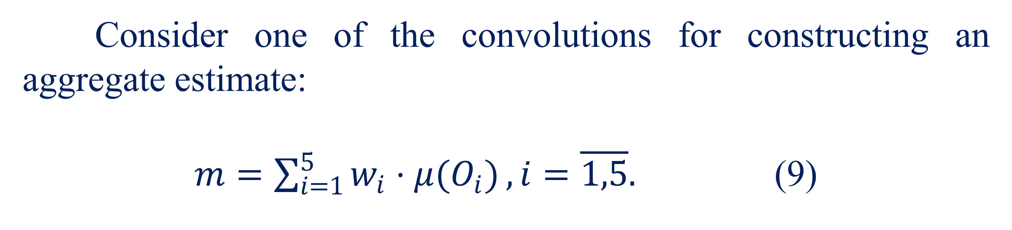
Mathematical model
Consider one of the convolutions for constructing an aggregate estimate:
$m=\sum_{i=1}^{5}{w_{i}⋅μ(O_{i})},i=\overline{1,5}.$ (9)
27

Slide 28
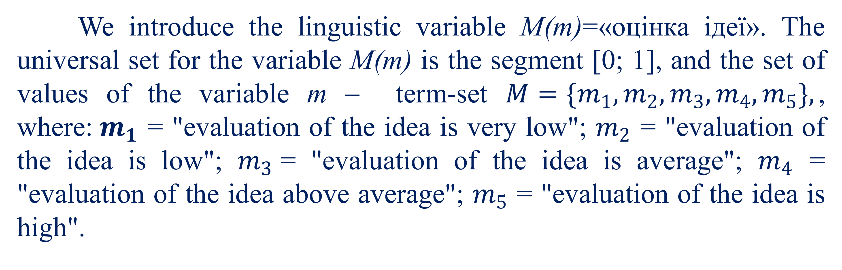
Mathematical model
We introduce the linguistic variable М(m)=«оцінка ідеї». The universal set for the variable M(m) is the segment [0; 1], and the set of values of the variable m − term-set $M=\{m_{1},m_{2},m_{3},m_{4},m_{5}\},$, where:$m_{1}$ = "evaluation of the idea is very low"; $m_{2}$ = "evaluation of the idea is low"; $m_{3}$= "evaluation of the idea is average"; $m_{4}$ = "evaluation of the idea above average"; $m_{5}$ = "evaluation of the idea is high".
28

Slide 29
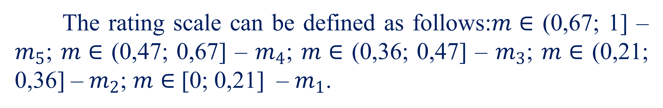
Mathematical model
The rating scale can be defined as follows:$m∈$ (0,67; 1] – $m_{5}$; $m∈$ (0,47; 0,67] – $m_{4}$; $m∈$ (0,36; 0,47] – $m_{3}$; $m∈$ (0,21; 0,36] – $m_{2}$; $m∈$ [0; 0,21] – $m_{1}$.
29

Slide 30

03
Example

Slide 31
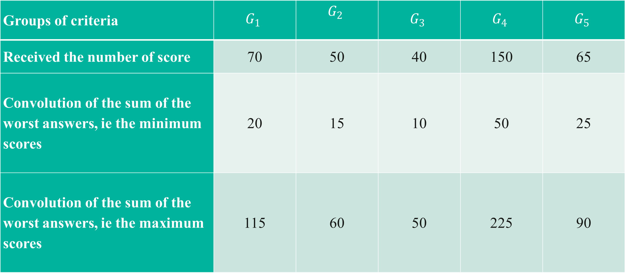

Example
The developed mathematical model is used to evaluate the startup $S$, table. 3.
Table 3. Input data on the startup
Groups of criteria | $$G_{1}$$ | $$G_{2}$$ | $$G_{3}$$ | $$G_{4}$$ | $$G_{5}$$
Received the number of score | 70 | 50 | 40 | 150 | 65
Convolution of the sum of the worst answers, ie the minimum scores | 20 | 15 | 10 | 50 | 25
Convolution of the sum of the worst answers, ie the maximum scores | 115 | 60 | 50 | 225 | 90
31

Slide 32
Example
According to the received input data it is necessary to estimate the considered startup and to deduce a linguistic estimation of «idea».
Consider the first level of the proposed model.
32

Slide 33
Example
Let DM have its preferences for the «desired values» for each set of criteria. We denote them by the vector Т=(80; 55; 35; 165; 50), the values of which correspond to each group of criteria.
For the obtained number of points and "desired values" calculate the values of membership functions according to (1). All values are presented according to the table. 4.
33

Slide 34
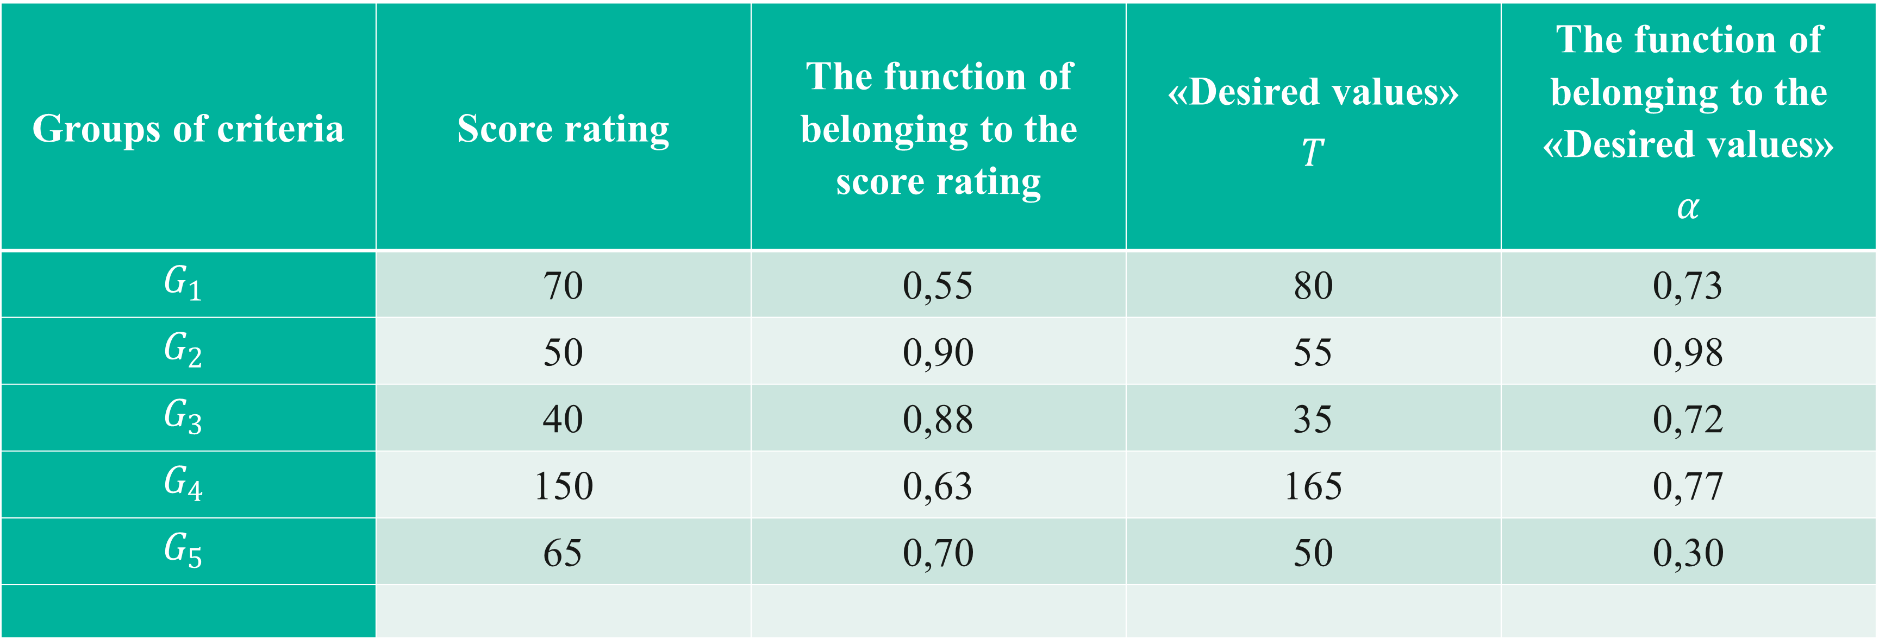
Example
Table 4. The obtained data on the startup according to the first level
Groups of criteria | Score rating | The function of belonging to the score rating | «Desired values» $$T$$ | The function of belonging to the «Desired values» $$α$$
$$G_{1}$$ | 70 | 0,55 | 80 | 0,73
$$G_{2}$$ | 50 | 0,90 | 55 | 0,98
$$G_{3}$$ | 40 | 0,88 | 35 | 0,72
$$G_{4}$$ | 150 | 0,63 | 165 | 0,77
$$G_{5}$$ | 65 | 0,70 | 50 | 0,30
34

Slide 35
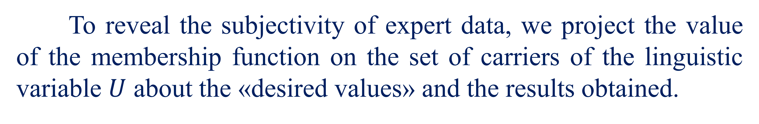
Example
Then we move on to the second level of the model.
To reveal the subjectivity of expert data, we project the value of the membership function on the set of carriers of the linguistic variable $U$ about the «desired values» and the results obtained.
35

Slide 36
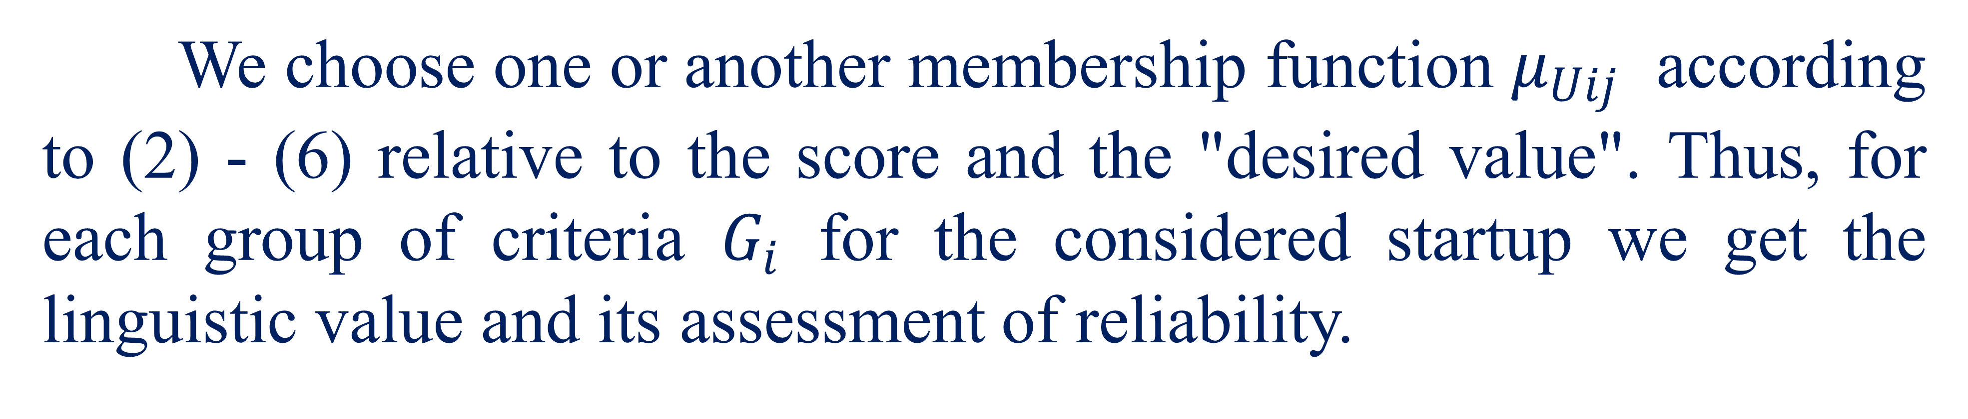
Example
We choose one or another membership function $μ_{Uij}$ according to (2) - (6) relative to the score and the "desired value". Thus, for each group of criteria $G_{i}$ for the considered startup we get the linguistic value and its assessment of reliability.
The results of the calculation and the wishes of DM about the terms by groups of criteria are presented in the table. 5.
36

Slide 37
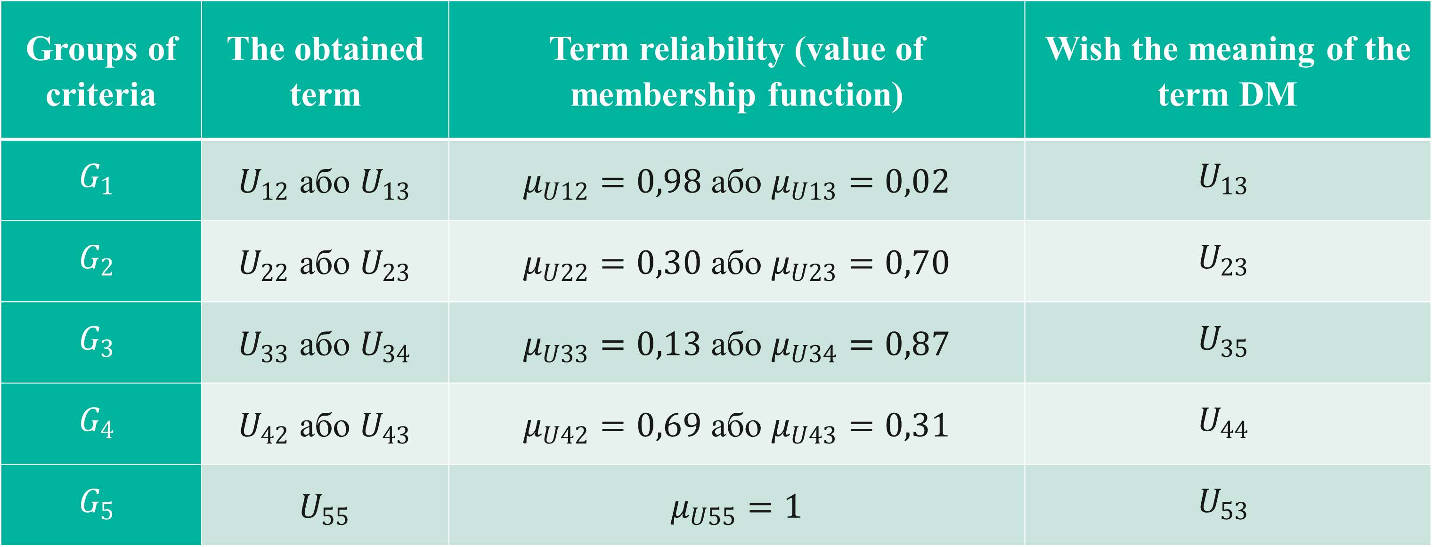
Example
Table 5. The obtained data on the startup according to the second level
Groups of criteria | The obtained term | Term reliability (value of membership function) | Wish the meaning of the term DM
$$G_{1}$$ | $U_{12}$ або $U_{13}$ | $μ_{U12}=0,98$ або $μ_{U13}=0,02$ | $$U_{13}$$
$$G_{2}$$ | $U_{22}$ або $U_{23}$ | $μ_{U22}=0,30$ або $μ_{U23}=0,70$ | $$U_{23}$$
$$G_{3}$$ | $U_{33}$ або $U_{34}$ | $μ_{U33}=0,13$ або $μ_{U34}=0,87$ | $$U_{35}$$
$$G_{4}$$ | $U_{42}$ або $U_{43}$ | $μ_{U42}=0,69$ або $μ_{U43}=0,31$ | $$U_{44}$$
$$G_{5}$$ | $U_{55}$ | $μ_{U55}=1$ | $$U_{53}$$
37

Slide 38
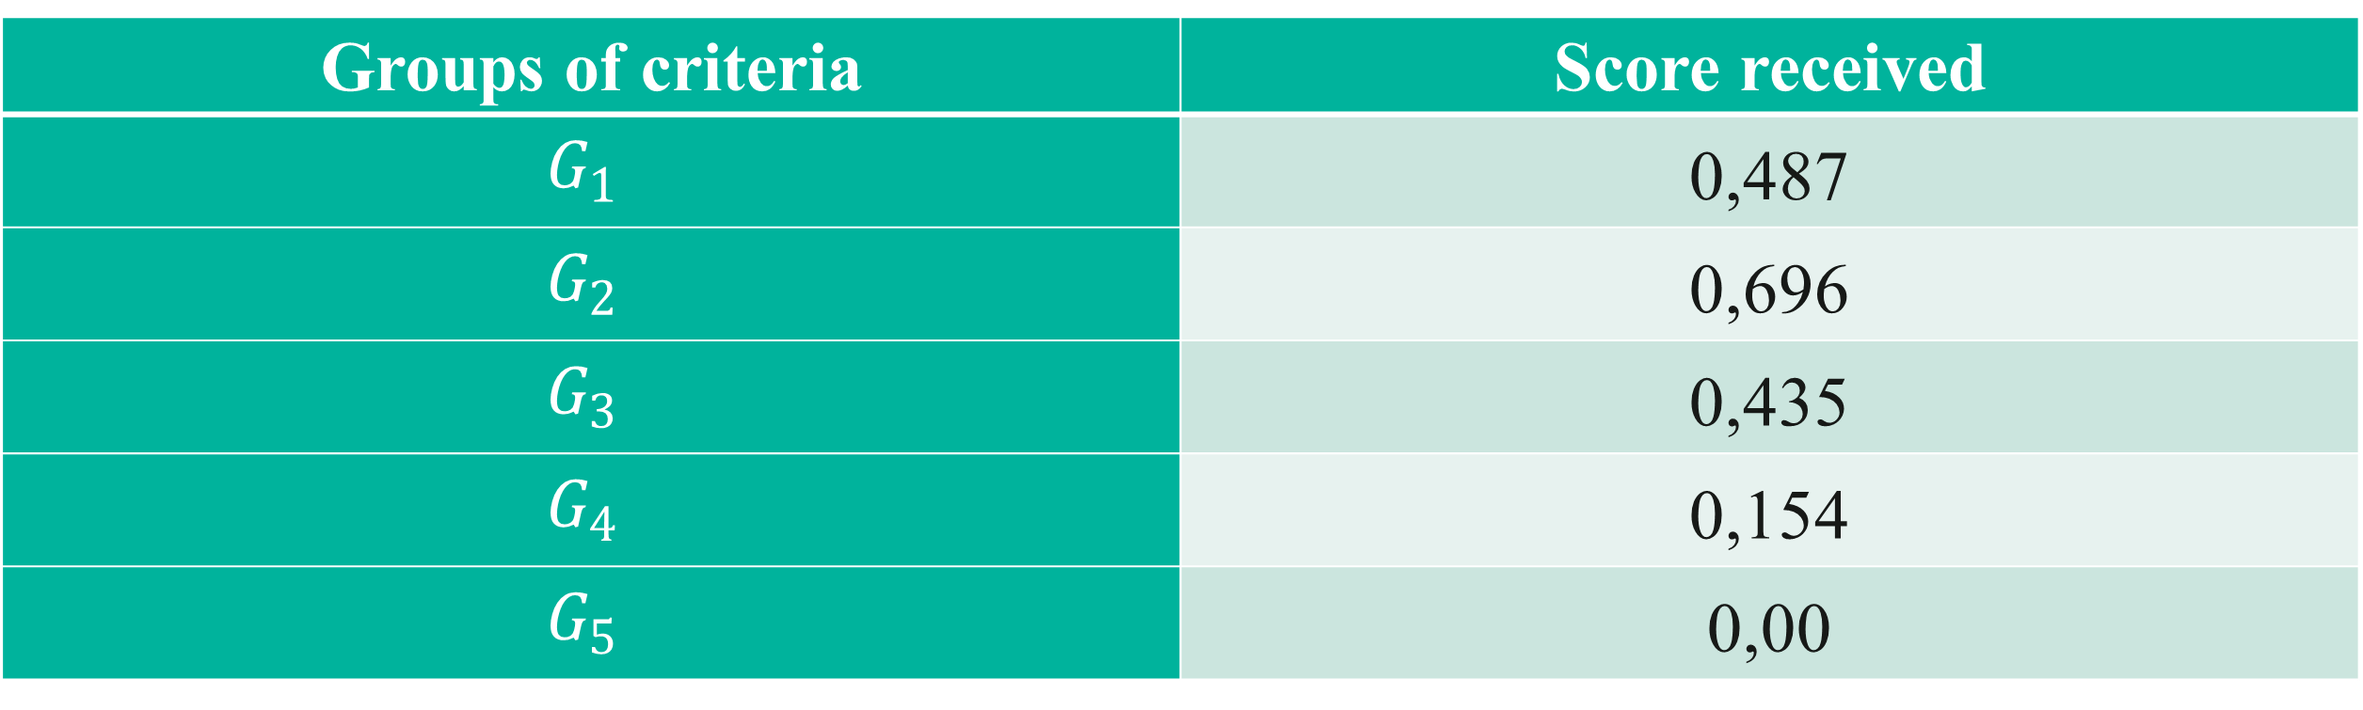
Example
In the next step, we calculate the estimates of the obtained and desired terms according to (7), table. 6 .:
Table 6. Values of evaluations by groups of criteria
Groups of criteria | Score received
$$G_{1}$$ | 0,487
$$G_{2}$$ | 0,696
$$G_{3}$$ | 0,435
$$G_{4}$$ | 0,154
$$G_{5}$$ | 0,00
38

Slide 39
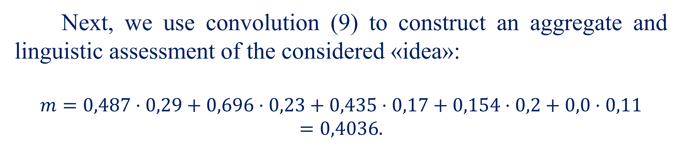
Example
Let DM determine the weights for each group of criteria as follows {10; 8; 6; 7; 4}. Then we determine for each group of criteria normalized weights according to (8) - {0,29; 0,23; 0,17; 0,2; 0,11}.
Next, we use convolution (9) to construct an aggregate and linguistic assessment of the considered «idea»:
$$m=0,487⋅0,29+0,696⋅0,23+0,435⋅0,17+0,154⋅0,2+0,0⋅0,11=0,4036.$$
39

Slide 40
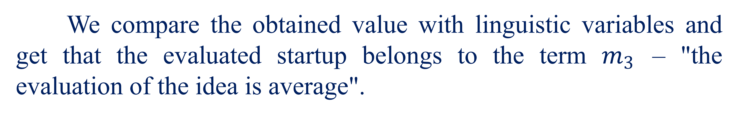
Example
We compare the obtained value with linguistic variables and get that the evaluated startup belongs to the term $m_{3}$ – "the evaluation of the idea is average".
40

Slide 41

Questionnaire-evaluation of startup projects
04

Slide 42
Questionnaire-evaluation of startup projects
№ | The name of the criterion | Meaning
Groups of criteria – « the essence of the idea »
1 | The proposed idea is a product or service?
 | 1. that came for a while (5 points);
 | 2. which is currently under development, with marketing research and a business plan (20 points);
 | 3. that at the stage of the working protocol, which is tested by potential customers (25 балів);
 | 4. which is currently receiving income (30 points).
42

Slide 43
Questionnaire-evaluation of startup projects
2 | To which field does the developed idea belong?
 | 1. the product is relevant to sales to the general public (retail, food, entertainment, etc.) (10 points);
 | 2. the proposed idea is not yet recognized as an industry (20 points);
 | 3. the product was popular with investors a few years ago (25 points);
 | 4. The product is currently popular with investors (medical devices, nanotechnology, security software, money-saving corporate software, etc.) (30 points).
43

Slide 44
Questionnaire-evaluation of startup projects
3 | The social significance of the idea?
 | 1. insignificant value of novelty (5 points);
 | 2. make life a little easier and more enjoyable for many people, but does not solve any fundamental problems (20 points);
 | 3. helps people or businesses in their work (25 points);
 | 4. will help save a lot of lives and/or money (ie, a product based on the idea urgently needed in the market) (30 points).
44

Slide 45
Questionnaire-evaluation of startup projects
4 | The power of the idea (if venture companies have decided to supply their resources to competitors in this area, then tomorrow the product based on the idea will be?):
 | 1. there will be nothing from it (0 points);
 | 2. I understand that the market is currently won by a big player, but will have to agree to a smaller market share (5 points);
 | 3. the opportunity to stay one step ahead through innovation, agility, and speed (20 points);
 | 4. glad to work with them for our technology as there is no way competitors can win this market (25 points).
The sum of points for 1 group of criteria
45

Slide 46
Questionnaire-evaluation of startup projects
Groups of criteria – « authors of the idea »
1 | The level of entrepreneurial experience is achieved through:
 | 1. reading books and magazines of doing business (5 points);
 | 2. start a successful small business (10 points);
 | 3. working as a co-founder or employee in a successful high-tech company (20 points);
 | 4. founder of several successful companies (25 points).
46

Slide 47
Questionnaire-evaluation of startup projects
2 | Experience of management positions in the field of the startup market:
 | 1. never had (0 points);
 | 2. up to 2 years (5 points);
 | 3. 2 - 5 years (10 points);
 | 4. over 5 years (15 points).
47

Slide 48
Questionnaire-evaluation of startup projects
3 | Several hours of own time invested in the development of the startup:
 | 1. 0 – 999 (10 points);
 | 2. 1000 – 1999 (12 points);
 | 3. 2000 – 3999 (15 points);
 | 4. 4000 or more hours (20 points);
The sum of points for 2 groups of criteria
48

Slide 49
Questionnaire-evaluation of startup projects
Groups of criteria – «comparative characteristics of the idea»
1 | Main competitors (satisfaction of which requires confession):
 | 1. non-existent, as customers do not spend money to meet the needs of the product (5 points);
 | 2. large companies with a large marketing budget and existing sales channels (that is the product is a mature industry dominated by large competitors) (10 points);
 | 3. other startups (that is, I am entering a new market that is currently being studied by other startups) (15 points);
 | 4. replaced (proposed new product, has no direct competitor, but customers have other ways to meet these needs) (25 points).
49

Slide 50
Questionnaire-evaluation of startup projects
2 | Other startups in this industry at a similar stage of development received venture capital in the amount of:
 | 1. under $ 1 million (5 points);
 | 2. $ 1-2 million (10 points);
 | 3. $ 2-5 million (15 points);
 | 4. over $ 5 million (25 points).
The sum of points on 3 groups of criteria
50

Slide 51
Questionnaire-evaluation of startup projects
Groups of criteria – « the commercial significance of the idea »
1 | Strategic partners:
 | 1. exchanged several letters with these people who met online (5 points);
 | 2. letter of intent prepared by a potential distributor for my product (10 points);
 | 3. several signed partnership agreements, and the rest in the work (20 points);
 | 4. partnership, licensing, supply, and sales agreements have been signed with dozens of companies (25 points).
51

Slide 52
Questionnaire-evaluation of startup projects
2 | Intellectual Property:
 | 1. all the developments in my head (10 points);
 | 2. there is a preliminary patent application prepared and filed by me (15 points);
 | 3. pending patents that have been filed for some time (25 points);
 | 4. several patents issued covering the entire value chain of the invention, along with trademarks and service marks to protect the trademark (35 points).
52

Slide 53
Questionnaire-evaluation of startup projects
3 | Availability of a business plan:
 | 1. does not exist (0 points);
 | 2. has a lot of mistakes (10 points);
 | 3. looks perfect in my eyes (20 points);
 | 4. looks perfect in the eyes of consultants, lawyers, and accountants who have seen it (30 points).
53

Slide 54
Questionnaire-evaluation of startup projects
4 | Several own funds invested in the startup:
 | 1. $0 - $24 999 (10 points);
 | 2. $25 000 - $99 999 (20 points);
 | 3. $100 000 - $249 999 (30 points);
 | 4. $250 000 or more (35 points).
54

Slide 55
Questionnaire-evaluation of startup projects
5 | corporate lawyer platform is:
 | 1. a lawyer with only legal education (5 points);
 | 2. small local firm (10 points);
 | 3. a medium-sized firm operating in the investment sphere (25 points);
 | 4. a nationally recognized corporate law firm with a large number of connections in the venture community (35 points).
55

Slide 56
Questionnaire-evaluation of startup projects
6 | Availability of an intellectual property specialist:
 | 1. acquaintance understood in this case (10 points);
 | 2. a small local firm that claims to be a universal intellectual property (15 points);
 | 3. a small or medium-sized local firm that works with a large number of startups (20 points);
 | 4. one of the nationally recognized intellectual property law firms, staffed by lawyers who worked in my area before going to law school (30 points).
56

Slide 57
Questionnaire-evaluation of startup projects
7 | Available sales and marketing plans:
 | 1. if I build, they will come (10 points);
 | 2. if I create sites with the product and submit them to Google, they will come (20 points);
 | 3. I will hire sellers on commission to sell my product (25 points);
 | 4. I have a quality, well-designed marketing and sales plan that includes a combination of proven, cost-effective sales and marketing tactics (35 points).
The sum of points on 4 groups of criteria
57

Slide 58
Questionnaire-evaluation of startup projects
Groups of criteria – « Expected results »
1 | The startup will compete with products whose annual revenues are:
 | 1. $25 000 - $99 999 (10 points);
 | 2. $100 000 - $249 999 (13 points);
 | 3. $250 000 - $549 999 (16 points);
 | 4. $549 000 or more (20 points).
58

Slide 59
Questionnaire-evaluation of startup projects
2 | The magnitude of the percentage growth of the market for this startup:
 | 1. growth not more than 10% (5 points);
 | 2. growth of 10-30% per year (10 points);
 | 3. growth of more than 30% per year (15 points).
59

Slide 60
Questionnaire-evaluation of startup projects
3 | The amount of expected income for the next 12 months:
 | 1. $0 - $24 999 (5 points);
 | 2. $25 000 - $99 999 (10 points);
 | 3. $100 000 - $249 999 (15 points);
 | 4. $250 000 or more (20 points).
60

Slide 61
Questionnaire-evaluation of startup projects
4 | Величина очікуваних доходів через 5 років:
 | 1. $0-$1 million (5 points);
 | 2. $1 million - $ 5 million (10 points);
 | 3. $ 5 million or more (15 points);
 | 4. $ 10 million or more (20 points).
61

Slide 62
Questionnaire-evaluation of startup projects
5 | The xpected value of gross profit after the startup enters the market:
 | 1. unknown (0 points);
 | 2. everything will go to business service (5 points);
 | 3. increase gradually as a hardware business (10 points);
 | 4. Fast growing as a business software (15 points).
The sum of points on the 5th group of criteria
62

Slide 63
References
Polishchuk V. Evaluation of start-up projects in conditions of risk and uncertainty. – Uzhhorod: Publishing house "FOP Sabov AM", 2021. – 120 p. ISBN 978-617-7798-49-0.
Polishchuk, V.; Kelemen, M.; Gavurová, B.; Varotsos, C.; Andoga, R.; Gera, M.; Christodoulakis, J.; Soušek, R.; Kozuba, J.; Blišťan, P.; Szabo Jr., S. A Fuzzy Model of Risk Assessment for Environmental Start-up Projects in the Air Transport Sector. Int. J. Environ. Res. Public Health 2019, 16, 3573. https://doi.org/10.3390/ijerph16193573
Kelemen, M.; Polishchuk, V.; Gavurová, B.; Szabo, S.; Rozenberg, R.; Gera, M.; Kozuba, J.; Andoga, R.; Divoková, A.; Bliš’an, P. Fuzzy Model for Quantitative Assessment of Environmental Start-up Projects in Air Transport. Int. J. Environ. Res. Public Health 2019, 16, 3585. https://doi.org/10.3390/ijerph16193585
63

Slide 64
Thank you!
WWW.SITE2MAX.PRO

