Slide 1
Evaluation of start-up projects
Chapter 12
Evaluation and management of start-up teams
Lecturer: doc. Polishchuk Volodymyr, PhD.

Slide 2
Information criteria for evaluating start-up project development teams
Lecture content
General algorithm for evaluating start-up teams
Data defuzzyfication and rating of start-up teams

Slide 3

Information criteria for evaluating start-up project development teams
01

Slide 4
We formulate the evaluation problem as follows. Let's have at the entrance some commercial projects
Information criteria for evaluating start-up project development teams
Today's ingenious start-up idea does not mean successful business in the future. There are people behind any project who implement it. Even for a very good start-up project, with a very high rating and prospects for success, successful commercialization depends, to a greater extent, on the quality of the developers who are ready to bring the product to market and successfully decide on its sale. Therefore, investors in start-ups like to say that they primarily invest in the team, that the success or failure of the project depends largely on the founders (development team).
We formulate the evaluation problem as follows. Let's have at the entrance some commercial projects
4

Slide 5
We formulate the evaluation problem as follows. Let's have at the entrance some commercial projects
Information criteria for evaluating start-up project development teams
Most successful start-up projects have been implemented by teams because they have a better chance of survival. This is due to the fact that the team makes better and more effective decisions, provides psychological and emotional support to its members and is able to significantly expand the social network of contacts of the project.
We formulate the evaluation problem as follows. Let's have at the entrance some commercial projects
Consider the information criteria for evaluating teams of developers of start-up projects.
5

Slide 6
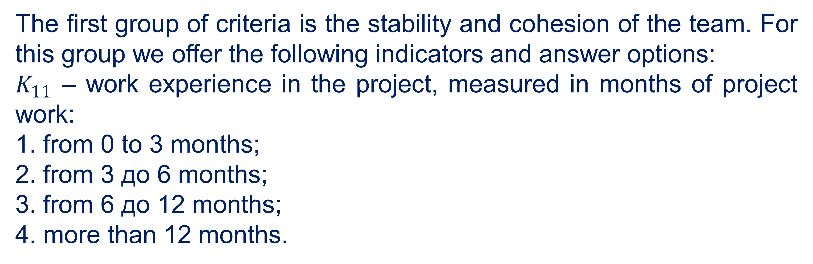
We formulate the evaluation problem as follows. Let's have at the entrance some commercial projects
Information criteria for evaluating start-up project development teams
The first group of criteria is the stability and cohesion of the team. For this group we offer the following indicators and answer options:
$K_{11}$ – work experience in the project, measured in months of project work:
1. from 0 to 3 months;
2. from 3 до 6 months;
3. from 6 до 12 months;
4. more than 12 months.
We formulate the evaluation problem as follows. Let's have at the entrance some commercial projects
6

Slide 7
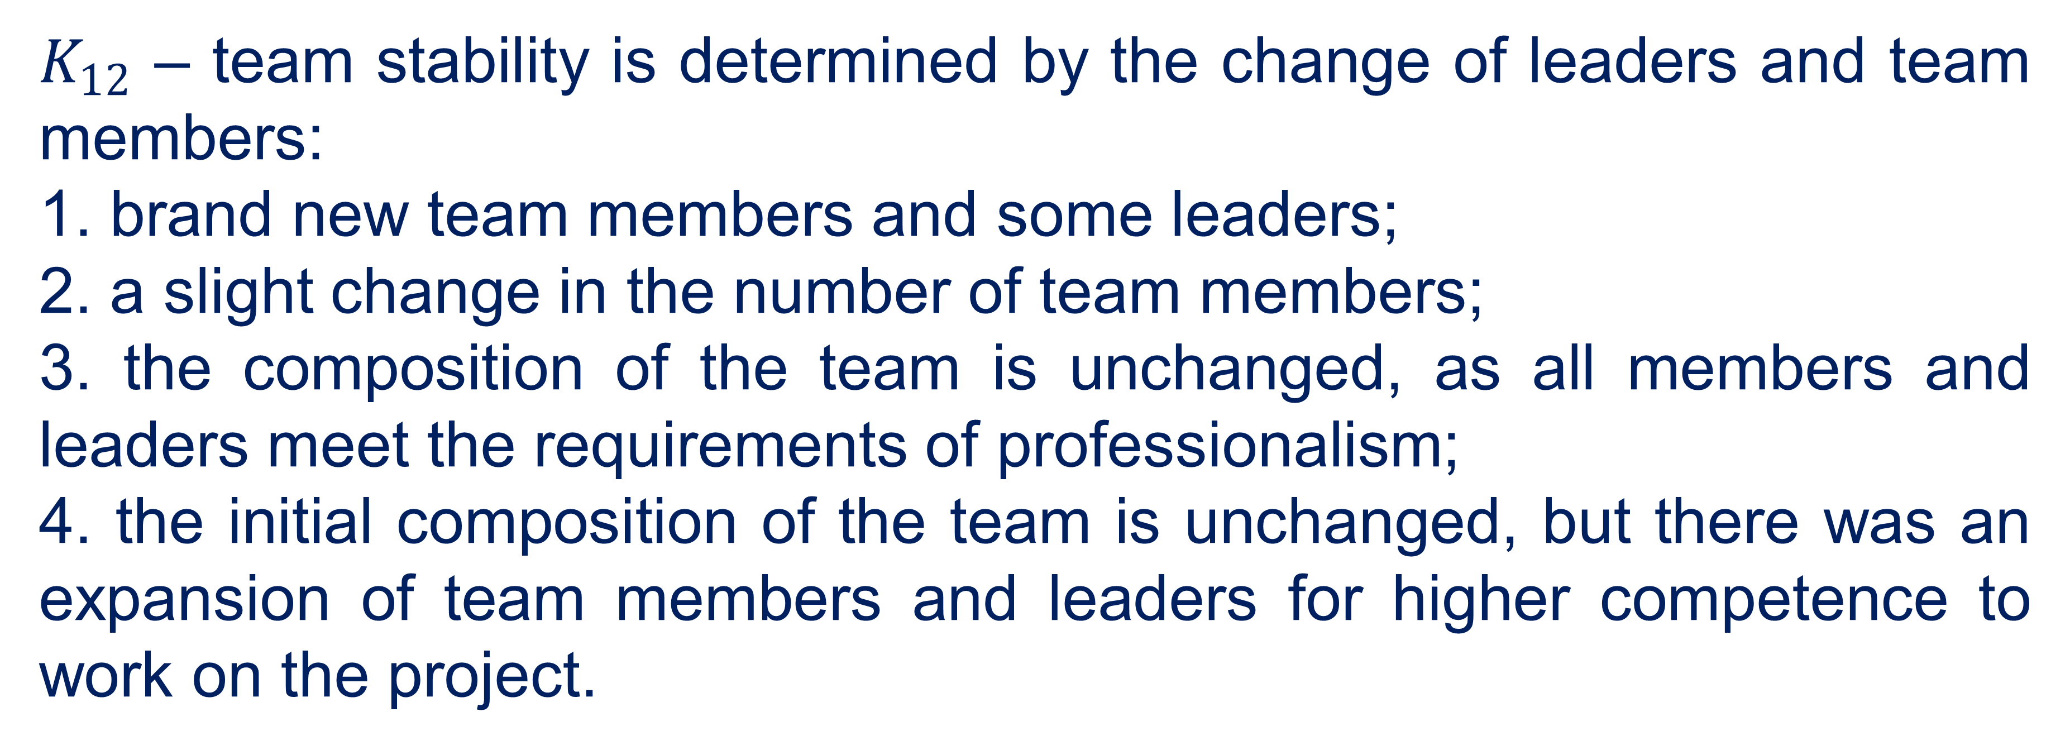
We formulate the evaluation problem as follows. Let's have at the entrance some commercial projects
Information criteria for evaluating start-up project development teams
$K_{12}$ – team stability is determined by the change of leaders and team members:
1. brand new team members and some leaders;
2. a slight change in the number of team members;
3. the composition of the team is unchanged, as all members and leaders meet the requirements of professionalism;
4. the initial composition of the team is unchanged, but there was an expansion of team members and leaders for higher competence to work on the project.
We formulate the evaluation problem as follows. Let's have at the entrance some commercial projects
7

Slide 8
We formulate the evaluation problem as follows. Let's have at the entrance some commercial projects
Information criteria for evaluating start-up project development teams
The second group of criteria is the professional competencies and experience of the team. For this group, we propose to divide into two subgroups: professional competencies of leaders and professional competencies of team members.
We formulate the evaluation problem as follows. Let's have at the entrance some commercial projects
8

Slide 9
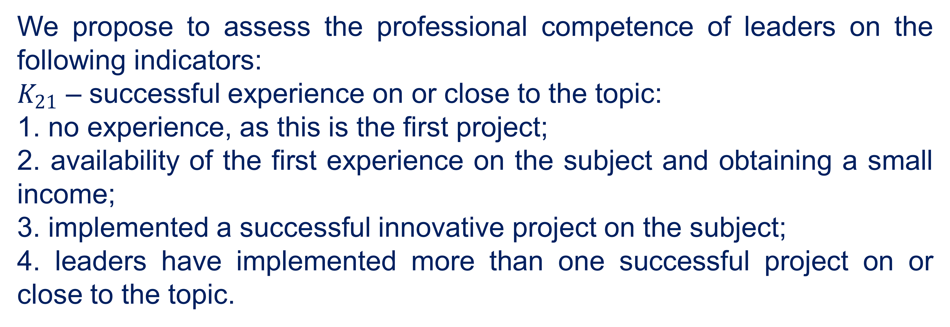
We formulate the evaluation problem as follows. Let's have at the entrance some commercial projects
Information criteria for evaluating start-up project development teams
We propose to assess the professional competence of leaders on the following indicators:
$K_{21}$ – successful experience on or close to the topic:
1. no experience, as this is the first project;
2. availability of the first experience on the subject and obtaining a small income;
3. implemented a successful innovative project on the subject;
4. leaders have implemented more than one successful project on or close to the topic.
We formulate the evaluation problem as follows. Let's have at the entrance some commercial projects
9

Slide 10
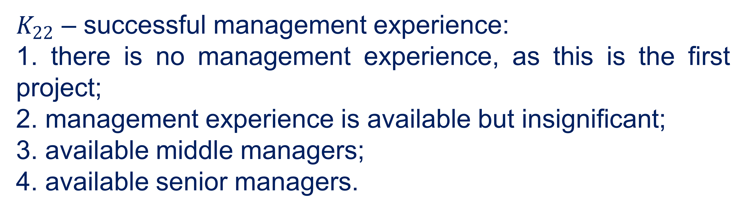
We formulate the evaluation problem as follows. Let's have at the entrance some commercial projects
Information criteria for evaluating start-up project development teams
$K_{22}$ – successful management experience:
1. there is no management experience, as this is the first project;
2. management experience is available but insignificant;
3. available middle managers;
4. available senior managers.
We formulate the evaluation problem as follows. Let's have at the entrance some commercial projects
10

Slide 11
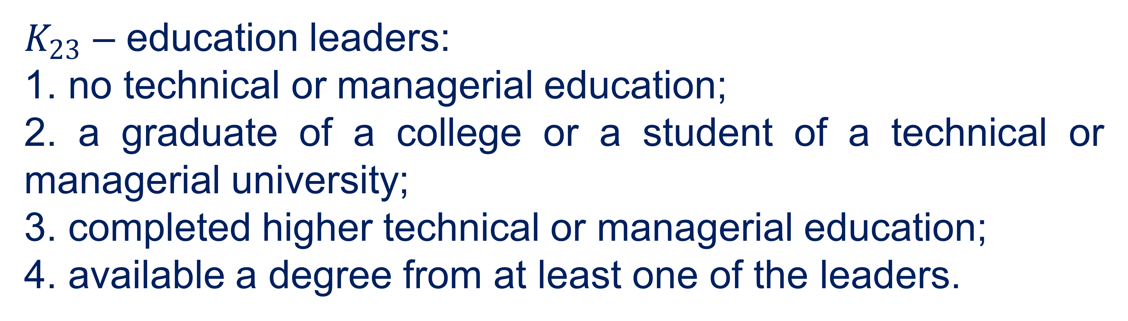
We formulate the evaluation problem as follows. Let's have at the entrance some commercial projects
Information criteria for evaluating start-up project development teams
$K_{23}$ – education leaders:
1. no technical or managerial education;
2. a graduate of a college or a student of a technical or managerial university;
3. completed higher technical or managerial education;
4. available a degree from at least one of the leaders.
We formulate the evaluation problem as follows. Let's have at the entrance some commercial projects
11

Slide 12
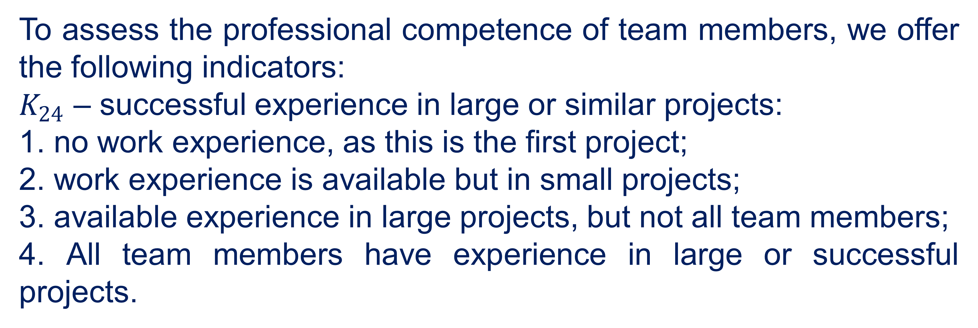
We formulate the evaluation problem as follows. Let's have at the entrance some commercial projects
Information criteria for evaluating start-up project development teams
To assess the professional competence of team members, we offer the following indicators:
$K_{24}$ – successful experience in large or similar projects:
1. no work experience, as this is the first project;
2. work experience is available but in small projects;
3. available experience in large projects, but not all team members;
4. All team members have experience in large or successful projects.
We formulate the evaluation problem as follows. Let's have at the entrance some commercial projects
12

Slide 13
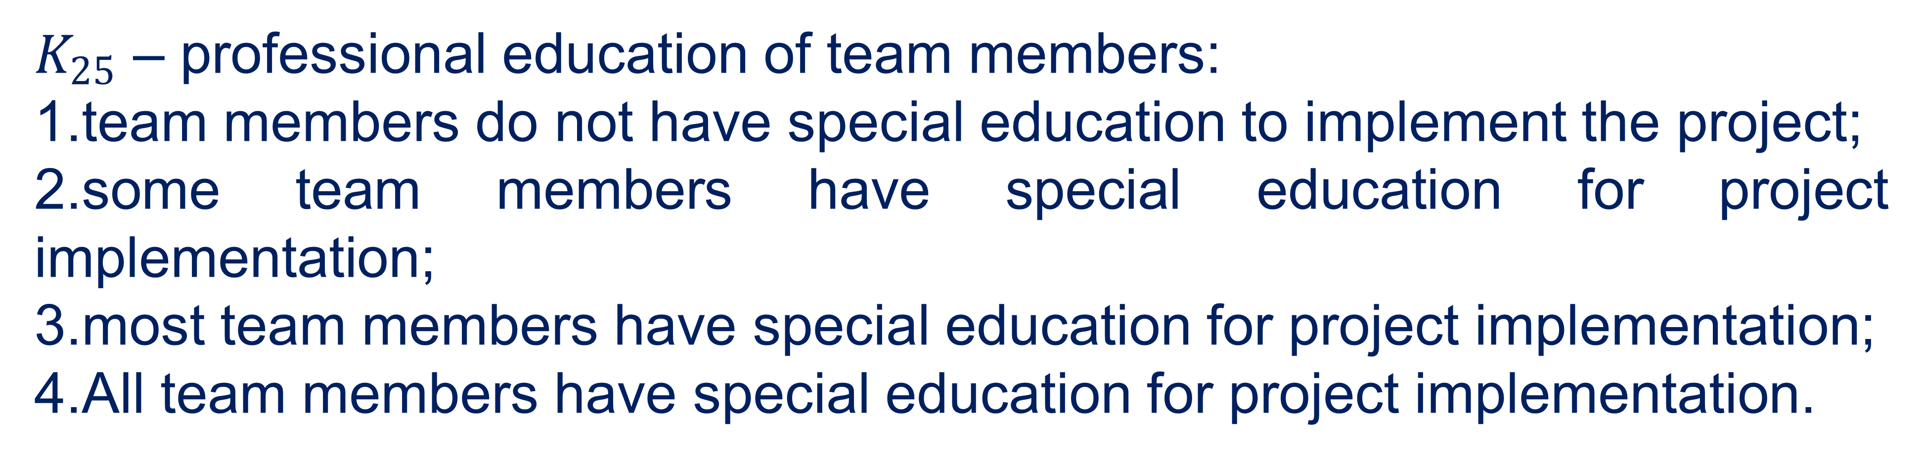
We formulate the evaluation problem as follows. Let's have at the entrance some commercial projects
Information criteria for evaluating start-up project development teams
$K_{25}$ – professional education of team members:
1.team members do not have special education to implement the project;
2.some team members have special education for project implementation;
3.most team members have special education for project implementation;
4.All team members have special education for project implementation.
We formulate the evaluation problem as follows. Let's have at the entrance some commercial projects
13

Slide 14
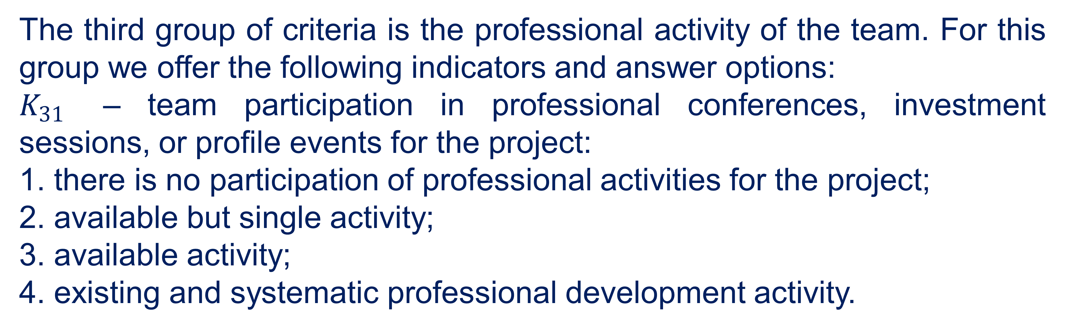
We formulate the evaluation problem as follows. Let's have at the entrance some commercial projects
Information criteria for evaluating start-up project development teams
The third group of criteria is the professional activity of the team. For this group we offer the following indicators and answer options:
$K_{31}$ – team participation in professional conferences, investment sessions, or profile events for the project:
1. there is no participation of professional activities for the project;
2. available but single activity;
3. available activity;
4. existing and systematic professional development activity.
We formulate the evaluation problem as follows. Let's have at the entrance some commercial projects
14

Slide 15
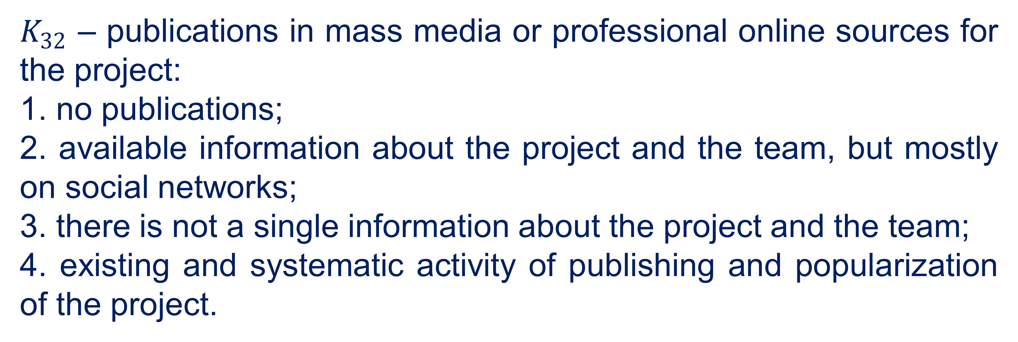
We formulate the evaluation problem as follows. Let's have at the entrance some commercial projects
Information criteria for evaluating start-up project development teams
$K_{32}$ – publications in mass media or professional online sources for the project:
1. no publications;
2. available information about the project and the team, but mostly on social networks;
3. there is not a single information about the project and the team;
4. existing and systematic activity of publishing and popularization of the project.
We formulate the evaluation problem as follows. Let's have at the entrance some commercial projects
15

Slide 16
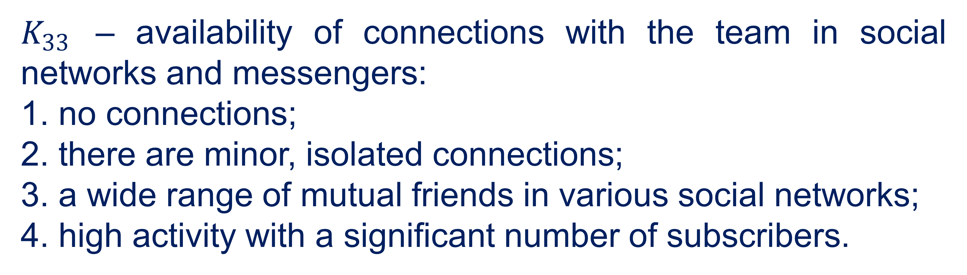
We formulate the evaluation problem as follows. Let's have at the entrance some commercial projects
Information criteria for evaluating start-up project development teams
$K_{33}$ – availability of connections with the team in social networks and messengers:
1. no connections;
2. there are minor, isolated connections;
3. a wide range of mutual friends in various social networks;
4. high activity with a significant number of subscribers.
We formulate the evaluation problem as follows. Let's have at the entrance some commercial projects
16

Slide 17
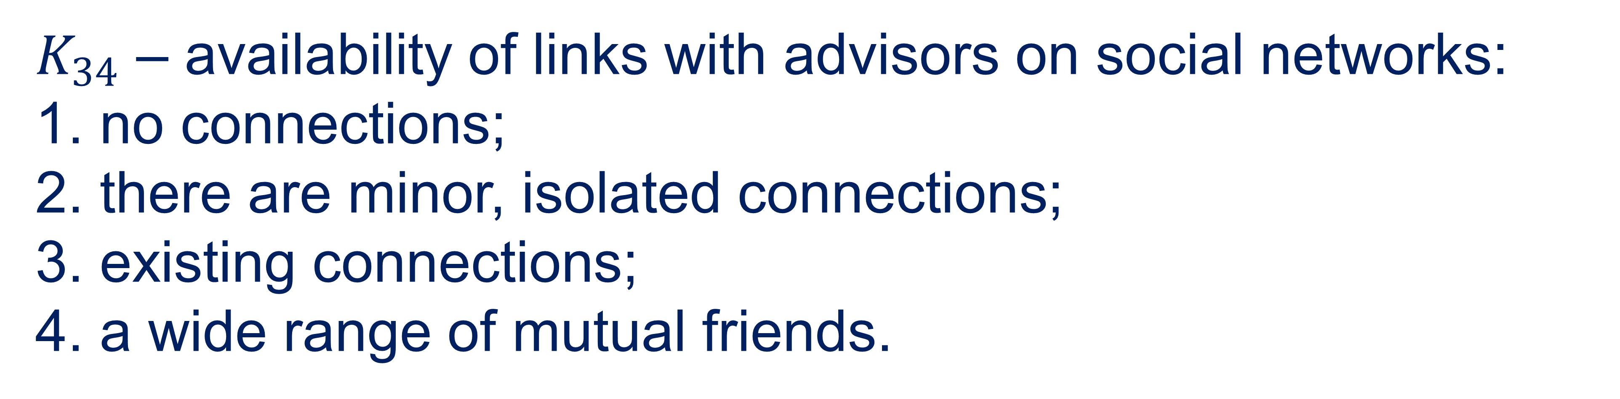
We formulate the evaluation problem as follows. Let's have at the entrance some commercial projects
Information criteria for evaluating start-up project development teams
$K_{34}$ – availability of links with advisors on social networks:
1. no connections;
2. there are minor, isolated connections;
3. existing connections;
4. a wide range of mutual friends.
We formulate the evaluation problem as follows. Let's have at the entrance some commercial projects
17

Slide 18
We formulate the evaluation problem as follows. Let's have at the entrance some commercial projects
Information criteria for evaluating start-up project development teams
Each criterion evaluates the next term set of linguistic variables L={H; HC; C; B}, where:
Н – «low level of the indicator»;
НС – «the level of the indicator is below average»;
С – «average level of the indicator»;
В – «high level of the indicator».
We formulate the evaluation problem as follows. Let's have at the entrance some commercial projects
18

Slide 19
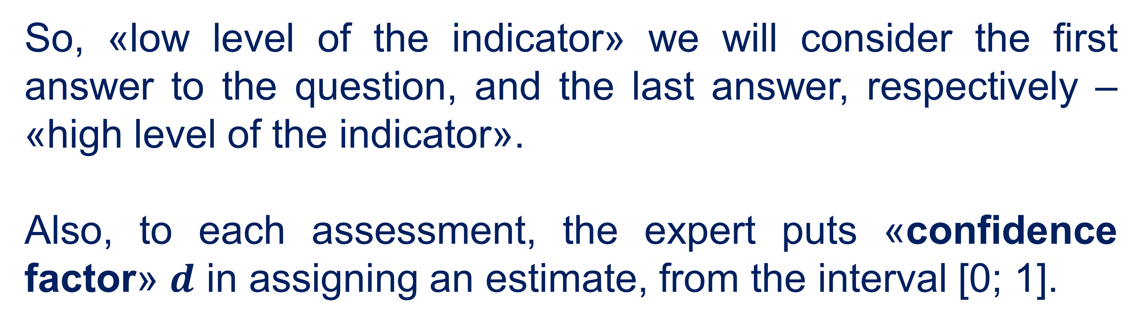
We formulate the evaluation problem as follows. Let's have at the entrance some commercial projects
Information criteria for evaluating start-up project development teams
So, «low level of the indicator» we will consider the first answer to the question, and the last answer, respectively – «high level of the indicator».
Also, to each assessment, the expert puts «confidence factor» $d$ in assigning an estimate, from the interval [0; 1].
We formulate the evaluation problem as follows. Let's have at the entrance some commercial projects
19

Slide 20

General algorithm for evaluating start-up teams
02

Slide 21
General algorithm for evaluating start-up teams
Consider the general neuro-fuzzy algorithm for constructing estimates of start-up teams and deriving their ratings as follows. For a better understanding of the algorithm in parallel, we will consider an example of calculation.
21

Slide 22

General algorithm for evaluating start-up teams
Let the following development teams $X=\left\{x^{1},x^{2},...,x^{5}\right\}$, which need to be evaluated, derive a rating, and build their ranking series.
1 step. The teams passed the expert evaluation and received the following input evaluations, table. 1.
22

Slide 23
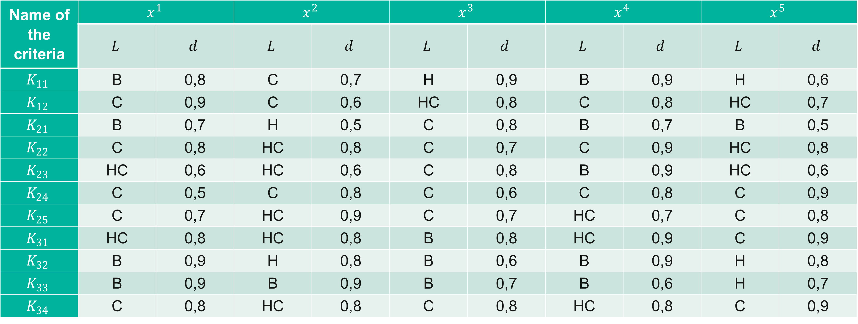
General algorithm for evaluating start-up teams
Table 1
Input signals according to evaluation criteria
Name of the criteria | $$x^{1}$$ |  | $$x^{2}$$ |  | $$x^{3}$$ |  | $$x^{4}$$ |  | $$x^{5}$$
 | $$L$$ | $$d$$ | $$L$$ | $$d$$ | $$L$$ | $$d$$ | $$L$$ | $$d$$ | $$L$$ | $$d$$
$$K_{11}$$ | В | 0,8 | С | 0,7 | Н | 0,9 | В | 0,9 | Н | 0,6
$$K_{12}$$ | С | 0,9 | С | 0,6 | НС | 0,8 | С | 0,8 | НС | 0,7
$$K_{21}$$ | В | 0,7 | Н | 0,5 | С | 0,8 | В | 0,7 | В | 0,5
$$K_{22}$$ | С | 0,8 | НС | 0,8 | С | 0,7 | С | 0,9 | НС | 0,8
$$K_{23}$$ | НС | 0,6 | НС | 0,6 | С | 0,8 | В | 0,9 | НС | 0,6
$$K_{24}$$ | С | 0,5 | С | 0,8 | С | 0,6 | С | 0,8 | С | 0,9
$$K_{25}$$ | С | 0,7 | НС | 0,9 | С | 0,7 | НС | 0,7 | С | 0,8
$$K_{31}$$ | НС | 0,8 | НС | 0,8 | В | 0,8 | НС | 0,9 | С | 0,9
$$K_{32}$$ | В | 0,9 | Н | 0,8 | В | 0,6 | В | 0,9 | Н | 0,8
$$K_{33}$$ | В | 0,9 | В | 0,9 | В | 0,7 | В | 0,6 | Н | 0,7
$$K_{34}$$ | С | 0,8 | НС | 0,8 | С | 0,8 | НС | 0,8 | С | 0,9
23

Slide 24
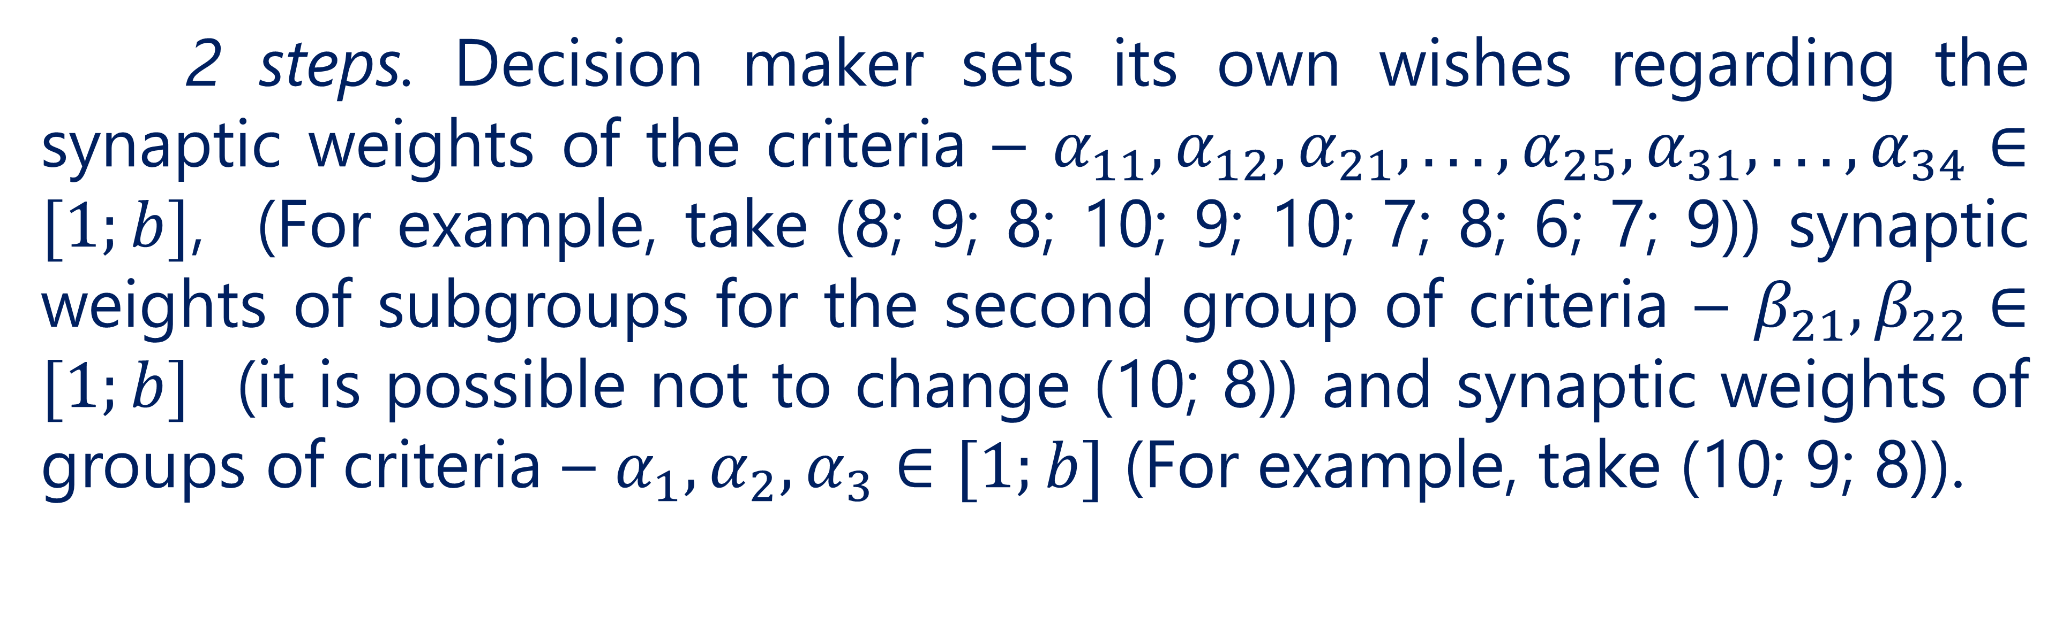
General algorithm for evaluating start-up teams
2 steps. Decision maker sets its own wishes regarding the synaptic weights of the criteria – $α_{11},α_{12},α_{21},...,α_{25},α_{31},...,α_{34}∈[1;b]$, (For example, take (8; 9; 8; 10; 9; 10; 7; 8; 6; 7; 9)) synaptic weights of subgroups for the second group of criteria – $β_{21},β_{22}∈[1;b]$ (it is possible not to change (10; 8)) and synaptic weights of groups of criteria – $α_{1},α_{2},α_{3}∈[1;b]$ (For example, take (10; 9; 8)).
24

Slide 25
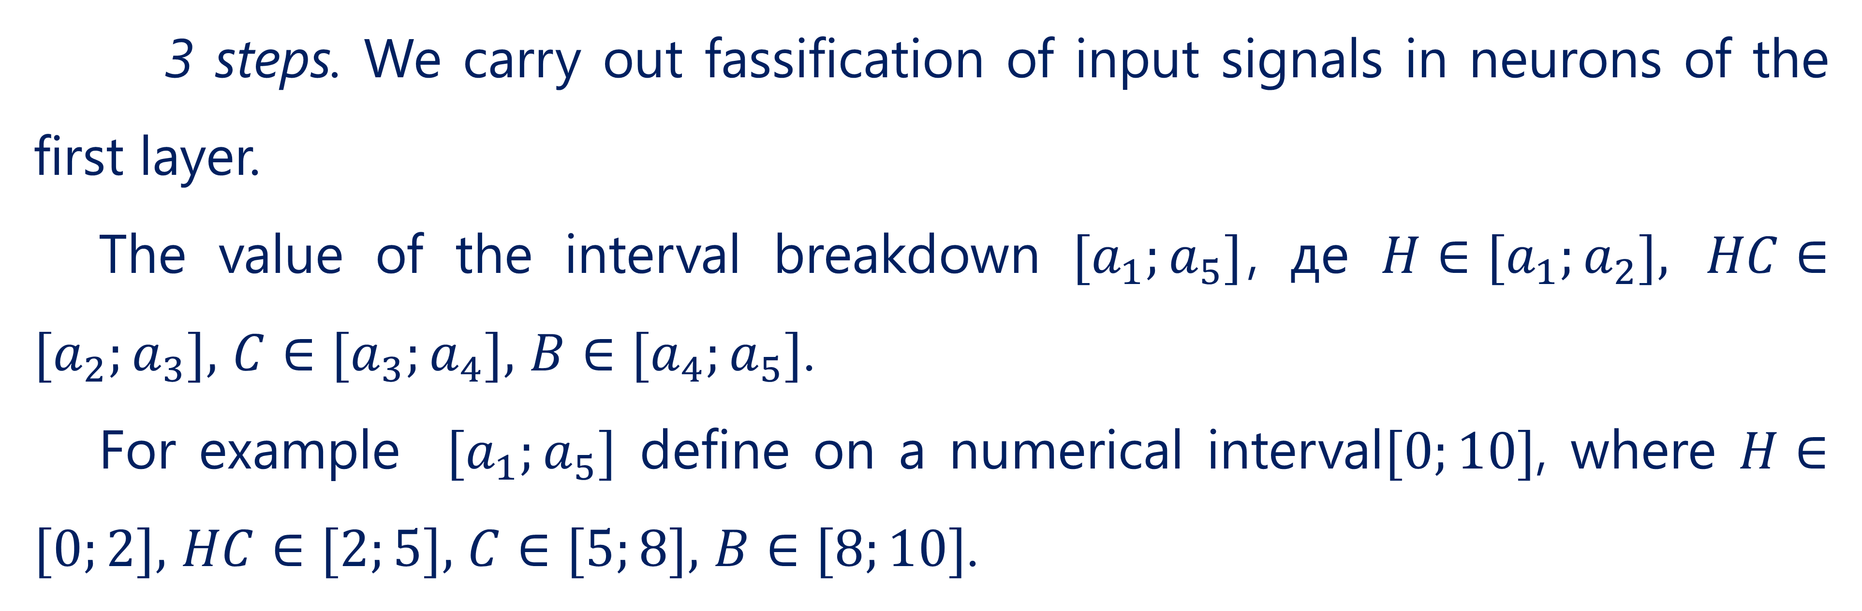
General algorithm for evaluating start-up teams
3 steps. We carry out fassification of input signals in neurons of the first layer.
The value of the interval breakdown $[a_{1};a_{5}]$, де $H∈[a_{1};a_{2}],$ $HC∈[a_{2};a_{3}],$ $C∈[a_{3};a_{4}],$ $B∈[a_{4};a_{5}]$.
For example $[a_{1};a_{5}]$ define on a numerical interval$[0;10]$, where $H∈[0;2],$ $HC∈[2;5],$ $C∈[5;8],$ $B∈[8;10]$.
25

Slide 26
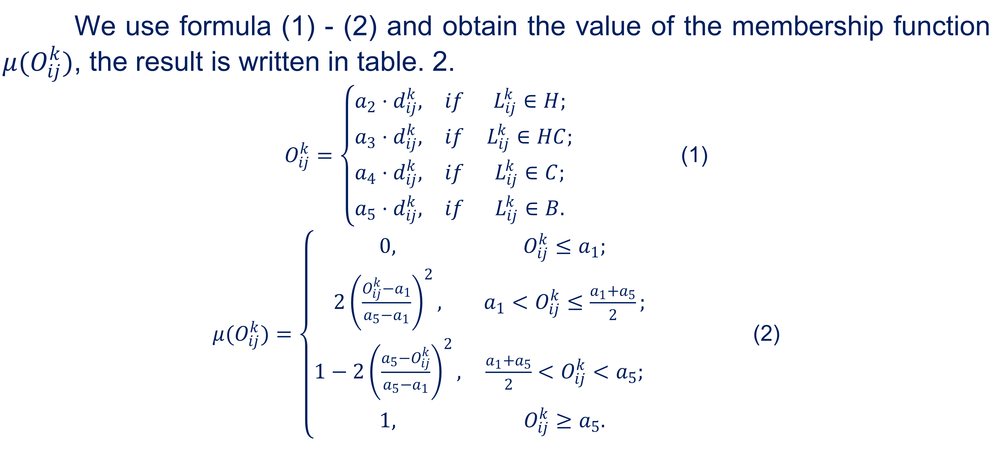
General algorithm for evaluating start-up teams
We use formula (1) - (2) and obtain the value of the membership function $μ(O_{ij}^{k})$, the result is written in table. 2.
$O_{ij}^{k}=\left\{\begin{matrix}a_{2}⋅d_{ij}^{k}, & if & L_{ij}^{k}∈H; \\ a_{3}⋅d_{ij}^{k}, & if & L_{ij}^{k}∈HC; \\ a_{4}⋅d_{ij}^{k}, & if & L_{ij}^{k}∈C; \\ a_{5}⋅d_{ij}^{k}, & if & L_{ij}^{k}∈B.\end{matrix}\right.$ (1)
$μ(O_{ij}^{k})=\left\{\begin{matrix}0, & O_{ij}^{k}≤a_{1}; \\ 2{\left(\frac{O_{ij}^{k}−a_{1}}{a_{5}−a_{1}}\right)}^{2}, & a_{1}<O_{ij}^{k}≤\frac{a_{1}+a_{5}}{2}; \\ 1−2{\left(\frac{a_{5}−O_{ij}^{k}}{a_{5}−a_{1}}\right)}^{2}, & \frac{a_{1}+a_{5}}{2}<O_{ij}^{k}<a_{5}; \\ 1, & O_{ij}^{k}≥a_{5}.\end{matrix}\right.$ (2)
26

Slide 27
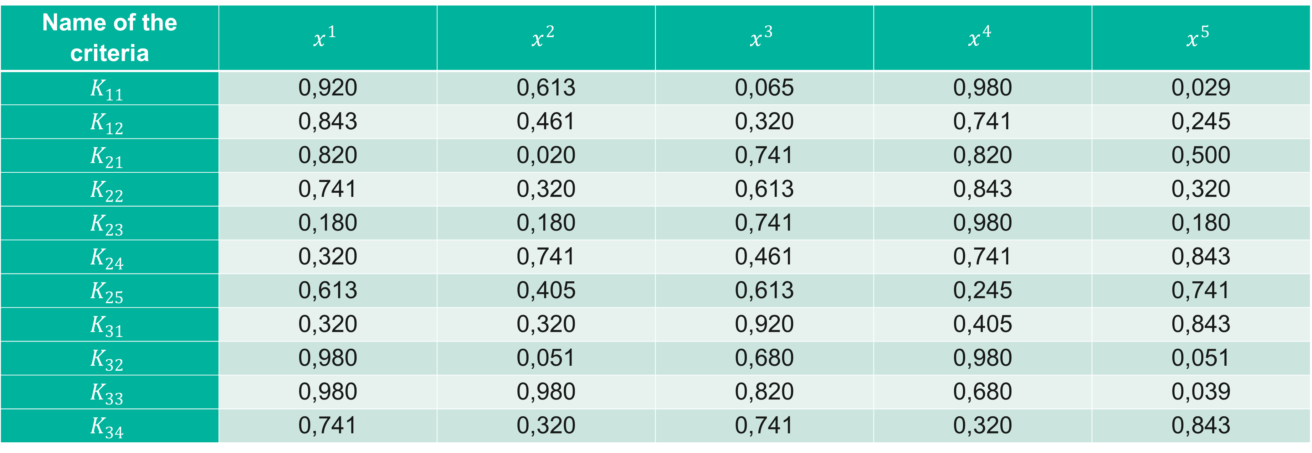
General algorithm for evaluating start-up teams
Table 2
Fuzzyfication of input signals
Name of the criteria | $$x^{1}$$ | $$x^{2}$$ | $$x^{3}$$ | $$x^{4}$$ | $$x^{5}$$
$$K_{11}$$ | 0,920 | 0,613 | 0,065 | 0,980 | 0,029
$$K_{12}$$ | 0,843 | 0,461 | 0,320 | 0,741 | 0,245
$$K_{21}$$ | 0,820 | 0,020 | 0,741 | 0,820 | 0,500
$$K_{22}$$ | 0,741 | 0,320 | 0,613 | 0,843 | 0,320
$$K_{23}$$ | 0,180 | 0,180 | 0,741 | 0,980 | 0,180
$$K_{24}$$ | 0,320 | 0,741 | 0,461 | 0,741 | 0,843
$$K_{25}$$ | 0,613 | 0,405 | 0,613 | 0,245 | 0,741
$$K_{31}$$ | 0,320 | 0,320 | 0,920 | 0,405 | 0,843
$$K_{32}$$ | 0,980 | 0,051 | 0,680 | 0,980 | 0,051
$$K_{33}$$ | 0,980 | 0,980 | 0,820 | 0,680 | 0,039
$$K_{34}$$ | 0,741 | 0,320 | 0,741 | 0,320 | 0,843
27

Slide 28
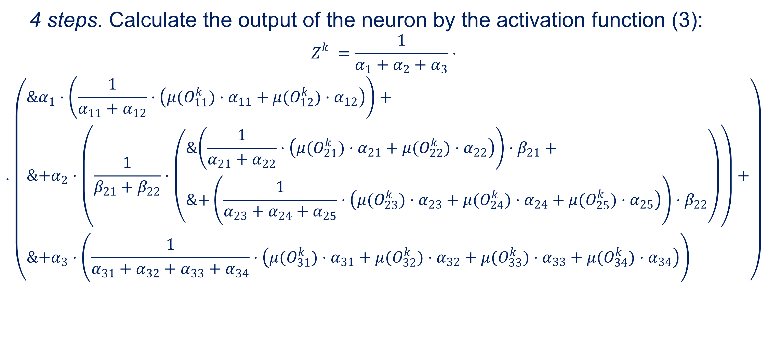
General algorithm for evaluating start-up teams
4 steps. Calculate the output of the neuron by the activation function (3):
$$Z_{}^{k}=\frac{1}{α_{1}+α_{2}+α_{3}}⋅ \\ ⋅\left(\begin{aligned}&α_{1}⋅\left(\frac{1}{α_{11}+α_{12}}⋅\left(μ(O_{11}^{k})⋅α_{11}+μ(O_{12}^{k})⋅α_{12}\right)\right)+ \\ &+α_{2}⋅\left(\frac{1}{β_{21}+β_{22}}⋅\left(\begin{aligned}&\left(\frac{1}{α_{21}+α_{22}}⋅\left(μ(O_{21}^{k})⋅α_{21}+μ(O_{22}^{k})⋅α_{22}\right)\right)⋅β_{21}+ \\ &+\left(\frac{1}{α_{23}+α_{24}+α_{25}}⋅\left(μ(O_{23}^{k})⋅α_{23}+μ(O_{24}^{k})⋅α_{24}+μ(O_{25}^{k})⋅α_{25}\right)\right)⋅β_{22}\end{aligned}\right)\right)+ \\ &+α_{3}⋅\left(\frac{1}{α_{31}+α_{32}+α_{33}+α_{34}}⋅\left(μ(O_{31}^{k})⋅α_{31}+μ(O_{32}^{k})⋅α_{32}+μ(O_{33}^{k})⋅α_{33}+μ(O_{34}^{k})⋅α_{34}\right)\right)\end{aligned}\right)$$
28

Slide 29
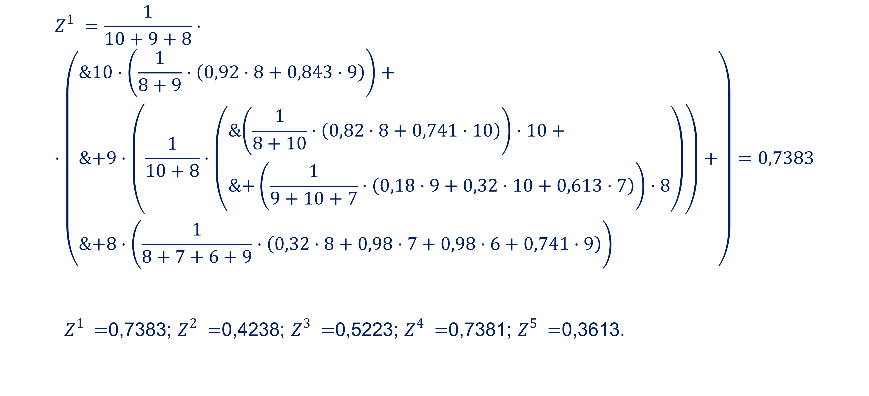
General algorithm for evaluating start-up teams
$$Z_{}^{1}=\frac{1}{10+9+8}⋅ \\ ⋅\left(\begin{aligned}&10⋅\left(\frac{1}{8+9}⋅\left(0,92⋅8+0,843⋅9\right)\right)+ \\ &+9⋅\left(\frac{1}{10+8}⋅\left(\begin{aligned}&\left(\frac{1}{8+10}⋅\left(0,82⋅8+0,741⋅10\right)\right)⋅10+ \\ &+\left(\frac{1}{9+10+7}⋅\left(0,18⋅9+0,32⋅10+0,613⋅7\right)\right)⋅8\end{aligned}\right)\right)+ \\ &+8⋅\left(\frac{1}{8+7+6+9}⋅\left(0,32⋅8+0,98⋅7+0,98⋅6+0,741⋅9\right)\right)\end{aligned}\right)=0,7383$$
$Z_{}^{1}=$0,7383; $Z_{}^{2}=$0,4238; $Z_{}^{3}=$0,5223; $Z_{}^{4}=$0,7381; $Z_{}^{5}=$0,3613.
29

Slide 30

Data defuzzyfication and rating of start-up teams
03

Slide 31
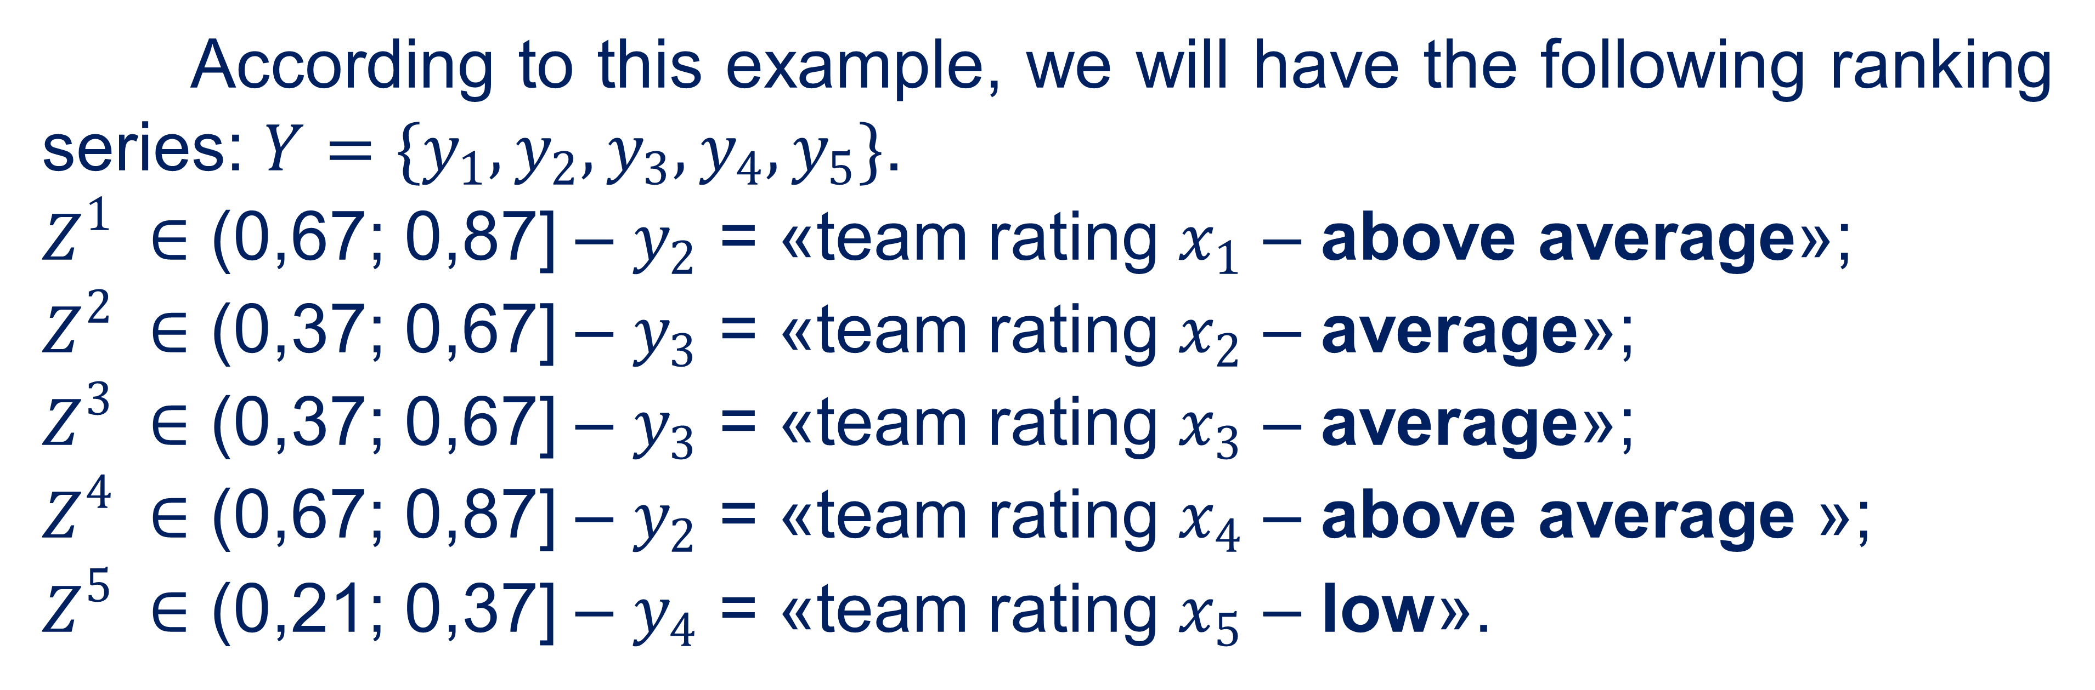
Data defuzzyfication and rating of start-up teams
According to this example, we will have the following ranking series: $Y=\{y_{1},y_{2},y_{3},y_{4},y_{5}\}$.
$Z_{}^{1}∈$ (0,67; 0,87] – $y_{2}$ = «team rating $x_{1}$ – above average»;
$Z_{}^{2}∈$ (0,37; 0,67] – $y_{3}$ = «team rating $x_{2}$ – average»;
$Z_{}^{3}∈$ (0,37; 0,67] – $y_{3}$ = «team rating $x_{3}$ – average»;
$Z_{}^{4}∈$ (0,67; 0,87] – $y_{2}$ = «team rating $x_{4}$ – above average »;
$Z_{}^{5}∈$ (0,21; 0,37] – $y_{4}$ = «team rating $x_{5}$ – low».
31

Slide 32
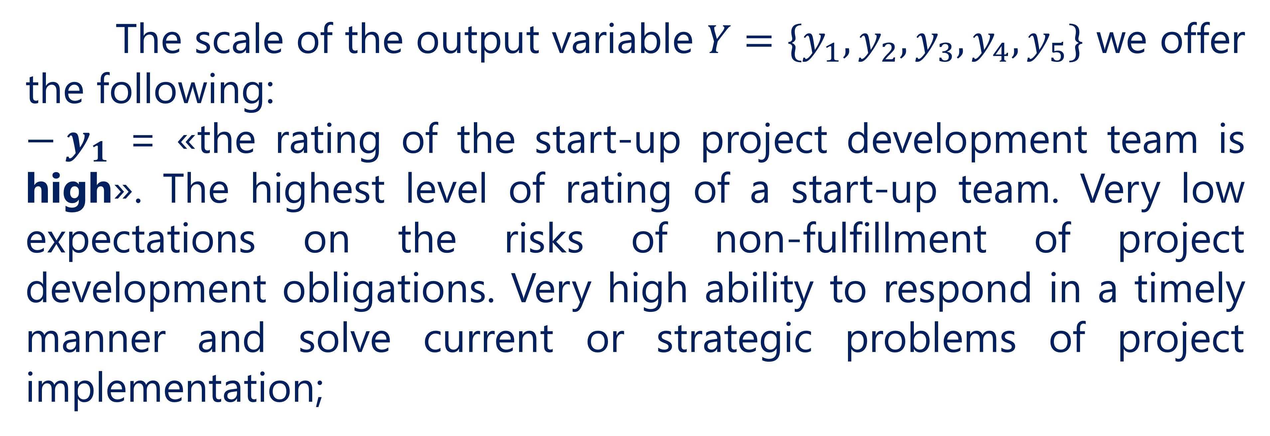
Data defuzzyfication and rating of start-up teams
The scale of the output variable $Y=\{y_{1},y_{2},y_{3},y_{4},y_{5}\}$ we offer the following:
${− y}_{1}$ = «the rating of the start-up project development team is high». The highest level of rating of a start-up team. Very low expectations on the risks of non-fulfillment of project development obligations. Very high ability to respond in a timely manner and solve current or strategic problems of project implementation;
32

Slide 33
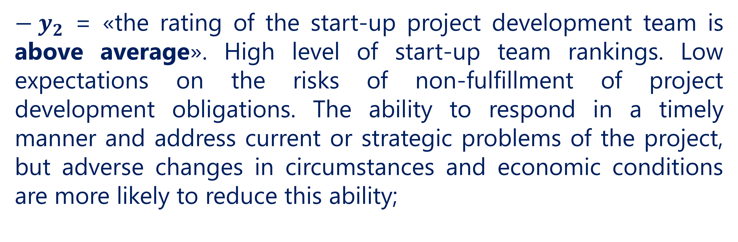
Data defuzzyfication and rating of start-up teams
${− y}_{2}$ = «the rating of the start-up project development team is above average». High level of start-up team rankings. Low expectations on the risks of non-fulfillment of project development obligations. The ability to respond in a timely manner and address current or strategic problems of the project, but adverse changes in circumstances and economic conditions are more likely to reduce this ability;
33

Slide 34
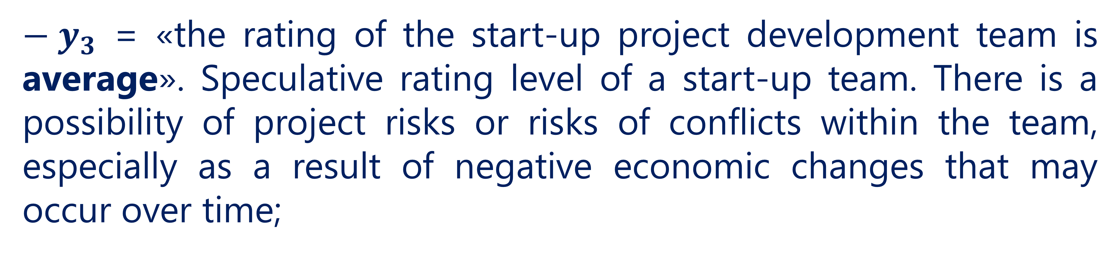
Data defuzzyfication and rating of start-up teams
${− y}_{3}$ = «the rating of the start-up project development team is average». Speculative rating level of a start-up team. There is a possibility of project risks or risks of conflicts within the team, especially as a result of negative economic changes that may occur over time;
34

Slide 35
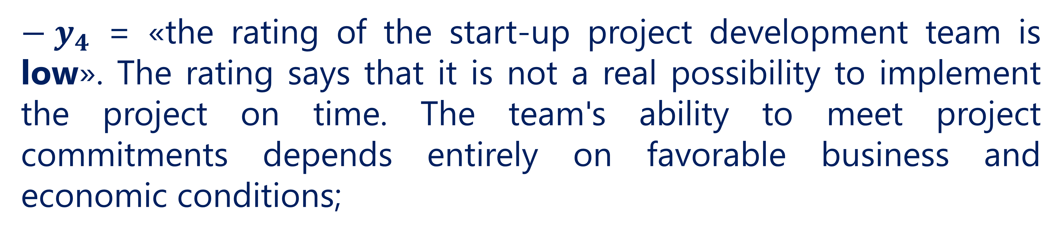
Data defuzzyfication and rating of start-up teams
${− y}_{4}$ = «the rating of the start-up project development team is low». The rating says that it is not a real possibility to implement the project on time. The team's ability to meet project commitments depends entirely on favorable business and economic conditions;
35

Slide 36
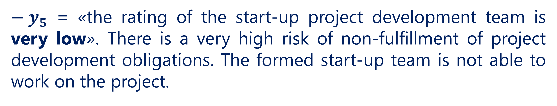
Data defuzzyfication and rating of start-up teams
${− y}_{5}$ = «the rating of the start-up project development team is very low». There is a very high risk of non-fulfillment of project development obligations. The formed start-up team is not able to work on the project.
36

Slide 37
References
Polishchuk V. Evaluation of start-up projects in conditions of risk and uncertainty. – Uzhhorod: Publishing house "FOP Sabov AM", 2021. – 120 p. ISBN 978-617-7798-49-0.
Polishchuk, V.; Kelemen, M.; Gavurová, B.; Varotsos, C.; Andoga, R.; Gera, M.; Christodoulakis, J.; Soušek, R.; Kozuba, J.; Blišťan, P.; Szabo Jr., S. A Fuzzy Model of Risk Assessment for Environmental Start-up Projects in the Air Transport Sector. Int. J. Environ. Res. Public Health 2019, 16, 3573. https://doi.org/10.3390/ijerph16193573
Kelemen, M.; Polishchuk, V.; Gavurová, B.; Szabo, S.; Rozenberg, R.; Gera, M.; Kozuba, J.; Andoga, R.; Divoková, A.; Bliš’an, P. Fuzzy Model for Quantitative Assessment of Environmental Start-up Projects in Air Transport. Int. J. Environ. Res. Public Health 2019, 16, 3585. https://doi.org/10.3390/ijerph16193585
37

Slide 38
Thank you!
WWW.SITE2MAX.PRO

