Slide 1

Assembling Correspondence
Lesson 6
https://www.eliassonmarketing.com/why-should-you-focus-on-email-marketing/
Lecturer: M. Kurbonov

Slide 2
What is correspondence?
Correspondence is the shortest form of technical writing, which may include emails, memos, text messages and letters. In today's climate of communication, these forms of written correspondence are usually transmitted online. This has led to the rise of "netiquette" - the codes of online-speak in a professional context.

Slide 3
"Netiquette"
The way that you communicate in writing carries a lot of significance. Virtual writing requires tact, skill and awareness and can often lead to someone obsessively re-reading their email and waiting a long time before pressing send (Last, 2020). This anxiety is understandable: unlike verbal communication, the Internet acts as an online archive of our communications, that could resurface in many years to come.
When corresponding online, therefore, you will want to represent yourself and/or your organization as best as possible, by deploying "netiquette" (Last, 2020). Communication should be clear and concise at a minimum. As with any form of technical writing, your content should always be determined by PAT: Purpose, Audience and Tone.

Slide 4
Emails
Emailing is familiar to almost everyone, from service users to students, having largely replaced print letters in everyday forms of correspondence. They are best used for brief messages but contain more content than a typical text message. Additionally, they vary in formality - ranging from the use of personal messages to business communication. This is an important thing to remember in emails; though they may seem like a fairly informal medium, appropriate respect should still be used in professional contexts (Last, 2020).

Slide 5
Here are some guidelines for constructing an email:
Appropriate salutations. When addressing people externally, you should usually opt for "Dear" in your introductory email. If they are internal to your organization and you have a relationship with them, a simple "Hi" should suffice.
Be brief. Try not to repeat yourself or include unnecessary information in your email.
Format properly. An email should not be condensed into one block of text. Make sure to paragraph appropriately - usually in three or less.
Keep your subject line simple. A cardinal sin in email correspondence is writing a waffly subject line; this immediately signals that something may be off with your communication skills. Choose the most relevant and brief summary of your email contents for your subject.

Slide 6
Here are some guidelines for constructing an email:
Sign off with a signature. A signature block containing your name and key contact information will add a professional touch to your email.
This is not Facebook messenger. No LMAO, ROFL or LOLs here please.
Review. Make sure to check for spelling and grammatical mistakes - especially your recipient’s name. Also make sure to test that all attachments/ links are working and correct.
Don't leave people hanging. Try to respond to an email within 24 hours. Likewise, if you don't receive a response to an important matter within a similar time frame, send a polite follow up.

Slide 7
Examples
The following is an example of a poorly written email:
Jan! I was thinking earlier that it would be rly fun to go to the climate conference on Saturday!!!! I've been thinking about it for agessss and think it will be really good. Don't leave me hanging LOL - Steph xx
The following is an example of a poorly written email:
Hi Jan, Hope you're doing well. I was wondering if you would like to attend the climate conference on Saturday with me? I've heard that it's going to include some really interesting panels. Look forward to hearing from you! Kind regards, Steph McLuskin www.stephmcluskinstudios.co.uk stephmcluskin@mcluskinstudios.org +8887433672910

Slide 8
Useful language: emails
 | Formal | Informal
Salutations: | Dear, To Whom It May Concern, (check appropriateness) | Hi,
Signoffs: | Yours sincerely, Kind regards, Best wishes, | Best, Regards, Thanks,

Slide 9
Texts
Though most often used amongst close friends, communicating via text is increasingly deployed in formal workplace settings.
The instinctively personal feeling of a text makes it even more essential that we think before we send. Once again, the PAT format should be followed when constructing a text. Additionally, you may want to be conscious of:

Slide 10
Texts
Though most often used amongst close friends, communicating via text is increasingly deployed in formal workplace settings.
The instinctively personal feeling of a text makes it even more essential that we think before we send. Once again, the PAT format should be followed when constructing a text. Additionally, you may want to be conscious of:

Slide 11
Misinterpretation
Because of the brief nature of texting, and the use of symbols and other signs, your message may convey something that you did not intend. Make sure to re-read your text to check that it won't be taken the wrong way!

Slide 12
Borderline harassment
Unlike emailing, texting can feel more invasive and needy. Only opt for texts when appropriate!

Slide 13
Basic memos
Unlike the above, memoranda or memos are specifically used to correspond "in-house"; they are a note, or a document usually sent from one person to one or more people in an organization. Though they are mostly informative, they can also be persuasive documents. Memos are commonly used to (Last, 2020):
Pass on/ request information
Outline policies
Present short reports
Propose ideas

Slide 14
Basic memos
The format of a memo is more complicated than an email, and many companies or organizations typically have their own styles or templates that are used. Overall, the main components of a memo are:
A logo or letterhead
This is optional, but you may choose to include your organization's letterhead at the top of your memo (often in the righthand corner). This will include the company logo and sometimes the name, address and contact information.
A header block
This will usually appear at the top left side of a memo, underneath the word MEMO or MEMORANDUM (in bold and caps). This is section which contains important information about the recipient, sender, and the subject of the memo. It will be formatted as follows:
TO: Recipients full name and their position within the organization (if applicable).
FROM: Sender's full name and their position within the organization. DATE: The date of sending the memo.
SUBJECT: A short summary of the message contents.

Slide 15
The message
This will vary in length depending on the subject matter of your memo; it may be a few sentences or a comprehensive report. Despite this, you should generally arrange the message of your memo like this:
Opening: Does your reader need to look at this and why?
Details: What does your reader need to know? This should include the main bulk of information and fulfil the central aims of your memo. You should not include unnecessary information here.
Closing: What should your reader do now? This may be the action, if there is any, that your reader is expected to take in response. You should aim to be polite and outline how taking this action may benefit them.

Slide 16
Useful language: memos
Opening: "I've noticed that", "Due to", "I'm writing to inform you that", "After speaking with".
Closing: "Thank you in advance for", "I am excited to discuss", "I look forward to", "We are confident that".
It is important to remember that memos, like most forms of technical writing, are very concise; there is no need to provide a warm-up to your piece with a lengthy introduction. Because they are used in the workplace, they tend to be even more dry and direct. Also remember to use a readable font such as Arial or Times New Roman, in size 10-point or 12-point. The following is an example of a typical short office memo:

Slide 17
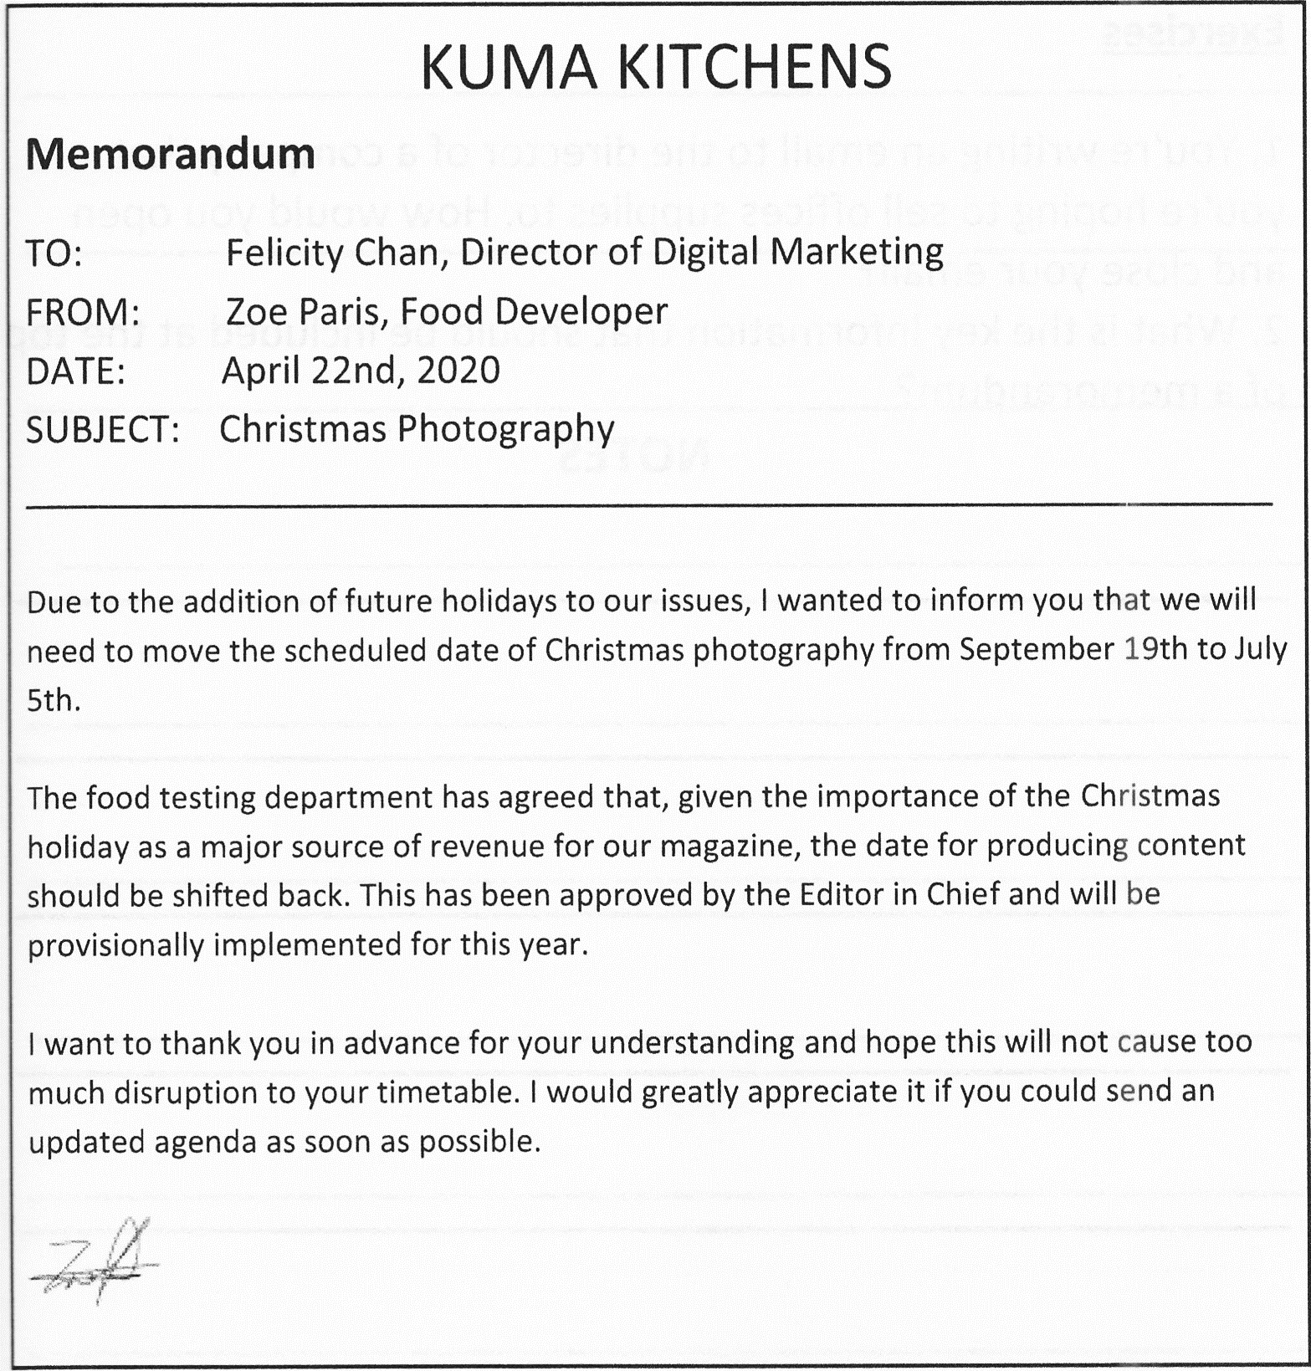

Slide 18
Review
Review commences once your final draft is complete, formatted and laid out. There are two parts to review - part one is editing and checking, which focusses on bringing your final draft up to a publishable state; part two is formal review and approval by a group of stakeholders and key subject matter experts (i.e. your review team) which provides the formal go- ahead to publish.
The first part of review begins with editing, the time-honored process of honing and polishing a document to bring it up to a publishable state. Editing usually involves a number of passes of varying depth, or levels. I’ve identified seven levels of editing in technical writing, which are described in the following section. The intention of editing is to make your documentation as presentable, user-friendly and technically accurate as possible before you submit it for formal stakeholder review. This cuts the number of review cycles required, avoids wasting your stakeholders’ valuable time on mistakes you should have picked up yourself, and generally creates a good impression.

Slide 19
Review
Depending on the type of documentation and quality required, further checks may be needed in addition to editing, such as peer review and testing by the quality assurance or testing team. These are both excellent methods of improving the accuracy of technical documentation with minimal effort on the writer’s behalf.
Once editing and checking is finished, it’s time for review. You will need to define a review team made up of stakeholders and key subject matter experts who can give you the final go-ahead for publication, and send out an email or other communication inviting the team to formally review your documentation. Just like the informal review process carried out during writing, formal review usually generates feedback which needs to be incorporated into the final draft. You may require a number of rounds of formal review before approval is granted.

Slide 20
Stay organized during reviews
It’s important to stay organized during the review process, as it can quickly become unmanageable. To stay on top of things, focus on the following areas:
Version control. Maintain strict version control during the editing and review process. This requires knowing which version has been sent out for editing and review, and reconciling the feedback received to that version.
Keeping track of comments. Use a Review Log to keep track of comments received, relate them to a specific version of the document, and track the actions you took to close them out.

Slide 21
Editing
Editing is a structured revision of your document, with the aim of bringing it up to scratch or putting on the final touches for a major milestone such as review or publication. Editing can range from a light proofread to a complete rewrite, depending on the completeness of the document and the level of attention required. Editing is usually performed using markup, comments or written opinions, typically using track changes (for softcopies) or written notes on the hardcopy text.
Two tools used in editing are: an Editing Checklist, a list of editing checks to be performed for each document; and an Editing Sheet, a list that the writer builds during the editing process to capture the correct spelling and punctuation of recurring terms found in the document such as product names and trademarks, and points of style unique to the document.

Slide 22
Editing
Editing can also involve a validation and testing phase, used mostly for product documentation. This is where you verify the technical accuracy of your documentation by checking that any text or pictures of the product in the documentation match the product, and by following your own steps, from start to finish. It’s important not to rely solely on subject matter experts for validation of the technical accuracy, as their limited time may mean that they aren’t able to invest the proper level of attention into rigorously testing the documentation.
These days, it’s common to find the technical writer performing the role of editor for their own documentation. However, it’s not unusual for components of editing or production to be outsourced, particularly where the error tolerance is low. Proofreading, for example, is often outsourced prior to translation or publication in print, or for high-profile documents. Freelance graphic designers or design agencies are often used for the production of designed content (in print or otherwise). Professional editing services are often used for high-profile documents such as reports, books or academic theses.

Slide 23
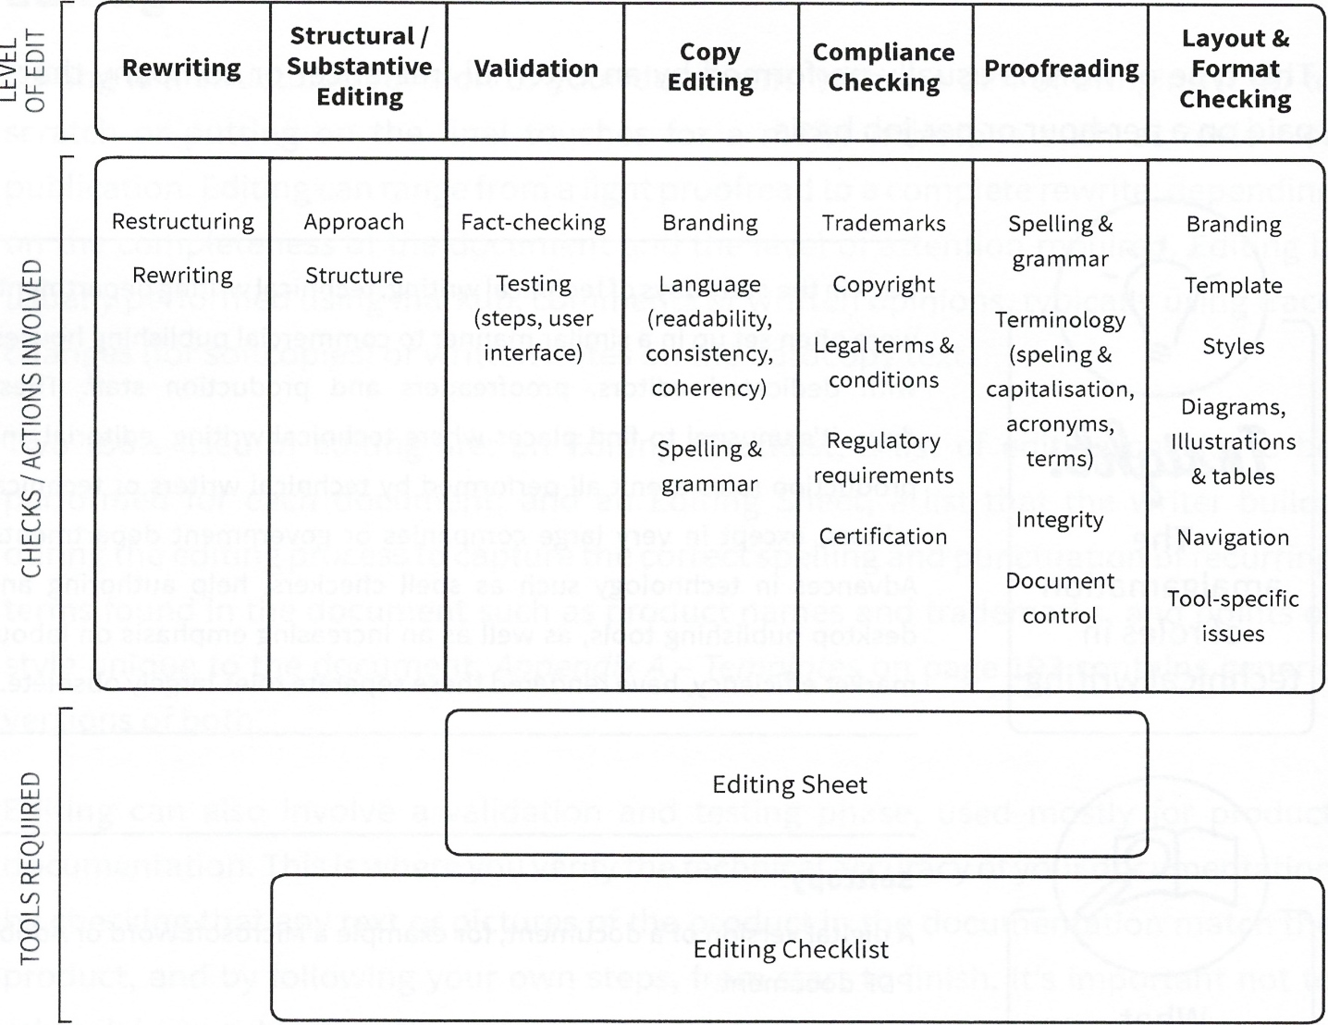
Levels of editing

Slide 24
Editing
Editing is traditionally divided into three fundamental levels: proofreading, copy editing, and structural or substantive editing. v I’m going to describe these three editing levels and add four others that I believe are particularly pertinent to technical writing: rewriting vi, validation, compliance (legal) checking, and layout and format checking.
Typically, the first pass of editing will be one of the more substantial levels, such as structural or substantive editing, proceeding through to copy editing and proofreading as the document quality is brought up to scratch. Of course, this is highly dependent on the state of completion of the documentation to be edited and the quality expectations. Some documents naturally require a higher degree of polish and care, such as commercially printed documents and any documents visible to your company’s clients.

Slide 25
Rewriting
Rewriting occurs when the majority of a document is overhauled. It usually involves restructuring and rewriting substantial chunks of text, with the end product typically bearing little resemblance to the original.
This often happens when one or more subject matter experts with varying writing skills hack together a document, handing it to the technical writer to polish up. This scenario is very common, and presents a unique challenge to the writer - bringing his or her writing and editorial skills to create a coherent and polished final document without losing the meaning or intention of the original.

Slide 26
Rewriting
This can be less a step of editing than co-authoring with the subject matter experts, but I’ve included it in the editing section because it’s quite common for technical writers to be asked to ‘edit’ a document that actually requires a rewrite.
In this scenario, the technical writer will simply reorganize and rewrite large chunks of the text as they please, usually without bothering to track their changes (the effort of tracking all those changes would be impractical). It’s essential for the writer to go back and forth with the subject matter expert(s) during this process to ensure the content is still conveying the desired meaning - it’s easy for seemingly minor, but important sentences or facts to get edited out of existence in a rewrite.

Slide 27
Structural or substantive editing
Structural or substantive editing is an in-depth examination of a document’s approach and structure:
Approach: The writer’s general approach to solving the challenges presented in the Documentation Plan is reviewed. This involves placing the document in context and asking challenging questions such as: Does this document adequately address the issues the audience faces? Does the document succeed overall - are there any weak points? Is the use of language (such as tone and narrative point of view) appropriate?
Structure: This part of the review ensures that the document progresses logically and has a natural flow as well as whether any components can be added to improve navigation of the document, such as tabs and indexes. Structural elements within the text are also reviewed, such as the placement or addition of reader aides, including callouts and diagrams.

Slide 28
Validation
Validation involves two aspects, both of which are relevant for product documentation:
Fact-checking: This involves verifying technical facts against specifications documents or with key subject matter experts, for example verifying that a volume range described in a product’s user guide matches the range described in the product specifications.
Testing: In testing, the writer attempts to follow the steps in the document to check that they produce the result described. They should also validate that any text or pictures from the product’s user interface reproduced in the documentation match the product exactly.

Slide 29
Copy editing
Copy editing is an in-depth review of a document’s language, spelling and grammar. The emphasis is on adding value by analyzing the writer’s use of language, its effectiveness for the target audience and its alignment with the company brand, as well as checking for correct punctuation, spelling and grammar.

Slide 30
Copy editing
In copy editing, language is checked for readability, coherency and consistency:
Readability involves an assessment of reading level (e.g. using automated means such as Flesch- Kincaid), sentence structure and length, as well as checking that text is broken into appropriately sized paragraphs, that the document isn’t too wordy (verbose), and that certain words or phrases haven’t been overused.
Consistency involves checking that the same phrases have been used to describe identical steps or actions (particularly important when editing for translation), and checking for consistent use of tense, point of view and the use of active voice vs. passive voice.
Coherency involves checking the logical flow of the document and ensuring that context is provided in the appropriate places (e.g. overviews, introductions).

Slide 31
Compliance checking
Compliance checking (also known as legal checking) involves verifying that trademarks have been correctly acknowledged and capitalized; a copyright statement exists (if necessary) and that all copyright sources used have been correctly acknowledged; legal terms and conditions, or other legal boilerplates, are in place; and the correct version and regulatory aspects such as symbols are in compliance with the relevant laws.

Slide 32
Proofreading
Proofreading focusses on checking the mechanical aspects of the document, such as spelling and grammar, consistency of terms and acronyms, and checking the integrity of the proof.
In an integrity check, the proof (the final version of a document which will be used for printing or publication) is compared against the approved final draft to detect any missing pages or sections and to ensure errors haven’t been introduced. This is particularly important if the proof has been laid out by a graphic designer - it’s easy for text to be copied and pasted into the wrong section or for minor typos to be accidentally introduced.
Proofreading is usually performed as the final check before a significant milestone, such as sending out a document for review or publication.

Slide 33
Layout and format checking
Checking layout and formatting is often lumped together with proofreading, but I’ve called it out as a separate category, as it’s such a common editing step in technical writing. I couldn’t count the number of times I’ve checked the layout and formatting of documents prior to upload into a content management system or publication on an intranet.
Checking layout and formatting involves ensuring the correct template has been applied; that the styles in the template have been applied to the appropriate elements in the text; those navigational elements such as hyperlinks and tables of contents are functioning properly; and that the appropriate company branding elements are in place, e.g. the correct version and placement of the company logo.
This step also involves checking for any tool-specific issues that arise with particular software packages, such as having to update fields in Microsoft Word. These checks are different for each tool and can form a significant part of an editing checklist.

Slide 34
Layout and format checking
You’ll see from the definitions and the previous diagram that there’s some overlap between the levels of editing (for example, both proofreading and copy editing involve a spelling and grammar check). This is intentional. Editing is one of those activities where there are numerous schools of thought, and there is no hard-and-fast rule on exactly what falls into each level of editing, or even how many levels exist! The model of editing I’ve described here has been designed with a number of specific goals in mind: to be a good method for editing technical documents, to keep the number of levels to a minimum, and to agree with commonly understood editing methods and terminology.
Another aspect of editing is editing for translation. Documents that will undergo translation prior to publication are edited particularly rigorously. This is designed to make the translation process less time-consuming and to weed out any terminology likely to cause problems for the translators.

Slide 35
Editing tools and resources
There are two tools used in editing: an Editing Checklist and an Editing Sheet. Here’s how they work:
An Editing Checklist is a list of items to be checked when editing technical documents. Its purpose is to ensure documents undergo a rigorous and consistent series of checks prior to publication. The template provided should be customized to suit your individual project, documents and writing tools.
An Editing Sheet (also called an editing stylesheet) is a list which is built by the writer during the editing process. It contains document-specific editing rules as well as the correct spelling and punctuation of terminology such as acronyms, technical jargon, product names, user interface elements and trademarks. Its purpose is to maintain consistency in style and terminology across the document and to save you from having to re-validate a term every time you encounter it.

Slide 36
Editing tools and resources
During the editing process, you’ll need to keep a number of resources close at hand. Here are some of the typical resources required during editing:
Editing Checklist – A list of items to be checked when editing technical documents.
Editing Sheet – A list of document-specific editing rules and terminology used in a technical document (acronyms, technical jargon, product names, user interface elements, trademarks, etc.).
General Style Guide – A book providing guidelines on grammar, punctuation, layout and formatting, structure, and other stylistic aspects of writing. Guidance varies from country to country, so make sure you’re using the correct style guide for your location.

Slide 37
Editing tools and resources
An example of a commonly used style guide is the venerable Chicago manual of style published by the University of Chicago Press in the United States (although there are a number of other guides available). In Australia, the Style manual: For authors, editors and printers by John Wiley & Sons is generally regarded as the standard.
House Style Guide – A company-specific (or even team-specific) style guide. House style guides contain guidelines for how to write in the company style, dos and don’ts, company trademarks, standard legal boilerplate, the correct tone to adopt, etc.
Technical documentation teams (especially well-established ones) often have their own style guides specifically for technical documentation. Sometimes these are even made available to the general public, such as the Microsoft Manual of Style, a style guide published by Microsoft for writers creating documentation about Microsoft products.
Domain-Specific Style Guide – A guide that contains rules for a particular domain, or field of writing such as medicine, journalism, law, and academia. Not all domains have their own style guides, but it’s worth investigating.

Slide 38
Editing tools and resources
Brand Guidelines – A company-specific guide which focusses on applying the company brand to documents, particularly graphic design aspects. The brand guidelines will typically mandate the use of company templates and explain the dos and don’ts with the company logo, colors, fonts, etc. They may also delve into writing aspects, blurring the line between house style and brand guidelines (this is common).
Brand guidelines usually originate in the marketing department and, because they’re typically written with marketing collateral in mind, may be of limited relevance to technical documentation.
Access to a dictionary – A dictionary is essential for checking spelling. In most cases, the spell-checker on your word processor will be sufficient. Make sure the language is set to the appropriate location, and be aware of the differences between regions. For example, British English is different to American English.
Access to the internet – You’ll need access to the internet to check the correct capitalization and spelling of company names and trademarks, and to perform basic fact-checking.

Slide 39
Editing tools and resources
Technical aspects of editing and review
Technically speaking, editing and review usually take the form of markup, comments or opinions by the editor or reviewer:
Markup is where the editor or reviewer marks their suggestions directly onto the text of the document by adding, changing or deleting words or sentences. This is typically accomplished via the track changes functionality in a word processor or help authoring tool for softcopies, or written markup on the pages of a hardcopy document.
Comments are notes made about specific sentences, paragraphs or sections of the document. These are typically added using track changes for softcopies, or written I stuck-on notes in the margins of hardcopy documents.
Opinions are comments about general aspects of the document (e.g. structural issues, problems with the general approach, language, etc.). Opinions are typically added by the reviewer as bulleted lists at the start or end of documents being reviewed, or in a separate message to the writer

Slide 40
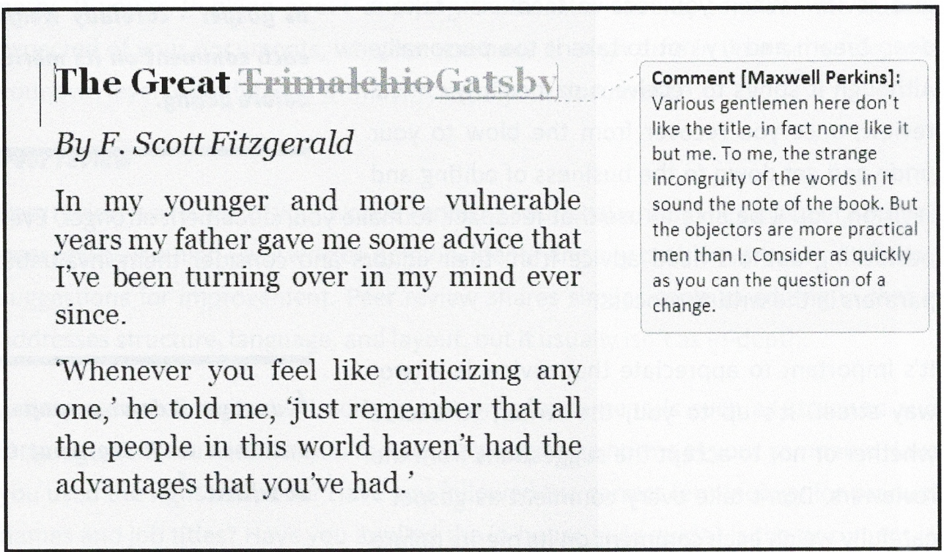
Here’s an example of a document that’s been edited using a mix of markup and comments:

Slide 41
Receiving feedback
It’s important for you, as the writer, to be prepared to take a step back from your work during editing and review. When you receive feedback, take a deep breath and try not to take it too personally. Although it stings to receive a particularly critical review, once you recover from the blow to your pride and get down to the business of editing and revision, you’ll be able to use that feedback to make your document stronger. Even bestselling authors heed advice from their editors and consider them invaluable partners in the writing process.
It’s important to appreciate that review is a two- way street. It’s up to you, the writer, to decide whether or not to accept the suggestions from the reviewers. Don’t take every comment as gospel - carefully weigh each comment on its merits before acting. Follow up with appropriate questions and verify any changes to technical details.
For example: if testing has shown an issue with your documentation, make sure you retest it yourself in order to get to the bottom of the issue. If an engineer insists that a performance threshold is different to what you’ve written, check the specifications documents (or check with another subject matter expert) to make sure consensus exists before you go ahead with the change. If something doesn’t seem right, check it out!

Slide 42
Checking
This section discusses two of the additional checks that can be performed on technical documents: peer review, and formal testing by a testing team (for product documentation). These checks can be a great way of improving the quality of documents with minimal effort on the writer’s part, as they’re performed by a third party. If you’re thinking about applying these extra checks, consider the quality expected of your documents, whether you have enough time in your schedule, and your own level of confidence with the state of your document.

Slide 43
Peer review
Peer review is a review of your work by another technical writer. The output of a typical peer review is a high-level written opinion, identifying any problem areas and offering suggestions for improvement. Peer review shares similar goals to editing in that it addresses structure, language, and layout, but it usually isn’t as in-depth.
A thorough peer review will address not only fundamentals such as structure and language, but also whether you’re following corporate norms at your company: Have you used the right template? Have you followed the correct terminology for product names and job titles? Have you applied the in-house style guide? Is the document in the correct format to be published on the content management system? And so on.

Slide 44
Peer review
When choosing a peer reviewer, select one whose work you know to be of high quality, and ideally someone who’s been at the company for a while (even better if they’re familiar with the product or process you’re documenting). Experienced writers will bring valuable insights which will improve your document. If they’re unfamiliar with your project, make sure you provide them with enough context so that they can conduct a meaningful review.
Make sure you explain the goals of the peer review explicitly as well as guide your reviewer on the format of the review. For example: ‘Dear Bob, I’d like you to provide me with a 1- to 3-page written opinion of my document, sharing your thoughts on any weak spots or areas for improvement in structure, completeness, language, layout, and adherence to the corporate norms / style guide.’ Most importantly, make sure you agree on a timeframe for the review to ensure you’ll have time to integrate the feedback.

Slide 45
How to conduct a good peer review
Peer review can add tremendous value to a document. Writers can learn significantly from one another, and it helps converge writing styles amongst a team of writers. However, being asked to review another writer’s work can definitely put strain on the relationship if the review isn’t performed in a sensitive manner.
Even if a reviewer doesn’t intend to - in fact, even if all their review feedback is completely spot on - they may still find it’s easy to put a writer off.
The key thing to remember is: if you’re a reviewer, a review is your personal opinion - and you might be wrong (even if you’re 100 per cent certain that you’re not). So, instead of phrasing your comments as fact, phrase your review comments as suggestions, and remember that it’s up to the writer whether or not to adopt them.
Don’t forget to offer praise for sections of the document that you thought worked well. A reviewer’s job is to be constructive, with the ultimate goal of improving the document.

Slide 46
How to conduct a good peer review
For example:
Poor review comment:
‘What happened to context? Audience and purpose must be defined.’
Better review comment:
‘I thought this document could be further improved by the addition of an ‘About’ section to frame the audience and purpose of the document.’
Notice how the first comment (in addition to being slightly snarky) is worded as absolute fact, but the second comment is phrased as the reviewer’s personal opinion? The latter comment is also more positive, as it talks about improving the document rather than pointing out a flaw, and suggests a solution - adding an ‘About’ section. Both comments are about the same essential point, but the latter is written in a way that avoids putting the writer off.

Slide 47
How to conduct a good peer review
Here are a couple other suggestions on giving a good peer review:
Be specific. Make sure the writer can relate your comments back to the relevant section of the document. This might seem obvious, but in a long document, it might not be easy for the writer to figure out which section you’re talking about.
Take your time to fully read and understand the document - don’t just skim it.
Jot down your initial thoughts somewhere as you go through the document. First impressions are important, and this list can form the basis of your review when you come back to write it up properly.

Slide 48
Testing by quality assurance or testing team
This section is about the testing of product documentation by a quality assurance or testing team. In this type of testing, the testing team develops a number of test cases based on the documentation, which they will then attempt to execute to see whether the documentation matches the functionality and user interface of the product.
The test cases may simply be a copy-and-paste of the text of the documentation, broken into bite-size chunks, which the testing team will then attempt to follow. If the instructions don’t produce the intended result, or if the pictures or text in the documentation don’t match the user interface of the product, they’ll chalk it up as a failure and pass it back for remedial action. Depending on the time available, the testing team may choose to test only a portion of your documentation (e.g. the sections concerning the most high-profile functionality).
Testing by a third party is a great way to validate your document’s technical accuracy with minimal effort on your part. It also adds a significant amount of credibility to your documentation and brings it closer in step with the product development process. If you are presented with the opportunity to have your documentation tested in this manner, fantastic - consider yourself lucky to be working for a company which values documentation so highly.

Slide 49
Define review team
Before you send your document out for a formal stakeholder review, take a moment to put yourself in your stakeholders’ shoes. Usually, they’re all busy people with plenty of other demands on their time. Reviewing your documents is probably just an unwelcome distraction in another busy day.
This is why it’s crucial for you to make sure that when they do sit down to review your document, they know what they’re meant to be looking for. If you don’t guide them, reviewers will usually focus on what’s most obviously wrong in a document. This will inevitably be typos, glaring grammatical errors, and obvious technical mistakes. Is this really how you want your review team to spend their valuable time?

Slide 50
Define review team
This is where a Review Matrix is essential. A Review Matrix is a simple table which sets out the names and job titles of the reviewers and the sections of the document or the topics you want each of them to concentrate on in their review. Use this tool to limit the review team’s responsibilities to what you really want them to look for and to guide them away from areas which are others’ specialties. Use your judgement in deciding whether to point your reviewers to a topic or theme (e.g. technical accuracy) or to specific sections, chapters or pages of the document.
Here’s an example of a Review Matrix for a fictional user guide. Notice how it also defines the fictional writer’s role (Jim Johnson, Senior Technical Writer)? This helps make it clear to your review team that someone else is taking responsibility for the basic writing stuff such as spelling and grammar, leaving them free to concentrate on areas where they can truly add value.

Slide 51
Define review team
Name & Title | Review Responsibilities
Wilma Wildwood Lightsaber Project Manager | Alignment with Lightsaber project objectives (esp. Introduction chapter) General usability
Alex Avery Senior Electrical Engineer | Technical accuracy - hardware
Barney Blundstone Senior Software Developer | Technical accuracy - software
Alice Allgood Communications Manager | Adherence to corporate brand requirements / Acme style guide General usability
Jim Johnson Senior Technical Writer | Language, spelling and grammar

Slide 52
Who belongs in a review team?
When you’re formulating a Review Matrix, make sure you’ve included stakeholders from the appropriate business functions. The following tables illustrate a range of stakeholders who may need to be included in product or process and procedure documentation projects.

Slide 53
Product documentation stakeholders
Subject Matter Experts (e.g. engineers, programmers) - Technical accuracy. Alignment with the product specifications. Reality check with the product functionality and user interface. Suitability for audience / end users.
Product Managers – Appropriate emphasis on commercially important features and functionality. Alignment with product branding and naming conventions. Reality check with the product functionality and user interface. Suitability for audience / end users.
Project Manager / Project Sponsor – Alignment with the project goals.
Line Manager – Quality check against expectations. Alignment with the writing team standards and style. Use of correct template. Completeness.

Slide 54
Product documentation stakeholders
Risk Management – Any risks inherent in the product have been appropriately documented (e.g. sharp edges, small pieces, etc.).
Intellectual Property – Trademarks (including third-party) appropriately acknowledged. Copyright and other intellectual property rights correctly asserted.
Legal / Regulatory – Compliance with applicable regulations and laws, e.g. use of correct symbols. Correctness of legal terms and conditions.
Marketing / Communications – Alignment with company brand guidelines / style guide. Use of correct branding elements (e.g. template, logo).

Slide 55
Process and procedure documentation stakeholders
Subject Matter Experts – Technical accuracy. Suitability for audience / end users
Process Owner – Accuracy of the high-level steps or process. Suitability for audience/end users.
Quality Manager / Process Manager – Compliance with the management system standards and templates.
Project Manager / Project Sponsor – Alignment with the project goals.
Line Manager – Quality check against expectations. Alignment with the writing team standards and style. Use of correct template. Completeness.

Slide 56
Conduct stakeholder review
A formal stakeholder review is the final hurdle your document must pass before the publication step. Formal stakeholder review involves distributing your document to a review team made up of stakeholders and key subject matter experts, and asking for their permission to publish the document. Don’t be surprised if you have to undergo a number of rounds of reviews before you get approval to publish - this is normal.
This process of formal review is very important because it allows you to demonstrate, to anyone who asks, that your documents have the endorsement of suitable authorities within the company. Formal review is a common requirement under company document control policies and standards such as ISO 9001, and part of the good housekeeping that all technical writers should practice.
The simplest way to submit documents for review is via an email to the review team, with the documents attached. Other common methods include submitting a workflow request in the company content management system or attaching a cover sheet to the printed hardcopy and physically giving it to the members of your review team.

Slide 57
Conduct stakeholder review
When sending documents for review, frame the accompanying email or note with care to ensure the review team understands what’s required of them. Include the following:
The timeframe by which a response is required
Your preferred means of receiving responses (Track changes? Written comments?)
Review team responsibilities (as per your Review Matrix)
Any necessary context (e.g. the project you’re working on) if there’s a chance the review team won’t be aware
A thank-you note to the review team for their time.

Slide 58
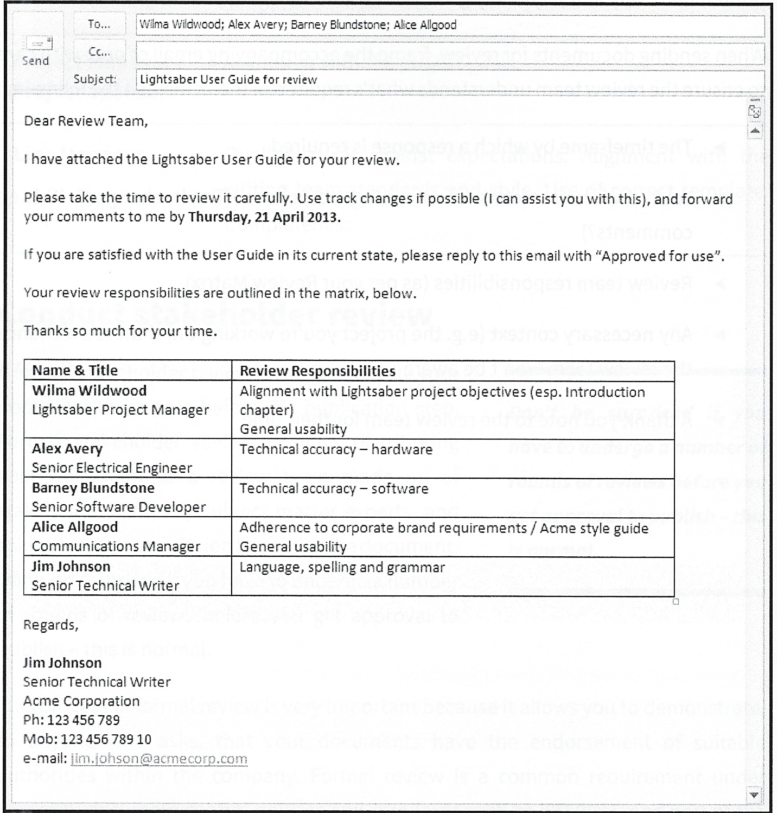
Here’s a sample email to the review team for a fictional user guide:

Slide 59
Managing the review process
It’s important to manage the review process effectively in order to get timely review feedback and approvals. Delays caused by poorly managed reviews can easily reflect poorly on the writer, regardless of whose fault they are. Here are some tips to manage the review process:
Send out chunks of a document for review, rather than the whole. Send smaller, completed chunks of a large document to reviewers before the entire document is complete. This method is especially useful when documents will take some time to create, or must by necessity be created in a piecemeal fashion (e.g. if certain sections require a feature of a product to be developed, or a particular technical expert to become available, before they can be documented).
Always perform reviews in parallel (i.e. concurrently). There’s no point having your document sitting on one person’s desk while half a dozen other reviewers are waiting. Send your document to the entire review team at once, if possible.

Slide 60
Managing the review process
Drop them a line. A few days before the review deadline, get in touch with your review team members individually to see how they’re progressing (and to jog their memories).
Schedule a review workshop. This can be a great technique for gathering outstanding feedback from recalcitrant reviewers, as well as promoting the flow of ideas. It doesn’t hurt to bribe your review team with food and drink! This will encourage participation.
Escalate to a manager. This is a last-ditch measure, as it may damage your relationship with the subject matter expert or stakeholder. If it’s absolutely critical to get a reviewer’s feedback or approval and they won’t oblige despite the world’s best cajoling, consider pulling their manager aside for a quiet word. The aim here is to bring diplomatic pressure to bear on the reviewer without spoiling the relationship.

Slide 61
Dealing with elusive stakeholders or subject matter experts
It can be very difficult to get hold of some stakeholders or subject matter experts. This is especially true for those who are higher up the management food chain or are highly regarded technical experts who are in constant demand.
If you encounter this problem, step into their shoes for a moment and consider the world from their point of view. They’re probably overworked, inboxes overflowing with requests, numerous other voices clamoring for their attention every day. Why would they pay attention to you?

Slide 62
Dealing with elusive stakeholders or subject matter experts
This can be a frustrating experience for a technical writer. Fortunately, there are techniques you can use to persuade elusive stakeholders or subject matter experts to come to the table and perform a review. They include:
Explaining the context. Why is it so vital that they devote time to you? Communicating that you only have a two-week window to obtain approval, and delays may push back the publication date of your documents (hence delaying a product launch or a major project milestone), may help foster a sense of urgency.
Being persistent. Remember that you’re only one of many voices clamoring for their attention every day. Be one of those voices that politely, yet persistently, reminds them on a regular basis that you need attention too. Send reminder emails, and follow up with phone calls.

Slide 63
Dealing with elusive stakeholders or subject matter experts
Being patient and looking ahead. It helps to plan things out a little. If you let your review team know well in advance (e.g. two weeks or more) that you require their time for a review or workshop, it’s much more likely they’ll find time for you than the person who drops a meeting invite on them with little or no notice.
Not asking the impossible. Instead of booking them in for that series of all-day workshops, try a one-hour meeting. Or even fifteen minutes if an hour isn’t possible. You may find that once you start talking to them, they’ll be happy to give you more time than they’d initially budgeted.
Dropping in on them in person. If they’re in the same office as you, try simply walking up to their desk, documents in hand. It’s easy to ignore an email, but harder to ignore a personal visit! Bring your documents with you, and politely ask if they have time to perform a review on the spot. If you do succeed with this method, make sure they sign off officially (e.g. by sending an email or approving in a content management system).

Slide 64
Collate feedback and revise draft
It’s very common (in fact, I’d say the norm) to receive review comments before final approval is granted, requiring further work on your document. Don’t be surprised if you require several rounds of formal review before you get final approval, particularly if you have a large review team or a lengthy or complicated document.
A Review Log will help you track and manage feedback. This is a spreadsheet which collates all the comments you’ve received from your review team, and the corresponding actions you make to close out the comments. It’s a handy tool for managing feedback, particularly if you receive a lot of comments.

Slide 65
Collate feedback and revise draft
Consider all review comments carefully (even if you don’t think it’s appropriate to implement them), and remember to thank the review team for their feedback. As with previous, less formal reviews, if you don’t implement one reviewer’s comments, make sure you respectfully explain why. This can be done by sending the reviewer a copy of your completed Review Log.
Try not to take negative feedback too personally - even if the comment is undiplomatically worded, the reviewer might have a valid point. If you feel they’ve misunderstood the point you’re trying to make or misread a section of your documentation, that can be a sign that perhaps some clarification or fine-tuning is required.

Slide 66
Obtain approval to publish
After all this review, you’d have thought it’d be okay to publish, right? Well, sure - provided you have a record of approval. Before you proceed to publication, make sure you have explicit, documented approval from your review team.
This can be as simple as a reply to an email with the word Approved, a digital signature in a content management system or a physical signature on a printed cover sheet. This is important (and standard practice) for a number of reasons: to demonstrate to anyone who may come asking that your document has been formally reviewed and approved by the appropriate authorities, to fulfil company document control policies, and to fulfil the record-keeping requirements of standards such as ISO 9001.
Keeping a record of approval also places a responsibility on the review team to do a thorough job. This won’t necessarily guarantee a thorough review, but it will definitely help to foster a sense of accountability within the review team.

Slide 67
References:
Technical Writing, Serena Henning, JP Publishing, LLC, 2020
Technical Writing Process, Kieran Morgan, Better on Publications, 2015
Spring into Technical Writing for Engineers and Scientists, Barry J. Rosenberg, Pearson Education, Inc, 2005
Technical Writing A-Z, Trever M. Young, Asme Press, 2009

Slide 68
THANK YOU FOR YOUR ATTENTION!

