Slide 1
Importance of Citation
(prof. Wha-Chul Son, Handong Global Univeristy)
Research Ethics

Slide 2
Learning Objectives
Understanding the Rationale of Citation
Understanding the Concept of Plagiarism
Knowing How to Avoid Plagiarism

Slide 3
The Purpose of Citation
To appreciate the colleague who presented new idea and won the competition within academia.
Academia is an open society and researchers are obliged to share all information. Citation is a method of such sharing.
To expose my research to examination by providing the reference

Slide 4
When do We Need to Provide Citation?
In all academic papers, books, and relevant documents
In most area where you are supposed to provide creative works, citation is very important.
It is not a matter of morality or decency, but a matter of regulations and potential legal problem.
ex) Do we have to cite when we use contents from Wikipedia, blogs, or photos from the Internet?

Slide 5
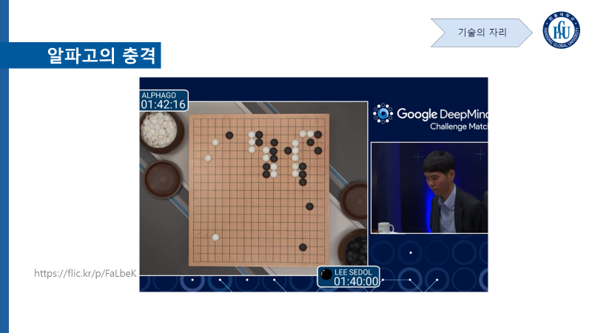
Make Sure that You Provide the Source

Slide 6
Why is Plagiarism a Problem?
If you do not provide proper citation, it is called “plagiarism.”
Taking other researcher’s achievement as one’s own instead of praising it - academic theft

Slide 7
Why do they Plagiarize?
In the past, the approach to plagiarism was completely different, as scholarly work has nothing to do with financial interest.
Some are not very sensitive about the issue as others and do not care.
Heated competition within academia - Connected to the matter of career

Slide 8
Definition of Plagiarism
Plagiarism is the representation of another author's language, thoughts, ideas, or expressions as one's own original work without appropriate citation. (Wikipedia)
Not only the text, but also structure of original writing could be plagiarized. Paraphrasing, copying or editing of contents or tables are all plagiarism.
Unclear or misleading citation is also plagiarism.

Slide 9
Definition of Plagiarism
Permission of the original author is irrelevant if the original work was published.
The similarity of the sentence is not the only criteria.
Matter of intentionality or simple mistake are irrelevant.
It is almost impossible that somebody is accused of plagiarism by chance.
All judgements on plagiarism should be made by academia of the given field, not news reporters.

Slide 10
How can We Avoid Plagiarism ?
Appropriate citation
Through appropriate citation, one can know what he/she learned from where and what is one’s own idea.

Slide 11
When Somebody Plagiarized My Work
As academic journals have their own system to process the accusation of plagiarism, you can report to the journal where the person published.
- You have to provide the evidence that your work is plagiarized in the article published in that particular journal and the journal will inform you after investigation. If the allegation is true, then they inform the institution of the person who plagiarized.

Slide 12
When Somebody Plagiarized My Work
In the case of a book, you have to report to the relevant academic society or the institution that recognize the particular work as achievement.

Slide 13
We Have Learned
Why we provide citation in academia
What is plagiarism
How to avoid plagiarism

Slide 14
Thank You! phtech@handong.edu

