Slide 1
Check List for Citation &
Publication Ethics
(prof. Wha-Chul Son, Handong Global Univeristy)
Research Ethics

Slide 2
Learning Objectives
Knowing Different Ways to Provide Citation
Getting Familiarized with the Check List for Citation
Understanding the Publication Ethics

Slide 3
Good Citation
There are different method of citation and their variant.
You can check the details later, but should mind consistency and few core factors.
Citation is required not only for the academic journal article, but also other materials for presentation and classes.

Slide 4
Useful Resource
Purdue Online Writing Lab
https://owl.purdue.edu/owl/research_and_citation/apa_style/apa_formatting_and_style_guide/in_text_citations_the_basics.html

Slide 5
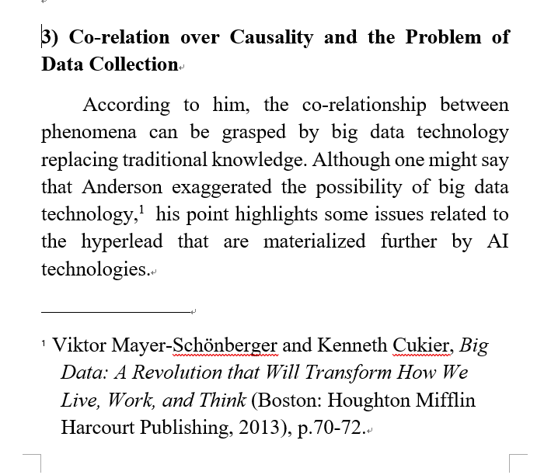
Basic Forms
Footnote or/and endnote only

Slide 6
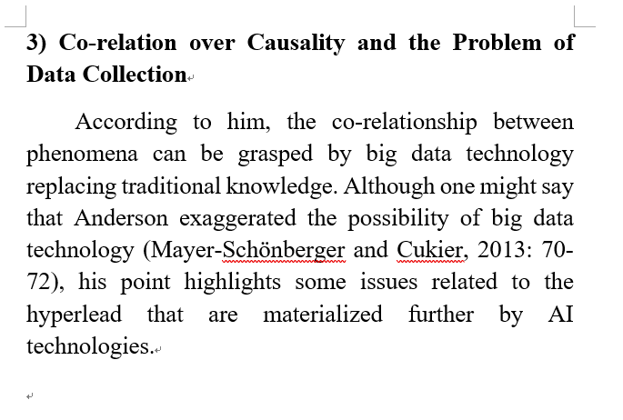
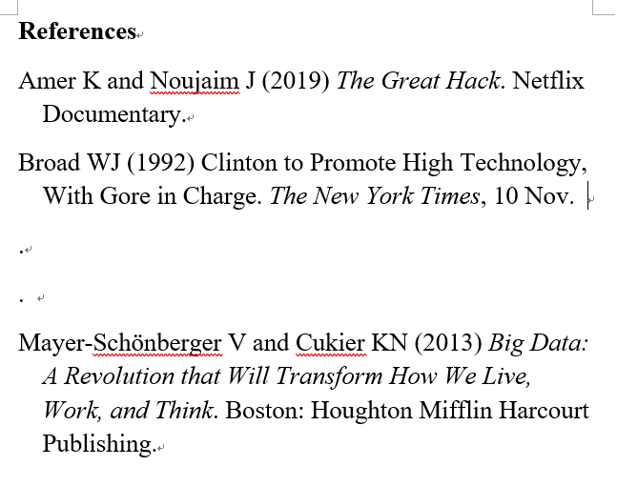
Basic Forms
Parenthetical Citation and Reference – various forms
– (Son 2020: 34) (Son 2020, p. 34) (Son, 2020, 34)

Slide 7
Footnote and References
In some Journals, the format of presentation in footnote and references are different .
- Footnote : Keith Oatley & Jennifer M. Jenkins, Understanding Emotions(London: Oxford, 1999), 101.
- References : Oatley, Keith & Jenkins, Jennifer M. Understanding Emotions. London: Oxford, 1999.

Slide 8
Different Formats for References
Refences of A publisher
Oatley, Keith & Jenkins, Jennifer M. Understanding Emotions. London: Oxford, 1999.
References of B publisher
Oatley, Keith & Jenkins, Jennifer M. (1999). Understanding Emotions. Oxford.

Slide 9
Checkpoint for Footnote and References
각주, 참고문헌의 표기에서 주의해야 할 사항들
Basically, one can check the style of the journal that he/she wants to submit.
In the case of Western name – the order of the first name and the second name
Ex) <Footnote> Keith Oatley & Jennifer M. Jenkins, Understanding Emotions(London: Oxford, 1999), 101쪽.
<References > Oatley, Keith & Jenkins, Jennifer M. Understanding Emotions. London: Oxford, 1999.

Slide 10
Checkpoint for Footnote and References
각주, 참고문헌의 표기에서 주의해야 할 사항들
Various signs and abbreviations – “ ” ,『』, italic, Vol., Ed. &, etc.
The location of information – year, translator.
Ex) Where to put the year of publication or translator info
Whether to write or not – first name, city, repeated names
Ex) W. C. Son / Wha-Chul Son / Son, Wha-Chul / Son WC
Consistency is the most important factor.

Slide 11
Cases of Inappropriate Publication
Duplicate Publication
- Pretending as if one publishes a new idea while it is an old one, and receives the credit for it.
In the case of course material or reports, one should not submit the same material twice.

Slide 12
Cases of Inappropriate Publication
Salami articles
- Dividing a research into two publication
- If you could submit the two papers to the same academic journal one after another(or simultaneously), then they are not salami articles.0

Slide 13
Who can Claim the Authorship?
The rules for authorship are different according to disciplines.
According to contribution – first author, corresponding author, 2nd co-author…
According to alphabetical order of authors
Just and fair authorship is important in all cases.

Slide 14
Just and Fair Authorship
Because of various evaluation in academia, authorship is becoming a sensitive issue.
Those who did not contribute to the research should not be authors of the work. It is inappropriate and a lie toward academia.
In order to avoid inappropriate authorship, it is important to discuss the issue before the beginning of the research.
In most cases, the problem of authorship originates from power relationships.

Slide 15
Inappropriate Authorship
Those who did NOT contribute to the research put their name as authors for the following reasons.
research funding
influence in the academia of the field
family
power relation (senior, professor)

Slide 16
We have Learned
How to provide citation
Issues of publication ethics
Just and fair authorship

Slide 17
Thank You! phtech@handong.edu

