Slide 1
Lecture 11. Web Standards Continued
Keywords: JS, JQuery, PHP, SQL, server side scripting, client side scripting

Slide 2
Lecture plan
Plan
Client side scripting
JavaScript
Server side scripting
PHP
Working with databases
Databases
JQuery
ASP
SQL
Client side scripting
Server Side Scripting
Databases
Reading and References

Slide 3
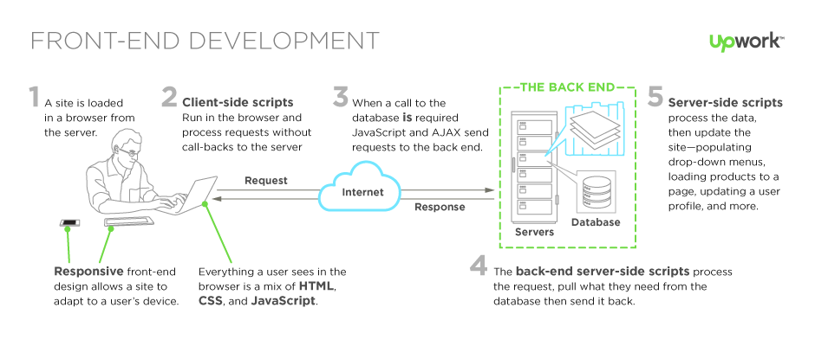
Plan
Client vs Server side Scripting
Client side scripting
Server Side Scripting
Databases
Reading and References

Slide 4
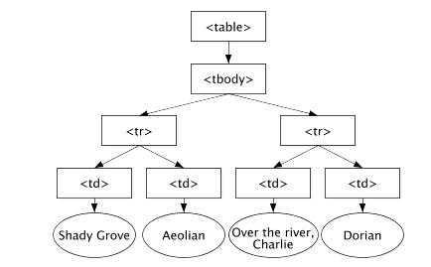
DOM
Plan
The Document Object Model (DOM) is an application programming interface (API) for valid HTML and well-formed XML documents. It defines the logical structure of documents and the way a document is accessed and manipulated.
Client side scripting
Server Side Scripting
Databases
Reading and References

Slide 5
JavaScript
Plan
Javascript (JS) is a scripting languages, primarily used on the Web. It is used to enhance HTML pages and is commonly found embedded in HTML code. JavaScript is an interpreted language. Thus, it doesn't need to be compiled. JavaScript renders web pages in an interactive and dynamic fashion. This allowing the pages to react to events, exhibit special effects, accept variable text, validate data, create cookies, detect a user’s browser, etc.
Client side scripting
Server Side Scripting
Databases
Reading and References

Slide 6
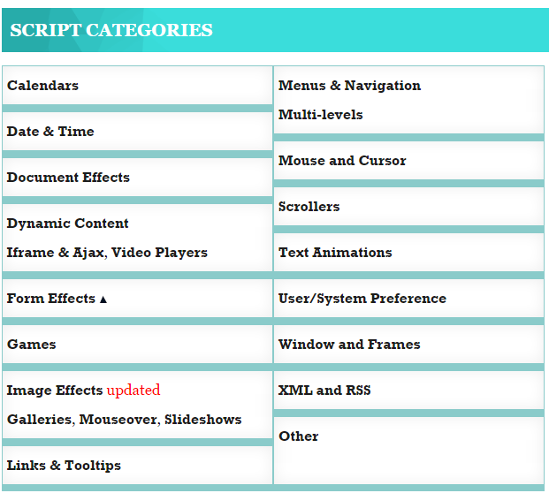
What can JS do?
Plan
www.dynamicdrive.com
Client side scripting
Server Side Scripting
Databases
Reading and References

Slide 7

JQuery
Plan
jQuery is a JavaScript library that allows web developers to add extra functionality to their websites.
Client side scripting
Server Side Scripting
Databases
Reading and References

Slide 8
Using JavaScript
Plan
<!DOCTYPE html>
<html>
<body>
<h1>My First JavaScript</h1>
<button type="button"
onclick="document.getElementById('demo').innerHTML = Date()">
Click me to display Date and Time.</button>
<p id="demo"></p>
</body>
</html>
Client side scripting
Server Side Scripting
Databases
Reading and References

Slide 9
Using JavaScript
Plan
<!DOCTYPE html>
<html><head>
<script>
function myFunction() {
document.getElementById("demo").innerHTML = "Paragraph changed.";
}
</script>
</head>
<body>
<h1>A Web Page</h1>
<p id="demo">A Paragraph</p>
<button type="button" onclick="myFunction()">Try it</button>
</body>
</html>
Client side scripting
Server Side Scripting
Databases
Reading and References

Slide 10
Using JavaScript
Plan
<!DOCTYPE html>
<html>
<body>
<script src="myScript.js"></script>
</body>
</html>
Client side scripting
Server Side Scripting
Databases
Reading and References

Slide 11
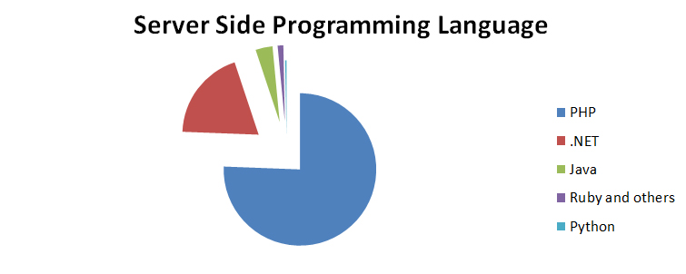
Plan
Server Side Scripting
Server-side scripting is a method of designing websites so that the process or user request is run on the originating server.
Client side scripting
Server Side Scripting
Databases
Reading and References

Slide 12

Plan
PHP
Self-referentially short for PHP: Hypertext Preprocessor,
an open source, server-side, HTML embedded scripting
language used to create dynamic Web pages.
Client side scripting
Server Side Scripting
Databases
Reading and References

Slide 13

Plan
ASP
Active Server Pages (also known as ASP or classic ASP) is Microsoft’s first server-side script engine that enabled dynamically-generated web pages.
Client side scripting
Server Side Scripting
Databases
Reading and References

Slide 14
Plan
Using PHP
<!DOCTYPE html>
<html>
<body>
<?php
echo "My first PHP script!";
?>
</body>
</html>
Client side scripting
Server Side Scripting
Databases
Reading and References

Slide 15
Plan
Using PHP
<!DOCTYPE html>
<html>
<body>
<form action="register.php" method="post">
</body>
</html>
Client side scripting
Server Side Scripting
Databases
Reading and References

Slide 16

Databases
Plan
A database is a collection of information organized to provide efficient retrieval.
Client side scripting
Server Side Scripting
Databases
Reading and References

Slide 17
SQL
Plan
Structured Query Language (SQL) is a standard language for storing, manipulating and retrieving data in databases.
Client side scripting
Server Side Scripting
Databases
Reading and References

Slide 18
Plan
Reading
http://www.yourwebskills.com/clientserver.php
https://www.w3schools.com/js/js_htmldom.asp
http://blog.stoneriverelearning.com/top-5-programming-languages-used-in-web-development/
Client side scripting
Server Side Scripting
Databases
Reading and References

Slide 19
https://www.upwork.com/hiring/development/how-scripting-languages-work/
Reading and References
Plan
Client vs. server side scripting: https://www.upwork.com/hiring/development/how-scripting-languages-work/
DOM: https://www.w3.org/TR/DOM-Level-3-Core/introduction.html
JQuery image: https://www.sitepoint.com/pagination-jquery-ajax-php/
Jquery definition: https://techterms.com/definition/jquery
Server side scripting: www.computerhope.com/jargon/s/server-side-scripting.htm
PHP: http://www.webopedia.com/TERM/P/PHP.html
ASP: https://www.techopedia.com/definition/23088/active-server-pages-asp-pages
SQL: https://www.w3schools.com/sql/default.asp
Client side scripting
Server Side Scripting
Databases
Reading and References

Slide 20
https://www.upwork.com/hiring/development/how-scripting-languages-work/
Reading and References
Plan
Database image: http://labs.sogeti.com/modern-databases-of-the-21st-century/
ASP.net image: https://www.asp.net/
PHP image: https://en.wikipedia.org/wiki/PHP
Server side language popularity image: http://blog.stoneriverelearning.com/top-5-programming-languages-used-in-web-development/
Client side scripting
Server Side Scripting
Databases
Reading and References

