Slide 1
Lecture 8. HTML
Keywords: Web standards, Hypertext, markup, web pages, HTML, tags, attributes

Slide 2
Lecture plan
Plan
What are web standards?
What is HTML?
Understanding HTML
Using HTML
Web Standards and HTML
Understanding HTML
Using HTML
Reading and References

Slide 3

What is W3C?
Plan
The World Wide Web Consortium (W3C) is an international community that develops open standards to ensure the long-term growth of the Web.
Web Standards and HTML
Understanding HTML
Using HTML
Reading and References

Slide 4
What are web standards
Plan
HTML – Hyper Text Mark Up Language
CSS – Cascading Style Sheet
JS – JavaScript
DOM – Document Object Model
Etc.
https://www.w3.org/TR/#w3c_all
Web Standards and HTML
Understanding HTML
Using HTML
Reading and References

Slide 5

Where to learn about
web standards?
Plan
Web Standards and HTML
Understanding HTML
Using HTML
Reading and References

Slide 6
What is HTML?
Plan
HTML is the standard markup language used to create web pages and its elements form the building blocks of all websites.
Web Standards and HTML
Understanding HTML
Using HTML
Reading and References

Slide 7
HTML History
Plan
Year | Version
1989 | Tim Berners-Lee invented www
1991 | Tim Berners-Lee invented HTML
1993 | Dave Raggett drafted HTML+
1995 | HTML Working Group defined HTML 2.0
1997 | W3C Recommendation: HTML 3.2
1999 | W3C Recommendation: HTML 4.01
2000 | W3C Recommendation: XHTML 1.0
2008 | WHATWG HTML5 First Public Draft
2012 | WHATWG HTML5 Living Standard
2014 | W3C Recommendation: HTML5
2016 | W3C Candidate Recommendation: HTML 5.1
Web Standards and HTML
Understanding HTML
Using HTML
Reading and References

Slide 8

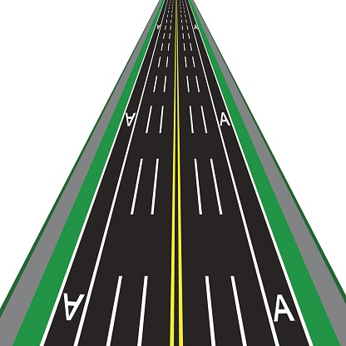
Mark up?
Plan
vs.
Web Standards and HTML
Understanding HTML
Using HTML
Reading and References

Slide 9
Mark up?
Plan
vs.
Web Standards and HTML
Understanding HTML
Using HTML
Reading and References

Slide 10
What is HTML all about?
Plan
TEXT and HYPERLINKS
Web Standards and HTML
Understanding HTML
Using HTML
Reading and References

Slide 11
How to understand HTML?
Plan
<!DOCTYPE html>
<html>
<head>
<title>Page Title</title>
</head>
<body>
<h1>This is a Heading</h1>
<p>This is a paragraph.</p>
</body>
</html>
Web Standards and HTML
Understanding HTML
Using HTML
Reading and References

Slide 12
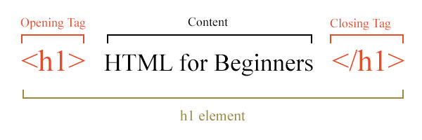
How to understand HTML?
Plan
Web Standards and HTML
Understanding HTML
Using HTML
Reading and References

Slide 13
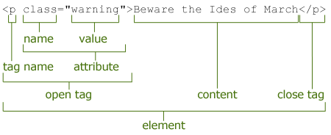
How to understand HTML?
Plan
Web Standards and HTML
Understanding HTML
Using HTML
Reading and References

Slide 14
How to use HTML?
Plan
Text Editors
Web development software
Email
Content Management Systems
Etc.
Web Standards and HTML
Understanding HTML
Using HTML
Reading and References

Slide 15
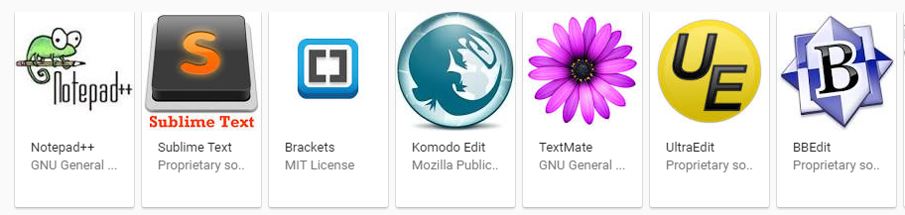
How to use HTML?
Plan
Text Editors
Web Standards and HTML
Understanding HTML
Using HTML
Reading and References

Slide 16
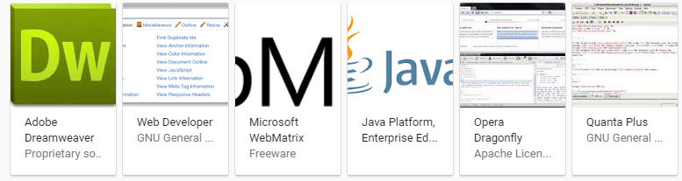
How to use HTML?
Plan
Web development software
Web Standards and HTML
Understanding HTML
Using HTML
Reading and References

Slide 17
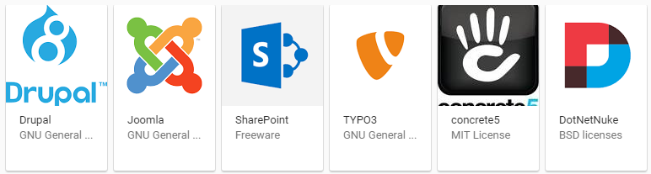
How to use HTML?
Plan
Content management systems
Web Standards and HTML
Understanding HTML
Using HTML
Reading and References

Slide 18
Reading
Plan
https://www.w3schools.com/html/default.asp
http://www.yourhtmlsource.com/starthere/whatishtml.html
Web Standards and HTML
Understanding HTML
Using HTML
Reading and References

Slide 19
References
Plan
Road markup: http://www.istockphoto.com/search/more-like-this/494122976?excludenudity=true&mediatype=illustration&sort=best
Road markup 2: www.podrobno.uz
HTML 5: https://www.w3.org/html/
HTML history: https://www.w3schools.com/html/html5_intro.asp
Web Standards and HTML
Understanding HTML
Using HTML
Reading and References

