Slide 1
Lecture 7. Web Search
Keywords: crawlers, indexing, search engine optimization, evaluation of sources

Slide 2
Lecture plan
Plan
aaaa
How does web search work?
How to search?
How to evaluate?
How to optimise for search engine?
Web Search
Searching and Evaluating
Optimization
Reading and References

Slide 3
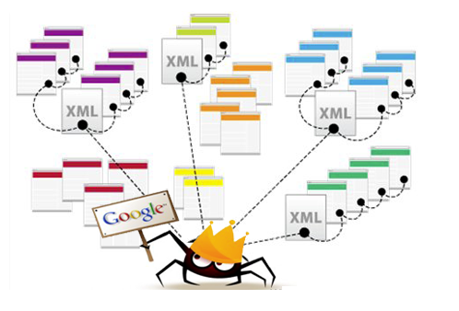
How Search Works
Plan
Crawling
Web Search
Searching and Evaluating
Optimization
Reading and References

Slide 4
How Search Works
Plan
Indexing
Web Search
Searching and Evaluating
Optimization
Reading and References

Slide 5
How Search Works
Plan
Ranking
Web Search
Searching and Evaluating
Optimization
Reading and References

Slide 6
How Search Works: Issues
Plan
Privacy
Bias
System load
Authorization
Invisible web = 500 x Visible web
Web Search
Searching and Evaluating
Optimization
Reading and References

Slide 7
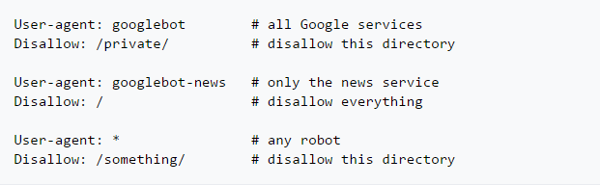
How Search Works: Solutions
Plan
Robots.txt
Web Search
Searching and Evaluating
Optimization
Reading and References

Slide 8
How Search Works: Solutions
Plan
Ranking
Relevance
External links
Updates
Synonyms
Match words
Popularity
Etc.
Web Search
Searching and Evaluating
Optimization
Reading and References

Slide 9
How To Search
Plan
AND
-
“”
Define:
https://www.lifewire.com/advanced-google-search-3482174
Web Search
Searching and Evaluating
Optimization
Reading and References

Slide 10
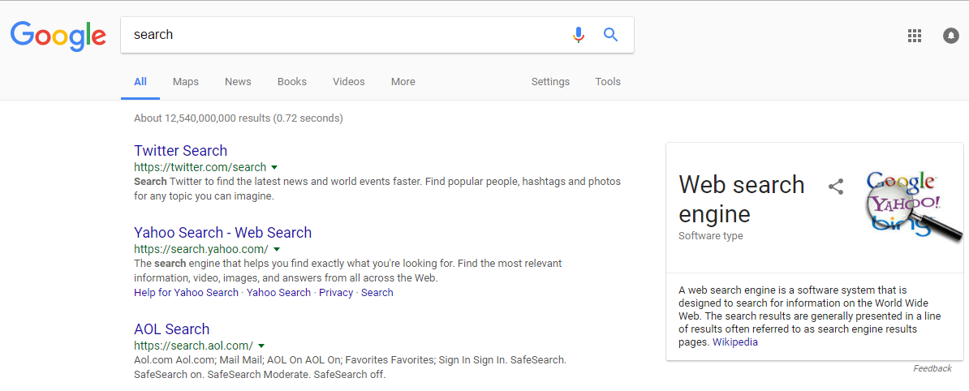
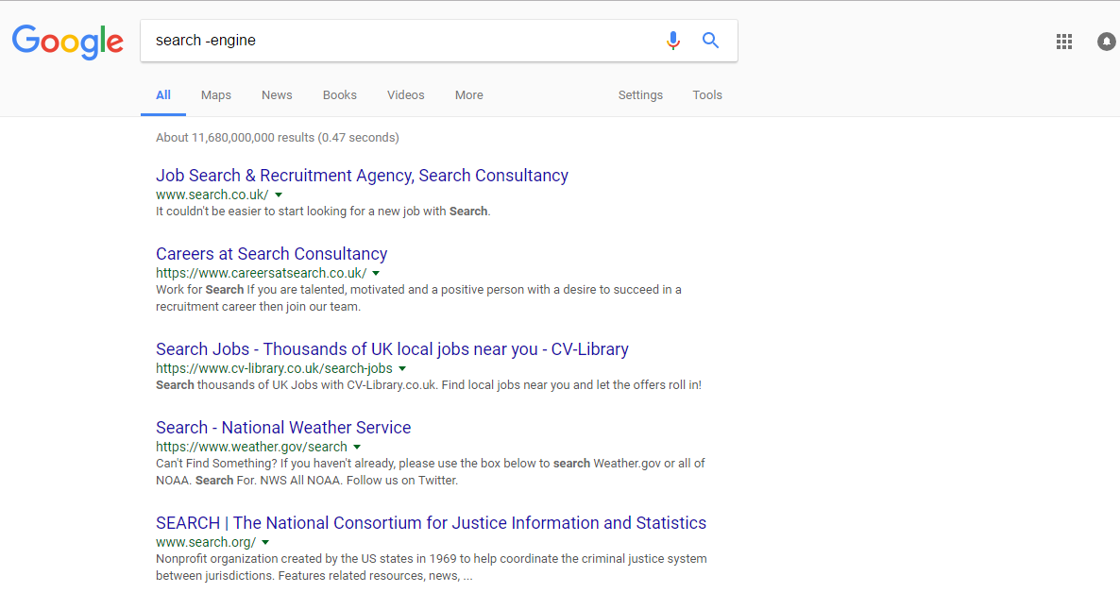
How To Search
Plan
Web Search
Searching and Evaluating
Optimization
Reading and References

Slide 11
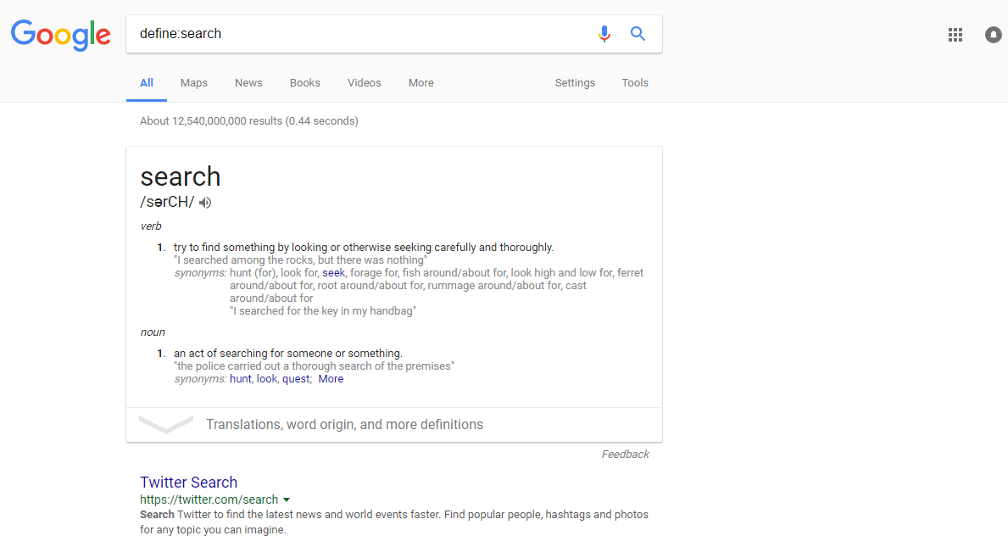
How To Search
Plan
Web Search
Searching and Evaluating
Optimization
Reading and References

Slide 12
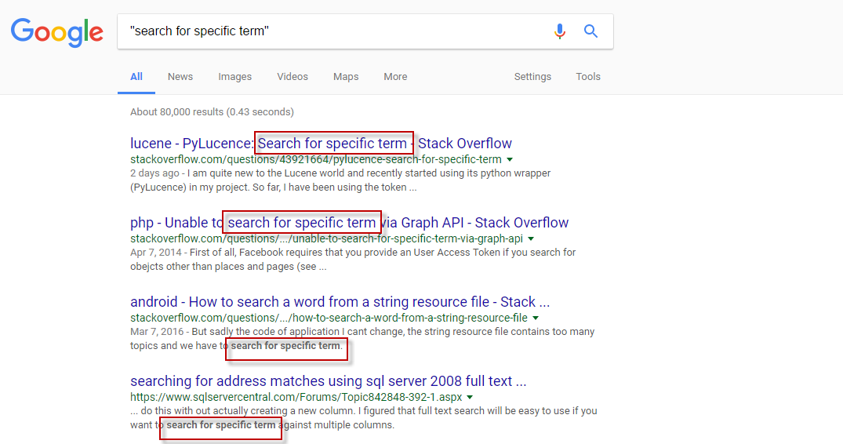
How To Search
Plan
Web Search
Searching and Evaluating
Optimization
Reading and References

Slide 13
How To Search
Plan
www.wolframalfa.com
https://doaj.org/
http://onlinebooks.library.upenn.edu/
http://www.census.gov/
Etc.
Web Search
Searching and Evaluating
Optimization
Reading and References

Slide 14
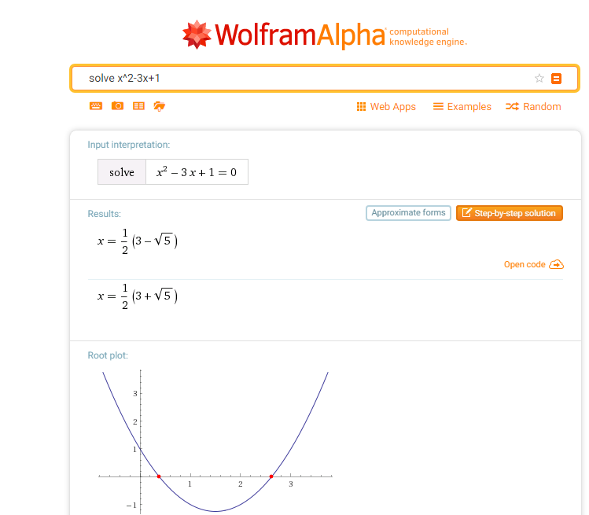
How To Search
Plan
www.wolframalfa.com
Web Search
Searching and Evaluating
Optimization
Reading and References

Slide 15
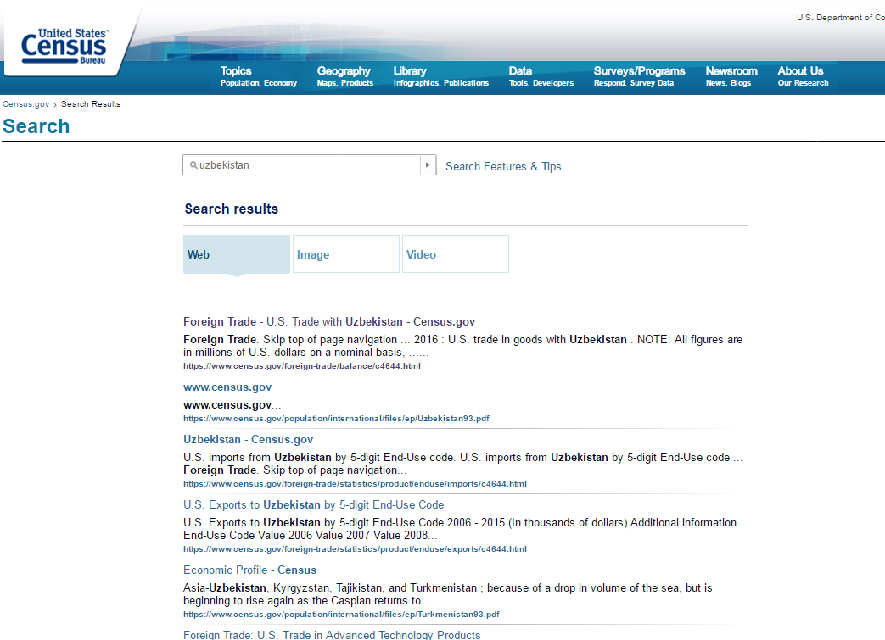
How To Search
Plan
http://www.census.gov/
Web Search
Searching and Evaluating
Optimization
Reading and References

Slide 16
How To Evaluate
Plan
Source: primary, secondary…
Type of data: qualitative, quantitative…
Dates: when published
Authors: relevance to the subject
Web Search
Searching and Evaluating
Optimization
Reading and References

Slide 17
How To Evaluate
Plan
Sponsorship and affiliation: relationship between the source and the data
Author-topic relationship: relationship between the author and the topic
Triangulation: do others confirm findings?
Opposite views: search for alternative views
Web Search
Searching and Evaluating
Optimization
Reading and References

Slide 18
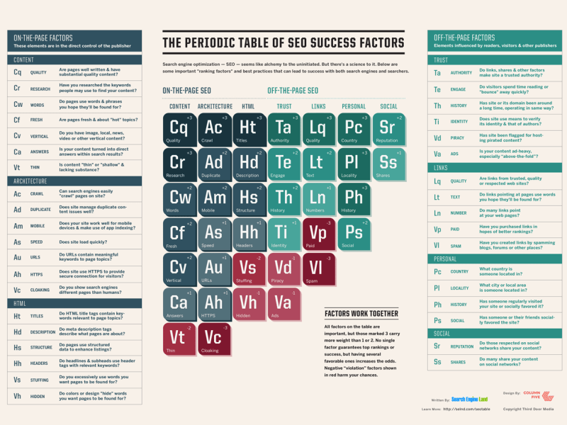
Search Engine Optimization
Plan
http://searchengineland.com/guide/what-is-seo
Web Search
Searching and Evaluating
Optimization
Reading and References

Slide 19
Search Engine Optimization
Plan
Internal links
Partnership with other websites
Constant update of the content
Sitemap
Social networks promotion
Links in comments to relevant content
Online advertising
Keywords
Meaningful titles, content, page names
Meta tag in HTML
Web Search
Searching and Evaluating
Optimization
Reading and References

Slide 20
Reading
Plan
http://searchengineland.com/guide/seo/content-search-engine-ranking
https://www.lifewire.com/web-search-tricks-to-know-4046148
https://www.lifewire.com/advanced-google-search-3482174
http://www.onlineuniversities.com/articles/students/how-to-search-invisible-web/
Web Search
Searching and Evaluating
Optimization
Reading and References

Slide 21
References
Plan
Web crawling image: https://www.promptcloud.com/few-pains-of-web-crawling/
Periodic table for SEO: http://searchengineland.com/seotable
Web Search
Searching and Evaluating
Optimization
Reading and References

