Slide 1
Lecture 5. Security Threats
Keywords: security, encryption, malware, protection

Slide 2
Lecture plan
Plan
Main Definitions
Threats
Protection
Main Definitions
Threats
Protection
Reading and References

Slide 3
Information Security
Plan
  Confidentiality - Protection from unauthorized persons
  Legitimate use - ensuring appropriate use by authorized users
Main Definitions
Threats
Protection
Reading and References

Slide 4
Information Security
Plan
  Integrity - consistency of data; no unauthorized creation, alteration or destruction
  Availability - ensuring access to legitimate users
Main Definitions
Threats
Protection
Reading and References

Slide 5
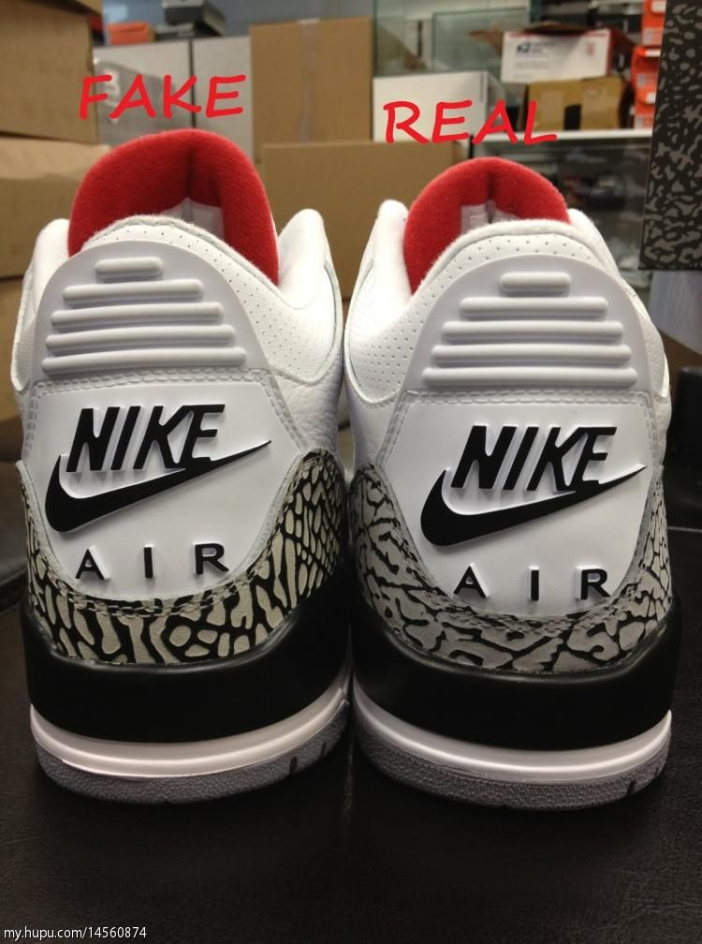
Authentication
Plan
  the process or action of verifying the identity of a user or process.
Main Definitions
Threats
Protection
Reading and References

Slide 6
Internet Security
Plan
  Internet security is a catch-all term for a very broad issue covering security for transactions made over the Internet. Generally, Internet security encompasses browser security, the security of data entered through a Web form, and overall authentication and protection of data sent via Internet Protocol.
Main Definitions
Threats
Protection
Reading and References

Slide 7
Threats
Plan
Information Theft
Malware
Denial of Service
Information deletion
Information alteration
Privacy violation
Phishing
Main Definitions
Threats
Protection
Reading and References

Slide 8
Information Theft
Plan
Information Theft poses a threat of privacy violation, gaining access to personal data and unauthorised use of stolen data.
Main Definitions
Threats
Protection
Reading and References

Slide 9
Malware
Plan
Viruses
Trojans
Adware
Spyware
Worms
Main Definitions
Threats
Protection
Reading and References

Slide 10
Denial of Service
Plan
An interruption in an authorized user's access to a computer network, typically one caused with malicious intent.
Main Definitions
Threats
Protection
Reading and References

Slide 11
Information deletion
and alteration
Plan
This threat poses a problem of losing valuable data, using altered data and can be costly to account for if happened.
Main Definitions
Threats
Protection
Reading and References

Slide 12
Privacy violation
Plan
Intrusion into private affairs with possible legal implications.
Main Definitions
Threats
Protection
Reading and References

Slide 13
Protection mechanisms
Plan
Filters
Encryption
Secure connection
Backup
Virus protection
Main Definitions
Threats
Protection
Reading and References

Slide 14
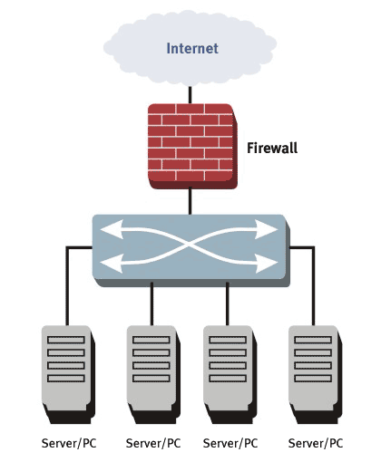
Firewall
Plan
A firewall inspects network traffic and denies or permits passage based on a set of rules.
Main Definitions
Threats
Protection
Reading and References

Slide 15

Backup
Plan
Making copy of data
Main Definitions
Threats
Protection
Reading and References

Slide 16
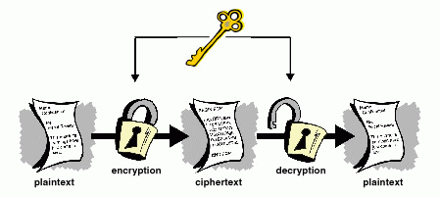
Symmetric key encryption
Plan
Main Definitions
Threats
Protection
Reading and References

Slide 17
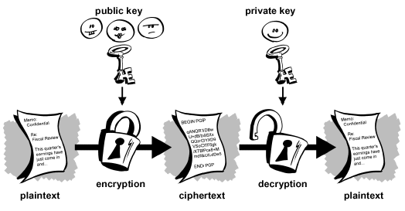
Asymmetric key encryption
Plan
Main Definitions
Threats
Protection
Reading and References

Slide 18
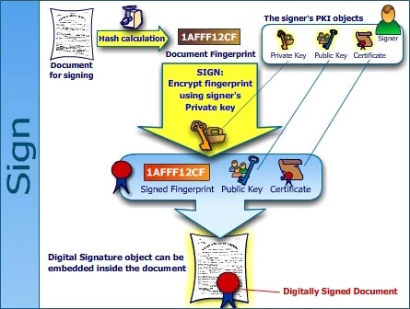
Encryption
Plan
Main Definitions
Threats
Protection
Reading and References

Slide 19
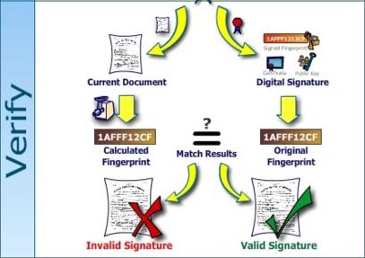
Encryption
Plan
Main Definitions
Threats
Protection
Reading and References

Slide 20
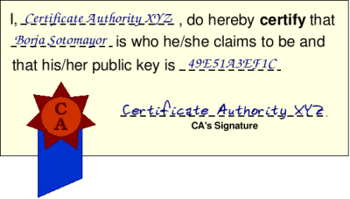
Digital certificate
Plan
Main Definitions
Threats
Protection
Reading and References

Slide 21
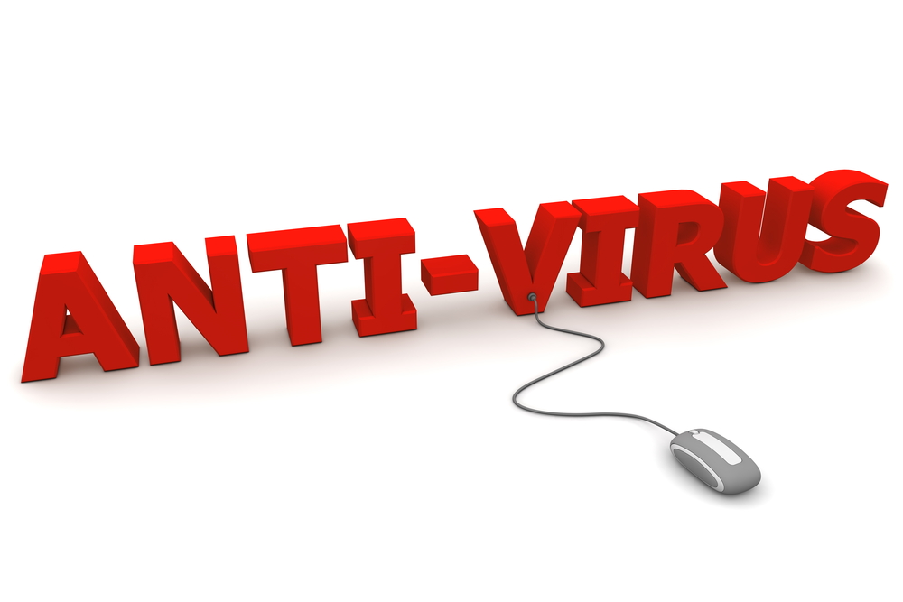
Anti virus
Plan
Main Definitions
Threats
Protection
Reading and References

Slide 22
Online transactions
Plan
  Authentication- we are who we say we are
  Certification - guarantee by 3rd party
  Confirmation - digital receipt of transaction
  Non-repudiation - binding agreement, digital proof of transaction
  Encryption - for all of the above, encoded passage of information over open networks
Main Definitions
Threats
Protection
Reading and References

Slide 23
Reading
Plan
Effy Oz, “Foundations of E-commerce”,
Chapters 7-8,10-11
https://www.symantec.com/content/dam/symantec/docs/infographics/istr-zero-day-en.pdf
http://usa.kaspersky.com/internet-security-center/threats/computer-viruses-and-malware-facts#.WJRQ5FN97cs
Main Definitions
Threats
Protection
Reading and References

Slide 24
References
Plan
Internet security: https://www.techopedia.com/definition/23548/internet-security
Antivirus picture: http://www.seasnet.ucla.edu/anti-virus-software/
Main Definitions
Threats
Protection
Reading and References

