Slide 1
“COLLEGE WRITING”
OUTLINE
Akhmadjonov khasan
English teacher
12/01/2017

Slide 2
Agenda
Outlining an Essay
Evaluating an Outline

Slide 3
What is an Outline?
A list of the information
Begins with thesis
Shows the organisation of the essay
Tells what ideas you will discuss and shows which ideas come first, second
Ends with conclusion
Skeleton?

Slide 4
Writing an outline before.
Show you what to write before u actually begin writing
Help make your essay well organised and clearly focused
Keep u from forgetting any important points

Slide 5
How to write?
Gathering ideas
Editing
Deciding on a topic
Numbering (numbers, letters, roman numerals for main ideas

Slide 6
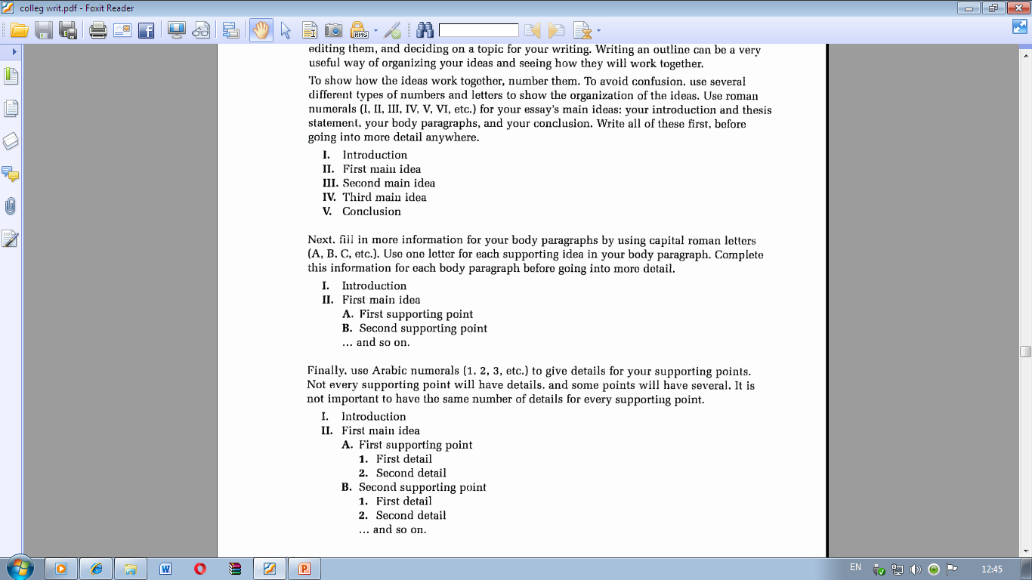

Slide 7
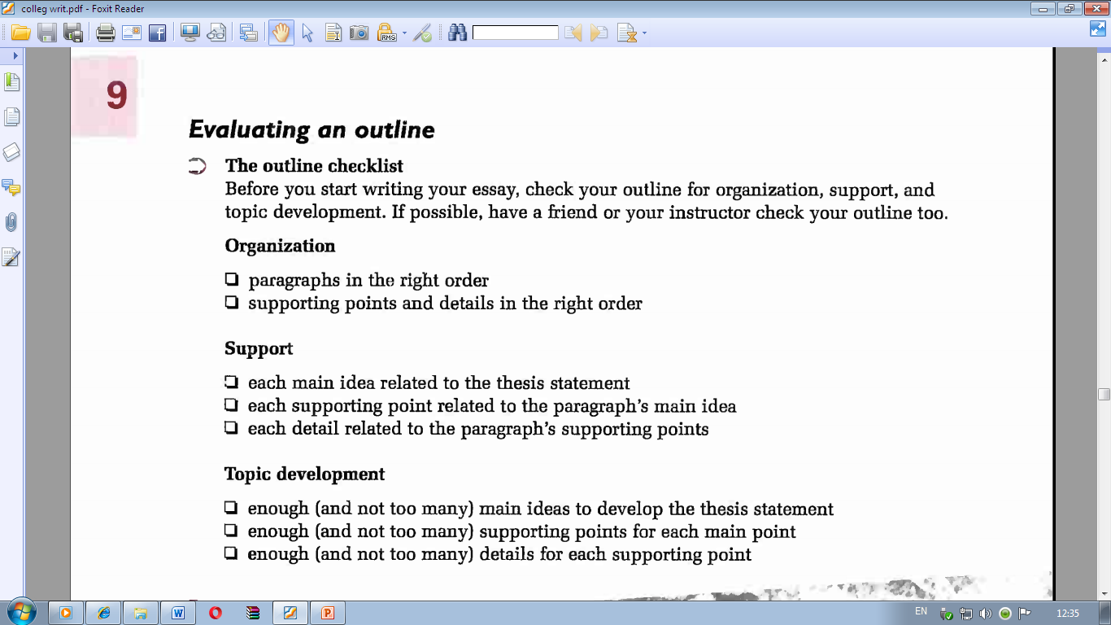

Slide 8


