Slide 2

REWARD MANAGEMENT

Slide 3
What’s Reward Management?
Reward management is concerned with the formulation and implementation of strategies and policies in order to reward people fairly, equitably and consistently in accordance with their value to the organization.
It deals with the design, implementation and maintenance of reward systems
Reward can be regarded as the fundamental expression of the employment relationship

Slide 4

Why do we need Reward Management?
Mutually beneficial
Motivation
Absenteeism
Loyalty
Morale
Teamwork

Slide 5

The Reward System
The base (basic) pay
Job evaluation
Market rate analysis
Grade and Pay Structures
Contingent Pay
Employee benefits
Performance management
Non-financial rewards

Slide 6
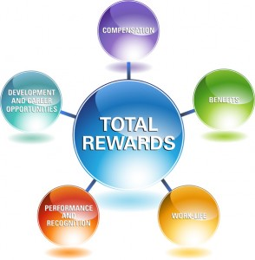
Total Reward System
Compensation
Recognition
Benefits
Work/Life Balance
Development

Slide 7

Advantages of TRS
Increased Employee Engagement
Fewer Voluntary Quits
Increased Retention

