Slide 1
Systems analysis and design
Lecture 6.
Introduction to UML

Slide 2
What is UML?
Unified Modeling Language
  OMG Standard, Object Management Group
  Based on work from Booch, Rumbaugh, Jacobson
UML is a modeling language to express and design documents, software
  Particularly useful for OO design
  Independent of implementation language

Slide 3
Why use UML
Open Standard, Graphical notation for
  Specifying, visualizing, constructing, and documenting software systems
Language can be used from general initial design to very specific detailed design across the entire software development lifecycle
Increase understanding/communication of product to customers and developers
Support for diverse application areas
Based upon experience and needs of the user community

Slide 4
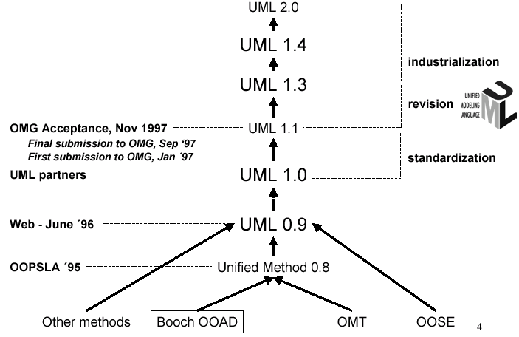
History of UML

Slide 5
Systems, Models and Views
A model is an abstraction describing a subset of a system
A view depicts selected aspects of a model
A notation is a set of graphical or textual rules for depicting views
Views and models of a single system may overlap each other
Examples:
System: Aircraft
Models: Flight simulator, scale model
Views: All blueprints, electrical wiring, fuel system

Slide 6
Systems, Models and Views
Flightsimulator
Blueprints
Aircraft
Electrical
Wiring
Scale Model

Slide 7
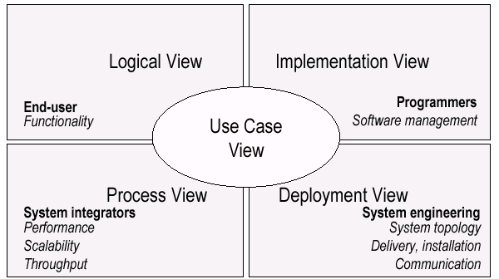
UML Models, Views, Diagrams
UML is a multi-diagrammatic language
  Each diagram is a view into a model
    Diagram presented from the aspect of a particular stakeholder
    Provides a partial representation of the system
    Is semantically consistent with other views
  Example views

Slide 8
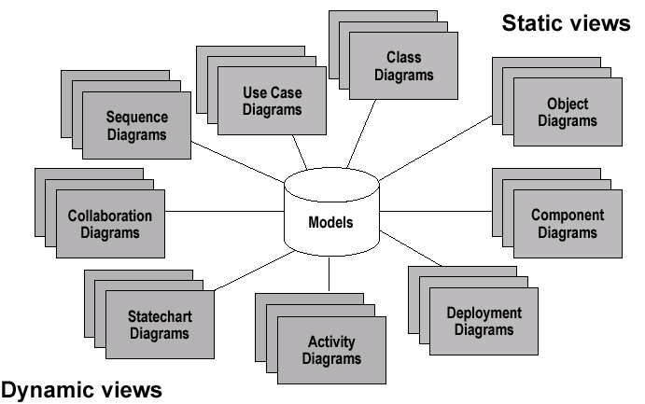
Models, Views, Diagrams

Slide 9
UML: First Pass
You can model 80% of most problems by using about 20 % UML
We only cover the 20% here

Slide 10
Basic Modeling Steps
Use Cases
  Capture requirements
Domain Model
  Capture process, key classes
Design Model
  Capture details and behaviors of use cases and domain objects
  Add classes that do the work and define the architecture

Slide 11
UML Baseline
Use Case Diagrams
Class Diagrams
Package Diagrams
Interaction Diagrams
  Sequence
  Collaboration
Activity Diagrams
State Transition Diagrams
Deployment Diagrams

Slide 12
Use Case Diagrams
Used during requirements elicitation to represent external behavior
Actors represent roles, that is, a type of user of the system
Use cases represent a sequence of interaction for a type of functionality; summary of scenarios
The use case model is the set of all use cases. It is a complete description of the functionality of the system and its environment
Passenger
PurchaseTicket

Slide 13
Actors
An actor models an external entity which communicates with the system:
  User
  External system
  Physical environment
An actor has a unique name and an optional description.
Examples:
  Passenger: A person in the train
  GPS satellite: Provides the system with GPS coordinates
Passenger

Slide 14
Use Case
A use case represents a class of functionality provided by the system as an event flow.
A use case consists of:
Unique name
Participating actors
Entry conditions
Flow of events
Exit conditions
Special requirements
PurchaseTicket

Slide 15
Use Case Diagram: Example
Name: Purchase ticket
Participating actor: Passenger
Entry condition:
Passenger standing in front of ticket distributor.
Passenger has sufficient money to purchase ticket.
Exit condition:
Passenger has ticket.
Event flow:
1. Passenger selects the number of zones to be traveled.
2. Distributor displays the amount due.
3. Passenger inserts money, of at least the amount due.
4. Distributor returns change.
5. Distributor issues ticket.
Anything missing?
Exceptional cases!

Slide 16
The <<extends>> Relationship
<<extends>> relationships represent exceptional or seldom invoked cases.
The exceptional event flows are factored out of the main event flow for clarity.
Use cases representing exceptional flows can extend more than one use case.
The direction of a <<extends>> relationship is to the extended use case
Passenger
PurchaseTicket
<<extends>>
<<extends>>
<<extends>>
OutOfOrder
<<extends>>
TimeOut
Cancel
NoChange

Slide 17
The <<includes>> Relationship
<<includes>> relationship represents behavior that is factored out of the use case.
<<includes>> behavior is factored out for reuse, not because it is an exception.
The direction of a <<includes>> relationship is to the using use case (unlike <<extends>> relationships).
Passenger
PurchaseMultiCard
PurchaseSingleTicket
<<includes>>
<<includes>>
<<extends>>
CollectMoney
<<extends>>
NoChange
Cancel

Slide 18
Use Case Diagrams: Summary
Use case diagrams represent external behavior
Use case diagrams are useful as an index into the use cases
Use case descriptions provide meat of model, not the use case diagrams.
All use cases need to be described for the model to be useful.

Slide 19
Class Diagrams
Gives an overview of a system by showing its classes and the relationships among them.
  Class diagrams are static
  they display what interacts but not what happens when they do interact
Also shows attributes and operations of each class
Good way to describe the overall architecture of system components

Slide 20
Classes – Not Just for Code
TariffSchedule
Table zone2price
Enumeration getZones()
Price getPrice(Zone)
Name
TariffSchedule
Attributes
Signature
zone2price
getZones()
getPrice()
Operations
TariffSchedule
A class represent a concept
A class encapsulates state (attributes) and behavior (operations).
Each attribute has a type.
Each operation has a signature.
The class name is the only mandatory information.

Slide 21
Instances
tarif_1974:TariffSchedule
zone2price = {
{‘1’, .20},
{‘2’, .40},
{‘3’, .60}}
An instance represents a phenomenon.
The name of an instance is underlined and can contain the class of the instance.
The attributes are represented with their values.

Slide 22
UML Class Notation
A class is a rectangle divided into three parts
  Class name
  Class attributes (i.e. data members, variables)
  Class operations (i.e. methods)
Modifiers
  Private: -
  Public: +
  Protected: #
  Static: Underlined (i.e. shared among all members of the class)
Abstract class: Name in italics

Slide 23
UML Class Notation
Lines or arrows between classes indicate relationships
  Association
    A relationship between instances of two classes, where one class must know about the other to do its work, e.g. client communicates to server
    indicated by a straight line or arrow
  Aggregation
    An association where one class belongs to a collection, e.g. instructor part of Faculty
    Indicated by an empty diamond on the side of the collection
  Composition
    Strong form of Aggregation
    Lifetime control; components cannot exist without the aggregate
    Indicated by a solid diamond on the side of the collection
  Inheritance
    An inheritance link indicating one class a superclass relationship, e.g. bird is part of mammal
    Indicated by triangle pointing to superclass

Slide 24

Aggregation
Aggregation is an association with a “collection-member” relationship
void doSomething()
aModule.service();
Hollow diamond on
the Collection side
No sole ownership implied

Slide 25
Composition
Composition is Aggregation with:
Lifetime Control (owner controls construction, destruction)
Part object may belong to only one whole object
members[0] =
new Employee();
…
delete members[0];
Filled diamond on side of the Collection

Slide 26
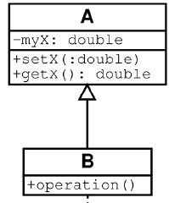
Inheritance
Standard concept of inheritance
Base Class
Derived Class
class B() extends A
…

Slide 27
UML Multiplicities
Links on associations to specify more details about the relationship
Multiplicities | Meaning
0..1 | zero or one instance. The notation n . . m indicates n to m instances.
0..* or * | no limit on the number of instances (including none).
1 | exactly one instance
1..* | at least one instance

Slide 28
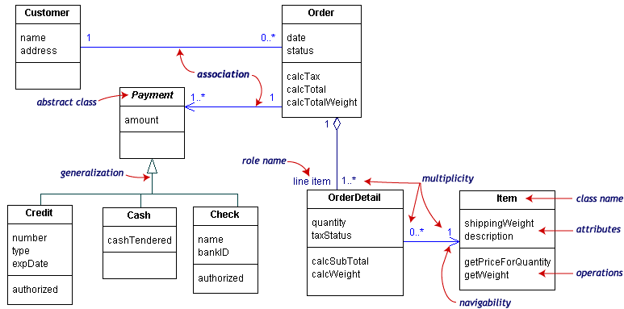
UML Class Example

Slide 29
Association Details
Can assign names to the ends of the association to give further information
Team
-
Employee
group
-
Name
-
:
string
members
:
Employee
-
individual
+
ID
:
long
#
Salary
1
:
double
-
adfaf
*
:
bool
+
getName
() :
string
+
setName
()
-
calcInternalStuff
(
in x
:
byte
,
in y
:
decimal
)

Slide 30
Package Diagrams
To organize complex class diagrams, you can group classes into packages. A package is a collection of logically related UML elements
Notation
  Packages appear as rectangles with small tabs at the top.
  The package name is on the tab or inside the rectangle.
  The dotted arrows are dependencies. One package depends on another if changes in the other could possibly force changes in the first.
  Packages are the basic grouping construct with which you may organize UML models to increase their readability

Slide 31
Package Example
DispatcherInterface
Notification
IncidentManagement

Slide 32
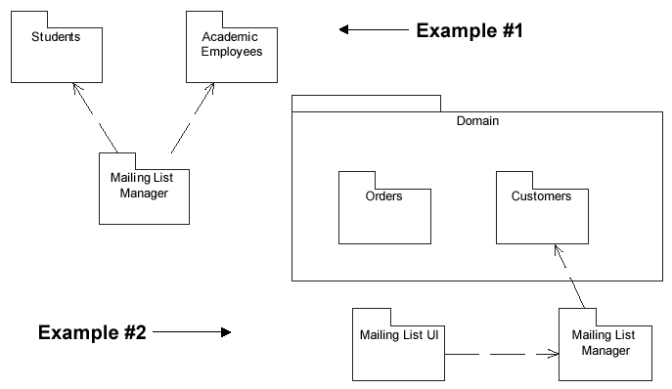
More Package Examples

Slide 33
Interaction Diagrams
Interaction diagrams are dynamic -- they describe how objects collaborate.
A Sequence Diagram:
  Indicates what messages are sent and when
  Time progresses from top to bottom
  Objects involved are listed left to right
  Messages are sent left to right between objects in sequence

Slide 34
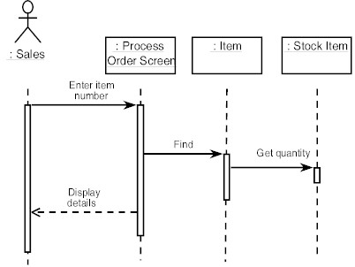
Sequence Diagram Format
Actor from
Use Case
Objects
1
Activation
2
3
4
Lifeline
Calls = Solid Lines
Returns = Dashed Lines

Slide 35
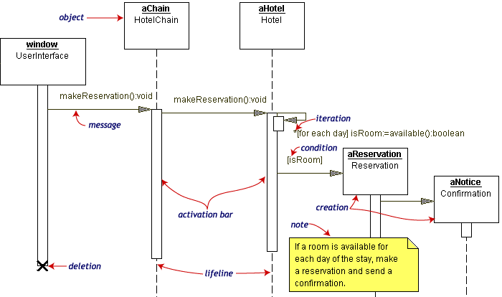
Sequence Diagram Example
Hotel Reservation

Slide 36
Collaboration Diagram
Collaboration Diagrams show similar information to sequence diagrams, except that the vertical sequence is missing. In its place are:
  Object Links - solid lines between the objects that interact
  On the links are Messages - arrows with one or more message name that show the direction and names of the messages sent between objects
Emphasis on static links as opposed to sequence in the sequence diagram

Slide 37
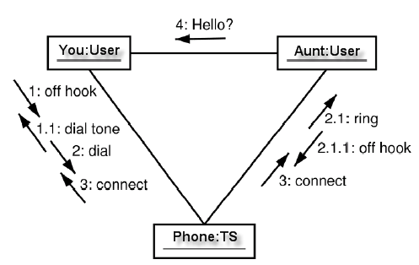
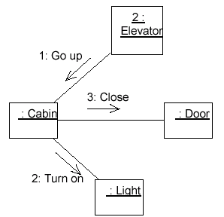
Collaboration Diagram

Slide 38
Activity Diagrams
Fancy flowchart
  Displays the flow of activities involved in a single process
  States
    Describe what is being processed
    Indicated by boxes with rounded corners
  Swim lanes
    Indicates which object is responsible for what activity
  Branch
    Transition that branch
    Indicated by a diamond
  Fork
    Transition forking into parallel activities
    Indicated by solid bars
  Start and End

Slide 39
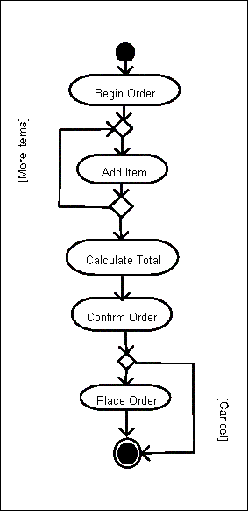
Sample Activity Diagram
Ordering System
May need multiple diagrams from other points of view

Slide 40
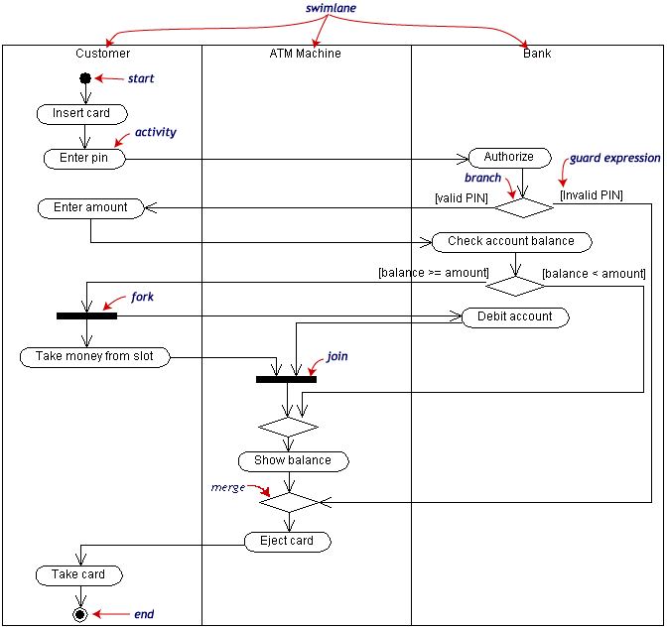
Activity Diagram Example

Slide 41
State Transition Diagrams
Shows the possible states of the object and the transitions that cause a change in state
  i.e. how incoming calls change the state
Notation
  States are rounded rectangles
  Transitions are arrows from one state to another. Events or conditions that trigger transitions are written beside the arrows.
  Initial and Final States indicated by circles as in the Activity Diagram
    Final state terminates the action; may have multiple final states

Slide 42
button1&2Pressed
button2Pressed
Blink
Increment
Hours
Hours
button1Pressed
button1&2Pressed
Blink
button2Pressed
Increment
Minutes
Minutes
button1Pressed
button2Pressed
Stop
Blink
Increment
Blinking
Seconds
Seconds
Figure 2-4. A UML statechart diagram for SetTime use case of the SimpleWatch.

Slide 43
State Representation
The set of properties and values describing the object in a well defined instant are characterized by
  Name
  Activities (executed inside the state)
    Do/ activity
  Actions (executed at state entry or exit)
    Entry/ action
    Exit/ action
  Actions executed due to an event
    Event [Condition] / Action ^Send Event

Slide 44
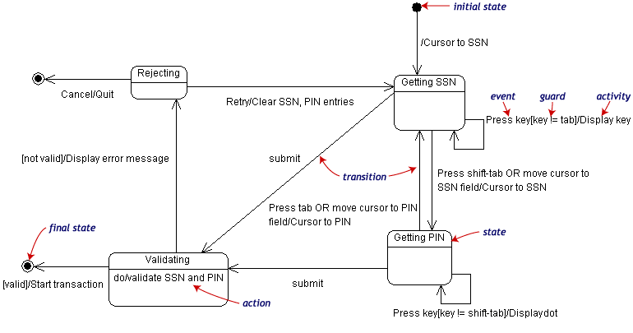
State Transition Example
Validating PIN/SSN

Slide 45
Component Diagrams
Shows various components in a system and their dependencies, interfaces
Explains the structure of a system
Usually a physical collection of classes
  Similar to a Package Diagram in that both are used to group elements into logical structures
  With Component Diagrams all of the model elements are private with a public interface whereas Package diagrams only display public items.

Slide 46


Component Diagram Notation
Components are shown as rectangles with two tabs at the upper left
Dashed arrows indicate dependencies
Circle and solid line indicates an interface to the component

Slide 47
Deployment Diagrams
Shows the physical architecture of the hardware and software of the deployed system
Nodes
  Typically contain components or packages
  Usually some kind of computational unit; e.g. machine or device (physical or logical)
Physical relationships among software and hardware in a delivered systems
  Explains how a system interacts with the external environment

Slide 48
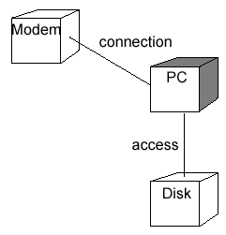
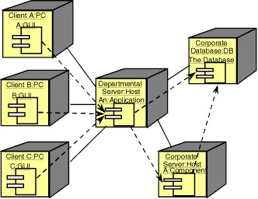
Some Deployment Examples

Slide 49
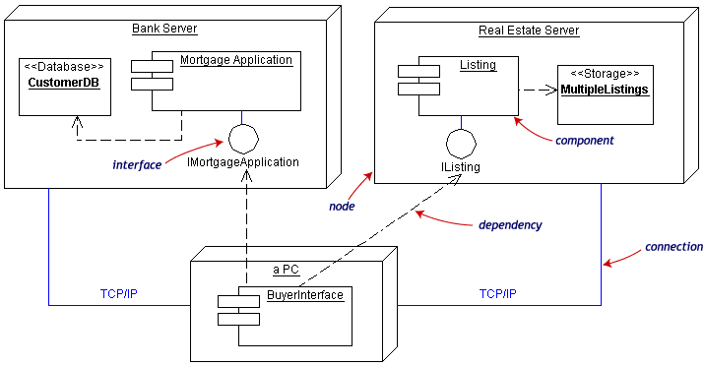
Deployment Example
Often the Component Diagram is combined with the Deployment

Slide 50
Summary and Tools
UML is a modeling language that can be used independent of development
Adopted by OMG and notation of choice for visual modeling
  http://www.omg.org/uml/
Creating and modifying UML diagrams can be labor and time intensive.
Lots of tools exist to help
  Tools help keep diagrams, code in sync
  Repository for a complete software development project
  Examples here created with TogetherSoft ControlCenter, Microsoft Visio, Tablet UML
  Other tools:
    Rational, Cetus, Embarcadero
    See http://plg.uwaterloo.ca/~migod/uml.html for a list of tools, some free

